Slide 1
Exploring Initial Distributions at the Beam Test Facility
Kiersten Ruisard
5th ICFA mini-workshop on Space Charge Oct 25, 2022

Slide 2
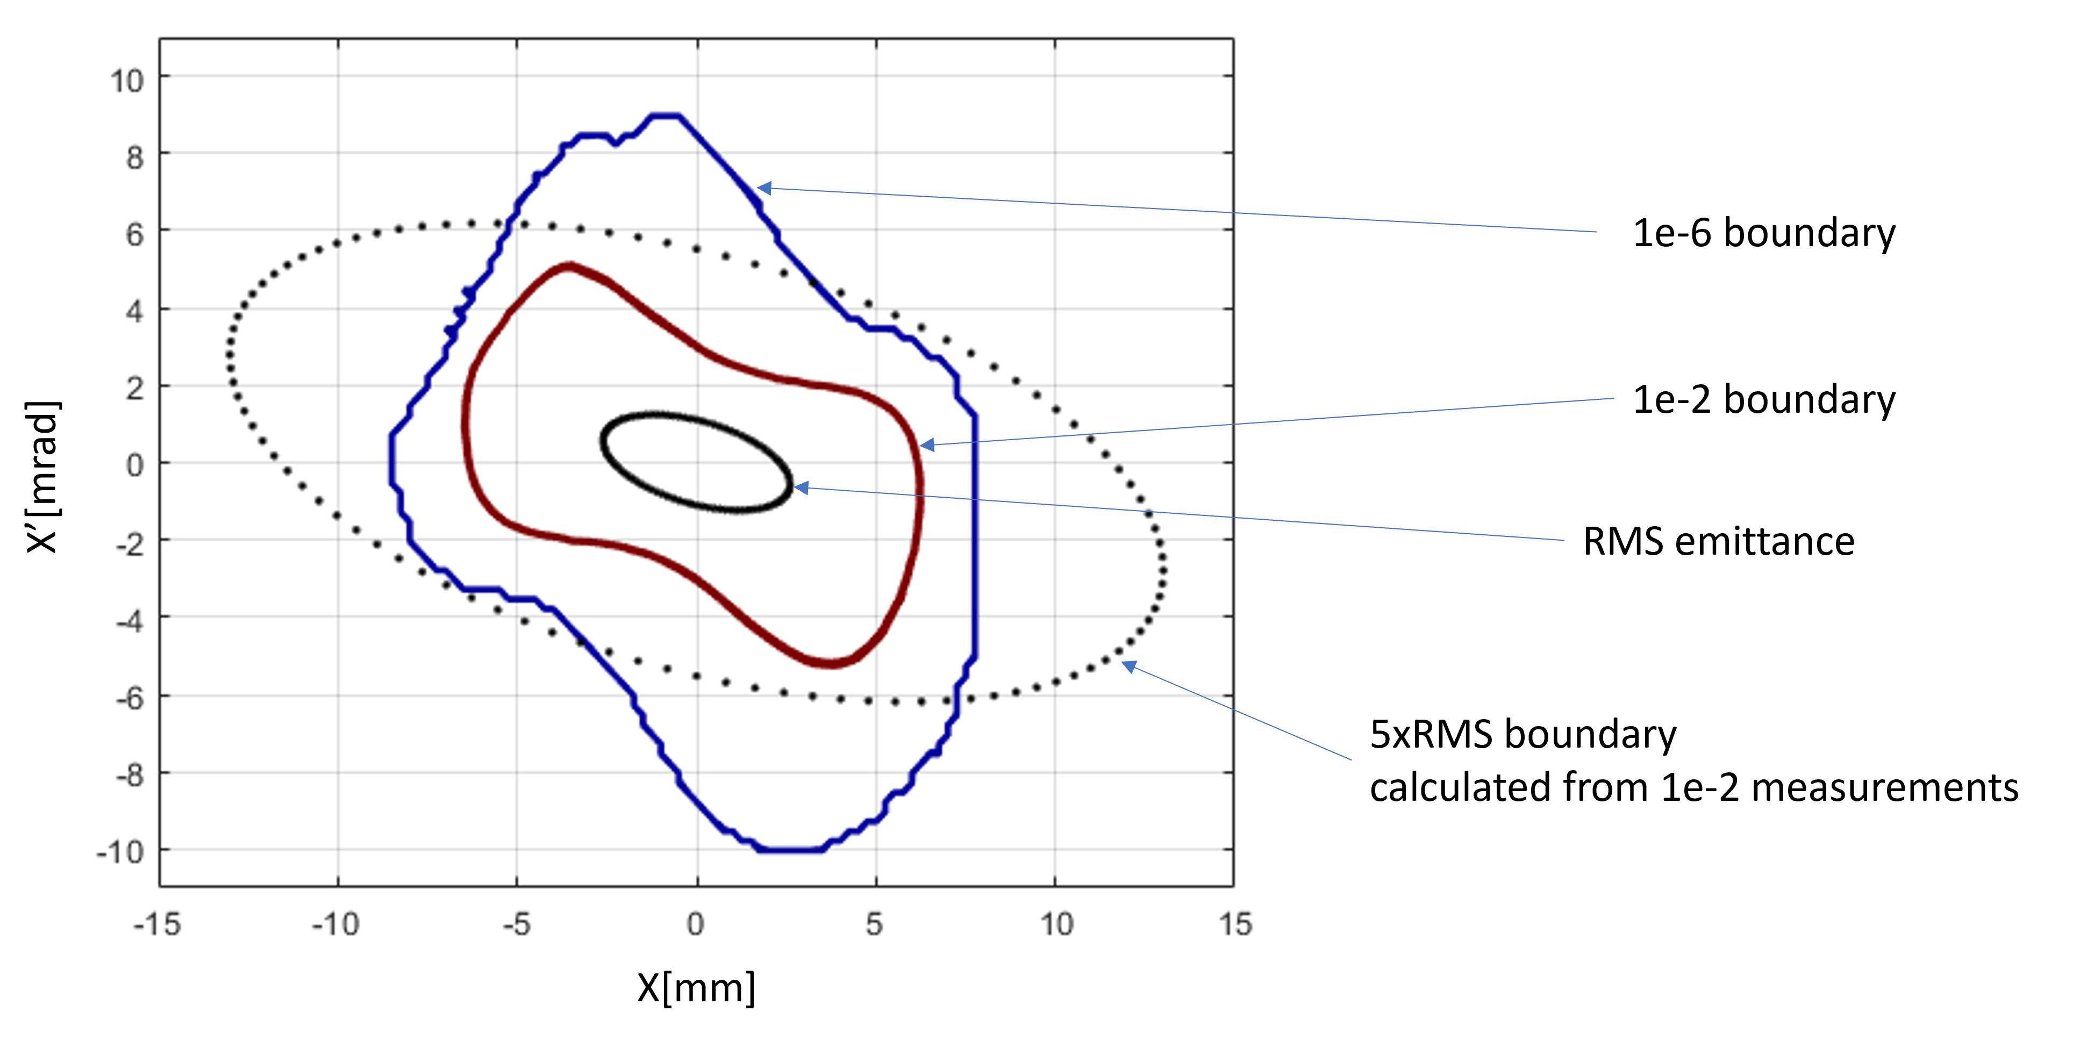
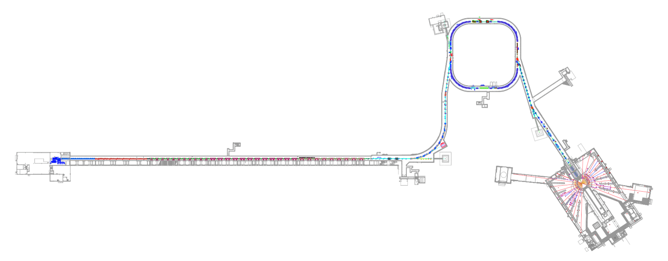
Background and Motivation
Broad goals:
predictive modeling for beam distribution with halo
better understanding of beam losses
Beam Test Facility (BTF)

Slide 3
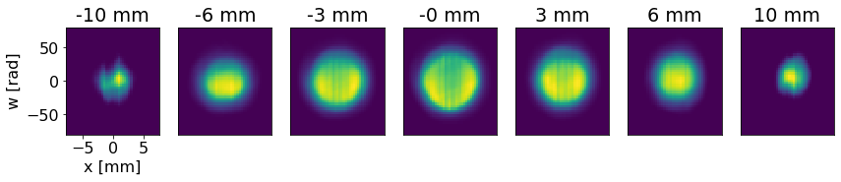
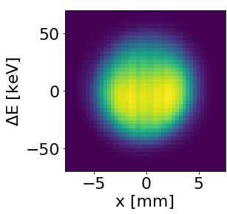
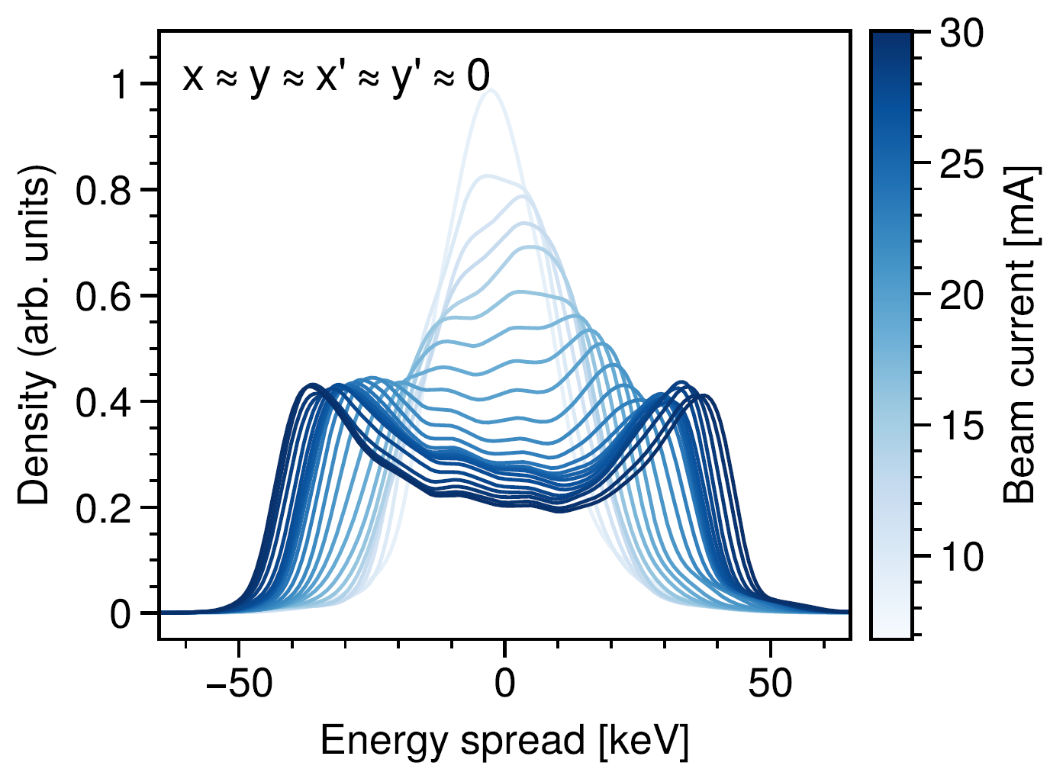


After RFQ, beam core is hollowed
Full projection:
Slices in y:
$$ΔE [keV]$$
This is dependent on charge:
y
x
$$ΔE$$

Slide 4
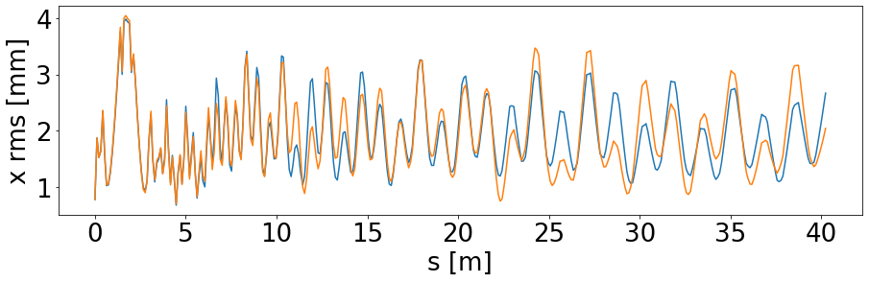
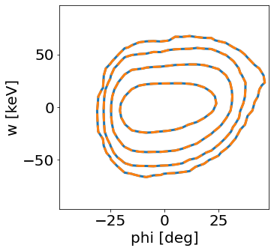
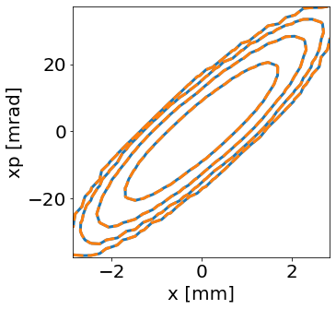
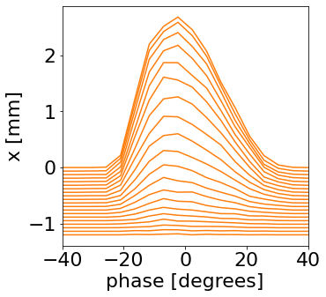
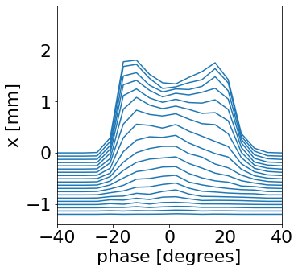
In simulation of MEBT, we predict that neglecting correlations will affect rms sizes and beam shoulders/tails
PyORBIT simulation of SNS linac (MEBT+DTL) with/without interplane correlation:
Initial simulation bunch from Parmteq simulation:
Phase distribution for y=0,x’=0,y’=0 and x=x_{i}
Full projections:
Fully correlated,
Not fully correlated

Slide 5
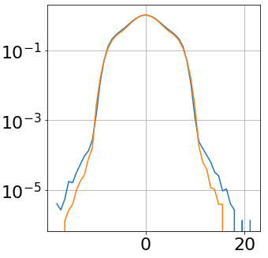
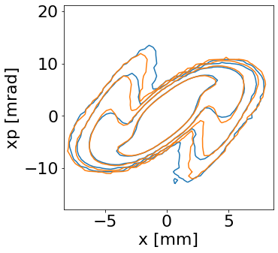
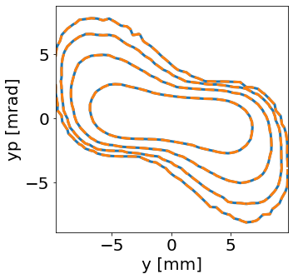
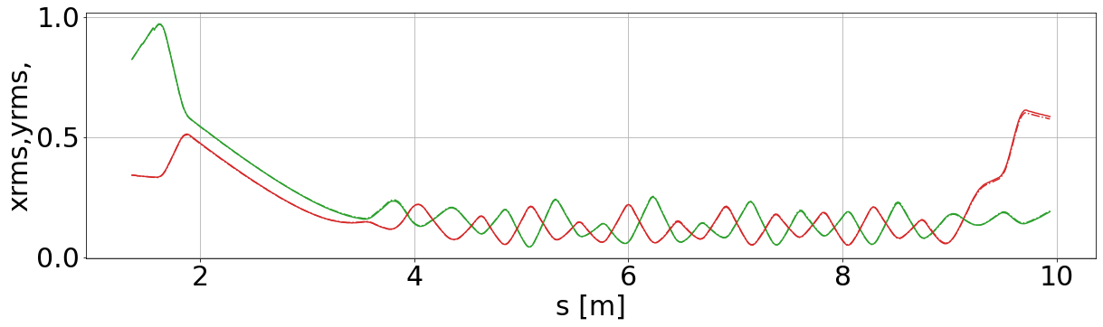
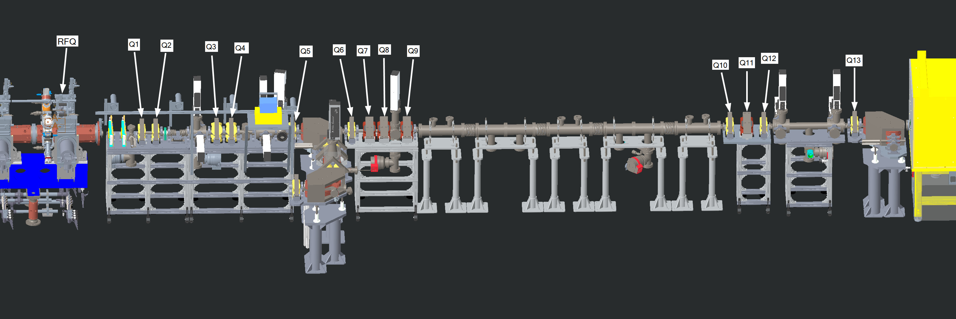
For BTF experiment, we expect effect at 3 orders of magnitude below core density
Fully correlated,
Not fully correlated
Initial bunch
from PARMTEQ,
8M particles
Density [au]
Contours at 10%, 1%, .1%, .01% of peak
x’ [mrad]
output
xrms, yrms [cm]
Notes:
This was highlighted in 2019 SC workshop talk; I didn’t imagine we’d be in this boat today.
2 reasons: Focus on high-dim over lattice benchmarking due to impending configuration (some questions about dipoles raised….so get rid of dipoles?)

Slide 6
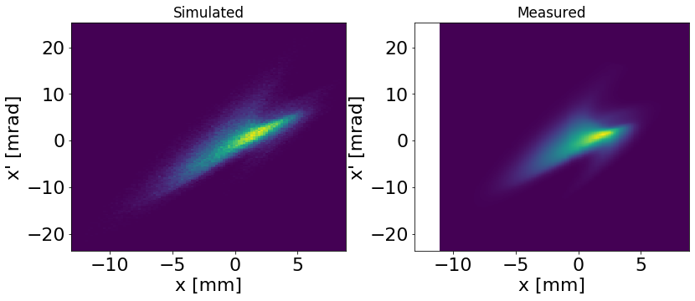
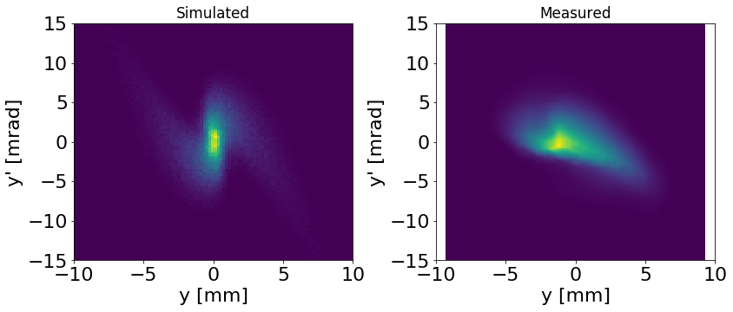
Right now, lattice errors far exceed sensitivity needed to examine effect of 6D
Fully correlated,
Not fully correlated

Slide 7
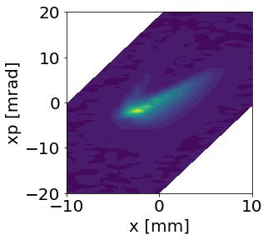
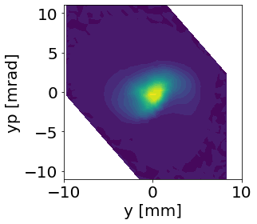
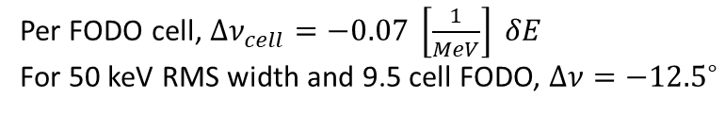
High chromaticity in BTF causes sensitivity to RFQ output energy
Per FODO cell, $Δν_{cell}=−0.07 \left[\frac{1}{MeV}\right] δE$
For 50 keV RMS width and 9.5 cell FODO, $Δν=−{12.5}^{∘}$
Full projection phase spaces:
Phase space for different energy slices:
* measurements
Notes:
* We will be sensitive to 10’s of keV offset in output energy from RFQ

Slide 8

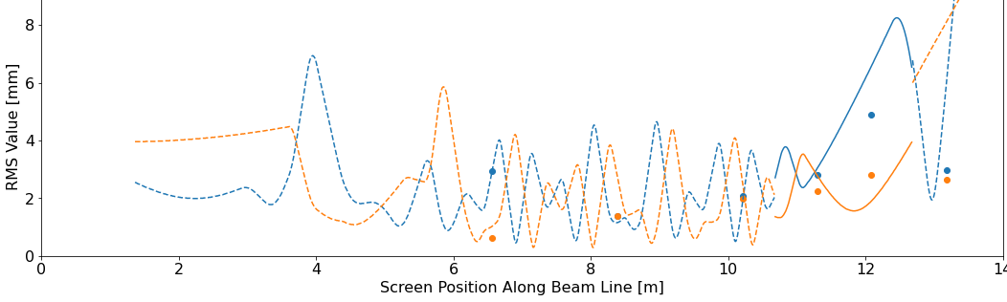
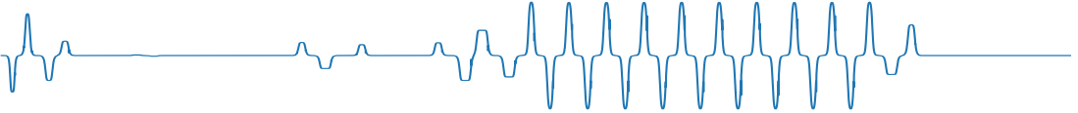
Current benchmark status: there is no RMS agreement
Slits (full beam)
X rms, Y rms
viewscreens (collimated beam)
2D phase spaces
RMS size [mm]
Notes:
Why is this so hard?
High phase advance (103 deg/cell)
Initially low diagnostics per cell.

Slide 9
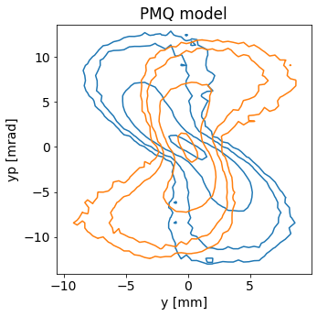
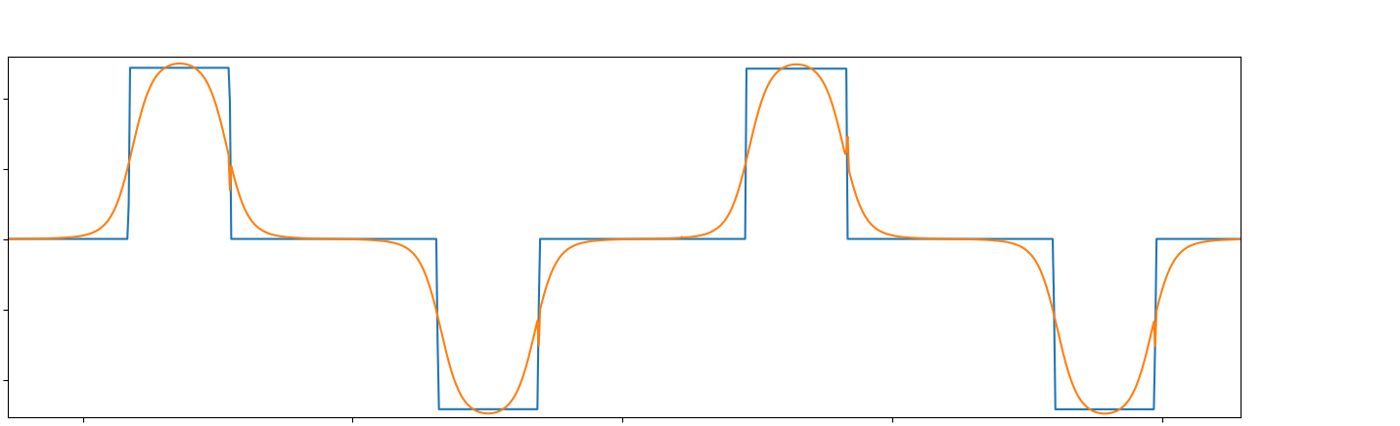
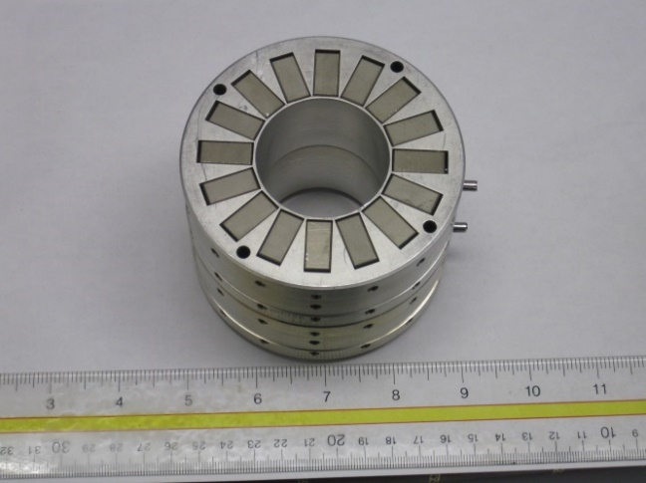
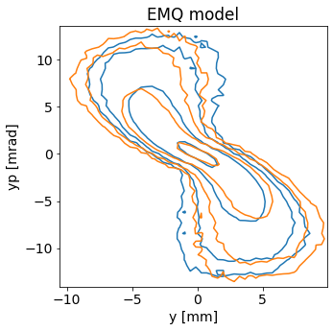


Soft-edged field profiles matters for permanent magnets in FODO section
$$G\left(z\right)= \frac{dB_{y}}{dx}$$
Contours:
60%,
10%,
1%,
.1% of peak
9”
$$∫G\left(z\right)dl=const$$
Implemented,
Not implemented
Halbach permanent magnet quad
We still (mostly) trust hard-edged model for electro-magnet quads! Are we wrong?

Slide 10
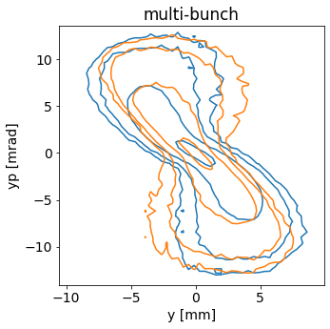
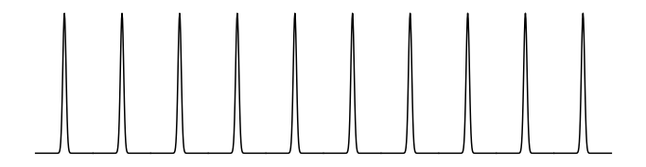
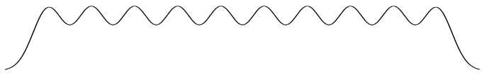
Py-orbit multi-bunch solver is required to get space charge right,
Beam rms width at FODO entrance > ${180}^{∘}$
T=2.48 ns
RFQ
FODO
Implemented,
Not implemented

Slide 11
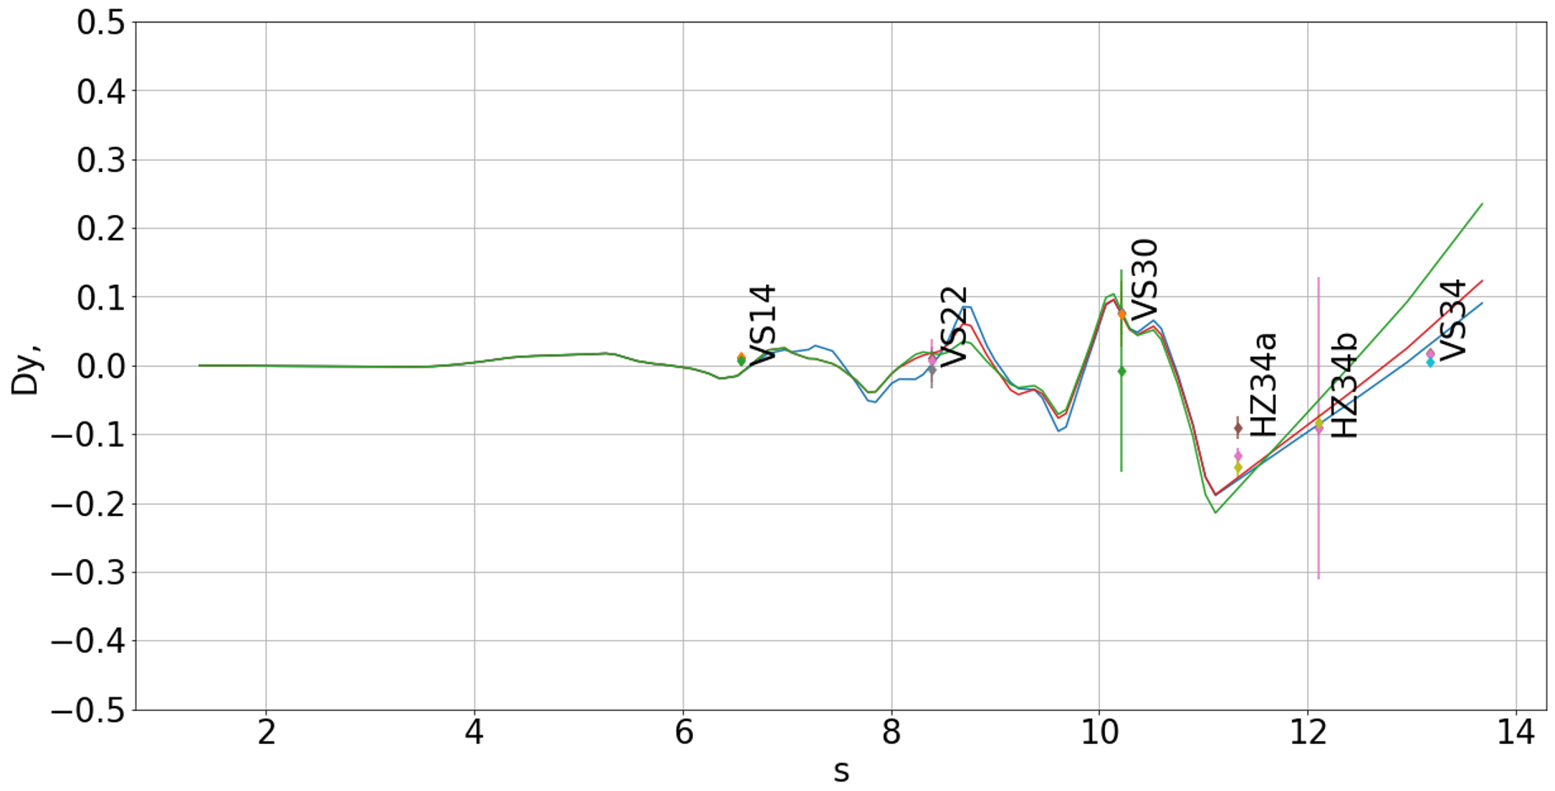
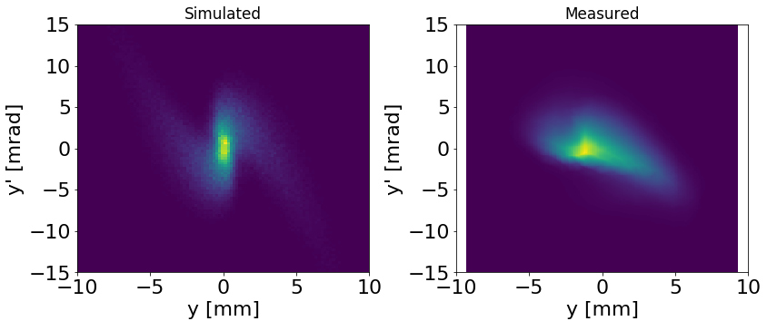
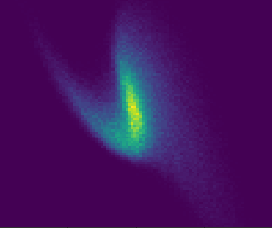
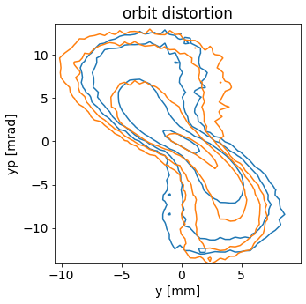
Residual vertical dispersion explains asymmetry in vertical phase space
orbit=0
orbit≠0
vertical dispersion [m]
Orbit error,
No error

Slide 12
Summary #1
Motivation: predicting halo extent
Initial bunch: core-hollowed due to nonlinear space charge
Status: Lattice model errors exceed distribution errors
Ranked importance:
  Field profile for PM quads
  Overlapping bunches
  Dipole model?
  Residual dispersion
  Energy, via chromaticity
  Field profile for electromagnet quads
  6D initial distribution

Slide 13

Summary slide, 5th ICFA mini-workshop on Space Charge
Theme: Bridging the gap in space charge dynamics
Summary:
This talk presented a study of the initial distribution and transport of (up to) 50 mA, 402.5 MHz H⁻ bunches at the SNS Beam Test Facility. The purpose of this work is to demonstrate prediction of beam halo + halo losses
From your perspective, where is the gap regarding space charge effects?
The gap is in our ability to predict beam evolution with space charge with desired accuracy
What is needed to bridge this gap?
Careful validation of models, including initial beam distribution
  Sufficient diagnostics
  efficient methods for calibration and error identification
Responsive simulation development (e.g., multi-bunch solver)
Other effects for linacs: Cavity models, longitudinal dynamics
Notes:
Other things: cavity modeling;

Slide 14
Backup

Slide 15
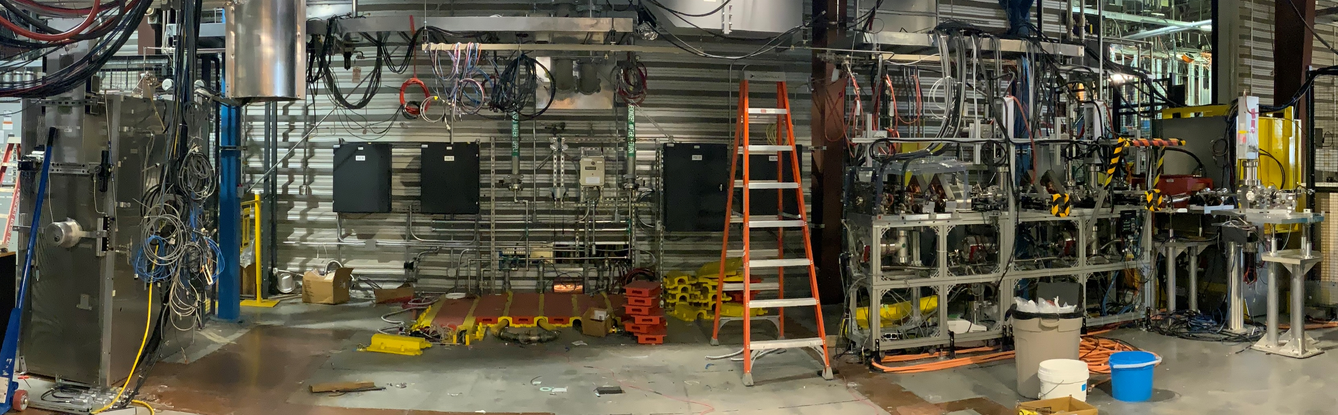
Project Status
Shutdown August 2022
New RFQ commissioning
  ~Nov 2022
Straight BTF in 2023
Species | H⁻
Energy (MEBT) | 2.5 MeV
Energy (LEBT) | 65 keV
RFQ | 449 cells 402.5 MHz
Beam current | Up to 50 mA

Slide 16
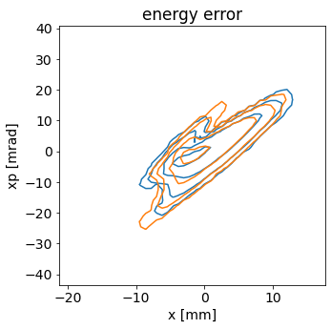
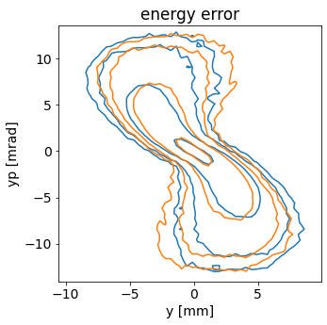
Energy error (chromatic effect)
Orange is 2.5 MeV-20 keV
Blue is 2.5 MeV

Slide 17
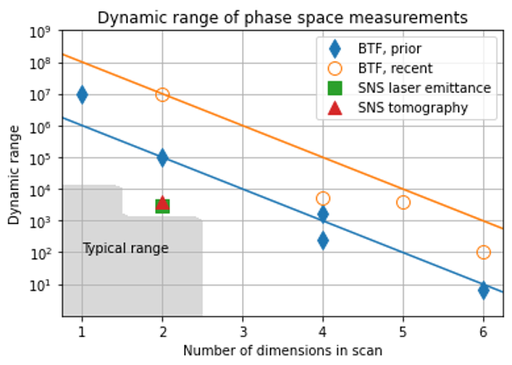
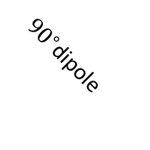





5D method
$$x_{1}=x$$
$$x_{2}\sim x′$$
${90}^{∘}$dipole
beam
$$y_{1}=y$$
$$y_{2}\sim y′$$
viewscreen
$$x_{3}\sim ΔE$$
Notes:
We always get asked about repeatability, stability;

Slide 18




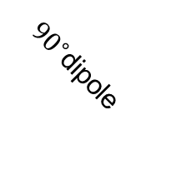


6D apparatus
grid 9x 9 x 9 x 9 x 9 x 512, ~24 hours
$$x_{1}=x$$
$$x_{2}\sim x′$$
${90}^{∘}$dipole
beam
$$y_{1}=y$$
$$x_{3}\sim ΔE$$
$$BSM wire\sim y′$$
RF
$$φ$$

Slide 19
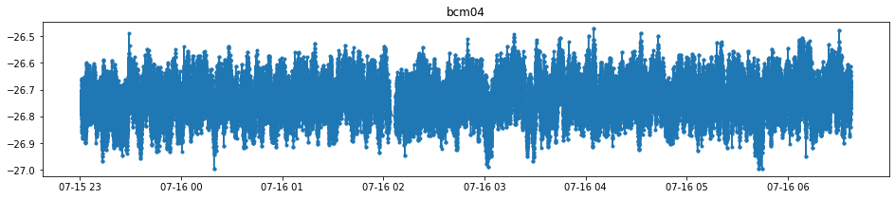
Beam current during 7.6-hour scan
average BCM current = -26.73 +- 0.06 mA
Notes:
Gap is a software bug, not a machine fault

Slide 20
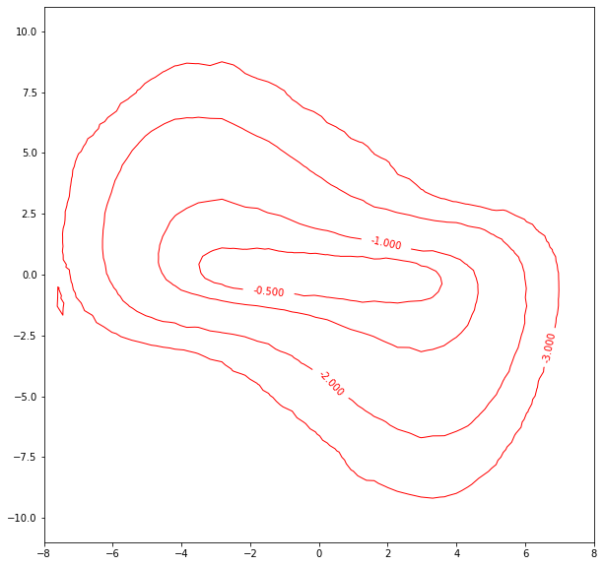
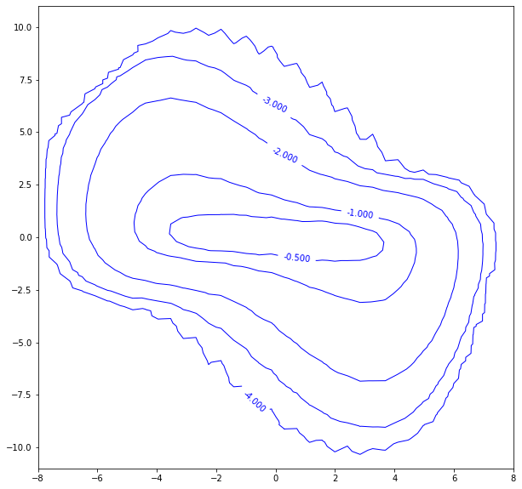
Comparison of 2 datasets taken 2 weeks apart
5D scan (integrated along other 3 dimensions)
7.6 hours
2D scan
~15 minutes
X’ [mrad]
X [mm]

Slide 21
BTF follows footsteps of earlier attempts to benchmark medium-energy beam evolution
matched
mismatched
LEDA @ LANL: extensive simulations aimed at benchmarking halo evolution measurements
Qiang, J., Colestock, P. L., Gilpatrick, D., Smith, H. V., Wangler, T. P., & Schulze, M. E. (2002). Macroparticle simulation studies of a proton beam halo experiment. Phys Rev ST-AB, 5(12), 35–47 .
Simulations of high-intensity ion front-ends benchmarked to RMS agreement but cannot reproduce tails/halo.
Hypothesis: Limited knowledge of initial distribution to blame for discrepancies
Notes:
IMPACT simulations; distributions simulated starting at plasma boundary of source

Slide 22
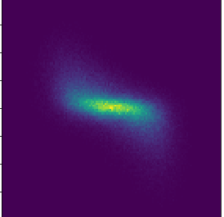
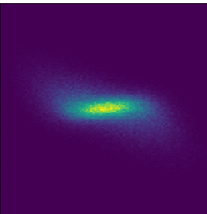
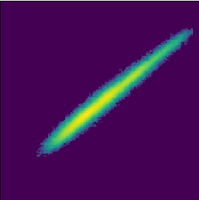






Typical input distribution based on 2D projections
Assumption: $f\left(x,x^{′},y,y^{′},z,dE\right)=f\left(x,x^{′}\right)∗f\left(y,y^{′}\right)∗f(z,dE)$
$$x^{′}= ±10 mrad$$
$$y′= ±10 mrad$$
$dE= ±0.1$MeV
$$x= ±10 mm$$
$$y= ±10 mm$$
$$φ= ±{130}^{∘}$$

Slide 23
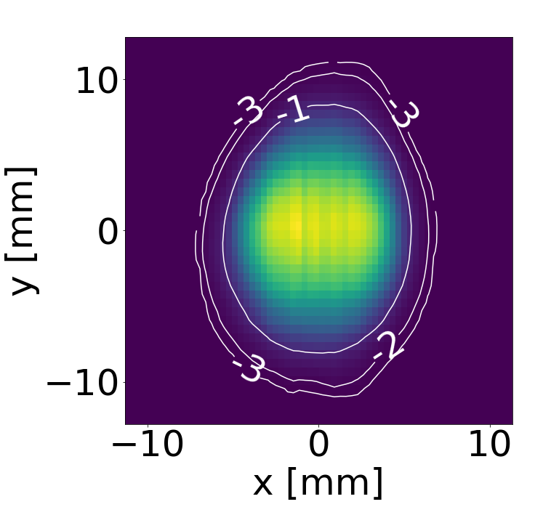
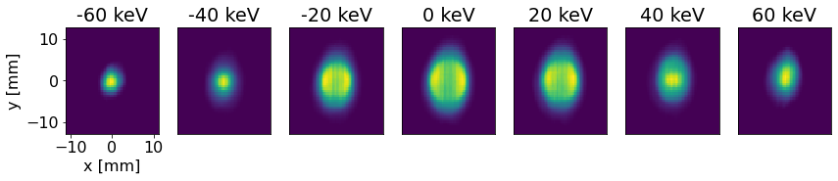

After RFQ, core is hollowed
y
x
$$ΔE$$

Slide 24
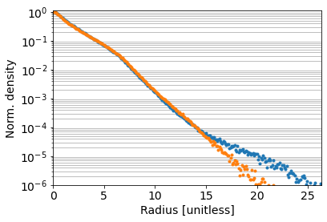
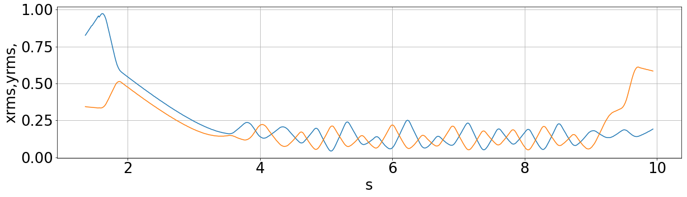
Right now, lattice errors far exceed sensitivity needed to examine effect of 6D
Initial bunch
from PARMTEQ,
8M particles
output
Correlated,
De-correlated
Notes:
This was highlighted in 2019 SC workshop talk; I didn’t imagine we’d be in this boat today.
2 reasons: Focus on high-dim over lattice benchmarking due to impending configuration (some questions about dipoles raised….so get rid of dipoles?)

Slide 25
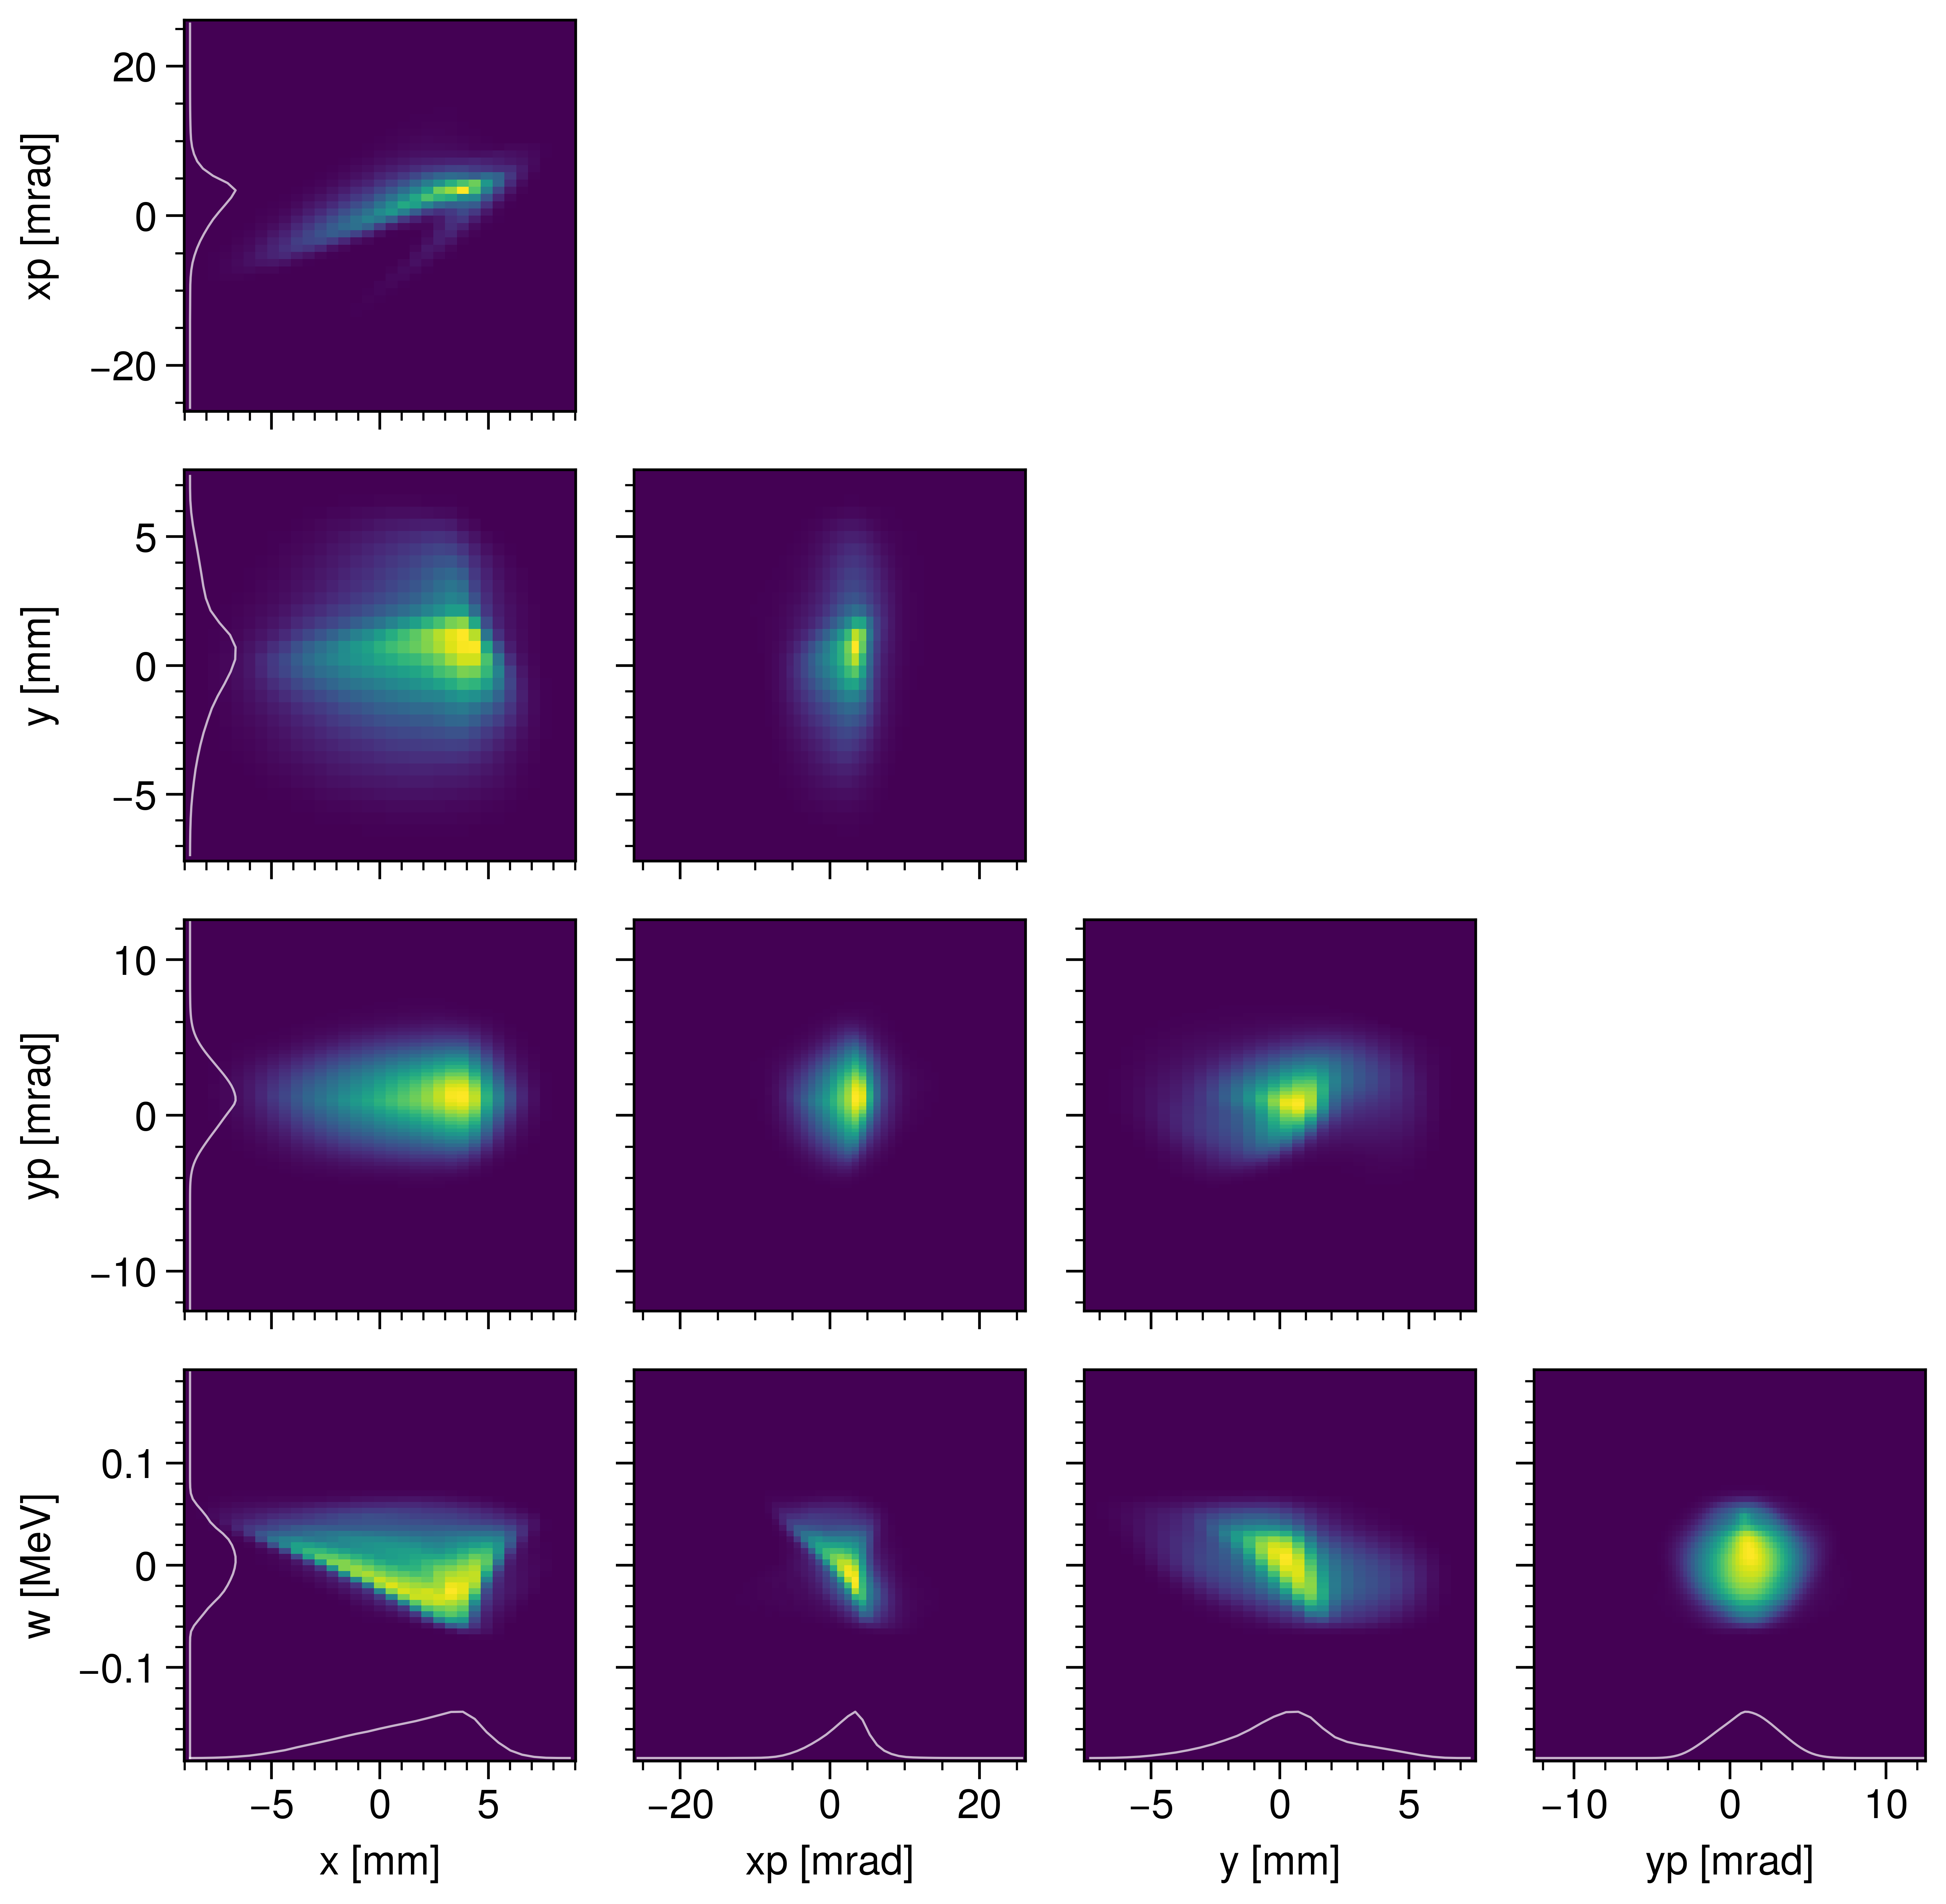

High-dimensional benchmark at end of beamline
Measurement
Simulation
Notes:
* Simulation includes dispersion, Orbit offset at HZ04:
Y0 = 6.17 mm
Y0’ = -2.2 mrad

Slide 26


2D projected phase space viewed at energy slices
Measurement
Simulation

Slide 27


2D projected phase space viewed at energy slices
Measurement
Simulation

Slide 28


collimate
Notes:
Why is this so hard?
High phase advance (103 deg/cell)
Initially low diagnostics per cell.

Slide 29




Chromaticity in FODO line
Per FODO cell, C = -0.00007 / keV
For 50 keV RMS width and 9.5 cell FODO, $Δν=−{12.5}^{∘}$
8 mm ~ ?? keV

Slide 30


RFQ Benchmark, full-projection
Measured
Simulated

Slide 31





RFQ Benchmark, slices
measured
$$ΔE$$
y, $±10$mm
x, $±10$mm
simulated
Notes:
* Scaes are the same

