Slide 1
Radioisotope Production at SNS (RIPS) Workshop
Justin Griswold, Sarah Cousineau, Sang-Ho Kim, Yong Joong Lee, Fulvia Pilat, Charlie Rasco, Dave Rotsch, Dan Stracener,
September 27, 2023

Slide 2
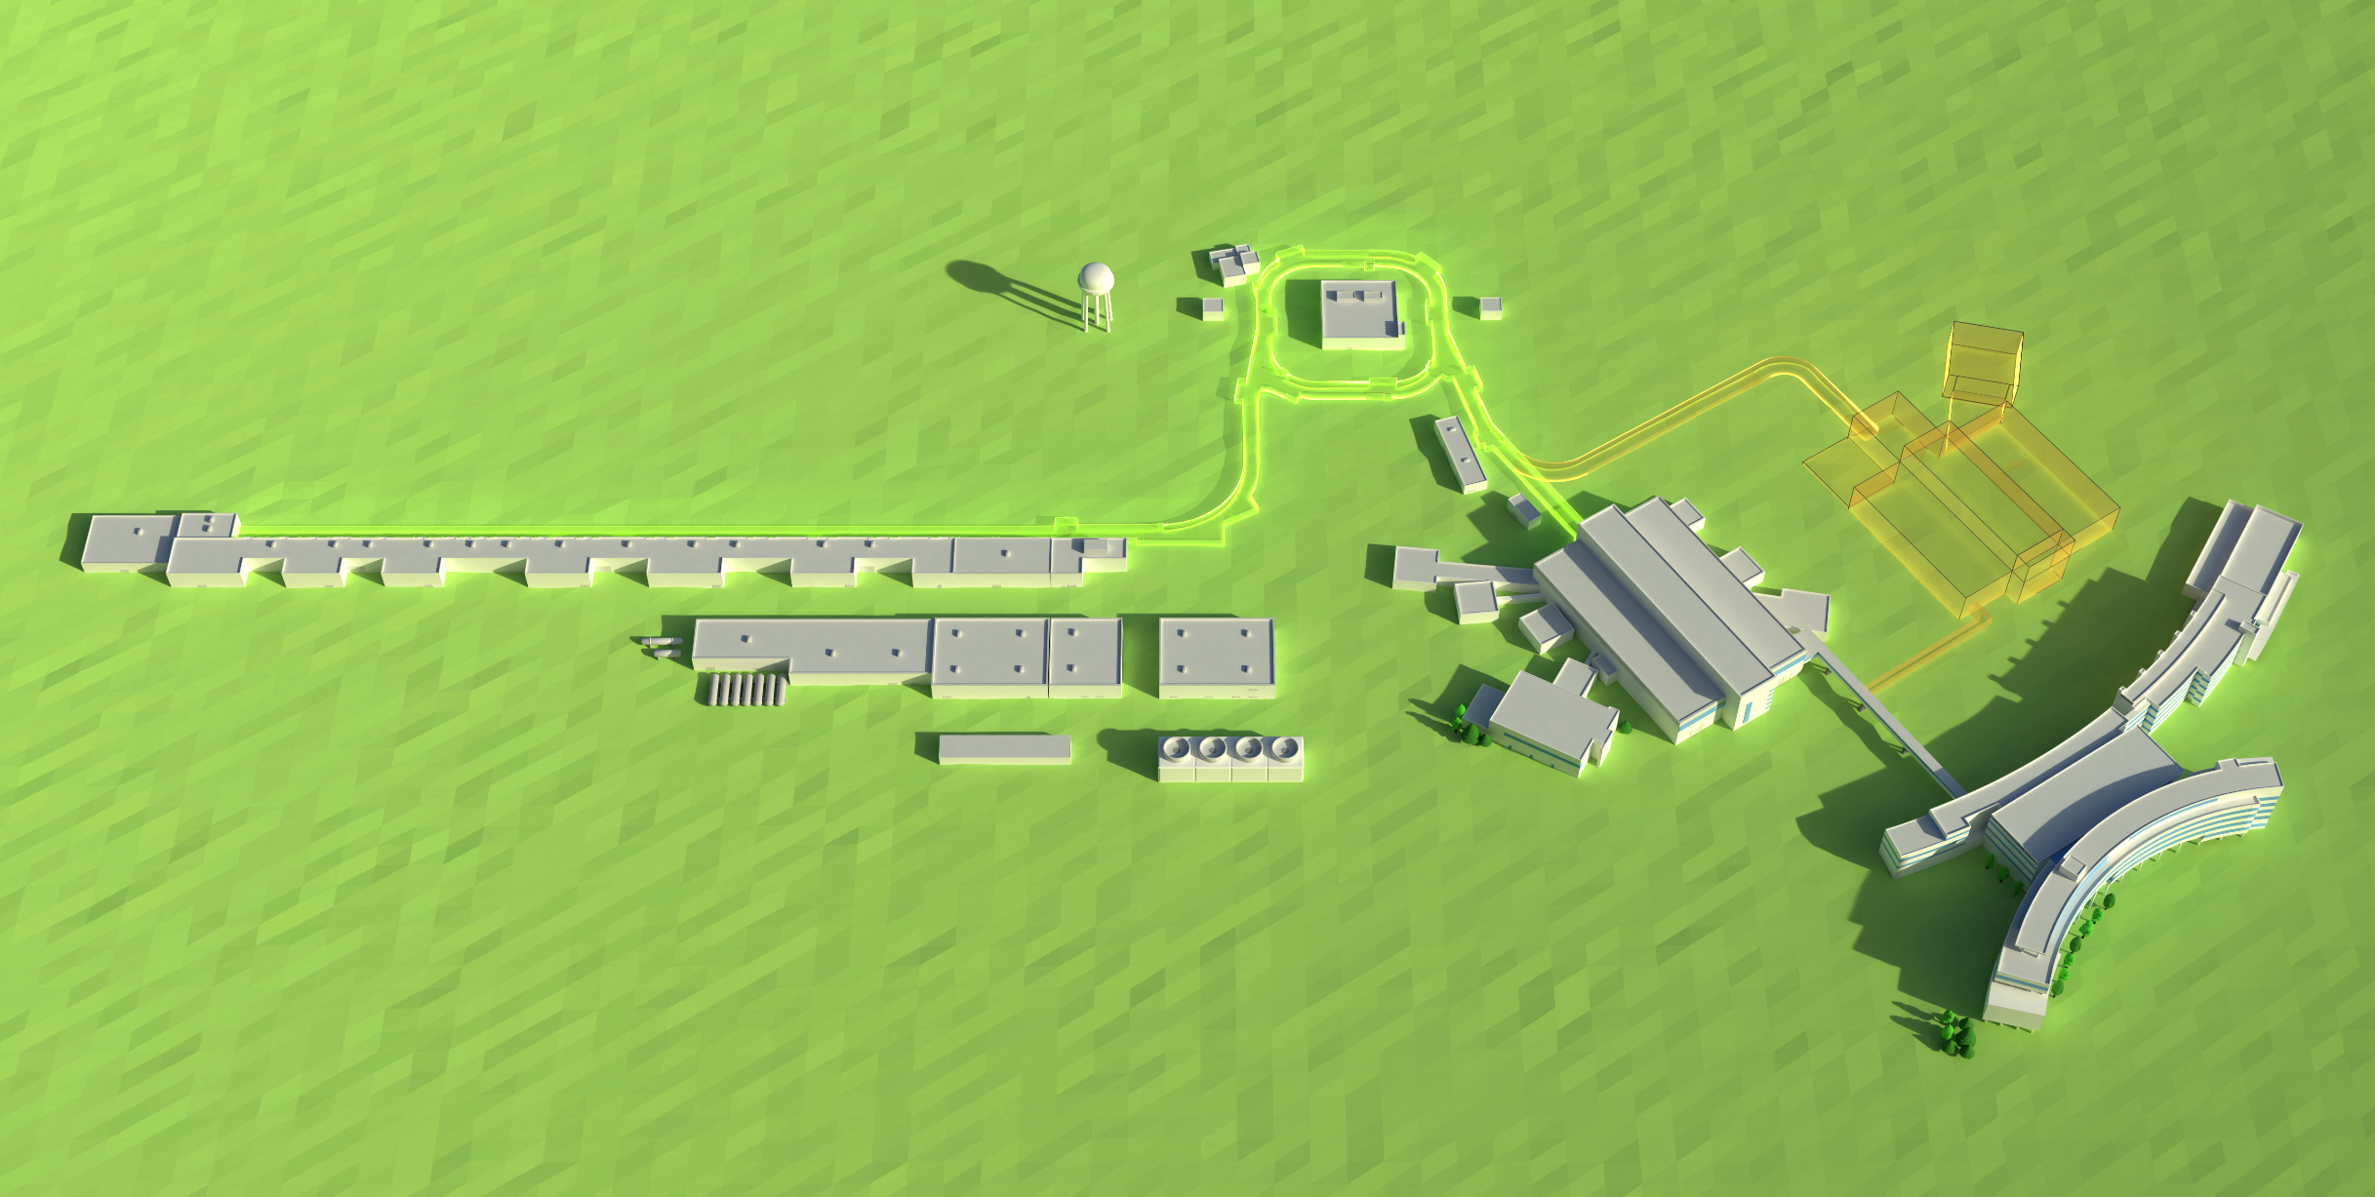
The SNS accelerator has existing dumps in the linear accelerator and a new beamline after the ring for STS
The accumulator ring compresses the pulse to ~700 nsec
Injection Dump
Future
Second Target Station
H-Source
Warm LINAC
Superconducting LINAC
186 MeV
~1000 MeV
Future RTST
beamline
Linac Dump
RFQ
The LINAC accelerates a 26 mA, ~1 msec long H⁻ beam
First Target Station
Liquid Hg Target
@ 60 Hz, this represents a 1.4 MW proton beam power
PPU will double the beam power capability to 2.8 MW and deliver 2.0 MW to the first target station
21-G02146/gim
Notes:
What infrastructure would be required to divert extra beam power?
There are many methods for diverting beams that are already demonstrated. The method chosen will depend on the location of the isotope target along the beamline and cost-effectiveness. Since these methods are well understood and do not present a technical challenge, they will not be explored in this proposal.

Slide 3
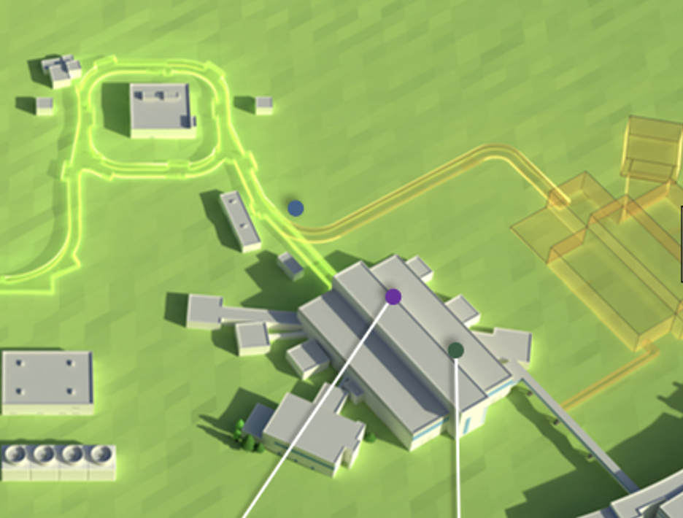
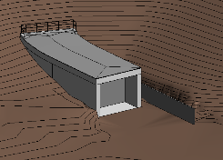
SNS will increase its excess power over the next decade
None of the existing dumps have infrastructure for radioisotope production experiments.
Energy degradation would be required for radioisotope production < 1 GeV.
Possible but not cost or energy efficient.
From accelerator infrastructure standpoint, radioisotope production at 1-1.3 GeV most attractive.
Possible isotope station
PPU stub
Year | Power | Power Capability (predicted) | Approx. Power Margin | Top Beam Energy
2023 | 1.55 MW | 1.55 MW | 105 kW | 1.1 GeV
2025 (post PPU) | 2.0 MW | 2.8 MW | 800 kW | 1.3 GeV
2035 (post STS) | 2.7 MW | 3.0 MW | 300 kW | 1.3 GeV
The PPU project will provide a “stub” for the future beamline.

Slide 4
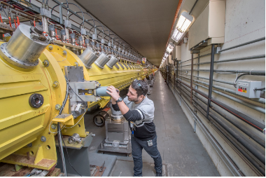
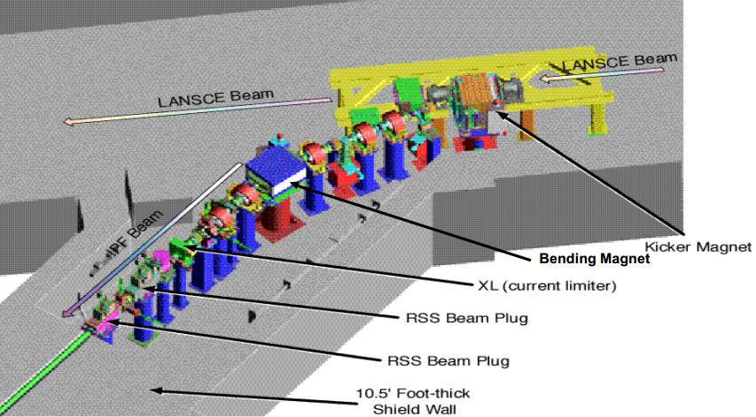
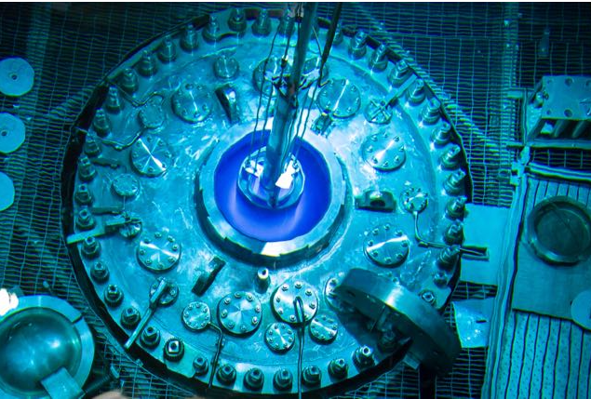
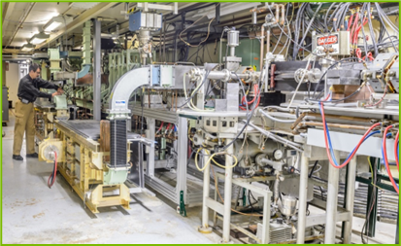
Nation’s Need for Radioisotopes
Demand for radioisotopes continues to grow for medical, industrial, and space applications.
Primary US sources include lower power medical cyclotrons (private, university), higher power cyclotrons and linear accelerators (national labs), and research reactors (national labs, universities).
BLIP at BNL
Accelerator systems currently used in novel radioisotope production in US:
BLIP at BNL
66 – 200 MeV protons (~150 µA)
IPF at LANL
100 MeV protons
(~275 µA)
LEAF at ANL
Up to 40 MeV photons (20 kW)
University cyclotrons at, U. Wash, U. Wis., UAB etc.
IPF at LANL
U. Wash
LEAF at ANL
HFIR

Slide 5
Workshop Objectives
1) Define some unique, desirable radioisotopes that can be produced using high-energy protons incident upon various spallation targets.
2) Determine how we can effectively isolate/separate the desired radionuclide(s).
a) On-line mass separation?
b) Bulk post-irradiation chemical and mass separation?
3) Identify the most challenging technological implementations and roadblocks.
a) What are the target technology limitations?
b) What is the target technical readiness?
c) What target materials would be interesting in terms of production with either protons or neutrons and post-irradiation handling?
4) Consider the regulatory aspects/challenges of adding isotope production to a facility (SNS) regulated by the Accelerator order.

Slide 6
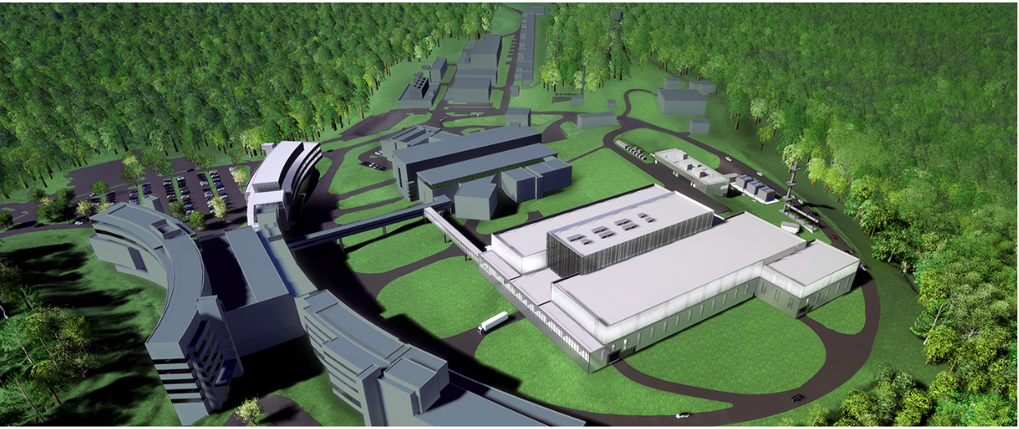
Thank You!

