Slide 1
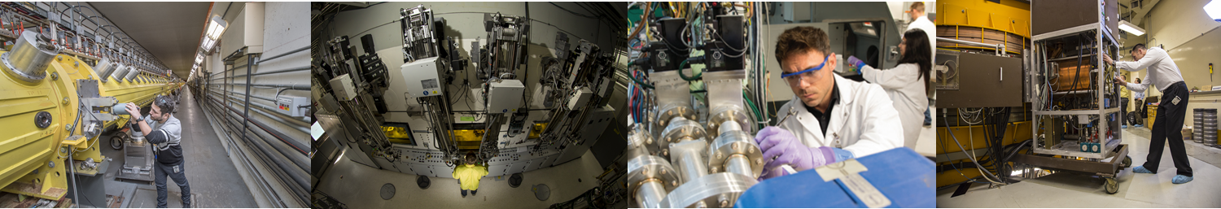
DOE Isotope Program: Accelerator Produced Radioisotope Landscape
Outline:
Introduction to the DOE Isotope Program
Isotope Program Programmatic Needs
Accelerator Landscape
Summary
Arne Freyberger
Program Manager for IP Accelerator Facilities
Sep, 27 2023

Slide 2
The DOE Isotope Program Mission
Produce and/or distribute stable isotopes and radioisotopes in short supply or unavailable in the U.S., including related isotope services.
Maintain mission readiness of critical national infrastructure and core competencies needed to manufacture isotopes and ensure national preparedness to respond to supply chain gaps during national crisis.
Conduct research and development (R&D) to develop transformative isotope production, separation, and enrichment technologies to enable federal, academic, and industrial innovation, research, and emerging technologies. Nurture a diverse and inclusive domestic workforce with unique and world-leading core competencies.
Mitigate U.S. dependence on foreign supplies of isotopes and promote robust domestic supply chains for U.S. economic resilience.
Nuclear Data: Cross section, decay rates and branching ratios:
Critical to the success of the IP mission
The more comprehensive the better
The more precise the better.
DOE IP supports creation of Nuclear Data:
R&D mission scope
Synergistic opportunities
    Other Office of Science efforts
    Office of Science initiatives

Slide 3

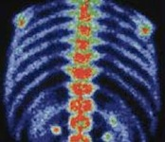
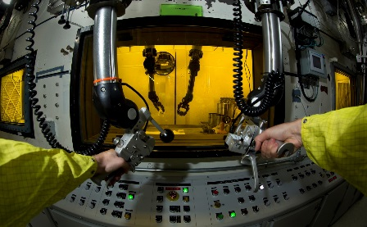
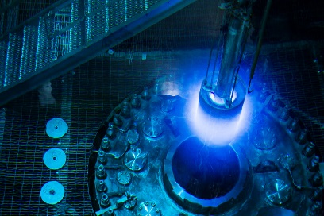
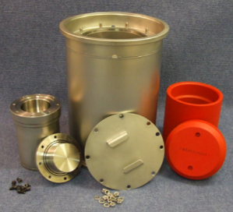
Program Authority
Public Law 101-101 (1990), as modified by Public Law 103-316 (1995) created the Isotope Production and Distribution Program Fund (called a revolving fund) and allows prices charged to be based on costs of production, market value, U.S. research needs and other factors.
Isotope Program in DOE has sole authority to produce isotopes for sale and distribution – labs may not embark on isotope production on their own.
DOE IP not responsible for Mo-99 (NNSA), Pu-238 RTG (NE) and SNM for weapons (NNSA) by congressional mandate.
DOE Isotope Program is the only Mission Essential Function in the Office of Science.

Slide 4
Government Role
Research program enables advances and workforce development
Coordinated isotope production capacity mitigates shortages
Ability to nurture markets, provide high risk, or boutique isotopes
Equal opportunity to access, technology
Leverage world-class capabilities at national laboratories
“Non-profit”, “No-compete”, research and government,stature enables unique perspective

Slide 5
Implications of Public Law 101-101
DOE IP is a unique Office of Science Program with unique authorities
DOE IP produces isotopes for SALE to the public
  The business face of DOE IP the National Isotope Development Center (NIDC)
    www.isotopes.gov
  DOE IP is one of few federal entities that sells/markets products to the public.
As a federal program, DOE IP does not compete with domestic industry.
  DOE IP mission is to fill gaps in the supply chain
  DOE IP assists transition of isotope production from DOE IP to domestic industry.
As a “business” DOE IP protects intellectual property developed by the DOE IP community
As the “sole authority” within the federal government, no federal (DOE) lab may embark on the production and sale of radioisotopes on their own. DOE IP must be involved.

Slide 6
Applications of Isotopes
Basic Research
Physics
Environment
Medicine
Therapies
Industry
Standards
Inspections
National Security
Imaging/Diagnostics
Communication
Detection
Super Heavy Elements
Nuclear Physics
Materials
Agriculture
Analytical Chemistry
Geosciences
Research
Dental
Testing
Sources
Nuclear Data
Forensics
Nuclear Data
Global Positioning
Sources

Slide 7
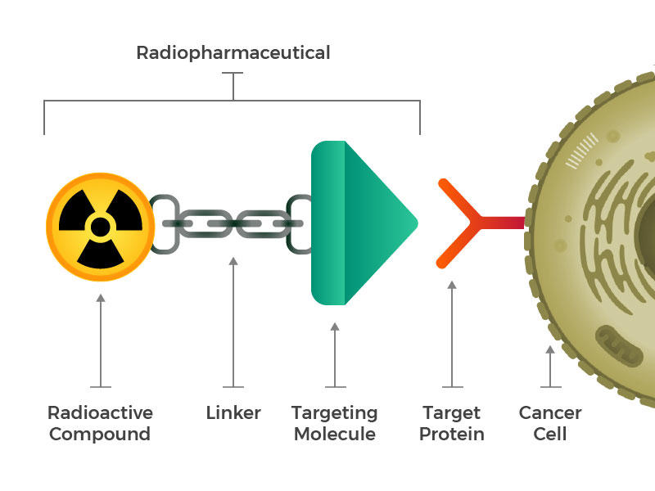
Targeted Alpha Therapy Primer
Over the last two decades there has been a surge in interest in radiopharmaceuticals that target cancer at the cellular level and may revolutionize cancer therapy.
Radioisotopes that are linked to cancer antibodies are inserted into the patient where it will:
Circulate internally and preferentially attach to the cancerous cell’s target protein.
When the radioisotope decays it deposits energy in a very small volume killing the cancer cell.
  For alpha decays the alpha particle travels about one cancel cell diameter.
  Minimizing collateral damage, very low radiation dose to the patient
Advantages of Targeted Alpha Therapy:
Ability to treat metastasized cancers
Credit: National Cancer Institute
The same linker-targeting molecule can be attached with a diagnostic pharmaceutical
  Track patients progress
  Prescreen patients for potential effectiveness of the therapy

Slide 8
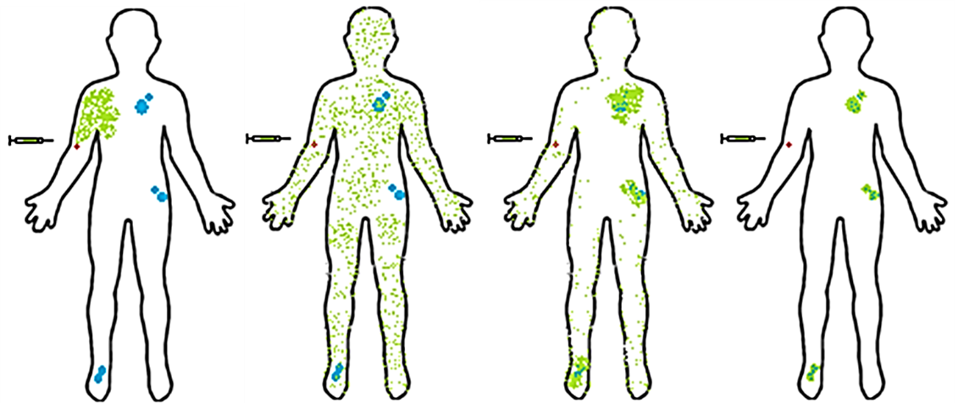
Medically-relevant alpha emitters are a priority
Th-232 (p,X) Ac-225
Spallation using 100-200 MeV protons
LANL-IPF/BNL-BLIP
Ra-226 (p,2n) Ac-225
~20 MeV protons
Small cyclotron at BNL
Ra-226 (γ,n) Ra-225;
Ra-225 -> Ac-225
Photo-nuclear production at the ANL-LEAF
Th-229 -> Ra-225;
Ra225 -> Ac-225
“Thorium Cow” @ ORNL
Limited to about 1 Ci/year
Bi-209 (α, 2n) At-211
α capable cyclotrons at universities.
Very short half-life: Multiple production sites (University based) to serve geographic regions.
Isotope | Half-life
²²⁵Ac | 10 d
²¹¹At | 7.2 h
²¹²Bi | 60 m
²¹³Bi | 46 m
²¹²Pb | 10.6 h
²²³Ra | 11.43 d
²²⁶Th | 31 m
²²⁷Th | 18.7 d
Alpha emitters are well suited for treatment of cancer and infectious diseases
Short range (50 to 80 microns or ≤ 5 cells)
High linear energy transfer (5 to 8 MeV)
Short half-life
1. Administration
2. Distribution
3. Localization
4. Retention
Priority alpha emitters that DOE IP is routinely producing or development production capabilities.

Slide 9
DOE IP Production Sites-
Unique collection of accelerators, reactors, other capabilities
PNNL
Sr-90 Y-90 generator for cancer therapy
BNL
Accelerator (BLIP):
Ac-225 Targeted cancer therapy
Ti-44 Sc-44 generator for PET imaging
Y-86 PET imaging
Univ. of Washington Supplier of research isotopes (e.g., At-211)
Univ. of Wisconsin
Supplier of research isotopes (e.g., Mn-52)
Michigan State Univ.
FRIB isotope harvesting development
Cyclotron (TR-19)
ANL Accelerator (LEAF)
Cu-67 Targeted cancer therapy
CARP (Clinical Alpha Radioisotope Producer)
INL
ATR Reactor:
Co-60 HSA Stereotactic radiosurgery, industrial NDA
Y-12 (NNSA Facility)
Li-6 Neutron detection
Li-7 Radiation dosimeter
Rad EMIS – nuclear forensics
ORNL
HFIR Reactor:
Ac-227 Cancer therapy
Se-75 Industrial NDA
Cf-252 Industrial sources
W-188 Cancer therapy
Radioisotopes Inventory:
Ac-225 Cancer therapy
Ra-223 Cancer therapy
Univ. of Missouri (MURR)
Supplier of research isotopes (e.g., Se-75, Lu-177, Au-199)
Texas A&M Cyclotron
Research isotopes, HIPPO
LANL
Accelerator (IPF):
Ac-225 Targeted cancer therapy
Ti-44 Sc-44 generator for PET imaging
Cd-109 X-ray fluorescence analyses
As-73 Environmental tracer
Si-32 Oceanographic research
RPF (Radioisotope Proc. Fac.)
Stable Isotopes Inventory:
E.g., Ca-48, Ga-69, Rb-87, Cl-37
Stable Isotope Production:
ESIPP – Yb-176
SIPF
SIPRC
Univ. of Alabama Birmingham
Supplier of research isotopes (e.g., Mn-52, Pb-203)
SRNL (NNSA Tritium Facility)
He-3 Neutron detection
Fuel source for fusion reactors
Lung testing
Plutonium Facility (PF-4):
Am-241 Oil and gas exploration

Slide 10
DOE IP Production Sites- Accelerators only
BNL
Accelerator (BLIP):
Ac-225 Targeted cancer therapy
Ti-44 Sc-44 generator for PET imaging
Y-86 PET imaging
Cu-67 Targeted cancer therapy
Cyclotron (TR-19)
Univ. of Washington Supplier of research isotopes (e.g., At-211)
Univ. of Wisconsin
Supplier of research isotopes (e.g., Mn-52)
Michigan State Univ.
FRIB isotope harvesting development
Cyclotron (TR-19)
ANL Accelerator (LEAF)
Cu-67 Targeted cancer therapy
CARP (Clinical Alpha Radioisotope Producer)
LANL
Accelerator (IPF):
Ac-225 Targeted cancer therapy
Ti-44 Sc-44 generator for PET imaging
Cd-109 X-ray fluorescence analyses
As-73 Environmental tracer
Si-32 Oceanographic research
Texas A&M Cyclotron
Research isotopes, HIPPO
Univ. of Alabama Birmingham
Supplier of research isotopes (e.g., Mn-52, Pb-203)
Cost-effectively exploits existing capabilities; green boxes under development

Slide 11
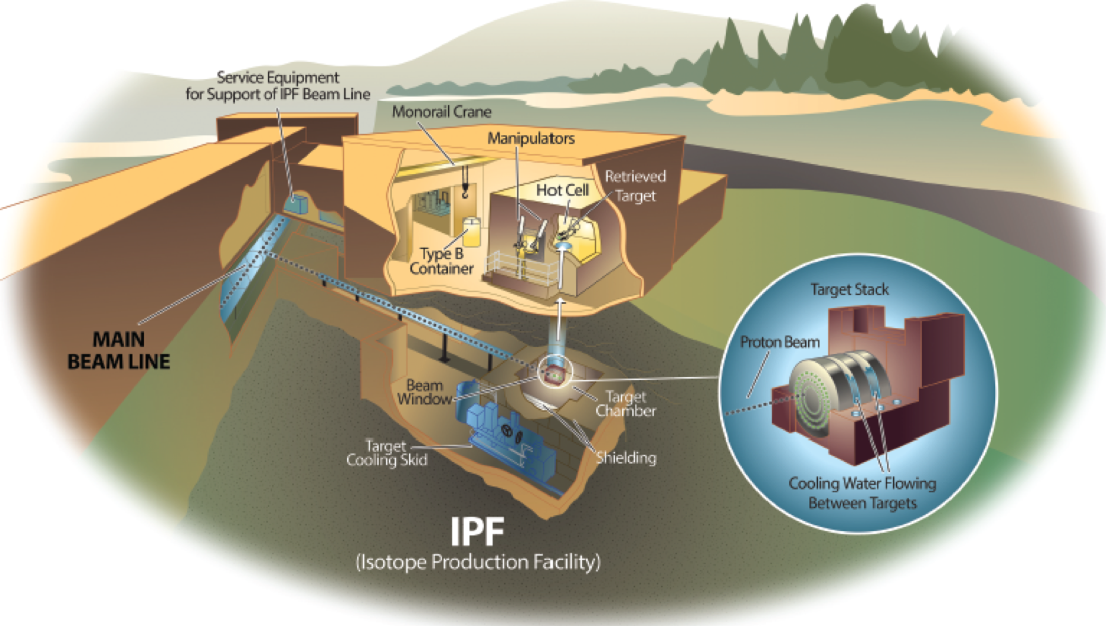
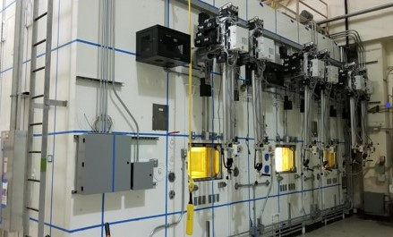
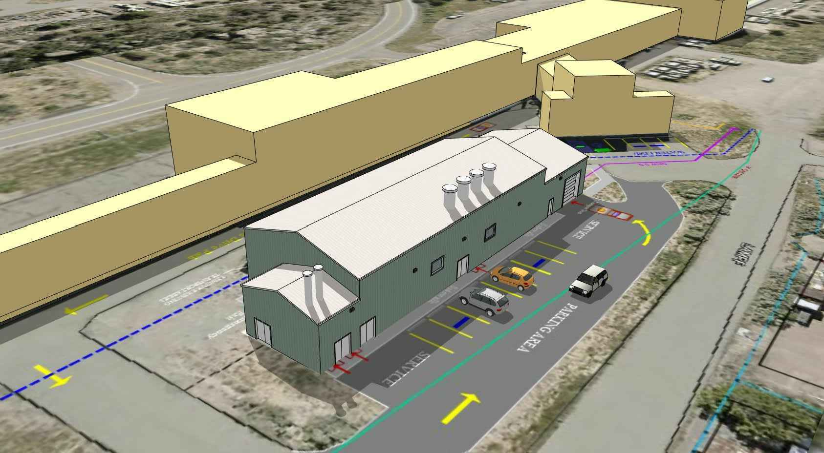
LANL-IPF and BNL-BLIP (Vermeulen and Medvedev)
BNL BLIP
200 MeV, 165 μA p+ beam
Ac-225, Ti-44, Se-72, Be-7, Y-86, Rb-83, Zn-65
AP hot cells under development for processing of alpha emitting isotopes
19 MeV cyclotron for Ac-225
Ops coordinated with RHIC
LANL IPF
100 MeV, 300 μA p+ beam
Ac-225, Am-241, Al-26, As-73, NA-22, Zr-88, Y-88
Ops parasitic with LANSCE
LML/API New processing capability (joint NNSA/DOE IP)
Long term vision is to establish HazCat 3 level processing facilities at both BNL and LANL for Ac-225 production.
BNL AP Hot Cells nearly ready for operation and Ac-225 production
LANL LML building being built to host DOE IP hot cells for Ac-225 production

Slide 12
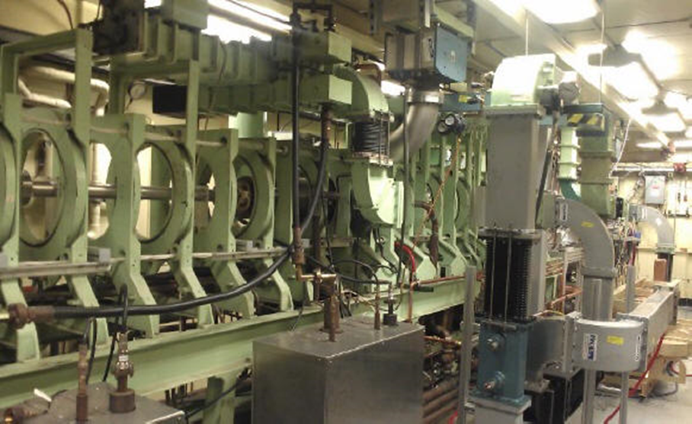
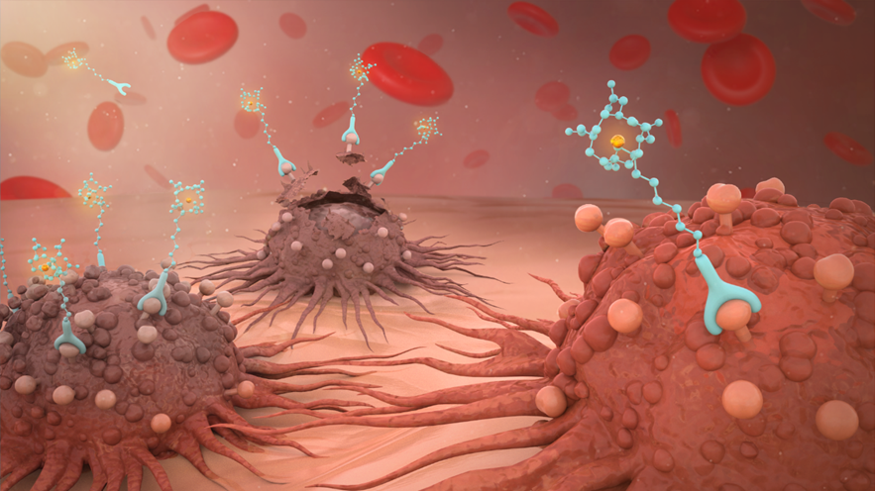
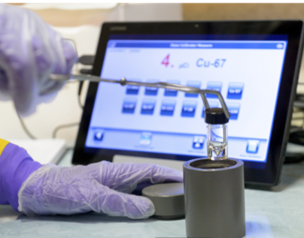
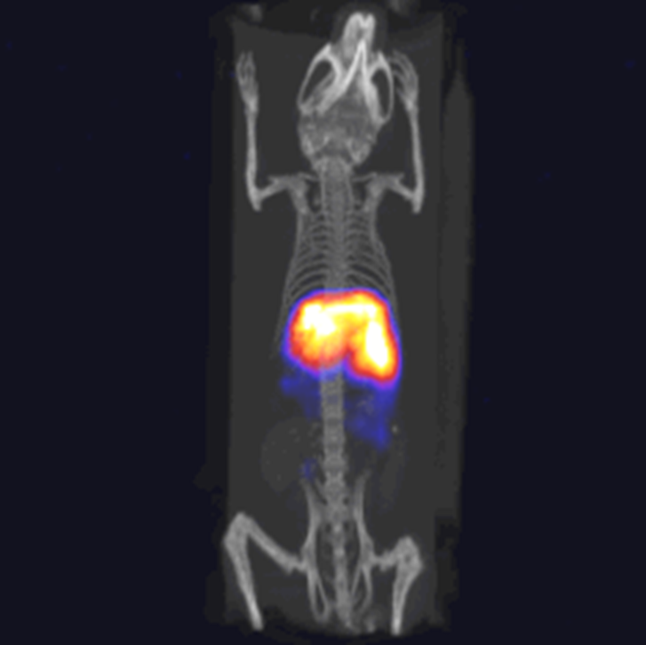
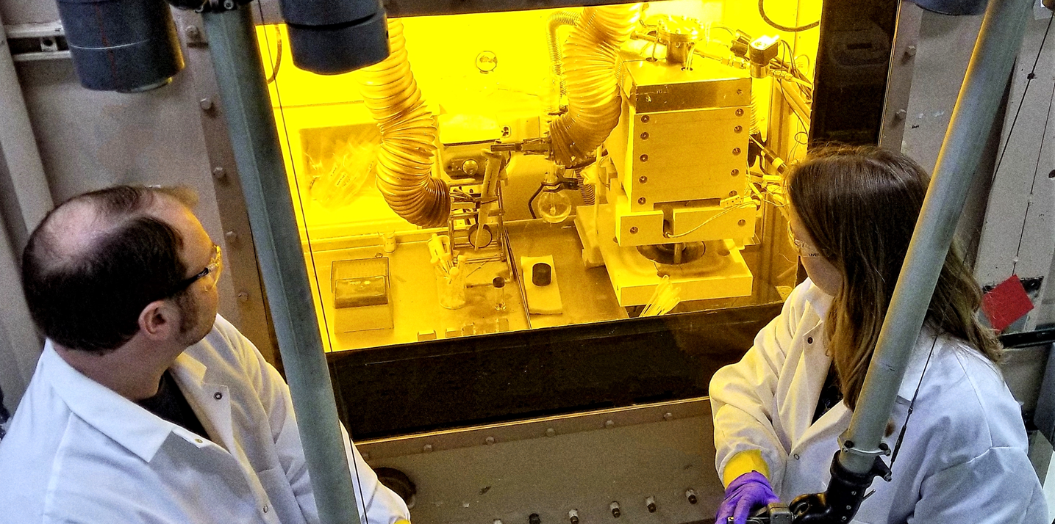
Argonne’s Radioisotope Research and Production Program (R2P2/LEAF)
Operates the LEAF: 20-55 MeV electron accelerator for production of radioisotopes.
Curie level batches of Cu-67 now routinely produced for distribution.
Cu-67 is a theranostic radioisotope: therapy and diagnostic capabilities in a single isotope
Sc-47 and Ac-225 production is under development
Artistic rendering of how targeted radionuclide therapy finds, attacks, and destroys cancer cells.
The 55 MeV electron linear accelerator at Argonne’s Low Energy Accelerator Facility (LEAF).
Hot cell processing of Cu-67
Cu-67 ready for shipment
Diagnostic demonstration of Cu-67 in living mice, in collaboration with University of Alabama-Birmingham

Slide 13
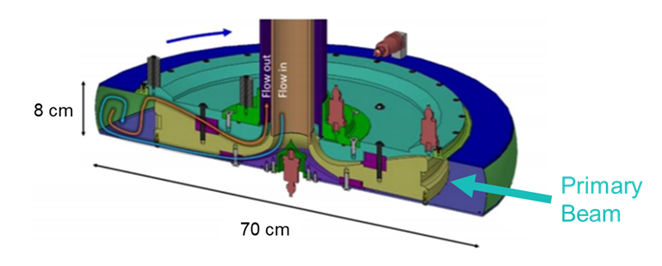
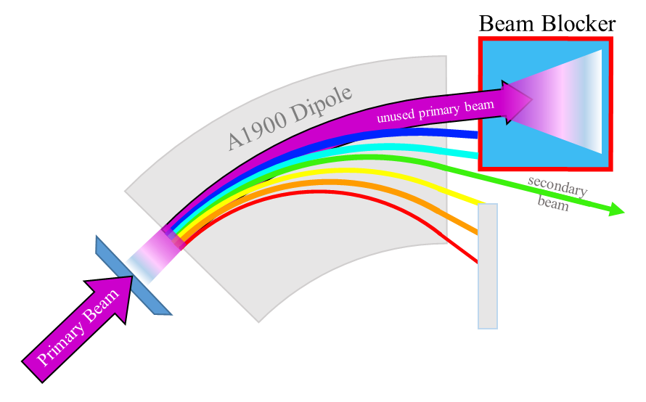
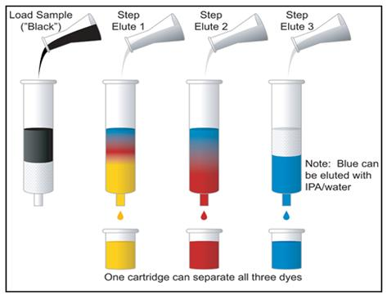
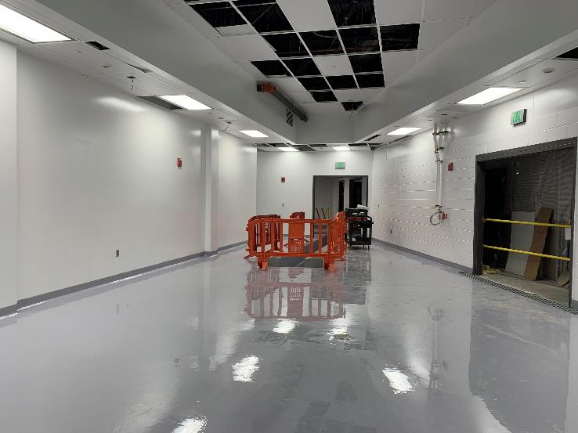
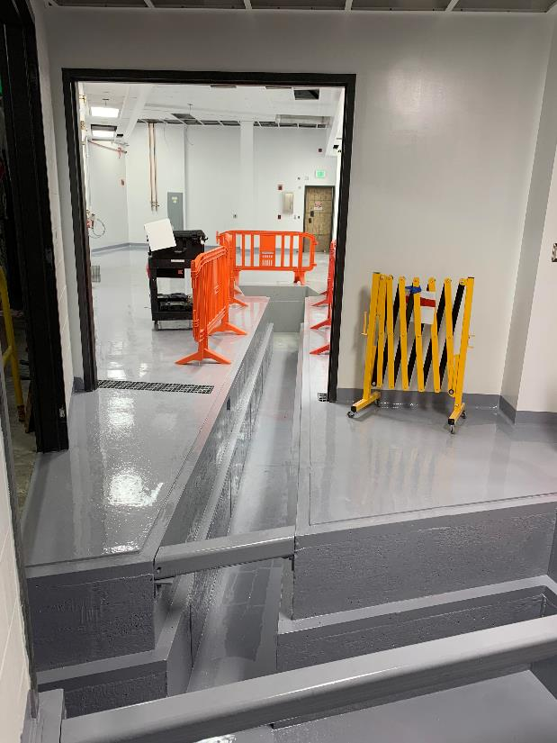
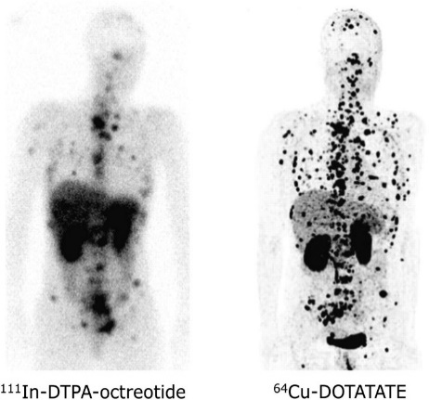
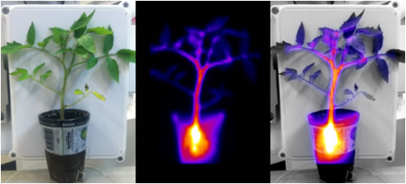
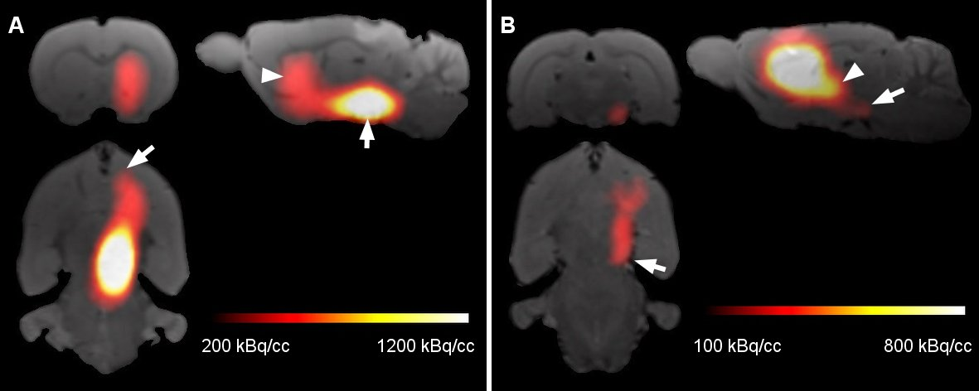
FRIB Isotope Harvesting (Severin Presentation)
2015 NSAC Isotope Program Long Range Plan Recommendation:
Infrastructure for isotope harvesting at FRIB – During routine operation for its nuclear physics mission, FRIB will produce a broad variety of isotopes that could be harvested synergistically without interference to the primary user.
Harvesting
Hot cell contract in place
Harvesting Vault room being prepared for harvesting equipment
Effluent transfer from FRIB Beam dump to Harvesting Vault progressing
Early completion Q2FY2024

Slide 14
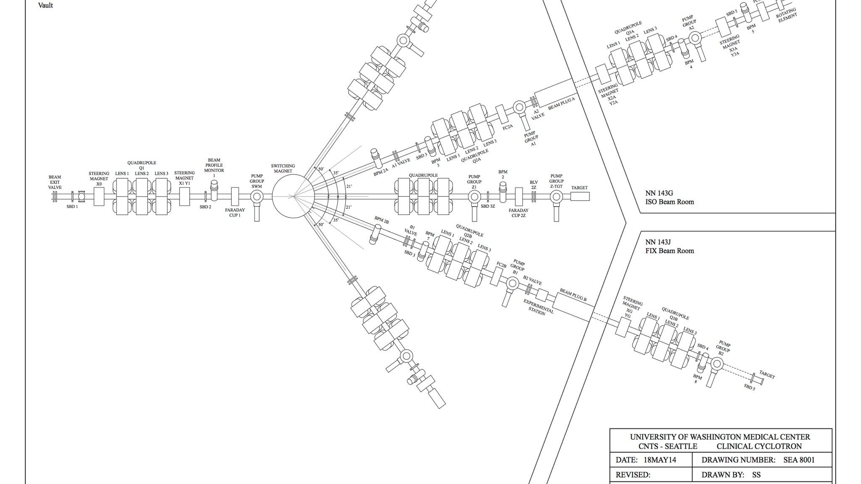
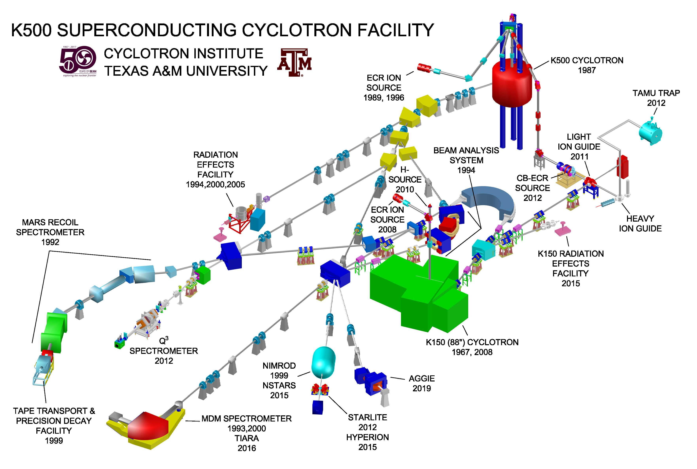
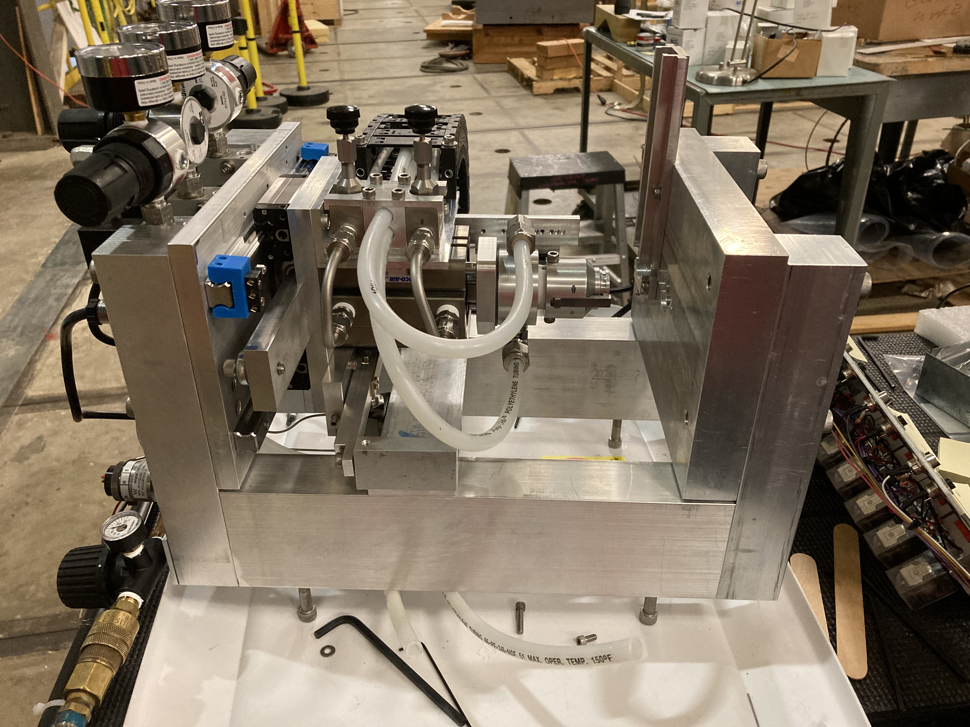
University Isotope Network (UIN)
University | Routine Isotopes NIDC | R&D Effort or potential NIDC sales | Machine/Equipment
Texas A&M University | At-211 | Pb-203 | K500 cyclotron (8-70 MeV protons, 2 - 15 MeV nucleon)
University of Alabama-Birmingham | V-48, Mn-52g, Co-55, Pb-203 | Ti45?, Sc-44? | TR-24 Cyclotron, 4 external beamlines, 8 hot cells
University of California-Davis |  | At-211 | 76"(88") Cyclotron (4-67.5 MeV, protons, deuterons, alphas)/Reactor
University of Pennsylvania (PENN) |  | At-211 | Cyclotrons: 30 MeV JSW, proton, deuterons, He-3 and alpha for At-211 18 MeV IBA for F-18 production
University of Washington-Seattle | At-211, Sn-117m (irradiation), Re-186, Se-72, Bi-205/206 |  | Scanditronix MC-50 compact cyclotron: routine 50.5 MeV p, 29.0 and 47.3 MeV alpha beams, procuring a hot cell
University of Wisconsin-Madison | Y-86, Br-77, Mn-52g |  | RDS-112 Cyclotron, 11.3 MeV protons, hot cell, and targetry infrastructure

Slide 15
Items to consider
Carve out a niche that is beyond the reach of industry
  For example, the ORNL High flux Reactor (HFIR)
  Proton energies above 70 MeV (above 200 MeV would be unique within DOE IP)
Match the radioisotope lifetimes with the SNS run cycle
  Short lived isotopes need to be provided year round, will SNS support this?
  Long lived isotopes likely need a long irradiation time, will the safety basis support this?
Minimize impact of DOE IP operations to the parent program (in this case BES SNS operations)
  Bump less target insert/withdrawal (see LANL and BNL presentations)
Transition from Accelerator Safety Order (irradiation) and Nuclear Safety Order (processing)
  ORNL has expertise in both these safety basis, but transfer from one safety basis to the other may present new challenges (inventory, staff training).

Slide 16
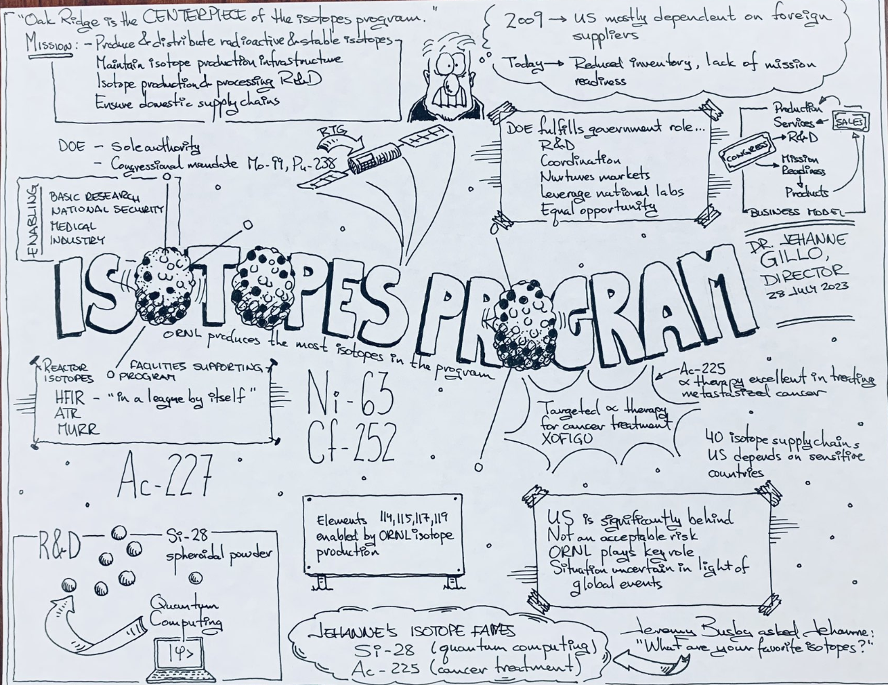
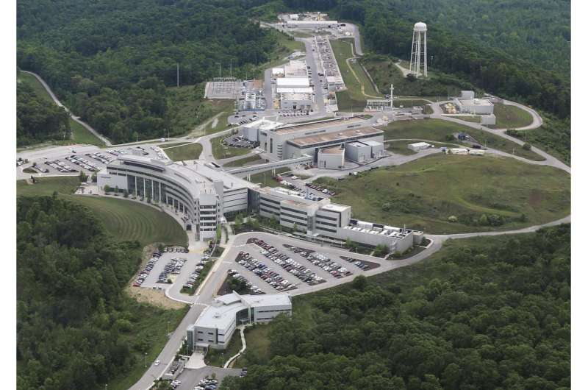
Summary Jehanne Gillo’s Seminar curtesy of Rob Dimeo
Accelerator Production of Radioisotopes at ORNL would complete this picture.

Slide 17

Thank you!

Slide 18





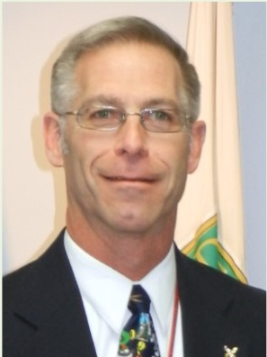






Office of Isotope R&D and Production (SC-26)
Became standalone office in 2020 SC restructuring and first appropriation in 2022
Jehanne Gillo
Director
Bill Newton
Subcontract Support
Valerie Mocca
Admin Assistant
Andrea Condrad
Financial Management Specialist
Budget Formulation
Deanna Ammons
Financial Management Specialist
Budget Execution
Leonard Mausner
Subcontract Support
Ethan Balkin
Radioisotope Production R&D
David Bivans
Alternative Isotope Production
Kenneth Brooks
Isotope Program Operations (NIDC)
Arne Freyberger
Isotope Accelerator Facilities
April Gillens
Stable Isotopes
Khianne Jackson
Isotope Program Initiatives
Jon Neuhoff
Isotope Reactor Facilities
Kristian Myhre
Technical Advisor

Slide 19
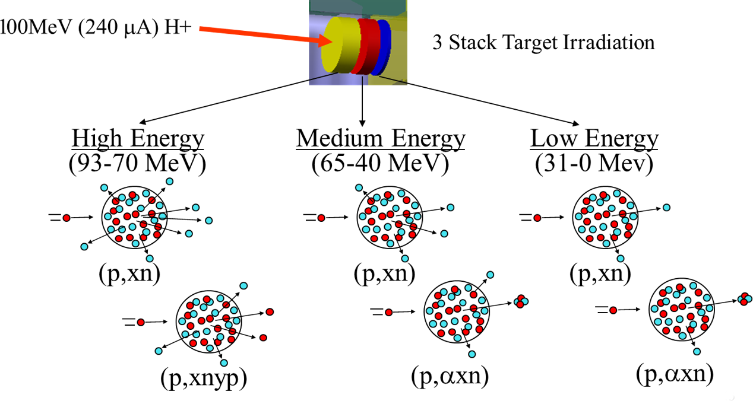
Accelerator Production of Isotopes
 | α,3n | α,2n ³He, n | α, n
p,2n | p,n | d,n ³He, np | t,n α,np ³He,p
 | p,pn n,2n | Original Nucleus Z,N | d,p n,γ t,np | t,p
p,α | n,t d,α n,nd | n,np p,2p n,d | n,p t,³He
 | n,α n,n³He | n,³He n,pd
Z
N
n = neutron
p = proton (H)
d = deuteron (²H; [pn])
t = triton (³H); [p2n]
³He = [2pn]
= alpha particle (⁴He); [2p2n]

