Slide 1
Nuclear Batteries:
Possible Applications for SNS-produced Radioisotopes
Chris Duke,
National Security Sciences Directorate
National Security Program Manager
Oak Ridge National Laboratory
Commercial/STE: 865-241-3310
Secure: 361-8500
dukecm@ornl.gov
Brad Johnson, PhD
Isotope Science and Engineering Directorate
Program Manager, Nuclear Batteries
Oak Ridge National Laboratory
865-574-1333
johnsonbr1@ornl.gov
OFFICIAL USE ONLY
May be exempt from public release under the Freedom of Information Act (5 U.S.C. 552), exemption number and category: 5, Privileged Information
Department of Energy Review required before public release
Name/Org: B. R. Johnson. Date: April 18, 2022
Guidance (if applicable): ORNL Isotope Science & Engineering Office

Slide 2
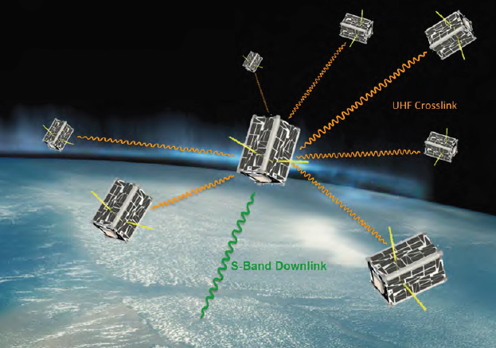
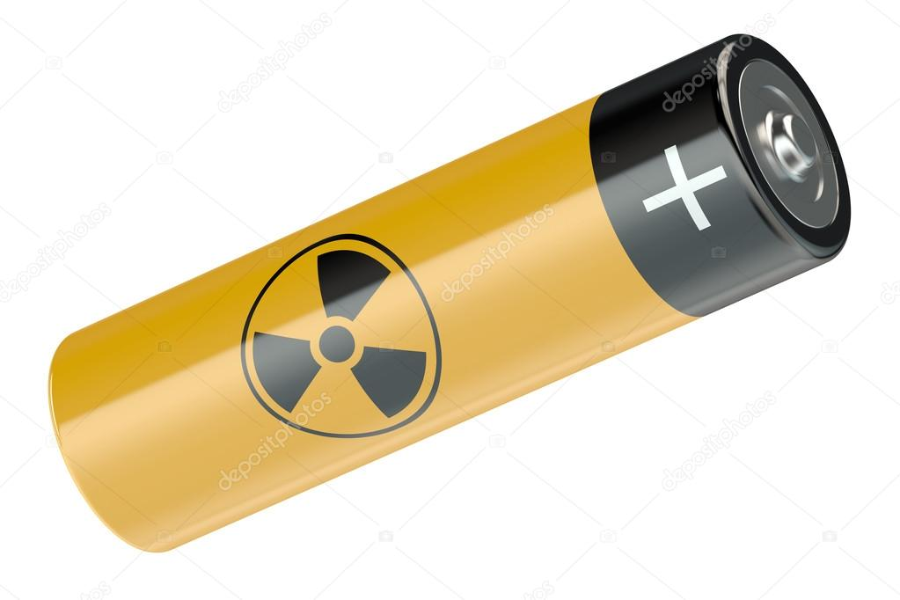
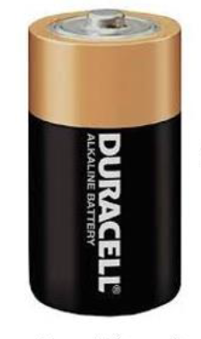
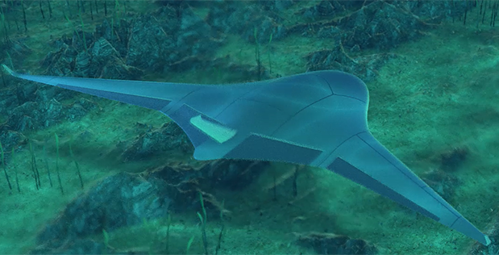
Nuclear Battery (NB) Overview
NBs = constant current power supplies.
NB advantages:
  Long-lived (months – decades)
  Rugged, durable
  Silent
  Temperature insensitive
Challenges:
  Traditional NB SWAP ≠ current mission needs
  Supply chain
  Economics
NB
D-Cell sized
Nuclear
Battery
Baseline

Slide 3

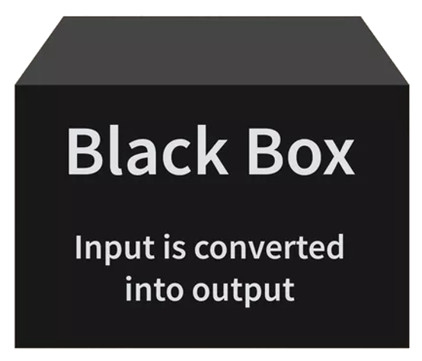
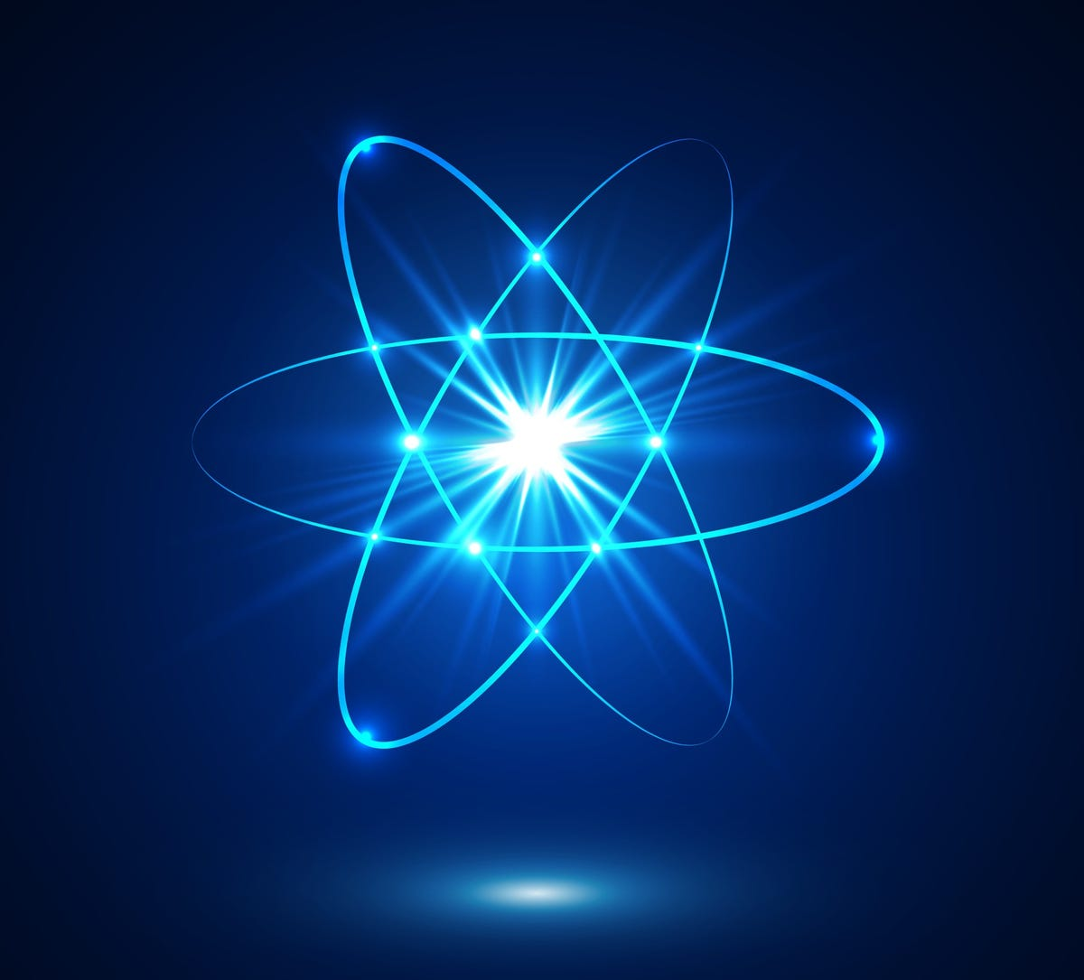
Nuclear Battery Concepts:
Transducer
Input
Output
Radioisotope
Electricity
Energy Source:
Radioisotope decay energy
• Pu-238: alpha particle
• Sr-90: high energy beta
• Am-241: alpha
• Ni-63: low energy beta
Transducers:
RTG: Thermoelectric (PbTe, SiGe, etc.), Stirling engine
BV: Semiconductor (SiC, GaN, Si, etc.)
BPV: Scintillator + photovoltaic

Slide 4

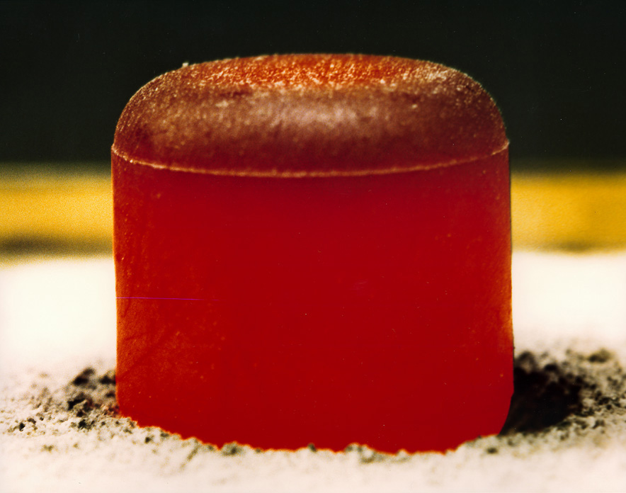
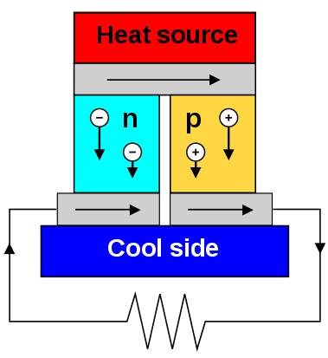
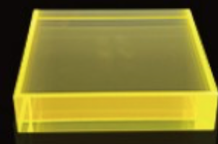
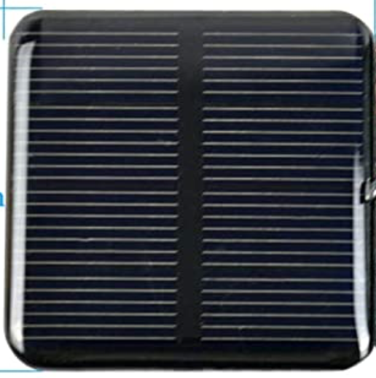
Types of Nuclear Batteries:
BVs
Betavoltaics
RTGs
Radioisotope Thermoelectric
Generators
Beta-Photovoltaics
BPVs
Radio-isotope
Beta particle source
NASA RTG heat source
Scintillator
Adams_2015_Rsrch-Dev-and-Eval-Cap-for-Betavoltaic-Pwr-Sources_ ASEE#13983
Semiconductor
Transducer
PV
Pu-238
Thermoelectric Transducer

Slide 5
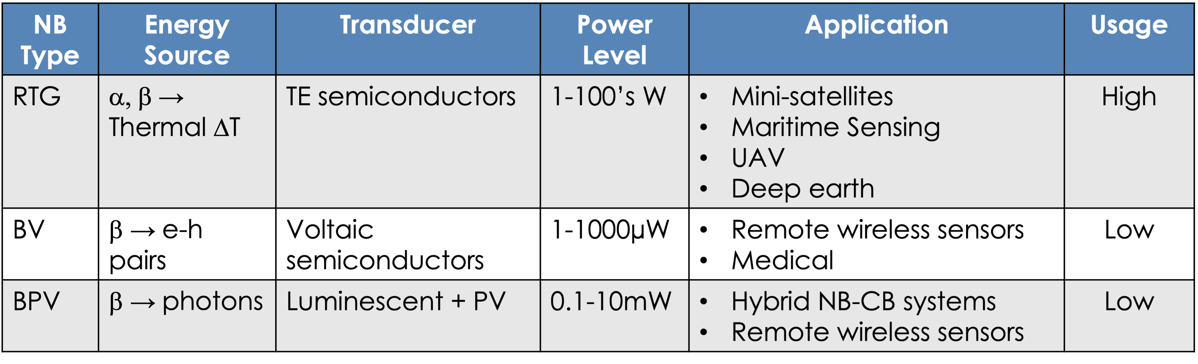
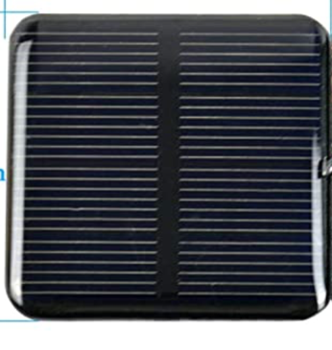

Different ways to convert radioactivity into electricity
NB Type | Energy Source | Transducer | Power Level | Application | Usage
RTG | α, β → Thermal ΔT | TE semiconductors | 1-100’s W | Mini-satellites Maritime Sensing UAV Deep earth | High
BV | β → e-h pairs | Voltaic semiconductors | 1-1000µW | Remote wireless sensors Medical | Low
BPV | β → photons | Luminescent + PV | 0.1-10mW | Hybrid NB-CB systems Remote wireless sensors | Low
PV
Scintillator
PV
Scintillator
Isotope
Adams_2015_Rsrch-Dev-and-Eval-Cap-for-Betavoltaic-Pwr-Sources ASEE#13983

Slide 6
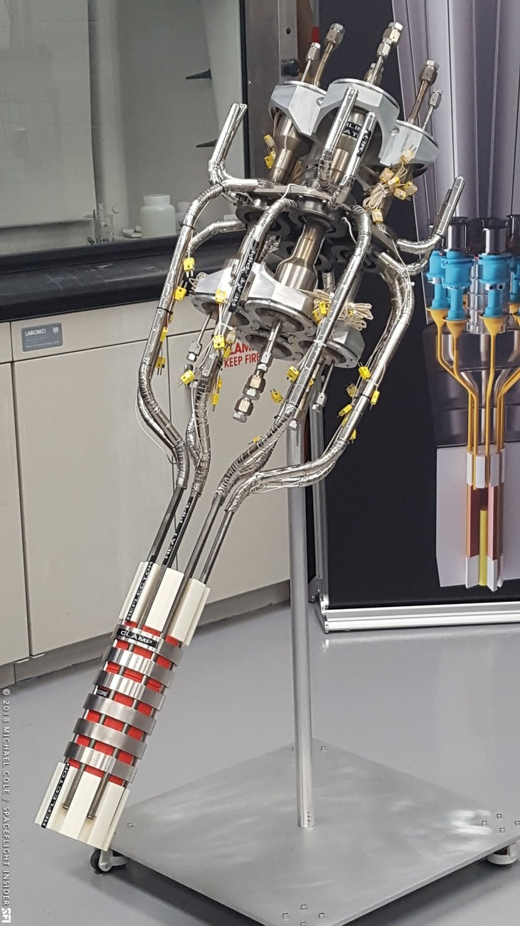
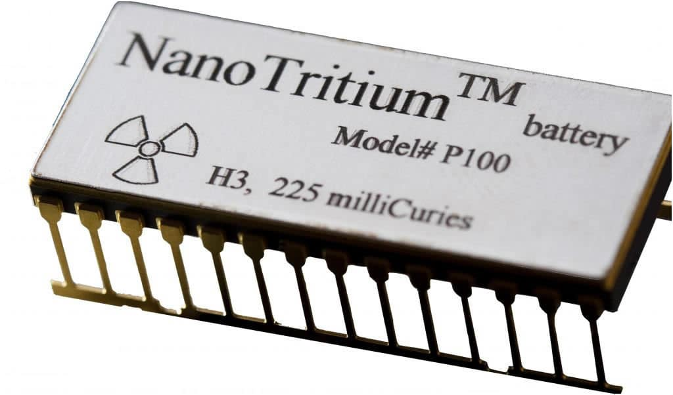
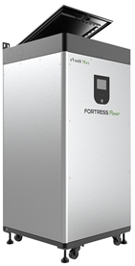
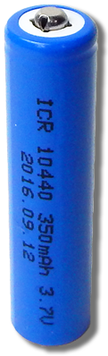

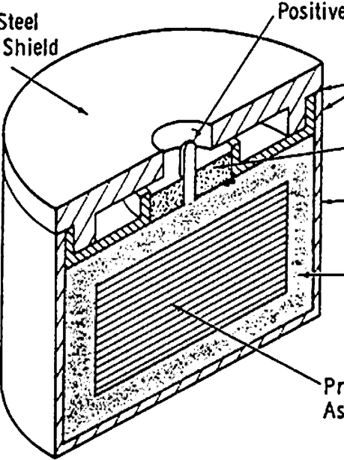
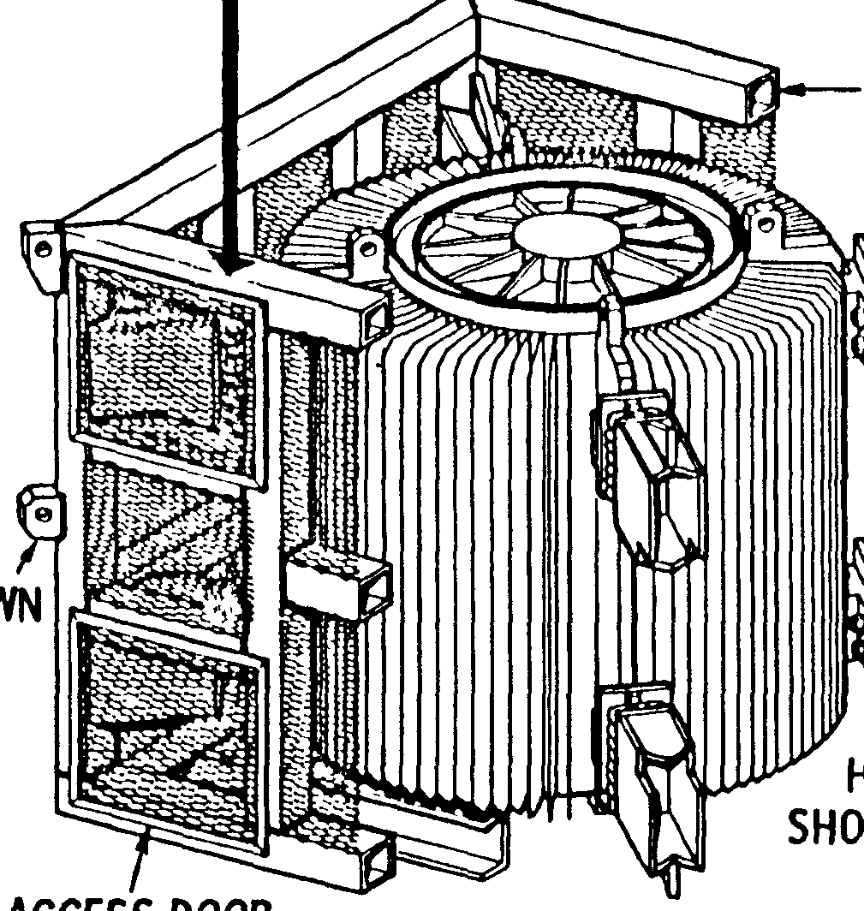
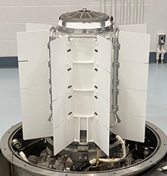
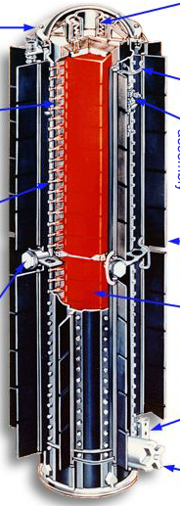
Nuclear Battery Power Ranges
LANL - ”KRUSTY”
BV-hybrid concept
RTG-hybrid concept
Power Mgmt Unit
Power Mgmt Unit
Betavoltaic (BV)
RTG
Fission 10kW
100µW
10mW peak
1.5kW peak
µW
mW
W
kW
MW
Betacel®
400µW
NASA MMRTG
110W
NASA GPHS
292W
BUP-500: 650W

Slide 7
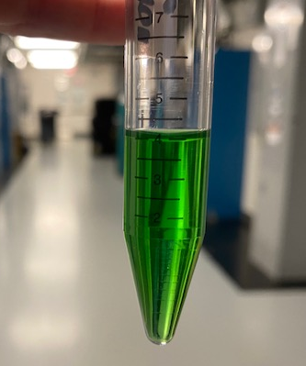
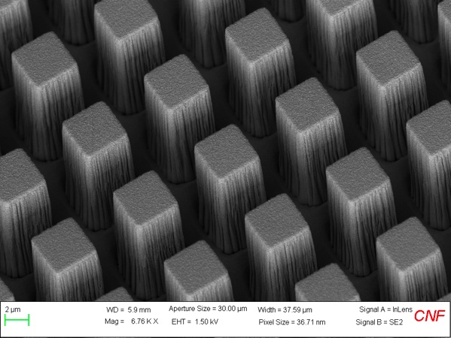
Example BV Nuclear Battery:
Transducer
Input
Output
Radioisotope
Electricity
Ni-63: Pure beta emitter
~ 17 keV/decay
~ 100y half-life
Ni-63
Textured SiC

Slide 8
Example RTG Nuclear Battery:
Transducer
Input
Output
Radioisotope
Electricity
NASA heat source
Pu-238
Pu-238: alpha emitter
~ 5.5 MeV/decay
~ 88y half-life
NASA high temp thermoelectric

Slide 9
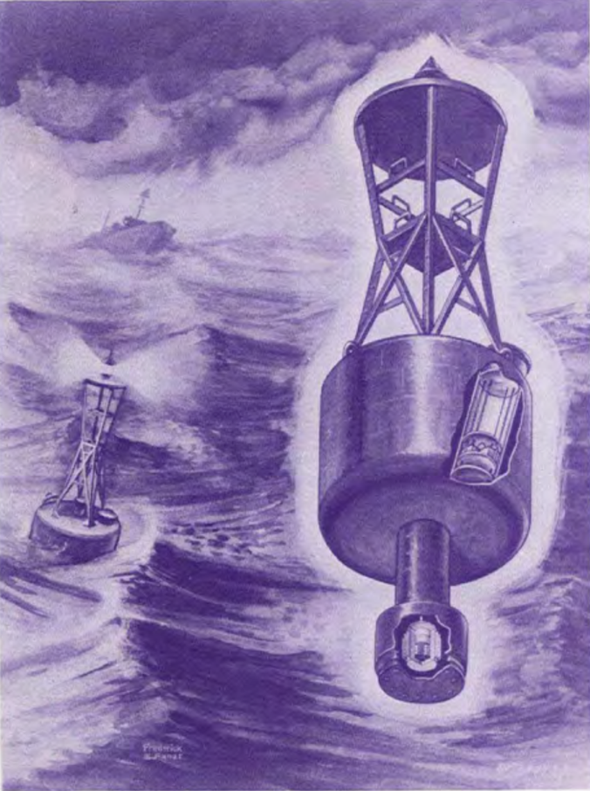
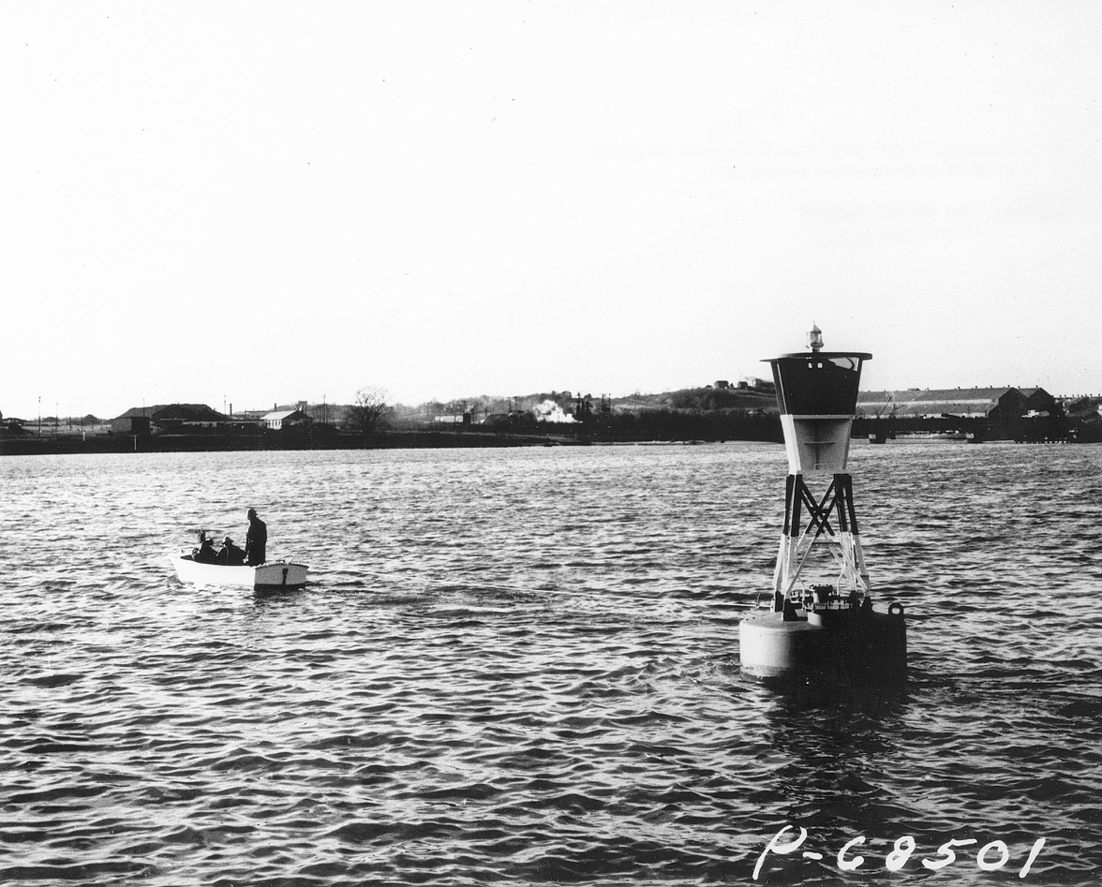
ORNL: Heritage Nuclear Battery Expertise
Prime supplier of RTGs from the 1950’s – 1970’s
Name | Watts, Electric | Date | Buyer | Use | Place
Sentry (Weather Bureau) | 5 | 1961 | Weather Bureau | Weather Station | Axel-Heiberg Island
SNAP7A | 10 | 1962 | US Coast Guard | Buoy Light | Curtis Bay, MD
SNAP7B | 60 | 1964 | US Coast Guard | Lighthouse | Baltimore, MD
SNAP 7C | 10 | 1962 | US Navy | Weather Station | Antarctic Mainland
SNAP7D | 60 | 1964 | US Navy | Barge weather station | Gulf of Mexico
SNAP 7E | 7.5 | 1964 | US Navy | Sonic beacon | Undersea near FL
SNAP 7F | 60 | 1965 | Philips Petroleum | Buoy warning and control station | Gulf of Mexico
URlPS (P1-1002) | 1 | 1966 | US Navy | Deep sea | Port Hueneme, CA
URIPS (PI-1001A) | 1 | 1967 | US Navy | Deep sea | Port Hueneme, CA
NUMEC (2) | 7 | 1966 | Israel | Undersea or surface
U1-1001 | 1 | 1967 | AGN-BMI-Bendix | Geodetic benchmark | Pacific Ocean near Anacupa, Is
NUMEC 100MA (2) milli TRACS | 0.1 | 1967 | US Navy | Deep sea | Port Hueneme, CA
NUMEC TRACS-25A | 20 | 1968 | US Navy | Tidal wave warning system | Bahamas
RlPPLE III | 0.7 | 1967 | US Navy (Loan) | Undersea test | Port Hueneme, CA
RlPPLE IV | 2 | 1967 | US Navy | Submarine cable repeater
RlPPLE IX | 4 | 1967 |  | Aircraft ground beacon
MW-3000A | 2.5 | 1967 | US Navy | Deep sea
SNAP-21 (5) | 10 | 1969 | US Navy | Undersee | Offshore San Clemente Is, CA
LCG 25A | 25 | 1966 | US Navy | Oceanographic Instruments | Fairway Rock, AK
LCG 25B | 25 | 1967 | US Navy |  | Port Hueneme, CA
SNAP 23A | 60 | 1969 | US Navy | Terrestrial
Sentinel 25E (11, 12, 13) | 25 | MAR 1969 | US Navy | Oceanographic data stations
Sentinel 25D (8, 9, 10) | 25 | JUN 1969 | US Navy | Terrestrial and to 1000 ft undersea buoys
LCG 25C1 | 25 | 1968 | NASA | Interrogation, recording, and location system | Puerto Rico coast sub-surface buoy
P1-1003 P1-1004 P1-1005 P1-1006 | 1.2 | 1970 | US Navy | Deep ocean | Port Hueneme, CA
33 RTGs
24 USN
SNAP-7B, Light Buoy, Baltimore, MD
Fuel: Sr-90 from Hanford

Slide 10
ORNL: Current Key Contributor to NASA RTGs
MMRTG used on Mars Perseverance Rover
Fuel: Pu-238 from SRS + ORNL

Slide 11
NASA General Purpose Heat Source RTGs: Modular Design
General Purpose Heat Source Module

Slide 12

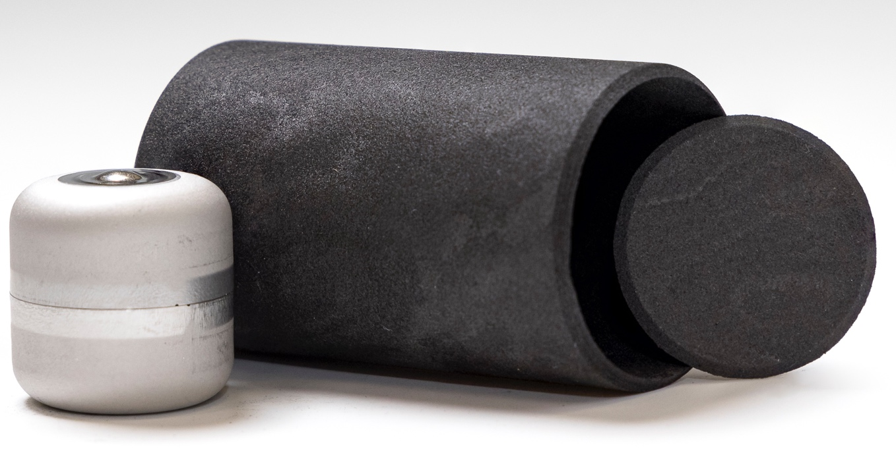
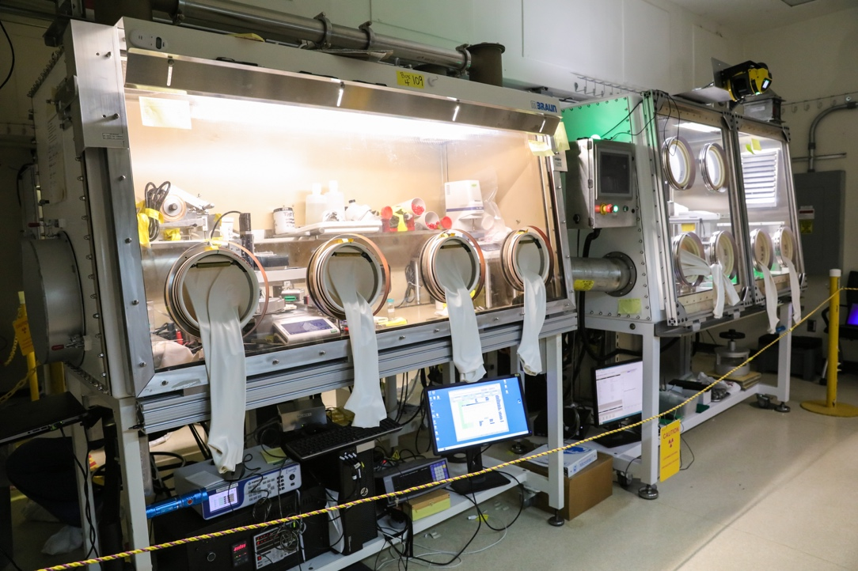
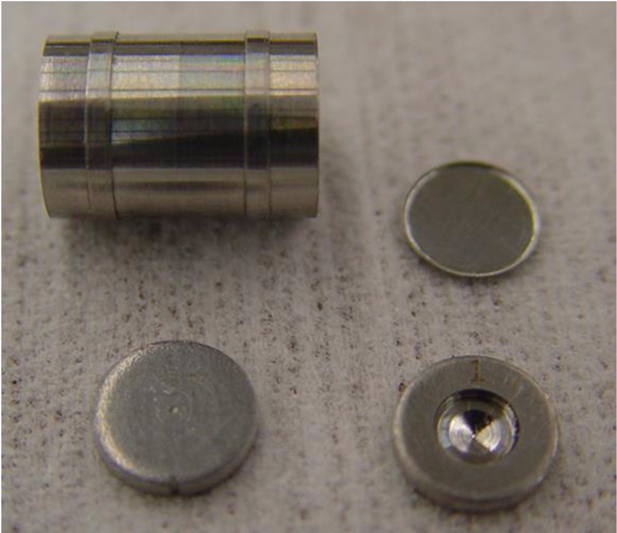
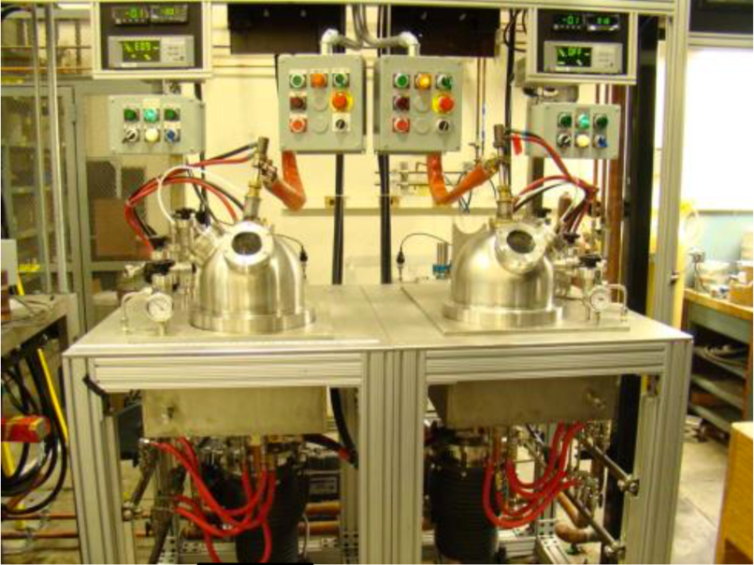
ORNL: Integrated Nuclear Battery Technology Provider
Isotope production
Materials processing
Packaging and encapsulation
Energy conversion
Device design & fab

Slide 13

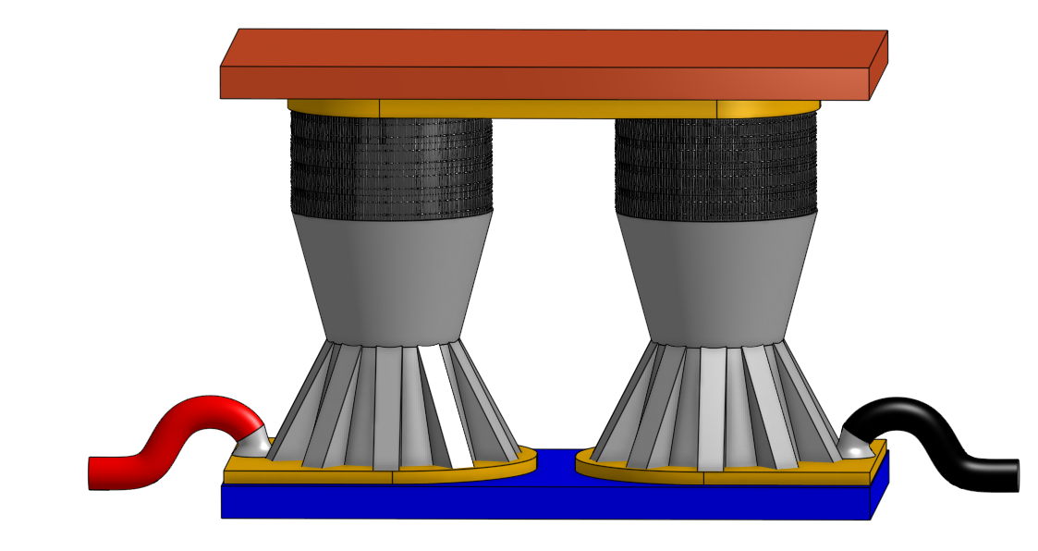
Nuclear Battery Challenges:
Transducer
Input
Output
Fuel: Need efficient, large scale radioisotope production
Electricity
3. Power Control: Low-loss, hybrid power management
2. Energy conversion: Advanced, high efficiency technologies
Thermoelectric Unicouple:
5% 20% (?)

Slide 14
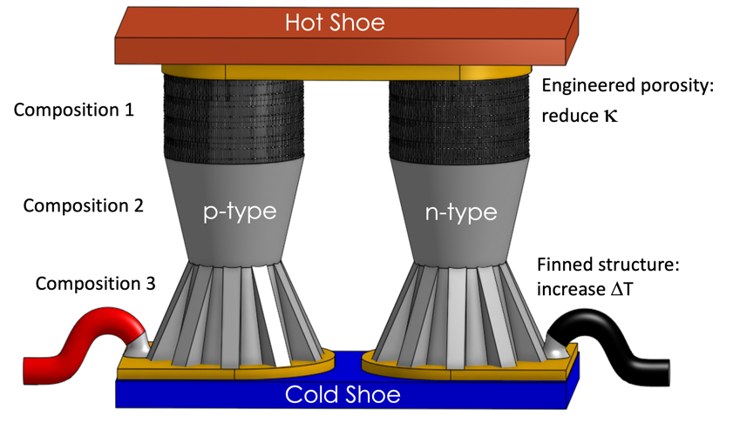
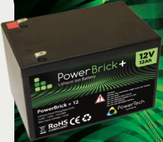
Solving nuclear battery challenges:
Efficient fuel production
  Isotopes with long decay chains
Efficient energy conversion:
  Improved transducers
²³⁸Pu ²³⁴U : (5.5 MeV/decay)
²²⁷Ac ²²⁷Th ²²³Ra ²¹⁹Rn ²¹⁵Po ²¹¹Pb ²¹¹Bi ²⁰⁷Tl ²⁰⁷Pb
(32.9 MeV/decay)
• Efficient use of radioisotopes:
  - Hybrid Power Supplies
Power Management Unit
RTG

Slide 15
Nuclear Battery Energy Economics:
Isotopes of Interest | Type of NB | Example Size NB | #g @ BOL for 20y NB* | #Ci @ BOL for 20y NB*
Pu-238 | RTG | 10W | 420.7 | 7,202
Am-241 | RTG | 10W | 1854.4 | 6,357
Sr-90 | RTG | 10W | 350.3 | 48,340
Ac-227 | RTG | 10W | 26.8 | 1,941
Pm147 | BV/BPV | 10mW | .98 | 910
Eu-155 | BV | 3mW | .74 | 360
Ni63 | BV | 1mW | 5.8 | 330
H-3 | BV | 100µW | 0.01 | 100
Sr-90 Example:
1.13 E 6 eV/decay
1 Ci = 3.7 E 10 decays/sec
1 J = 6.24 E18 eV
1 W = 1J/s
∴149 Ci Sr90 for1 W_{th} energy
For 5% efficient RTG:
2,987 Ci Sr90/W_{e}
*BOL = Beginning of life; Assuming 5% Efficient RTG; 3% Efficient BV
Key Facts:
NBs need an abundant supply of radioisotope fuel
Radioisotopes are difficult to make and expensive
NBs must use radioisotope fuel efficiently
Modest improvements in energy conversion have significant impact on size, weight & cost

Slide 16
Nuclear Battery Isotope Wish List:
Isotope | Half-Life (y) | Specific Activity (Ci/g) | Mean Energy @ Secular Equilibrium (KeV) | Specific Power @ Secular Equilibrium (W/g) | mW/Ci | W/g compared to Pu-238 | Grams for 10W thermal | Ci for 10W thermal
Pu-238 | 87.70 | 17.12 | 5,487 | 0.557 | 32.53 | 1.00 | 17.96 | 307.43
Sr-90 | 28.79 | 138.0 | 1,129.6 | 0.924 | 6.70 | 1.66 | 10.82 | 1,493.33
H-3 | 12.30 | 9,618.9 | 5.7 | 0.324 | 0.034 | 0.58 | 30.87 | 296,899.15
Pb-210 | 22.20 | 76.3 | 6,472.7 | 2.928 | 38.37 | 5.26 | 3.42 | 260.62
Si-32* | 153.00 | 73.05 | 764 | 0.331 | 4.53 | 0.59 | 30.22 | 2,207.97
Ac-227 | 21.77 | 72.3 | 3.3E+04 | 14.085 | 194.78 | 25.29 | 0.71 | 51.34
U-232 | 68.9 | 22.36 | 4.1E+04 | 5.422 | 242.47 | 9.74 | 1.84 | 41.24
Cm-244 | 18.11 | 78.97 | 5,796.4 | 2.714 | 34.36 | 4.87 | 3.69 | 291.02
³H: Low energy beta; No shielding
²¹⁰Pb -> ²¹⁰Bi -> ²¹⁰Po: Mass efficient heat source; good T_{1/2} ; high energy beta req’s shielding
³²Si -> ³²P -> ³²S; betas < 1MeV; min shielding; excellent T_{1/2} ; more vol efficient than ³H; not SNM
²²⁷Ac & ²³²U: Excellent W/g, but high energy γ’s
²⁴⁴Cm: Neutron emitter

Slide 17
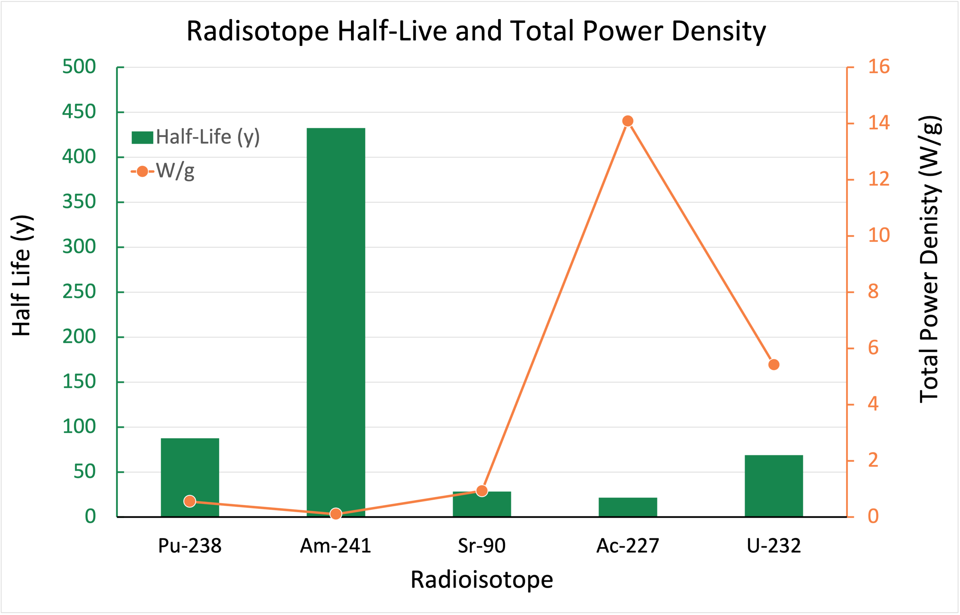
Efficient Fuel Production: Power Output of Various Isotopes

Slide 18
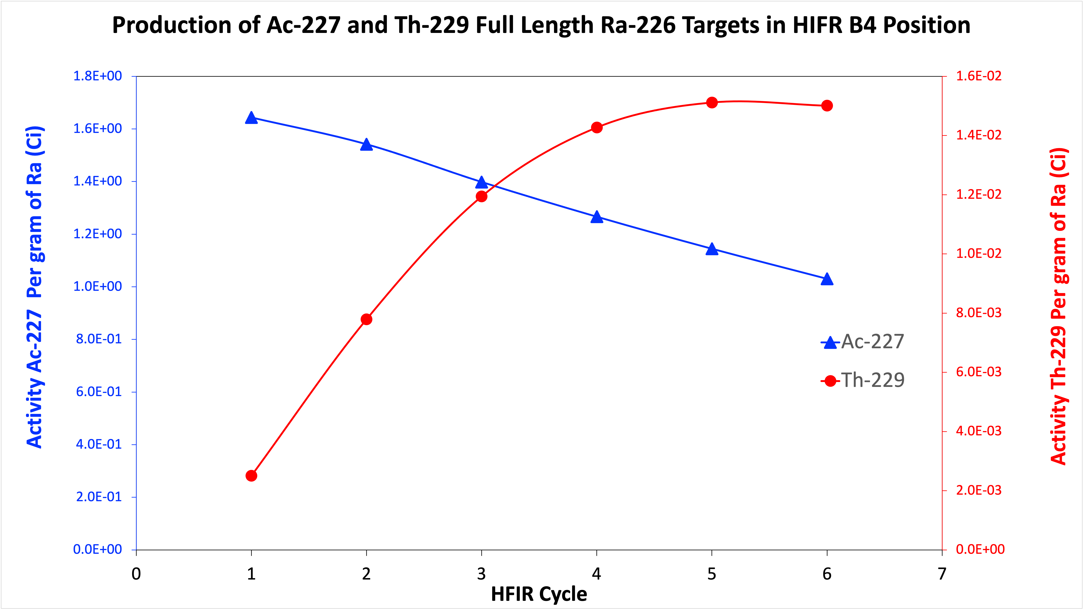
Efficient Production: Co-Produced Radioisotopes
NOTE: Th-229 is the parent isotope for Ac-225, a very valuable medical isotope for cancer therapy
12 Full Length Rods, (1,923 Pellets), 3 Cycles = 100Ci Ac-227
10W_{e}, 5% η, 20-yr RTG needs 1,941 Ci Ac-227 ~ 20 HFIR cycles ~ 3+ yr
* Calculations by Justin Griswold & Victor Bautista, ORNL

Slide 19
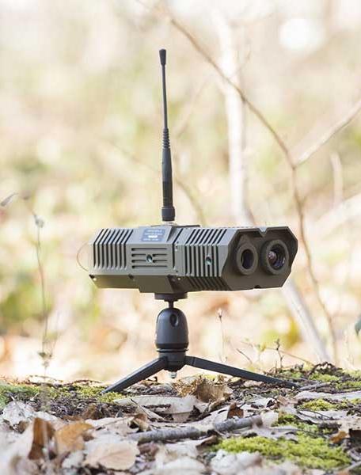
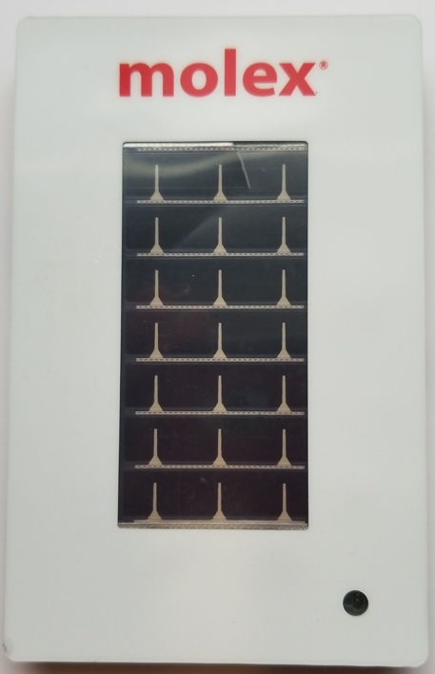
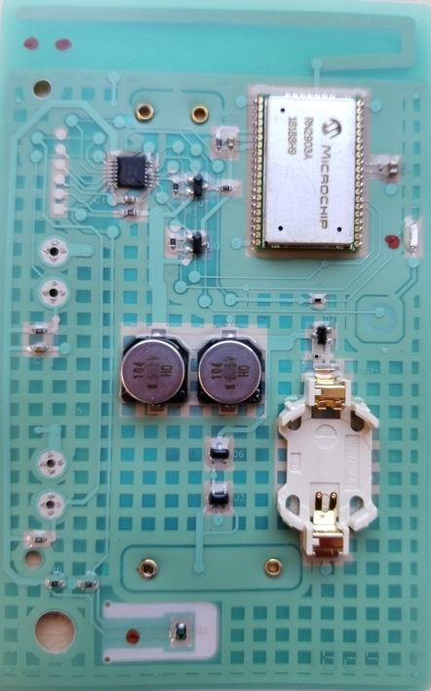
Nuclear Battery Significance & Opportunity:
National needs for advanced NBs
Adv. technology is able to create NB breakthroughs
The infrastructure, talent & team exists to develop & commercialize adv. NB technology
ORNL has already committed internal R&D $$ on advanced NB technology

