Slide 1

Secondary Neutron Production Evidence in TREND Experiments
Catherine Apgar
Department of Nuclear Engineering
University of California, Berkeley

Slide 2

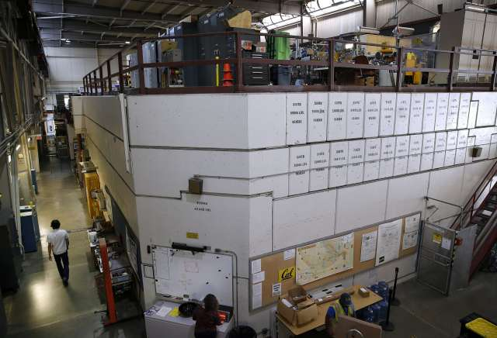
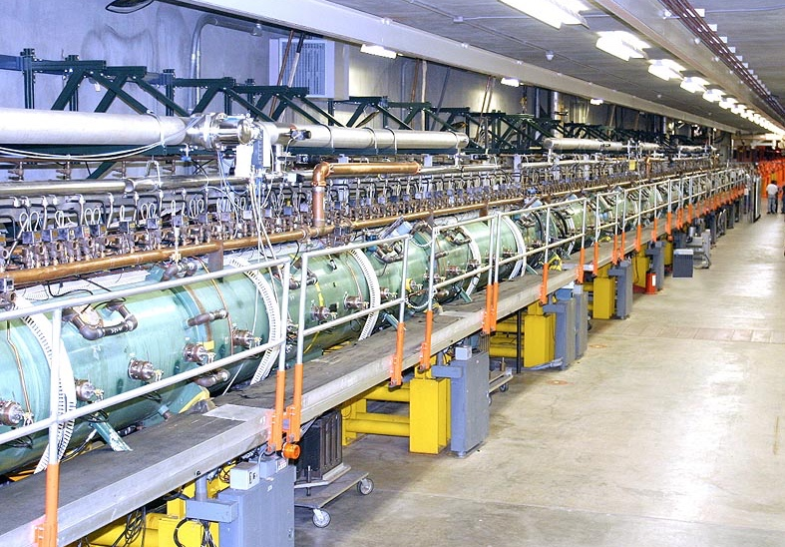
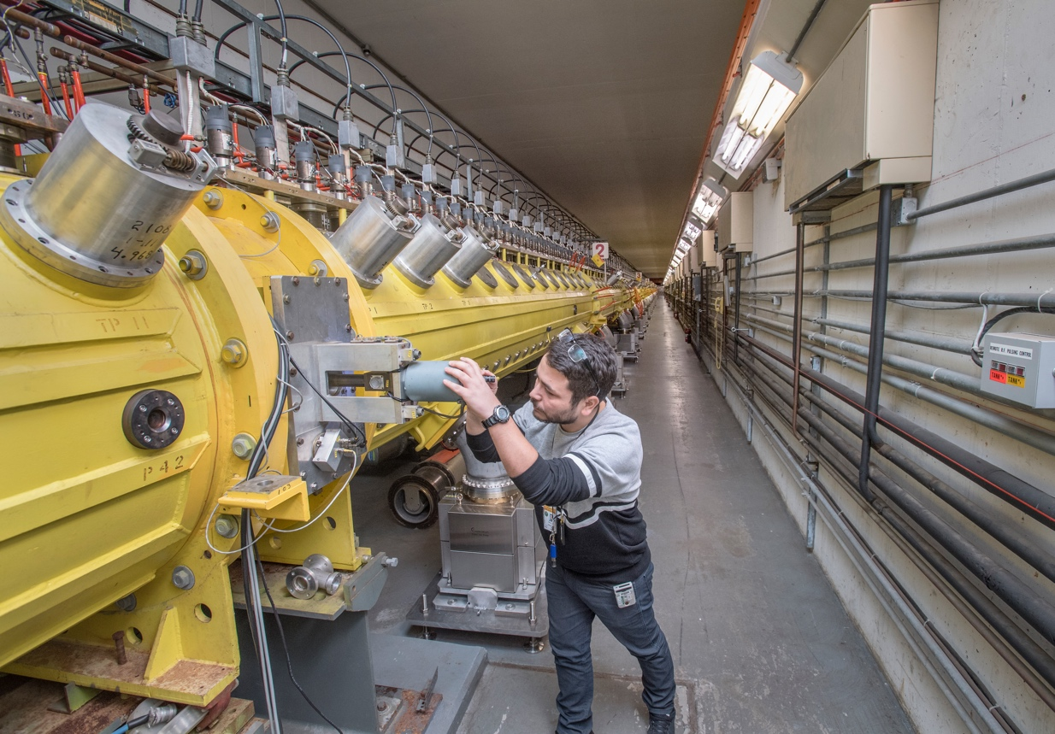
Overview
A Tri-lab collaboration has been formed between LBNL, LANL, and BNL to measure (p,x) reactions relevant to isotope production from threshold to 200 MeV for primary isotopes of interest and their impurities.
LBNL 88-Inch Cyclotron
E_{p,max} = 60 MeV
LANL IPF
E_{p,max} = 100 MeV
BNL BLIP
E_{p,max} = 200 MeV
2

Slide 3
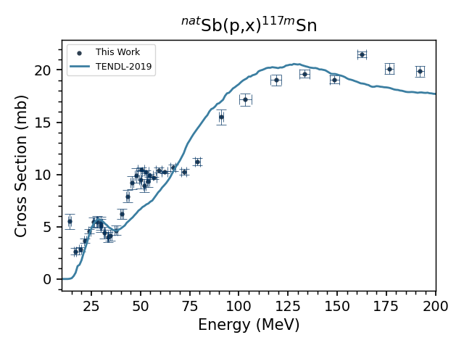
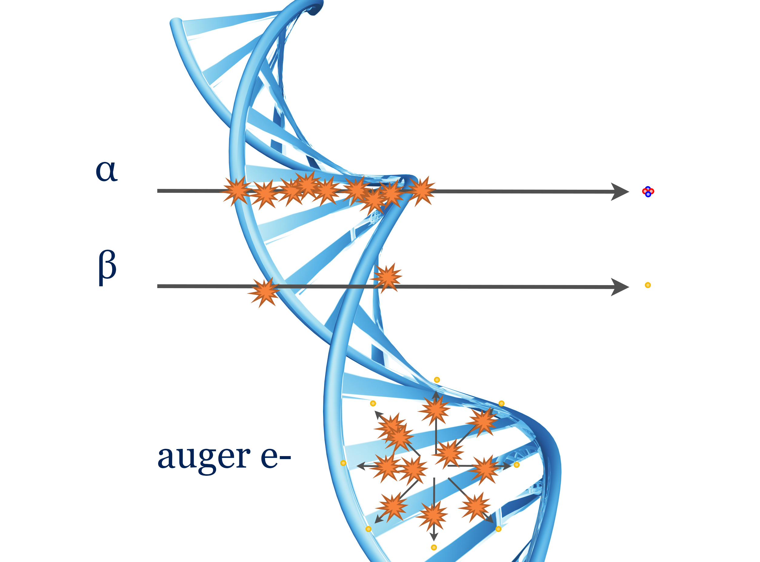
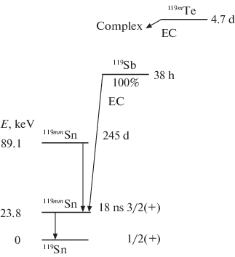
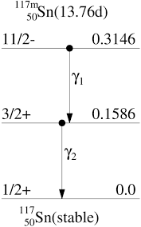
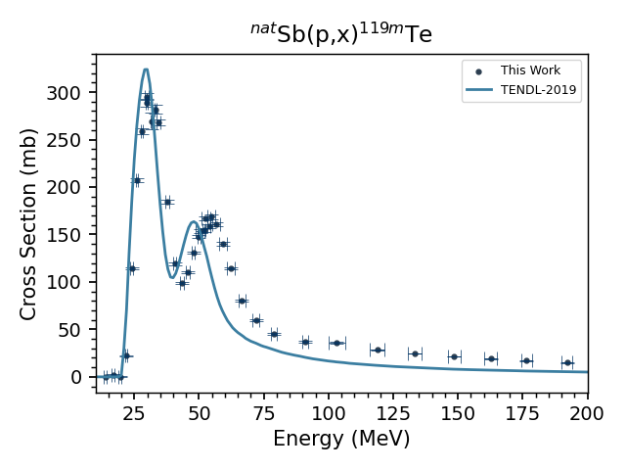
Isotope Production Motivation for Sb(p,x) Experiments
Cross section measurements of ^{117m}Sn and ^{119m}Te (a cow for ¹¹⁹Sb) to optimize production for high SA with minimal impurities
These Auger emitters a promising candidate for OA via RSV and potentially small mass tumors.
Primary Isotopes:
^{119m,119g}Te, ^{117m}Sn
Potential Impurities:
^{116,117,118,121m,121g,123m}Te, ^{113,119m,121m,121g}Sn
3
Notes:
^{117m}Sn colloid has shown promising results in preclinical trials for the treatment of arthritis.
Undergoes electron conversion, very low energy gamma given the large difference in the spin/parity between the isomer and the ground state
14 day half life simplifies its distribution logistics
Decays to stable Sn-117
Tends to migrate to the bones, and specifically where there is more disease in the bone.
It is currently being used for the treatment of joint pain in canines and is in clinical trials in humans
^{119m}Te is also being investigated as an isotope generator for ¹¹⁹Sb, an auger emitter for targeted radiotherapy of small tumors.
119mTe has a half life of 4.7d, compared to the 16hr half life of its ground state (again, another 11/2-→1/2+ ground state
117mSn – similar gamma emission (158keV vs 140keV) to 99mTe for imaging
Properties of Sn – tend to goes where the disease is in bone, less disease, less tin, more tin
Short range relative to beta emitters,
Low energy conversion electron emission

Slide 4
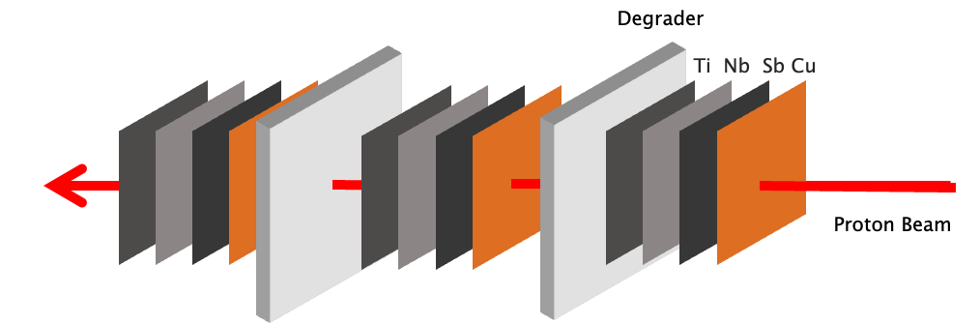
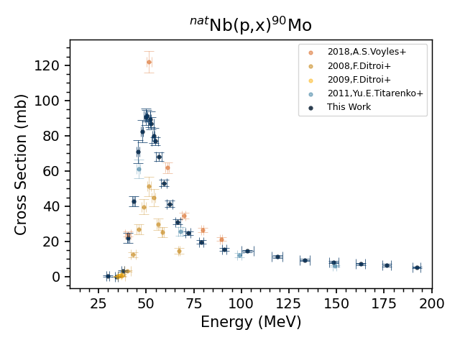
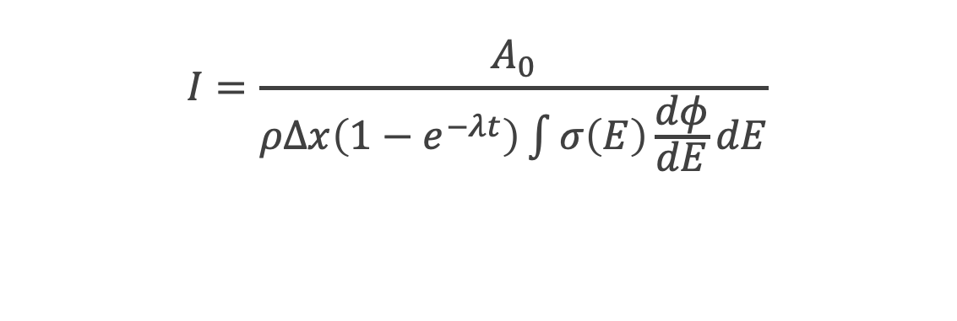
Experimental Setup
Irradiation via traditional ^{nat}Sb foils placed with monitor foils and degradiers to determine current using IAEA charged particle monitor reactions (2017)
A. Hermanne et al., Nucl. Data Sheets 148 (2018) 338-382
IAEA Monitor Reactions
^{nat}Cu(p,x)⁶²Zn
^{nat}Cu(p,x)⁶³Zn
^{nat}Cu(p,x)⁶⁵Zn
^{nat}Cu(p,x)⁵⁶Co
^{nat}Cu(p,x)⁵⁸Co
^{nat}Ti(p,x)⁴⁶Sc
^{nat}Ti(p,x)⁴⁸V
$$I=\frac{A_{0}}{ρΔx\left(1−e^{−λt}\right)\int{σ\left(E\right)\frac{dφ}{dE}dE}}$$
Experiments included preliminary cross section measurements for the ^{nat}Nb(p,4n)⁹⁰Mo proposed monitor reaction
4
Notes:
The use of monitor foils in each compartment provides us with the opportunity to not only more accurately characterize the current, but the energy within each stack too. This is done by a technique demonstrated in previous work, where density is treated as a free parameter and adjusted to minimize the variance of the reaction cross sections across the stack.
(This is especially useful for parts of the stack where one or more monitor cross section is changing drastically, and definitely more pronounced towards the back of the stack,
You can see in this video how the measured values fall in line with IAEA cross sections up to ~104.8%. After this point they diverge again.
IAEA data is represented by the solid line with uncertainty, measurements from the 100 MeV irradiation are the data points
A correction for range straggling and limited stopping power characterization involved treating the density of degraders as a variable to minimize systemic uncertainty in the current.
Again, this is not physically suggesting a change in density, but more to account for any potential limitations in stopping power calculations.
This weighted energy and current for each compartment can then be used to determine the cross sections for the isotopes of interest. This was implemented using a python code written by a former PhD student in the group, Jon, Morrell and uses an Anderson and Ziegler-based Monte Carlo code.
Where $A_{0}$ is initial activity at end of irradiation, $ρΔx$ is areal density,$\int{σ\left(E\right)\frac{dφ}{dE}dE}$ is the average cross section based on incident energy and energy loss within the foil, $λ$ is the decay constant, and t is irradiation time.
In addition to using Cu and Ti for monitor reactions, Nb was used as well in the 55 Mev, 100MeV, and 200 MeV stacked targets. Although this is not yet an established monitor xs by the IAEA, the (p,4n) reaction to produce 90Mo is a strong independent channel in the energy ranges we frequently look at, has a reasonably long half-life of 5.5 h, and has several strong gamma lines.
As it stands currently, only 58Co has established monitor cross section energies above 100 MeV and up to our 200 MeV range, so additional monitor cross sections are very beneficial

Slide 5
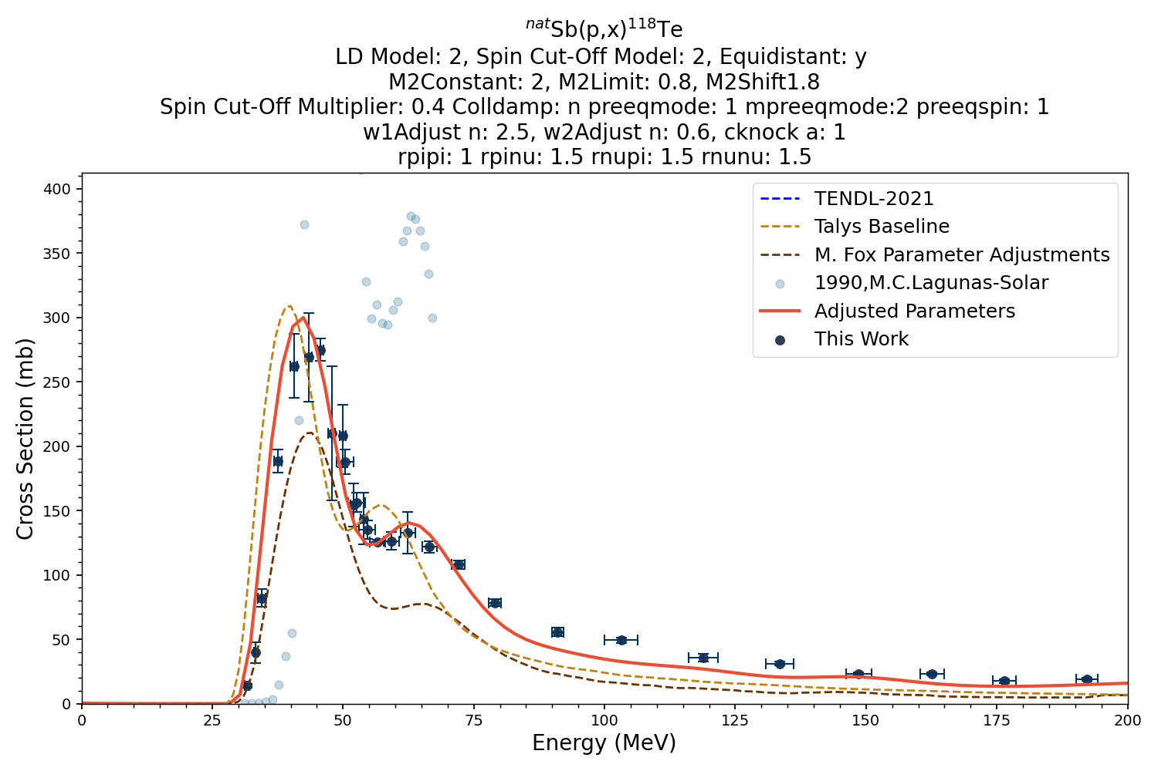
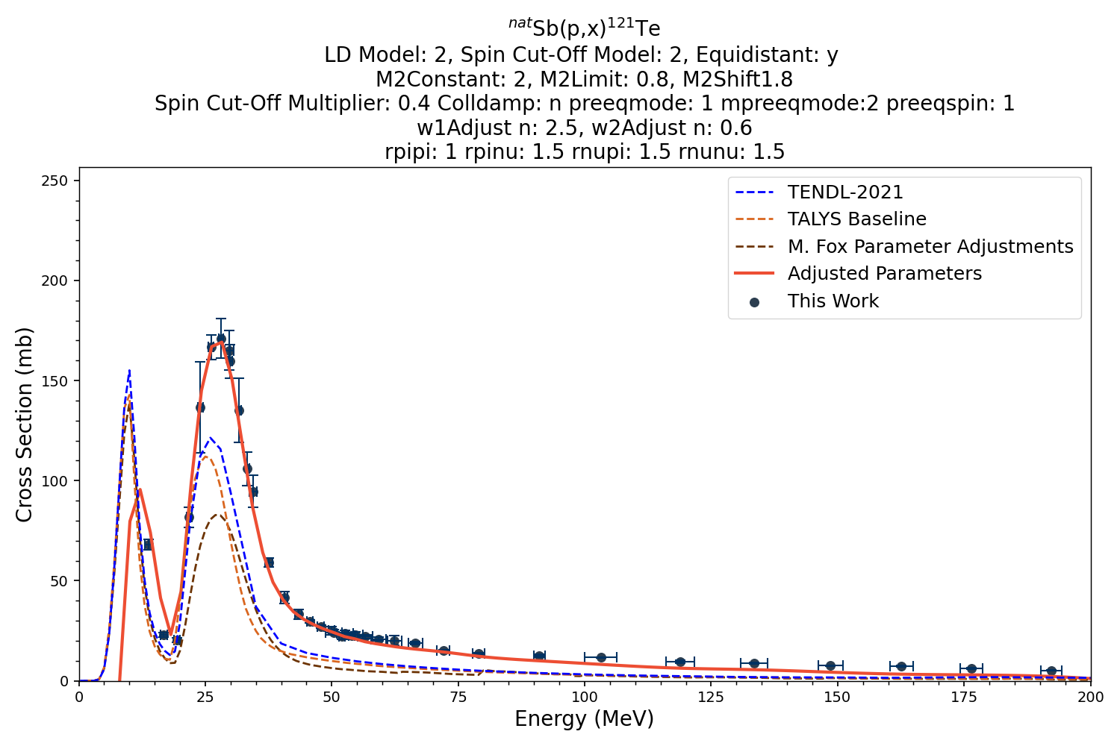
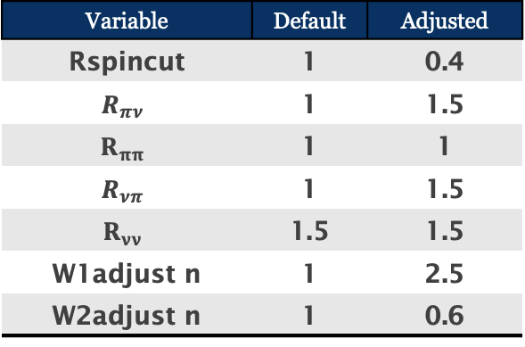
Nuclear Data Motivation for Sb(p,x) Experiments
Evaluation for high-energy (p,x) reactions and improvements to existing reaction models
Iterative approach in TALYS
  Select level density model
  Adjust level density models
  Adjust pre-equilibrium parameters
  Adjust optical model potential parameters
  Sensitivity review on previous adjustments
Variable | Default | Adjusted
Rspincut | 1 | 0.4
$$R_{πν}$$ | 1 | 1.5
$$R_{ππ}$$ | 1 | 1
$$R_{νπ}$$ | 1 | 1.5
$$R_{νν}$$ | 1.5 | 1.5
W1adjust n | 1 | 2.5
W2adjust n | 1 | 0.6
*Other adjusted parameters include ldmodel, strength, equidistant, m2constant, m2limit, m2shift, spincutmodel, preeqmode, mpreeqmode, preeqspin.
5
Notes:
These adjustments greatly improved fitting for pre-equilibrium tail for higher incident energies

Slide 6
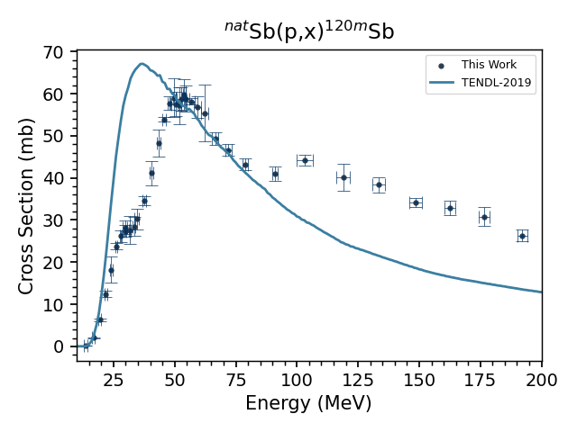
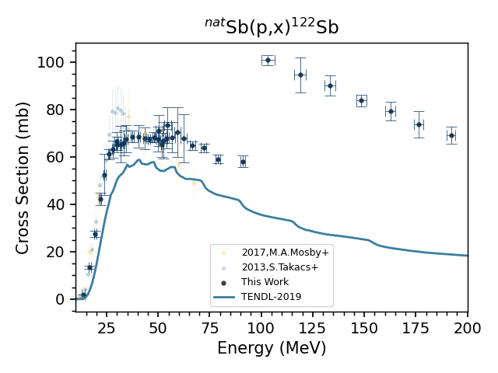
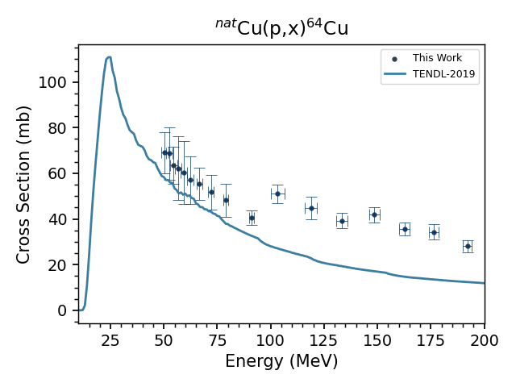
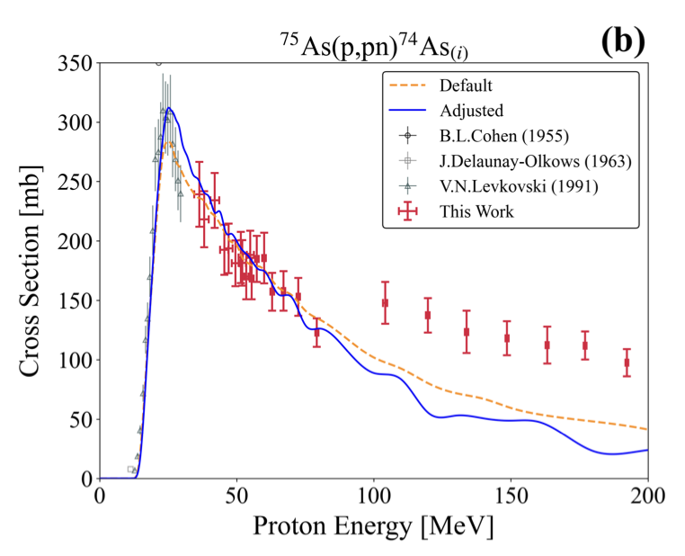
Another Interesting Finding from these Experiments:
We see evidence of (n,2n) on targets run at BNL where incident energies are highest
Sb
no isomer
As
J^{π}=8⁻
Cu
6
Notes:
Bottom line up front

Slide 7
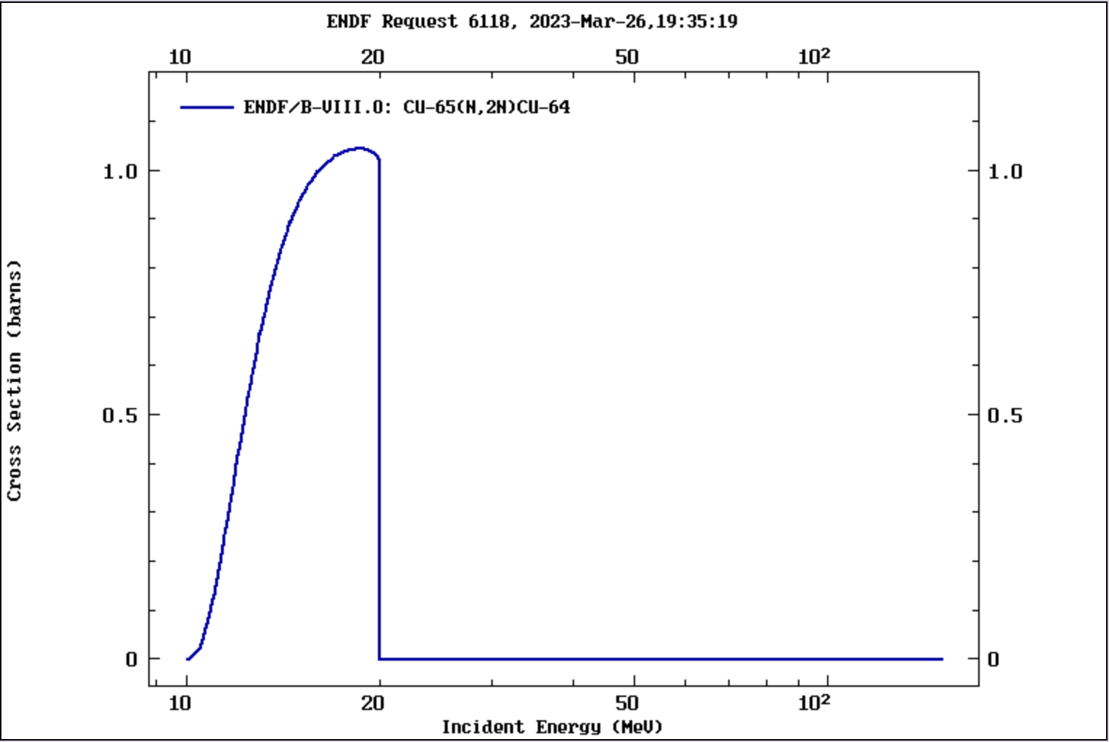
Can we use this information to extract the secondary neutron spectrum?
⁶⁵Cu(p,pn) vs. (n,2n)
TREND Experimental Results
ENDF ⁶⁵Cu(n,2n) ⁶⁴Cu
TENDL ⁶⁵Cu(n,2n) ⁶⁴Cu
Note: Data was not observed during the June 2020 run, Oct 2022 run analysis in progress
(n,2n) reaction on ⁶⁵Cu peaks at ~20MeV at nearly 1 barn!
7

Slide 8
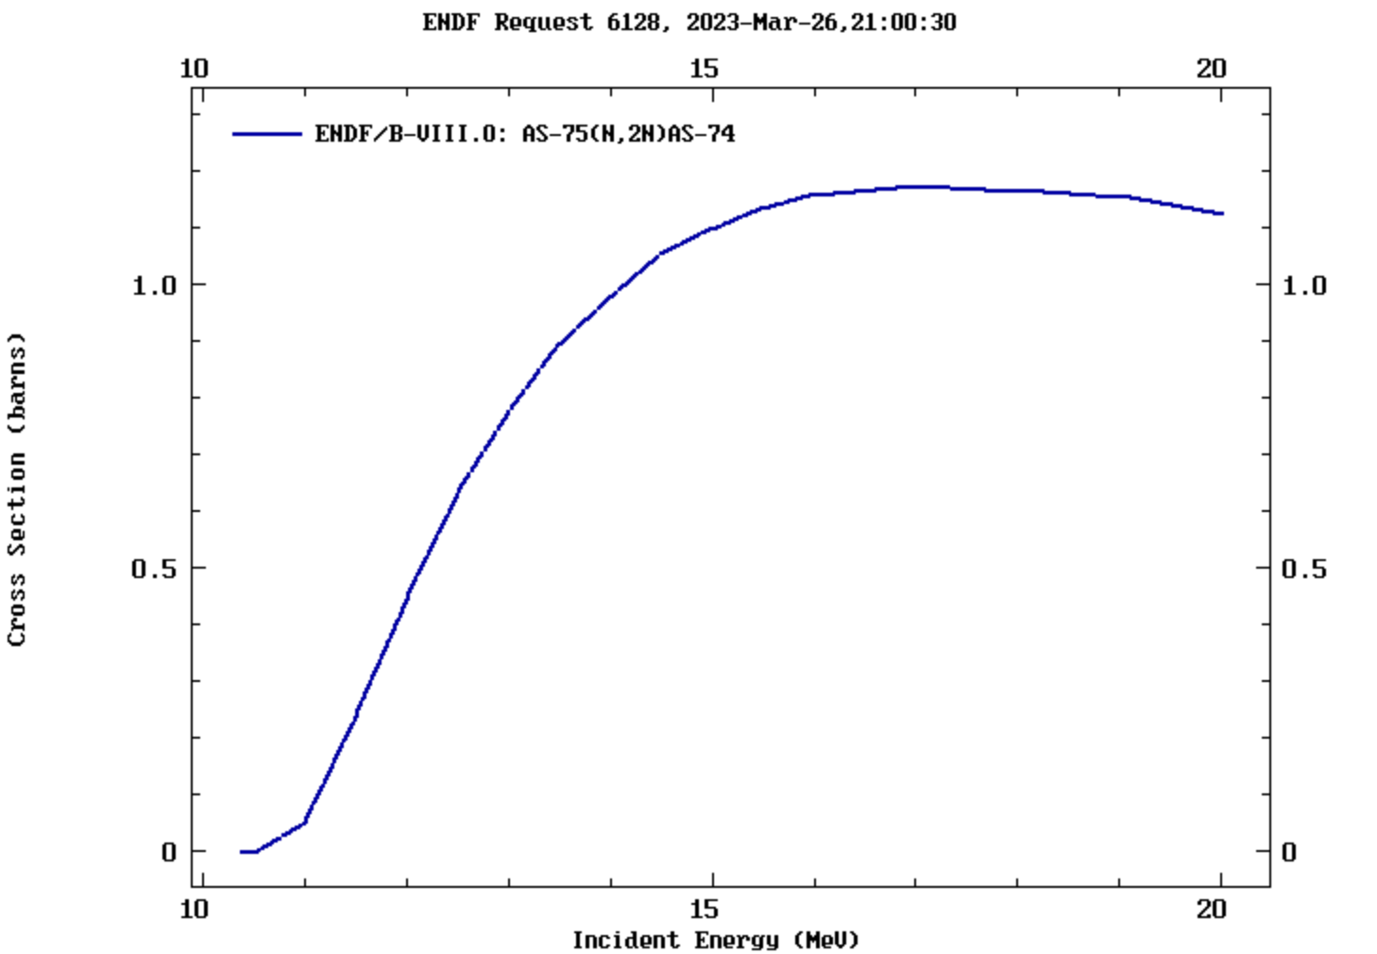
Can we use this information to extract the secondary neutron spectrum?
⁷⁵As(p,pn)⁷⁴As
TREND Experimental Results
ENDF ⁷⁵As(n,2n)⁷⁴As
TENDL ⁷⁵As(n,2n)⁷⁴As
Similar result was seen in M. Fox et al.
(n,2n) reaction on ⁷⁵As peaks in a similar energy range at a similar magnitude
Source: Measurement and modeling of proton-induced reactions on arsenic from 35 to 200 MeV, 2021
8

Slide 9
Can we use this information to extract the secondary neutron spectrum?
¹²¹Sb(p,pn)^{120m}Sb
TREND Experimental Results
TENDL ¹²¹Sb(n,x) ¹²⁰Sb (total)
TENDL ¹²¹Sb(n,x) ¹²⁰Sb (gs)
J^{π}=8⁻
Calculated difference between total and gs
CAVEAT: This would require a lot more rigorous analysis than a simple subtraction, I’m only including it because we see a similar pattern.
9

Slide 10
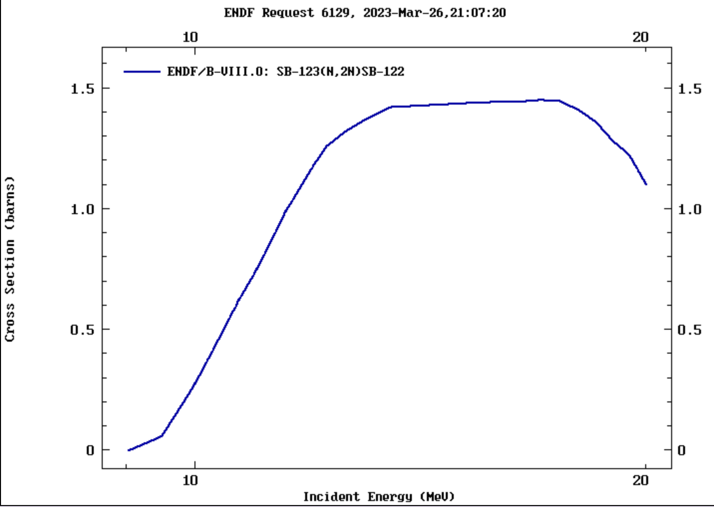
Can we use this information to extract the secondary neutron spectrum?
¹²³Sb(p,pn)¹²²Sb
TREND Experimental Results
ENDF ¹²³Sb(n,2n) ¹²²Sb
TENDL ¹²³Sb(n,2n) ¹²²Sb
As much yield here
As here
This reaction channel is off by a larger order of magnitude than prior results
(n,2n) reaction on ¹²³Sb peaks in a similar energy range at but is ~50% greater cross section
A 200 MeV proton drops to 100 MeV in 4.4 cm of Sb
The nuclear areal density of 4.4 cm of Sb is ≈4x10²³
This corresponds to a σ_{reaction}ρR≈0.8
10

Slide 11
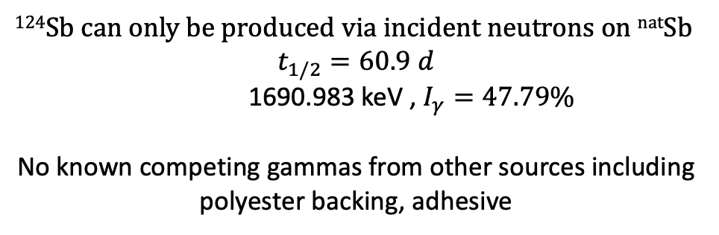
Additional Indicators
Indications of ^{nat}Sb(n,g) seen in observations of ¹²⁴Sb at BNL (limited amount at LANL as well)
¹²⁴Sb can only be produced via incident neutrons on ^{nat}Sb
$$t_{1/2}=60.9 d$$
1690.983 keV , $I_{γ}=47.79\%$
No known competing gammas from other sources including polyester backing, adhesive
Note this is not an absolute cross section as the neutron energy/flux is unknown
11

Slide 12
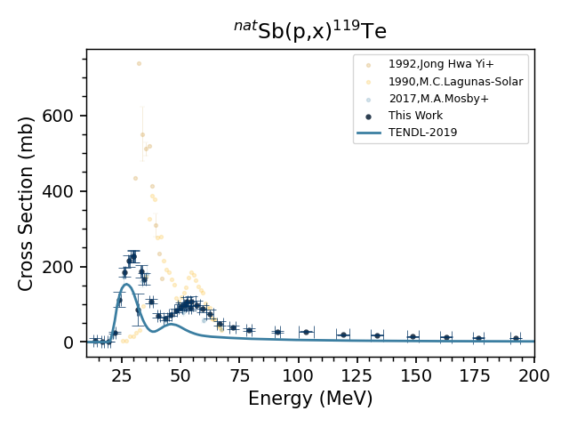

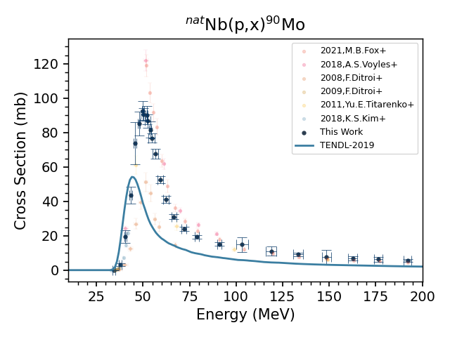
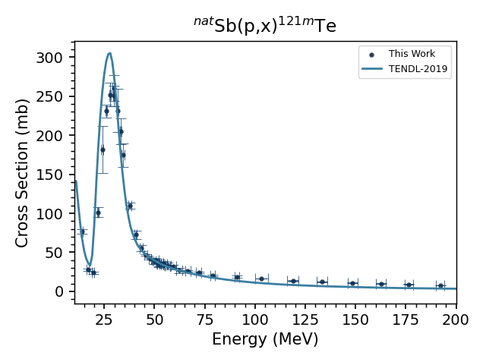
Additional Indicators
Large discrepancies between sites are not seen in all reaction channels
This indicates that it is likely not the result of systematic error in calculations
12

Slide 13
The adjustments we made to the Pre-eq model parameters have a significant influence on the secondary neutron spectrum
Range of (n,2n) peak
What are the implications for ²²⁶Ra(n,2n)?
13

Slide 14
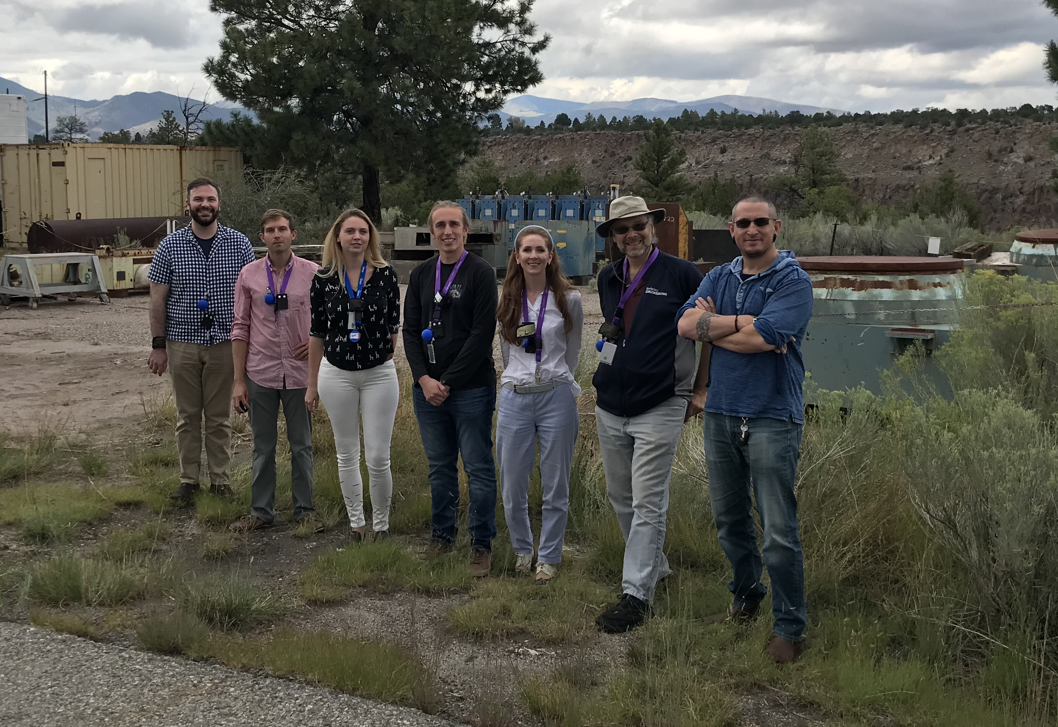



Thank You!
Special thanks to the members of the
Tri-Lab Evaluated Data Collaboration:
Lee Bernstein
Dmitri Medvedev
Etienne Vermeulen
Jon Batchelder
Eva Birnbaum
Cathy Cutler
Morgan Fox
Yun-Hsuan Lee
Jonathan Morrell
Meiring Nortier
Ellen O’Brien
Michael Skulski
Andrew Voyles
This research was supported by the Isotope Program within the U.S. Department of Energy’s Office of Science, carried out under Lawrence Berkeley National Laboratory (Contract No. DE-AC02-05CH11231), Los Alamos National Laboratory (Contract No. 89233218CNA000001) and Brookhaven National Laboratory (Contract No. DEAC02-98CH10886)
14

Slide 15
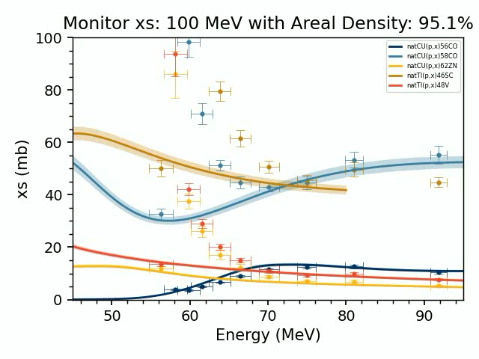
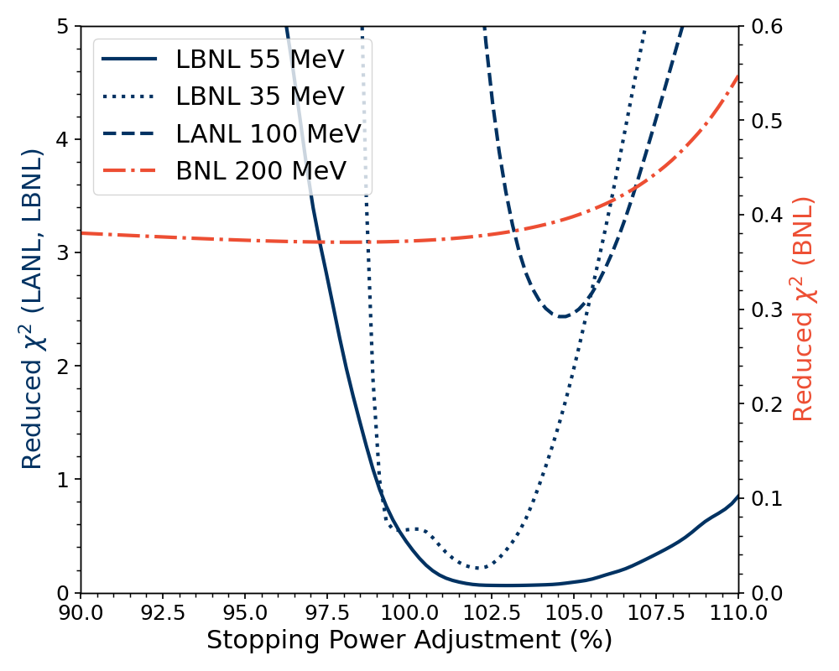
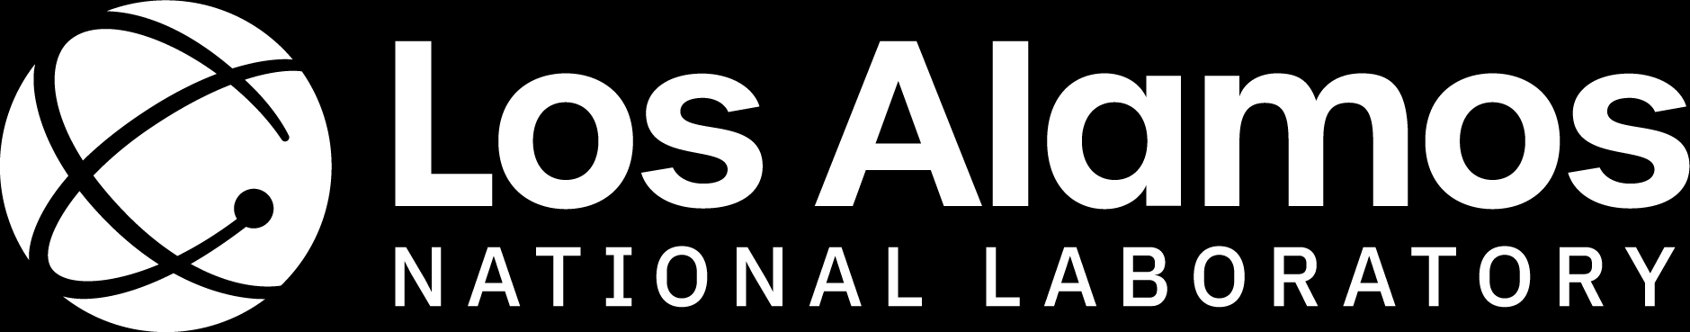
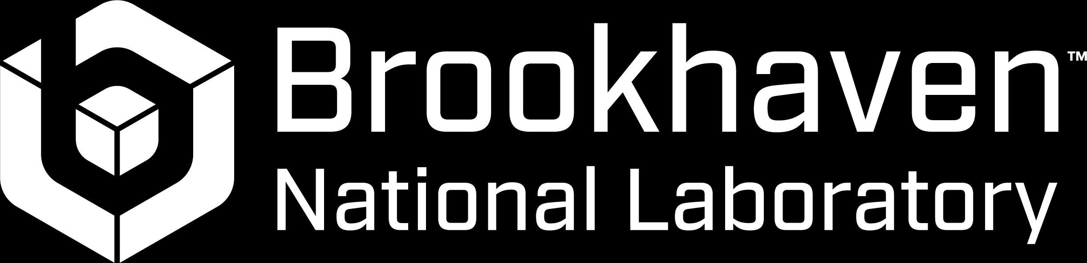
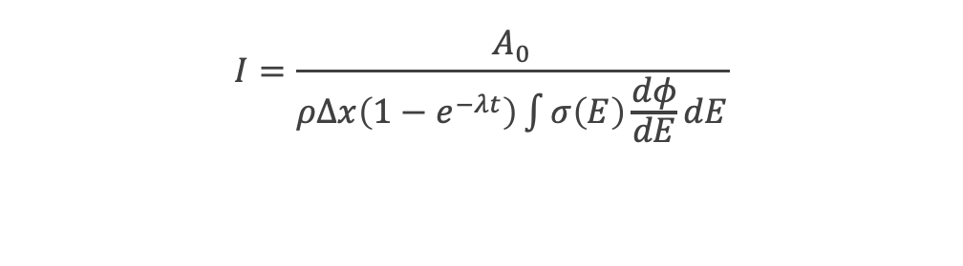

Experimental Analysis
Nominally varying the areal density of the stack materials provides a better representation of current and energy in each bin reduces systematic uncertainty due to range straggling and limitations in stopping power characterization.
This variance minimization technique has been utilized in Graves et al., Voyles et al., Fox et al., and Morrell et al.
$$I=\frac{A_{0}}{ρΔx\left(1−e^{−λt}\right)\int{σ\left(E\right)\frac{dφ}{dE}dE}}$$
Varying the range of $±10\%$ resulted in local minima at the various sites
15
Notes:
The use of monitor foils in each compartment provides us with the opportunity to not only more accurately characterize the current, but the energy within each stack too. This is done by a technique demonstrated in previous work, where density is treated as a free parameter and adjusted to minimize the variance of the reaction cross sections across the stack.
(This is especially useful for parts of the stack where one or more monitor cross section is changing drastically, and definitely more pronounced towards the back of the stack,
You can see in this video how the measured values fall in line with IAEA cross sections up to ~104.8%. After this point they diverge again.
IAEA data is represented by the solid line with uncertainty, measurements from the 100 MeV irradiation are the data points
A correction for range straggling and limited stopping power characterization involved treating the density of degraders as a variable to minimize systemic uncertainty in the current.
Again, this is not physically suggesting a change in density, but more to account for any potential limitations in stopping power calculations.
This weighted energy and current for each compartment can then be used to determine the cross sections for the isotopes of interest. This was implemented using a python code written by a former PhD student in the group, Jon, Morrell and uses an Anderson and Ziegler-based Monte Carlo code.
Where $A_{0}$ is initial activity at end of irradiation, $ρΔx$ is areal density,$\int{σ\left(E\right)\frac{dφ}{dE}dE}$ is the average cross section based on incident energy and energy loss within the foil, $λ$ is the decay constant, and t is irradiation time.
In addition to using Cu and Ti for monitor reactions, Nb was used as well in the 55 Mev, 100MeV, and 200 MeV stacked targets. Although this is not yet an established monitor xs by the IAEA, the (p,4n) reaction to produce 90Mo is a strong independent channel in the energy ranges we frequently look at, has a reasonably long half-life of 5.5 h, and has several strong gamma lines.
As it stands currently, only 58Co has established monitor cross section energies above 100 MeV and up to our 200 MeV range, so additional monitor cross sections are very beneficial

Slide 16
Experimental Setup
Irradiation via traditional ^{nat}Sb foils placed with monitor foils and degradiers to determine current using IAEA charged particle monitor reactions (2017)
A. Hermanne et al., Nucl. Data Sheets 148 (2018) 338-382
IAEA Monitor Reactions
^{nat}Cu(p,x)⁶²Zn
^{nat}Cu(p,x)⁶³Zn
^{nat}Cu(p,x)⁶⁵Zn
^{nat}Cu(p,x)⁵⁶Co
^{nat}Cu(p,x)⁵⁸Co
^{nat}Ti(p,x)⁴⁶Sc
^{nat}Ti(p,x)⁴⁸V
$$I=\frac{A_{0}}{ρΔx\left(1−e^{−λt}\right)\int{σ\left(E\right)\frac{dφ}{dE}dE}}$$
A preliminary cross section measurement for the ^{nat}Nb(p,4n)⁹⁰Mo proposed monitor reaction
16
Notes:
The use of monitor foils in each compartment provides us with the opportunity to not only more accurately characterize the current, but the energy within each stack too. This is done by a technique demonstrated in previous work, where density is treated as a free parameter and adjusted to minimize the variance of the reaction cross sections across the stack.
(This is especially useful for parts of the stack where one or more monitor cross section is changing drastically, and definitely more pronounced towards the back of the stack,
You can see in this video how the measured values fall in line with IAEA cross sections up to ~104.8%. After this point they diverge again.
IAEA data is represented by the solid line with uncertainty, measurements from the 100 MeV irradiation are the data points
A correction for range straggling and limited stopping power characterization involved treating the density of degraders as a variable to minimize systemic uncertainty in the current.
Again, this is not physically suggesting a change in density, but more to account for any potential limitations in stopping power calculations.
This weighted energy and current for each compartment can then be used to determine the cross sections for the isotopes of interest. This was implemented using a python code written by a former PhD student in the group, Jon, Morrell and uses an Anderson and Ziegler-based Monte Carlo code.
Where $A_{0}$ is initial activity at end of irradiation, $ρΔx$ is areal density,$\int{σ\left(E\right)\frac{dφ}{dE}dE}$ is the average cross section based on incident energy and energy loss within the foil, $λ$ is the decay constant, and t is irradiation time.
In addition to using Cu and Ti for monitor reactions, Nb was used as well in the 55 Mev, 100MeV, and 200 MeV stacked targets. Although this is not yet an established monitor xs by the IAEA, the (p,4n) reaction to produce 90Mo is a strong independent channel in the energy ranges we frequently look at, has a reasonably long half-life of 5.5 h, and has several strong gamma lines.
As it stands currently, only 58Co has established monitor cross section energies above 100 MeV and up to our 200 MeV range, so additional monitor cross sections are very beneficial

Slide 17
Energy Differential ^{nat}Sb(p,x) Cross Section Measurements up to 200 MeV
Nominally varying the areal density of the stack materials provides a better representation of current and energy in each bin reduces systematic uncertainty due to range straggling and limitations in stopping power characterization.
This variance minimization technique has been utilized in Graves et al., Voyles et al., Fox et al., and Morrell et al.
$$I=\frac{A_{0}}{ρΔx\left(1−e^{−λt}\right)\int{σ\left(E\right)\frac{dφ}{dE}dE}}$$
Varying the range of $±10\%$ resulted in local minima at the various sites
17
Notes:
The use of monitor foils in each compartment provides us with the opportunity to not only more accurately characterize the current, but the energy within each stack too. This is done by a technique demonstrated in previous work, where density is treated as a free parameter and adjusted to minimize the variance of the reaction cross sections across the stack.
(This is especially useful for parts of the stack where one or more monitor cross section is changing drastically, and definitely more pronounced towards the back of the stack,
You can see in this video how the measured values fall in line with IAEA cross sections up to ~104.8%. After this point they diverge again.
IAEA data is represented by the solid line with uncertainty, measurements from the 100 MeV irradiation are the data points
A correction for range straggling and limited stopping power characterization involved treating the density of degraders as a variable to minimize systemic uncertainty in the current.
Again, this is not physically suggesting a change in density, but more to account for any potential limitations in stopping power calculations.
This weighted energy and current for each compartment can then be used to determine the cross sections for the isotopes of interest. This was implemented using a python code written by a former PhD student in the group, Jon, Morrell and uses an Anderson and Ziegler-based Monte Carlo code.
Where $A_{0}$ is initial activity at end of irradiation, $ρΔx$ is areal density,$\int{σ\left(E\right)\frac{dφ}{dE}dE}$ is the average cross section based on incident energy and energy loss within the foil, $λ$ is the decay constant, and t is irradiation time.
In addition to using Cu and Ti for monitor reactions, Nb was used as well in the 55 Mev, 100MeV, and 200 MeV stacked targets. Although this is not yet an established monitor xs by the IAEA, the (p,4n) reaction to produce 90Mo is a strong independent channel in the energy ranges we frequently look at, has a reasonably long half-life of 5.5 h, and has several strong gamma lines.
As it stands currently, only 58Co has established monitor cross section energies above 100 MeV and up to our 200 MeV range, so additional monitor cross sections are very beneficial

Slide 18
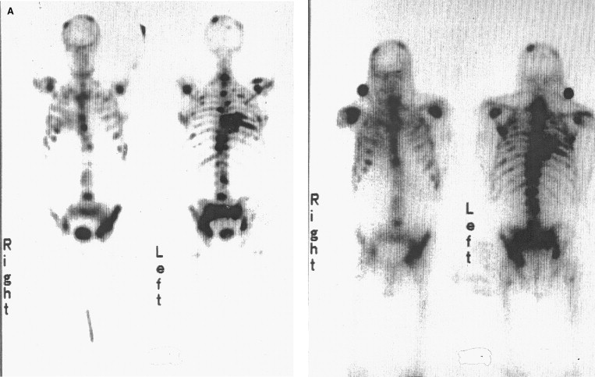
Motivations for Sb(p,x) Experiments
Cross section measurements of ^{117m}Sn and ^{119m}Te (a cow for ¹¹⁹Sb) to optimize production for high SA with minimal impurities
These Auger emitters a promising candidate for OA via RSV and potentially small mass tumors.
Primary Isotopes:
^{119m,119g}Te, ^{117m}Sn
Potential Impurities:
^{116,117,118,121m,121g,123m}Te, ^{113,119m,121m,121g}Sn
^{99m}Tc ^{117m}Sn
Imaging with ^{117m}Sn compared to ^{99m}Tc
^{[Swailem et al. 1998]}
18
Notes:
^{117m}Sn colloid has shown promising results in preclinical trials for the treatment of arthritis.
Undergoes electron conversion, very low energy gamma given the large difference in the spin/parity between the isomer and the ground state
14 day half life simplifies its distribution logistics
Decays to stable Sn-117
Tends to migrate to the bones, and specifically where there is more disease in the bone.
It is currently being used for the treatment of joint pain in canines and is in clinical trials in humans
^{119m}Te is also being investigated as an isotope generator for ¹¹⁹Sb, an auger emitter for targeted radiotherapy of small tumors.
119mTe has a half life of 4.7d, compared to the 16hr half life of its ground state (again, another 11/2-→1/2+ ground state
117mSn – similar gamma emission (158keV vs 140keV) to 99mTe for imaging
Properties of Sn – tend to goes where the disease is in bone, less disease, less tin, more tin
Short range relative to beta emitters,
Low energy conversion electron emission

Slide 19
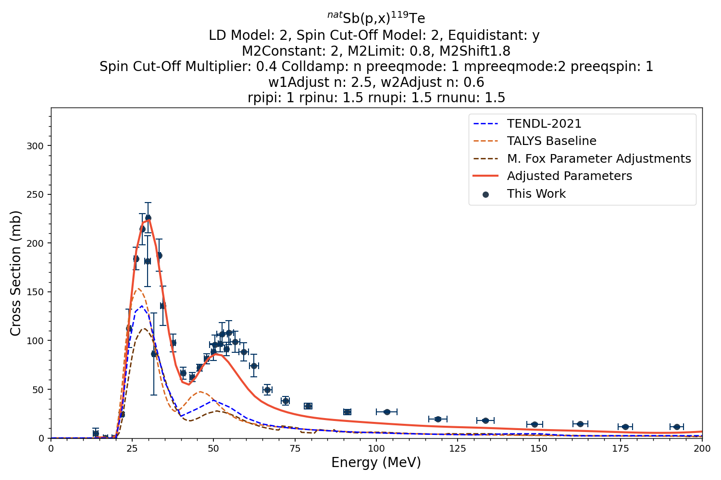
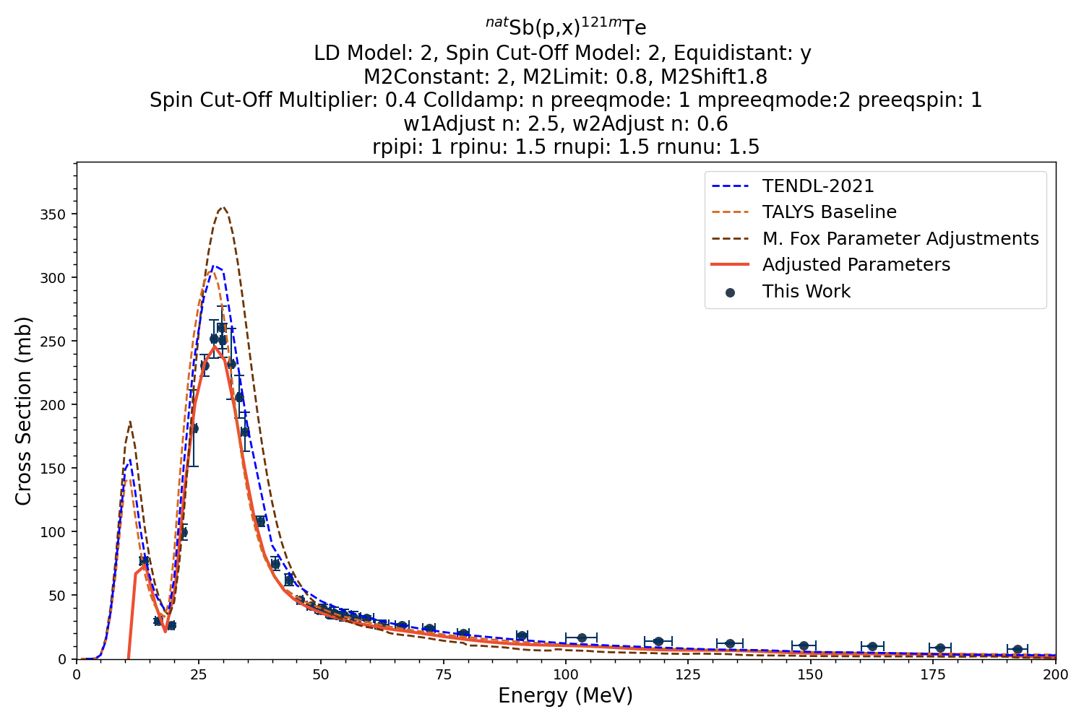
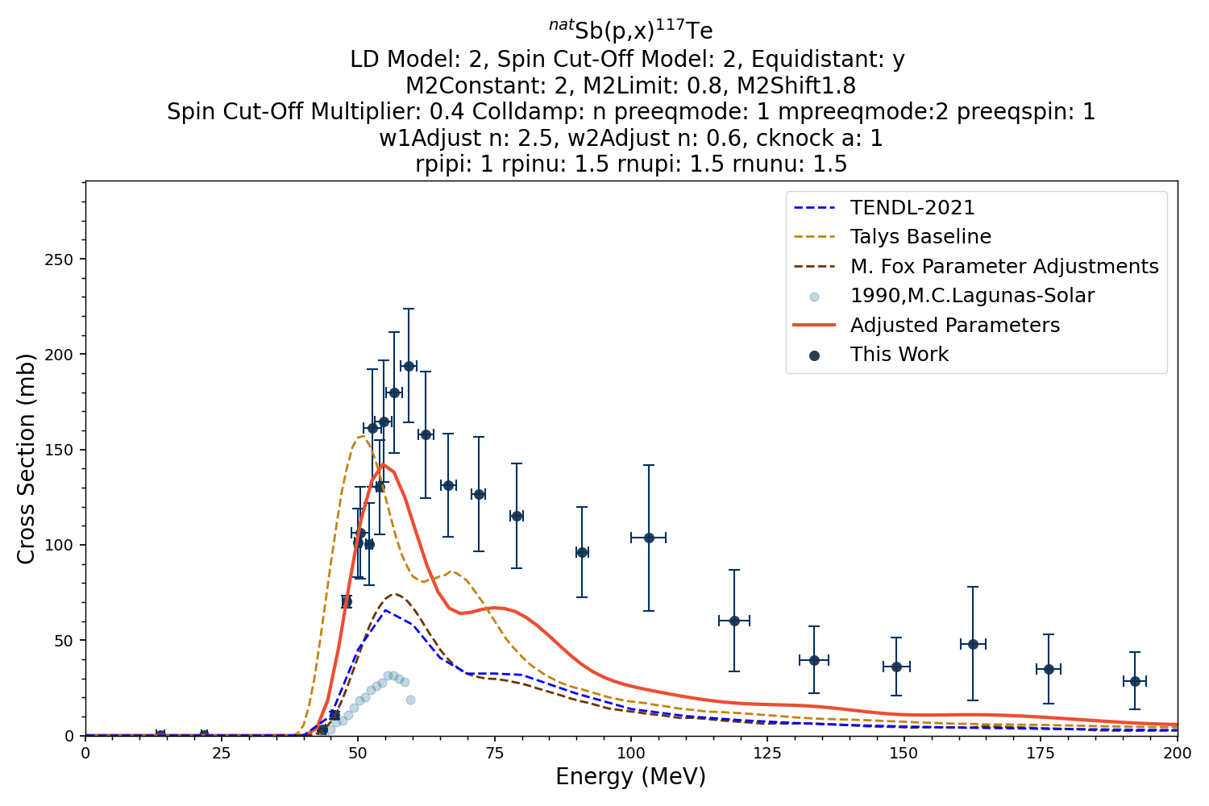
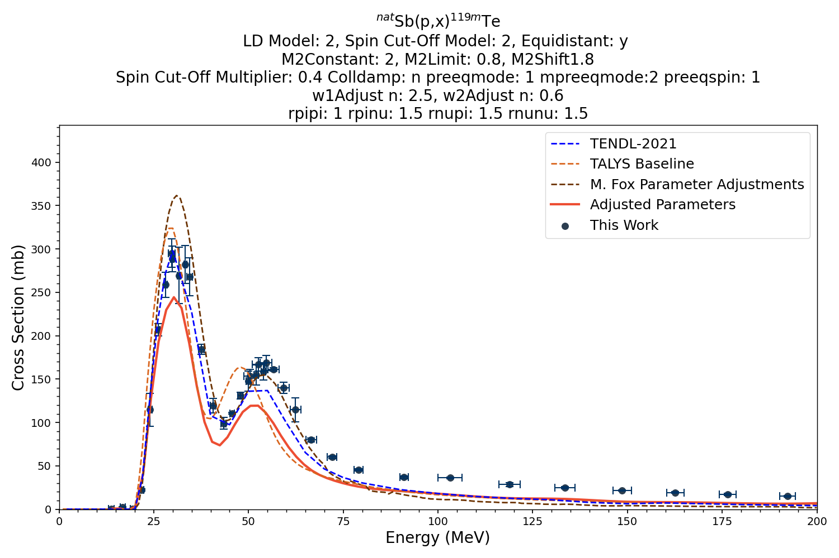
TALYS Modeling: Additional Parameter Adjustments
19
Notes:
These adjustments greatly improved fitting for pre-equilibrium tail for higher incident energies

Slide 20
Cross Section Measurements for Medical Radioisotopes ^{117m}Sn and ^{119m}Te
Preliminary cross section measurements have been calculated for ^{117m}Sn and ^{119m}Te (a cow for ¹¹⁹Sb) up to 200 MeV via proton bombardment
Auger-Meitner therapy with ^{117m}Sn is currently used to treat canine OA and companies are pursuing clinical trials for human treatment.
The high LET and short range makes Auger-Meitner emitters a promising candidate for small mass tumor treatment as well.
20
Notes:
^{117m}Sn
Potential Therapeutic Radionuclide – Radiosynoviorthesis (RSO)
t_{1/2}=13.76d
Logistically easy to handle
Will not be an ongoing issue in the body
Isomeric Transition, emitting 158.56keV photon
Similar energy to 99mTc, meaning similar gamma imaging techniques in hospitals
CE with 140 KeV discrete energy for therapy have an average range of ~300 μm in tissue
High radiotoxicity in localized area
Unlikely to damage surrounding healthy tissue
In preclinical tests, it remains localized, safe
Tests have been conducted in mice and dogs
Te-119m (4.7d)
Potential Therapeutic Radionuclide Generator – ¹¹⁹Sb (t_{1/2}=38h)
Low energy auger electrons
High dose, high radiotoxicity, minimum damage to normal tissue
Current production in cyclotron facilities using ¹¹⁹Sn(p,n)¹¹⁹Sb
Using a radionuclide generator expands treatment options

