Slide 1
Radioisotope production at BNL
Presenter: Dmitri Medvedev
Medical Isotope Research and Production program, Brookhaven National Laboratory, Upton, NY, USA
Radioisotope Production at SNS (RIPS) Workshop
Oak Ridge National Laboratory, Oak Ridge, TN
September 27, 2023

Slide 2
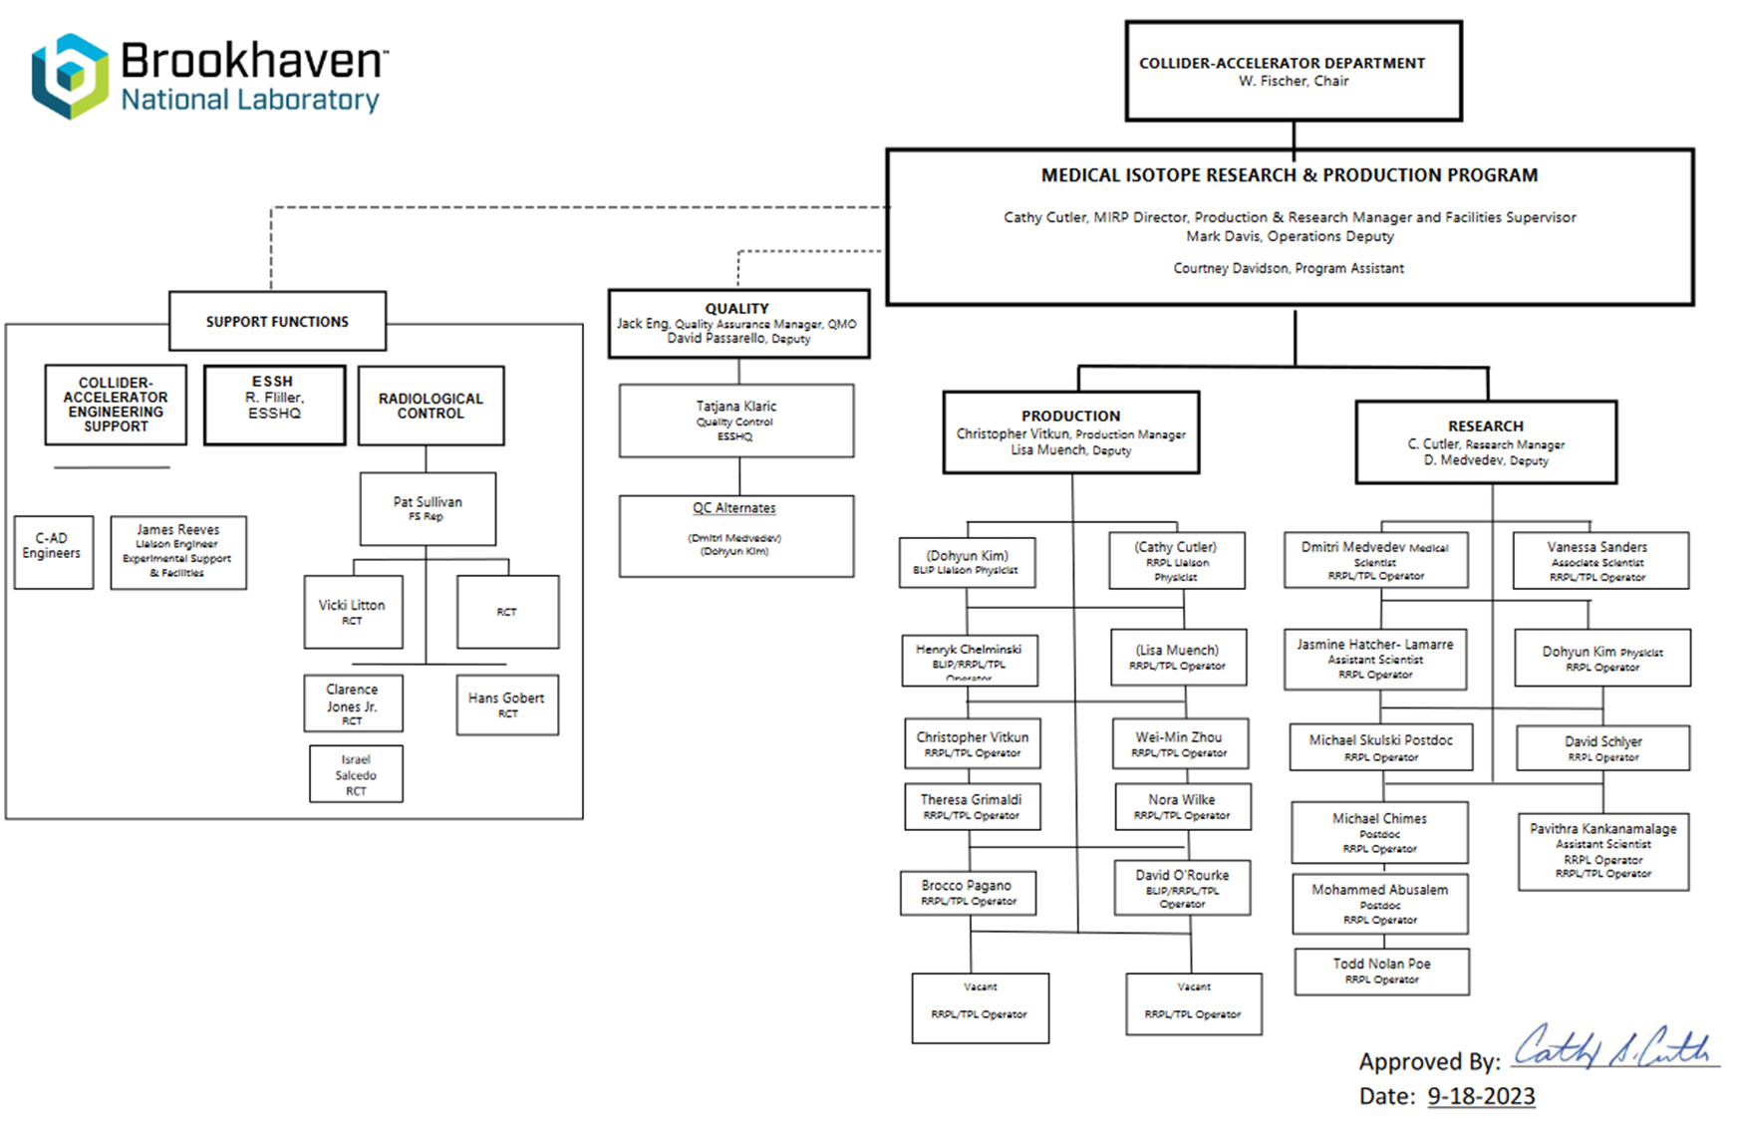
Speaking on behalf of MIRP program

Slide 3
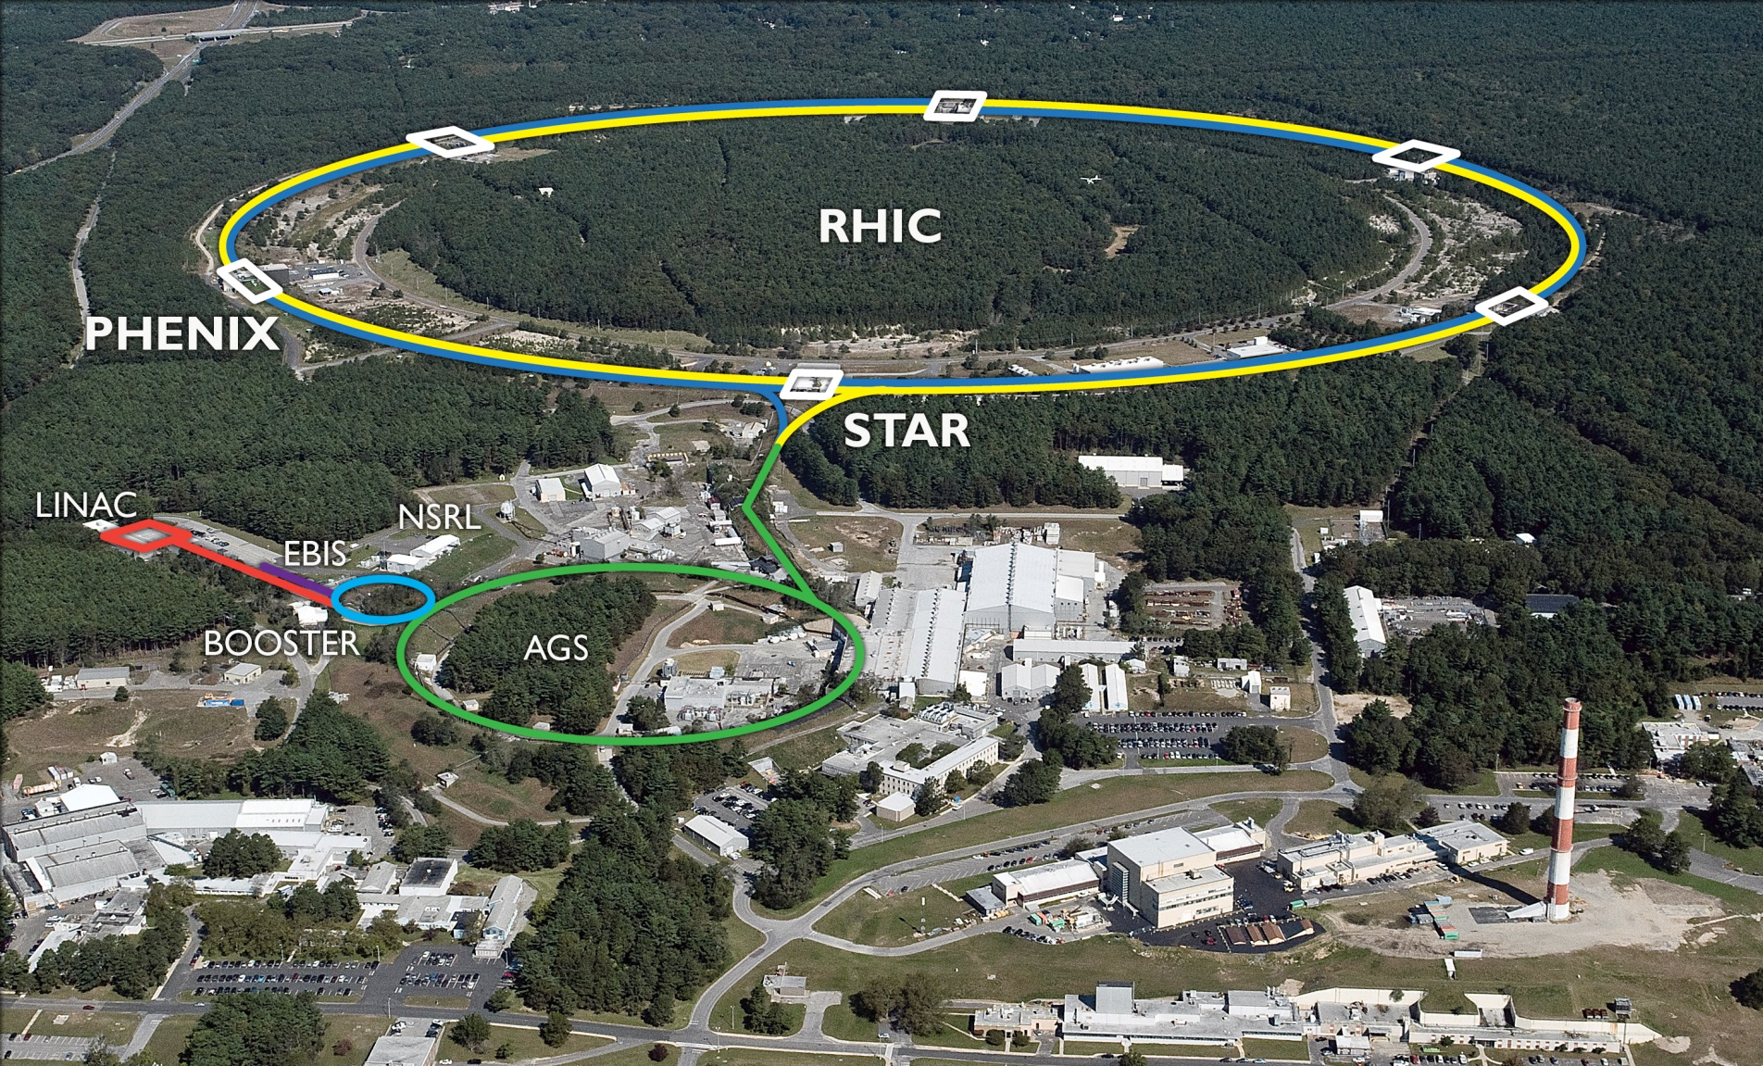
Brookhaven Lab and its accelerator complex
RHIC
BLIP
TPL
NSLS II
AGS – Alternating Gradient Synchrotron, RHIC-Relativistic Heavy Ion Collider
Notes:
The LINAC supplies protons to the Booster for nuclear physics. Excess pulses (~85%) are diverted to BLIP. Energy is incrementally variable from 66-202 MeV.

Slide 4
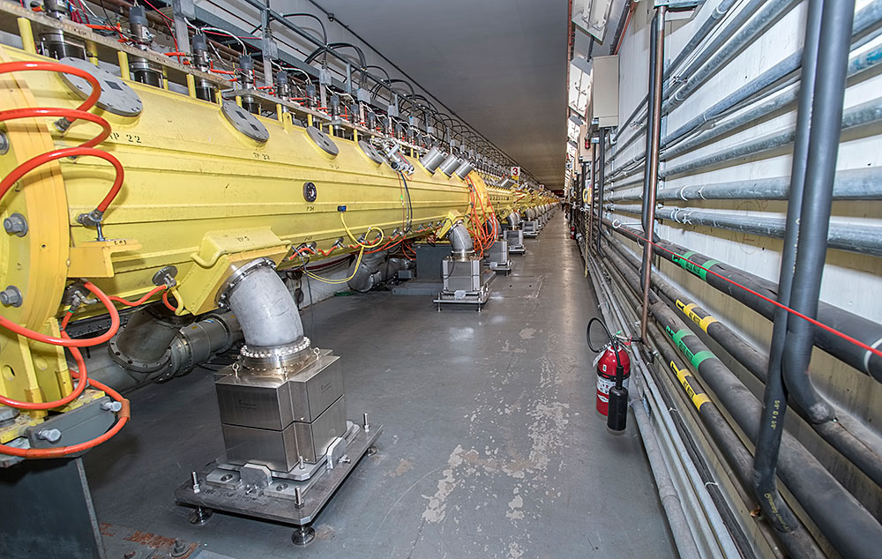
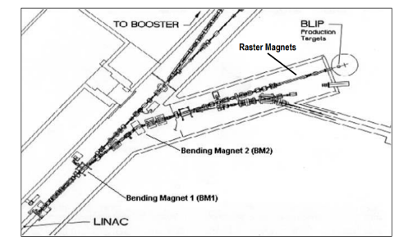
200 MeV Linac at BNL
A 459-foot-long LINAC with 9 accelerator RFQ cavities
Operates in a pulsed mode: >90% of the pulses are used for isotope production, the rest is used for HEP experiments
The pulses for BLIP occur at frequency 6.67 Hz. Each pulse is 450 μsec long and can be up to 55 mA in intensity
Energy is incrementally tunable from 33 to 200 MeV, with 66 MeV the lowest practical energy for isotope production
Maximum average current of 165 µA is regularly achieved
Rastered and focused beam capability

Slide 5
Schematic representation of the BLIP beam line hardware*
*Mausner et al. The new BLIP raster system and associated target modifications. AIP Conference Proceedings.
1845, 020014 (2017)
Notes:
Validated experimentally: BPM,

Slide 6
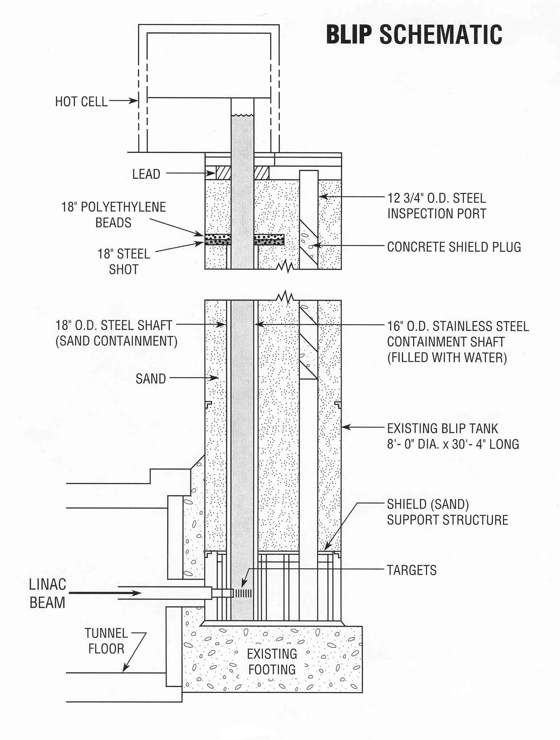
Brookhaven Linac Isotope Producer (BLIP) target station
Located 30 feet below the surface, close to the bottom of the water shaft
Targets delivered to and retrieved from the beamline using chain drive system
About 6 inches (152.4 mm) of space available along the beam pass for target positioning
Designed specifically for isotope production: operation at high current
Top of the hill

Slide 7
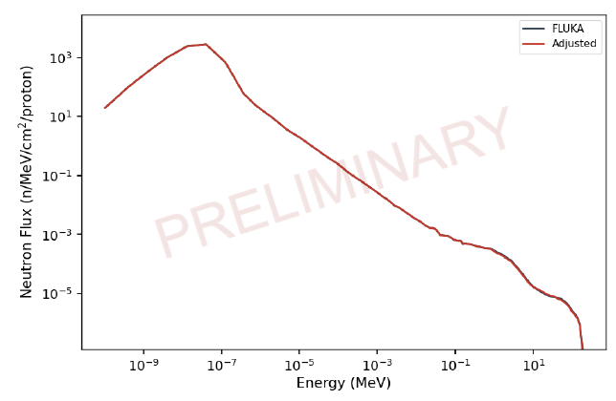
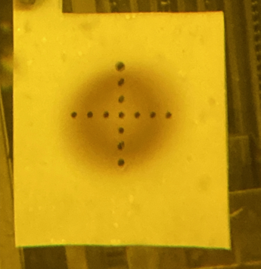
3D rendering of BLIP target stack
30 MeV (C-slot)
68 MeV
97 MeV
106 MeV
degrader
RbCl 2
RbCl 1
80 mm (~3 inch)
Proton beam
Secondary neutron spectrum behind 200 MeV stack
Target basket
Cooling water

Slide 8
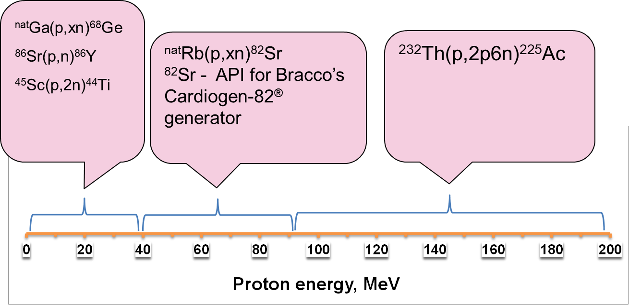
Energy slots occupation by targets at BLIP

Slide 9
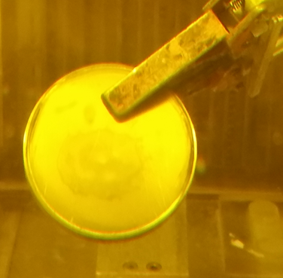
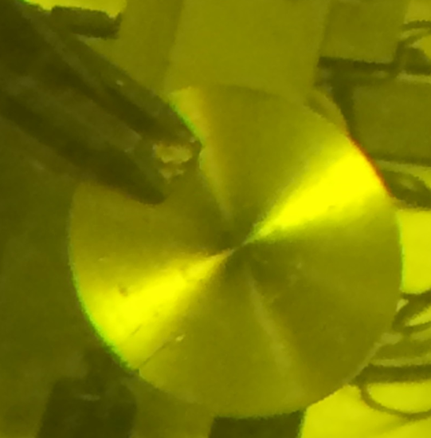
Example: Sc target for raster operation

Slide 10
Separation of Sc from Ti on Zr resin (Triskem int.)

Slide 11
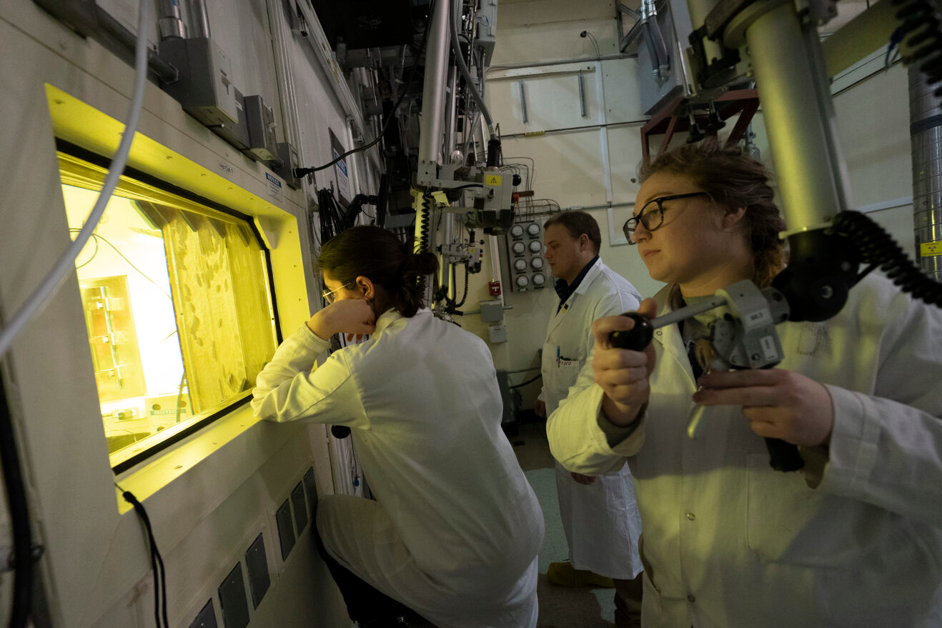
Chemical separations carried out in shielded hot boxes

Slide 12
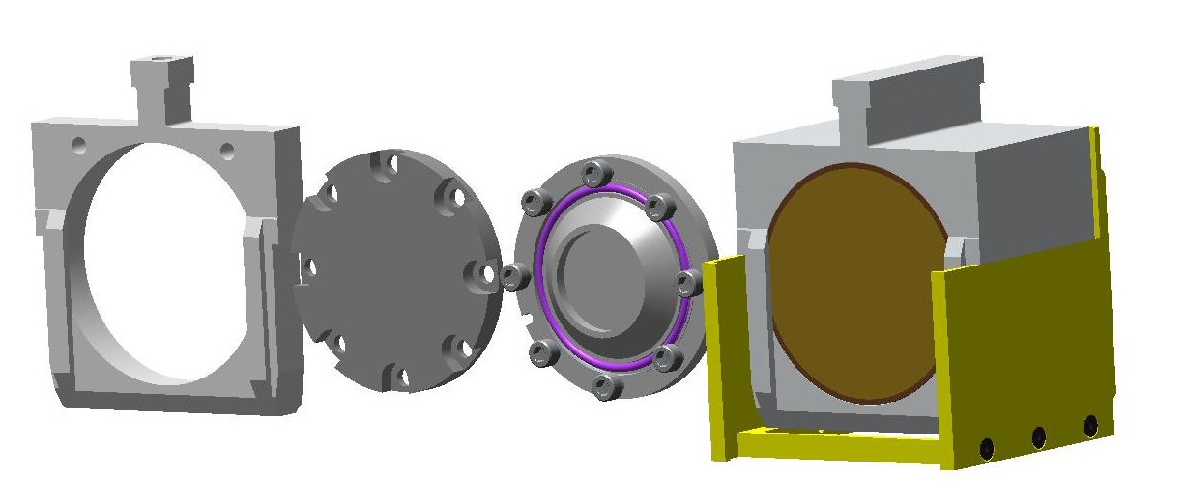
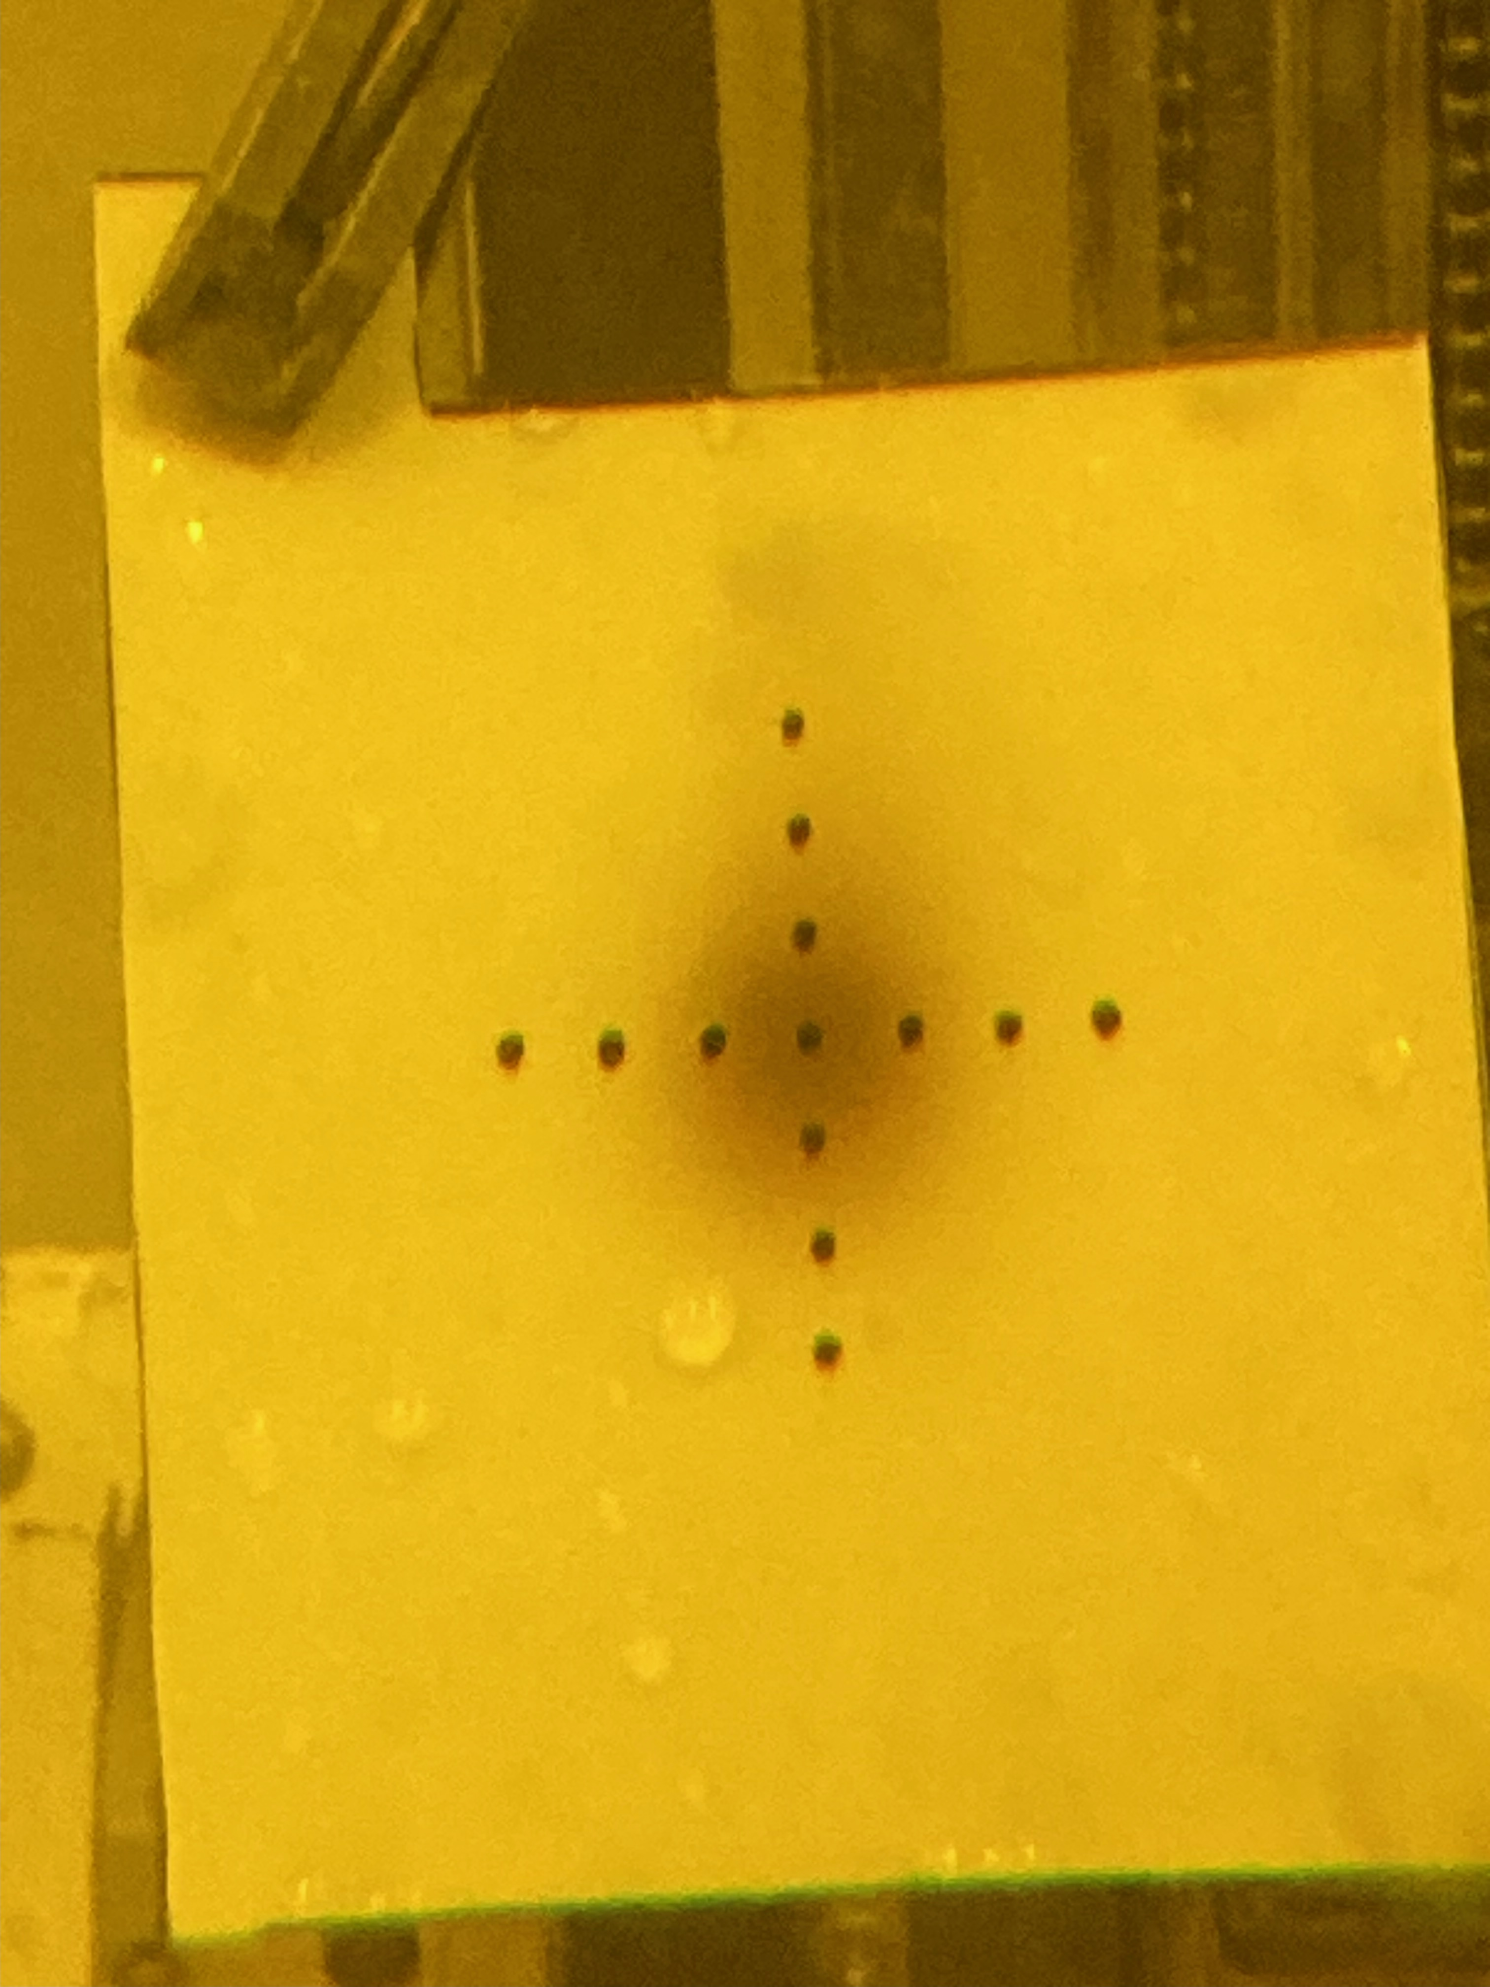
Operations with focused beam continues for production rate measurements and enriched targets irradiation
Bolted capsule for small disks/foil
Holder
Degrader to tailor proton energy on downstream targets

Slide 13
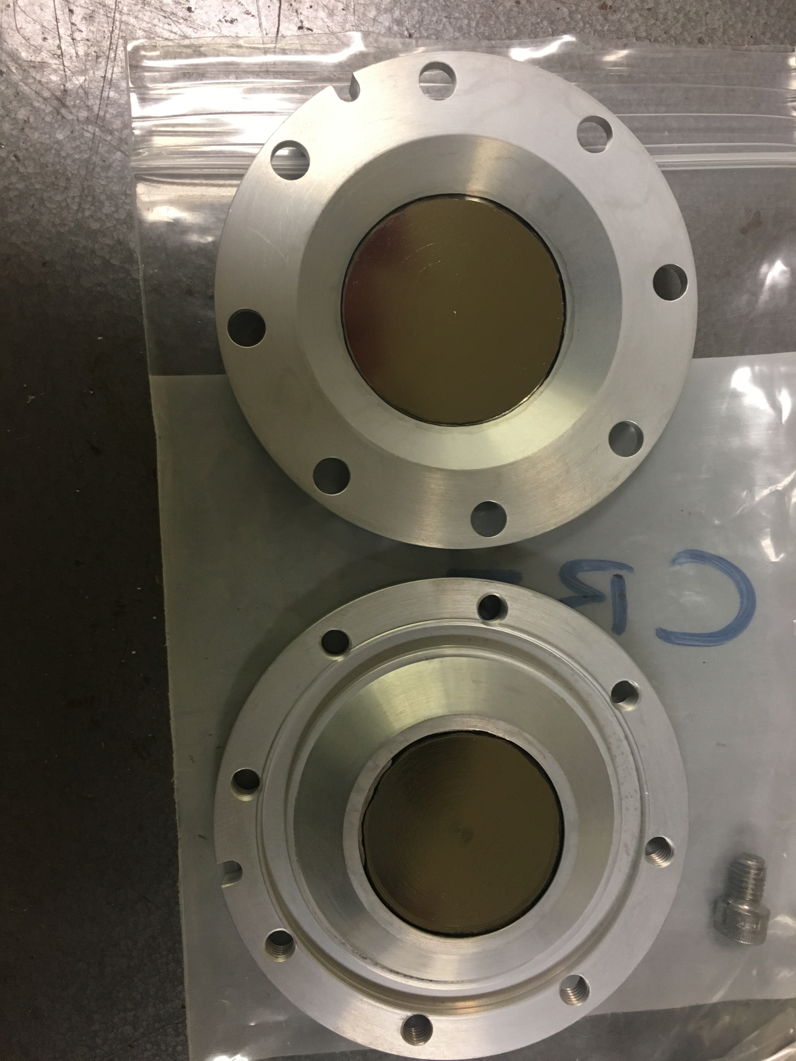
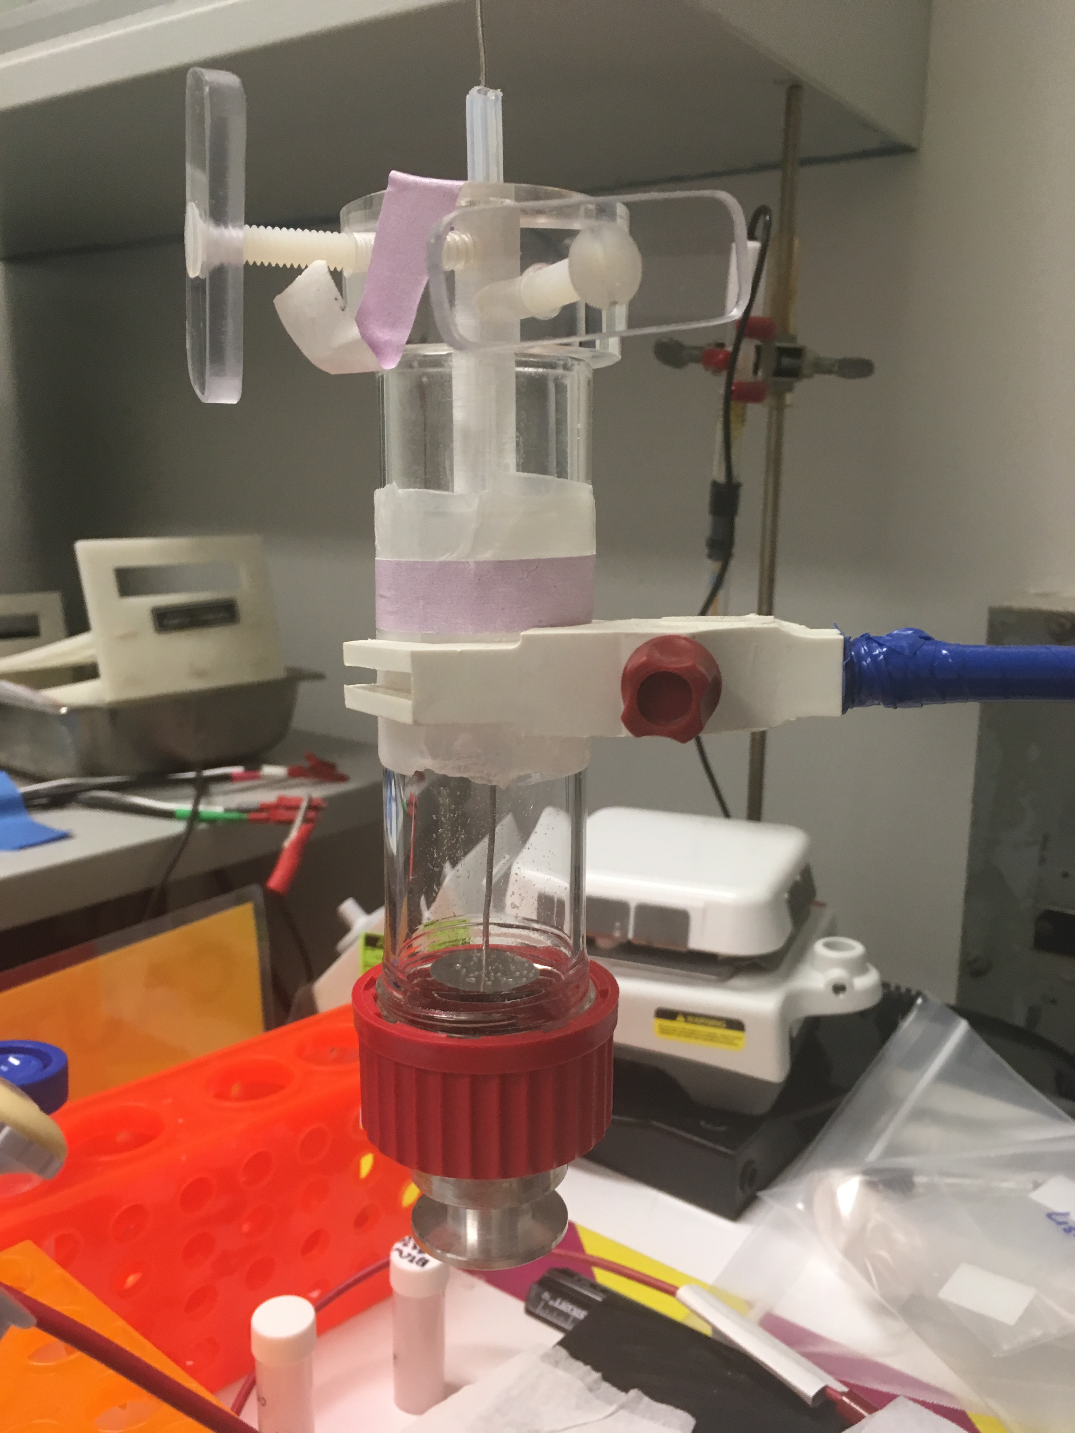
Example: production from enriched Zn-68

Slide 14
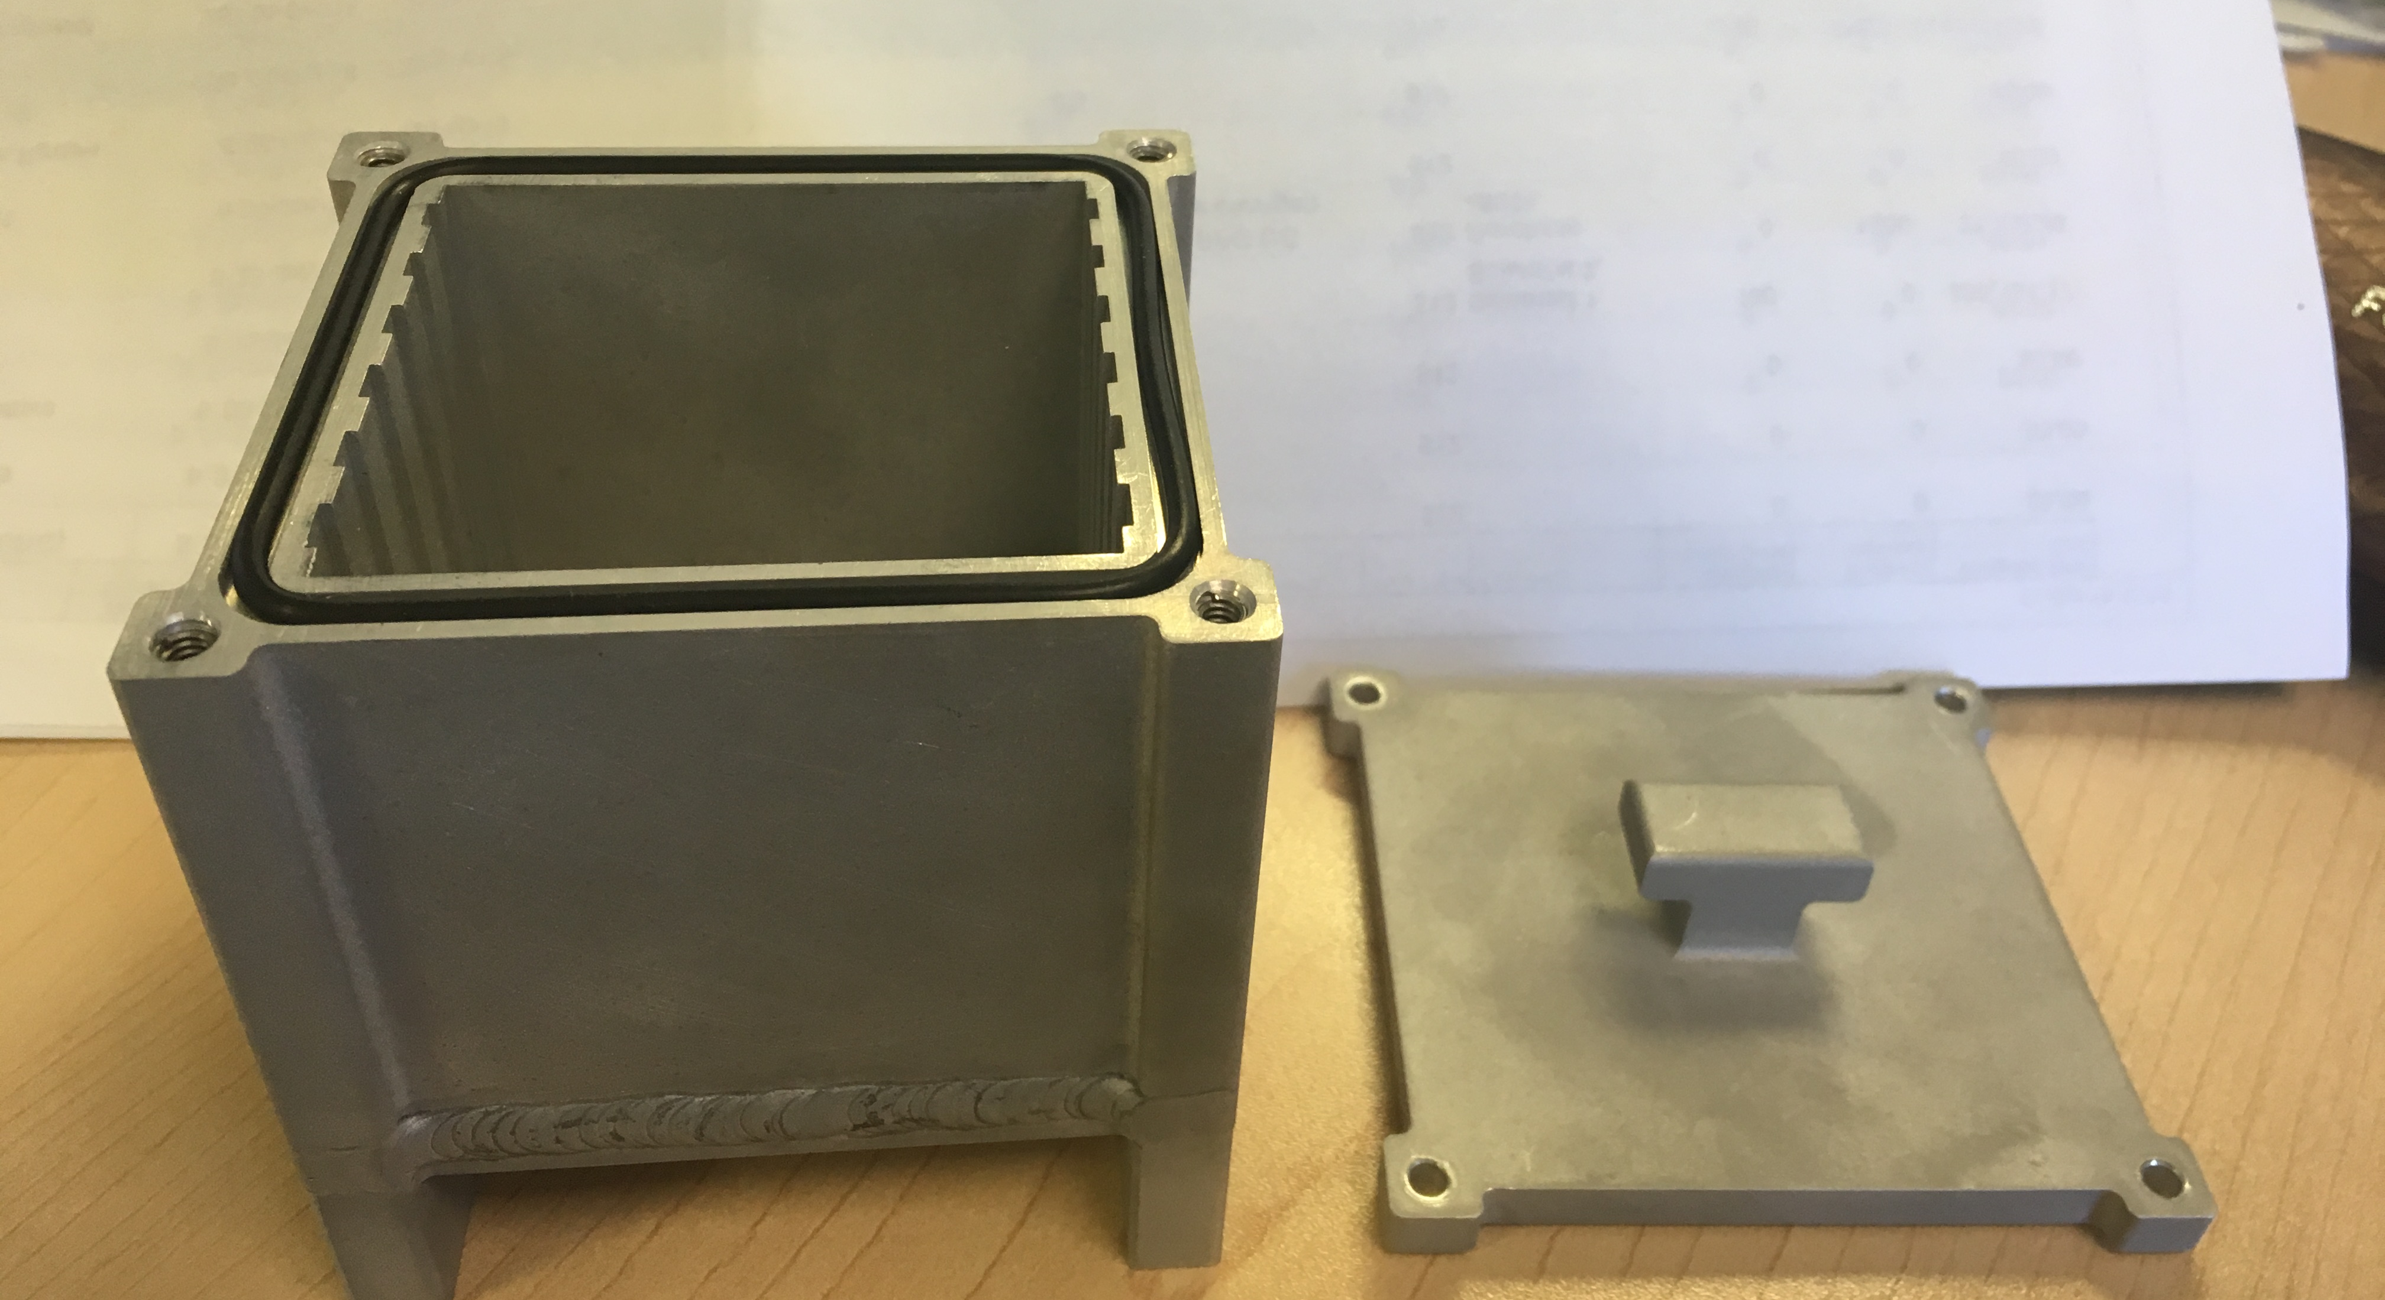
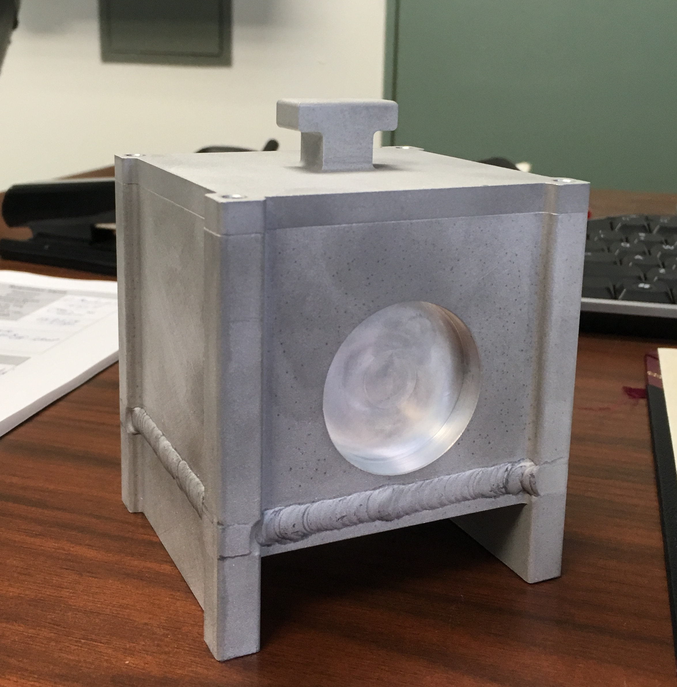
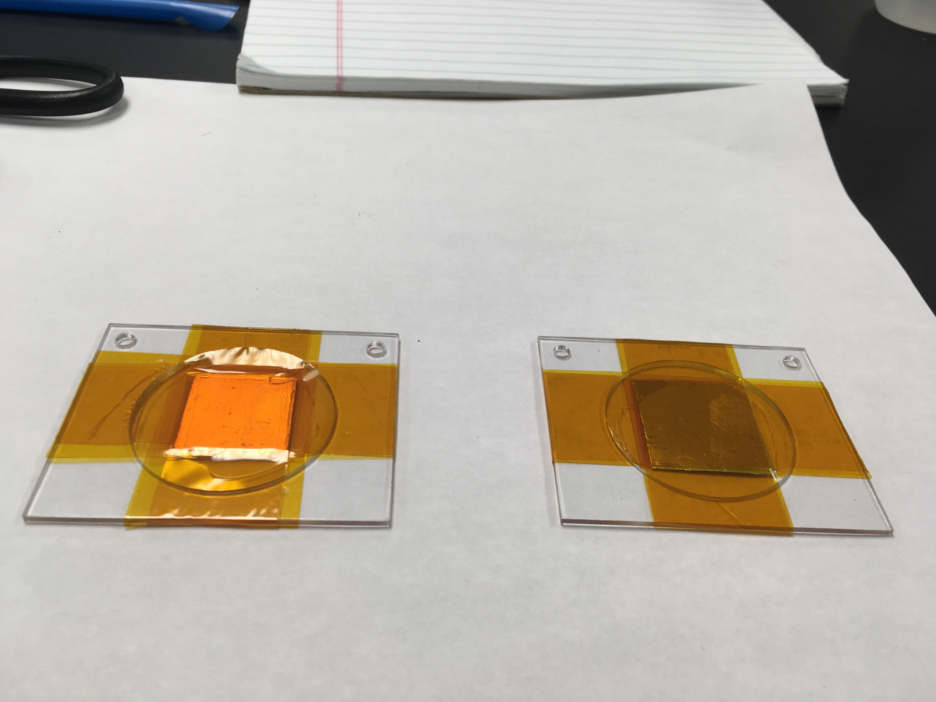
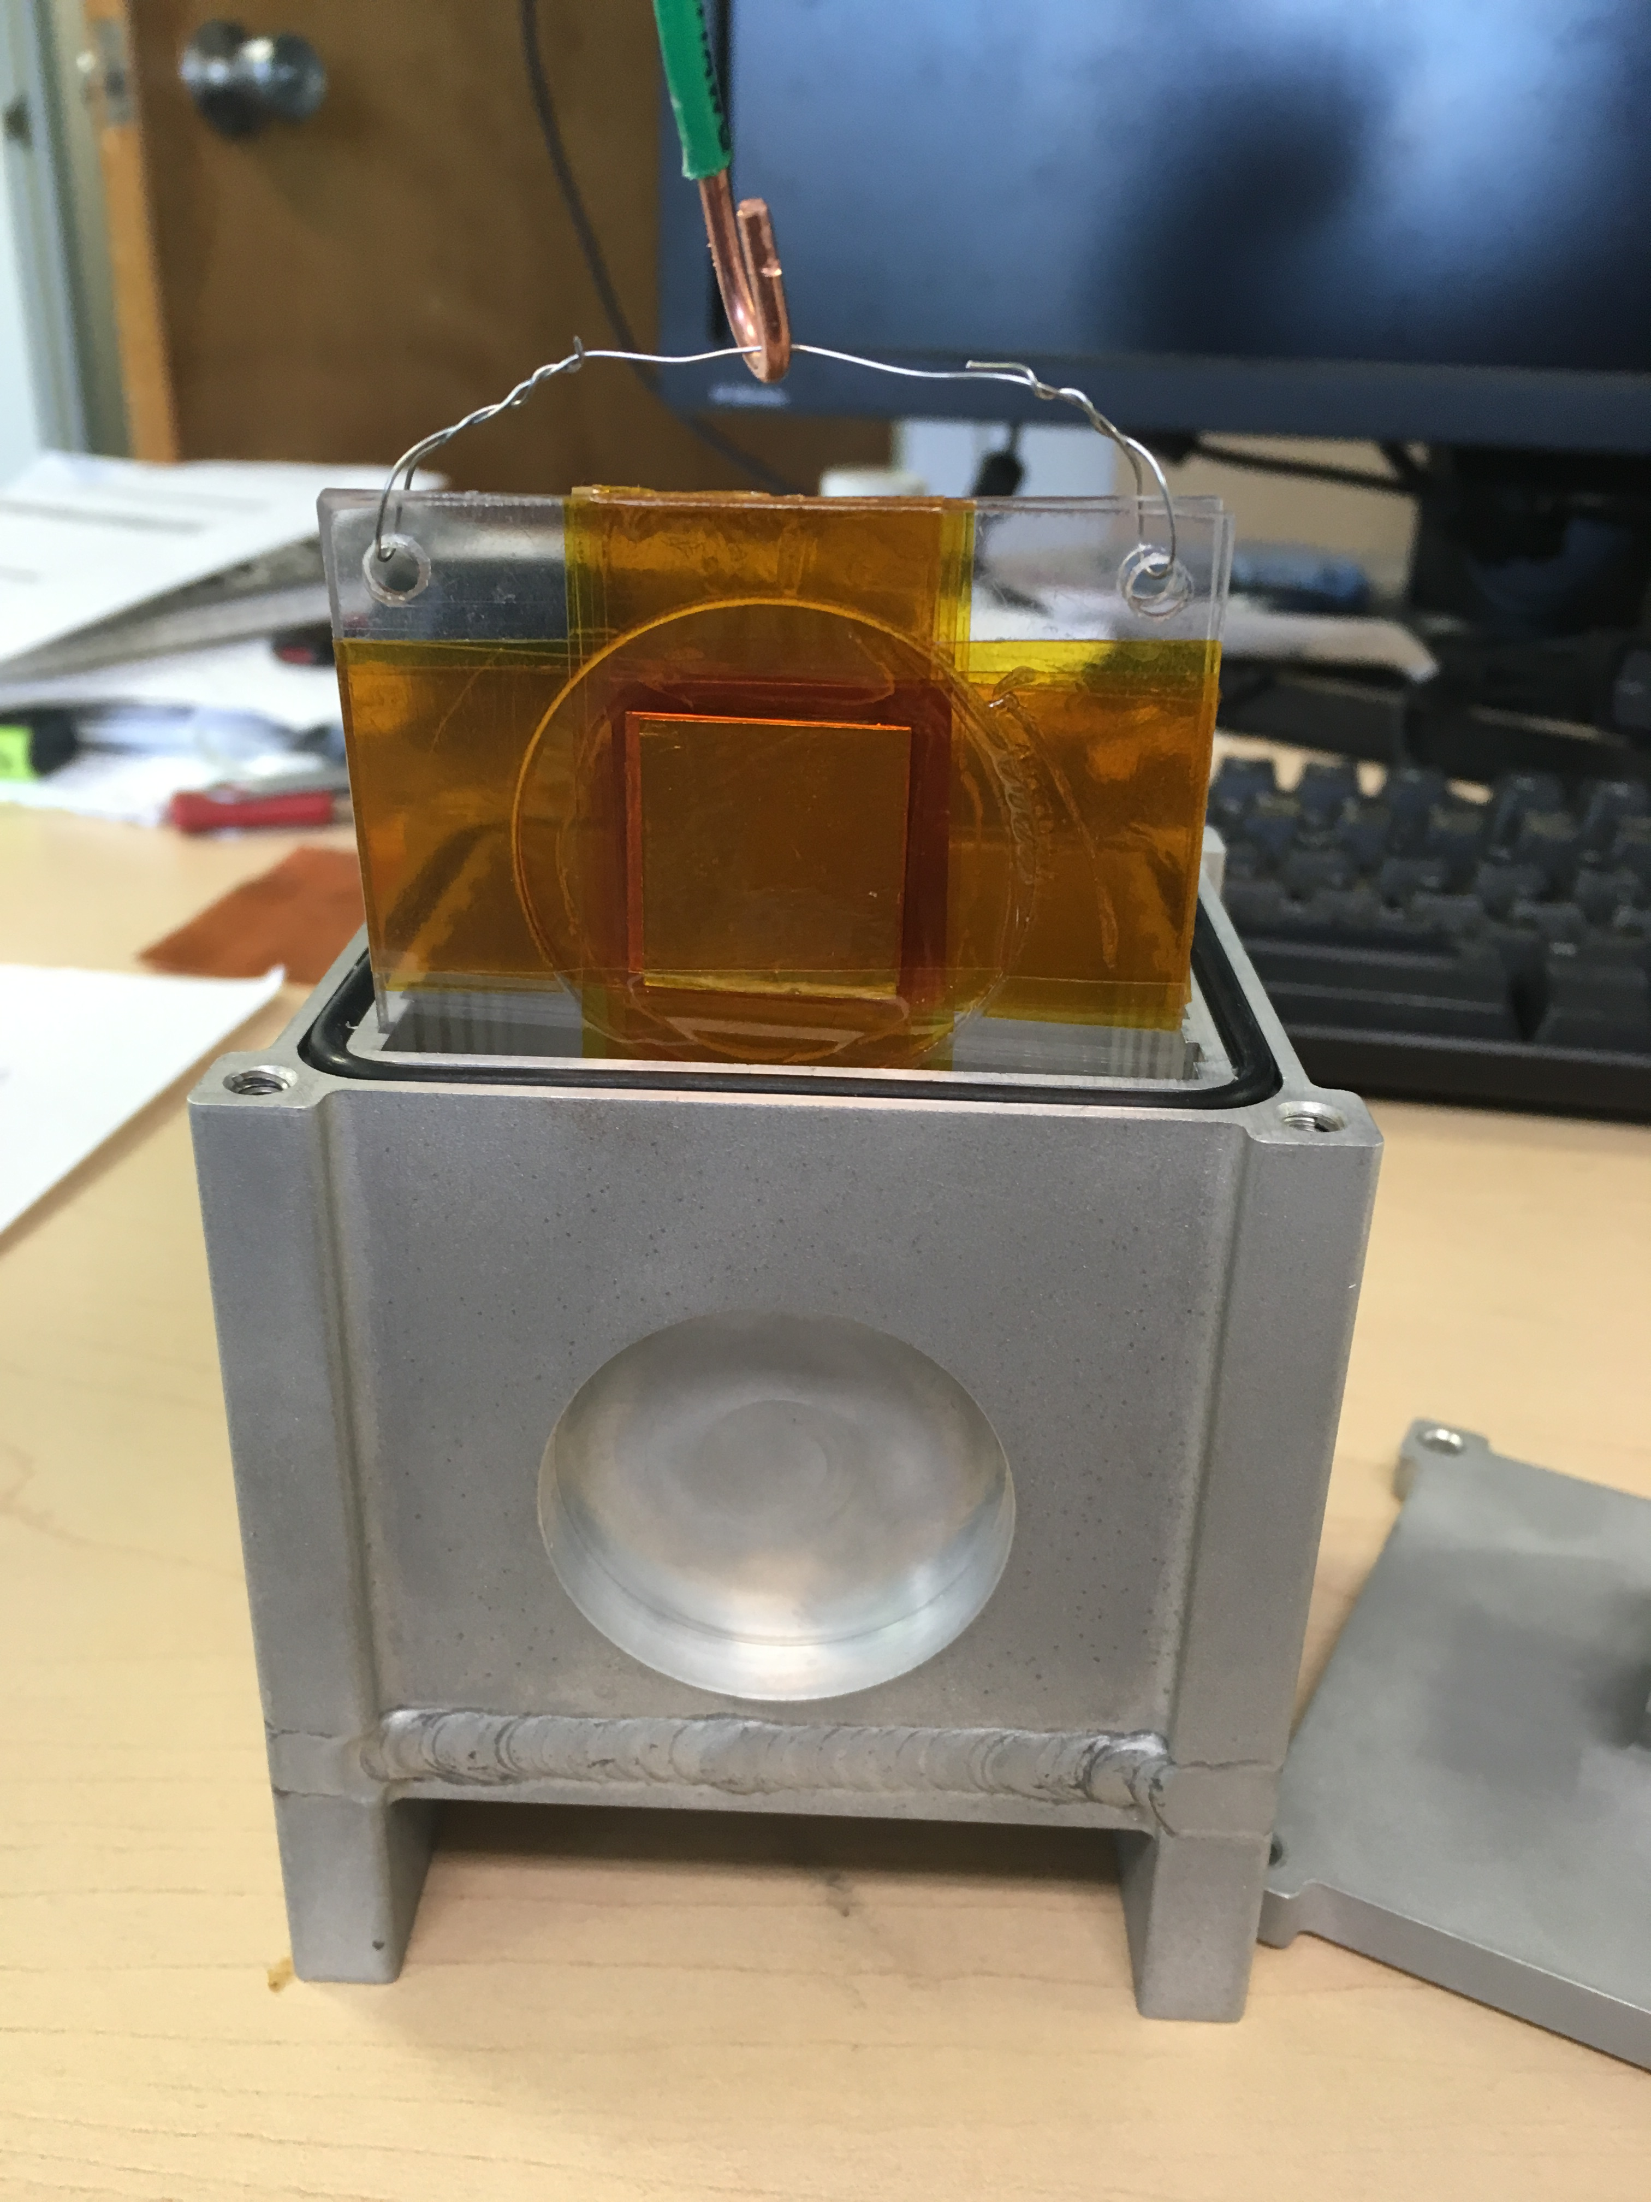
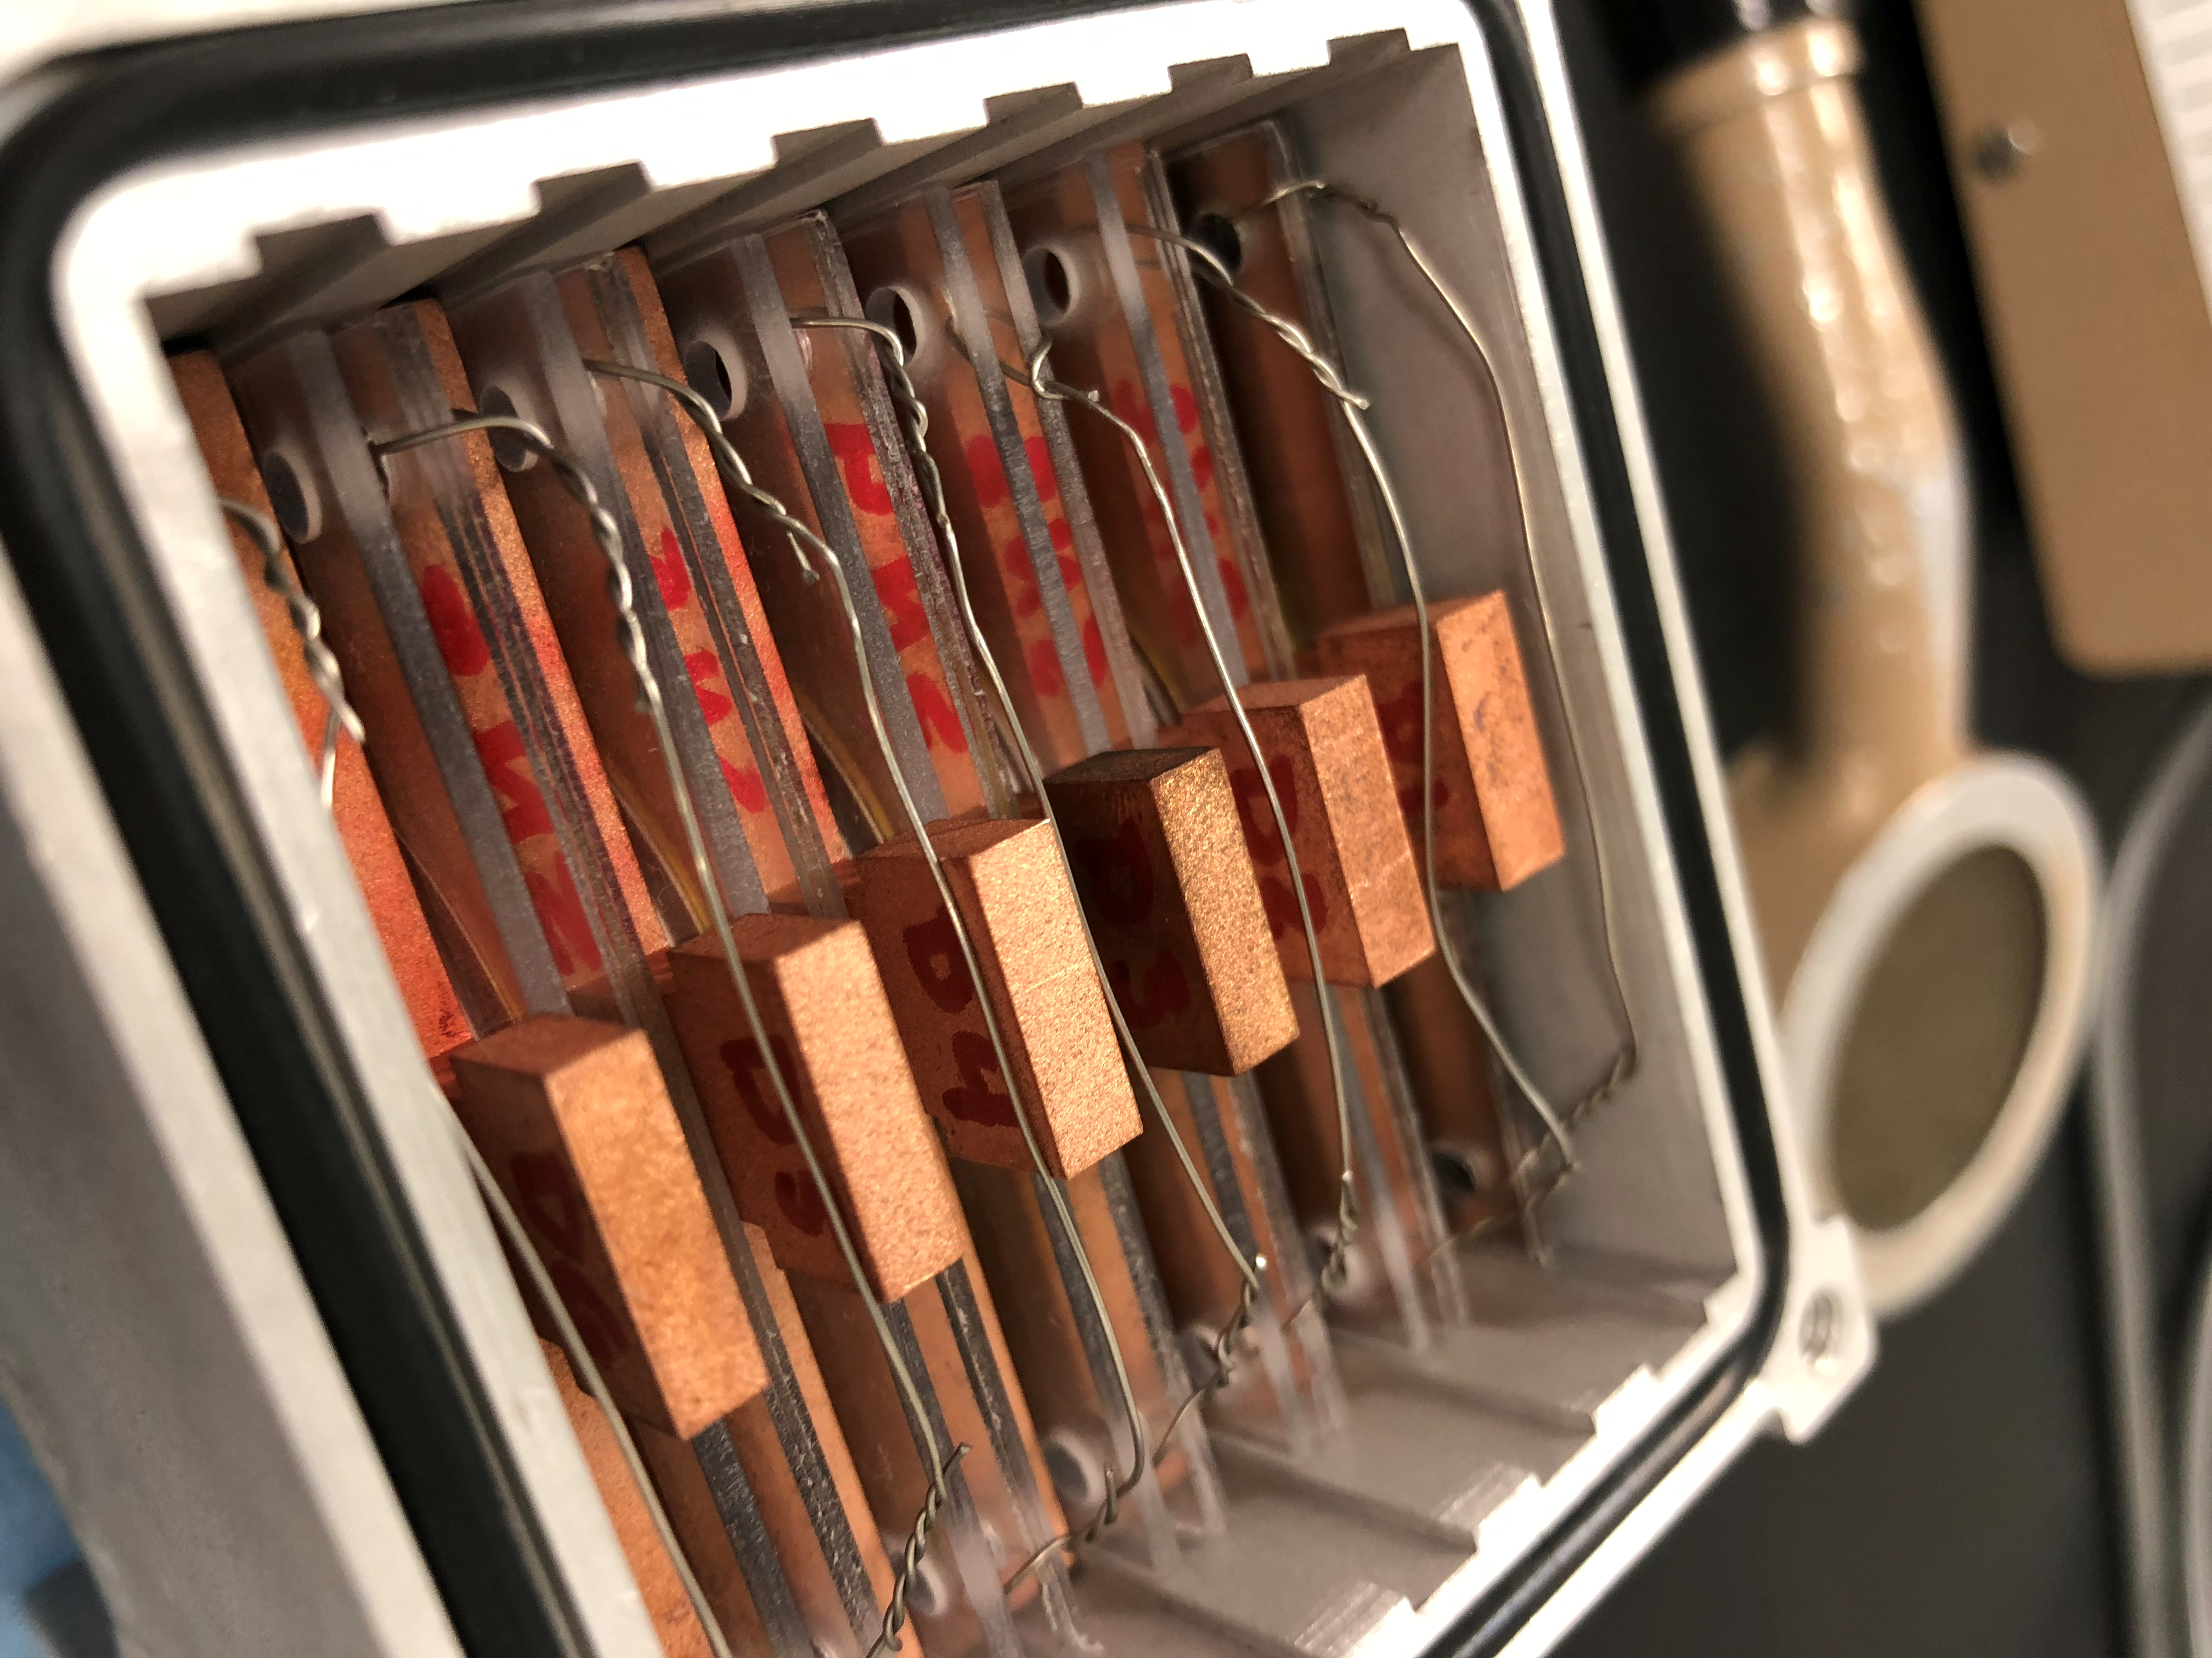
Irradiation of foils at a very low current

Slide 15
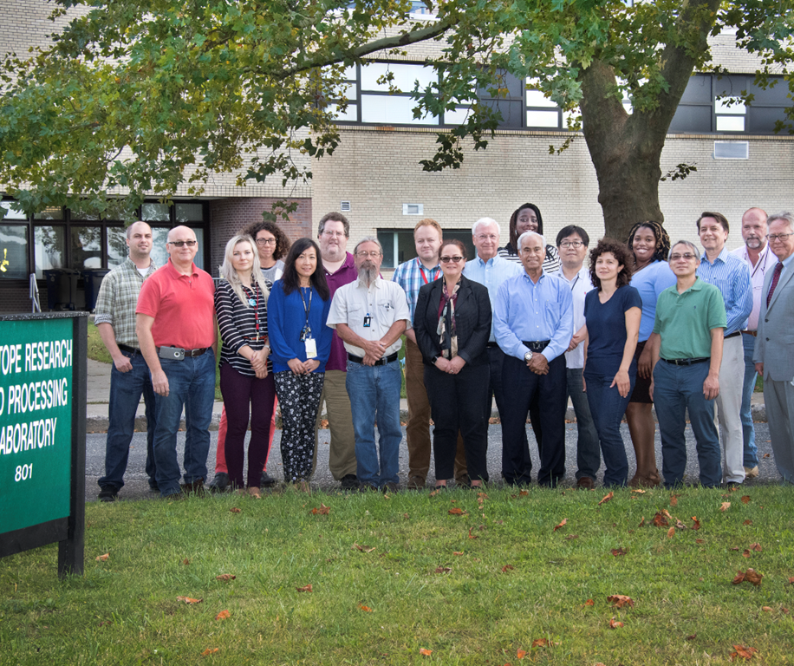
Acknowledgement
The MIRP program is funded by the US DOE Isotope program

