Slide 1

Radioisotope Production at Los Alamos National Laboratory
Etienne Vermeulen
LANL Isotope Program
September 26th, 2023
ORNL RIPS Workshop
LA-UR-20-28653, 22-28729

Slide 2
“I realize, of course, that DID budgets are not enormous. I believe, in fact, that the national interest demands that they be substantially increased. The way to do this is by not only vigorously supporting those activities which are of proven value but also by exploring new activities which offer unusual promise....Thus, with the support of the DID for this proposal, we can assist in obtaining additional funds for an isotope production facility at LAMPF.”
L.Rosen – Presentation to the AEC Division of Isotopes Development
15 December 1970

Slide 3
Isotopes
We make can make a wide range of radioactive isotopes that have a huge range of application spaces for many different end users.
Isotope | Half-life
⁸²Sr | 25.5 d
⁶⁸Ge | 270 d
¹³⁴Ce | 75.9 h
⁴⁴Ti | 58.9 a
²²⁵Ac | 10 d
²³⁰U | 20.8 d
^{119m}Te | 4.71 d
Isotope | Half-life
³²Si | 153 a
⁷³As | 80.3 d
¹⁰⁹Cd | 462.6 d
²²Na | 2.6 a
²³⁶Np | 1.5 10⁵ a
Environmental Applications
Medical applications
Industrial Applications
Cancer therapy
Nuclear Forensics

Slide 4
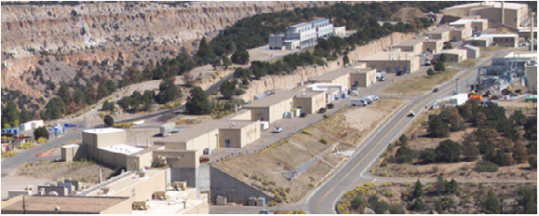
LANSCE & The LANL Isotope Production Facility (IPF)
Proton Injectors
201.25 MHz
805 MHz
pRAD & UCN
Drift Tube Linac
H+
Side Coupled Cavity Linac
800 MeV
H+
H-
SCCL is 90% of accelerator length
Area A
H-
750 keV
Line D
H-
100 MeV
Transition Region
Proton Storage Ring
Weapons Neutron Research Facility
100 MeV proton beam routinely used at 250 μA for isotope production
Notes:
So where do we make these isotopes?
We use the Isotope Production Facility, located at the Los Alamos Neutron Science Center linear proton accelerator. We are located at the front end, where we extract protons at an energy of 100 MeV. You can see that the accelerator is able to continue to accelerate protons up to 800 MeV which are utilized by the other downstream facilities.

Slide 5
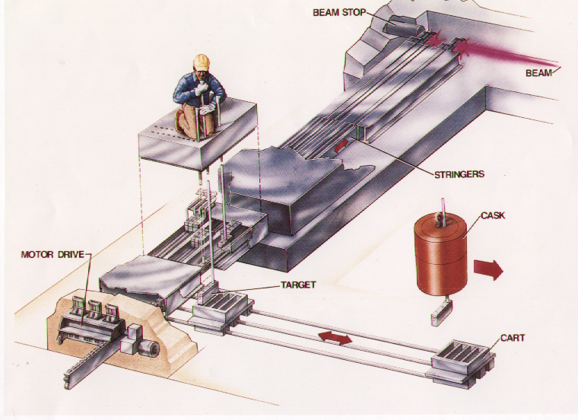
IPF v1 Location
Proton
Existing
Injectors
Isotope Production
H+
201.25 MHz
805 MHz
Line X
Station
Drift Tube Linac
H+
Side Couple Cavity Linac
800 MeV
Line A
H-
SCCL is 90% of accelerator length
Line D
Beam
H-
750 keV
100 MeV
Stop
Transition
Region
Proton Storage Ring
LANSCE Accelerator Complex
Manuel Lujan, Jr. Neutron Scattering Center
Weapons Neutron Research Facility

Slide 6
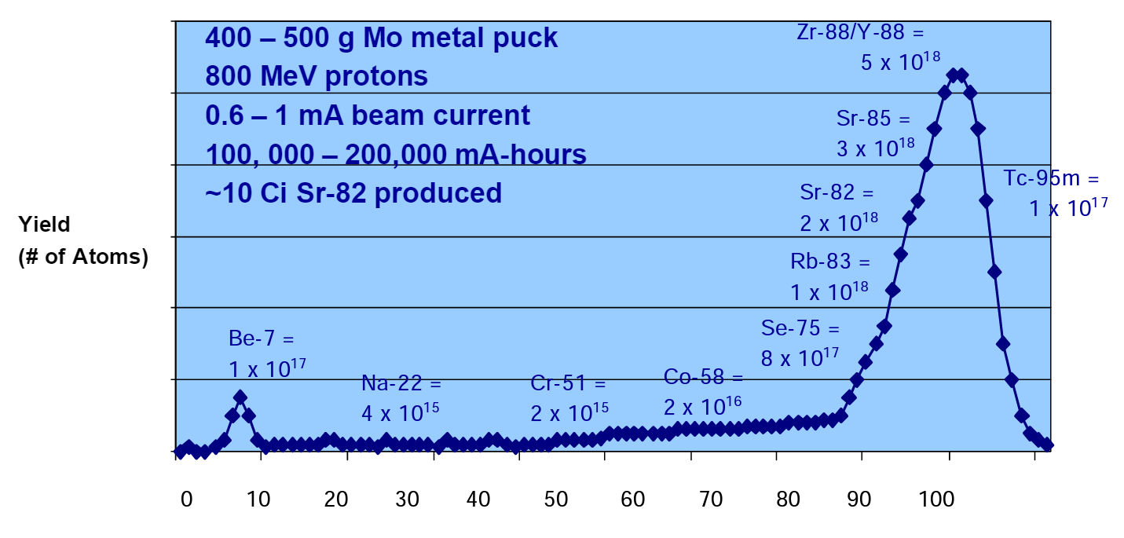
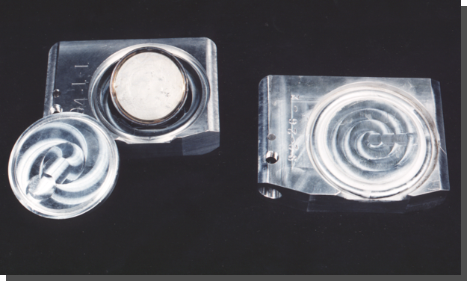
Targets

Slide 7
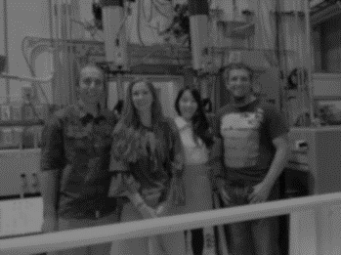
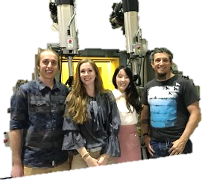
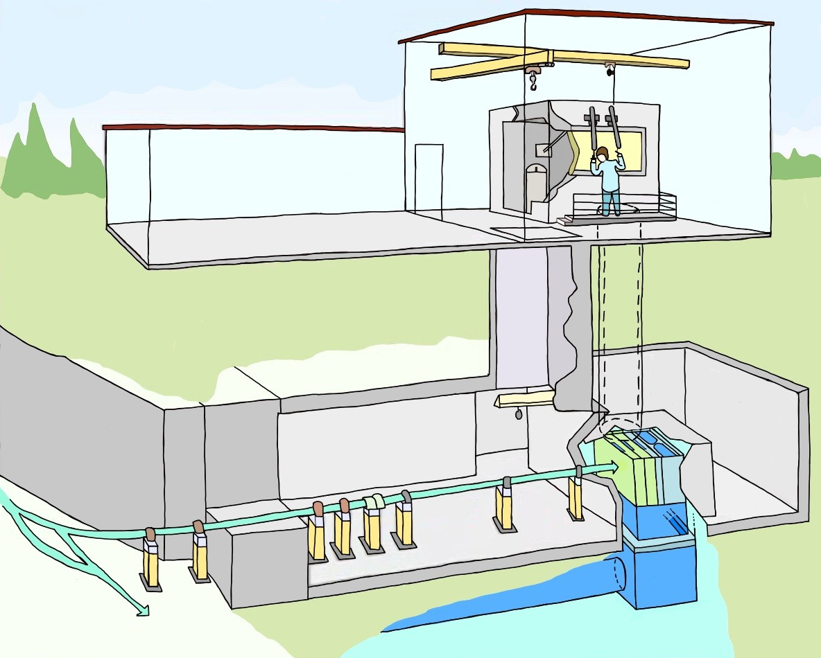
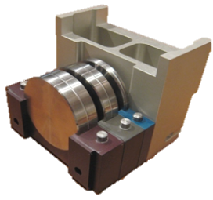
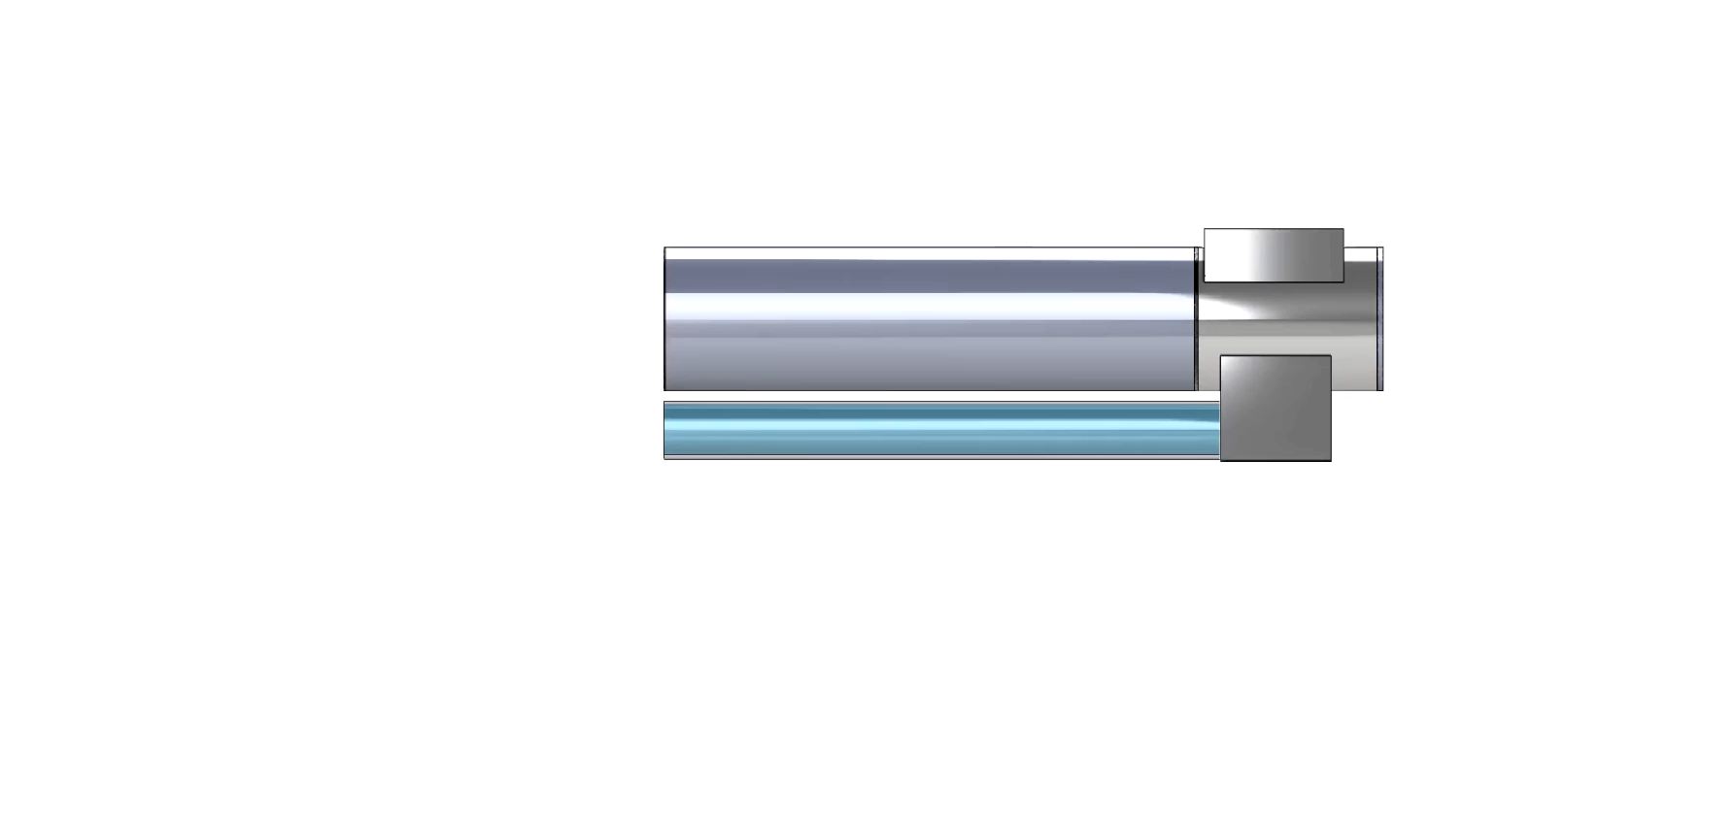
Isotope Production Facility (IPF)
In front of the Hot Cell
IPF
Monorail Crane
Manipulators
Hot Cell
40’ Water
Target system 3D model
100 MeV
Target Cooling System
Main beam Line

Slide 8
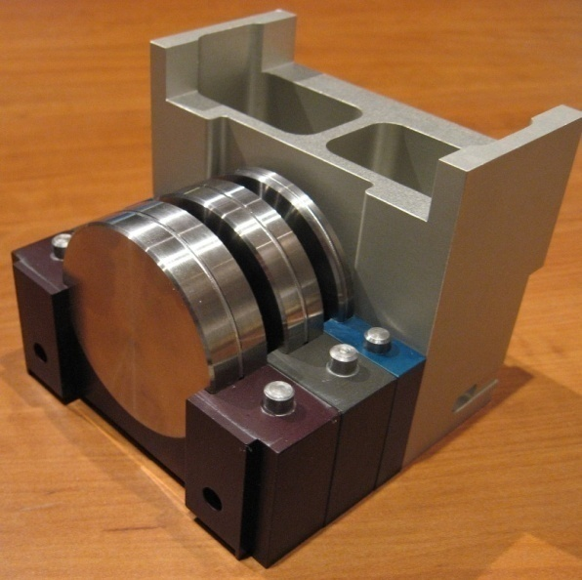
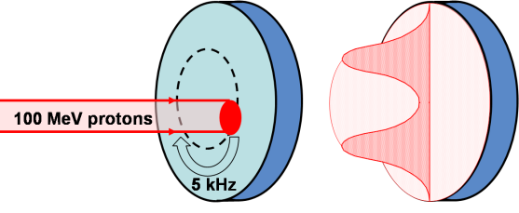

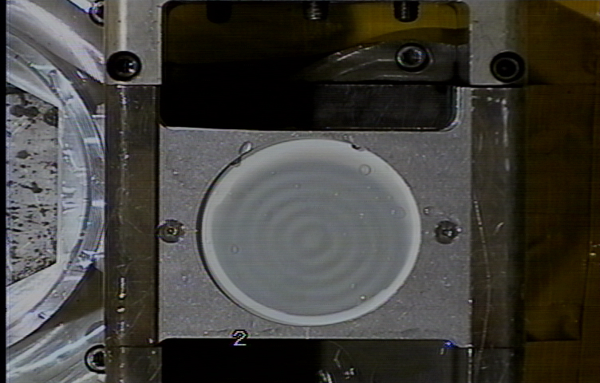
100 MeV Proton Beam at IPF
100 MeV pulsed proton beam (100 Hz) on hockey puck-sized targets
~250 µA proton beam current = 1.6e15 protons/s!
RbCl
Protons
(100 MeV)
Beam
5-circle raster pattern
Swept in circle(s) to produce a concentric ring-shaped profile, reducing peak power density on the target
Average target size
Notes:
Now HOW do we make these isotopes?!
We use a 100 MeV pulse proton beam. When I say pulsed I mean that our beam is not constant, it has a specific pulse structure and is delivered at a rate of 100 Hz, meaning we receive proton pulses 100 times per second. We use an average beam current of ~250 uA, which corresponds to about 1.6 *10^15 protons /second. In addition, our proton beam is very rapidly swept in a series of concentric circles to distribute the heat more evenly on the target. You can see the image of our five circle raster pattern here, and this is distributed on a target about the size of a hockey puck.
We use a three-stacked target configuration (3 targets in a row), separated by small gaps, to allow us to force cooling water along the front and back faces to remove the pretty substantial amounts of heat we are dumping into these targets with our proton beam.

Slide 9
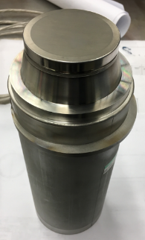
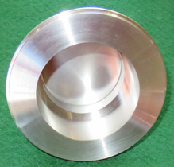
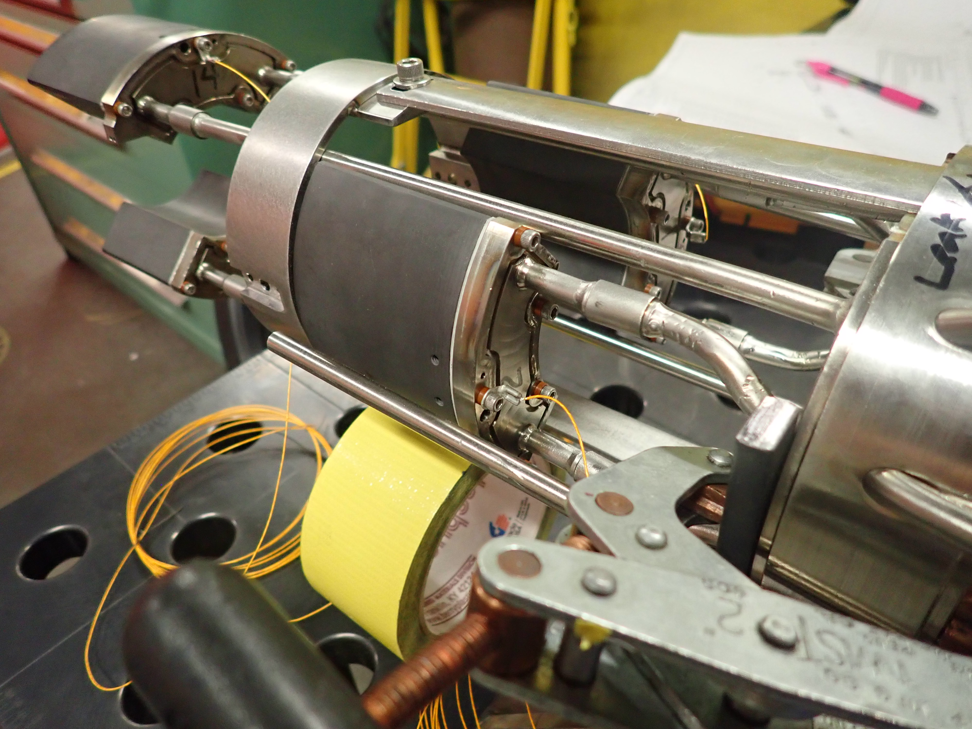
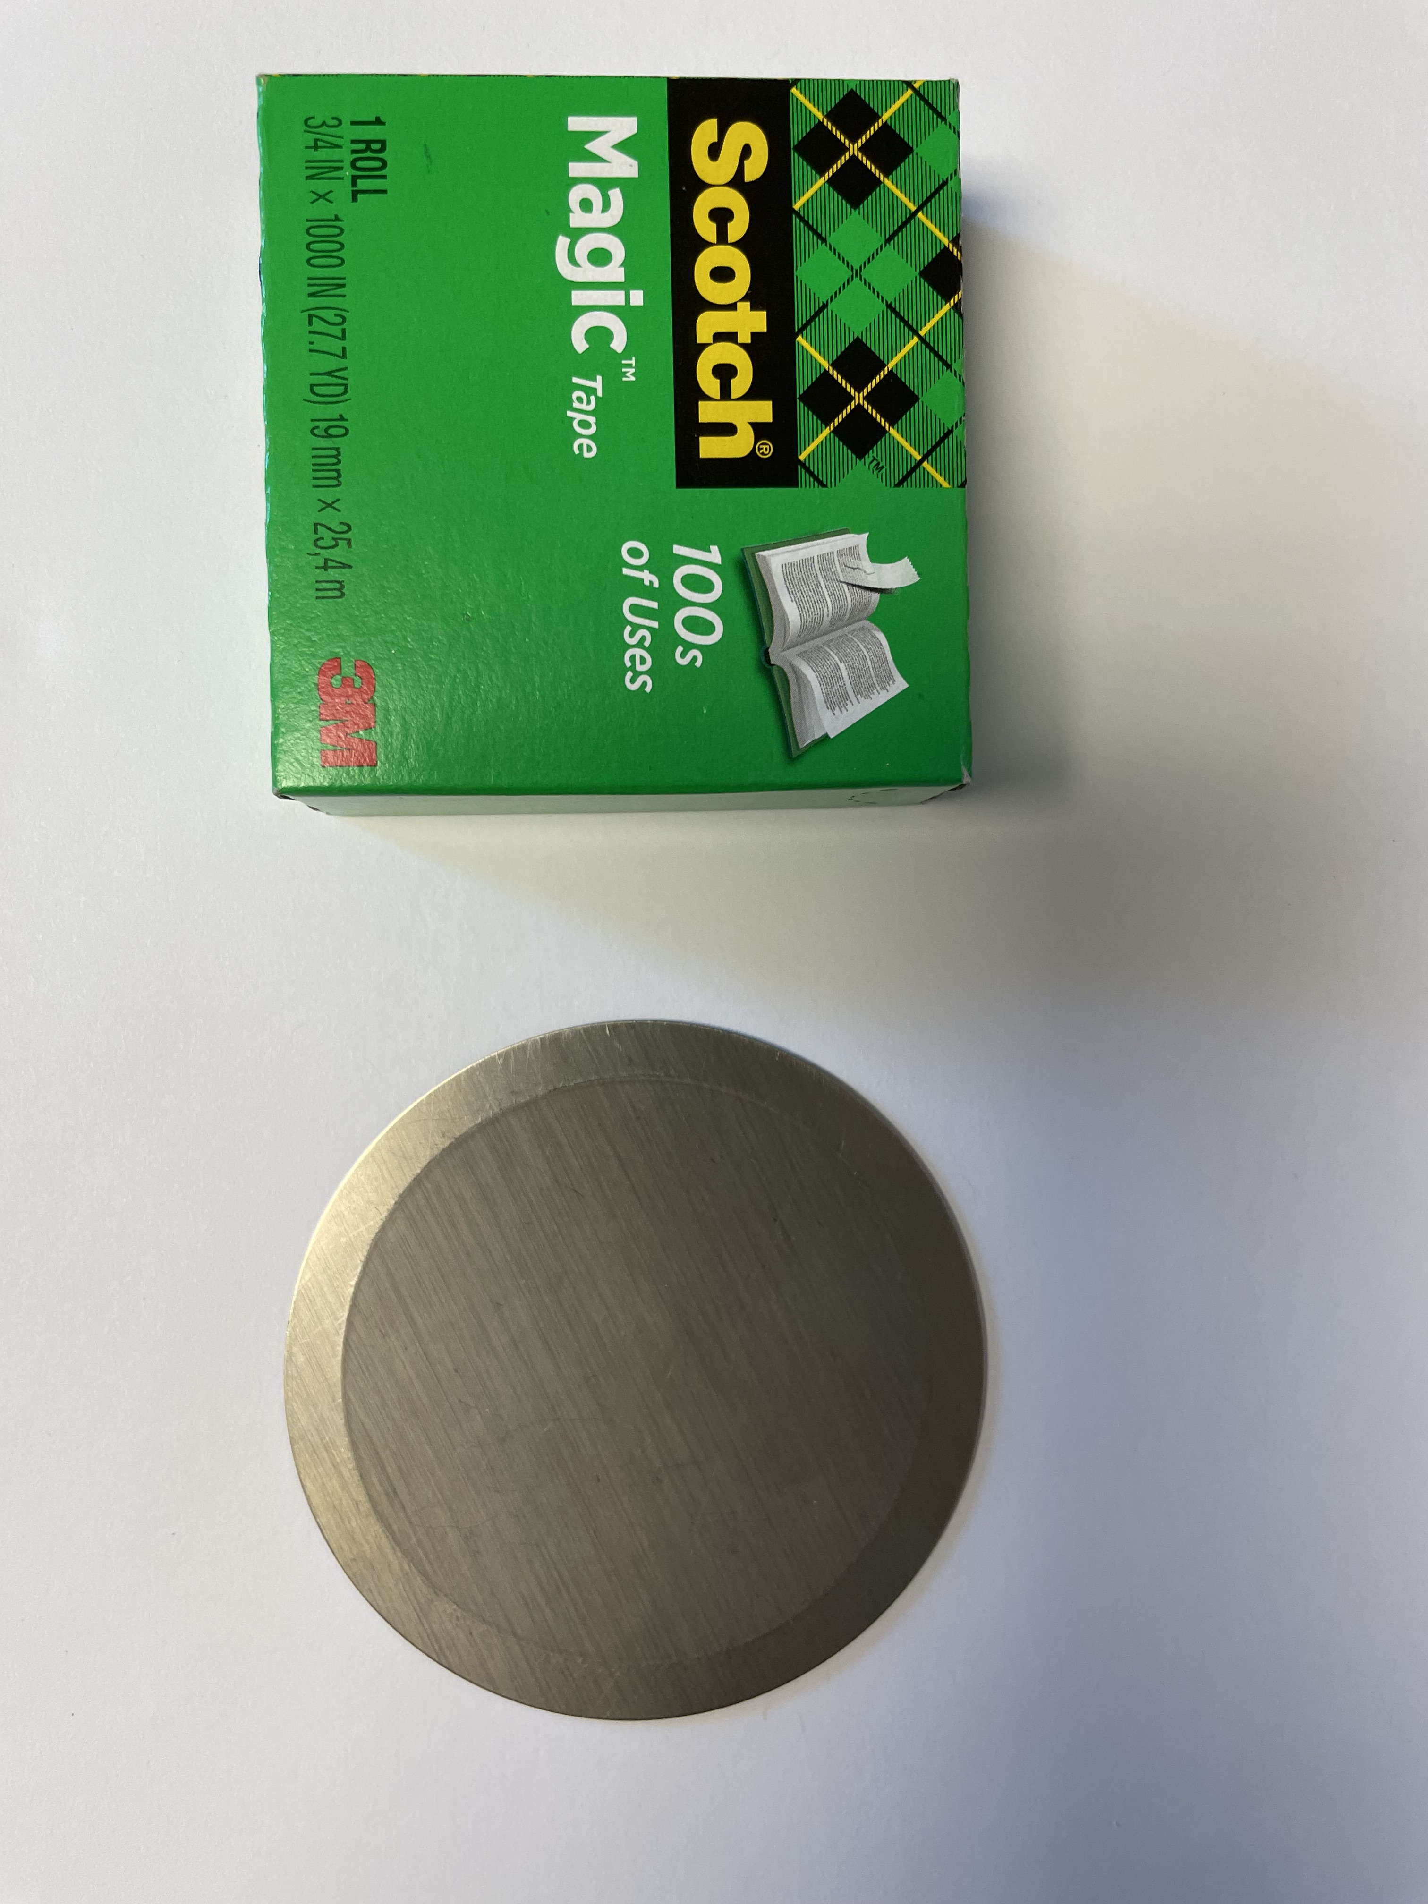
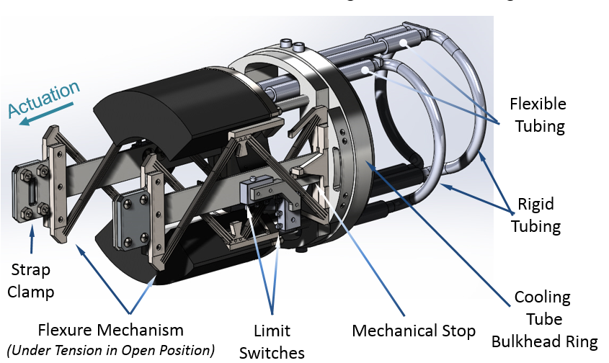
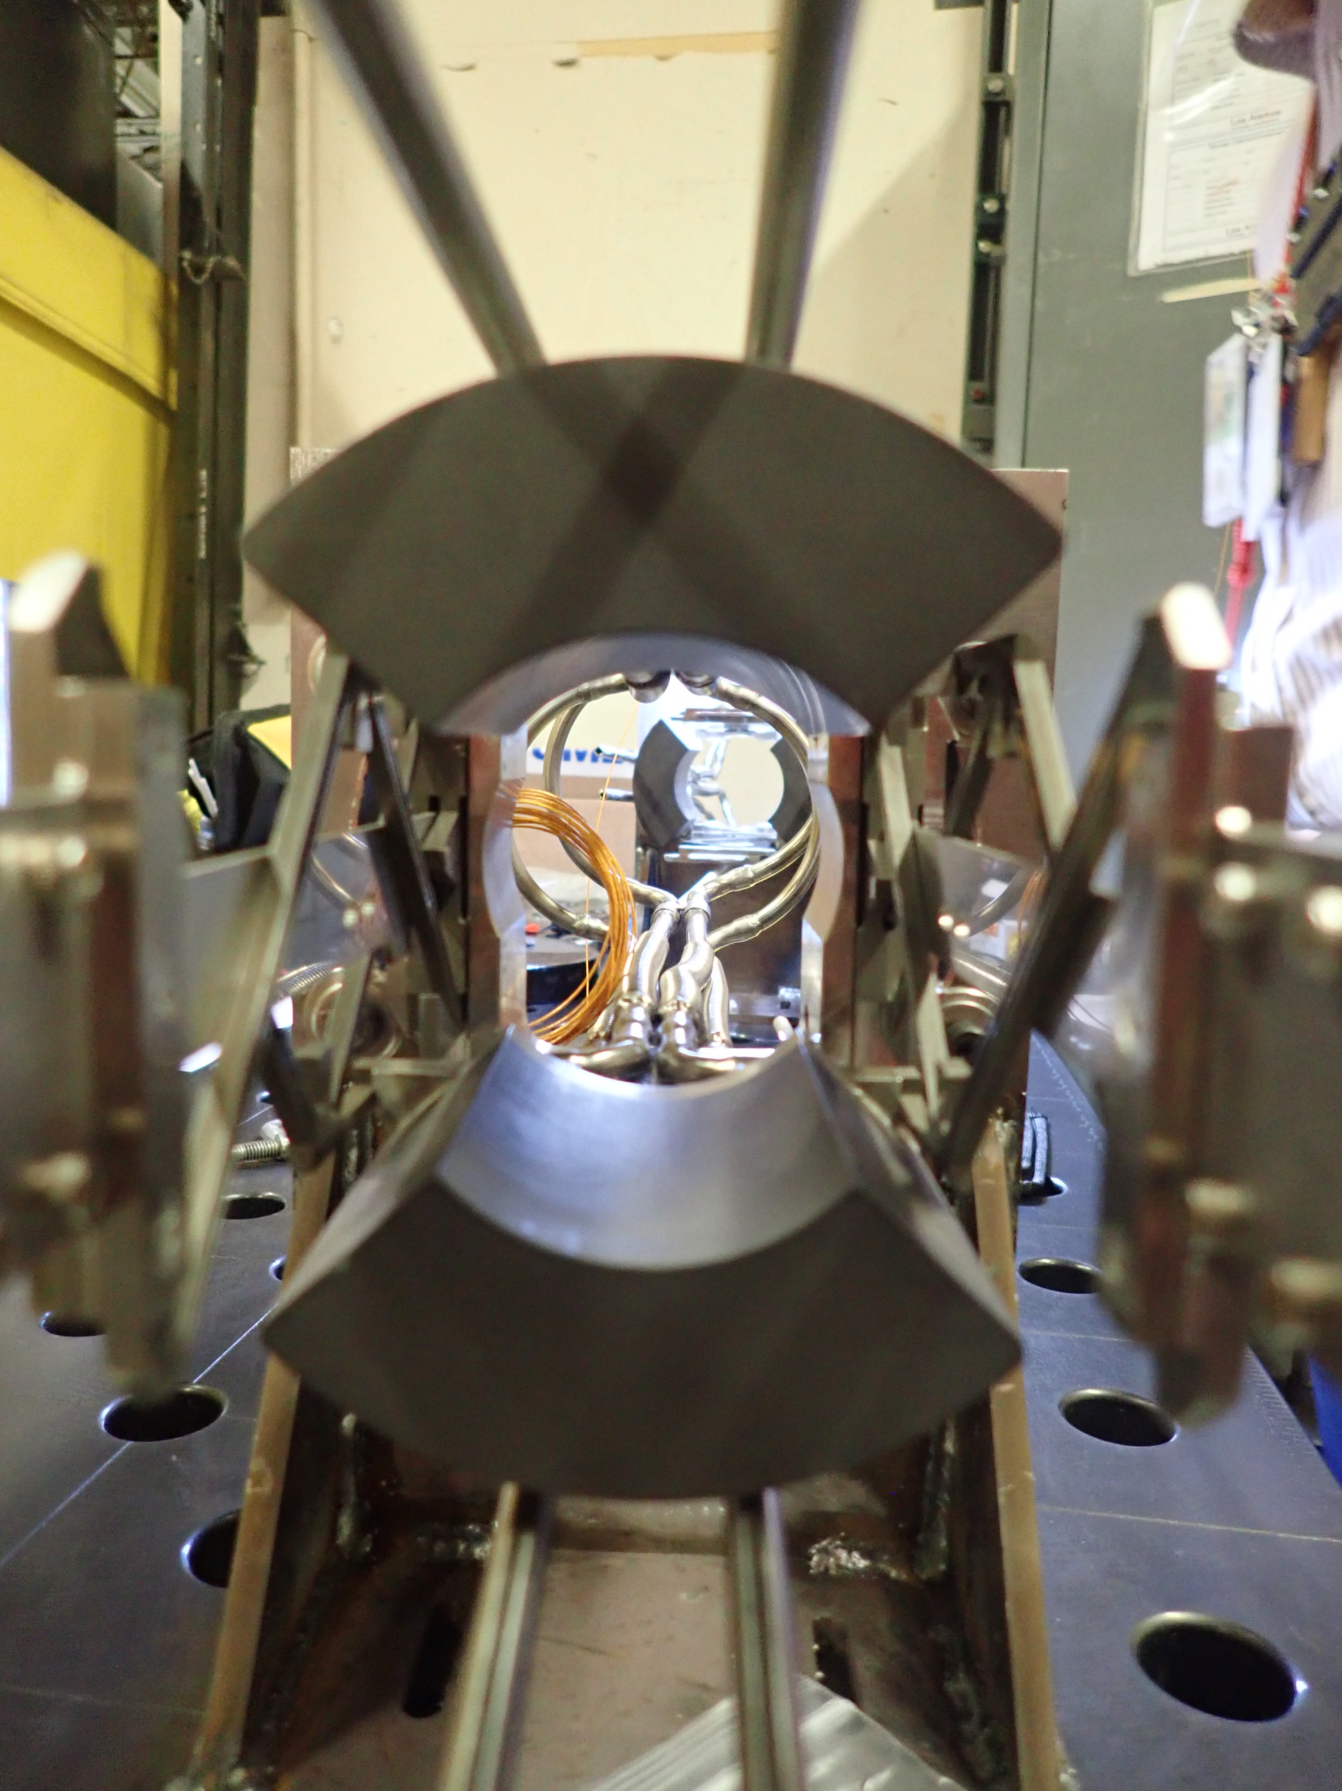
IPF Beam Window Assembly
Notes:
To provide more context, while the beam window itself is no bigger than the palm of my hand in surface area (or as this pictures indicates, smaller in area than a box of scotch magic tape). and only half a mm thick, this beam window is not an independent component, easily replaced in the event of failure.
nickel alloy, welded onto a beam pipe containing active adjustable collimator segments. This beam window assemb
This beam window is actually weleded on to a stainless steel flange, and then welded onto a section of beam pipe containing 4 fixed and 4 adjustable collimator segments, capable of moving from aperature diameters of 1.4 to 2.3” via a flexure mechanisms. These collimator segments are active, in that they are installed with connections for both temperature and current (beam spill) feedback), and they have cooling lines running through them.
This assembly is contained withing a nearly 7 foot (2m) section of beam pipe that is welded together and enclosed inside of a larger pipe through which our cooling water returns.
2m (6.5 ft)

Slide 10
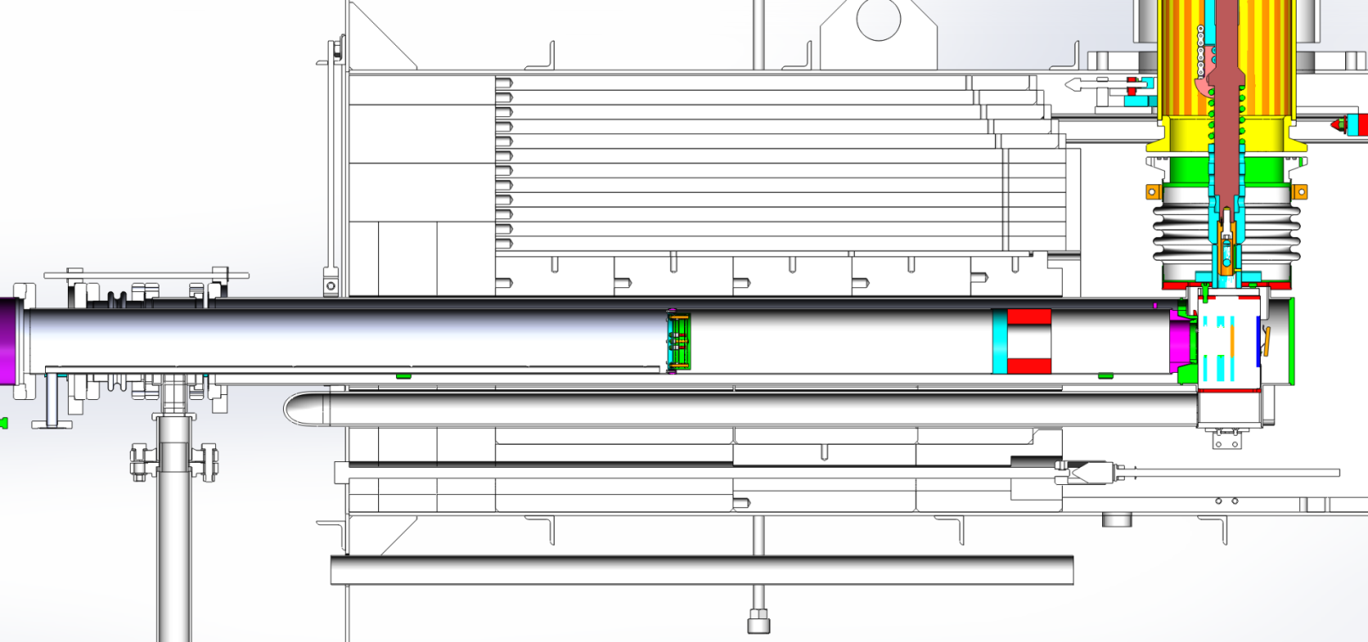
IPF Beam Window Assembly
6.5’
Shielding
IPF beam window assembly
IPF target station
IPF beam window
Notes:
Here I have shown the entire beam window & collimator assembly, as it is installed relative to the IPF target station You can see that this section of pipe must be inserted into the concrete shielding block surrounding the IPF target station, and that once installed, the majority of this assembly is inside of the shielding.

Slide 11
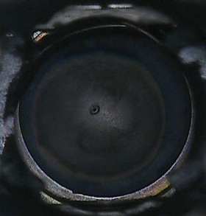
Indications of Beam Window Failure
Rapid/nearly instantaneous degradation of beamline vacuum.
  Fast valves upstream closed due to increase in vacuum.
When the vacuum team was trying to recover IPF beamline vacuum, they noticed water coming out of the vacuum pump.
Opening the beamline revealed water in the vacuum pump, and other beamline diagnostic components.
Camera inspection clearly showed a puncture hole in the beam window.
Notes:
Rapid/nearly instantaneous degradation of beamline vacuum.
Fast valves upstream closed due to increase in vacuum.
When the vacuum team was trying to recover IPF beamline vacuum, they noticed water coming out of the vacuum pump.
Opening the beamline revealed water in the vacuum pump, and other beamline diagnostic components.
Camera inspection clearly showed a puncture hole in the beam window, looks very similar to the hole that we saw in our plastic beam imaging foil.

Slide 12
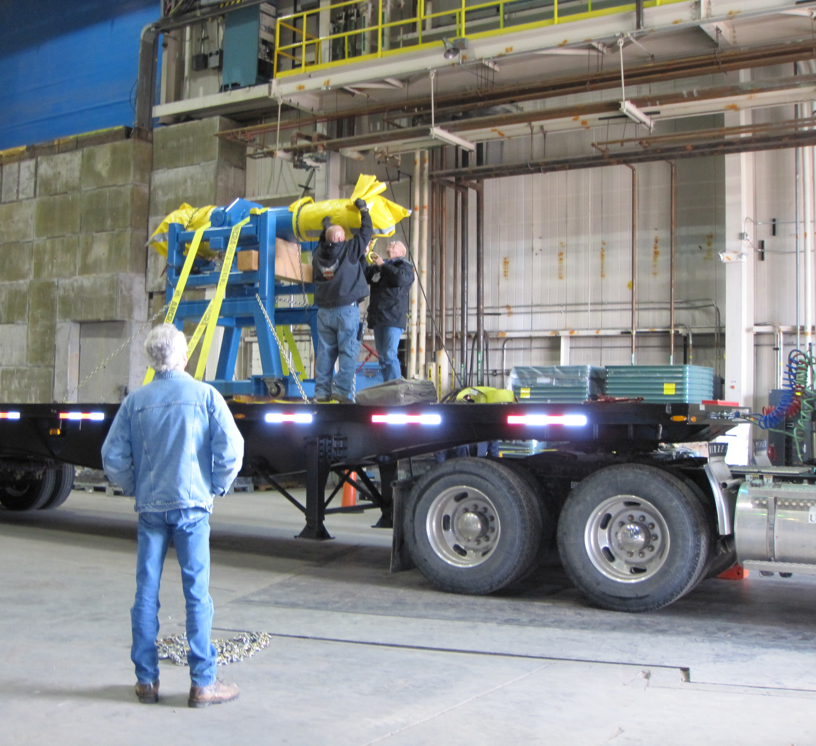
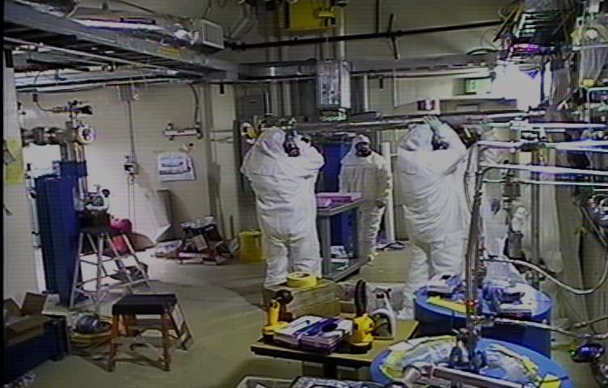
IPF Beam Window Assembly Removal Process
Notes:
To give a sense of the effort and planning involved in removal and replacement of this beam window assembly, I have shown two pictures here.
The picture on the left shows an image pulled from video taken during the beam window assembly removal – due to the contamination, full PPE and respiratory protection is required.
In addition, the dose rate associated with this assembly can be quite significant, so planning for this to ensure worker protection took a significant amount of effort and planning.
Once this assembly is removed, the picture on the right shows just how difficult it is to transport this assembly and the unusual shipping cask (of which there is only one) required to safely move and store it.
Transported on flat bed trucka n dmoved with crane.

Slide 13
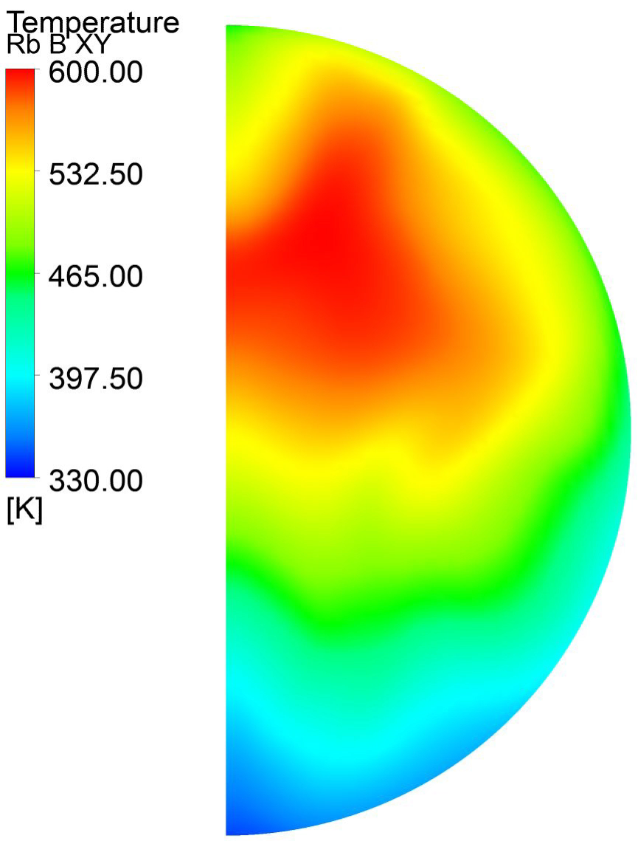
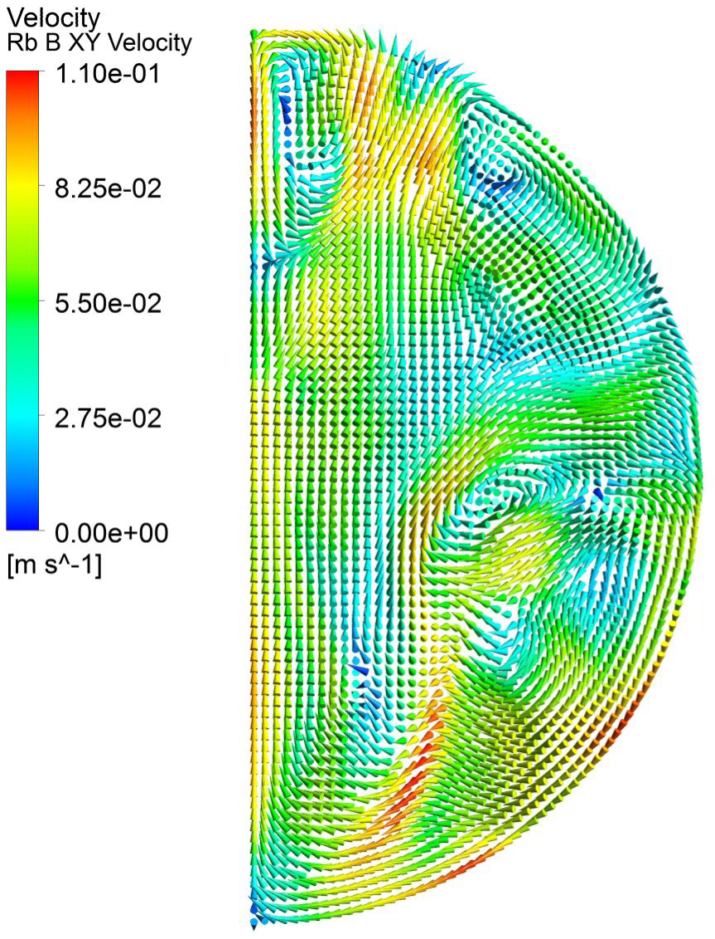
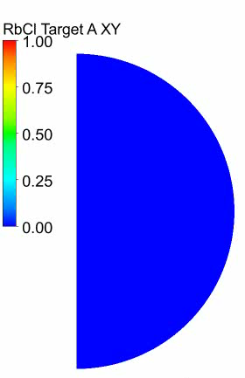
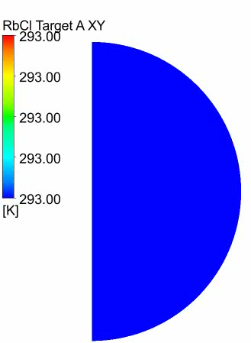
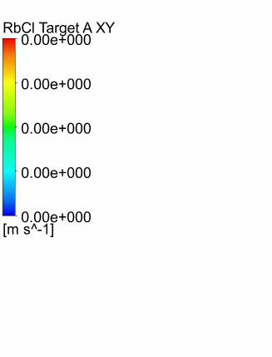
Computational Multi-Physics Modeling
Temperature
Velocity
Molten Rb Metal Target
Influence of thermal hydraulic behavior?
What are the protons doing?
RbCl Target Melting Front
Liquid Fraction
Temperature
Velocity
Bubbles
Boiling in Cooling Water System
Bulk water flow
Notes:
All this experimental data informs our models so that we can have better predictive tools (that we now have more confidence in!) to tell us what our system is doing!!
Now how are we able to create a model to capture this multi-physics system and what can we gain by using this model? By applying two-way coupling between a particle transport code (to determine what the protons are doing) and a thermal hydraulics code, it is possible to determine how this highly interdependent system behaves.
Rb melting point – 103 F
RbCl melting point = 1324 F
Computational Coupling
This video shows the model-predicted time-dependent temperatures and velocities in a molten production target. In addition to understanding our targets better, another tangible benefit of modeling was the discovery of boiling in our cooling water – something that we must understand in order to push the limits of our system.
Ultimately, developing a computational model will allow us to not only understand our system and its limits, but to safely push the bounds of large scale radioisotope production as we know it while avoiding high consequence events like target failures. This work focuses on the front end of radioisotope production, but this first step is essential, and everything that happens downstream is dependent on our ability to safely and successfully make these radioisotopes.

Slide 14
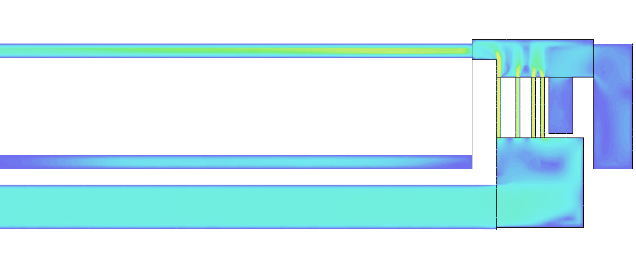
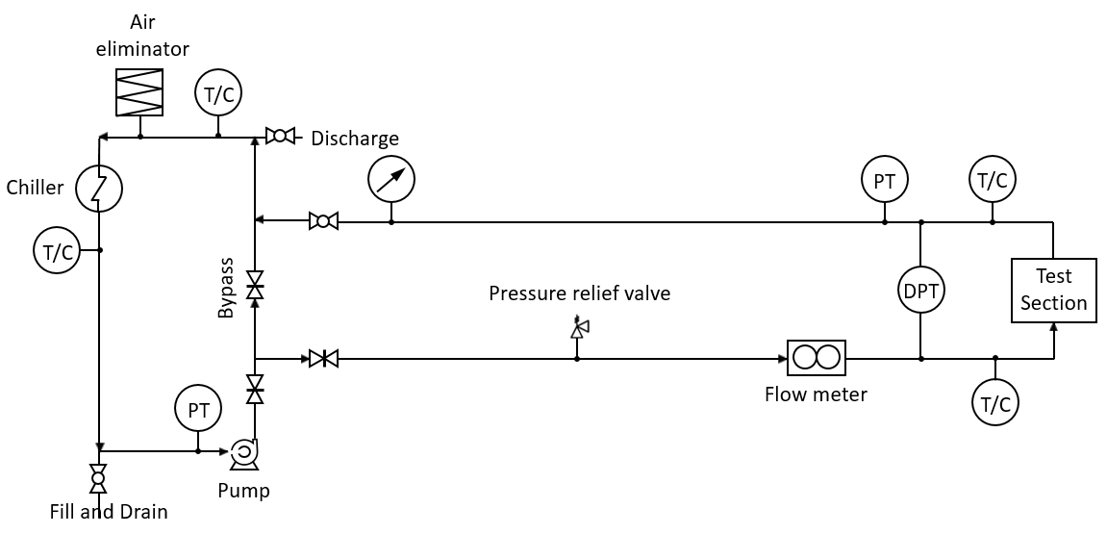
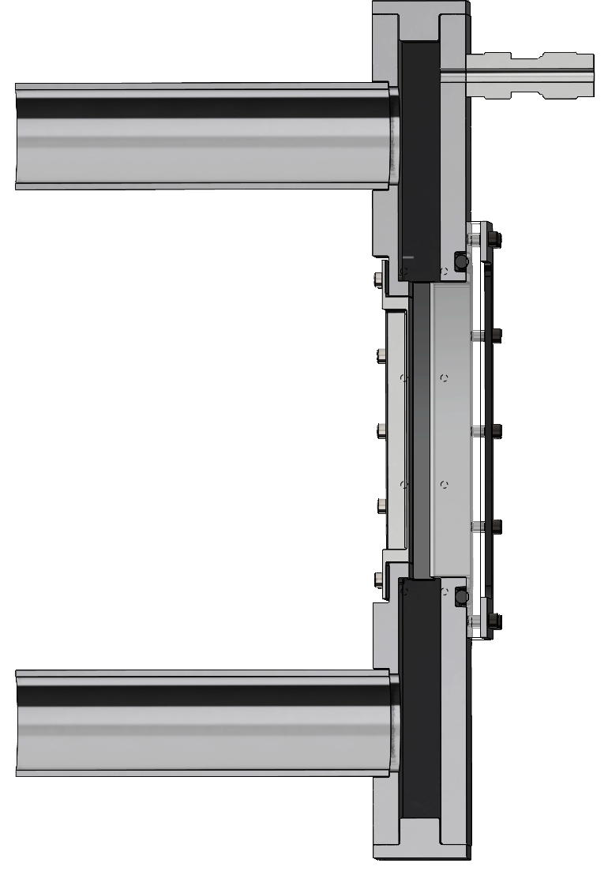
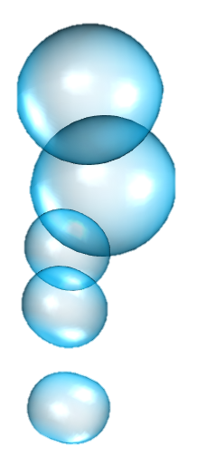


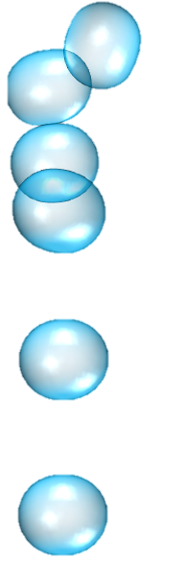
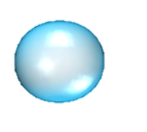

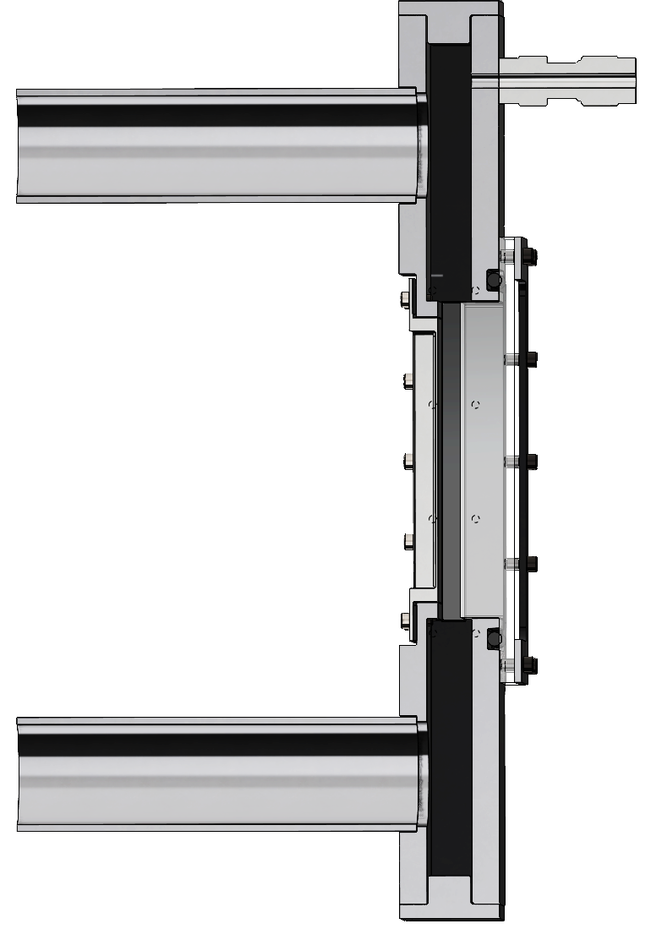

Experiment
(Inconel target capsule)
IPF’s specific conditions
Target A
Flow loop
B
Operating conditions
Inconel
window
C
10~12 GPM flow rate
85 K subcooling
2 bar pressure
Channel geometry
Flow
Non-fully developed
IPF cooling system – 1st channel
T_{Outlet}
Flow
P
Induction heating
Optical access
Mirror
G
Inconel
Test Section
T
High-speed
camera
(40000 fps)
Experimental flow loop
Flow
T_{Inlet}
5

Slide 15
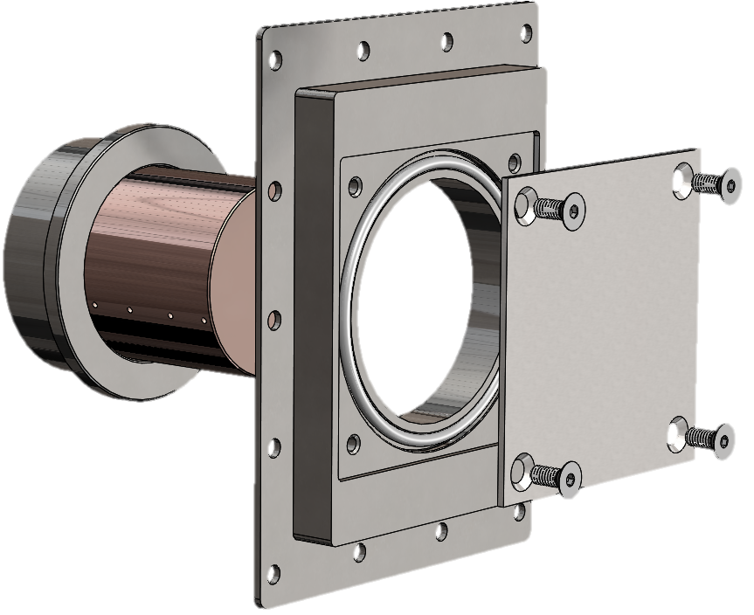
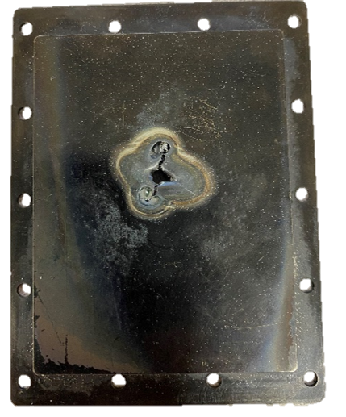
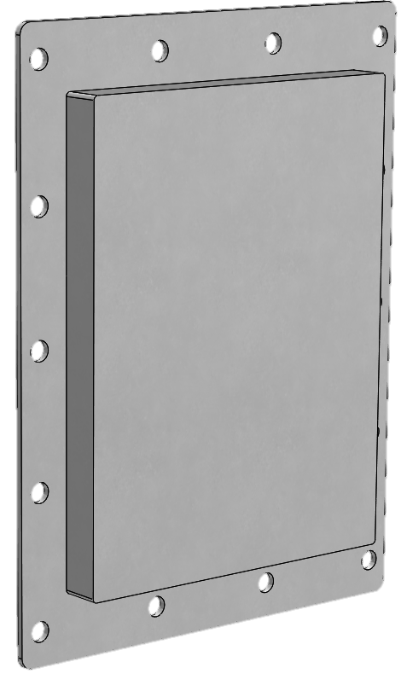
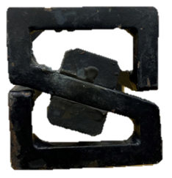
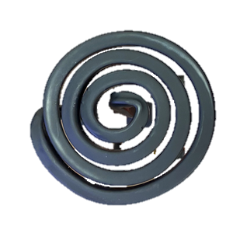
Experiment
Test section design
Aluminum
frame
Original test section design
Inconel test section
Copper
rod
D50mm Pancake coil
Steel
cap
S-coil
Inconel
T
T
T
T
T
(IPF ~3MW/m²)
Limited applied heat flux (0.9MW/m²)
due to poor thermal contact between
different metals.
☺ Uniform heat deliver to Inconel window
☺ Enable to calculate heat flux
☺ Off the shelf Inconel window
7

Slide 16
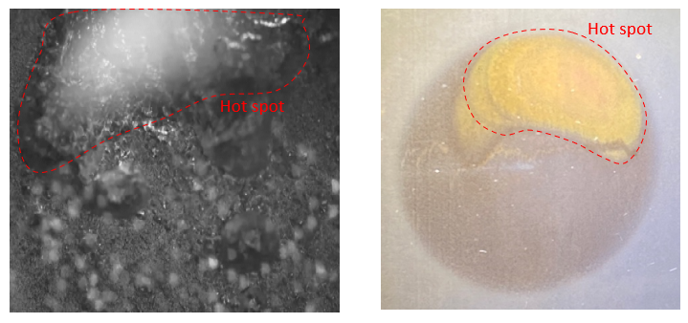
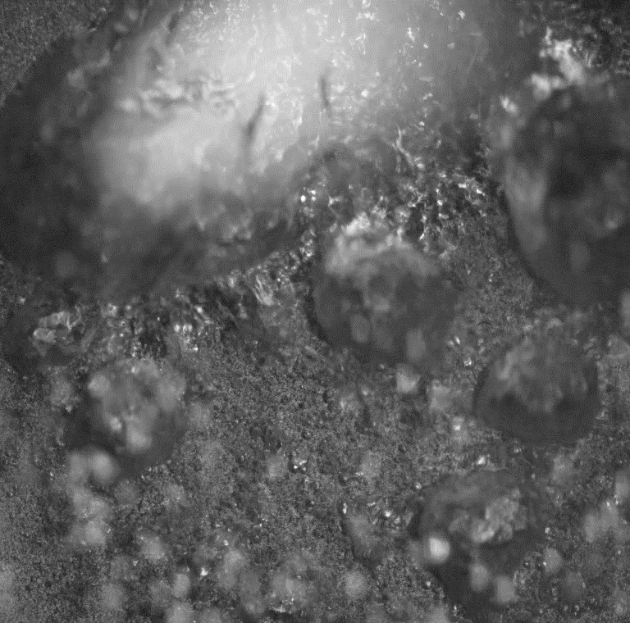

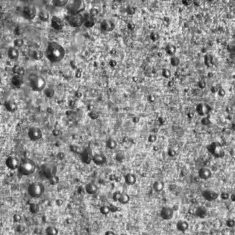
At IPF: Bubbles are small and fast departure – early stage of boiling
Experiment
IPF conditions
Reduced conditions
Critical Heat Flux
(CHF)
1.5 GPM flow rate
45 K subcooling
2 bar pressure
Boiling heat transfer coefficient of
~48000 W/m²/s
10 GPM flow rate
85 K subcooling
2 bar pressure
What would be the boiling crisis ?
(CHF)
30 mm
Burn mark
IPF avg. power
5 mm
*
CHF
5 mm
T_{wall} – T_{saturation}

