Slide 1
Stable Isotope Applications and Enrichment
Brian J. Egle egleb@ornl.gov
Adam Stevenson, Clint Ausmus,
Kevin Hart
Oak Ridge National Laboratory
Presented at the Friend of ORNL
February 12, 2019
Research sponsored by the U.S. Department of Energy - Office of Science, Nuclear Physics
Approval for public release
PTS 123052
Notes:
Adapted from PTS 52769, PTS 111862

Slide 2
Without new enrichment, DOE inventories of several stable isotopes are being depleted
Electromagnetic separation (EMIS) has enriched research quantities of most isotopes
Gaseous centrifuges (GCIS) are proposed for compatible isotopes requiring larger quantities
Future Proposed Enrichment Method
Present U.S. Inventory Enrichment Method
Number of isotopes sold out
EM Only
Isotopes with < 20 year supply
Demonstrated GCIS
by others
Electromagnetic
2nd pass enriched isotopes sold out
Other
Proposed by GCIS
1 or less stable isotope
2nd pass enriched isotopes with < 20 year supply
Approved for public release: October 15, 2013
Notes:
PTS 52769

Slide 3
Enrichment is difficult: A variety of methods have been explored
 | Typical Quantities | Enrichment per pass | Isotope Collection | Separation Medium | Research Required for New Isotopes
Electromagnetic Isotope Separation (EMIS) | mg to g | high | all simultaneous | ions | low
Gaseous Centrifuge Isotope Separation (GCIS) | kg | low | end isotopes | gas | medium
Gas Diffusion | kg | low | end isotopes | gas | high
Plasma Separation Process (PSP) | kg | moderate | single targeted | ions | medium
Atomic Vapor Laser Isotope Separation | kg | moderate | single targeted | vapor-ions | high
Chemical and physical processes | kg | varies | varies | varies | high
Notes:
PTS 52769

Slide 4
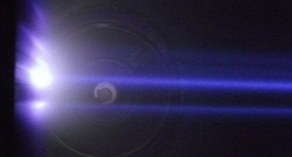
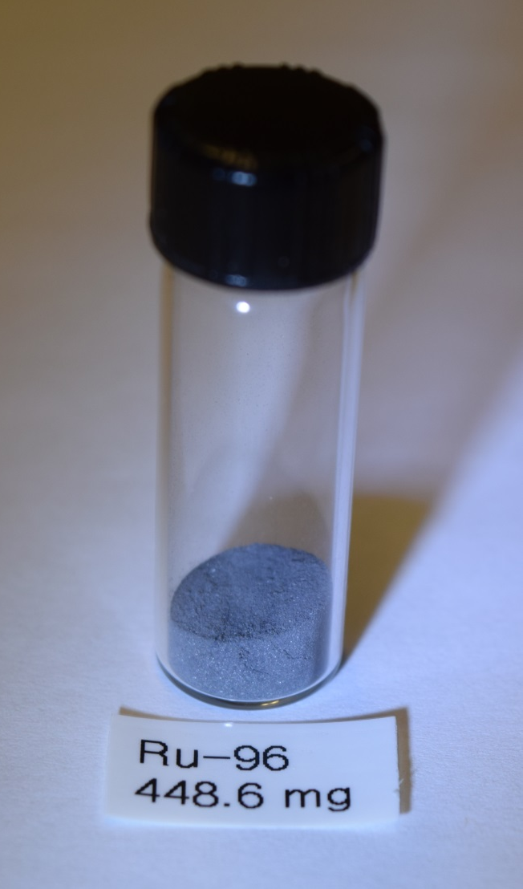
Basics of electromagnetic separation (EMIS)
Ions of different masses with equal energy and charge, bend at different radii in a uniform magnetic field
First modern mass spectrometer developed by A. J. Dempster in 1918; implemented on a massive scale by E. O. Lawrence during the Manhattan Project (~1945)
Collector
Dipole magnet
Picture of mass separated ion beams at the collector
Thin film of enriched material on graphite collection plate
Metal powder recovered from collector plates
Ion source with acceleration gap
Feed material (compound of target element) vaporized and transported to plasma chamber
Vapor ionized by ~100 eV electrons and extracted through a ~40 kV extraction gap
Ions bend through an approximately 0.1 to 0.6 T dipole field
Ions implanted and collected in individual collector pockets
EMIS product is a thin film of enriched material on a graphite collection plate
High enrichment and low throughput (mg/hr) =
Technology limited to gram quantity of high value isotopes
Notes:
Updated from PTS 52769

Slide 5
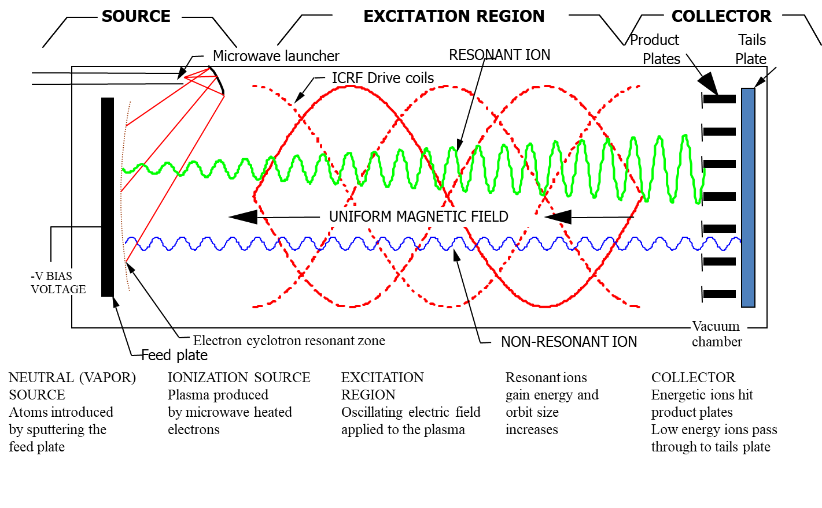
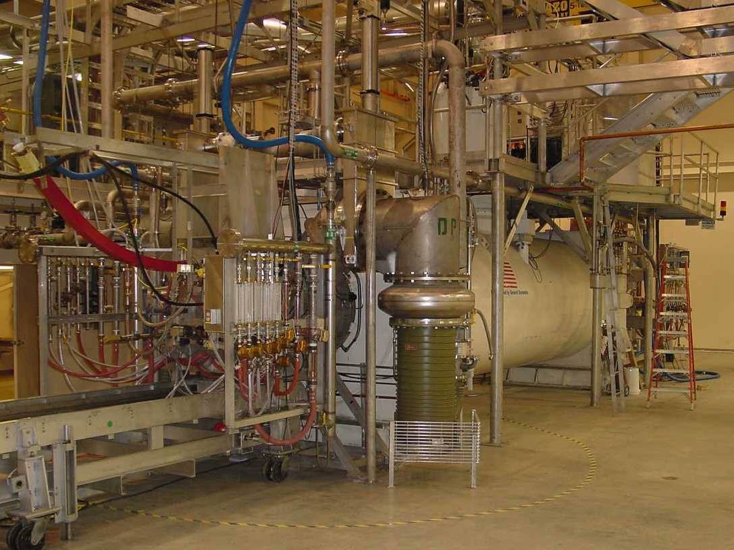
Plasma Separation Process
Picture of the PSP equipment installed at the Theragenics Facility in Oak Ridge Tennessee
Notes:
Grossbeck, Renier, Bigelow, “development of improved burnable poisons for commercial nuclear power reactors, Final Report on NERI Project Number 99-0074, Sept 2003;

Slide 6
Enrichment is difficult: A variety of methods have been explored
 | Typical Quantities | Enrichment per pass | Isotope Collection | Separation Medium | Research Required for New Isotopes
Electromagnetic Isotope Separation (EMIS) | mg to g | high | all simultaneous | ions | low
Gaseous Centrifuge Isotope Separation (GCIS) | kg | low | end isotopes | gas | medium
Gas Diffusion | kg | low | end isotopes | gas | high
Plasma Separation Process (PSP) | kg | moderate | single targeted | ions | medium
Atomic Vapor Laser Isotope Separation | kg | moderate | single targeted | vapor-ions | high
Chemical and physical processes | kg | varies | varies | varies | high
Notes:
PTS 52769

