Slide 1
Experimental Aspects of Neutron Diffraction
William Ratcliff
NCNR
University of Maryland, College Park

Slide 2
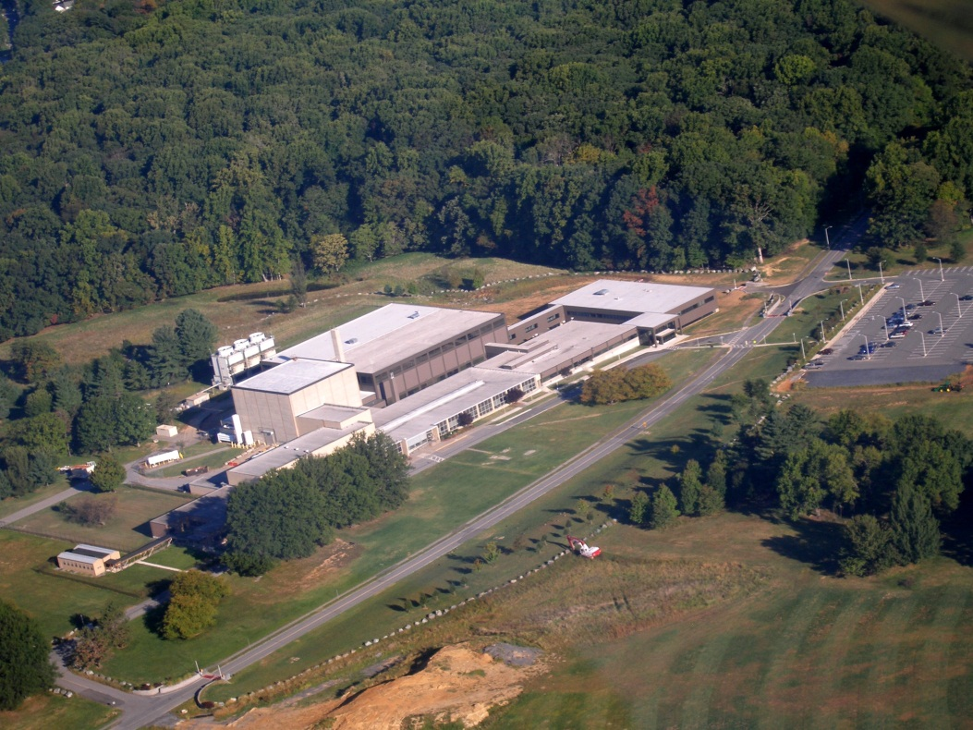

Slide 3
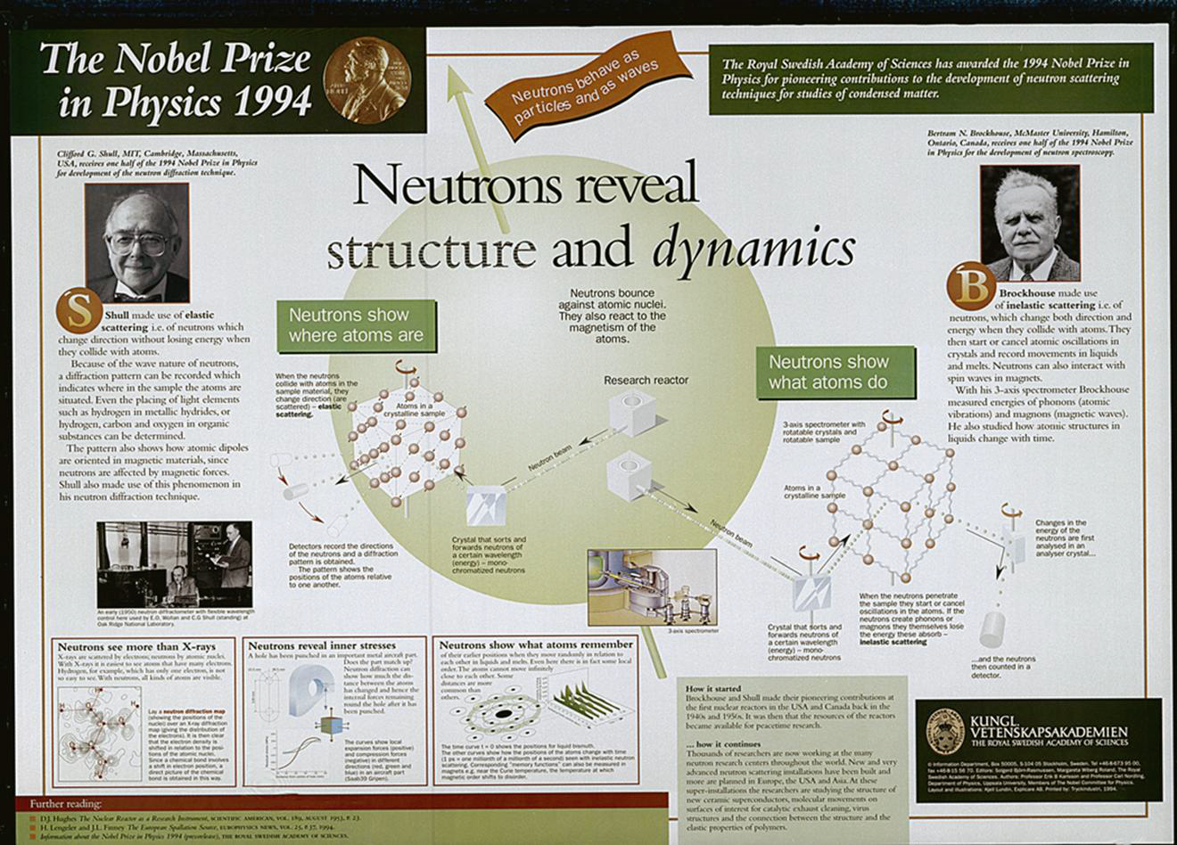

Slide 4
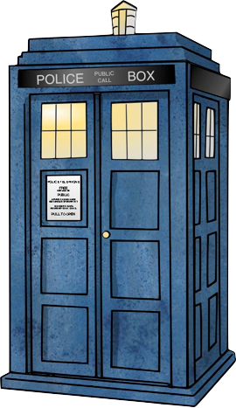

Slide 5
1932 Neutrons Discovered by Chadwick

Slide 6
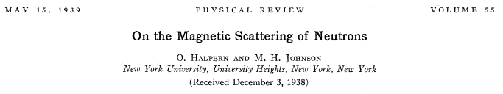

Slide 7
1942 Fermi’s 30th pile goes critical
An Account of Oak Ridge National Laboratory’s Thirteen Nuclear Reactors August 2009
https://info.ornl.gov/sites/publications/Files/Pub20808.pdf

Slide 8
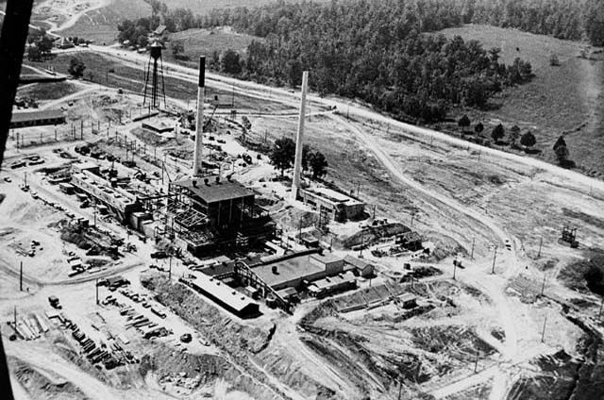
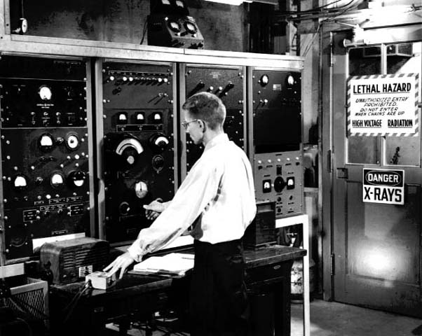
ORNL Graphite Reactor
1943-1963
An Account of Oak Ridge National Laboratory’s Thirteen Nuclear Reactors August 2009
https://info.ornl.gov/sites/publications/Files/Pub20808.pdf

Slide 9
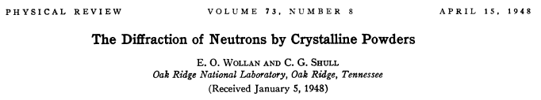
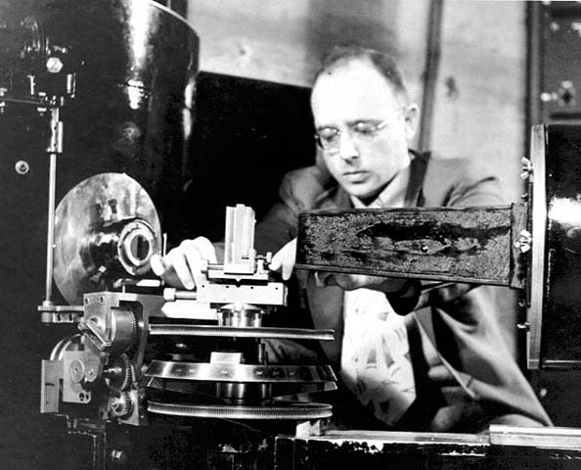
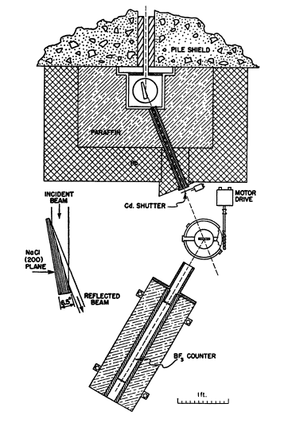
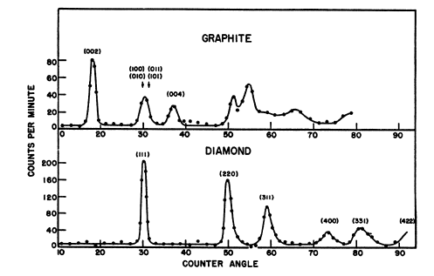

Slide 10


Slide 11
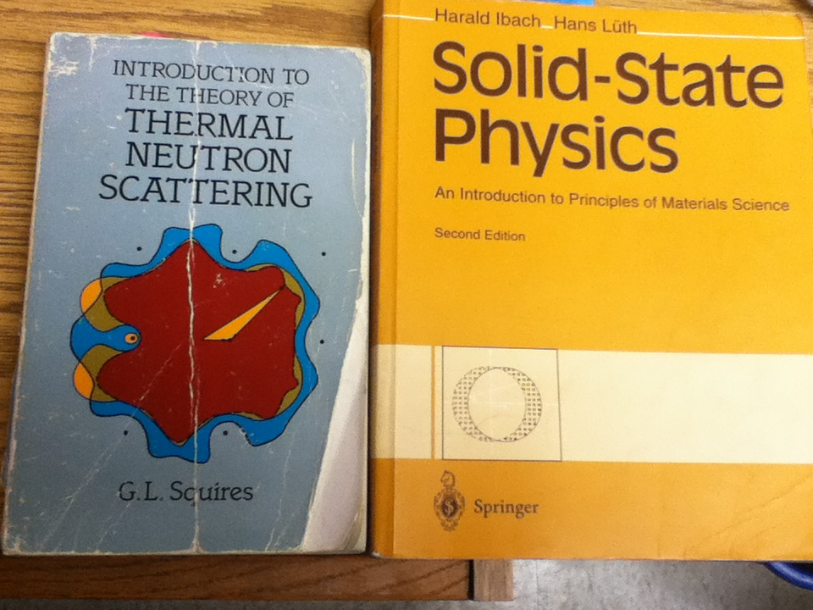

Slide 12
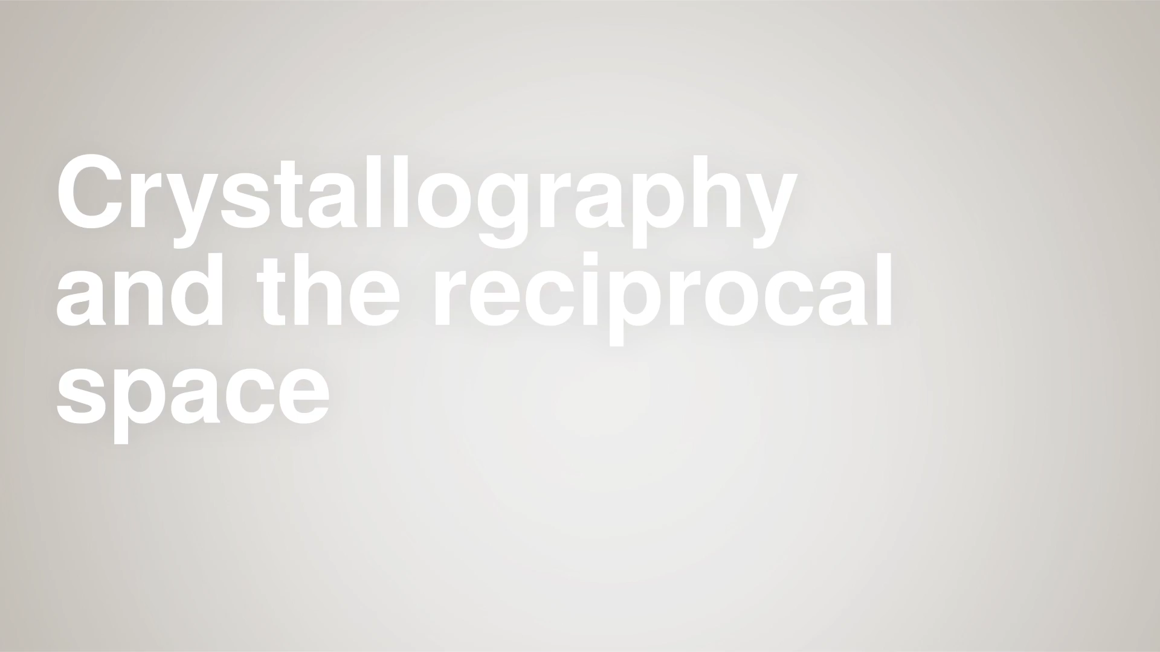
http://toutestquantique.fr/en/

Slide 13
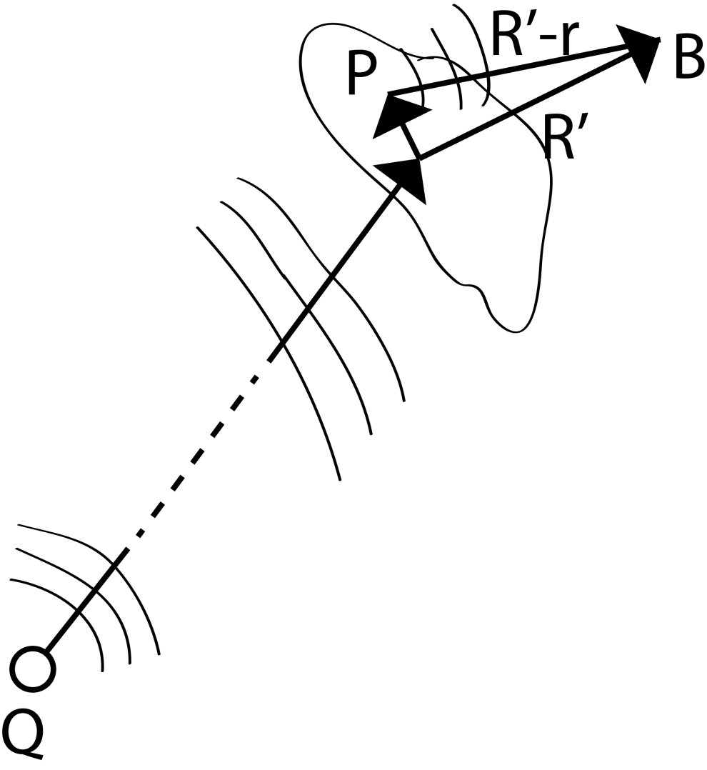
r
R

Slide 14
Reciprocal Space
a
a
a
a

Slide 15
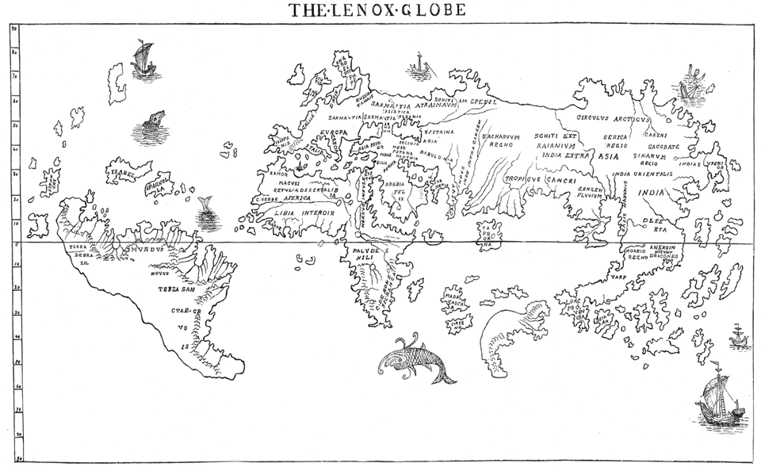
Here there be dragons…
The Hunt-Lenox Globe, as transcribed by B.F. da Costa
https://www.theatlantic.com/technology/archive/2013/12/no-old-maps-actually-say-here-be-dragons/282267/

Slide 16
Laue Condition

Slide 17
Here there be dragons…
The Hunt-Lenox Globe, as transcribed by B.F. da Costa
https://www.theatlantic.com/technology/archive/2013/12/no-old-maps-actually-say-here-be-dragons/282267/

Slide 18
Ewald Sphere
Notes:
Mention multiple scattering→ depleted by G1, or increased if multiple scattering by G2=G0-G1, or decreased by scattering through –G2

Slide 20
So…
See scattering where reciprocal lattice point lies on Ewald Sphere
But, whither magnetism???
Notes:
We see scattering where reciprocal lattice

Slide 21
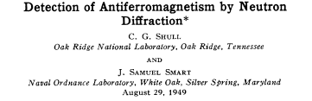

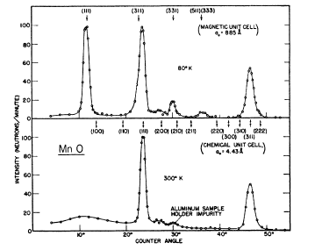
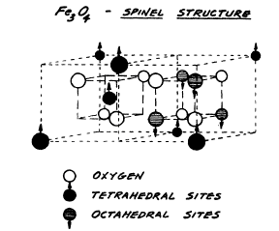
1932, Néel predicts Antiferromagnetic order
Notes:
Sadly, no structural solution for MnO, Neel had predicted in 1932, before any materials….

Slide 23
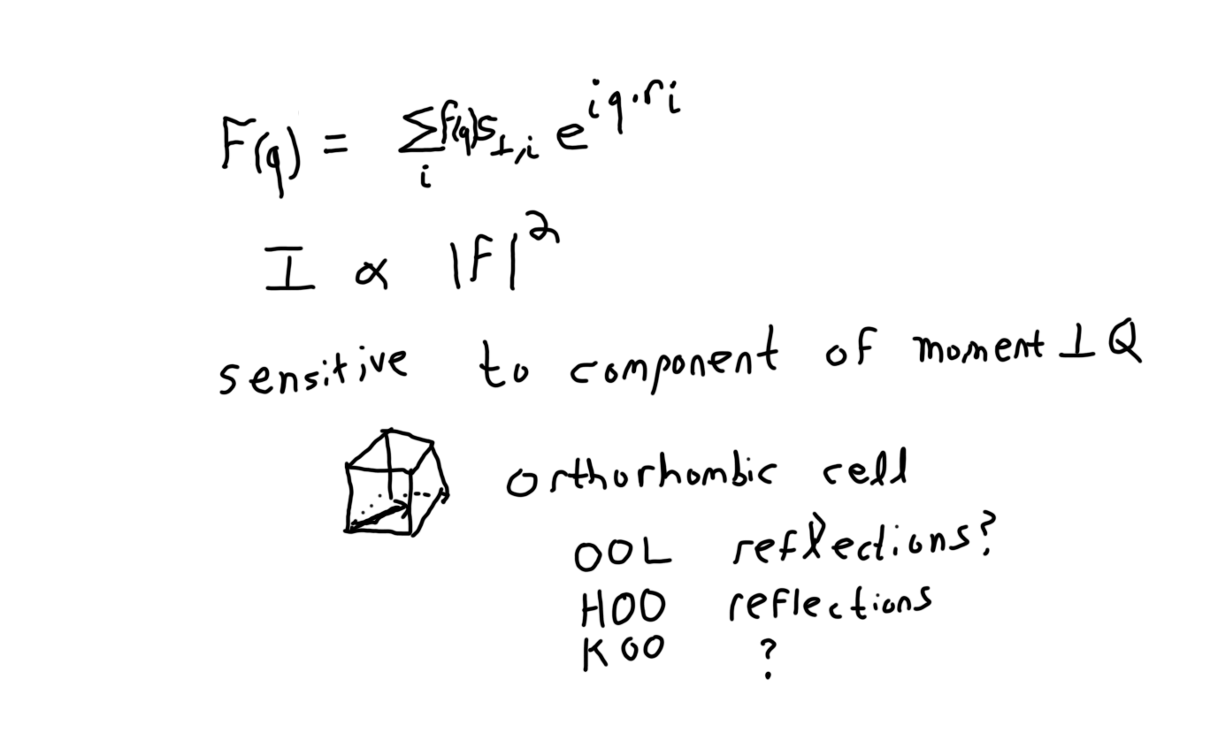

Slide 24
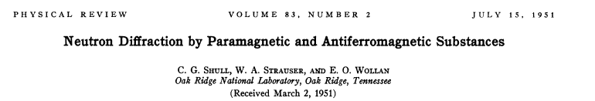
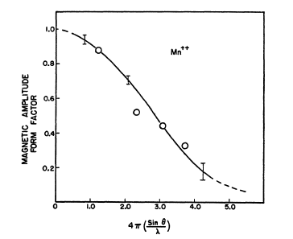
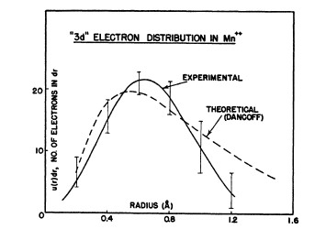

Notes:
Mention form factor is Fourier transform of unpaired electron density

Slide 25
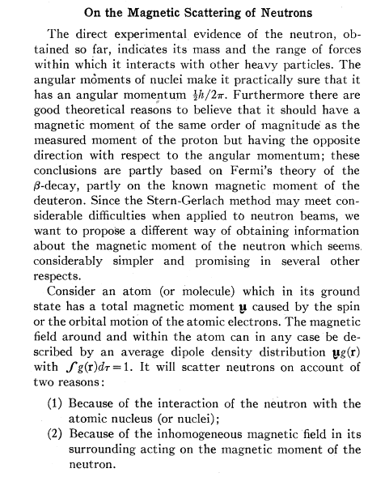

Slide 27
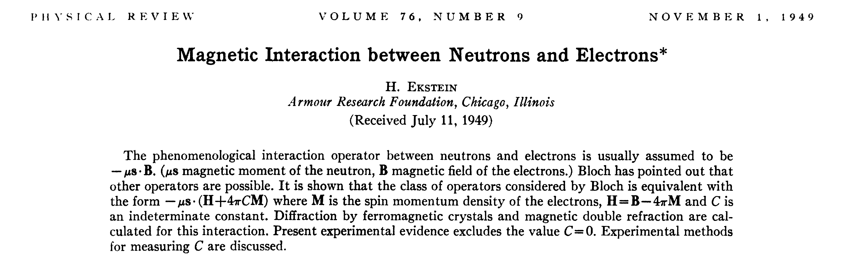

Slide 28
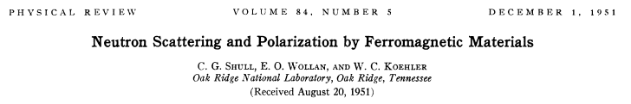
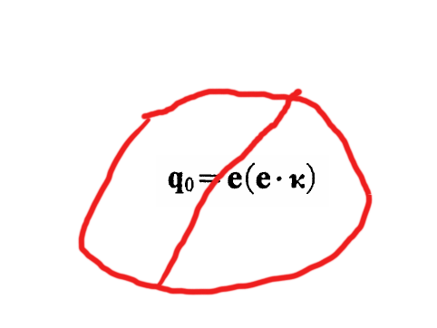
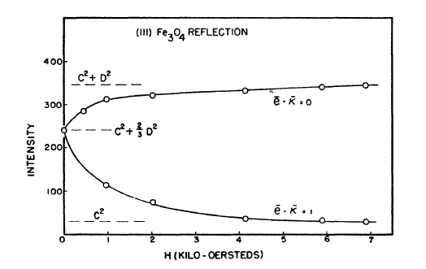

Slide 30
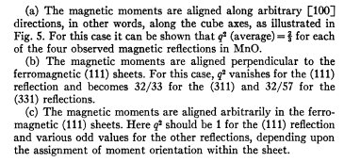
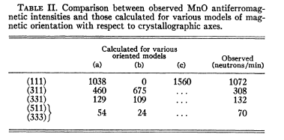
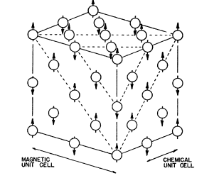

Slide 31
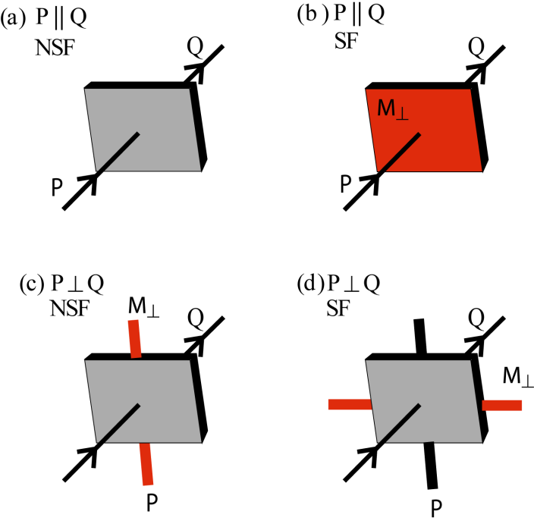

Slide 32
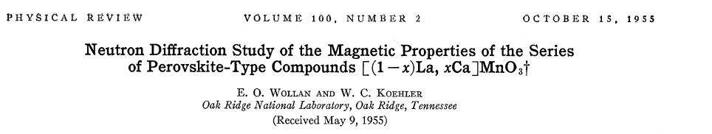
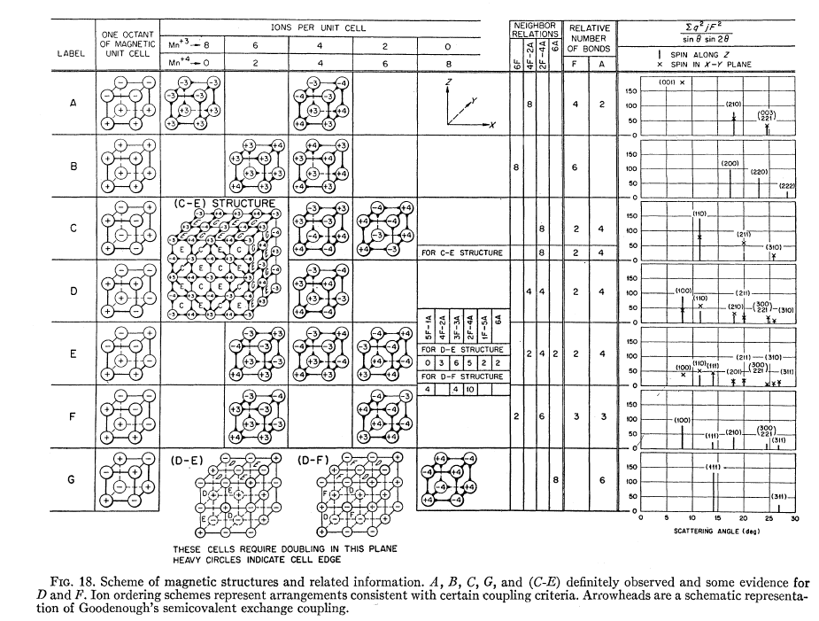

Slide 33
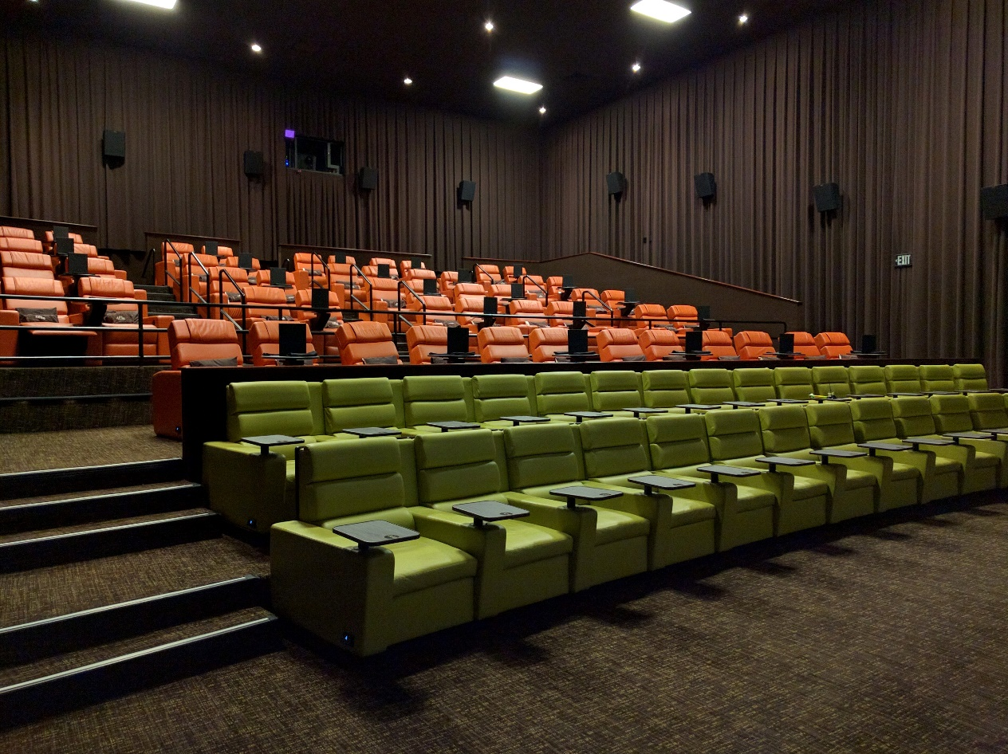
Intermission

Slide 34
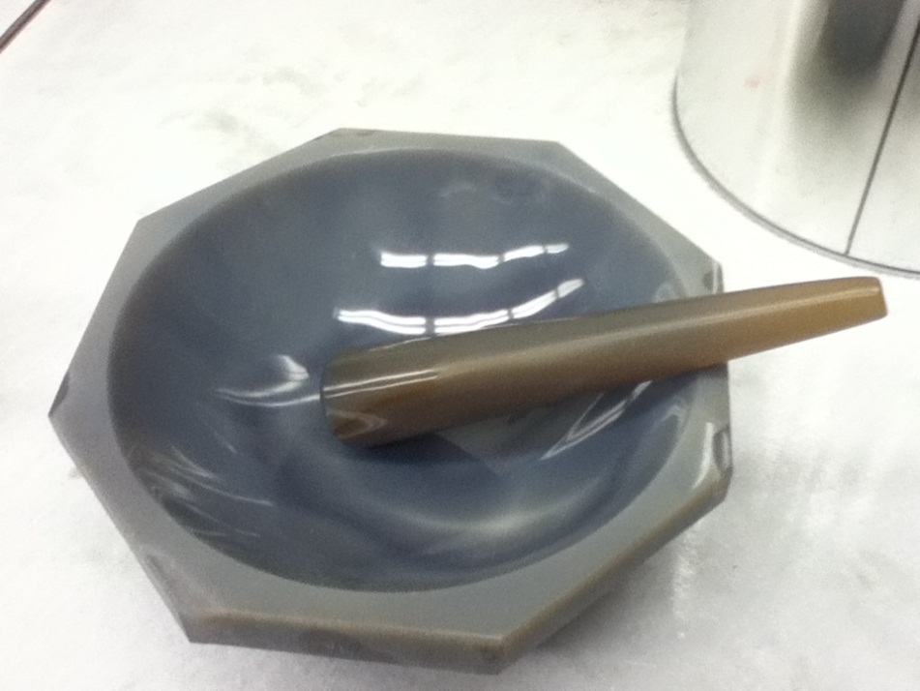
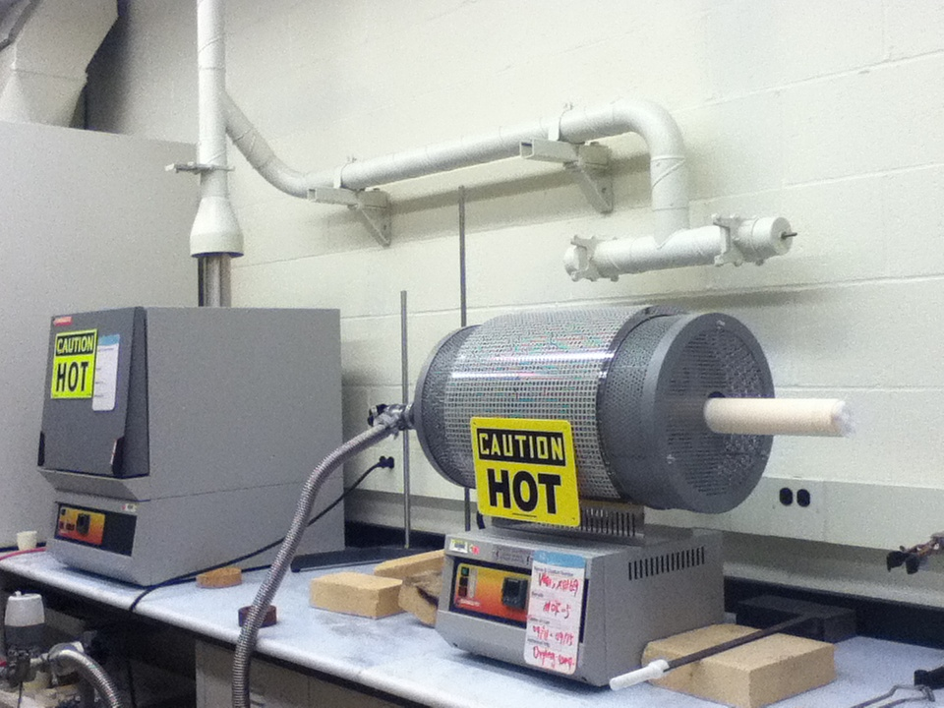
How it starts?

Slide 35
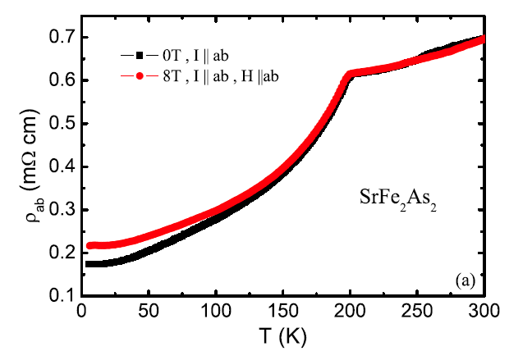
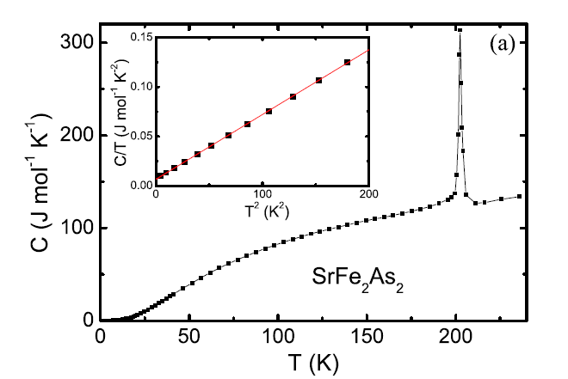
Bulk Data Comes In
Physical Review B 78, 22514 (2008)

Slide 36


Slide 37
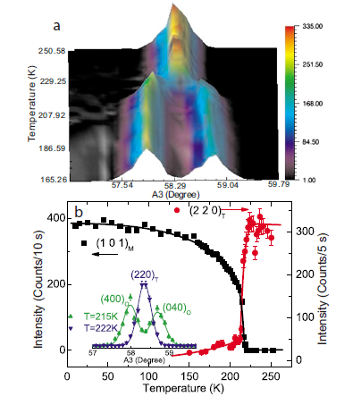
Neutrons to the Rescue
Physical Review B 78, 140504 (2008)

Slide 38
Guess and Check (Refinement)
Update model
Predict Intensities from model
Compare predicted intensities to data

Slide 39
Choices

Slide 40
Goodness of Fit
or
“R factors in Rietveld analysis: How good is good enough?”, Brian Toby,Powder Diffraction 21, 67 (2006)

Slide 41
Optimization Approaches
Simulated Annealing
Marquardt-Levenberg
Genetic Algorithm
Markov Chain Monte Carlo

Slide 42
How I proceed
Think about the problem
Powder diffraction
Think some more
Try Representational Analysis (or Group theory)
Single crystal diffraction
Think a lot!!!
Polarized diffraction
Spherical polarimetry
Think some more…
Notes:
Mention how representational analysis constrains parameters

Slide 43
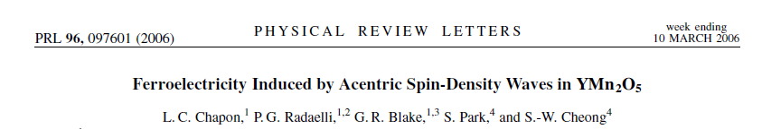
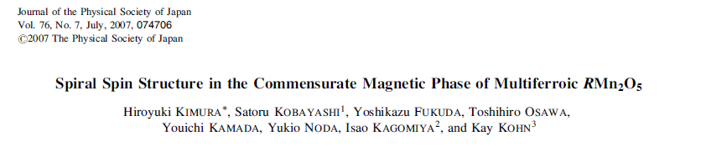
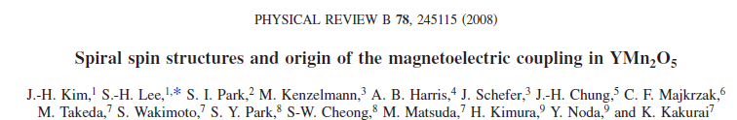
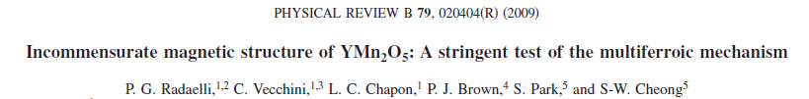
YMn₂O₅
Powder
xtal
Xtal+spherical polarimetry
Xtal+more representation analysis

Slide 44
Powder Diffraction
Advantages
Disadvantages
You get the big picture
Can get the propagation vector
Avoids the muss and fuss of extinction
It’s often Good EnoughTM
Can be hard to truly index k—is it [3 4 0] or [0 0 5]?
You average over all symmetry equivalent k at any particular Bragg angle
You lose information in the powder averaging
No domain info
No multi-k info
Can be very hard to determine phase

Slide 45
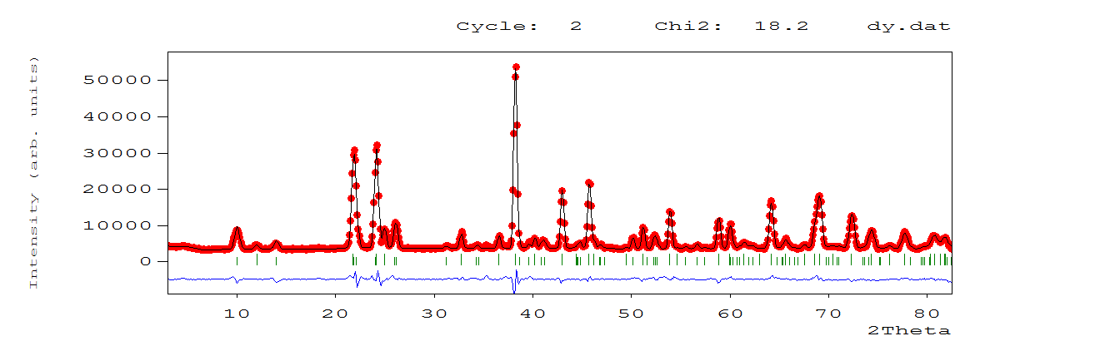

Slide 46
Single Crystal Diffraction
Advantages
Disadvantages
Can fully determine k
Can investigate domain populations
Can apply probes (magnetic field, E-field, pressure, etc.) along a particular direction to see effect on magnetic ordering
Extinction
Absorption depends on shape
Reciprocal space is large…
Crystal growth is hard…

Slide 47
Questions?

