Slide 1
Sample environments available on diffraction instruments
Stuart Calder
Neutron Scattering Division
Oak Ridge National Laboratory

Slide 2
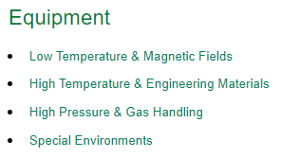
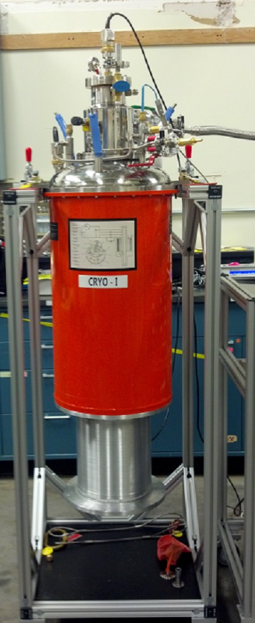
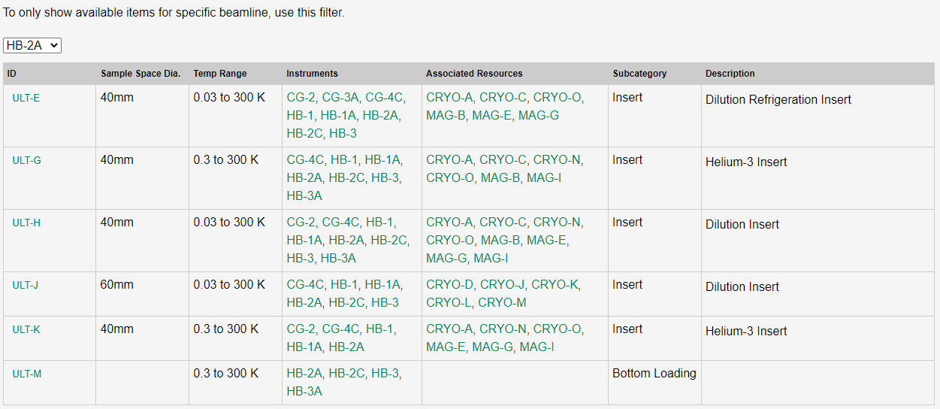
Sample environments available on diffraction instruments
https://neutrons.ornl.gov/sample/subpage/low-temperature-magnetic-fields

Slide 3
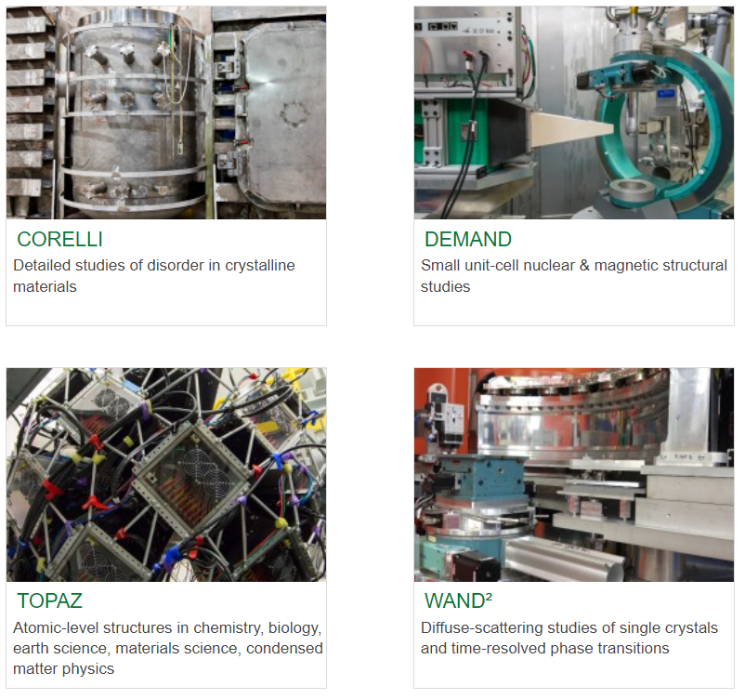
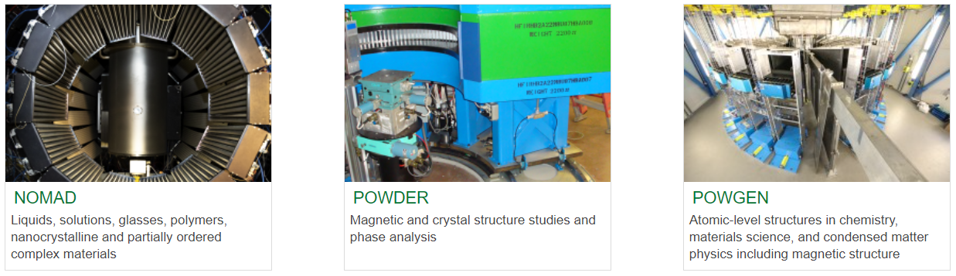
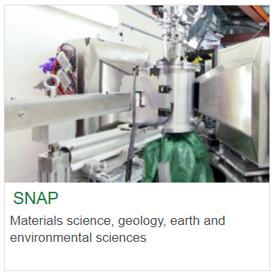
Low temperature capabilities: Diffraction at ORNL

Slide 4
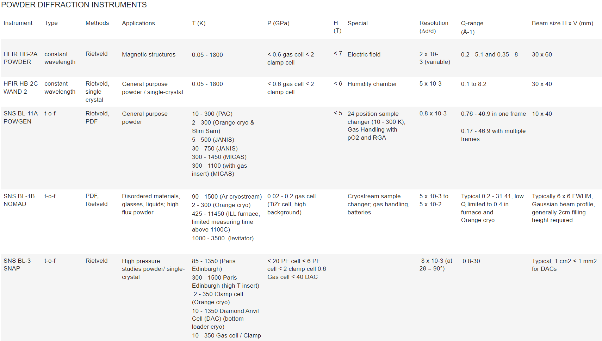
https://neutrons.ornl.gov/suites/diffraction

Slide 5
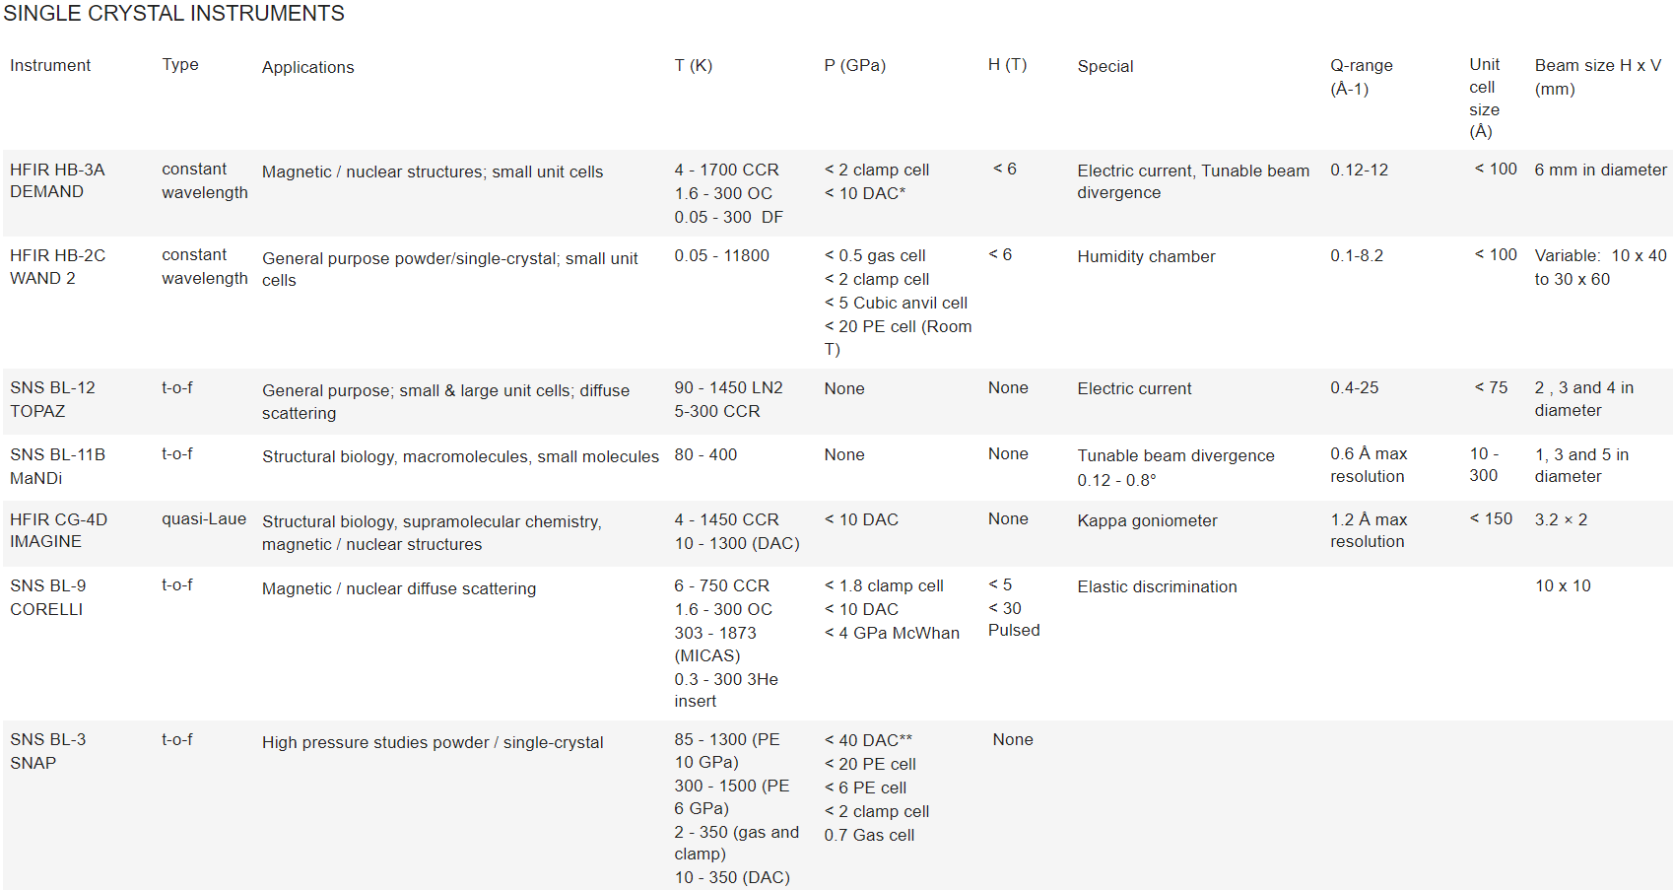
https://neutrons.ornl.gov/suites/diffraction

Slide 6
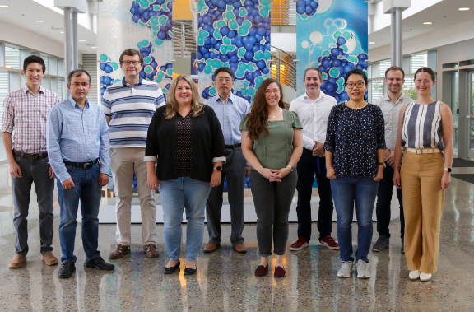
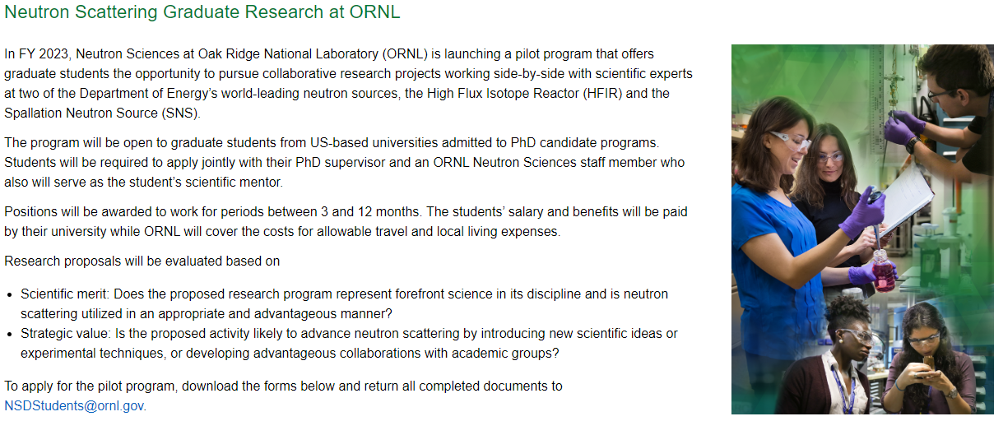
How can external users get engaged?
General community involvement, conferences, SHUG, etc
Direct collaboration with ORNL staff (instrument teams, SE staff, NTD, etc)
  Develop new or custom equipment for experiments
  Funding Proposals (NSF,DOE)
Students hosted at ORNL
  SULI, HERE (undergraduate) ~3 months
  SCGSR (graduate students) 3-12 months
    https://science.osti.gov/wdts/scgsr/SCGSR-Awards
  New graduate program at ORNL (pilot program FY23)
    https://neutrons.ornl.gov/neutron-scattering-graduate-program
SHUG

