Slide 1
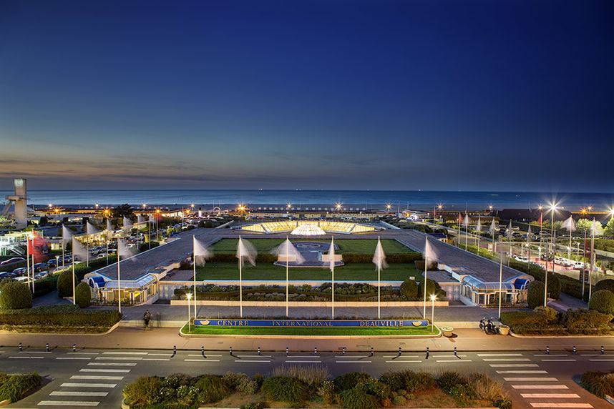
IPAC’26 Centre International de Deauville (CID) Sunday 17th – Friday 22nd May, 2026

Slide 2
Planning Roadmap
Conference centre:
International conference centre of Deauville
LOC structure:
Under construction
Call for tender for other activities are on-going:
Social program
PCO
Contract in place

Slide 3
IPAC’26 Team ….. so far
Peter McIntosh: International Organising Committee Chair and represents EPS.
Rogelio Tomás: Scientific Programme Committee Chair
Hanna Frånberg Delahaye. Local Organising Committee Chair
Isabelle Côme: Conference Assistant
Nicolas Delerue: Editor-in-Chief
Sylvie Feuardant: Accounting and Budget Monitoring
Laurent Fortin: website manager
Bertrand Franel: Legal manager
Emanuela Indries: Purchasing Manager
Guillaume Lalaire: IT Manager
Sabrina Lecerf: Scientific secretary
Magali Tence: Communication

Slide 4
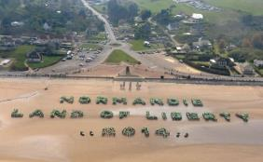
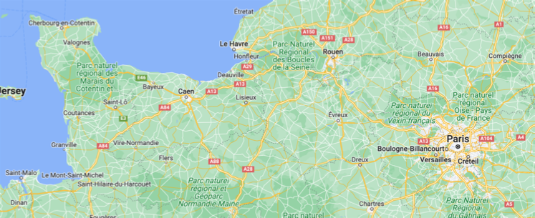
IPAC’26 in Normandy
1500 participants.
140 industrial booths.
2 parallel sessions.
Up to 440 posters per day nominally.
IPAC’26
GANIL

Slide 5
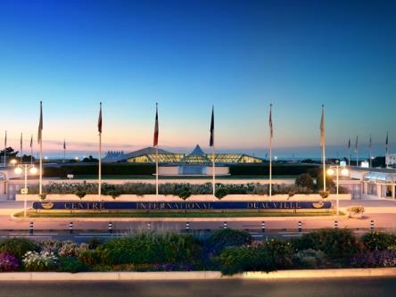
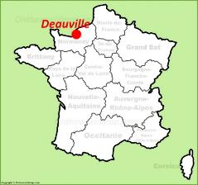
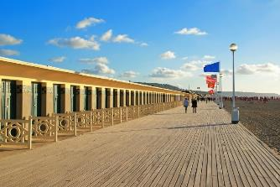
Centre International de Deauville
The Normandy region and Deauville.
An enthralling destination and historically significant location.
CID hosts ~140 events/yr, up to 7,000 delegates.
Change of scenery and tranquility guaranteed for all participants.
Venue located on the seafront, close to all local facilities.
Everything by foot in Deauville 4km²
Easy access from Paris by car or train.
Several flexible main rooms.
Highly professional staff.

Slide 6
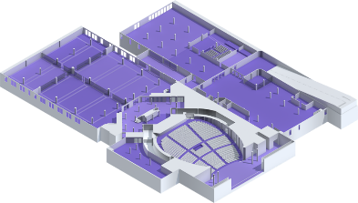
CID Details
2 main auditoriums.
1 auditorium for larger group meetings.
Place for industrial exhibition.
Place for posters.
Implementations for coffee breaks and light lunch buffet if necessary.
Stand up tables with and without chairs for discussions.
IT services.
AV installations (for local transmissions between the meeting rooms).

Slide 7
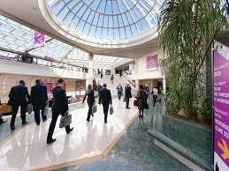
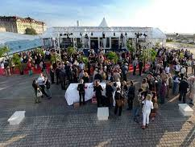
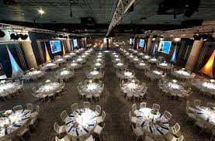
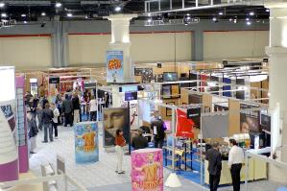
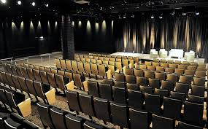
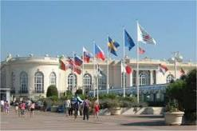
Centre International de Deauville

Slide 8
Student Poster Session – Sunday
Close to the main auditorium and registration desk.
Note:
The exhibition areas not accessible due to vendor installation work planned on Sunday afternoon.

Slide 9
Contracts so far…
Installation of industrial exhibition and deliveries:
Wednesday – Sunday before the conference.
JACOW office with specific entrance (30 spaces):
from Wednesday week before.
Student posters – installation, panels and space:
Sunday 14:00-18:00
Opening for registrations at the conference:
Sunday from 14:00
Welcome reception from:
Sunday from 18:00
Coffee breaks Monday to Friday.
Meeting rooms:
LOC secretariat x2
Paper editing café:
Wifi, tables, chairs…
Screens with direct diffusion of the two conference rooms.
Speaker preparation room
Wifi, tables, chairs, projections …
Screens with direct diffusion of the two conference rooms.
Press office.
PCO room + refreshments.
Meeting rooms « U format » 10/20/30 persons

Slide 10
Contracts so far…
Not yet contracted:
PCO:
General support and industrial exhibition.
Reception staff.
Catering.
Hotel provisions – conference bureau.
Ancillary venues:
Chair’s reception.
Banquet.
Mounting and dismounting staff:
Auditoriums, meeting rooms, industrial exhibitions, posters.
Video, light and sound technicians:
Installation, surveillance.
Safety and security personnel.
Stage organisation.
Cleaning.
Electricity installations and on-call personnel.
Wifi installations, maintenance, programming and on-site personnel.
Web site.

Slide 11
Upcoming Meetings
JTM’24 : JACoW team meeting take place 4-8 Nov.
OC1/SPC1: Meeting being planned for week of 2-6 Dec.

Slide 12
Proposition of Registration Fees
 | IPAC22 | IPAC23 (Europe) | IPAC24 (America) | IPAC25 (Asia) | IPAC26 – proposition at the moment
Early registration (non members) | 580 € | 850 € | (900$) 840 € | 800 € (not yet fixed) | ~850 € (not yet fixed)
Student |  | 475 € |  |  | 475 €

Slide 13
IPAC’26 Centre International de Deauville Sunday 17th – Friday 22nd May, 2026
Welcome to Deauville, Normandy, France
in 2026!

Slide 14
JACOW office at IPAC’26
Acces from Wednesday 14/5-2026
~30 working places
Bar/lounge
Specific access
Reception of authors in the same room but physically separated.
Included in the contract
Tables, Chairs
Electrical installations for computers, screens, printers
Wifi and cable connections

