Slide 1
May 21, 2024, IPAC24 Update
May 19-24, 2024
Nashville TN, United States
Fulvia Pilat – Conference Chair
Robert Saethre – Local Organizing Committee Chair

Slide 2
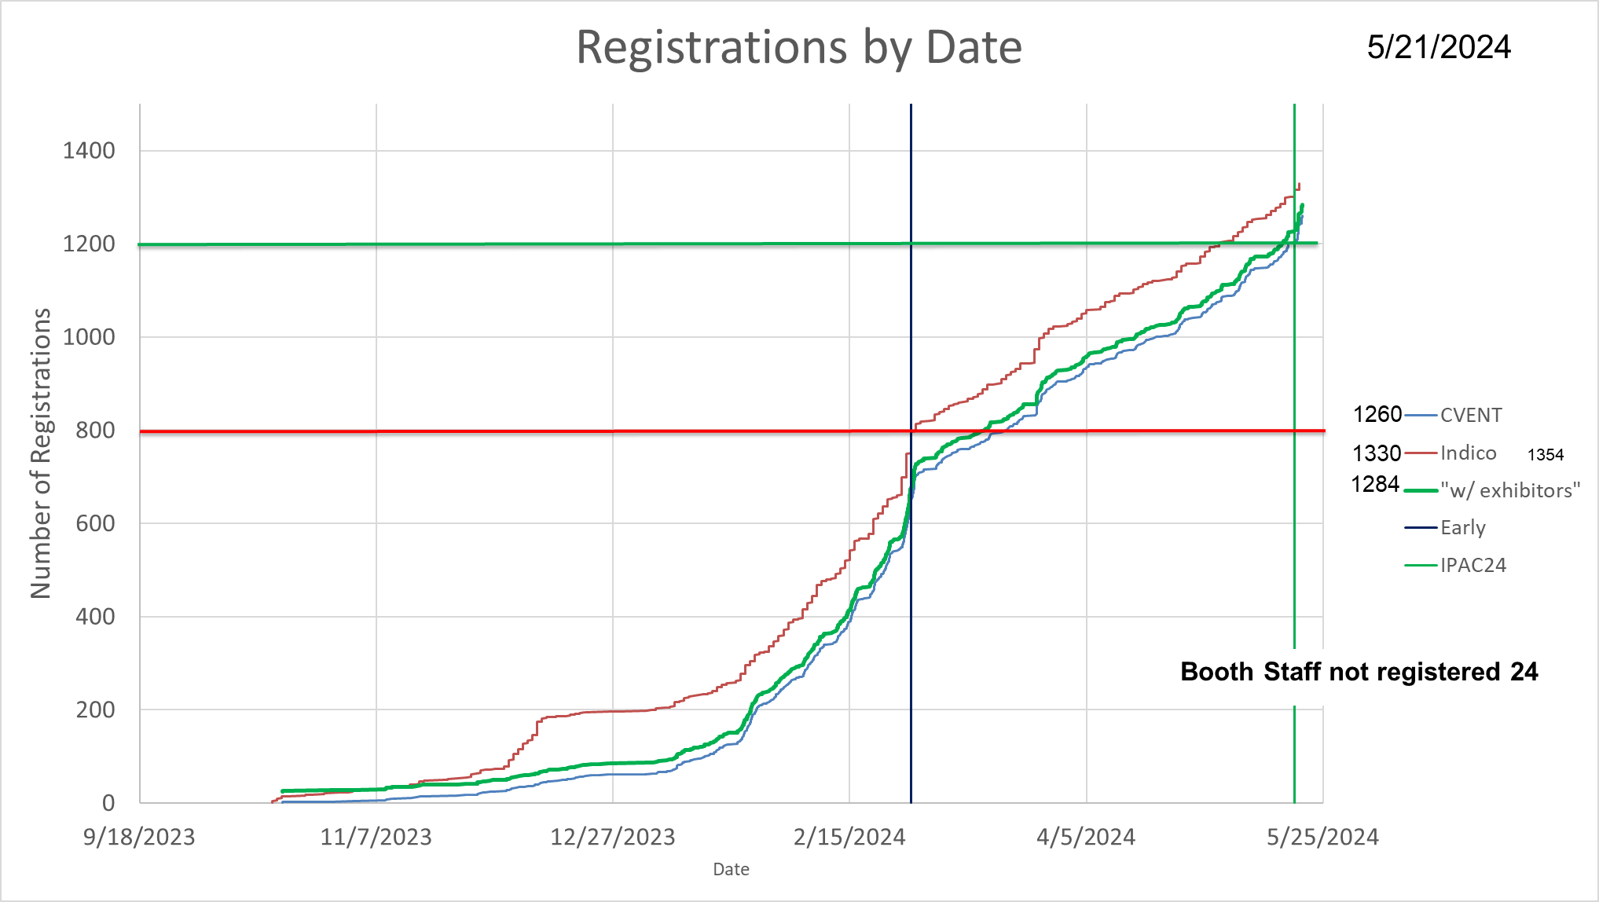

Slide 3
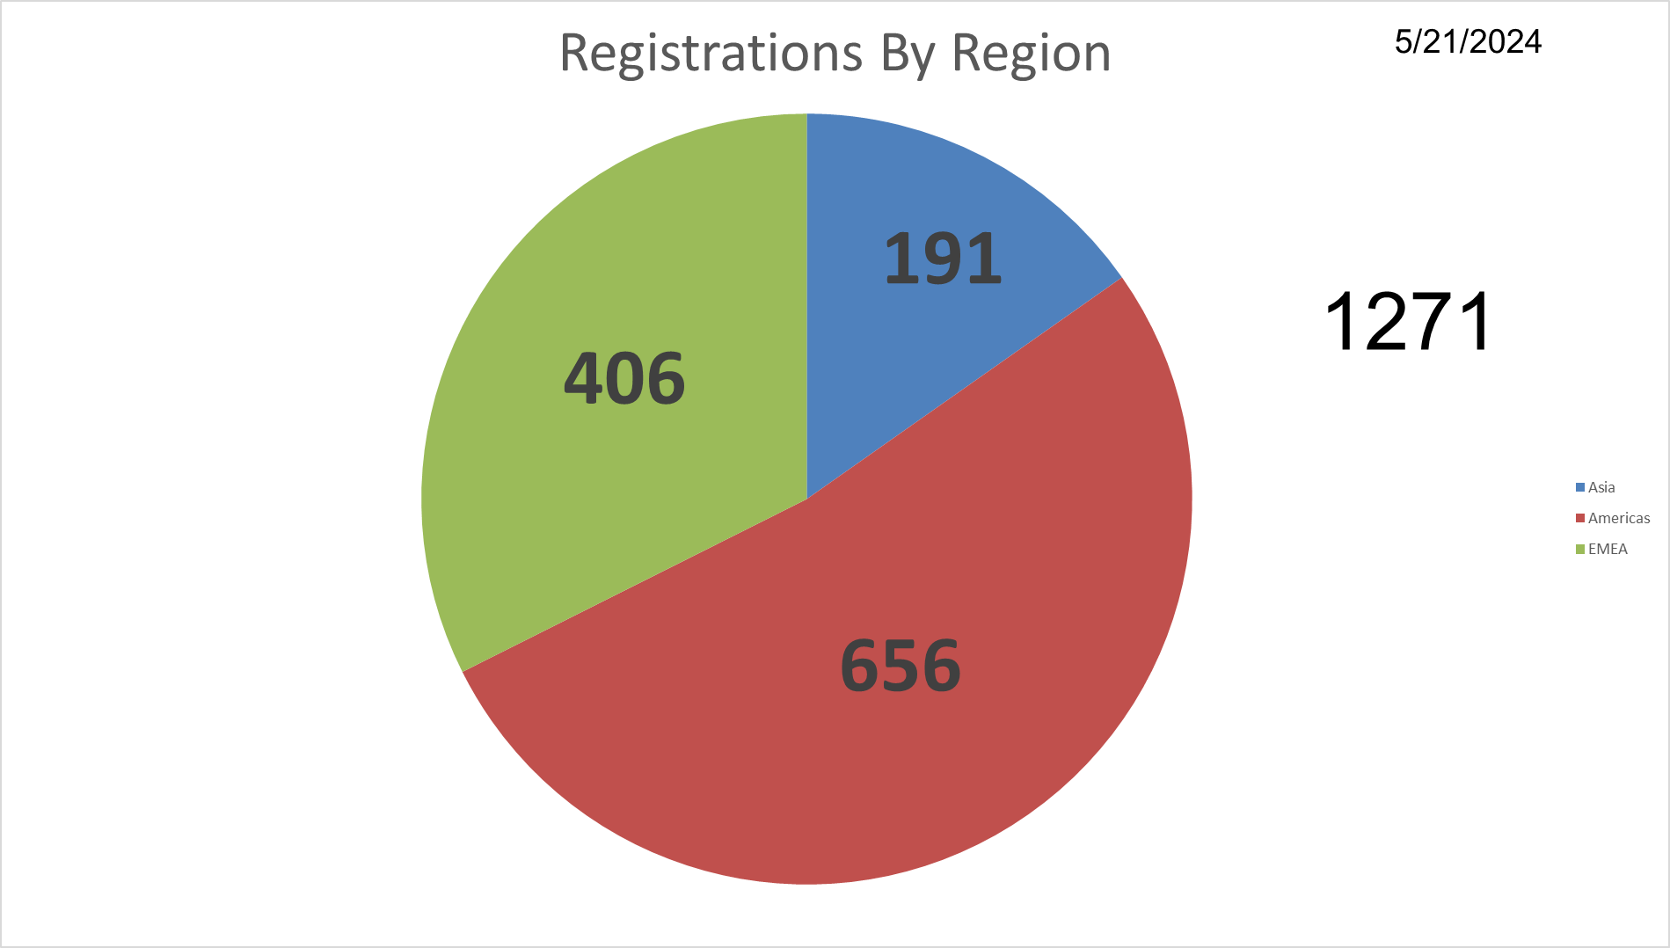

Slide 4
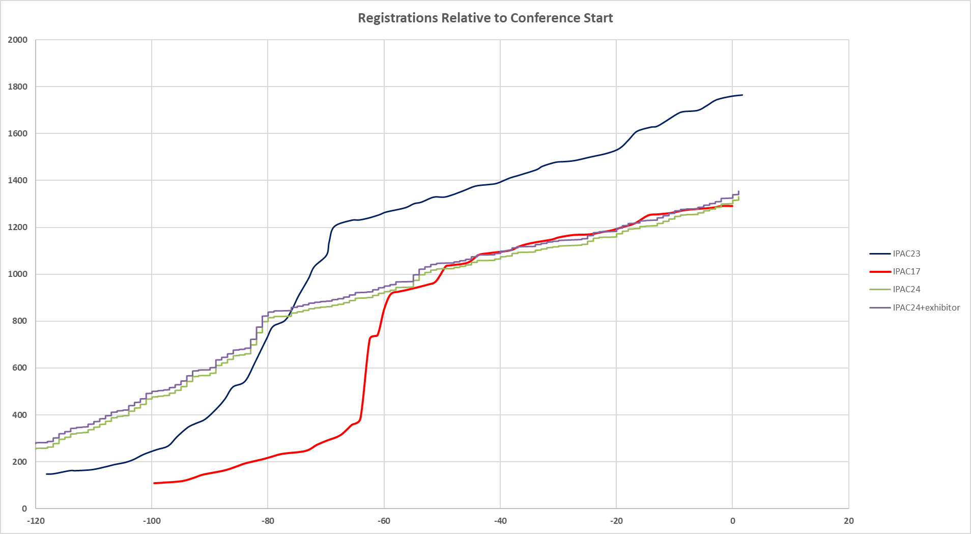

Slide 5
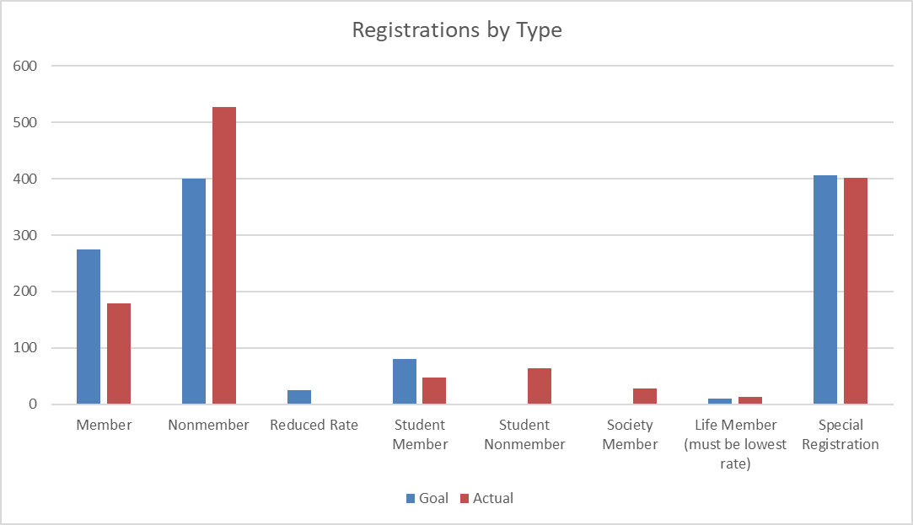

Slide 6
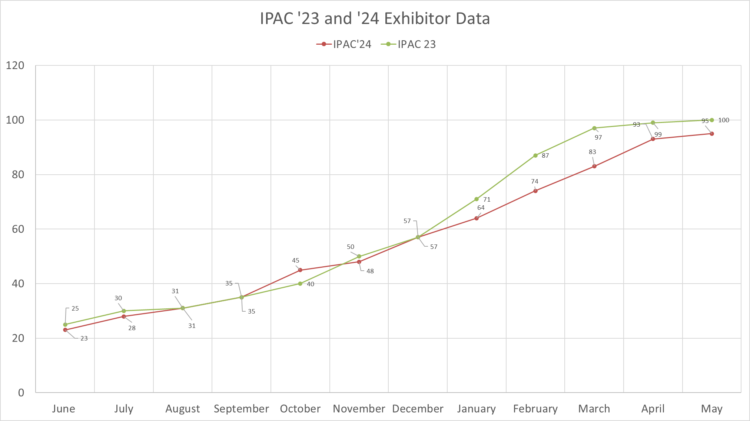
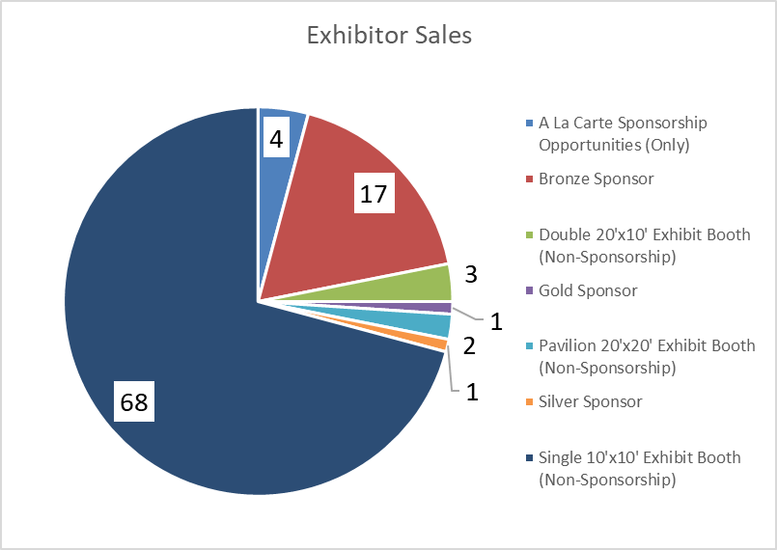
Exhibition Sales

Slide 7
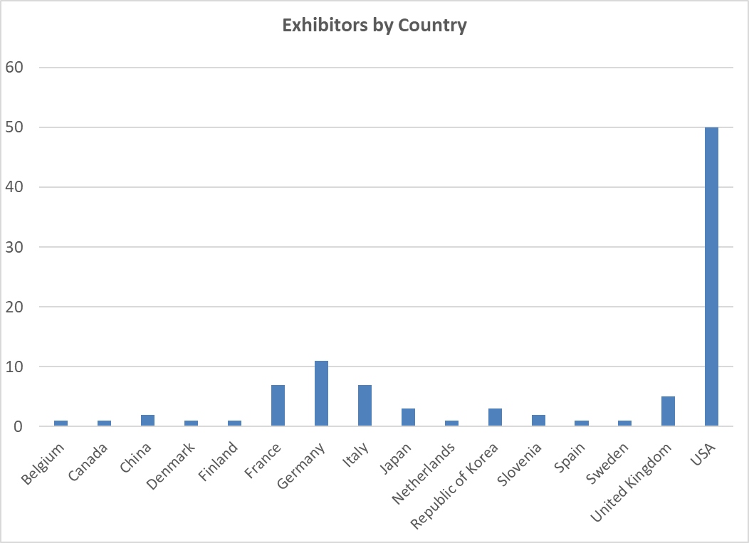
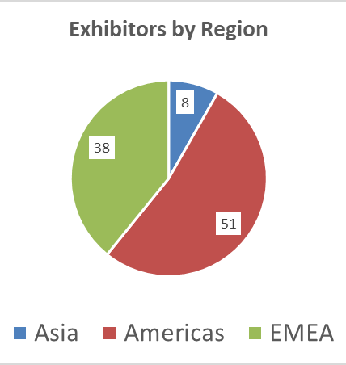
Exhibitors by Country/Region

Slide 8
Thank you!

