Slide 1




OPC UA
EPICS Device Support
Interfacing Industrial Controllers
Ralph Lange

Slide 2
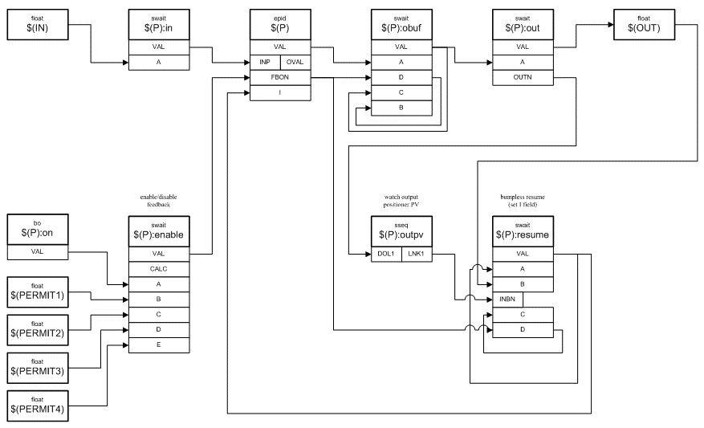
Context: Device Support
Connecting Records to Hardware
EPICS clients connect using the pvAccess and Channel Access network protocols
Configurable interconnected objects (records) provide flexibility and functionality
Records that represent I/O channels use the Device Support layer to connect to hardware
EPICS IOC
PVA & CA Network Servers
EPICS Process Database
Device Support Modules

Slide 3

Choices: Standard or Flexibility
EPICS Principle: Configuration over Coding
High-level communication standard
  Rich standard covers everything you ever need
  On-the-wire protocol: standard
  Shifts integration effort to the device (vendor)
Low-level communication abstraction with a flexible configuration
  Transport of messages is handled by fixed (coded) parts,
  Content of messages is handled by a configurable engine
  On-the-wire protocol: device specific
  Shifts integration effort to the IOC (control system engineer)
StreamDevice

Slide 4
Controller Integration Wishlist
Also the OPC UA Feature List
Symbolic addressing
  names, not numbers
No PLC programming
  keep contractors happy
Industrial standard
  one to connect them all
Portability
  at least Linux, Windows
User-defined structures
  for reusable PLC objects
Subscription mechanism
  update on change
Server-side queues
  handle bursts well
Browsing support
  find variables easily
Security (TLS, X.509)
  encrypt, sign, authenticate
Remote procedure calls
  with parameters and results

Slide 5
The OPC UA Standard
Interfacing SCADA to Controllers (PLCs)
Industrial standard (2008) to interface controllers
  Covers data, alarms, events, historical data, remote methods
  Symbolic addressing
  Browsable
Based on OPC Classic (Microsoft, 1996), adding
  Portability (does not require DCOM/Windows)
  WAN Support (TCP instead of DCOM)
  Safety/security (certificate-based authentication and encrypted connection)
  Information modeling (user-defined structures)

Slide 6

Why OPC UA?
Strategic and Conceptual Arguments
OPC UA is gaining momentum as universal industrial integration standard across vendors and application fields
Open standard, managed by the OPC Foundation, which provides
a reference implementation
Vendors can have their products certified by authorized labs, ensuring compliance and compatibility
More and more controllers (e.g., Siemens S7 PLCs, Beckhoff TwinCAT, LabVIEW) offer an embedded OPC UA server

Slide 7
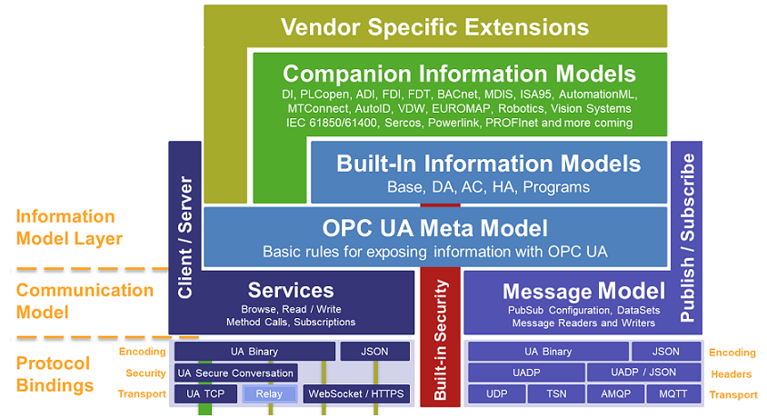
OPC Unified Architecture Overview
The Big Picture
Source: Unified Automation

Slide 8
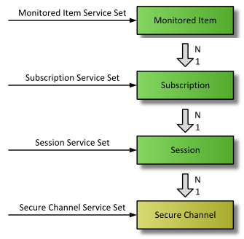
OPC UA Subscription Concept
Context Necessary to Subscribe to Data Changes
Monitored Item
  One piece of data (simple or structured) that the client is interested in
Subscription
  Updates are grouped and sent together
Session
  Logical connection
  Specific user authN/authZ
Secure Channel
  Connection to an OPC UA server
  Secured (encrypted and/or signed)
Source: Unified Automation

Slide 9
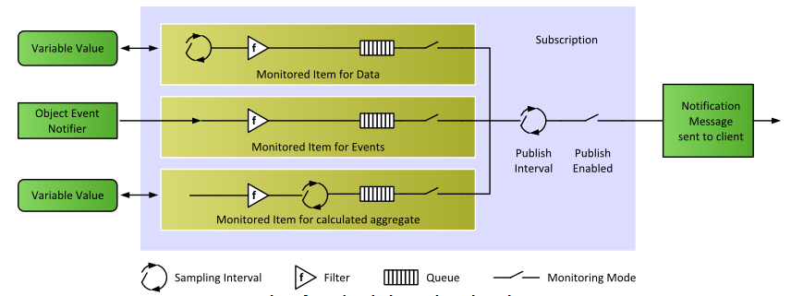
OPC UA Subscription Concept
Settings for Subscription and Monitored Items
Source: Unified Automation
Not Supported (Yet)

Slide 10
EPICS Device Support Module
Brief History
Evaluation of client library options and Device Support prototype
Bernhard Kuner (HZB/BESSY)
ITER use cases tested by F4E (Spain) and TCS (India)
  Against S7-1516/1518 embedded OPC UA server
  Against WinCC-OA embedded OPC UA server
Current implementation, using a design that allows integrating different low-level client libraries
Recent major contributions from PSI, HZB/BESSY and ESS

Slide 11
EPICS Device Support Module
Low-Level OPC UA Client Choices
Stable: Use of commercial C++ Client SDK by Unified Automation
  4k€ for source code and 1 year support (extend support: 20% per year)
  one developer/many products or many developers/one product
  Binaries can be deployed/distributed royalty-free
  Platforms: Windows and Linux; evaluation bundles available
  Newest versions (1.7.9 and 1.8) have issues
New: Use of free open62541 SDK client libraries
  Work by Dirk Zimoch (PSI) and Carsten Winkler (HZB/BESSY)
  Not trivial to set up
  More complexity on the Device Support side
  Less documentation than the Unified Automation SDK

Slide 12
EPICS Device Support Module
Status
Requirements Specification v1.1: https://bit.ly/opcua-srs-11
Design done (no formal doc)
Implementation nearly complete
  All basic data types and arrays thereof (read/write/subscribe)
  Supporting all applicable EPICS record types (bidirectional outputs)
  User-defined structures (read/write/subscribe), timestamps from data
  Server-side queues, configurable connection behavior
  OPC UA Security (encrypt, sign, authenticate)
  Lots of testing help by Roland Fleischhauer (HZB/BESSY)
  Integrated end-to-end test against a software server
  Work by Ross Elliot and Karl Vestin (ESS)

Slide 13
EPICS Device Support Module
Roadmap
Started:
  Wiki pages: List of servers that have been integrated
  Useful tricks and hints
Currently:
  User Manual (Ralph)
  ~30% done: integration of current READMEs and Cheat Sheet
  Server-side deadband filters (Dirk)
  Better enum support (read choices from server) (Dirk)
Soon:
  Support for OPC UA methods (remote execution of PLC code) (Ralph)
  Support for servers that change structures on-the-fly (Karl)

Slide 14
EPICS Device Support Module
Download
Device Support under EPICS license
Upstream repository, Wiki pages, binaries, (future manual):
https://github.com/epics-modules/opcua
The GitHub download area has statically linked shared libraries containing the Unified Automation SDK client
(i.e., plug-in libraries to link your IOCs against)
  Easy to use, fully functional, free forever
  Needs to match exactly your Linux distro and EPICS Base
  Used in the hands-on part

Slide 15
Users (2022)
Facility | OPC UA Server | Status
ASIPP | LabVIEW | production
 | PLC Siemens S7-1500 | production
Australian Synchrotron | PLC Siemens S7-1500F | near production
BESSY II @HZB | PLC Siemens S7-1500 | production
 | Phoenix Contact | production
 | Softing uaGate | production
CHIMERA @CCFE | PLC Siemens S7-1500 | development
 | LabVIEW | development
ESS | PLC Siemens S7-1500F | production
 | ABB Power SCADA | near production
 | Siemens DESIGO | development
Fermilab | Kepware KEPServerEX | testing
 | PLC Siemens S7-400 | development
IPR | PLC Siemens S7-1500 | testing
ITER | PLC Siemens S7-1500 | production
 | Siemens WinCC OA | production
 | PCVue | production
KATRIN @KIT | LabVIEW | prototyping
PSI | PLC Siemens S7-1500 | development
Varian ProBeam | PLC Siemens S7 | production
 | PLC Beckhoff | production

Slide 16
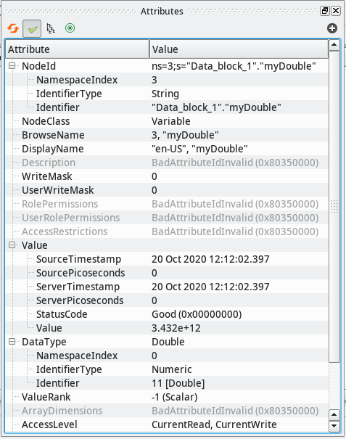
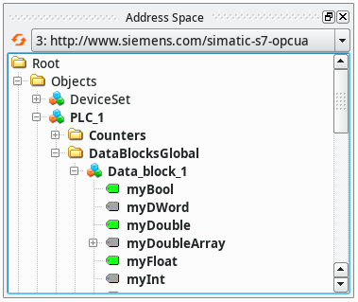
OPC UA Integration Workflow
Step 1: Browse the Server
Free browsing tool: UaExpert

Slide 17
OPC UA Integration Workflow
Step 2: Configure the IOC
Configure the OPC UA server connections from the startup script
Add an EPICS record to your database
    opcuaSession PLC1 opc.tcp://plc1.controls.local:4840 sec-mode=None
    opcuaSubscription SUB1 PLC1 200
    record(ai, "$(DEVICE):dbl1") {
    field(DTYP, "OPCUA")
    field(INP, "@SUB1 ns=3;s=\"Data_block_1\".\"myDouble\"")
    field(PREC, "3")
    }

Slide 18
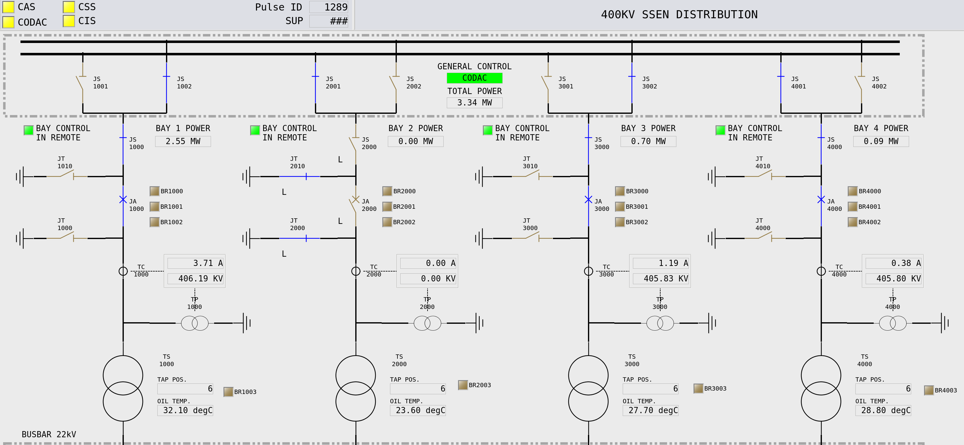
OPC UA Integration Workflow
Step 3: Design Your Client Applications and Connect

Slide 19
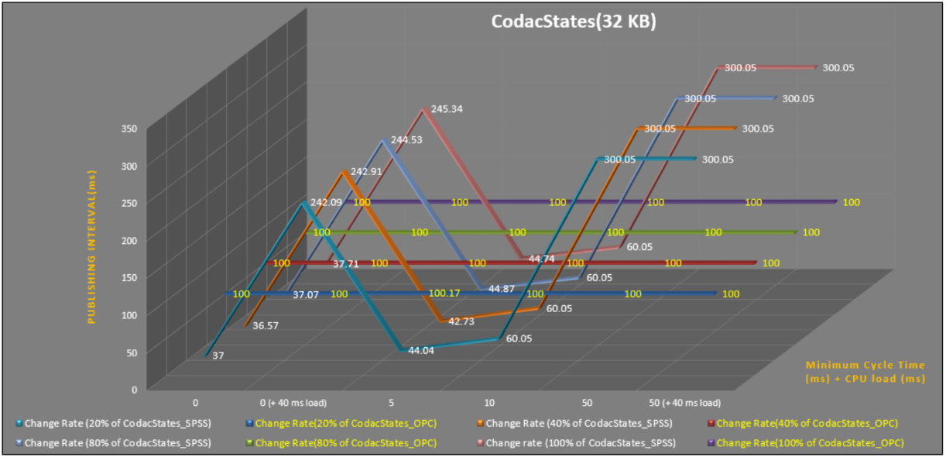
Performance
It All Depends – Mostly on the Server
Early tests by TCS, comparing TCP Data Block transfer with OPC UA:
“big” S7-1518, 32kB data (integers), “empty” / 40ms cycle artificial load

Slide 20
Performance
It All Depends – Mostly on the Server
Test in 2021 for ITER building automation integration
  Trying to verify realistic conditions
  3x the estimated size (500kB data, mixed types)
  On a mid-size S7-1516
  250ms sampling/publishing period
  No performance fine-tuning
Results:
  Fit for this purpose
  Best performance when using few large structures

Slide 21
Limitations
It All Depends – Mostly on the Server
Limits found on the server end
  S7-1500: depends on the model (S/M/L) and data organization
  How many, how large, how often?
  Client-side fine tuning available
  e.g., “registering” items to cache server-side name resolution
  Servers separate from PLCs introduce additional latency
Found one limit in the client
  LabVIEW serving 600 arrays of 7500 doubles each (~36MB data)
  -> SDK client has a limit of ~16MB for the serializer
  Solved by splitting to three subscriptions of 200 arrays each

Slide 22
Out-of-Scope
Interesting Ideas

Slide 23
An IOC as an OPC UA Server?
Complicated and Hard to Do
This way of operation has not been requested by anyone
  EPICS is usually the top SCADA system used for integration
  Two exceptions: teams that wanted to use an EPICS IOC as a controller in the context of an industrial control system
The open62541 server could be run on the IOC
  In EPICS 7, there is a server API that both CA and PVA servers use
  QSRV could work as a model for the Database integration
The big task: getting the information model right
  Needs considerable experience with OPC UA server design
  The Companion Information Model needs to be done right to assure interoperability

Slide 24
A Generic OPC UA – EPICS Bridge?
Even More Complicated and Harder to Do
OPC UA has well-defined, located namespaces
EPICS has a single global namespace
  Scalability: a single OPC UA server can’t serve a complete facility
  Unlike EPICS, OPC UA has the concept of a “device”
  OPC UA always needs the server name first
  CA/PVA only use the PV name, never the server
OPC UA is completely browsable
CA is not browsable, PVA only if the server implements it
Companion Information Model would need to cover PVA in a generic way
  Can the Normative Types be mapped to standard OPC UA structures?

