Slide 1
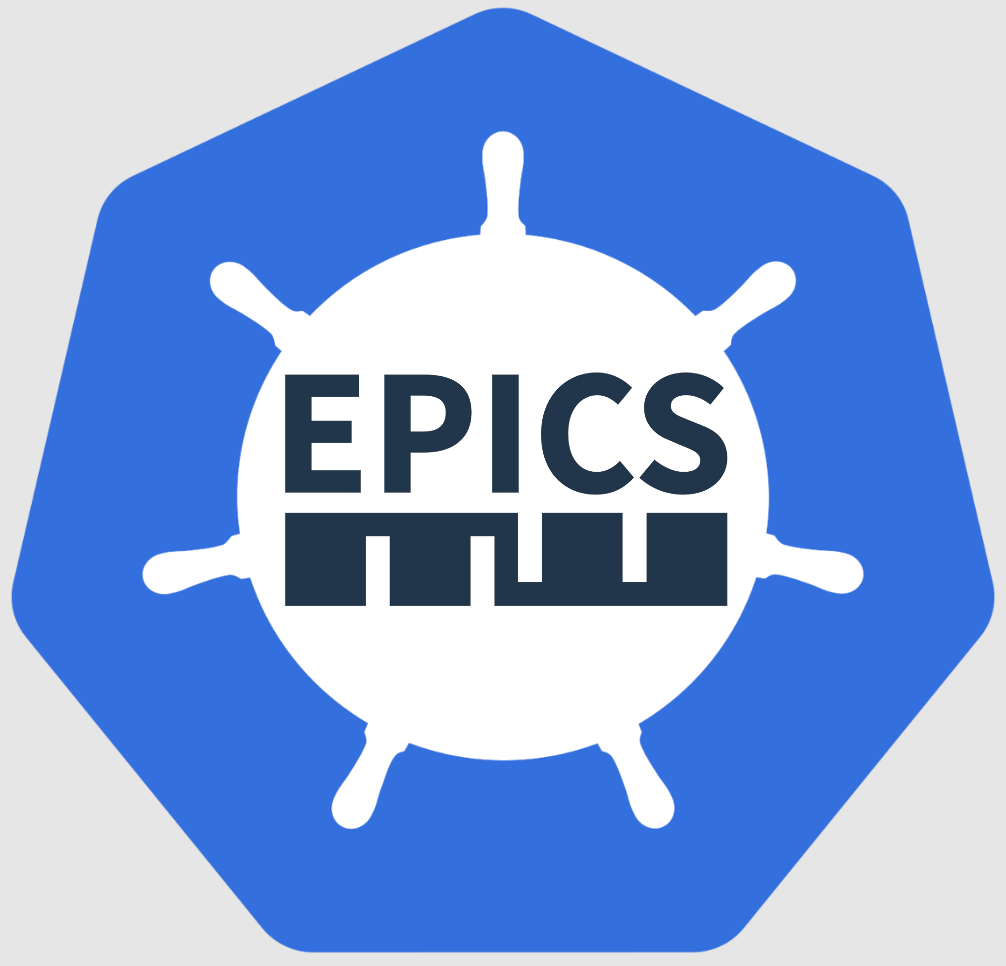
epics-containers
A workshop to look at containerizing EPICS IOCs
EPICS Collaboration Meeting @ ORNL
Sept 16th, 2024
giles knap & Marcell Nagy
Beamline Controls – Diamond Light Source
Notes:
We have been iterating on how to do IOCs in containers for around 3 years now and feel that we are approaching the final iteration.
It is therefore time to introduce a wider audience to some of the details.
What I'm about to present to you is the current state of affairs but we welcome feedback, and I'm sure there may be one or two more iterations yet.

Slide 2
epics-containers
A workshop to look at containerizing EPICS IOCs
Diamond Light Source
Tues Sept 10th, 2024
giles knap
Beamline Controls – Diamond Light Source
Notes:
We have been iterating on how to do IOCs in containers for around 3 years now and feel that we are approaching the final iteration.
It is therefore time to introduce a wider audience to some of the details.
What I'm about to present to you is the current state of affairs but we welcome feedback, and I'm sure there may be one or two more iterations yet.

Slide 3
epics-containers workshop ORNL
13:40 – Presentation: an overview of epics-containers
14:20 – Questions
14:30 – Hands On Tutorials: Create an IOC in a container
15:00 – Break
15:30 – Demo: Kubernetes and ArgoCD on a DLS test beamline
16:10 – Questions and discussion
16:30 – Hands On Tutorials continued
17:10 - End
Notes:
This is a loose agenda for the afternoon.
Please think of today as a taster session. All the tutorials are available online and you can complete them at your leisure. If you need help you can leave an issue on GitHub or email me.
We will only be covering local development today but there are tutorials that cover how we use Kubernetes and these will be expanded in the future.

Slide 4
epics-containers workshop DLS
13:00 – Presentation: an overview of epics-containers
13:40 – Questions
14:00 – Practical: experimenting with a simulation beamline
14:50 – Break
15:00 – Practical: introducing developer containers for generic IOCs
16:00 – Demo: Kubernetes and ArgoCD on a DLS test beamline
16:40 – Questions and discussion
17:00 - End
Notes:
This is a loose agenda for the afternoon.
Please think of today as a taster session. All the tutorials are available online and you can complete them at your leisure. If you need help you can leave an issue on GitHub or email me.
We will only be covering local development today but there are tutorials that cover how we use Kubernetes and these will be expanded in the future.

Slide 5
Preamble
This presentation is about how DLS will be building and managing IOCs using containers.
However, we have applied the following principals to make this work useful to other facilities:
Open source first. All source, re-usable containers, example beamlines and documentation is available at https://github.com/epics-containers.
Modular. All parts of the framework are as far as practical independent – you may adopt just the features you find useful.
Standard EPICS only. We use the default EPICS build system, upstream versions of EPICS base and support modules.
Standard Tools only. The tools used in the framework are widely adopted FOSS only.
The SPARC beamline at INFN-LNF in Rome is already using epics-containers in production.
Notes:
This is a reminder that the framework itself is not DLS specific, and is intended to be useful to other facilities, in particular Kubernetes is not a hard requirement and many of the benefits of using containers still apply without it. In fact the tutorials we will do in a moment are all based on docker compose, we won't be using Kubernetes today although there will be a demo of the additional features it can bring at the end.
DLS benefits from making this framework open source and facility agnostic, because:-
the skills required are reusable and can be hired
there is less bespoke code to maintain
Gives a better chance of attracting collaboration
In fact we already have a collaborator – INFN in Rome are running a production beamline using Kubernetes and many but not all of the parts of this framework – SPARC National Laboratory of Frascati
---- cut here – the below may be too much ---
So although this presentation is about how DLS is doing containerized IOCs, we have tried to make sure that this work is not DLS centric and is of use to other facilities. These 3 principals have been applied to make this possible:
Everything we are doing is open source, we are even using this transition as an opportunity to open source Support Modules that have been developed internally but not yet shared. It is important to recognize that the framework does support internal work for those modules that are proprietary or simply too specialized to the original facility. But the default is for support modules, IOC container images and documentation to be made on GitHub.
Many people I have spoken to about this topic are reluctant to adopt Kubernetes as they recognize that this is not trivial. Therefore we have made all the parts of this framework as independent as possible. If you would prefer to eschew Kubernetes then this does not preclude taking advantage of much of the rest of the framework. We provide docker compose as an example alternative to deploy and manage IOCs but other options are available.
I personally committed to making the minimum amount of bespoke software. All of the tools we use in this framework are widely available open source only.
--- Notes from SPARC NLF

Slide 6
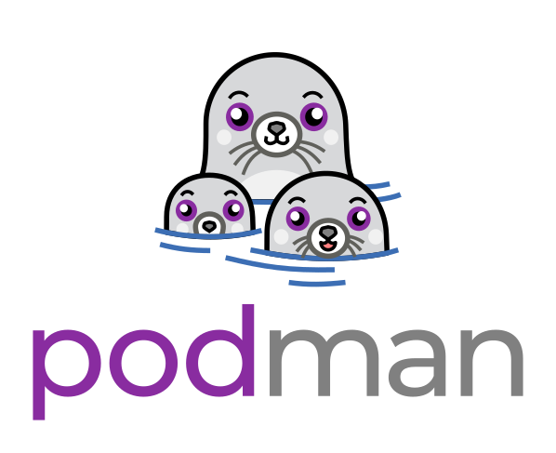
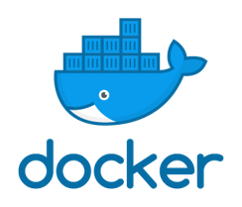
What?
Applying modern industry practices for software delivery to EPICS IOCs
Containers:
Package IOC software and execute it in a lightweight virtual environment​
Orchestrates all IOCs at a facility​
Deploy IOCs into Kubernetes with version management​
Source and container repositories manage all the above assets
Source repositories automatically build assets from source when updated
Deployment repositories are automatically synced with the cluster
Kubernetes:​
Helm Charts:​
Repositories:
​CI:
​CD:
Notes:
What is epics-containers? - it is our attempt to bring modern cloud native software delivery to EPICS IOCs
IOCs are built and run inside containers that hold all their dependencies including system dependencies.
Each beamline gets it's own Kubernetes Cluster and that looks after the servers on that beamline, distributing the IOCs to those severs in order to balance the available resources. The accelerator will also get its own dedicated cluster.
Helm is the most popular package manager for Kubernetes and this is the tool we use to deploy our IOCs into a cluster.
All of the assets required to build and run an IOC are held in repositories, both source repositories and container repositories. This replaces the need for a shared filesystem for software delivery that the legacy approach at DLS uses.
Continuous Integration is always validating changes to source code and generating built assets from that source code. For this purpose we use GitHub actions for our public facing repositories and GitLab CI for our internal repostiories.
Continuous Deployment allows us to manage the set of IOCs we are currently running using a deployment repository. We use Argo CD for this purpose and it means that the historical state of the cluster is always discoverable.
This looks like the technology stack for any modern cloud native software. But it is also the stack that will be used by DAQ and Analysis teams at DLS going forward, many of our system tools are now also deployed this way. So Kubernetes provides a consistent platform for deploying and managing much of the software DLS will be running in future.

Slide 7
Why?
IOCs are decoupled from the OS
No modifying support modules to suit facility infrastructure
Allows us to use upstream support modules with no need for local forks
Protection from many security vulnerabilities
Simple server setup: any Linux + container runtime only.
Very easy server OS upgrades
Remove maintenance of internal management tools
Kubernetes provides (not just for IOCs!):
Shared software deployment and management
Shared Logging, monitoring, alerting
Shared resource management: Disk / CPU / Memory
Skills required are transferrable
A huge range of supporting tools and applications both FOSS and licensed
Just Google it when things go wrong
Notes:
The benefits of running in containers are widely documented. I've put up a few reasons that are key to our adoption.
One of the things that DLS is always struggling with is keeping the RHEL version on our servers and workstations up to date. Our current system of running IOCs natively requires that we recompile all of our IOC instances each time there is a new release of RHEL to roll out. The process is always protracted and we are often chasing the end of life date of our current version of RedHat.
There are also security benefits, because you are no longer required to install all your system dependencies on your host operating system. We will look into some details on this in a later demo.
Finally, if you are using Kubernetes then there are many advantages that extend to more than just your IOCs. Again we'll look into some of those benefits in a later demo.

Slide 8
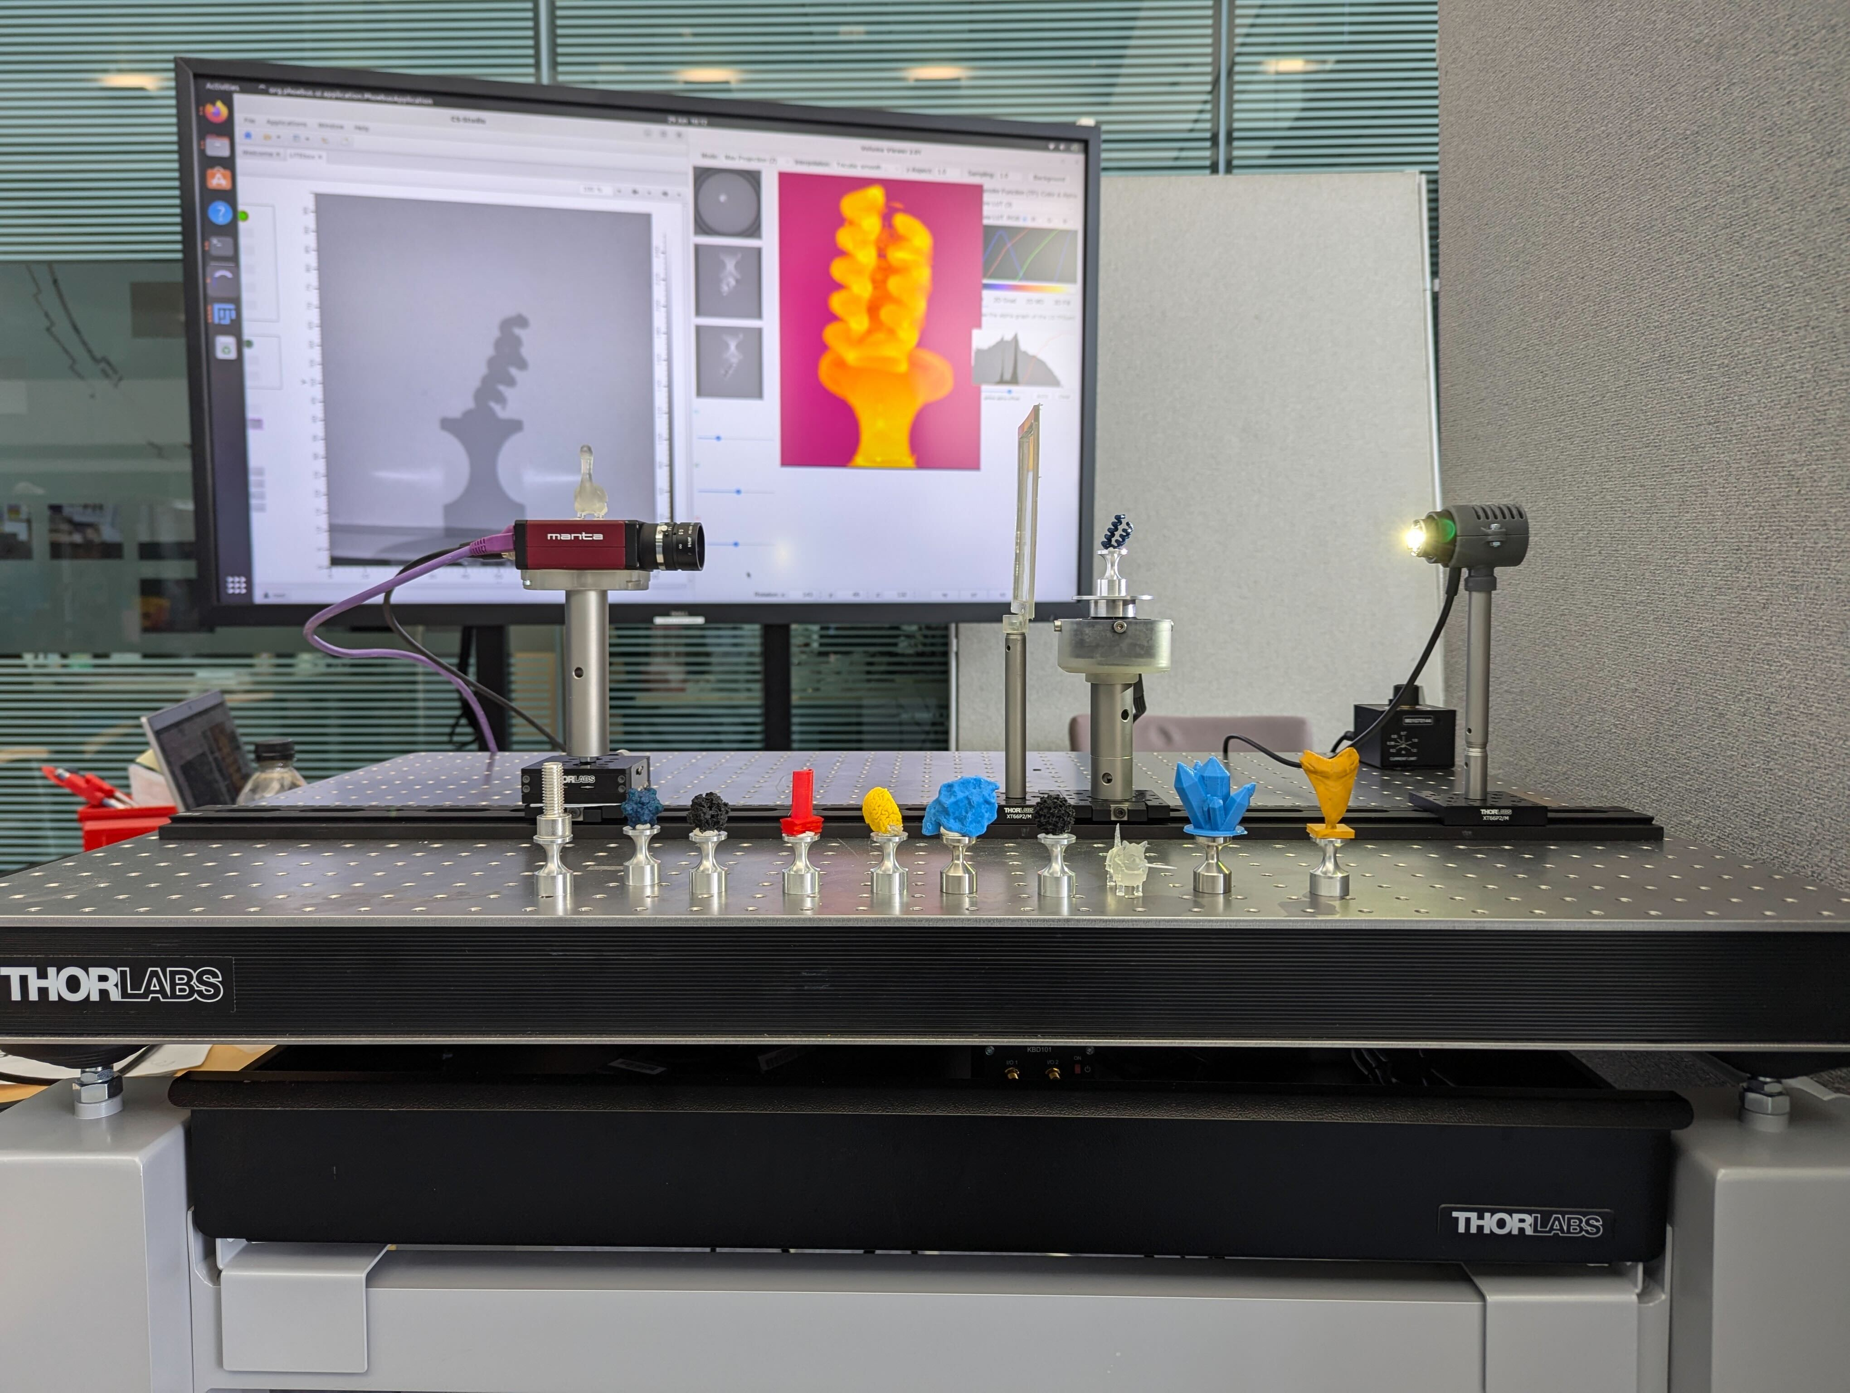
Why?
Portability:
Develop anywhere.
Execute anywhere.
e.g.
DIAD's portable tomography demo made for the RAL public open day.

Slide 9
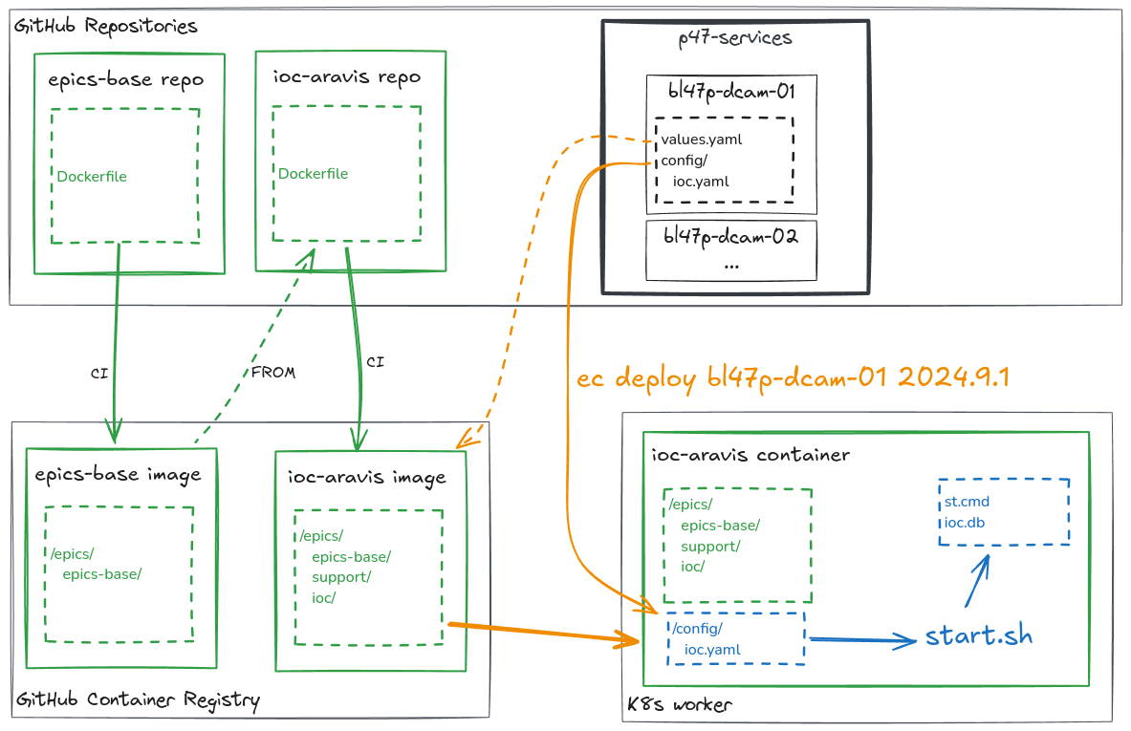
How?
Notes:
Epics-containers adds a new concept to building IOCs that sits between compiling Support Modules and compiling IOC instances. This is called the generic IOC.
Generic IOCs contain a built IOC binary which links in the support and dbd files required to control a class of device. For example there is a generic IOC for Aravis Gige Cameras called ioc-adaravis. Any time you want to control a GigE camera you start with this Generic Container Image. You then make an IOC instance by adding some configuration to say which camera to connect to, what PV prefixes to use and which AreaDetector Plugins to add to the Instance. Thus the generic IOC has all the compiled binaries but the instance adds the EPICS Db and startup script.
Generic IOCs are built in a container and include:
A base container image which includes the OS files and epics base
Install of any system dependencies using apt-get
Fetch and compile the primary support module and all of its dependencies
A compile IOC binary that links all of the support libraries and dbd files
The Generic IOC image is added to a container registry by the CI when changes to its source repo are pushed
When we come to run an IOC instance we could supply our own startup script and substitution file as runtime instance assets. Alternatively we can use yaml to describe the runtime assets we want. This declarative yaml approach is provided by the ibek tool discussed in the next slide.

Slide 10
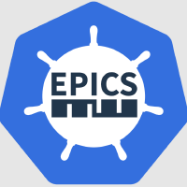
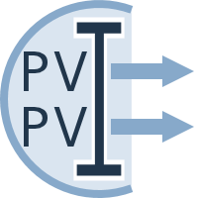
Supporting Tools
ibek – IOC builder for EPICS and Kubernetes
Runs inside the container at build time
Helpers for building Support and Generic IOC in the container environment
Runs inside the container at runtime startup
Makes IOC instance startup script and database from a YAML description
Extracts IOC instance engineering screens from the container
ec – the epics containers CLI for developers
Runs outside the container
Helpers for building and deploy IOC Instances
Helpers for local debugging and testing of Generic IOCs
Thin wrapper around the tools git, helm, kubectl and argocd – can be used to learn these tools too
PVI - Process Variables Interface
Provides structure for the PV interface to a device
Auto generates engineering screens for the device (bob/edm/adl)
Supplies DB metadata for use with Bluesky
Notes:
We have a few supporting tools that assist in building and running IOCs. These represent the only bespoke code in the framework.
Ibek is IOC builder for EPICS and Kubernetes. It always runs inside a Generic IOC container and is used in 3 different phases of the lifecycle:
During container build it assists in fetching, configuring and compiling support modules
During container runtime it generates the startup script and Database using Instance configuration files
It also is available inside the developer container when testing and debugging a generic IOC
Ec is a tool that runs outside of the container and is used for monitoring and controlling IOC instances. It is a thin wrapper around the underlying tools git, helm, kubectl and argocd
Finally PVI is used for generating PVA records that describe the structure of a devices PVs – used by bluesky experimental orchestration. Adding structure to the device PVs also allows PVI to auto-generate engineering screens for each device.

Slide 11
How to make an IOC Instance?
1. Create a services repository
2. Edit the new IOC Instance config
3. Deploy the IOC instance
Notes:
In the next few slides we will look into the process for creating an IOC instance.
We are going to be looking at quite a lot of YAML files today. Kubernetes uses yaml a great deal and so do the tools associated with it, including our ibek.
First we need to make a services repository, this is easily done using the copier template provided and a single copier command above will ask you for details about your beamline and generate a new repository from the template. Note that I'm using beamline as an example but the repository could equally represent a collection of IOCs for the accelerator.
In this first slide we will assume that someone has already made the generic IOC container for GigE cameras using the ADAravis detector driver. This Generic IOC already exists and this is a working example.
Now make a copy of the included ioc instance template in the 'services' folder.
In this folder you need to edit a couple of files.
Values.yaml is a helm values override file which is read by helm when deploying this folder. It need only contain a value for 'image' which tells helm which container image to use. We pick ioc-adaravis-runtime which is hosted in the GitHub container registry.
Next provide details of the Instance itself in the form of an ibek ioc instance YAML file. We give the IOC a name and then list the entities that we'd like to create – entities have a set of parameters and generate startup script lines, database template substitutions or both. You can use the schema from the generic IOC to guide what entities are supported – with a YAML aware editor like vscode you get auto completetion and checking of the types and values you enter.
Here we have defined two entities, one to set the EPICS_MAX_ARRAY_BYTES variable and one to create a camera driver object.
Note we could easily add further entities in order to add AreaDetector plugins
That’s all you need, now you can push and tag your repo and deploy your new IOC with an 'ec' command.
This sequence of steps does assume that we had a Kubernetes cluster available for our beamline. However if you used the compose copier template instead of the helm one you will have a very similar sequence of steps to get get your IOC deployed directly to a workstation or server. This is what we will do in the practical following this talk.

Slide 12
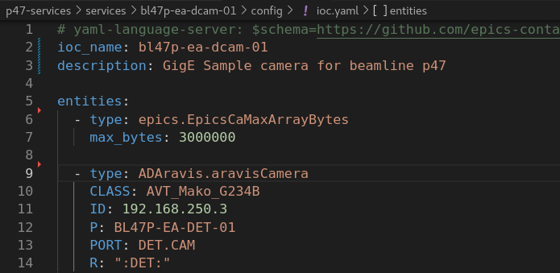
How to make an IOC Instance?
1. Create a services repository
copier copy gh:epics-containers/services-template-helm .
cp –r services/.ioc-template services/my-new-ioc
2. Edit the new IOC Instance config
2a. A helm chart values override file. The only required field is the URL of the Generic IOC to use.
2b. An ibek IOC YAML file listing the support 'entities' that we want to instantiate for this IOC instance.
3. Deploy the IOC instance:
Tag and push the beamline repo
ec deploy bl45p-ea-ioc-01 2024.9.1
Notes:
In the next few slides we will look into the process for creating an IOC instance.
We are going to be looking at quite a lot of YAML files today. Kubernetes uses yaml a great deal and so do the tools associated with it, including our ibek.
First we need to make a services repository, this is easily done using the copier template provided and a single copier command above will ask you for details about your beamline and generate a new repository from the template. Note that I'm using beamline as an example but the repository could equally represent a collection of IOCs for the accelerator.
In this first slide we will assume that someone has already made the generic IOC container for GigE cameras using the ADAravis detector driver. This Generic IOC already exists and this is a working example.
Now make a copy of the included ioc instance template in the 'services' folder.
In this folder you need to edit a couple of files.
Values.yaml is a helm values override file which is read by helm when deploying this folder. It need only contain a value for 'image' which tells helm which container image to use. We pick ioc-adaravis-runtime which is hosted in the GitHub container registry.
Next provide details of the Instance itself in the form of an ibek ioc instance YAML file. We give the IOC a name and then list the entities that we'd like to create – entities have a set of parameters and generate startup script lines, database template substitutions or both. You can use the schema from the generic IOC to guide what entities are supported – with a YAML aware editor like vscode you get auto completetion and checking of the types and values you enter.
Here we have defined two entities, one to set the EPICS_MAX_ARRAY_BYTES variable and one to create a camera driver object.
Note we could easily add further entities in order to add AreaDetector plugins
That’s all you need, now you can push and tag your repo and deploy your new IOC with an 'ec' command.
This sequence of steps does assume that we had a Kubernetes cluster available for our beamline. However if you used the compose copier template instead of the helm one you will have a very similar sequence of steps to get get your IOC deployed directly to a workstation or server. This is what we will do in the practical following this talk.

Slide 13
How to make an IOC Instance?
1.Create a Generic IOC repo
2. Deploy Generic IOC to your container registry
Notes:
In the next few slides we will look into the process for creating an IOC instance.
We are going to be looking at quite a lot of YAML files today. Kubernetes uses yaml a great deal and so do the tools associated with it, including our ibek.
First we need to make a services repository, this is easily done using the copier template provided and a single copier command above will ask you for details about your beamline and generate a new repository from the template. Note that I'm using beamline as an example but the repository could equally represent a collection of IOCs for the accelerator.
In this first slide we will assume that someone has already made the generic IOC container for GigE cameras using the ADAravis detector driver. This Generic IOC already exists and this is a working example.
Now make a copy of the included ioc instance template in the 'services' folder.
In this folder you need to edit a couple of files.
Values.yaml is a helm values override file which is read by helm when deploying this folder. It need only contain a value for 'image' which tells helm which container image to use. We pick ioc-adaravis-runtime which is hosted in the GitHub container registry.
Next provide details of the Instance itself in the form of an ibek ioc instance YAML file. We give the IOC a name and then list the entities that we'd like to create – entities have a set of parameters and generate startup script lines, database template substitutions or both. You can use the schema from the generic IOC to guide what entities are supported – with a YAML aware editor like vscode you get auto completetion and checking of the types and values you enter.
Here we have defined two entities, one to set the EPICS_MAX_ARRAY_BYTES variable and one to create a camera driver object.
Note we could easily add further entities in order to add AreaDetector plugins
That’s all you need, now you can push and tag your repo and deploy your new IOC with an 'ec' command.
This sequence of steps does assume that we had a Kubernetes cluster available for our beamline. However if you used the compose copier template instead of the helm one you will have a very similar sequence of steps to get get your IOC deployed directly to a workstation or server. This is what we will do in the practical following this talk.

Slide 14
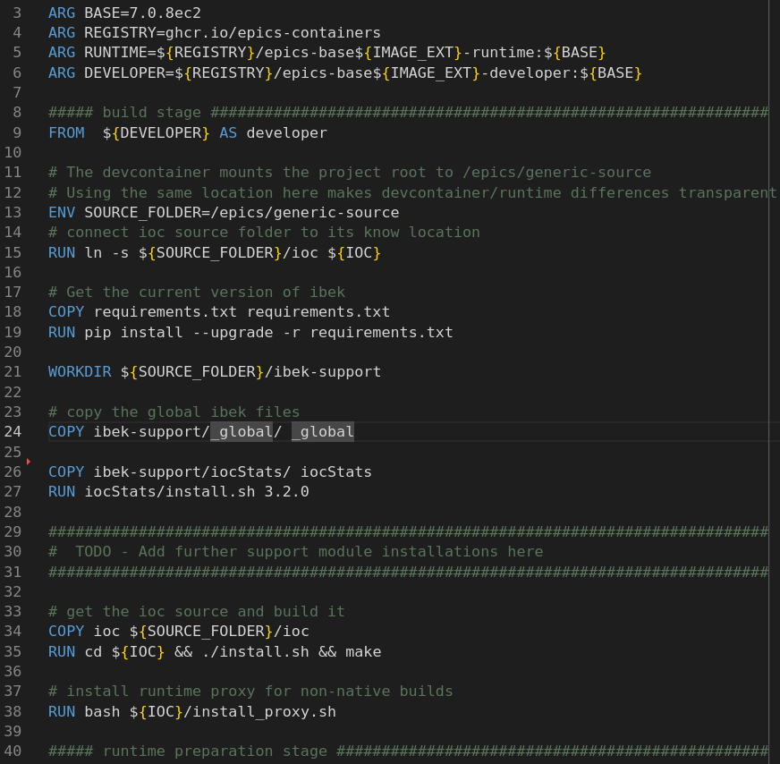
How to make a Generic IOC?
1. Create a Generic IOC repo:
copier copy gh:epics-containers/ioc-template
edit Readme.md
edit Dockerfile: add COPY and RUN for each support module using ibek-support recipies
2. Deploy Generic IOC to your container registry:
Tag and push the generic IOC repo
CI then:
Builds the container image
Publishes it to GHCR
Publishes a JSON schema for the ibek 'entities' provided inside the container
Dockerfile: iocStats serves as an example for how to add additional support modules
Notes:
In our IOC instance creation slide we assumed that the generic IOC for the device we wanted to connect to was already available. But what if that is not true – it is quite easy to create a new Generic IOC.
To make a generic IOC we really only need to specifiy the set of support modules that we would like compiled in.
Again there is a template to create all of the boilerplate for a generic IOC repo. You need only modify the Readme and the Dockerfile.
A Dockerfile is just a list of instructions to run inside of a container to build a new container image. It starts with a FROM command that specifies the base image as a starting point for the container filesystem, in this case the epics-containers base image which contains the OS and epics base.
Add in additional support modules using iocStats as an example.
The ibek-support repository is a sub-module used by all generic IOCs that contains the recipies for how to build each support module inside of the container, and also describes the set of ibek 'entities' that this support module adds to the container.
When you commit this repo to GitHub CI will:
Build a container image
Publish the image to the GitHub Container Registry
Publish a schema for use in your ibek instance yaml

Slide 15
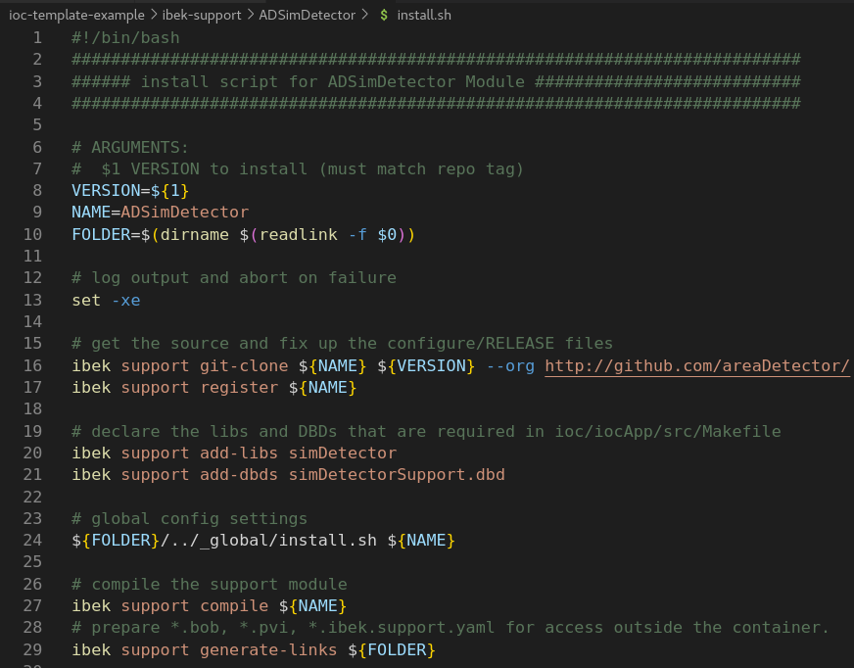
How to Add a new Support Module 1.
1. Add a folder in the ibek-support repo
Shared ibek-support on GitHub
Or private ibek-support per facility
Public Generic IOCs should only use shared ibek-support
Internal Generic IOCs may use both
2. Add a new install.sh file:
Use the new support in your Generic IOC Dockerfile
Install.sh example for ADSimDetector. Most install.sh would look almost identical to this but You can add custom steps as needed –it's just bash.
Notes:
When we made a Generic IOC in the last slide, we assumed that all support modules we needed were already added to the ibek-support submodule.
If this is not the case then it is relatively easy to add these in too.
We just add a folder for our new support module into ibek-support and create two files.
An install.sh for building the support module in container build time
A ibek support yaml description that defines which 'entities' the support module is adding to the generic IOC.
An example install.sh for ADSimDetector is shown here. Most install.sh would look pretty similar to this but you are free to add in any bash script you require.
At the top of the script we set what the name of our module is and determine the folder in which this file resides in order to allow relative paths.
The common operations that we perform are all provided by the `ibek support` subcommand. It is important that these commands are idempotent and this is one of the reasons we choose to have ibek do them instead of just raw bash script. It also makes ibek-support far easier to maintain.
We typically clone the support module from it's public upstream location, the default value for –org is epics-modules on github.
The register function updates the global configure/RELEASE file to add in this new support module. It also adds a RELEASE.local so that this module will find that RELEASE file.
Next we declare the dbds and libs that this support module will add, these will then get linked into the IOC binary.
Finally we compile the module and add links to the files in this folder so that ibek can find them at runtime.
That is all we need to do if we want to compile in a new support module. But if we would also like to use ibek instance YAML to describe our use of this module in our IOC instances then we need the next slide.

Slide 16
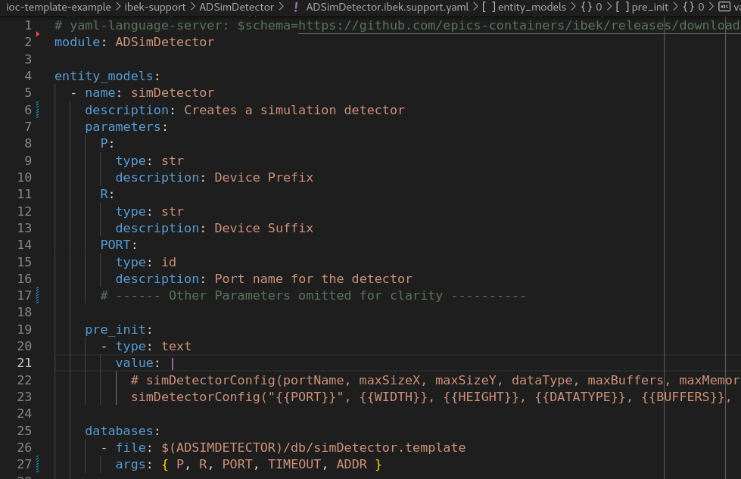
How to Add a new Support Module 2.
1. Add a folder in the ibek-support repo
Shared ibek-support on GitHub
Or private ibek-support per facility
Public Generic IOCs should only use shared ibek-support
Internal Generic IOCs may use both
2. Add a new install.sh file:
Use the new support in your Generic IOC Dockerfile
3. Add an ibek support YAML description:
This allows us to describe our IOC instances as ibek IOC YAML.
Support YAML example for ADSimDetector. Declares instance arguments, startup script lines and database template substitutions.
Notes:
Adding an ibek support yaml file to the ibek-support module folder means that we declare the 'entities' that can be created using this module. 'entities' are simply templated EPICS DB and startup script command lines expressed in YAML.
Here we add an entity_model for the sim detector driver. We define a number of parameters for the entity and then express what this entity will add into the startup script plus a list of DB templates for it to instantiate.
The value in pre_init uses Jinja Templating for rendering. At it's simplest form this just means that enclosing a parameter name in double curly braces will put in the argument supplied to that parameter. JInja can get more sophisticated that this and even work with loops and lists of values.
The databases key specifies a list of the parameters that will be used as macros in the template substitution. Listing a key with no value means that the value supplied to that parameter will be used. However you can also use Jinja expressions to combine arguments into something else.

Slide 17
Developer Containers
epics-containers development defines 3 levels of changes:
Changing IOC instance details only
Edit values.yaml or ioc.yaml in your beamline repository
Push and tag the changes, re-deploy the update instance
Changing a Generic IOC
Edit Dockerfile or ibek-support sub-module in a Generic IOC repository
Push changes to publish a new container image
Go to 1. to update affected instances
Changing Support Modules
Edit the support module, verify and push and tag source changes.
Go to 2. to update a Generic IOC to include the new support version
2 and 3 require rebuilding and deploying containers. For this reason, we use Developer Containers for a fast "inner loop".
For epics-containers the generic IOC container image is an ideal developer container.
Notes:
Developer containers are a great way to make a portable development environment that you can specify in a repo alongside the source code.
In epics-containers we can use the generic IOC container itself as a developer container.
When generic IOCs are built they first install of the build tools and build time dependencies, then clone and compile all of the source. We then throw away everything we don't need at runtime so we get a lightweight container for executing IOCs. However we keep two container images, a runtime one and a developer one which is taken just after the IOC compile completes. This is ideal for use as a developer container because it container all of the tools and source necessary to experiment with changes to the code.

Slide 18
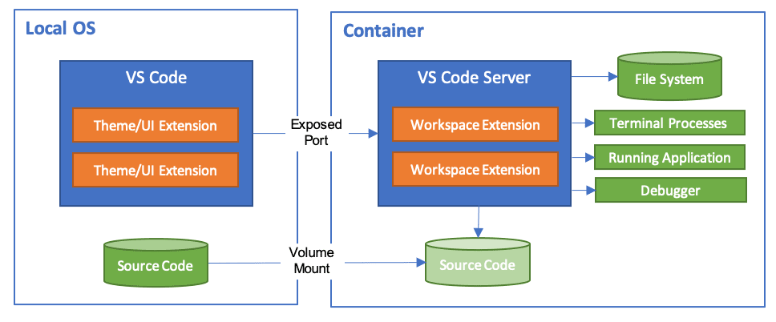
Developer Containers
See developer target in https://github.com/epics-containers/ioc-template/blob/main/template/Dockerfile
Notes:
Developer containers are a great way to make a portable development environment that you can specify in a repo alongside the source code.
In epics-containers we can use the generic IOC container itself as a developer container.
When generic IOCs are built they first install of the build tools and build time dependencies, then clone and compile all of the source. We then throw away everything we don't need at runtime so we get a lightweight container for executing IOCs. However we keep two container images, a runtime one and a developer one which is taken just after the IOC compile completes. This is ideal for use as a developer container because it container all of the tools and source necessary to experiment with changes to the code.

Slide 19
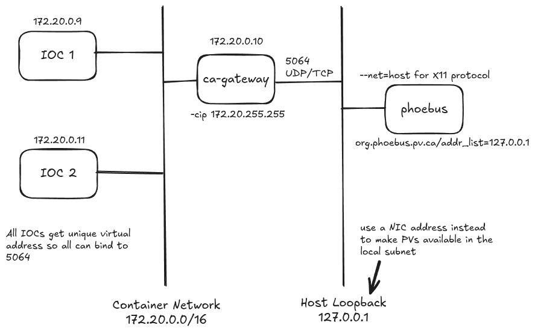
Networking
For local development and testing we configure the network like this:
Notes:
This is how the tutorials allow us to run a few IOCs and see the PVs from the local machine but not on the rest of the subnet.
This approach could potentially be used in production if the gateway was bound to a server's NIC instead of the loopback adapter.

Slide 20
Networking network=host
At DLS we use network=host for Kubernetes IOCs
This means IOCs run without network isolation and look exactly like traditional IOCs from the client's perspective
Motivation
Channel Access cannot route into the container network​
We did not want to pass all PVs through a ca-gateway​
Channel Access is not the only protocol that will not route into CNI​
For example, GigE streaming protocol will also fail ​
Any protocol that does not like NAT will have this problem

Slide 21
Current Status - Sept 2024
The epics-containers framework is ready for wider exposure and feedback
There are tutorials to get people started using the framework
There are a growing number of reference generic IOCs
Example beamline repositories are also available
DLS has several beamline clusters running a handful of containerized IOCs in production, plus some fully containerized test beamlines.
DLS aims to have a representative set of production beamlines fully containerized before the DII dark period 12/2027.
And all beamlines fully containerized at the end of the dark period 06/2029.

Slide 22
One Take Away
https://github.com/epics-containers
Includes:
Tutorials
Documentation
Templates
Source code
A small but growing number of Generic IOC images
Example beamlines
A Simulation beamline

Slide 23
Questions ?

Slide 24
Hands On: Tutorials
https://epics-containers.github.io/main/tutorials/intro.html
Work through the tutorials at your own pace
Try out the simulation beamline
Create a services repository with docker compose
Create an IOC instance
Work with developer containers (stretch goal for today!)

Slide 25
Kubernetes
Kubernetes is by far the dominant container orchestration platform today
Open-sourced by Google in 2014
Managed by the Cloud Native Computing Foundation, part of the Linux Foundation
CNCF looks after a large list of open-source applications that run in Kubernetes
At DLS we will have a Kubernetes Cluster per beamline, one for the accelerator and a large central cluster for centralized services.

Slide 26
Demo: a Kubernetes Beamline at DLS
p47 is a training beamline with 2 detectors, 2 motors, 1 pandabox
Each Kubernetes Clusters at DLS runs standard services including:-
A landing page to access all user services
Kubernetes Dashboard – manage resources in the cluster
Alert Manager – sets thresholds and configures recipients of alerts
Prometheus – monitoring with time series Database
Grafana – rich visualization of the above data
StacksRox – monitor running containers for Common Vulnerabilities and Exploits
Keycloak – single sign on authorization service
Kynervo – policy engine
Argo CD – declarative GitOps continuous deployment
Notes:
Demo Notes
Kubernetes automatically manages the lifecycle of containerized applications and services.
It is by far the dominant container orchestration platform today.
It came from Google who open sourced it in 2014 and it is now managed by the Cloud Native Computing Foundation, part of the Linux Foundation.
The CNCF oversees a huge range of open source applications and tools that run in Kubernetes.
PHOEBUS:
launch and show p47 beamline – move some motors and see the sample move
Show that the auto-genenerated screens are served over http from the individual IOCs
(Hover over the tab for the auto-gen screen)
Landing Page:
These are the standard services available on all of the clusters at DLS
Brief description of each box
Dashboard:
Talk about the various resource types
P47 namespace
Pod
PVC
ConfigMap – show contents of an AD IOC
Service – show epics-opis and follow link
Grafana
Load in the node exporter page
Go to 172.23.168.47
Look for network traffic in the last few weeks
Probably container image pulls
StaxRox
Goto https://github.com/epics-containers/ibek-support/issues/41
Go look at the offending code in ADAravis
Get the CVE-2024-3094 here https://www.uptycs.com/blog/threat-research-report-team/xz-utils-backdoor-vulnerability-cve-2024-3094%E2%80%8B
See StaxRox slide notes or https://github.com/epics-containers/ibek-support/issues/41
TLDR: use stable releases of OS and packages, scan containers for CVEs
Argo CD
We have recently addopted Argo CD continuous deployment
Show GUI
TODO think on how to approach this and do show ec-cli too.

Slide 27
Questions ?

Slide 28
Remaining Slides
Images of demo screens in case I can't connect to DLS
Some overview diagrams for discussion if needed

Slide 29
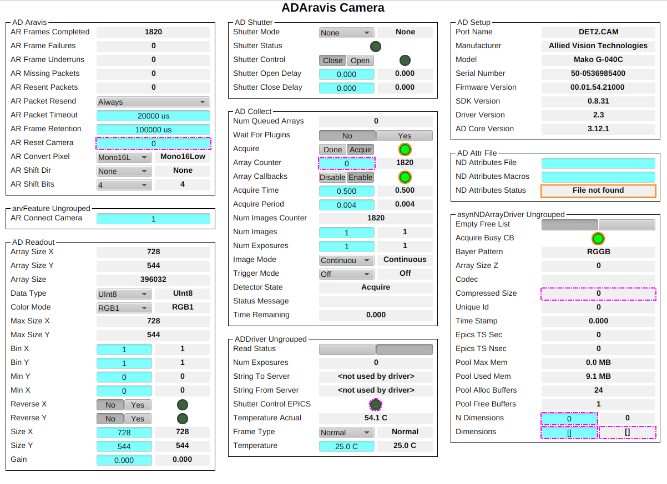
Demo: a Kubernetes Beamline at DLS P47

Slide 30
Cluster landing page

Slide 31
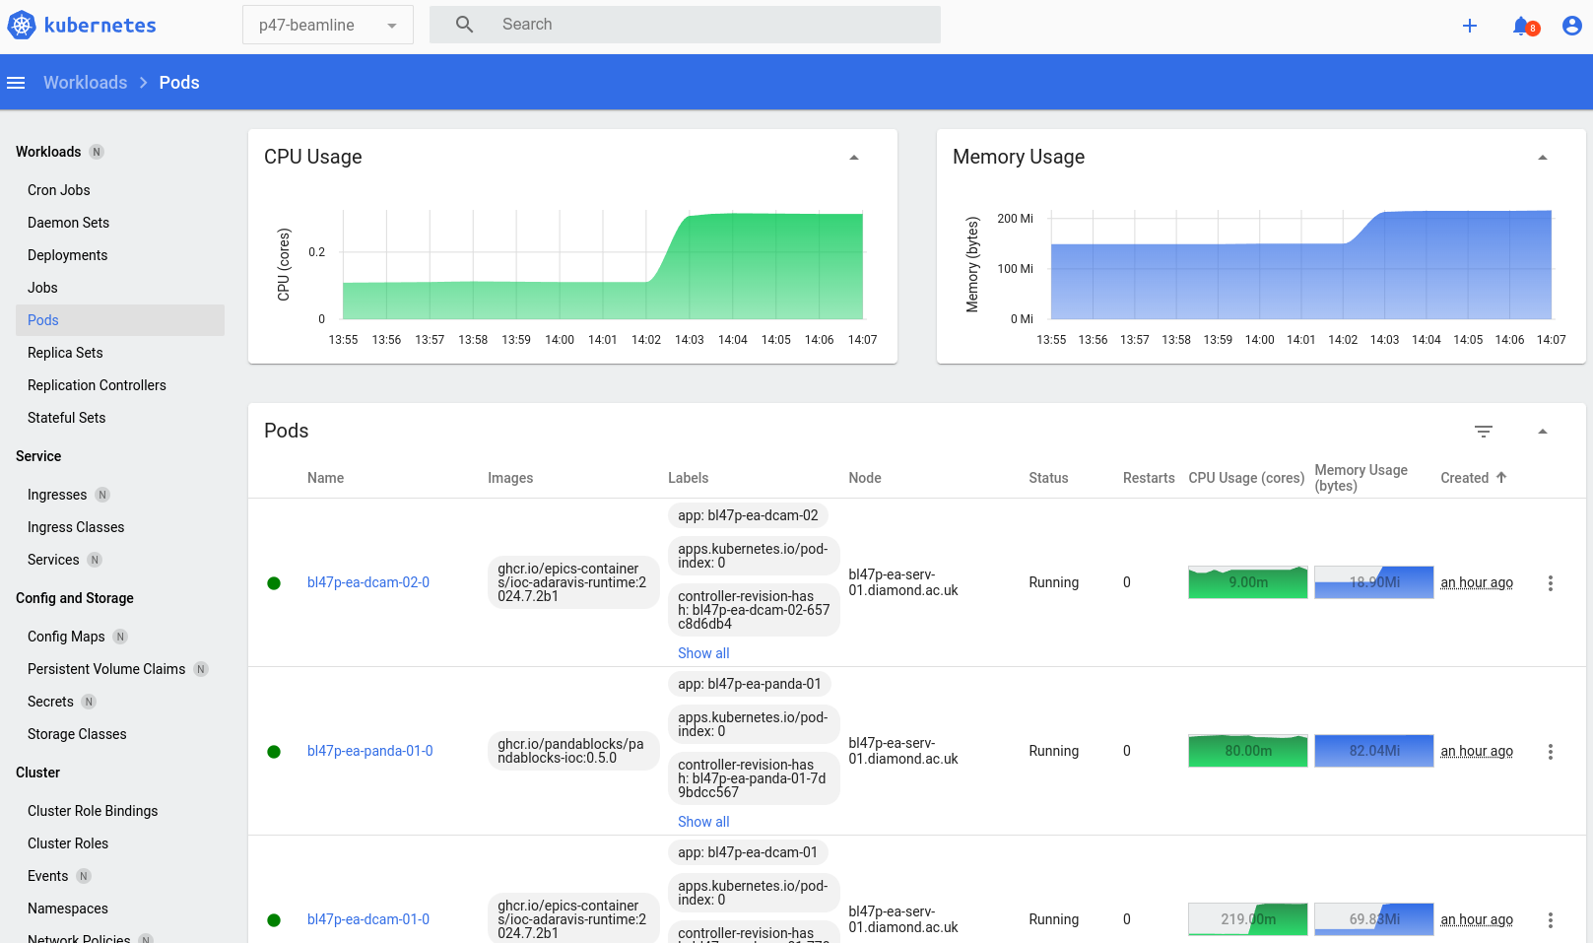
Kubernetes Dashboard

Slide 32
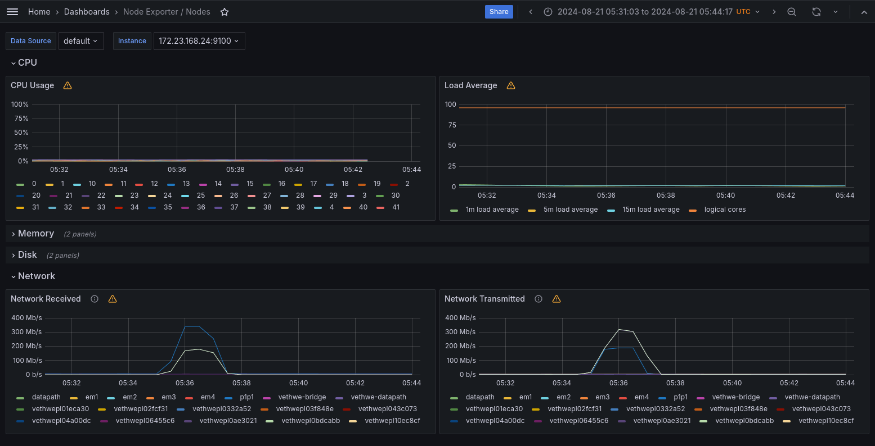
Grafana

Slide 33
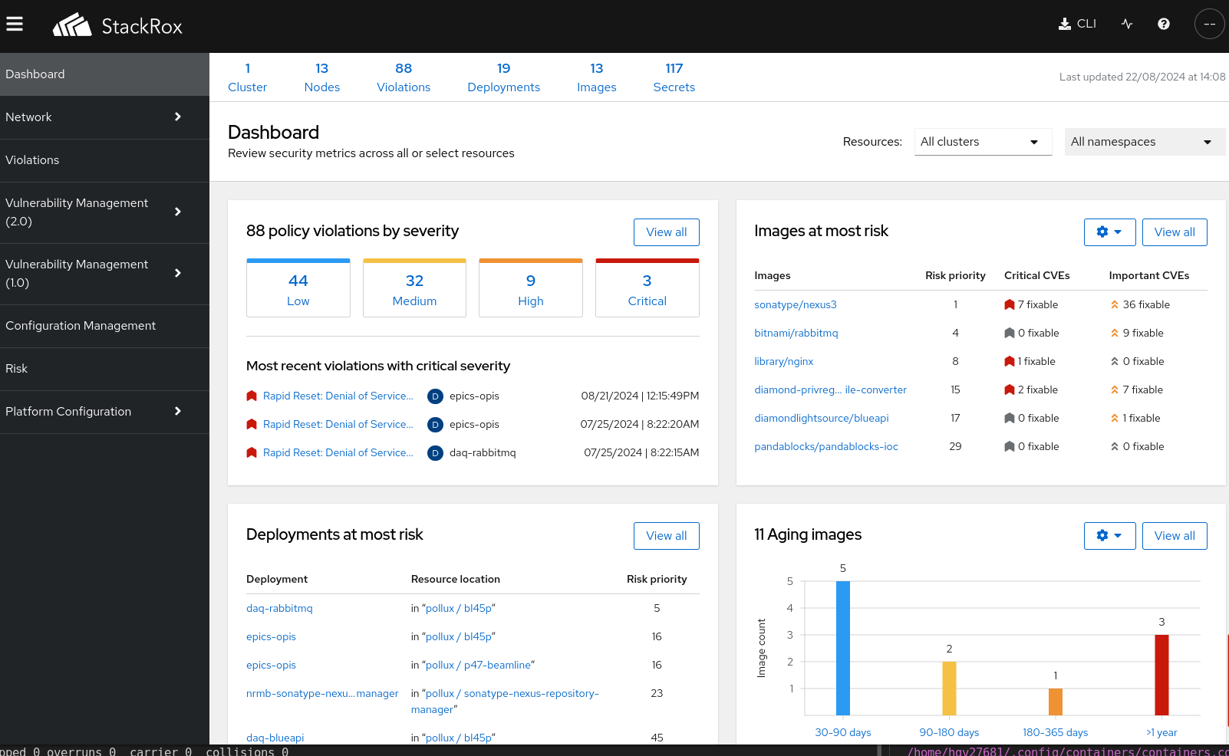
StacksRox
Investigate CVE 2024-3094
Notes:
StacksRox scans all of the running containers in the cluster for Common Vunerabilities and Exposures CVEs.
It can be set up to alert users when significant problems are detected.
I thought we'd take a look at a specific example to illustrate how security in containers looks.
In our ioc-adaravis container that we use for GigE Cameras there is a bit of suspect script – lets take a look at the reasons why this is not in fact an issue.
Open ioc-adaravis look in ibek-support/ADAravis/install.sh
This is the script that is run when we install the adaravis support module into our container
It uses xz-utils which recently was found to be adding a back door to ssh – a really significant issue
First notice that we are only using it in the developer target – what we run on the cluster is typically the runtime stage and you can see that we don't install xz-utils there, it is just used to help compile the aravis library
For the purpose of this demo I did use the developer version of the container for p47s overview camera – we would sometimes do this if we are trying to debug an issue that only occurs in cluster.
Therefore I can take a look in stacksrox and see if the container is flagged – and yes it is!
But when I drill into that it is only moderate issues I'm seeing
Let's look up the CVE in question https://www.uptycs.com/blog/threat-research-report-team/xz-utils-backdoor-vulnerability-cve-2024-3094
Apparently it is affecting 5.5.1alpha-0.1 to 5.6.1-1 version of xz-utils – so lets get a shell inside our container and see if it is affected
OK we are running 5.2.5-2ubuntu1 which should be fine and that is why stacksrox has not flagged it
In fact if we scroll down the page we see that released ubuntu versions are unaffected we base epics-containers on ubuntu LTS versions
But, even if stacksrox had flagged it and the compromised version was in our container we would still be safe.
That is because although a container may have a image of an OS it does not run an OS – it is just running the one IOC process. Therefore there is no ssh-server to be compromised here.
Even If we were running an ssh server we would only be vunerable if the ssh port were open on the container and the attack came from inside our network.
Looking around stacksrox I do see that one of the containers I have deployed is flagged with a critical denial of service vunerability
epics-opis which serves bob files to phoebus is using a special version of nginx that works in a low privilege container and it is based on an old version
We have fixed the issue that required use of this old version – so I'll update the container version soon.
If you did not have Kubernetes but were using containerized IOCs you could scan your container registry or cache in a similar fashion with one of these tools:
https://www.practical-devsecops.com/top-container-security-tools/

Slide 34
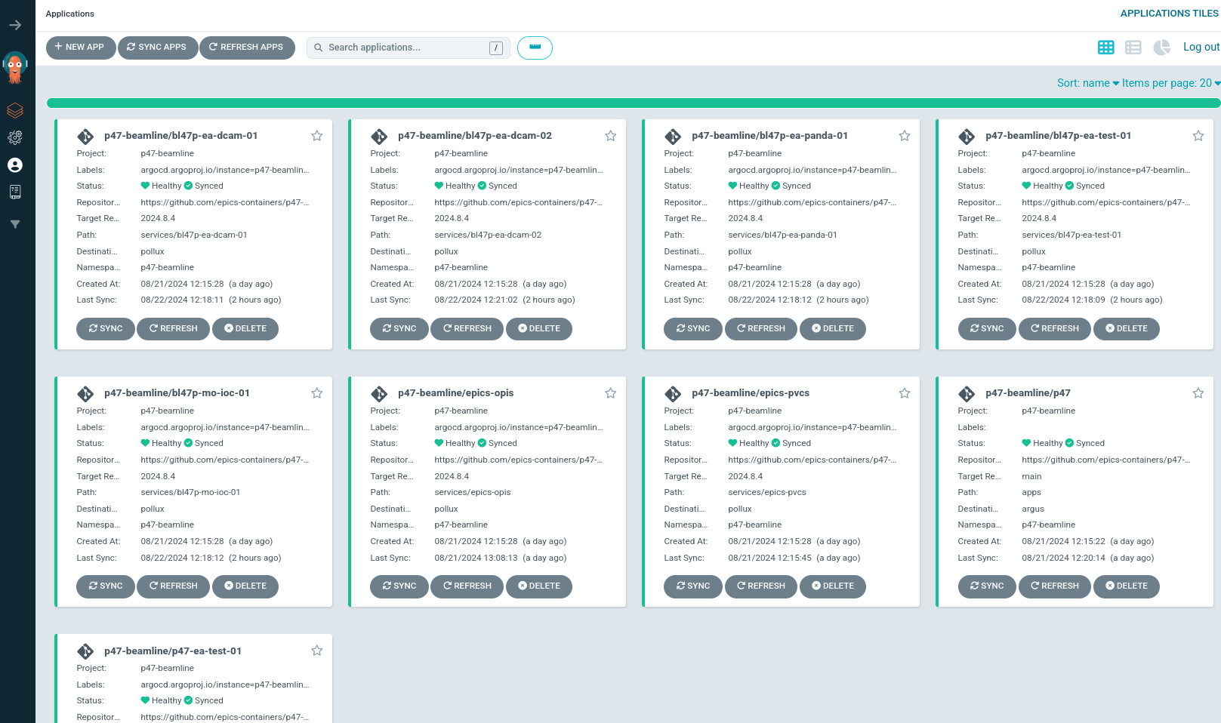
Argo CD for p47-beamline

Slide 35
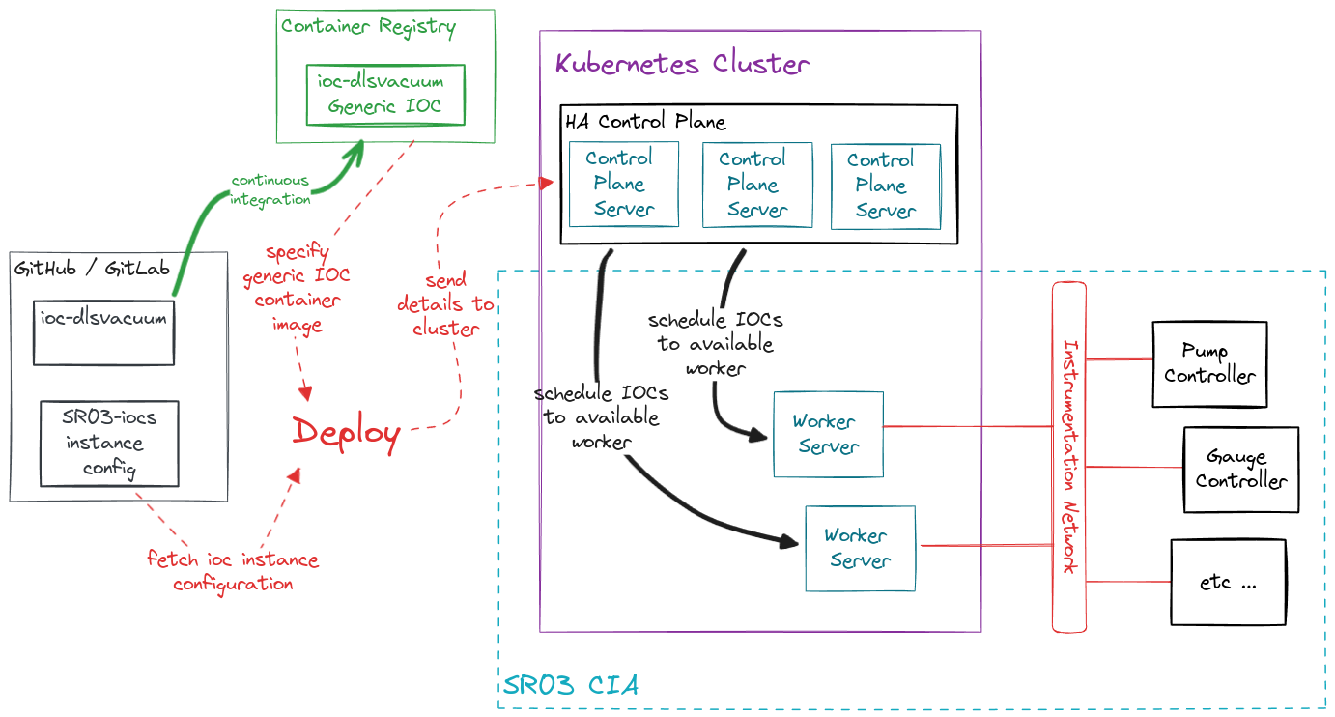

Slide 36
