Slide 1
MicroTCA Working Group
EPICS Meeting
MicroTCA Working Group
September 16-20, 2024
Alan Justice
Controls Hardware System Engineer
Oak Ridge National Laboratory
Spallation Neutron Source

Slide 2
Schedule
13:10 - 13:30 Introduction/MicroTCA at SNS
13:30 - 13:50 MicroTCA at FRIB
13:50 - 14:10 MicroTCA at FNAL
14:10 - 14:30 MicroTCA at APS
14:30 - 14:50 MicroTCA at ESS
14:50 - 15:00 Questions/Discussion
15:00 - 15:30 Break
15:30 - 15:50 SNS IPMI EPICS Tool
15:50 – 17:00 Open Discussion

Slide 3
MicroTCA Applications at the Spallation Neutron Source
EPICS Meeting
MicroTCA Working Group
September 16-20, 2024
Alan Justice
Controls Hardware System Engineer
Oak Ridge National Laboratory
Spallation Neutron Source

Slide 4
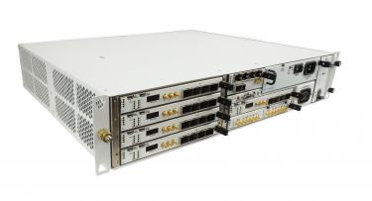
MicroTCA future at SNS
VME to MicroTCA upgrades are part of the Integrated Controls Section modernization strategy at SNS
Extensive in-house hardware & firmware expertise
Improving the reliability through extensive component health monitoring (IPMI)
This Photo by Unknown Author is licensed under CC BY-SA-NC
Vadatech VT814

Slide 5
MicroTCA Applications at SNS
Low Level RF
Ring LLRF
LINAC LLRF
Machine Protection System(MPS)
Magnet Power Supplies(PS) - Injection Kickers
Waveform Monitor
Waveform Generator
Personnel Protection System(PPS)
Beam Power Limiting System

Slide 6
MicroTCA Hardware in production at SNS
MicroTCA Systems in Production(69)
Crates
VT815(3), VT811(19), VT819(47)
FPGA cards
AMC523(92), AMC502(32), AMC560(4)
MCH
UTC002(25), UTC006(1)
Processors
AMC726(22)

Slide 7
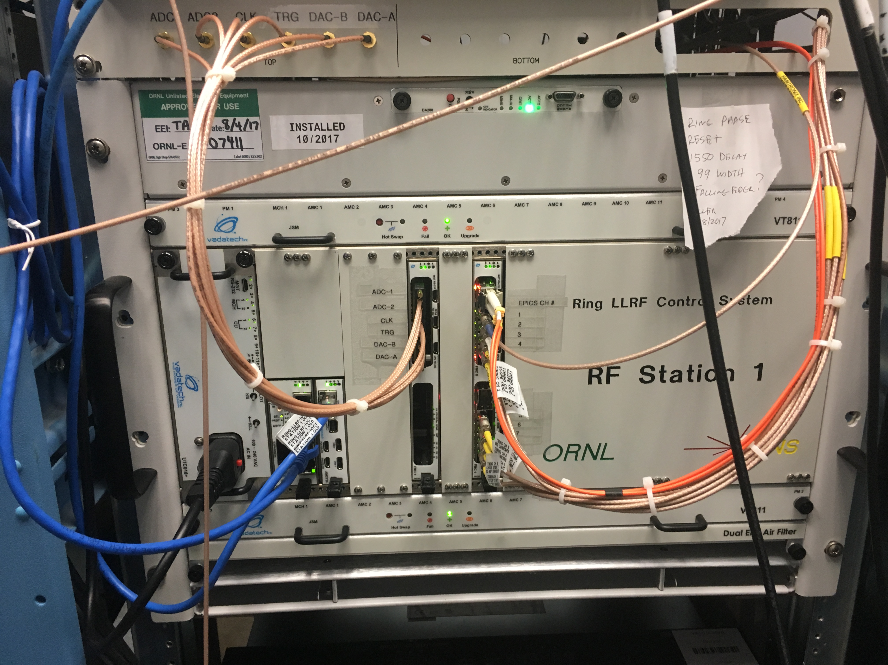
Ring Low Level RF
Upgrade from VME in 2016
First MicroTCA production deployment at SNS
Total of 4 LLRF systems in use
Hardware
Vadatech VT811 Chassis
Vadatech UTC002 MCH
Vadatech AMC502 carrier cards
Vadatech AMC726 Processor
Custom FMC Timing Receiver
Custom FMC ADC/DAC
Ring LLRF Station 1
Notes:
Preventative Maintenance
Spares

Slide 8
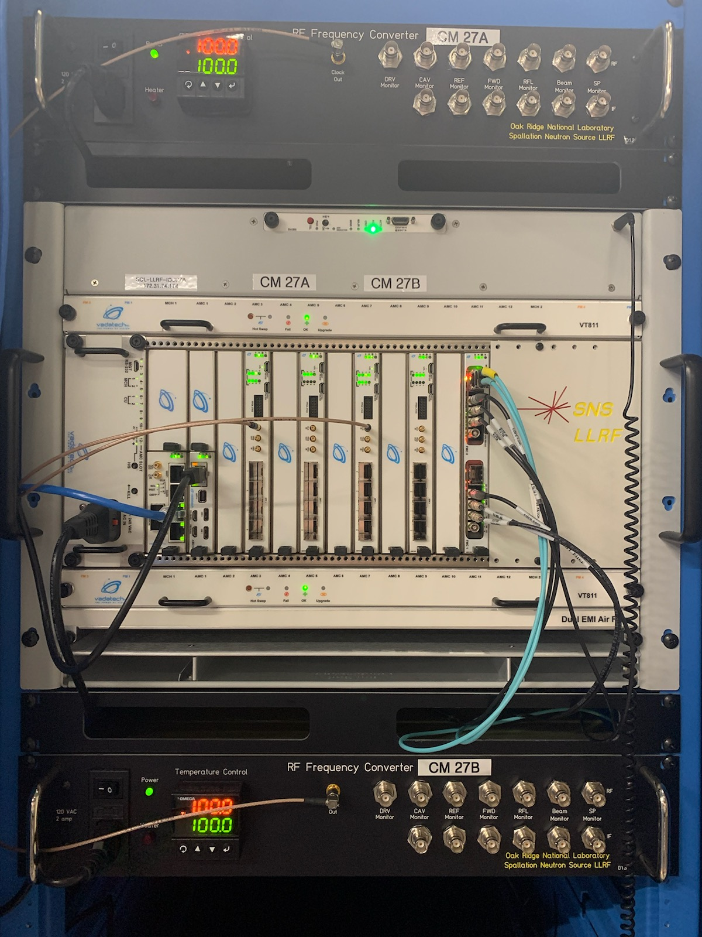
LINAC LLRF
Upgrade from VXi
Began as part of the Proton Power Upgrade Project
Total of 14 LLRF systems in use
Will be extended to all LINAC LLRF over the next 3 years
Hardware
Vadatech VT811 Chassis
Vadatech UTC002 MCH
Vadatech AMC523 with custom RTMs
Vadatech AMC726 Processor
Vadatech AMC502
Custom FMC Timing Receiver

Slide 9
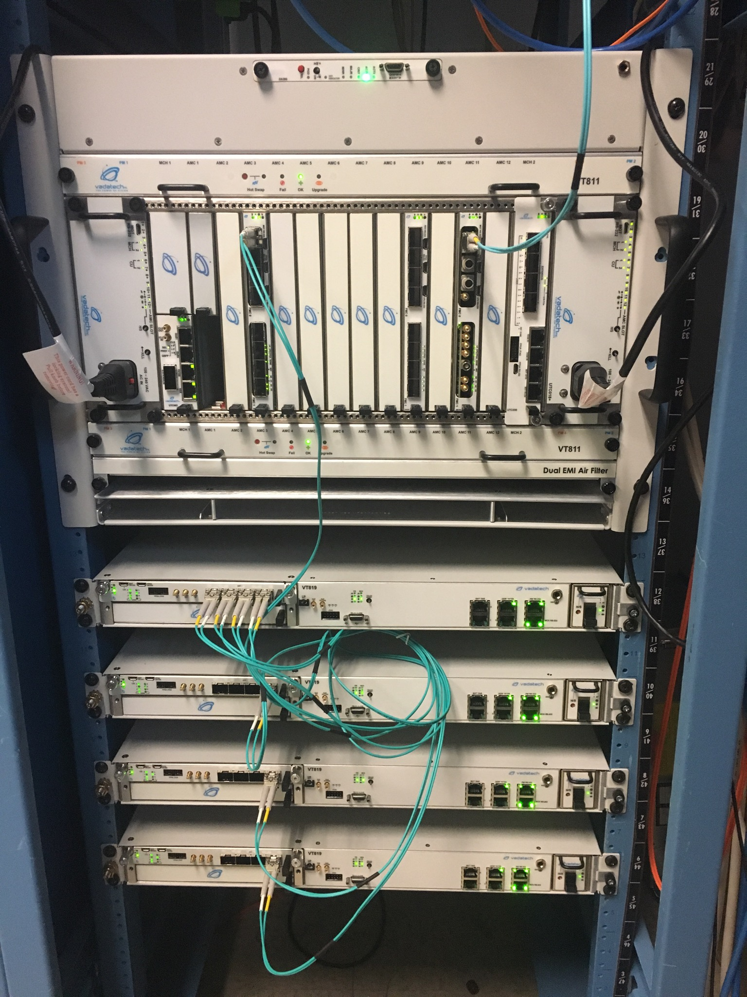
Upgraded Machine Protection System
Largest deployment so far with a total of 48 systems
Master Hardware
Vadatech VT815 Chassis
Vadatech UTC002 MCH
Vadatech UTC006 Crossbar/MCH
Vadatech AMC502 carrier cards
Vadatech FMC105 SFP transceivers
Vadatech AMC726 Processor
Field Node Hardware
Vadatech VT819 Chassis
Vadatech AMC523
Custom RTM
SNS MPS Master and Trigger Control
Notes:
Crossbar reference at the bottom

Slide 10
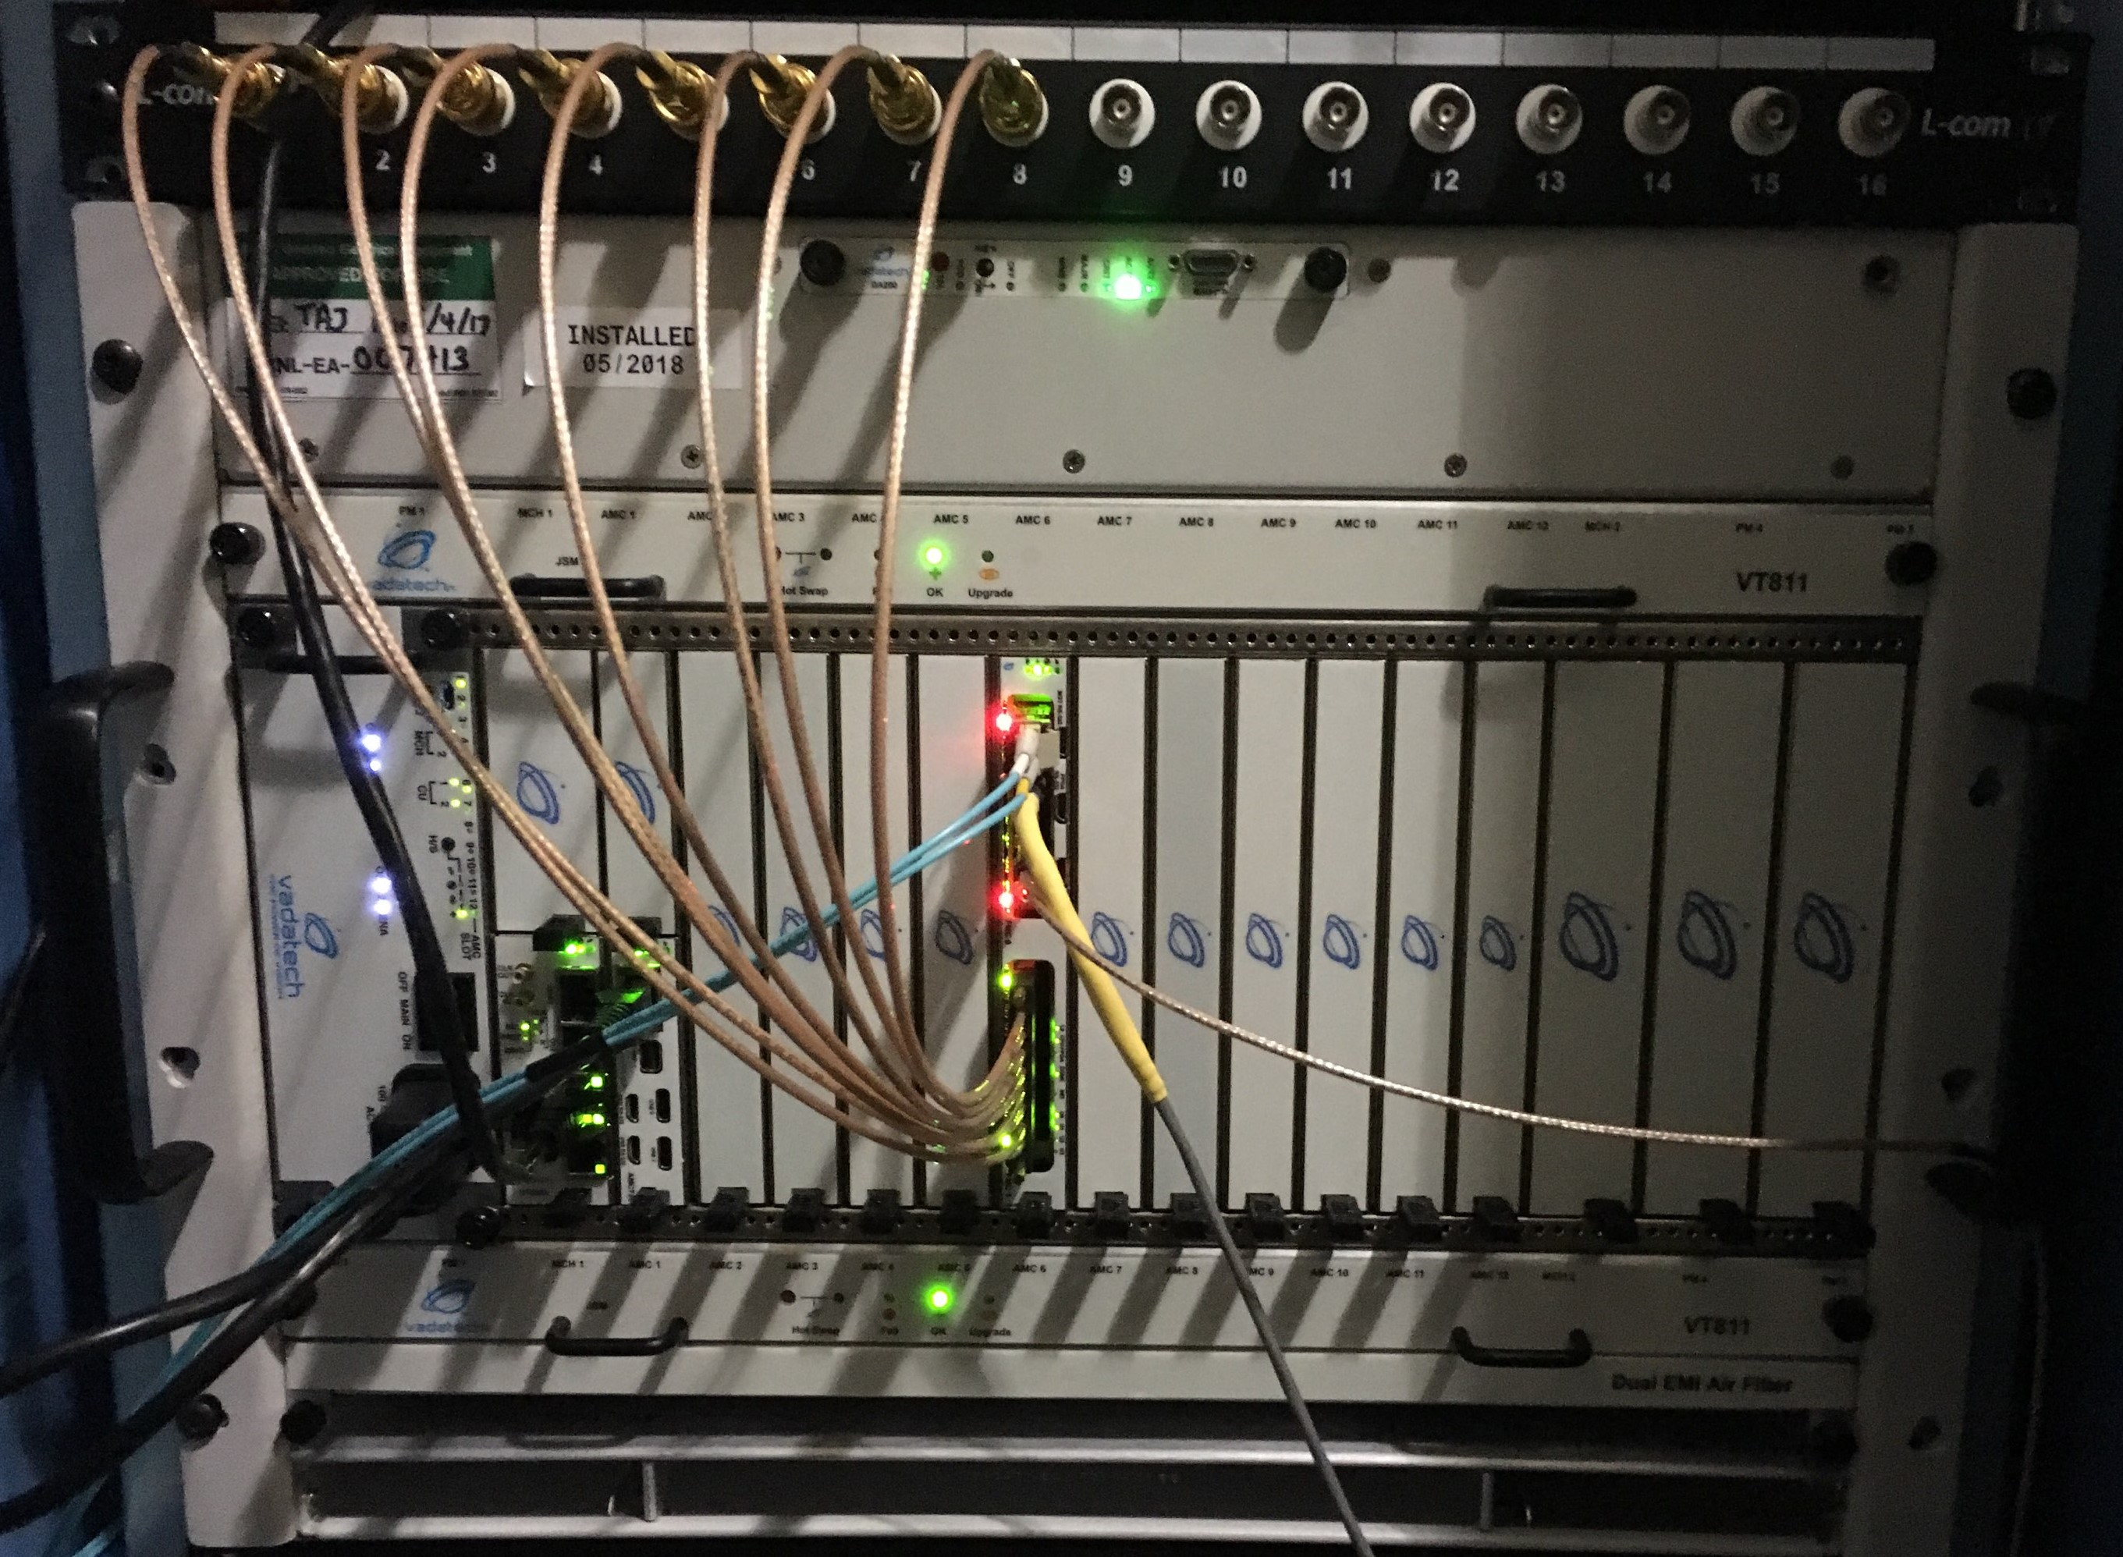
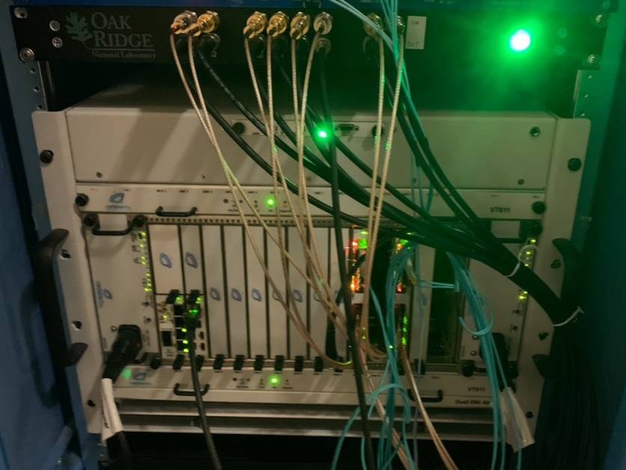
Magnet Power Supplies – Injection Kickers
Injection Kicker Waveform Monitor
Waveform Monitor Hardware
Vadatech VT811 Chassis
Vadatech UTC002 MCH
Vadatech AMC502 carrier cards
Vadatech AMC726 Processor
Custom FMC ADC
Waveform Generator Hardware
Vadatech VT811 Chassis
Vadatech UTC002 MCH
Vadatech AMC502 carrier cards
Vadatech AMC726 Processor
Custom FMC DACs
Injection Kicker Waveform Generator

Slide 11
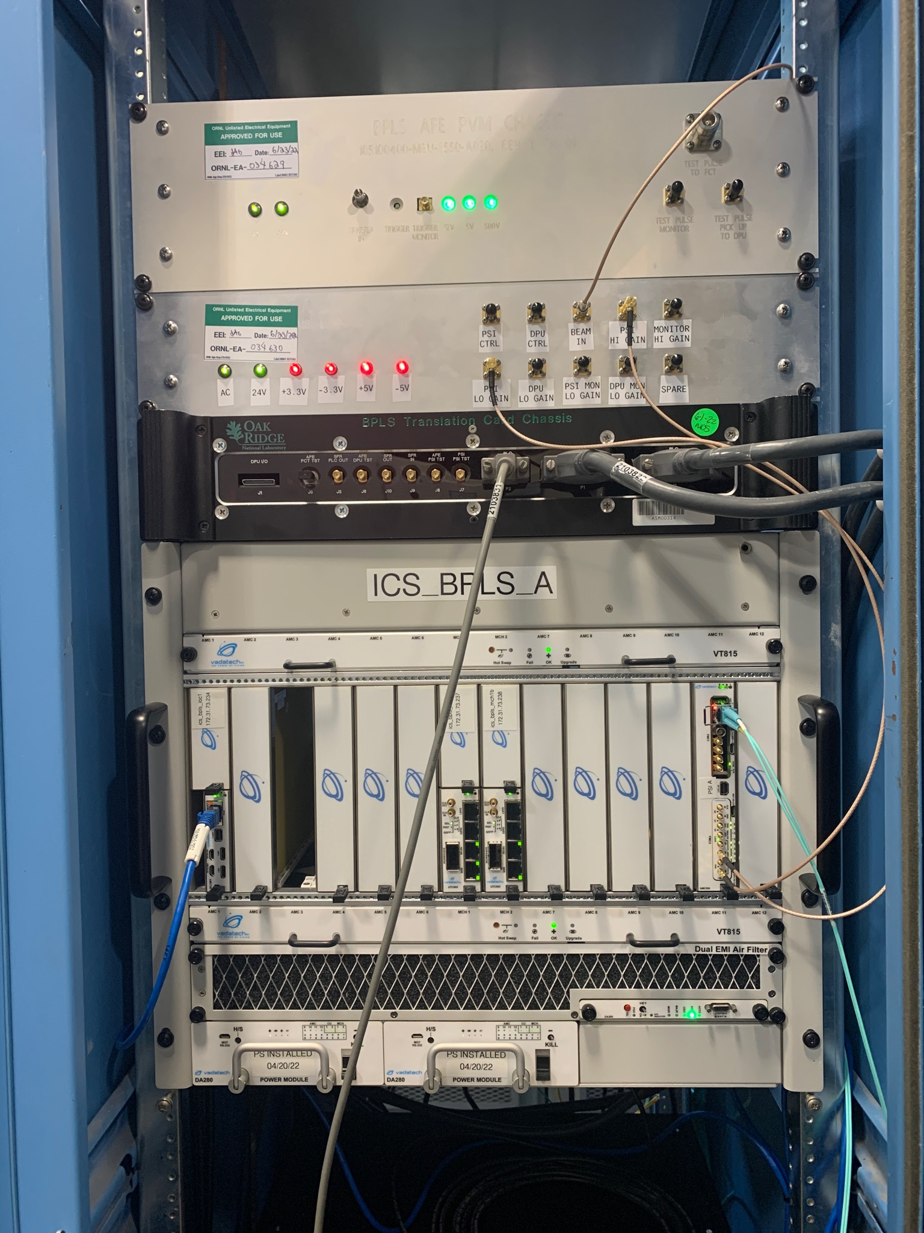
Beam Power Limiting System
Personnel Protection System and Machine Protection System functions
Limit Beam Power on First Target Station
Hardware
Vadatech VT815 Chassis
Vadatech UTC002 MCH
Vadatech AMC560 carrier cards
Vadatech AMC726 Processor
FMC 155 – RS485
FMC265 - ADC
Custom FMC Timing Receiver

Slide 12
Current and Future Development
Current Developments
LINAC HPRF
Extraction Kicker Monitor
Future Developments
LEBT Chopper
Timing Master

