Slide 1
Early Secure PV Access Prototype
Kay Kasemir, kasemirk@ornl.gov,
with Michael Davidsaver, Osprey DCS
Sept. 2024 EPICS Meeting

Slide 2
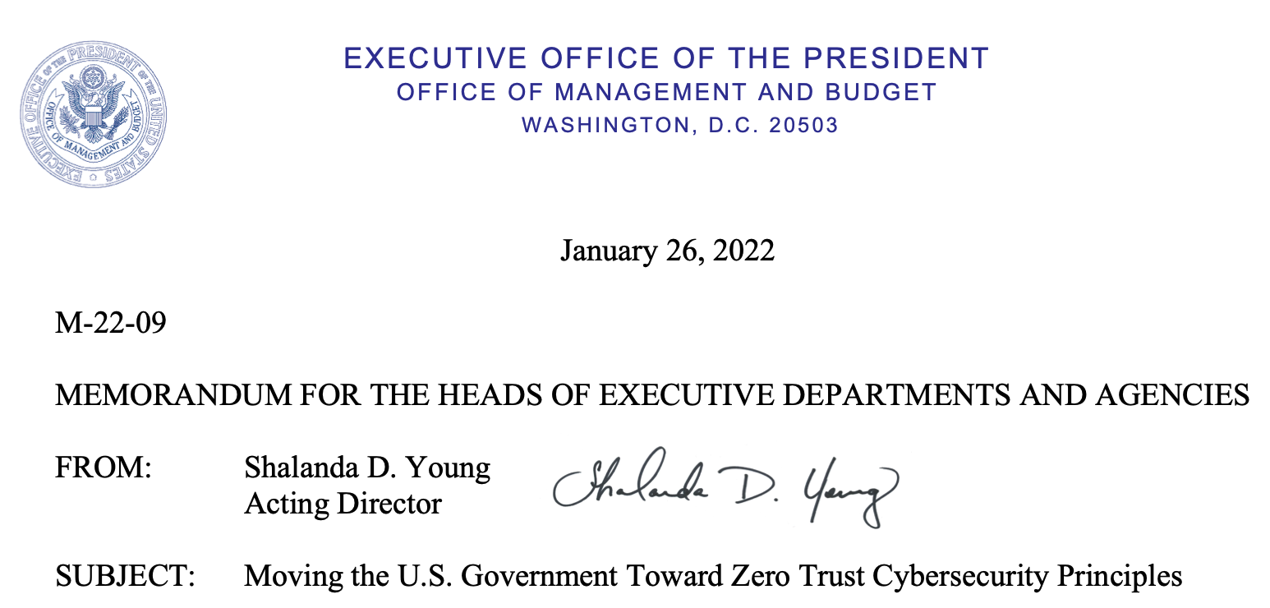
Security?
Privacy: Do we care who reads the accelerator power?
Authenticity: Is the “chief operator” logged in, do we grant write access (Authorization)? Does your organization require “https:” for all web traffic, “ssh” for all logins, “secure” for all network traffic?
➔ EPICS must soon have a secure network protocol

Slide 3
PVAccess 101
PVA Client
UDP or TCP…
PVA Server
Search for channel “X”, protocol: [ “tcp” ]
Found “X”, talk to me on tcp port 5075
TCP
5075
Read, write, subscribe, …
Basic idea:
Replace TCP with SSL/TLS
SSL - Secure Socket Layer, since 1999 called TLS - Transport Layer Security

Slide 4
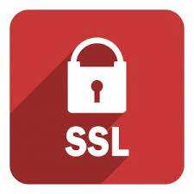
Plain vs. Secure PVA Prototype
Plain PVA Client
UDP or plain TCP…
Plain PVA Server
Search for channel “X”, protocol: [ “tcp” ]
Found “X”, talk to me on tcp port 5075*
Plain TCP
5075
Read, write, subscribe, …
Secure PVA Client
UDP, plain TCP or secure TCP …
Secure PVA Server
Search for channel “X”, protocol: [ “tcp”, “tls” ]
Found “X”, talk to me on tls port 5076*
Secure TCP: TLS v1.3, 2048-bit RSA
5076
Read, write, subscribe, …
Still replies “tcp” to older clients, but prefers “tls”
Done!
.. except for configuration details and site-specific needs
*
5076 UDP remains default for searches
5075 TCP remains default for plain TCP
5076 TCP now default for TLS

Slide 5
Example configurations
Minimal, “Hello World”
Specific keys for each IOC
Specific keys for each user

Slide 6
Secure PVA “Hello world” Setup
1) Certification Authority
3) Keypair for IOC
CA
IOC
sign
Restrict access to this private key!
2) CA Certificate
4) IOC Certificate
The CA
The IOC
The CA
IOC
CA
CA
Java keytool example. Results compatible with PVXS (C++) and core-pva (Java)
keytool -genkeypair -alias myca -keystore ca.p12 -storepass changeit -dname "CN=myca" -keyalg RSA -ext bc=ca:true
keytool -exportcert -alias myca -keystore ca.p12 -storepass changeit -rfc -file myca.cer keytool -importcert -alias myca -keystore trust_ca.p12 -storepass changeit -file myca.cer –noprompt
keytool -genkeypair -alias myioc -keystore ioc.p12 -storepass changeit -dname "CN=myioc" -keyalg RSA
keytool -certreq -alias myioc -keystore ioc.p12 -storepass changeit -file myioc.csr keytool -gencert -alias myca -keystore ca.p12 -storepass changeit -ext san=dns:myioc -infile myioc.csr -outfile myioc.cer keytool -importcert -alias myca -keystore ioc.p12 -storepass changeit -file myca.cer –noprompt keytool -importcert -alias myioc -keystore ioc.p12 -storepass changeit -file myioc.cer
“CA”:
Certification Authority

Slide 7
… “Hello world” …
5) IOC runs with EPICS_PVAS_TLS_KEYCHAIN=/path/to/IOC keystore
7) Runtime Handshake
Client: .. connect to IOC ..
IOC: Here’s my certificate
Client: I see it’s signed by the CA! You are indeed an IOC, and I now have your public key
Client: .. Sends encrypted data to IOC .. IOC: .. Replies with encrypted data ..
An IOC
The CA
IOC
CA
6) Client runs with EPICS_PVA_TLS_KEYCHAIN=/path/to/CA cert
The CA
Minimal:
One IOC cert for all IOCs
Encrypted
Authenticated
CA

Slide 8
… with individual Certificate for each IOC?…
5b) Each IOC runs with its own keystore EPICS_PVAS_TLS_KEYCHAIN=keystore for that IOC
7b) Runtime Handshake
Client: .. connect to IOC ..
IOC: I’m IOC XYZ, here’s my certificate
Client: You are indeed IOC XYZ!
IOC XYZ
The CA
IOC
CA
More work, any advantage?
IOC cert for each IOC
Encrypted
IOC is authenticated (but we presently don’t use that information)
Client is not authenticated

Slide 9
… with Client Certificate!
Plain Client
Plain Server
“I’m Chief”
6b) “Chief Operator” creates own key pair, gets signed certificate: EPICS_PVA_TLS_KEYCHAIN=Chief Operator keystore
Assume it’s “chief”
Like Channel Access security
Chief
The CA
Chief
7c) Runtime Handshake
IOC: Here’s my certificate
Client: You are indeed The IOC! Here’s my certificate IOC: You are indeed the Chief Operator! You may write ASG=ADMIN PVs:
Secure Client
Secure Server
CA
Know it’s the Chief Oper.
Client Certificate
...at least for “important” clients
Encrypted
IOC is authenticated (but we presently don’t use that information)
Client is authenticated (via “x509 principal”)
# example.acf
UAG(admins) { "x509/Chief" } ASG(DEFAULT){ RULE(1,READ) } ASG(ADMIN) { RULE(1,READ) RULE(1,WRITE){ UAG(admins) } }

Slide 10
Implementation Status
dormant
current
current
branch
CS-Studio (Eclipse)
EPICS 7.x softIocPVA
pvaPy
CS-Studio (Phoebus)
EPICS 7.x
softIocPVX
P4p & gatew.
pvAccessJava
pvAccessCPP
Core-PVA (Java)
PVXS (C++)
TLS
Plain TCP
Implemented in PVXS (C++) and PVA (Java) libraries
https://github.com/mdavidsaver/pvxs/pull/53 https://github.com/mdavidsaver/pvxs/tree/tls, Michael Davidsaver, Osprey DCS
https://github.com/ControlSystemStudio/phoebus/tree/master/core/pva https://github.com/ControlSystemStudio/phoebus/blob/master/core/pva/TLS.md

Slide 11
Secure PVA Prototype Summary
Secure PVA Client
Secure PVA Server
PVA can be secure
Encrypted
Authenticated
Recipes for creating keys and certificates
Local CA, IOC (server) certificates, client certificates
‘softIocPVX’ can communicate with both plain and TLS clients
Supports `UAG { … “x509/UserName” }`
Security prototype is available right now, but manual handling of certificates is cumbersome
Larger EPICS Security Project
tls

Slide 12
Additional Material

Slide 13
Public/Private Key Encryption
Bob has a public and private key (key pair)
Either one can encrypt(!), and the other then decrypt
Public key is shared with anybody (in ‘certificate’)
Privacy:
Alice sends a message to Bob
Mallory can’t read it
Bob can decode it
Authenticity:
Bob sends a message
Anybody can decode
If it decodes, it must be from Bob
Hi!
??
Hi!
It’s Bob
??
It’s Bob
“It’s Bob”
??
????

Slide 14
Bootstrapping Secure Communication
Alice knows Bob’s public key…
Alice calls Bob, who identifies as himself
Alice securely sends her (temporary) public key to Bob
Using that key, Bob can now encrypt messages back to Alice…
➔ Depends on Alice knowing and trusting Bob’s public key
It’s Bob
??
It’s Bob
My Key
??
My Key

Slide 15
Trusted Certificate Chains
Operating system, web browser: List of “Certification Authorities”
Amazon, DigiCert, Entrust, Verisign, …
.. or create your own local CA
CA, using its private key, can “sign” a certificate for Bob
Alice can check Bob’s signed certificate using the known public key of a CA
2) Here you go…
Bob
It’s indeed Bob’s public key
-- The CA
Bob
CA
CA
3) Call Bob…
1) Please sign…
4) Hi, here’s my signed cert.
5) Check signature using CA’s public key.. ➔ This is Bob’s public key!
Bob

