Slide 1





OPC UA
EPICS Device Support
Interfacing Industrial Controllers
Ralph Lange

Slide 2
Controller Integration Wishlist
Also the OPC UA Feature List
Symbolic addressing
  names, not numbers
No PLC programming
  keep contractors happy
Industrial standard
  one to connect them all
Portability
  at least Linux, Windows
User-defined structures
  for reusable PLC objects
Subscription mechanism
  update on change
Server-side queues
  handle bursts well
Browsing support
  find variables easily
Security (TLS, X.509)
  encrypt, sign, authenticate
Remote procedure calls
  with parameters and results

Slide 3


The OPC UA Standard
Interfacing SCADA to Controllers (PLCs)
Industrial standard (2008) to interface controllers
  Covers data, alarms, events, historical data, remote methods
  Symbolic addressing
  Browsable
Based on OPC Classic (Microsoft, 1996), adding
  Portability (does not require DCOM/Windows)
  WAN Support (TCP instead of DCOM)
  Safety/security (certificate-based authentication and encrypted connection)
  Information modeling (user-defined structures)

Slide 4
EPICS Device Support Module
Brief History
Evaluation of client library options and Device Support prototype
Bernhard Kuner (HZB/BESSY)
ITER use cases tested by F4E (Spain) and TCS (India)
  Against S7-1516/1518 embedded OPC UA server
  Against WinCC-OA embedded OPC UA server
Current implementation, using a design that allows integrating different low-level client libraries
Recent major contributions from PSI, HZB/BESSY and ESS

Slide 5
EPICS Device Support Module
Low-Level OPC UA Client Choices
Stable: Use of commercial C++ Client SDK by Unified Automation
  4k€ for source code and 1 year support (extend support: 20% per year)
  one developer/many products or many developers/one product
  Binaries can be deployed/distributed royalty-free
  Platforms: Windows and Linux; evaluation bundles available
  Newest versions (1.7.9 and 1.8) have issues
New: Use of free open62541 SDK client libraries
  Work by Dirk Zimoch (PSI) and Carsten Winkler (HZB/BESSY)
  Not trivial to set up
  More complexity on the Device Support side
  Less documentation than the Unified Automation SDK

Slide 6
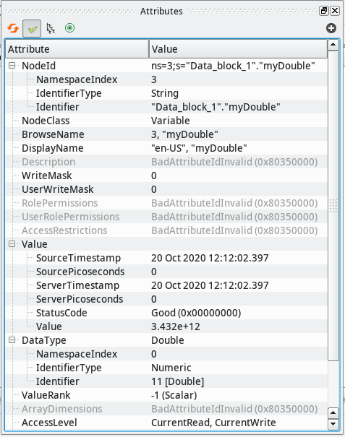
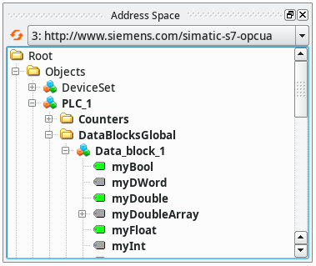
OPC UA Integration Workflow
Step 1: Browse the Server
Free browsing tool: UaExpert

Slide 7
OPC UA Integration Workflow
Step 2: Configure the IOC
Configure the OPC UA server connections from the startup script
Add an EPICS record to your database
    opcuaSession PLC1 opc.tcp://plc1.controls.local:4840 sec-mode=None
    opcuaSubscription SUB1 PLC1 200
    record(ai, "$(DEVICE):dbl1") {
    field(DTYP, "OPCUA")
    field(INP, "@SUB1 ns=3;s=\"Data_block_1\".\"myDouble\"")
    field(PREC, "3")
    }

Slide 8
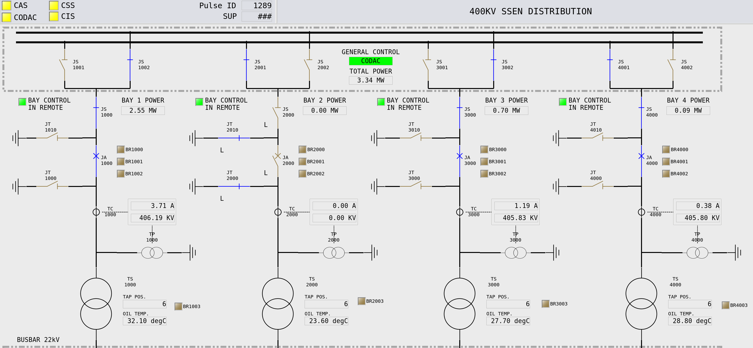
OPC UA Integration Workflow
Step 3: Design Your Client Applications and Connect

Slide 9
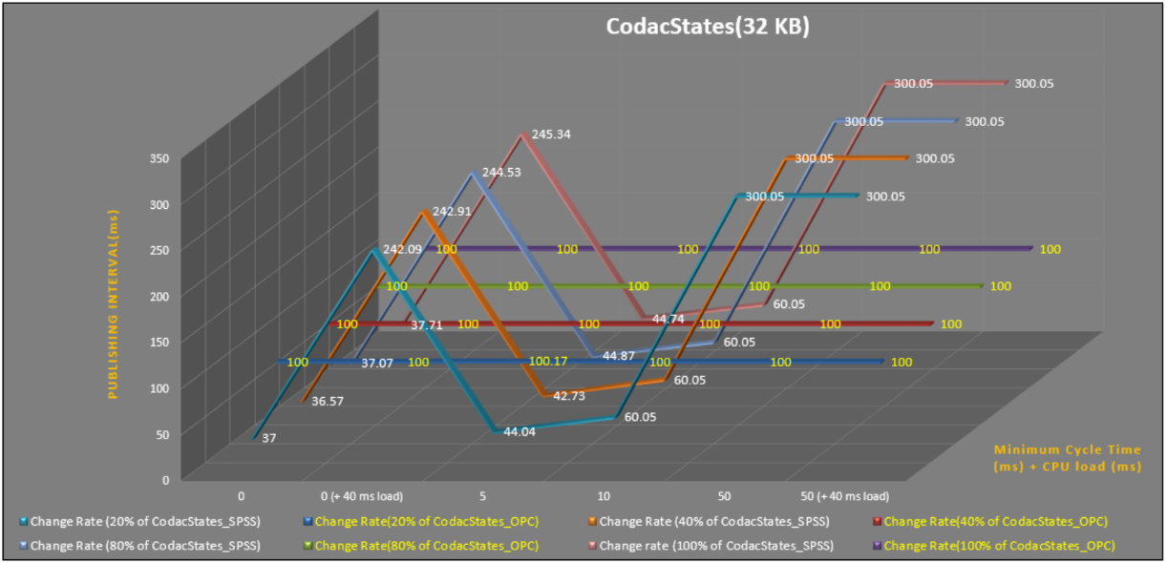
Performance
It All Depends – Mostly on the Server
Early tests by TCS, comparing TCP Data Block transfer with OPC UA:
“big” S7-1518, 32kB data (integers), “empty” / 40ms cycle artificial load

Slide 10
Performance
It All Depends – Mostly on the Server
Test in 2021 for ITER building automation integration
  Trying to verify realistic conditions
  3x the estimated size (500kB data, mixed types)
  On a mid-size S7-1516
  250ms sampling/publishing period
  No performance fine-tuning
Results:
  Fit for this purpose
  Best performance when using few large structures

Slide 11
Limitations
It All Depends – Mostly on the Server
Limits found on the server end
  S7-1500: depends on the model (S/M/L) and data organization
  How many, how large, how often?
  Client-side fine tuning available
  e.g., “registering” items to cache server-side name resolution
  Servers separate from PLCs introduce additional latency
Found one limit in the client
  LabVIEW serving 600 arrays of 7500 doubles each (~36MB data)
  -> SDK client has a limit of ~16MB for the serializer
  Solved by splitting to three subscriptions of 200 arrays each

Slide 12
EPICS Device Support Module
Status
Requirements Specification v1.1: https://bit.ly/opcua-srs-11
Design done (no formal doc)
Implementation nearly complete
  All basic data types and arrays thereof (read/write/subscribe)
  Supporting all applicable EPICS record types (bidirectional outputs)
  User-defined structures (read/write/subscribe), timestamps from data
  Server-side queues, configurable connection behavior
  OPC UA Security (encrypt, sign, authenticate)
  Lots of testing help by Roland Fleischhauer (HZB/BESSY)
  Integrated end-to-end test against a software server
  Work by Ross Elliot and Karl Vestin (ESS)

Slide 13
EPICS Device Support Module
Roadmap
Started:
  Wiki pages: List of servers that have been integrated
  Useful tricks and hints
Currently:
  User Manual (Ralph)
  ~30% done: integration of current READMEs and Cheat Sheet
  Server-side deadband filters (Dirk)
  Better enum support (read choices from server) (Dirk)
Soon:
  Support for OPC UA methods (remote execution of PLC code) (Ralph)
  Support for servers that change structures on-the-fly (Karl)

Slide 14
Users (2022)
Facility | OPC UA Server | Status
ASIPP | LabVIEW | production
 | PLC Siemens S7-1500 | production
Australian Synchrotron | PLC Siemens S7-1500F | near production
BESSY II @HZB | PLC Siemens S7-1500 | production
 | Phoenix Contact | production
 | Softing uaGate | production
CHIMERA @CCFE | PLC Siemens S7-1500 | development
 | LabVIEW | development
ESS | PLC Siemens S7-1500F | production
 | ABB Power SCADA | near production
 | Siemens DESIGO | development
Fermilab | Kepware KEPServerEX | testing
 | PLC Siemens S7-400 | development
IPR | PLC Siemens S7-1500 | testing
ITER | PLC Siemens S7-1500 | production
 | Siemens WinCC OA | production
 | PCVue | production
KATRIN @KIT | LabVIEW | prototyping
PSI | PLC Siemens S7-1500 | development
Varian ProBeam | PLC Siemens S7 | production
 | PLC Beckhoff | production

Slide 15
EPICS Device Support Module
Download
Device Support under EPICS license
Upstream repository, Wiki pages, binaries, (future manual):
https://github.com/epics-modules/opcua
The GitHub download area has statically linked shared libraries containing the Unified Automation SDK client
(i.e., plug-in libraries to link your IOCs against)
  Easy to use, fully functional, free forever
  Needs to match exactly your Linux distro and EPICS Base
  Used in the hands-on training on Monday

