Slide 1
Timing Workshop
EPICS Collaboration Meeting
Oak Ridge, September 20, 2024
Timing System Introduction – Jukka/MRF
Demo – Joao/ESS
Event Timing for cPCI-Serial – PSI, presented by Jukka

Slide 2

Micro-Research Finland Oy
MRF Timing System Development
The MRF Timing system originally developed for the Swiss Light Source (SLS), Paul-Scherrer Institute in 1999
First commercially available timing system for particle accelerators
Current users include:
  SLS, PSI, Switzerland
  Diamond Light Source Ltd., U.K.
  SSRF, Shanghai, China
  Australian Synchrotron
  ALBA, Spain (Tango)
  Elettra, Trieste, Italy (Tango)
  BEPCII, Insitute for High Energy Physics, Beijing, China
  LCLS, Stanford Linear Accelerator Center, USA
  KEK, Japan
  FERMI, Trieste, Italy (Tango)
  TLS, Taiwan
  KIT, Germany
  NSLS II, Brookhaven, USA
  PAL-XFEL, Pohang, South Korea
  LANSCE upgrade, Los Alamos, USA
  FRIB, Michigan, USA
  SwissFEL, PSI, Switzerland
  STFC, Daresbury, U.K.
  ESS, Sweden
  APS-U, Argonne National Lab, USA
  ELBE, HZDR, Germany
  Bessy II, Germany
Most of the sites listed above are using EPICS
jukka.pietarinen@mrf.fi

Slide 3
Micro-Research Finland Oy
What do you need a timing system for?
Phase and frequency locked clocks at different locations
Trigger something at different locations at the same time with high accuracy
Make something happen in sequence with predefined time intervals
Synchronize the local time at different locations with high precision
Timestamp events at different locations to analyze what happened first or timestamp data acquisition

Slide 4
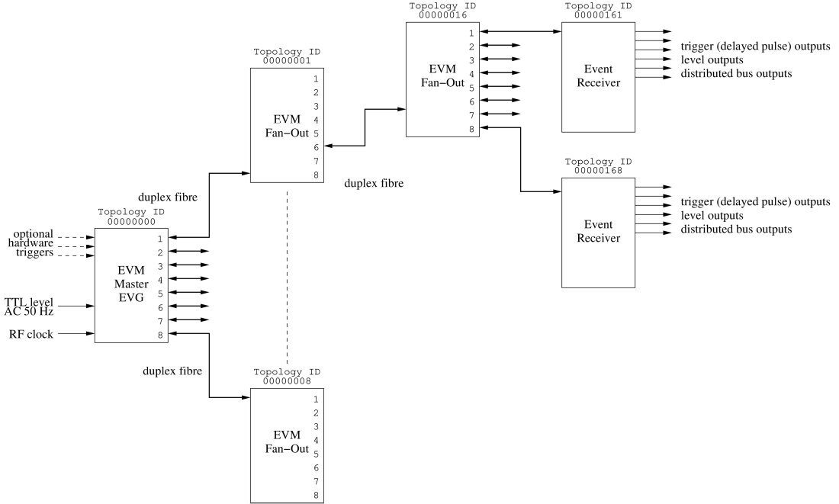
Typical System Layout - Delay Compensation (DC)
Event link protocol carries:
8 bit event codes @ event rate max. 167 MHz
8 bit distributed data bits @ ½ event rate
Data buffer transfers up to 2 kbyte
Segmented data buffers up to 128 x 16 bytes
Max. data transfer rate 83 Mbytes/s

Slide 5
Micro-Research Finland Oy
Operating Principle of the MRF Timing System
Event based system
256 Event codes, one event code/cycle (7 ns - 20 ns or 50 MHz to 142 MHz)
In addition to events there are eight signals (distributed bus) that are updated at half the rate (14 ns - 40 ns or 25 MHz to 71 MHz)
Synchronous data transfers
Transmission medium: optical fiber
  multi-mode 850 nm, OM3 or better up to 550 m
  single-mode 1310 nm, up to 10 km
  Two-color single mode 1270/1330 nm over single fiber, up to 10 km
Line code or “event stream” based on 8B10B encoding

Slide 6
Micro-Research Finland Oy
Event Clock
Base clock of MRF timing system
Typically driven from external source e.g. accelerator RF signal
Has to be in range 50 MHz to 142 MHz (7 ns to 20 ns cycle)
Has to be provided to the Timing System Master, all other nodes regenerate this clock from the event stream received through the fiber
The Timing Master has an input divider to divide the provided RF clock by 1, 2, 3, ..., 12, 14, 15, 16, ..., 32.Event based system

Slide 7
EVG Basic Building Blocks
Trigger Events
Multiplexed Counters
Sequencers
Software Event
Time distribution logic
Configurable Size Data buffer
Segmented Data buffer

Slide 8
Trigger Event
A Trigger Event has one event code assigned to it
Upon a trigger this event code is sent out
Sources for triggers:
  External signal
  Multiplexed Counter edge
  AC main synchronization logic

Slide 9
Multiplexed Counter
32 bit counters running at the event clock rate
Can produce frequencies from event clock rate/(2³² - 1) to event clock rate/2
Counters can be reset simultaneously by software
Configurable polarity

Slide 10
Sequencer
A sequencer sends out events in predefined order with predefined timing
2k dual-port memory for 32-bit timestamp, event code and mask
Operating modes: single, normal (trigger) and recycle

Slide 11
Sequencer triggering
Multiplexed counter
AC Synchronization logic
External trigger
Software trigger

Slide 12
Sequencer operating modes
Single sequence mode
  Plays back sequence once until end sequence event
Normal mode
  Plays back sequence and waits for next trigger after end sequence event
Recycle mode
  Plays back sequence and immediately restarts sequence from beginning after end sequence event

Slide 13
Time Distribution Logic
Support for 32 bit Seconds register
32-bit sub second register - e.g. 1 us precision can be used
Seconds value is send out with event codes
Sub-second clock is send out as an event or on the distributed bus
1 PPS and faster clock e.g. 1 MHz have to be supplied externally and these two clock must be rising edge aligned

Slide 14
Configurable Size Data Buffer
2k byte dual-port memory
Transfer size 4 bytes to 2k in 4 byte increments
Controlled by software

Slide 15
Segmented Data Buffer
Introduced with Delay Compensation hardware
2k byte dual-port memory
128 16-byte segments
Can send a single or multiple segments at a time
Controlled by software
Last segment #127 is reserved for delay compensation
  delay compensation data
  Topology ID

Slide 16
EVR Basic Building Blocks
Event Mapping RAM
Pulse Generators
Prescalers
Timestamping logic
Event FIFO
Event Log
Data buffer
Segmented Data buffer

Slide 17
Event Mapping RAM
256 x 128 bit dual-port RAM
Each event code has 128 bits assigned and these bits define what functions are to be performed
Map bit | Default event code | Function
127 |  | Save event in FIFO
126 |  | Latch timestamp
125 |  | Led Event
124 |  | Forward event
123 | 0x79 | Stop log
122 |  | Log event
101 | 0x7A | Heartbeat
100 | 0x7B | Reset Prescalers
99 | 0x7D | Timestamp reset event
98 | 0x7C | Timestamp clock event
97 | 0x71 | Timestamp Seconds ‘1’
96 | 0x70 | Timestamp Seconds ‘0’
95 - 64 |  | Trigger pulse generator 31 - 0
63 - 32 |  | Set pulse generator 31 - 0 output high
31 - 0 |  | Reset pulse generator 31 - 0 output low

Slide 18
Pulse Generator

Slide 19
Prescaler
Programmable counter that can produce different frequencies
All prescalers are reset by one event code, thus all prescalers on all EVRs can be synchronized
Can be output directly on I/O or used to trigger pulse generators

Slide 20
Timestamping Logic and Event FIFO

Slide 21
Event Log
Similar to Event FIFO, but with ring buffer
Event FIFO stops when full
Event Log rolls over and overwrites old events
Can be used for diagnostics: stop log event e.g. after beam loss, read out log events

Slide 22
Data Buffer
Receive Data Buffer send by EVG
Data buffer has to be armed to receive anything
Data buffer is automatically disable after a received buffer
Data buffers can be lost if buffer is not read and re-armed before EVG sends next buffer
Software interrupt upon reception

Slide 23
Segmented Data Buffer
Receive Segments send by EVG
Segmented Data buffer is enabled all the time
Flags for each segment: receive complete, checksum mismatch, overflow flag
Each segment has a received data bytes counter
Software interrupt configurable for each segment independently

Slide 24
Micro-Research Finland Oy
Delay Compensation
RF input
VME-EVM
Delay Compensation Master
Beacon event 0x7A, @ ~4 kHz
Master DC Data Packet: delay value ½ of round-trip delay to next stage
Triggers
Fan-Out / Concentrator
Send back beacon event
Measure internal delay (beacon propagation time)
Send beacon forward
DC Data Packet: sum of received delay value + internal delay + ½ of round-trip delay to next stage
VME-EVM
VME-EVR
EVR
Send back beacon event
Measure receive FIFO delay
Adjust FIFO and recovered clock phase so that received delay value + FIFO delay matches target delay

Slide 25
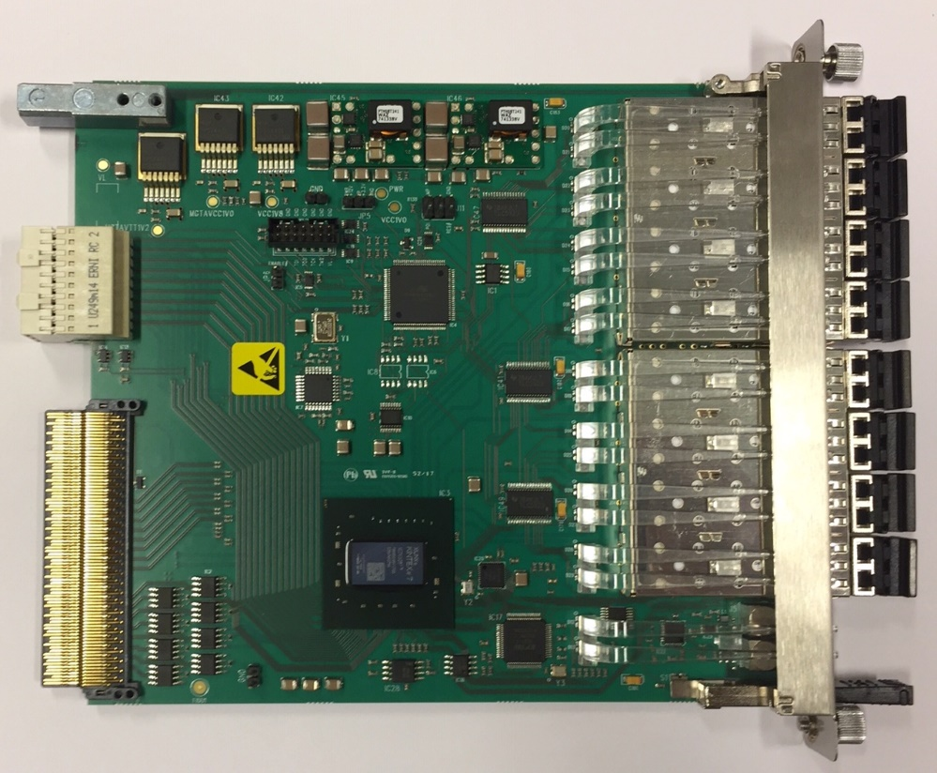
mTCA-EVM-300
Event Generator (EVG)
  2 sequencers with maskable events
    Max. 2047 events/sequence
    32 bit timestamp
  8 multiplexed counters
  data buffer up to 2k bytes
  segmented data buffer
    127 segments, 16 bytes each
7-Way Fan-Out/Concentrator
Two Event Receivers (EVR)
  8 internal pulse outputs
  one sequencer
Event rate conversion (with some data buffer related limitations)
Front panel input phase monitoring/select features
Distributed bus phase selection
RF input monitoring
Support for rear transition module

Slide 26
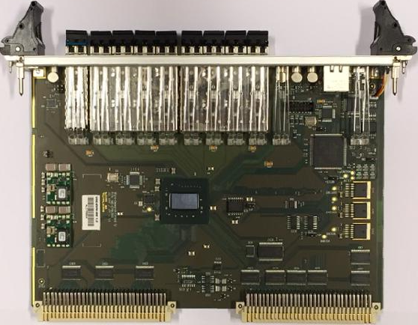
Micro-Research Finland Oy
VME-EVM-300
VME64x
Event Generator
8-Way Fan-Out / Concentrator
Event clock up to 142,9 MHz
Integrated Fan-Out Concentrator and Event Generator
  Reference clock from RF input or recovered clock from upstream EVM
  Allows for fully synchronized downstream EVGs
Masked events in Sequencer
  Hardware or software mask/enable
Segmented Data Buffer
  127 segments of 16 bytes each (2 kbyte buffer)

Slide 27
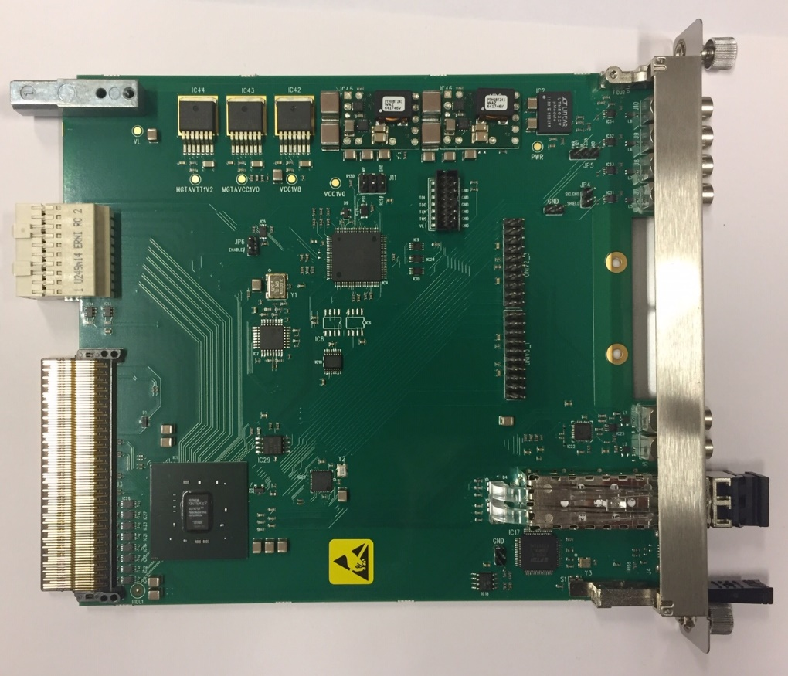
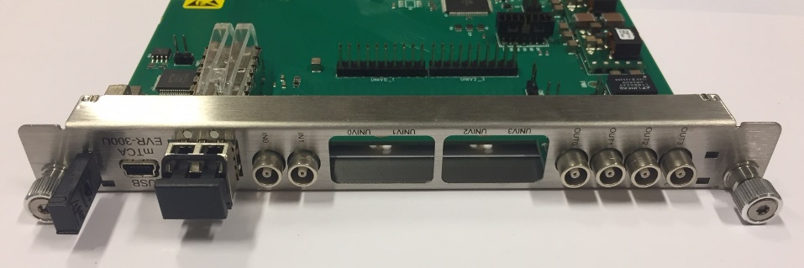
Micro-Research Finland Oy
mTCA-EVR-300U
Event Receiver (EVR)
Two Universal I/O slots
  both compatible with -DLY modules
Four LVTTL outputs
Two TTL inputs for external triggers
Backplane triggers
Can drive TCLKA/TCLKB clocks with GTX logic
RTM interface

Slide 28
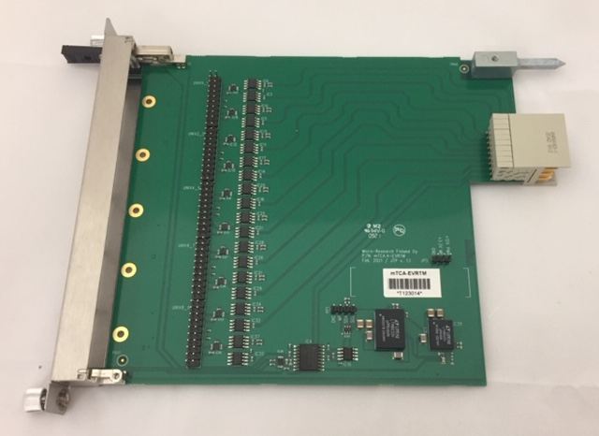
Micro-Research Finland Oy
mTCA-EVRTM-300
Supports up to 5 Universal I/O Modules
Up to ten inputs or outputs
Can be used for mTCA-EVM-300, mTCA-EVR-300U and mTCA-EVR-300RF
Supports –DLY modules

Slide 29
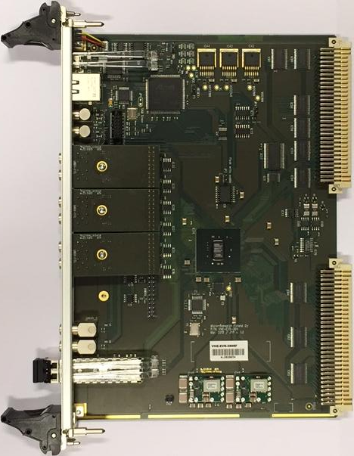
Micro-Research Finland Oy
VME-EVR-300
VME64x
Event Receiver
Four Universal I/O Slots (one slot driven by GTX)
Two differential CML outputs (GTX)
Two TTL inputs with default state selectable with jumpers
Optional transition board VME-UNIV-TB64x
Pulse Generator Triggers from prescalers and DBUS bits
Gated pulse outputs
Dual output mapping registers
Segmented Data Buffer

Slide 30
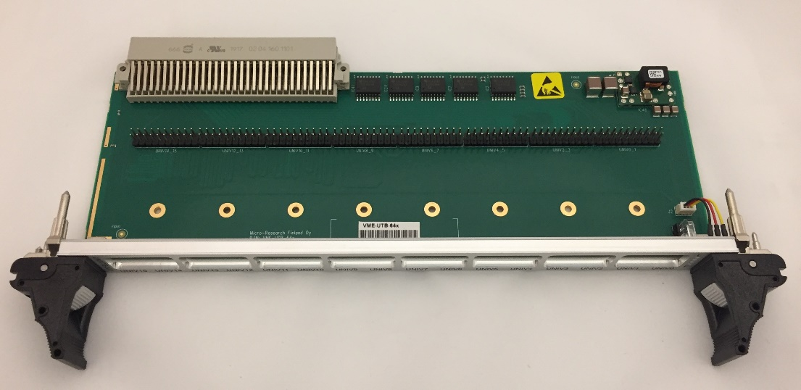
Micro-Research Finland Oy
VME-UTB-64x
VME-UTB-64x transition board for MRF VME products
Support for Universal I/O modules requiring GPIO (VME-EVR-300 only)
  UNIV-LVPECL-DLY
  UNIV-TTL-DLY
Added status LEDs (VME-EVR-300 only)
  Link / Violation / Event in / Event out
Compatible also with older HW (230 series), only new features are not supported
Power both through front board and backplane +5V pins

Slide 31
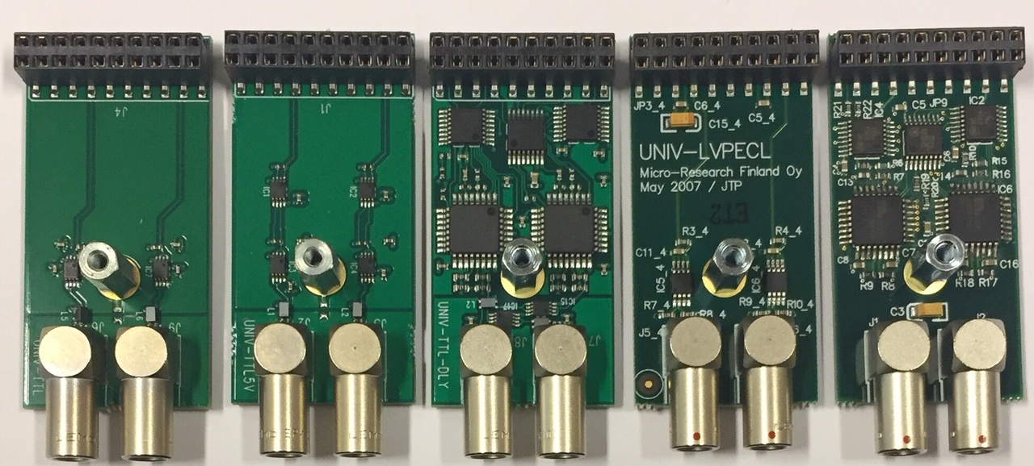
Micro-Research Finland Oy
Universal I/O Modules
UNIV-TTL
  LVTTL output
UNIV-TTL5V
  5V TTL output
UNIV-TTL-DLY
  LVTTL output
  Delay tuning 1024 steps of ~9 ps
UNIV-LVPECL
  differential LVPECL output
UNIV-LVPECL-DLY
  differential LVPECL output
  Delay tuning 1024 steps of ~9 ps
UNIV-TTL
UNIV-TTL5V
UNIV-TTL-DLY
UNIV-LVPECL
UNIV-LVPECL-DLY

Slide 32
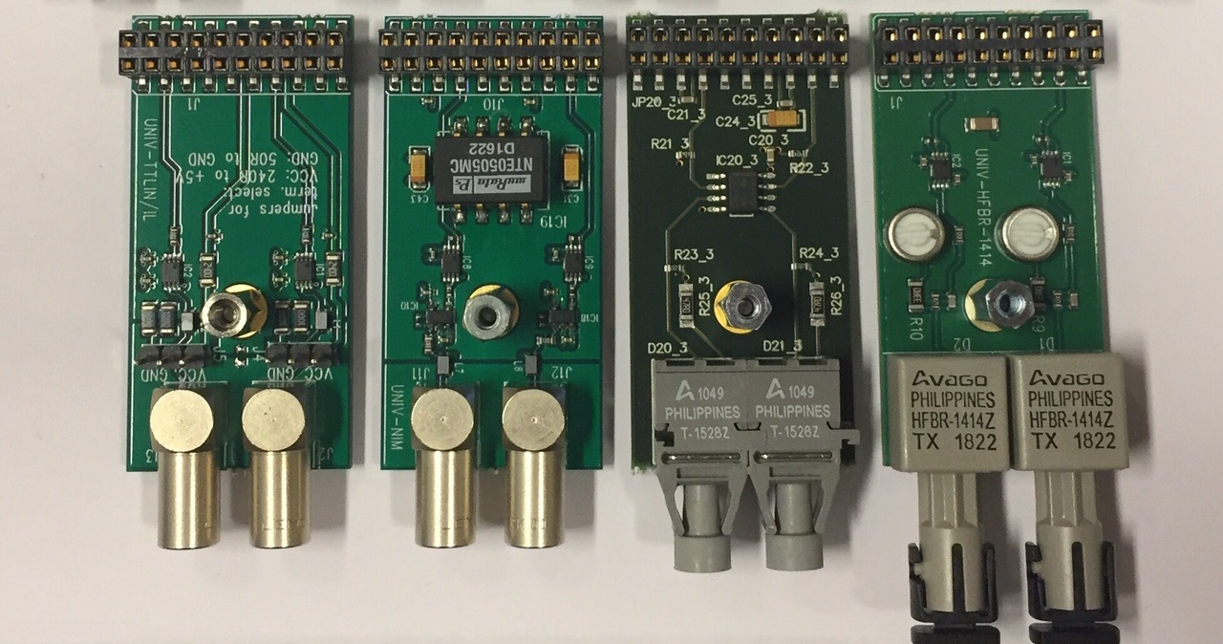
Micro-Research Finland Oy
Universal I/O Modules
UNIV-TTLIN/IL
UNIV-NIM
UNIV-HFBR-1528
UNIV-HFBR-1414
UNIV-TTLIN
  TTL input
  configurable term.
    240 ohm to +5V
    50 ohm to GND
UNIV-NIM
  NIM output
UNIV-HFBR-1528
  650 nm Optical Output
  POF
UNIV-HFBR-1414
  820 nm Optical Output
  50/125 μm, 62.5/125 μm, 100/140 μm, 200 μm PCS

Slide 33
Micro-Research Finland Oy
Firmware Changes
New EVM features (by Cosylab)
Sequencer start/stop counting
  Count the number of times a sequencer has been started and how many times the sequence has run
Sequencer countdown mode
  Run a sequence a predefined number of repetitions
New EVR features
32-bit pulse width and delay for all pulse generators
Added support for pulse trains for pulse generators
  Configurable number of pulses (32-bit value)
  Repeat delay (32-bit value)
Pulse Counting (by Cosylab)
  Counters have been added that count the number of pulses of each pulse generator

Slide 34
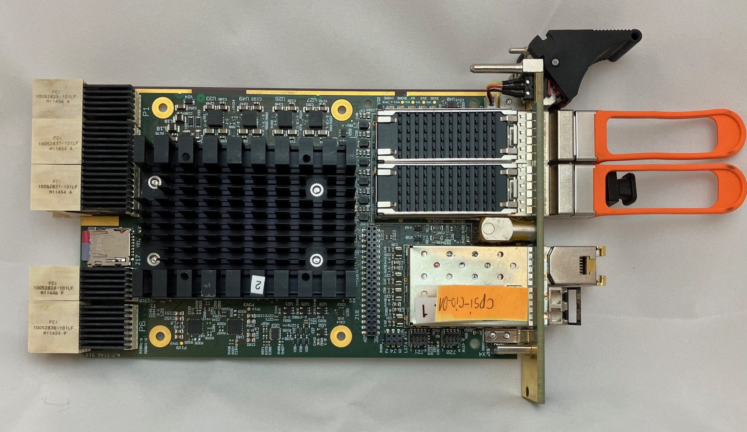
Micro-Research Finland Oy
EVM firmware port for CompactPCI Serial
CPSI-S COM-IO to be used for SLS-II upgrade
Xilinx Zynq Ultrascale+
Runs Linux on same module
Till Straumann did a lot of work on the port, including a decimation mode to be able to support existing SLS event hardware running at an event rate of 50 MHz while the new hardware uses an event rate of 125 MHz

Slide 35
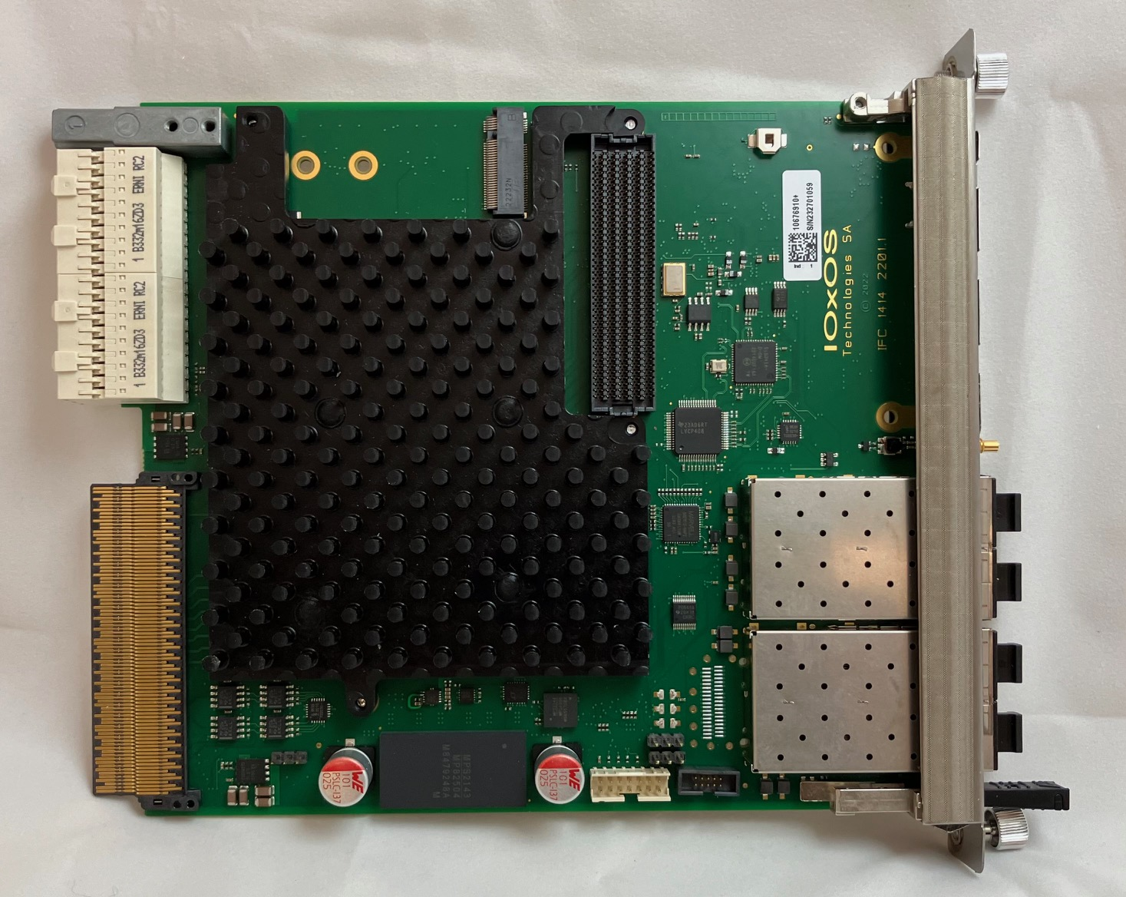
Micro-Research Finland Oy
Near Future Plans – EVR Firmware port for IOxOS IFC_1414-A0
mTCA.4
Processor AMC
Zynq Ultrascale+
FMC carrier
RTM interface

Slide 36
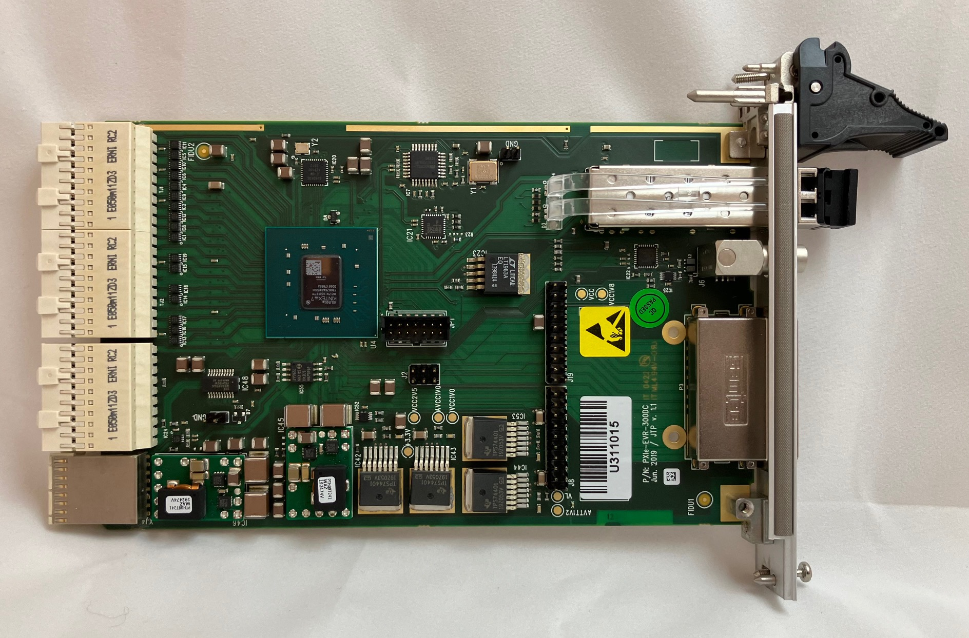
Micro-Research Finland Oy
Near Future Plans – PXI Express EVR PXIe-EVR-300DCS
Module for PXI Express System Timing Slot
Backplane Triggers in PXI system
Available from Cosylab

