Slide 1
Event Timing for
CompactPCI-Serial platform
Timing Workshop
EPICS meeting 16–20 Sept 2024
B. Kalantari, W. Koprek, M. Gloor (Electronics),
R.Vallotton, D. Anicic (Controls),
G. Theidel (NUM Electronics) and for ElNet-GERTS @ PSI
PSI, September 2024

Slide 2
Technology Change!
2019 decision to move from VME to CompactPCI-Serial
Form-factor aspect: 6U to 3U
Backplane Interconnect: parallel to serial point-to-point
First major application in SLS2.0 : LLRF, Timing, beam Diagnostics
full-mesh proprietary (10 Gbps, any-any slot)

Slide 3
Boundary conditions & requirements
Cost efficient, complementary to our high-end FMC+ carrier (CPSI_UFC)
Interoperability with MRF products
Multipurpose hardware (EVR, EVG, Fan-out)
Standalone operation (configuration and controls without additional hardware)
Typical functionalities & performances of the event system
Moderate development effort
We relied as well on our in-house expertise:
  Experience with Zynq UltraScale+ based MPSoC programming
  Experience with design of electronics around MPSoC System-On-Module (SoM)
  Experience with Embedded-EVR implementation (EEVR) on various FPGA platforms

Slide 4
CPSI_CIO
Communication & I/O board
Building required electronics around a cost optimized commercial SoM
Chosen SoM: Enclustra XU1-6CG (APU: Quad ARM® Cortex®-A53, RPU: Dual ARM®Cortex™-R5)
Careful design of the on-board clocking circuit
24x I/O
Enclustra SoM
Full-Mesh backplane interconnect
(incl. 10 Gbps links)
10x full-duplex optical links (10 Gbps)
1 used for network
Rear I/O via RTM
(40x LVDS, clokcs, I2C)
System CPU interconnect (PCIe, USB, SATA)

Slide 5
Timing & more
Enables complete, standalone processing & DSP system
Serial data processing & communication I/O (up to 10 Gbps)
Data streaming applications plus paralel I/O via RTM/extension
Other apps: global feedbacks, data concentration
Cost optimized
Linux/EPICS infrastructure available
Timing event system:
EVM: firmware ported by MRF
EVR: in-house EEVR implementation
Fan-out: in-house implemented and tested
CPSI_CIO
(picture without SoM installed)

Slide 6
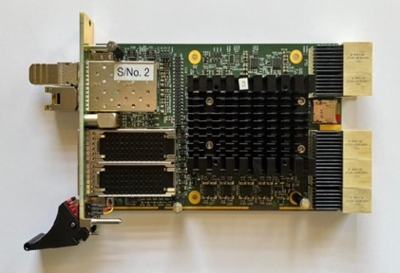
CPSI_CIO Status
Extensive testing of prototypes and pre-series
Successfully Done!
Functionalities, performances & interoperability passed all tests!
Batch 1
50 pcs being delivered for SLS2.0 timing system
Batch 2
50 pcs under production
CPSI_CIO

Slide 7

Rear I/O interfacing
Two RTM’s with modular and fixed I/O
RTM_MIO: up to 6 pluggable MRF UNIV modules
RTM_FIO: TTL 4 in/4 out; ref. clock 1 in/1 out, 1 SFP+
RTM_MIO
RTM_FIO
External I/O (event mask/trigger, AC sync)
Timing master setup (event generator)
Ref. clock input
RTM_FIO

Slide 8
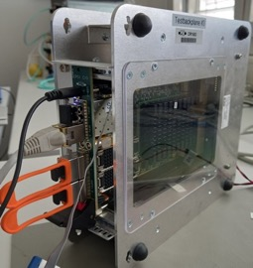
How we use CIO (crate types)
4U-Chassis with 9-Slot CPCI-S backplane, for timing distribution systems (up to 8x CIO)
1U-Chassis with 2-Slot CPCI-S backplane, for standalone applications with one CIO
Test Frame for lab/office testing with loop-backplane
We use also 4-slot crates
Office test-frame
3U high (9-slot)
1U high, 2-slot (standalone system)

Slide 9
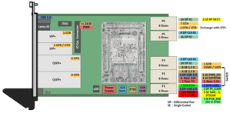
SLS2.0 Timing System using CPSI_CIO
Event Master, Distribution, Receiver
CPSI_RTM_FIO
CPSI_CIO
Timing Uplink
max 7event links
RF, AC sync, Interlock
To accelerator/beamline subsystems
max 10 event links
CPCI-S backplane
Example: timing master/distribution system within one CPCI-S crate.
Timing network comprises multiples of demonstrated system.

Slide 10
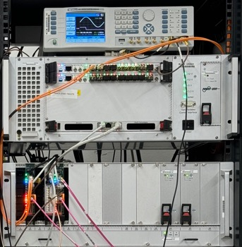
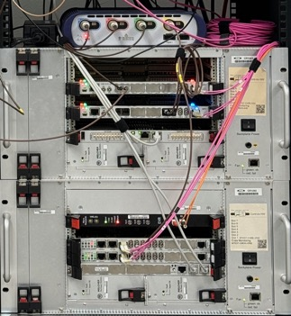
Performance and interoperability Tests
Measured delay Jitter: 25ps (standard deviation)
Phase reproducibility (via EEVR)
Interoperability with 100, 200 & 300 series verified
Data buffer protocols 230 & 300 compatible

Slide 11
Commercialization (hardware)
PSI is a research institute interested in collaborations with other research institutes/labs
We are open for collaborations and interested to expand CompactPCI-Serial user community
Pure hardware and manufacturing cost is currently about 1800-2400 CHF. Depending on batch size, pricing of materials & components, in particular the SoM, etc.
Various business models can be considered for CPSI_CIO hardware:
  Procurement by PSI (hardware + production effort + license)
  Procurement by a third company and a license fee per board for PSI
  Other ideas can be discussed as well…
  In case of interests, details will be worked out with PSI Tech-Transfer. Just contact us!

Slide 12
Firmware and embedded software
  EVM,
    we had FPGA code ported by MRF and we pay license fees per CPSI_CIO board in use
  EVR,
    In agreement with MRF we can provide our in-house developed FPGA code which supports PSI specific extensions too, or
    MRF provides EVR code according to some business model.
  PSI-developed FPGA and embedded software codes are open source, like:
    SD-Card image with standalone Linux and EPICS installation
    Reference Vivado project for the FPGA with VHDL components for peripheral devices and EEVR
    „Hello world” applications for Linux and for stand-alone real-time CPUs (RPU)
    Software support for clock chip configuration

