Slide 1
ALS SR RF Control System Upgrade Plan and Status
Najm Us Saqib Control Systems Engineer Advanced Light Source Upgrade (ALS-U)
A. Jurado, C. Toy, E. Andrade, D. A. Nawaz, Q. Du, J. H. Lee, B. Flugstad

Slide 2
Agenda
Introduction
Advanced Light Source Storage Ring RF Control System
Existing
Upgrade Plan
Present Status

Slide 3
Brief Speaker Intro
Najm us Saqib
Control Systems Engineer
Advanced Light Source Upgrade Project
Experience
~3 years synchrotron light source project → ALS-U/ALS
~5 years linear accelerator project → LINAC Project Pakistan

Slide 4
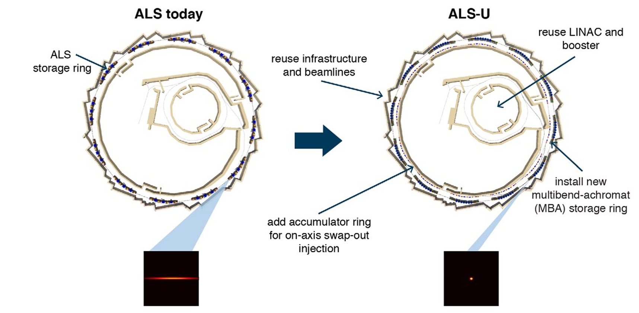
ALS/ALS-U
RF System doesn’t change

Slide 5
SR RF Control System
Low-level RF
Cavity Cooling System
Relay-based chassis
30 years old
PLC Controls
Horner All-in-one Controllers
7 subsystems: Klystron 1, Klystron 2, Feeder, Master Interlocks, HVPS, HVPAD, Fast Interlock Interface

Slide 6
SR RF Control System Upgrade
Low-level RF (remains same)
Cavity Cooling System Allen Bradley PLC
Relay-based chassis
30 years old
PLC Controls Allen Bradley PLC
Horner All-in-one Controllers
7 subsystems: Klystron 1, Klystron 2, Feeder, Master Interlocks, HVPS, HVPAD, Fast Interlock Interface

Slide 7
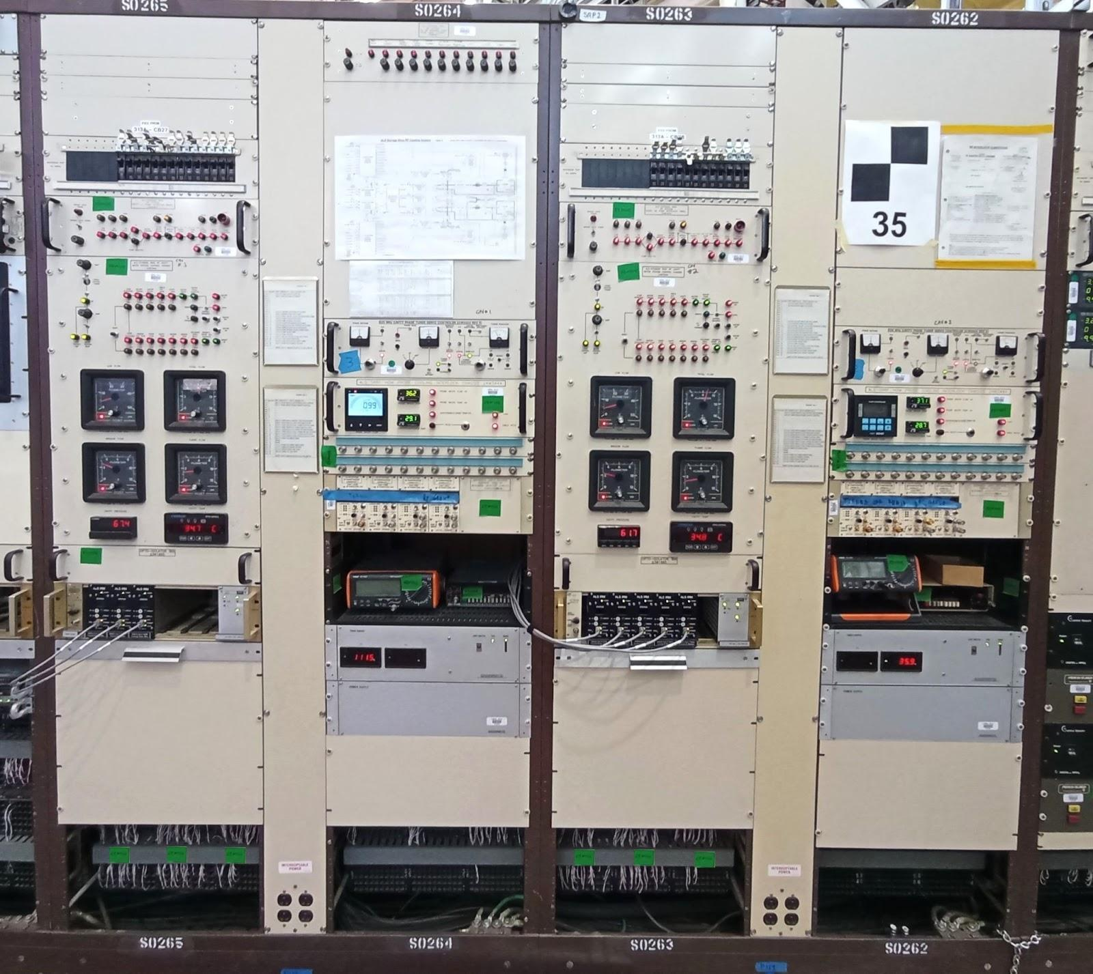
Cavity Cooling System - Existing
Why upgrade:
30 years old
Relay-based
Difficult to add more functionality
IRMs
EPICS

Slide 8
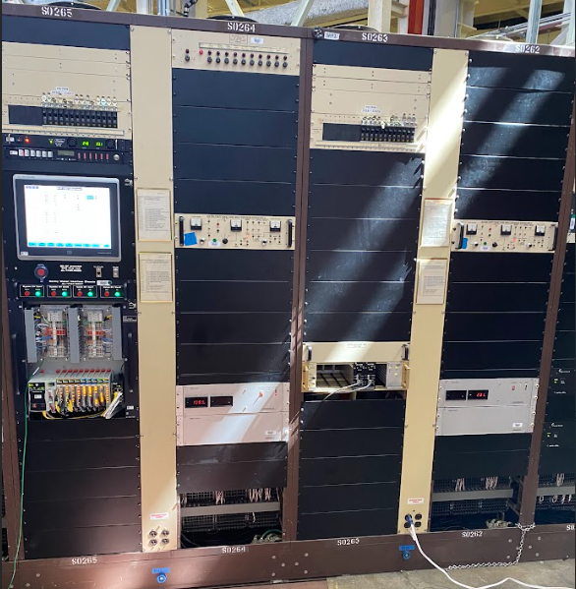
Cavity Cooling System - Present Status
Before Summer Shutdown 2024
Now
1 PLC
1 HMI
~120U got empty

Slide 9
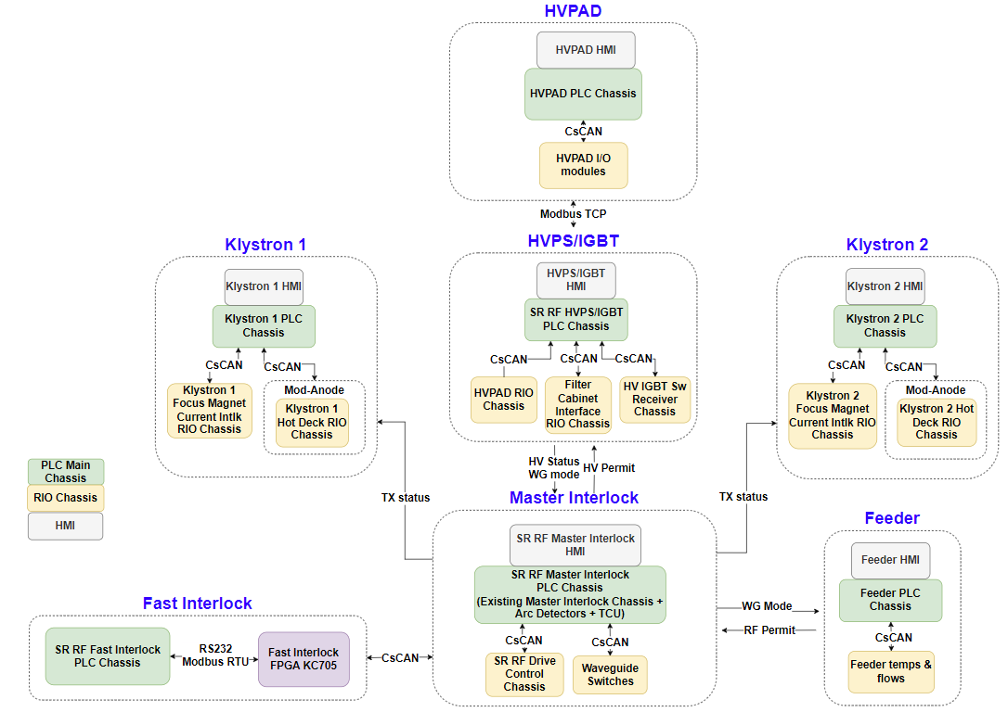
Existing SR RF PLC system
Why upgrade:
Horner controllers & HMI are end-of-life
Not enough spares available

Slide 10
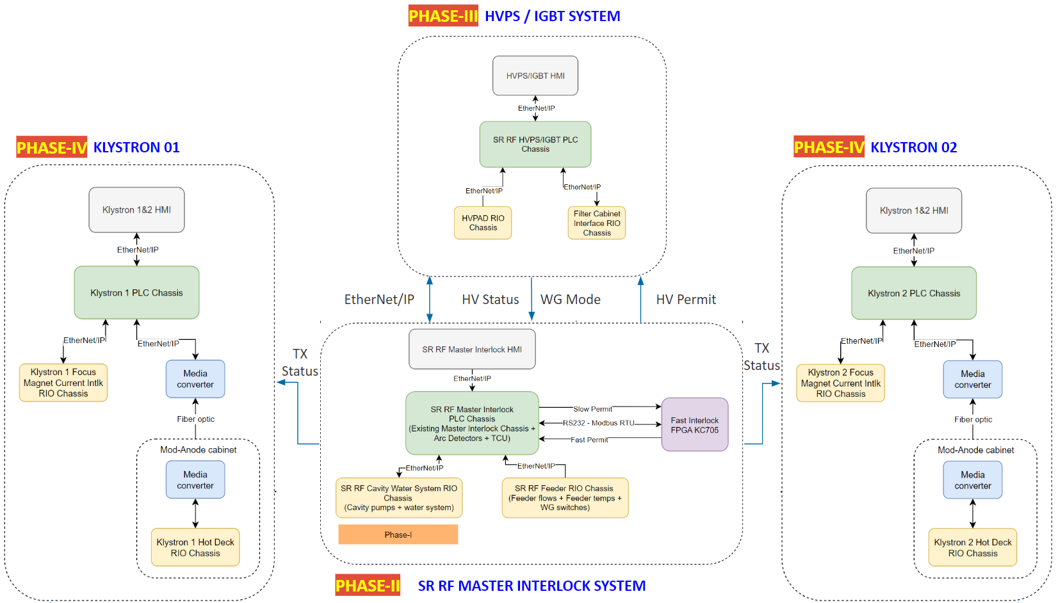
Upgrade Plan
Four Phases
Phase-I: Cavity Water Subsystem ✅
(Summer 2024)
Testing and Cold Commissioning
Phase-II: Master Interlock Subsystem
(Winter 2025)
Phase-III: HVPS Subsystem
(Summer 2025)
Phase-IV: Klystron 1&2 Subsystem
(Winter 2026)

Slide 11
Leveraging ALS-U AR RF System Experience
PLC chassis design
PLC programming
HMI development
EPICS database
Phoebus OPIs
AR RF PLC subsystems | SR RF PLC Upgrade subsystems
HPA 1 | Klystron 1
HPA 2 | Klystron 2
Master Interlock | Master Interlock
N/A | HVPS

Slide 12
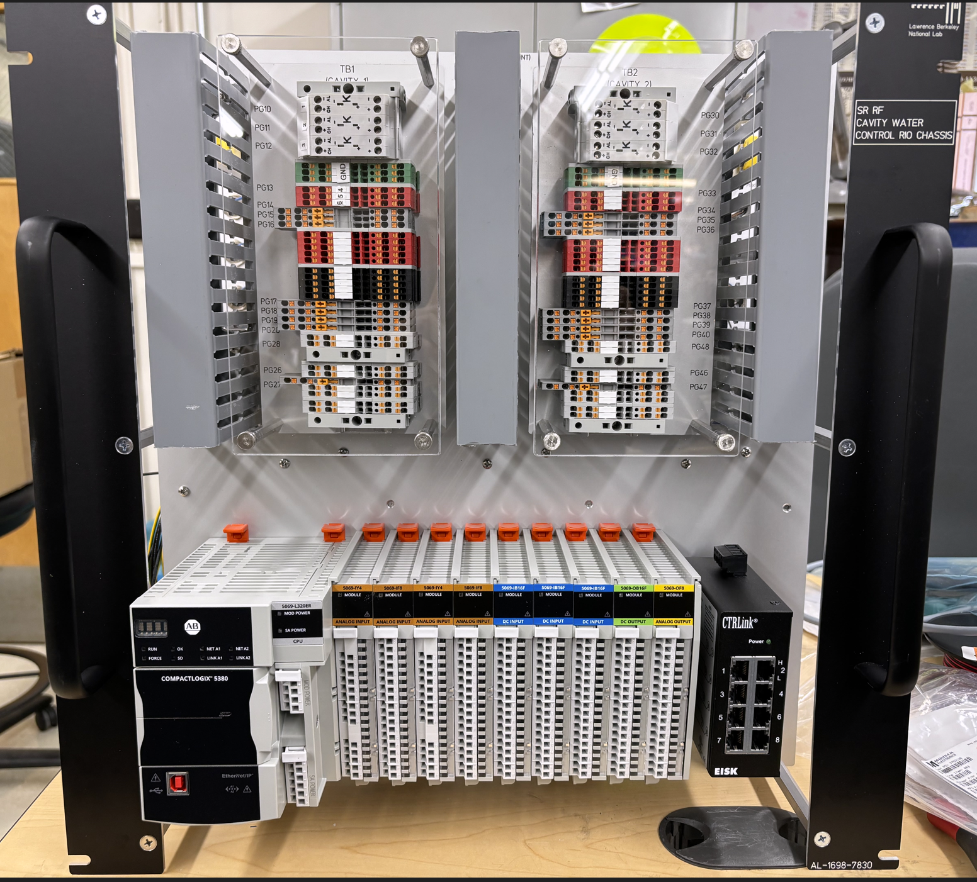
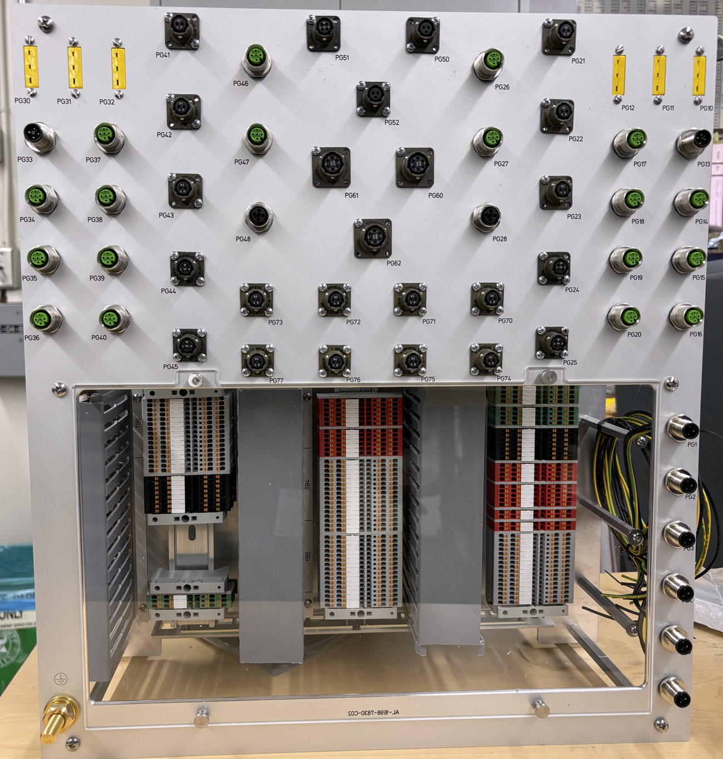
PLC Chassis Design
Follow ALS-U standards
Evolution from ALS-U Slow MPS, AR RF PLC Chassis
Hardware
Allen Bradley 5380 series
CPU: 5069-L320ER
I/O Modules: 5069-IF8, 5069-OF8, 5069-IY4, 5069-IB16, 5069-OB16
PanelView 5510 HMI
Front View
Rear View

Slide 13
PLC program/HMI
UDT_aiHi (Temperature)
User-Defined Types (UDT)
Base UDTs
Analog signal with high/low thresholds
Boolean signal with latch
High Level UDTs
System specific
Utilize Base UDTs
HMI Add-On Graphics
As per base UDTs
PLC code version control: GitLab + Studio 5000 Logix Compare Tool
HMI version control: GitLab
HMI templates
Raw Value
Gain
Offset
Scaled Value
Warning Setpoint
Warning Status bit
Trip Setpoint
Trip Status bit
Trip Latch bit
Bypass bit
Status
Configuration
Calibration

Slide 14
EPICS database
UDT_aiHi (Temperature)
ai_hi_udt.template
Phoebus templates
record(ai, "$(P)$(R)$(SIGNAL)") {
field(DESC, "$(SIGNAL) Value")
field(DTYP, "EtherIP")
field(INP, "@$(PLC) $(Tag).Val")
field(EGU, "$(EGU=°C)")
field(PREC, "$(PREC)")
field(SCAN, "$(SCAN)")
info(archive, "Fast")
}
record(bi, "$(P)$(R)$(SIGNAL)HiWrnSts") {
field(DESC, "$(SIGNAL) High Warning Status Bit")
field(DTYP, "EtherIP")
field(INP, "@$(PLC) $(Tag).HiWrnSts")
field(SCAN, "$(SCAN)")
field(ZNAM, "$(ZNAMHiWrnSts=Warning)")
field(ONAM, "$(ONAMHiWrnSts=OK)")
field(ZSV, "$(ZSVHiWrnSts=MINOR)")
field(OSV, "$(OSVHiWrnSts=NO_ALARM)")
info(archive, "Slow")
}
record(bi, "$(P)$(R)$(SIGNAL)HiTrpSts") {
field(DESC, "$(SIGNAL) High Trip Status Bit")
field(DTYP, "EtherIP")
field(INP, "@$(PLC) $(Tag).HiTrpSts")
field(SCAN, "$(SCAN)")
field(ZNAM, "Trip")
field(ONAM, "No Trip")
field(ZNAM, "$(ZNAMHiTrpSts=Fault)")
field(ONAM, "$(ONAMHiTrpSts=OK)")
field(ZSV, "$(ZSVHiTrpSts=MAJOR)")
field(OSV, "$(OSVHiTrpSts=NO_ALARM)")
info(archive, "Slow")
}
Raw Value
Gain
Offset
Scaled Value
Warning Setpoint
Warning Status bit
Trip Setpoint
Trip Status bit
Trip Latch bit
Bypass bit
Status
Configuration
Calibration

Slide 15
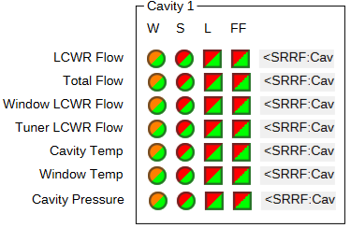
EPICS database
cavity.substitutions
file ai_hi_udt.template {
pattern { R, SIGNAL, Tag, EGU}
{ Cav$(N):, Temp, Cav$(N).Temp}
{ Cav$(N):, Pressure, Cav$(N).Pressure, psi}
{ Cav$(N):, WindowTemp, Cav$(N).WindowTemp}
{ Cav$(N)-HOM:, LCWR_Temp, Cav$(N)_HOM.LCWR_Temp}
{ Cav$(N)-HOM:, FlangeTemp, Cav$(N)_HOM.FlangeTemp}
}
file ai_lo_udt.template {
pattern { R, SIGNAL, Tag}
{ Cav$(N):, LCWR_Flow, Cav$(N).LCWR_Flow}
{ Cav$(N):, TotalFlow, Cav$(N).TotalFlow}
{ Cav$(N):, WindowFlow, Cav$(N).WindowFlow}
{ Cav$(N):, TunerFlow, Cav$(N).TunerFlow}
{ Cav$(N)-HOM:, LCWR_Flow, Cav$(N)_HOM.LCWR_Flow}
}
UDT_Cavity
Temp → UDT_aiHi
WindowTemp → UDT_aiHi
LCWR_Flow → UDT_aiLo
TunerFlow → UDT_aiLo
xx
yy
zz

Slide 16
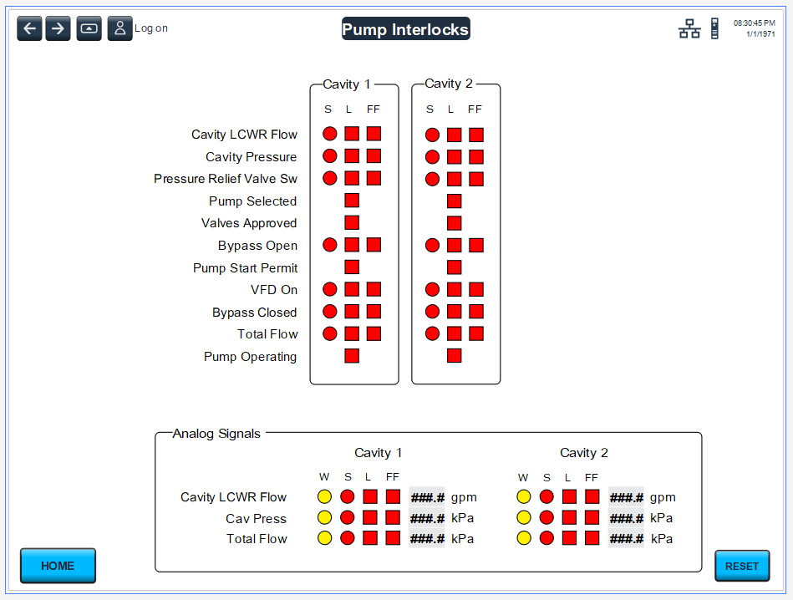
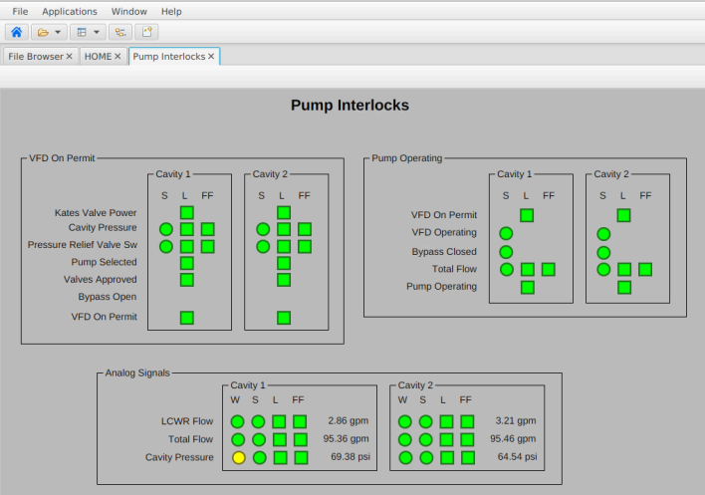
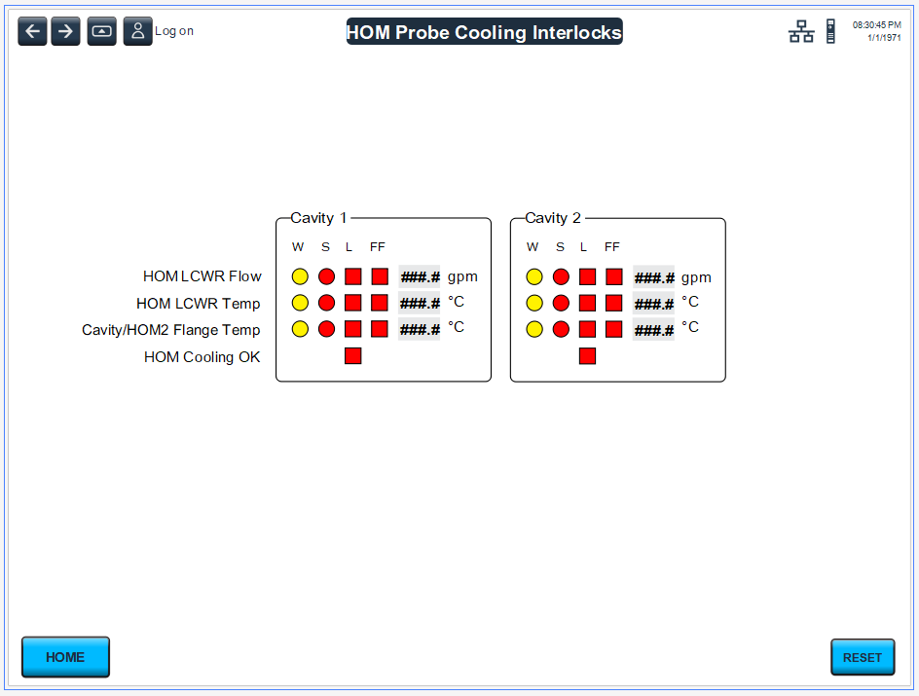
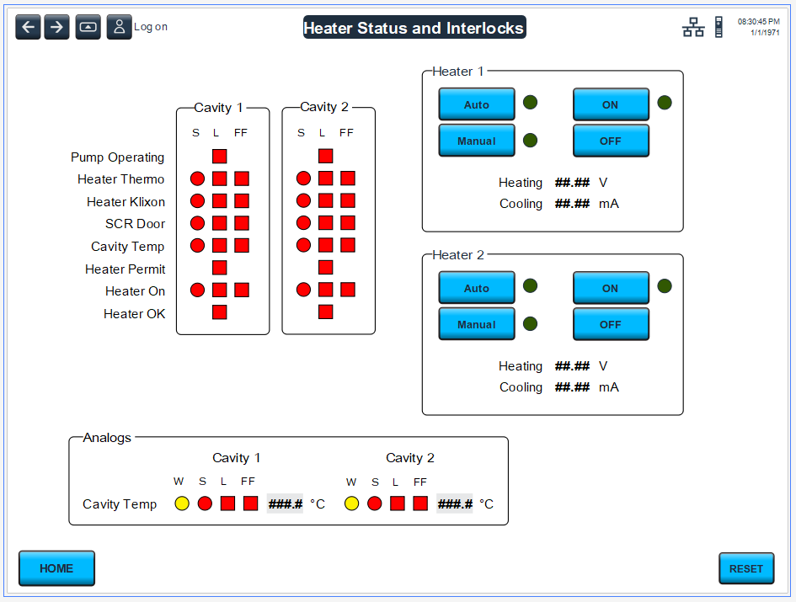
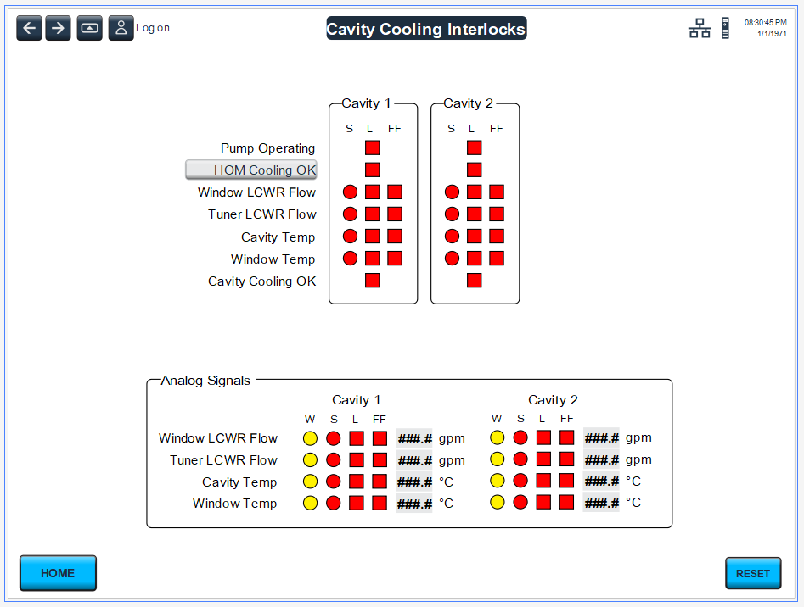
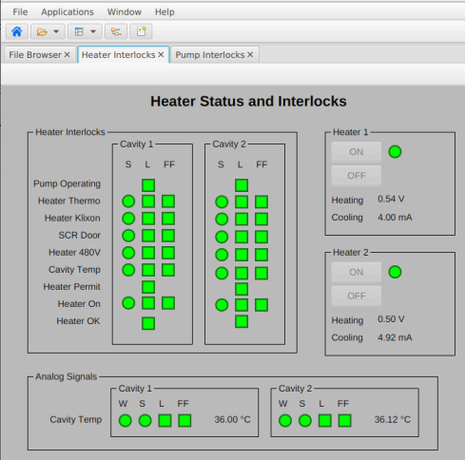
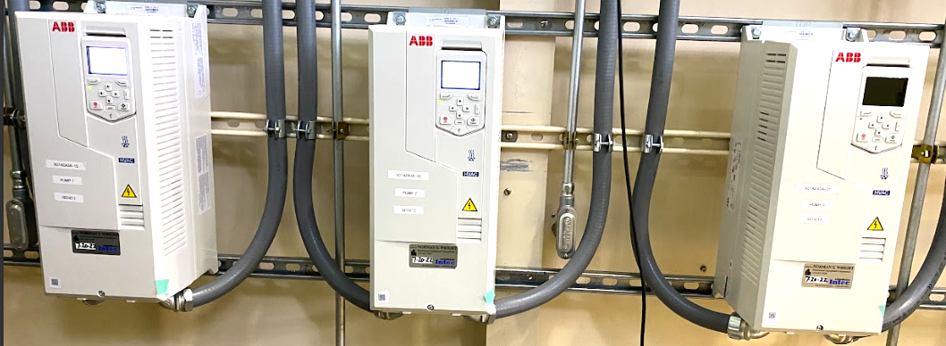
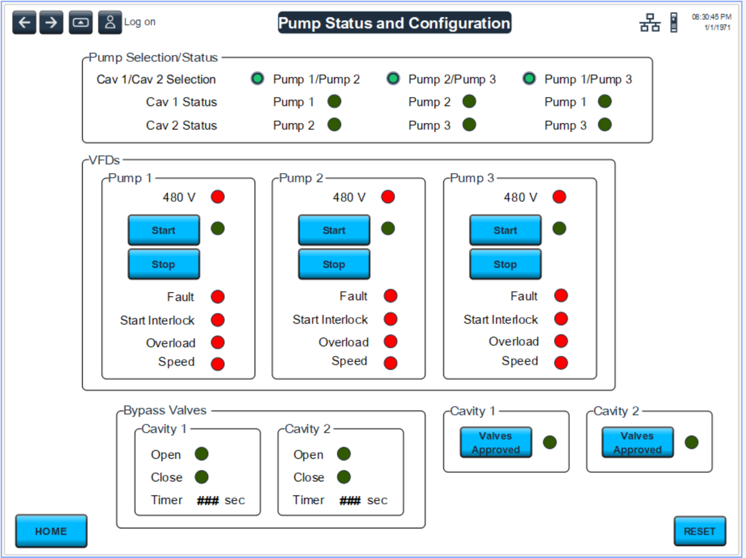
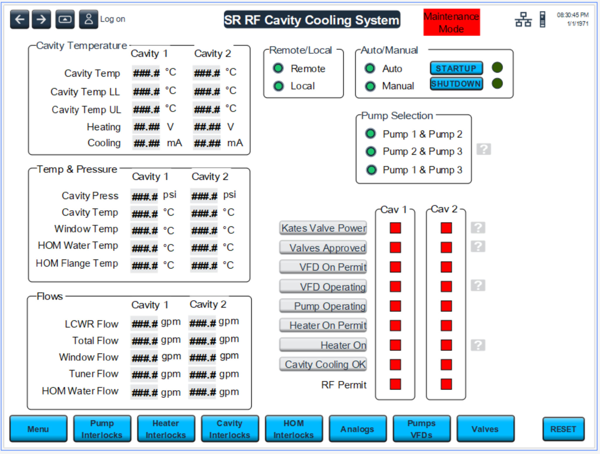
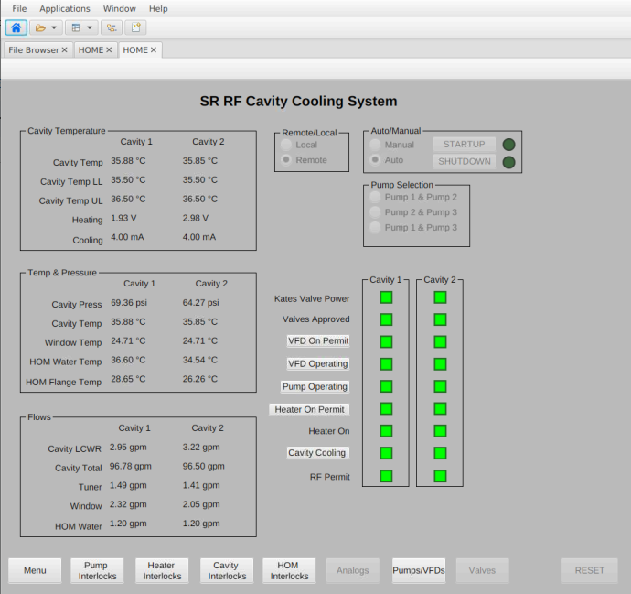
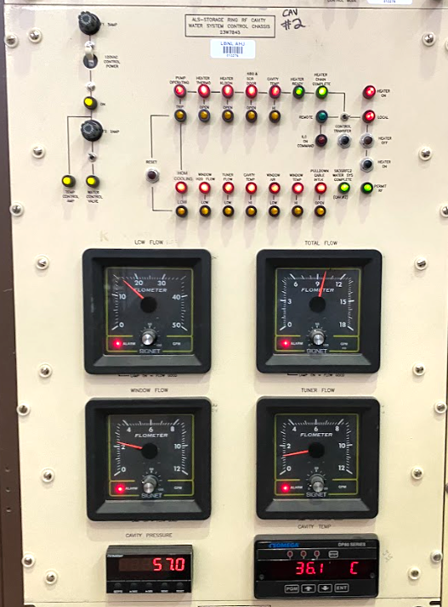
HMI/Phoebus - Same layouts for operators
Local HMI
Phoebus
Notes:
Existing system, new PLC system

Slide 17
Thank you!

