Slide 1
OACTree
Using behavior trees to automate operations and control
(or “How to plant an OACTree”?)
Robert Gunion, Gennady Pospelov, Walter Van Herck

Slide 2
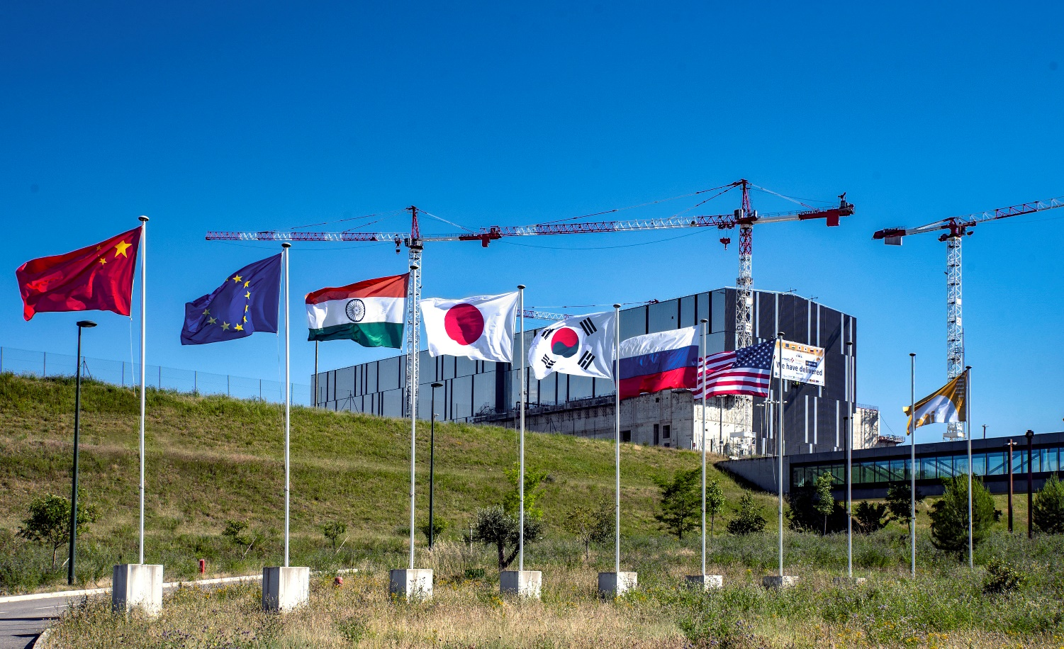
A MULTINATIONAL SCIENCE AND R&D COLLABORATION
Mission: to demonstrate key aspects of fusion’s scientific and technological feasibility.
Integrated operation of technologies for a fusion power plant
Production and control of a self-heating “burning plasma”
Safety demonstration

Slide 3
Goals & requirements
ITER's operation requires complex automation sequences that are beyond the scope of the finite state machine concept that the EPICS SNL Compiler/Sequencer implements (PvAccess?).
ITER needs a framework for monitoring, configuration & coordinated control of plant system I&Cs with the following requirements:
Create/execute operational procedures in a robust, repeatable and traceable way
Support concurrency/reactivity
Extensible
Composable
Maintainable
Required quality assurance level

Slide 4
Goals & requirements
Start pumps for cooling water loop
* Initialization: select pumps to use
* Check electrical systems
* Check switchgear
* Check interlocks
* Pressurizer pressure control
* Check pressure controller
* Set pressure setpoint
* Pressurizer level control
* Check demineralized water distribution
* Check level controller
* Set level setpoint
...

Slide 5
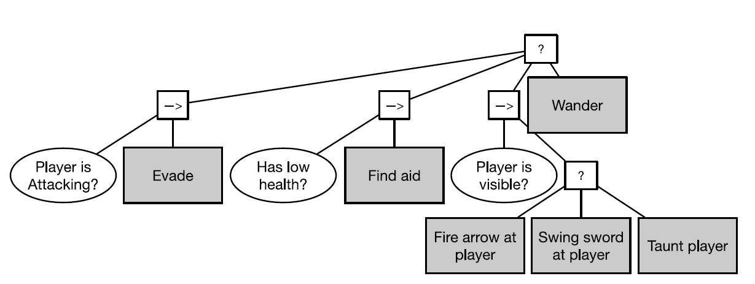
Behavior trees

Slide 6
Strengths
Handling of complexity
Split tasks into sequences or alternative solutions
Compose larger trees out of smaller ones: scalability
Goal-oriented semantics
Reactivity
Modular nature and maintainability
Easy to replace nodes
Simple interface allows simple extension
Locality: small changes lead to small changes in outcome

Slide 7
What is OACTree?
A C++ framework for creating and executing operational procedures using behavior trees:
Definition of instruction node and variable API
Common instructions for control flow (sequence, fallback, repeat, parallel, etc.)
Very basic variable implementations (in memory, file)
User I/O API
Plugin system
Concurrency
Command line applications to validate/execute procedures
GUI to create/edit/execute procedures
Plugins for ITER control system (EPICS, MathExpr, etc.)

Slide 8
Example

Slide 9
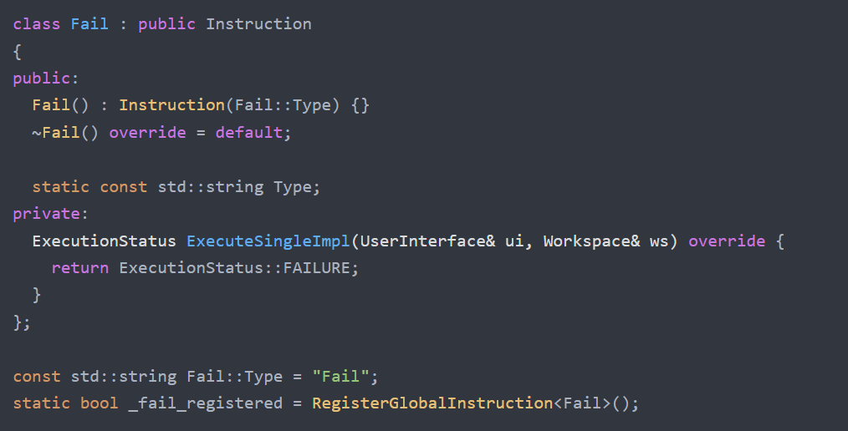
Plugins

Slide 10
Plugins
Control: common control logic; e.g. WaitForCondition
Mathexpr: evaluate mathematical expressions
EPICS plugin:
ChannelAccess: read/write PV instructions; client variable
PvAccess: read/write PV instructions; client and server variables; RPC client instruction
ITER specific: plant system configuration and pulse schedule handling

Slide 11
PvAccess counter

Slide 12
PvAccess monitor

Slide 13
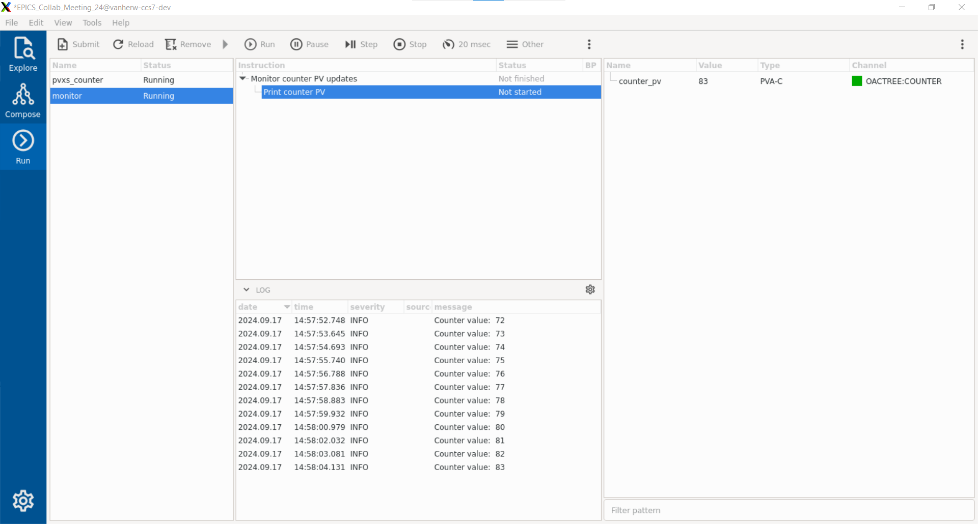

Slide 14
OACTREE at ITER
Demineralized water plant operational efficiency assessment
Start/stop/monitor cooling water loops
Translation of plant system states into common operational states
Snapshot/restore of plant system configurations

Slide 15
CC2D startup

Slide 16
Roadmap
Improve GUI
functionality (e.g. undo/redo)
user experience
Automation servers and clients
Enable dedicated servers to run operational procedures
Enable multiple clients to monitor/control the execution of those procedures
Collaboration & outreach
Facilitate building/packaging on non-ITER systems
Make source available on public website
Collaborations

