Slide 1
Overview of the Cryomodule Test Stand control system for the SARAF project
Gabriel Desmarchelier on behalf of
Antoine Choquet, David Dardé, Guillaume Ferrand, Alexis Gaget, Françoise Gougnaud, Patrice Guiho, Tom Joannem, Ange Lotodé, Sébastien Monnereau, Victor Nadot, Rémi Nicole, Stéphane Tzvetkov

Slide 2
TOPICS
A few words on the SARAF project
A Cryomodule Test Stand
Cryomodule RF control
Cryomodule solenoid control
Main Control System tools
Conclusion

Slide 3
A few words on the SARAF project
1

Slide 4
SARAF (Soreq Applied Research Accelerator Facility) Phase II
Collaboration between CEA-Irfu and IAEC-SNRC to the upgrade of the SARAF accelerator to 5 mA CW 40 Mev deuteron and proton beams (Phase II)
SARAF is being constructed in Soreq NRC (SNRC) in Israel
CEA is in charge of the design, construction and commissioning of the MEBT and superconducting linac
The EPICS framework was chosen for the control system. The control baseline was presented during the EPICS Meeting at Cadarache (France) in 2019.
Phase II
Injector in operation since 2010

Slide 5
SARAF Phase II
Injector = ECR ion source + LEBT + RFQ
MEBT includes three 176 MHz rebuncher warm cavities, 8 quadrupoles and 8 steering magnets
Super Conducting Linac (SCL) with 4 cryomodules (CM)
CM1 6 cavities, 6 BPMs and 6 solenoids
CM2 7 cavities, 6 BPMs and 6 solenoids
CM3 and CM4: 7 cavities, 4 BPMs and 4 solenoids
Each cryomodule is tested at CEA before being shipped to SNRC. At the moment, CM1 is installed and being tested at SNRC.
Super Conducting Linac
Injector
MEBT

Slide 6
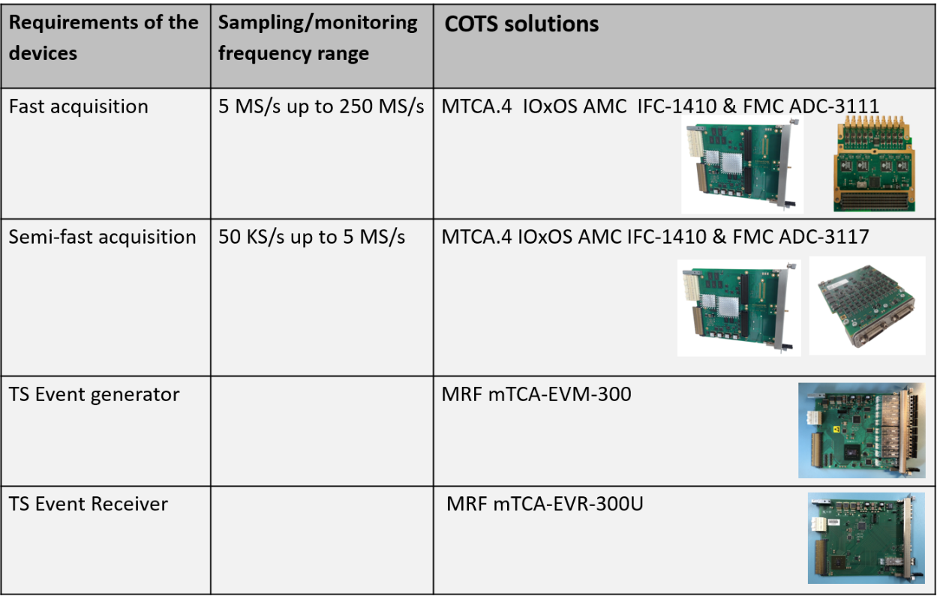
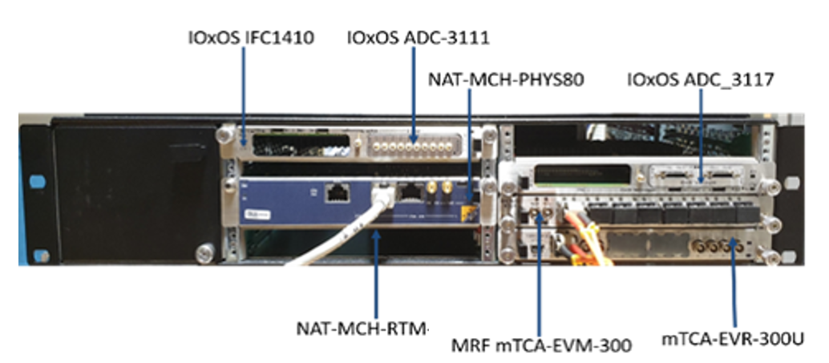
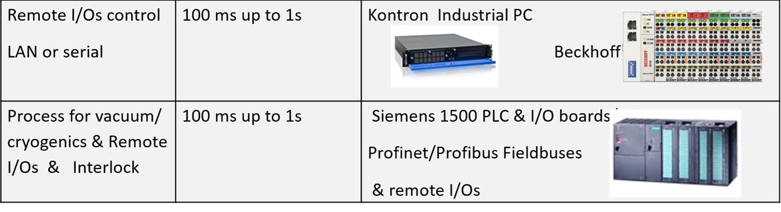
SARAF Phase II – Control baseline
MTCA.4 platform for the EPICS control system.
This platform is based on the very compact NATIVE-R2 crate with a common core on each crate:
NAT-MCH-PHYS80 board (80-port PCIe Gen3 switch) combined with Rear Transition Module CPU: RTM-COMex-E3 or RTM-COMex-Ce16 (more recently)
IOxOS IFC-1410 boards with various FPGA Mezzanine Cards (ADC-3117, ADC-3111, DIO-3118)
MRF boards for the Timing System
Siemens S7-1500 PLC

Slide 7
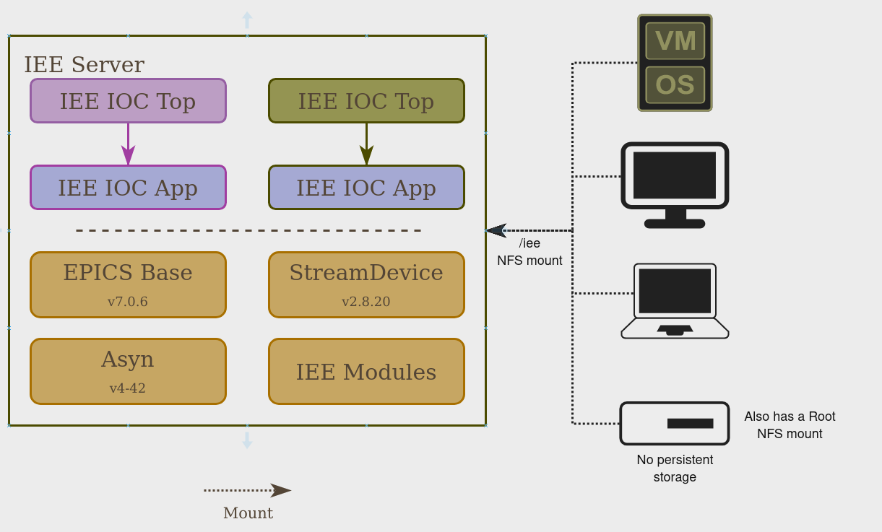
SARAF Phase II – Control baseline
IRFU EPICS Environment (IEE)

Slide 8
A Cryomodule Test Stand
2

Slide 9
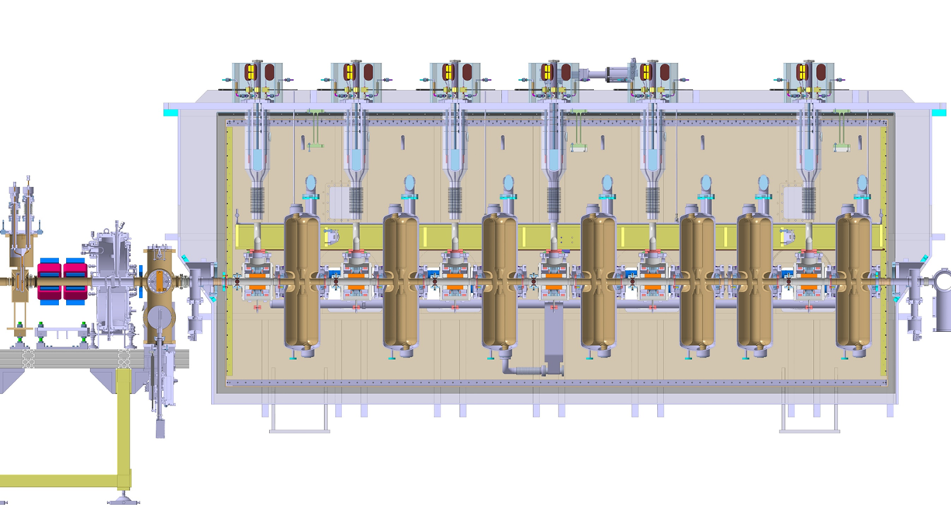
The cryomodule
Accelerating cavity
Solenoid
(superconducting electromagnet)

Slide 10
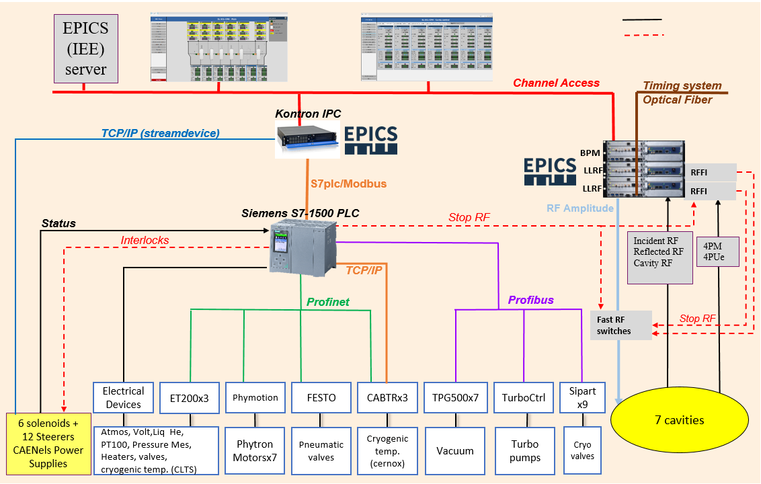
Overview of one CM control
Electrically wired
Wired alarms

Slide 11
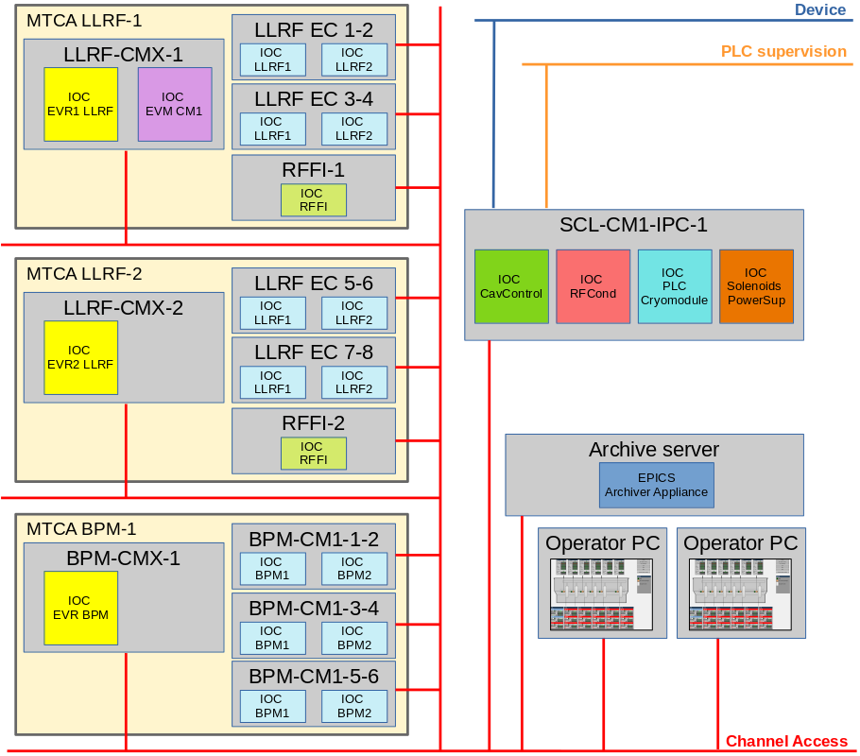
CMTS EPICS architecture
IOCs in charge of fast acquisition are embedded in the MTCA crates : Timing IOCs and some of the RF IOCs
IOCs in charge of slow acquistion are hosted by the industrial PC : PLC supervision IOC and solenoids power supplies IOC
Some other high-level IOCs are hosted by the industrial PC : RF conditioning IOC and Cavity Control IOC. High-level IOCs are IOCs which are not directly communicating with hardware but only with other IOCs.

Slide 12
Cryomodule RF control
3

Slide 13
RF control architecture
Several interdependent subsystems :
Low-Level RF (LLRF), responsible for RF power control in open or closed loop, and of incident, reflected and cavity power measurement
RF Conditioning, an EPICS application that works on LLRF and Timing system to manage the long process of cavity conditioning
Cavity Control, an EPICS application on top of the LLRF that allows non-expert operator to manage RF cavities
RF Fast-Interlock (RFFI), responsible for electron pickup and photomultiplier measurement and associated RF security
PLC, responsible for vacuum and temperature measurement and associated RF security as well as tuner motors control

Slide 14
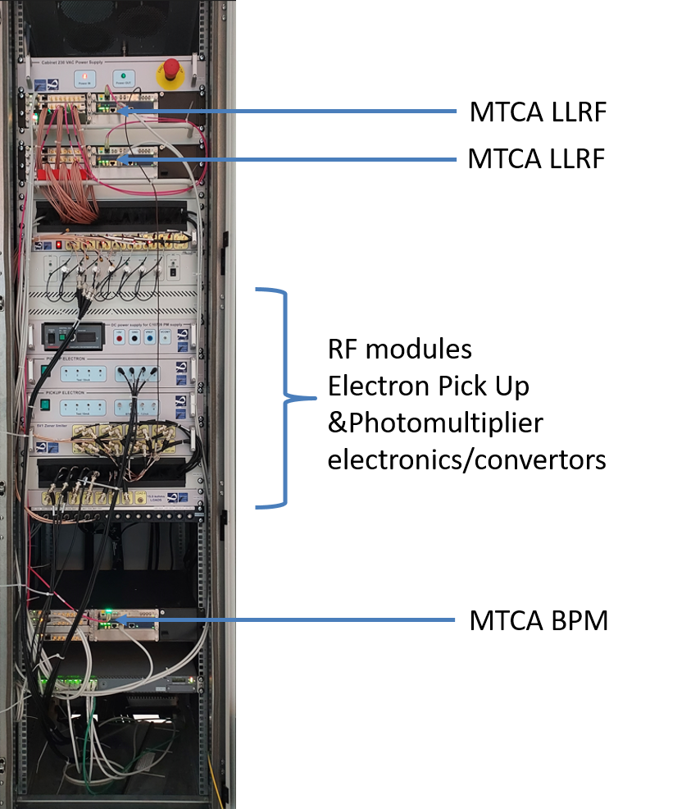
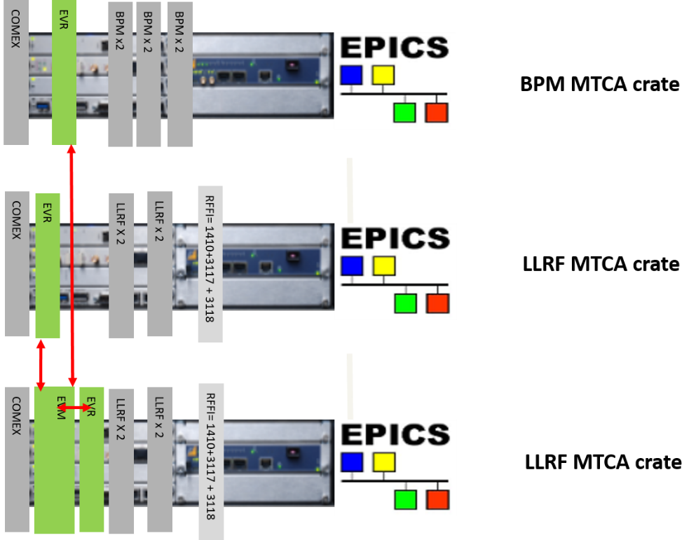
LLRF outsourced boards
Outsourced to 7Solutions/Orolia/Safran
Each LLRF MTCA Native-R2 crate includes:
2 7Solutions LLRF boards, each LLRF board manages 2 LLRFs
1 RF Fast Interlock (RFFI) system based on IOxOS board

Slide 15
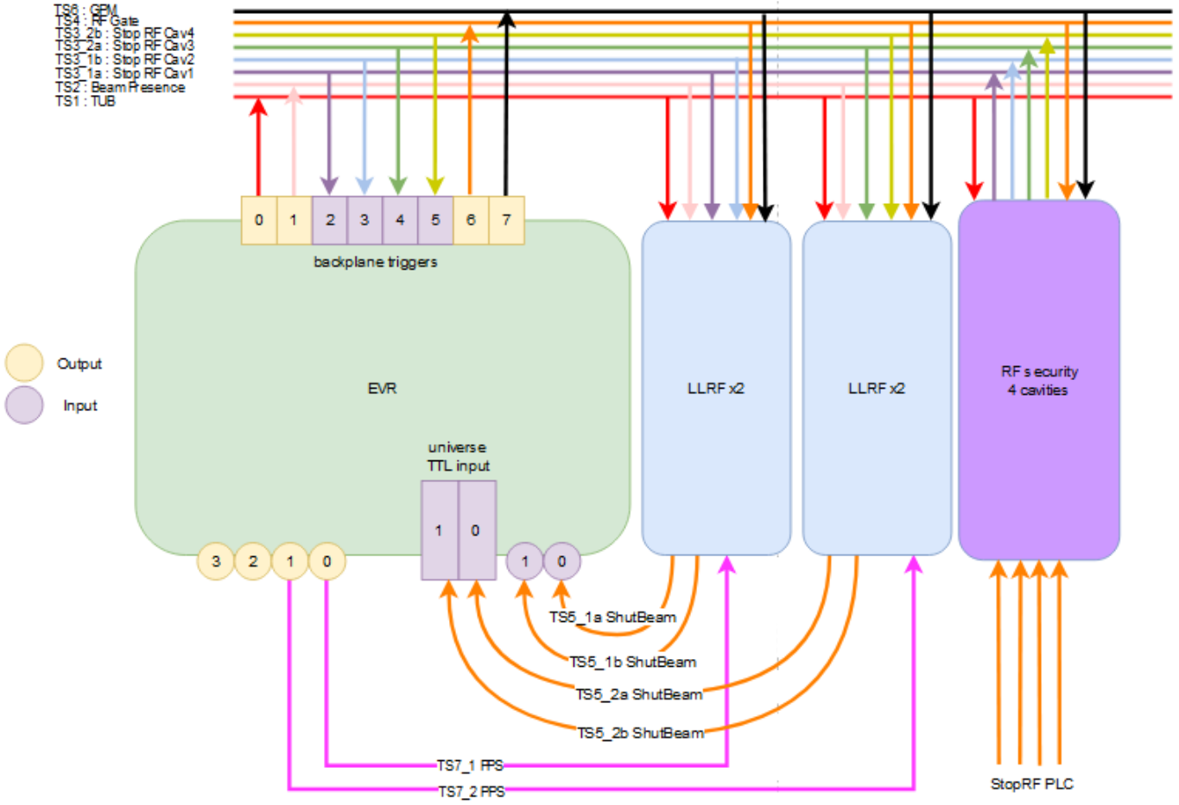
Use of MTCA backplane for trigger signals
The use of 4 lines (17-20) of MTCA.4 bus allows the addition of 8 trigger signals to the EVR inputs/ouputs
This use allows many wire connection problems to be avoided and more reliability
LLRF MTCA backplane
Backplane standardization
Chassis bus line | Trigger code | Trigger nick-name
17_1 | TS1 | Trigger user buffer (TUB)
17_2 | TS2 | Beam presence or Acquisition (RoI)
18_1 | TS3_m | Signals dedicated to the protection (m = instance of LLRF, BPM …)
18_2 | TS3_m
19_1 | TS3_m
19_2 | TS3_m
20_1 | TS4 | RF gate
20_2 | TS6 | General post mortem (GPM)

Slide 16
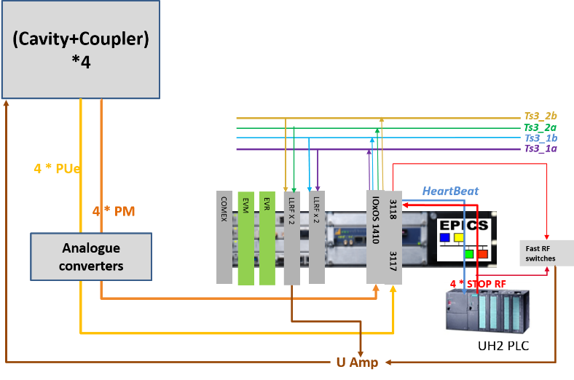
RF Fast-Interlock
Electron pickup (PUe) and photomultiplier (PM) monitoring
FPGA-based security features
Stops the RF through the RF switch when PUe or PM passes the security threshold
Spread PLC stop RF to the LLRF and to the Timing System

Slide 17
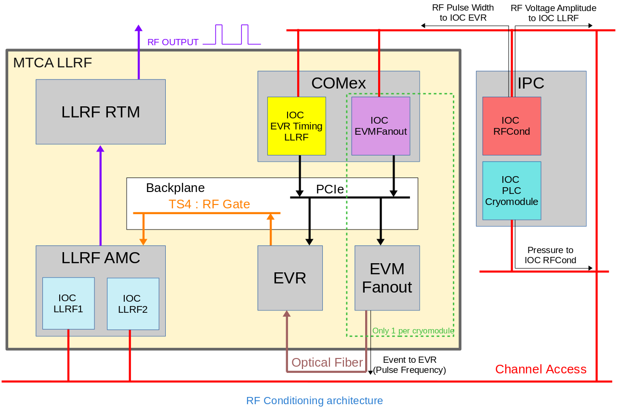
RF Conditioning
This high-level application is in charge of ramping the accelerating cavities to their nominal power
A ramp is applied on the RF amplitude thanks to the LLRF
A ramp is applied on the RF duty cycle thanks to the Timing system
The ramps speeds up or slows down depending on various measurements such as cavity pressure

Slide 18
RF control GUI

Slide 19
RF test results
Warm conditioning :
Slowly increase the accelerating field in the cavity monitoring a variety a sensors (pressure, temperature, electron pickup, photomultiplier, reflected RF power)
Cold conditioning :
Increase the accelerating field in the cavity to its nominal value
Very quick once the warm conditioning was correctly done
RFFI fast RF shutdown tests

Slide 20
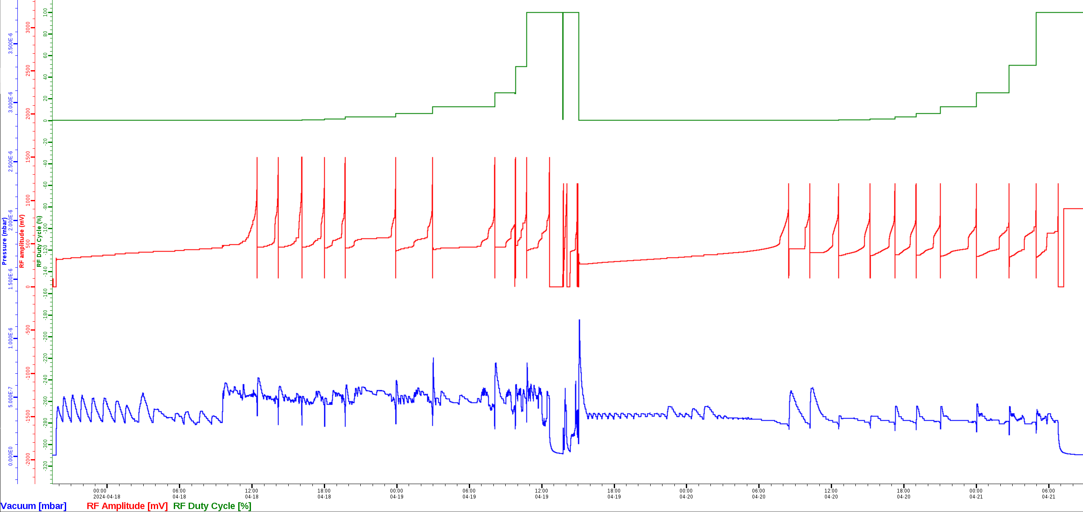
RF test results
Warm conditioning
Warm conditioning of Cryomodule 4, Equipped Cavity 1
T=296K
RF Duty Cycle range : 0.001 - 100%
RF Amplitude range : 150 - 1500 mV
Final RF DC = 100%
Initial RF DC = 0.001%
Final RF amplitude = 1500mV
Initial RF amplitude = 150mV

Slide 21
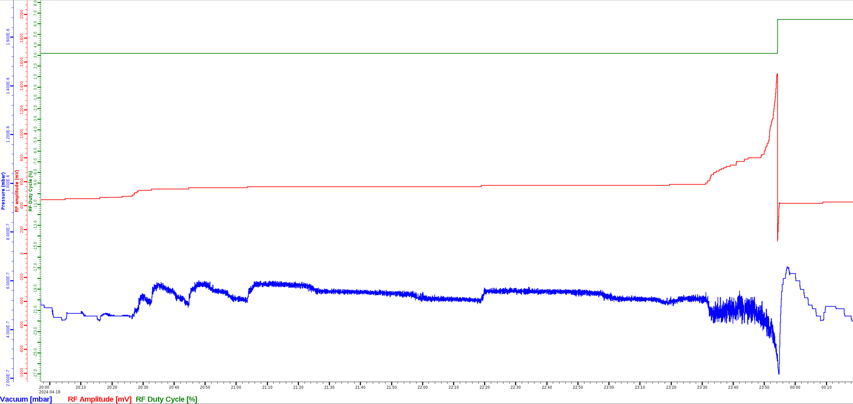
RF test results
Warm conditioning of Cryomodule 4, Equipped Cavity 1
RF power ramping causes the pressure inside the cavity to increase
Pressure increasing causes the RF power ramping to slow down
Vacuum warning threshold = 5.2E-7 mbar

Slide 22
Cryomodule solenoid control
4

Slide 23
Solenoid control architecture
Each cryomodule includes from 4 to 6 superconducting solenoid packages
Each solenoid package includes :
A main solenoid to focus the beam
2 pairs of steerers, one pair for horizontal deviation of the beam, another pair for vertical deviation of the beam
These coils are bathed in 4K liquid helium (cryogenics control will not be dealt with in this presentation)
The coils are powered by CAENels power supply units
S7-1500 PLC is in charge of current lead voltage measurements.
If the voltage measurement overpasses a 500mV threshold, the coil is considered as losing its superconductivity : it is a quench and the PLC then trips the power supply

Slide 24
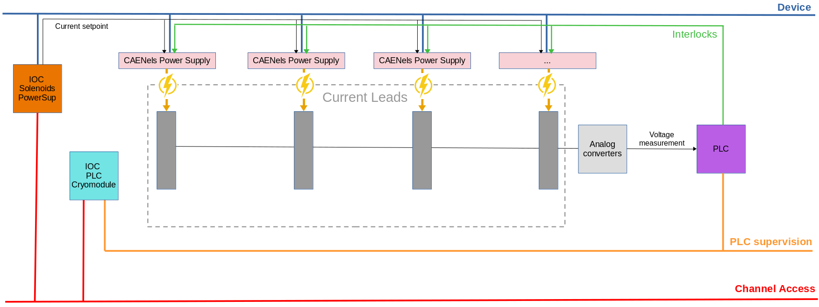
Solenoid control architecture

Slide 25
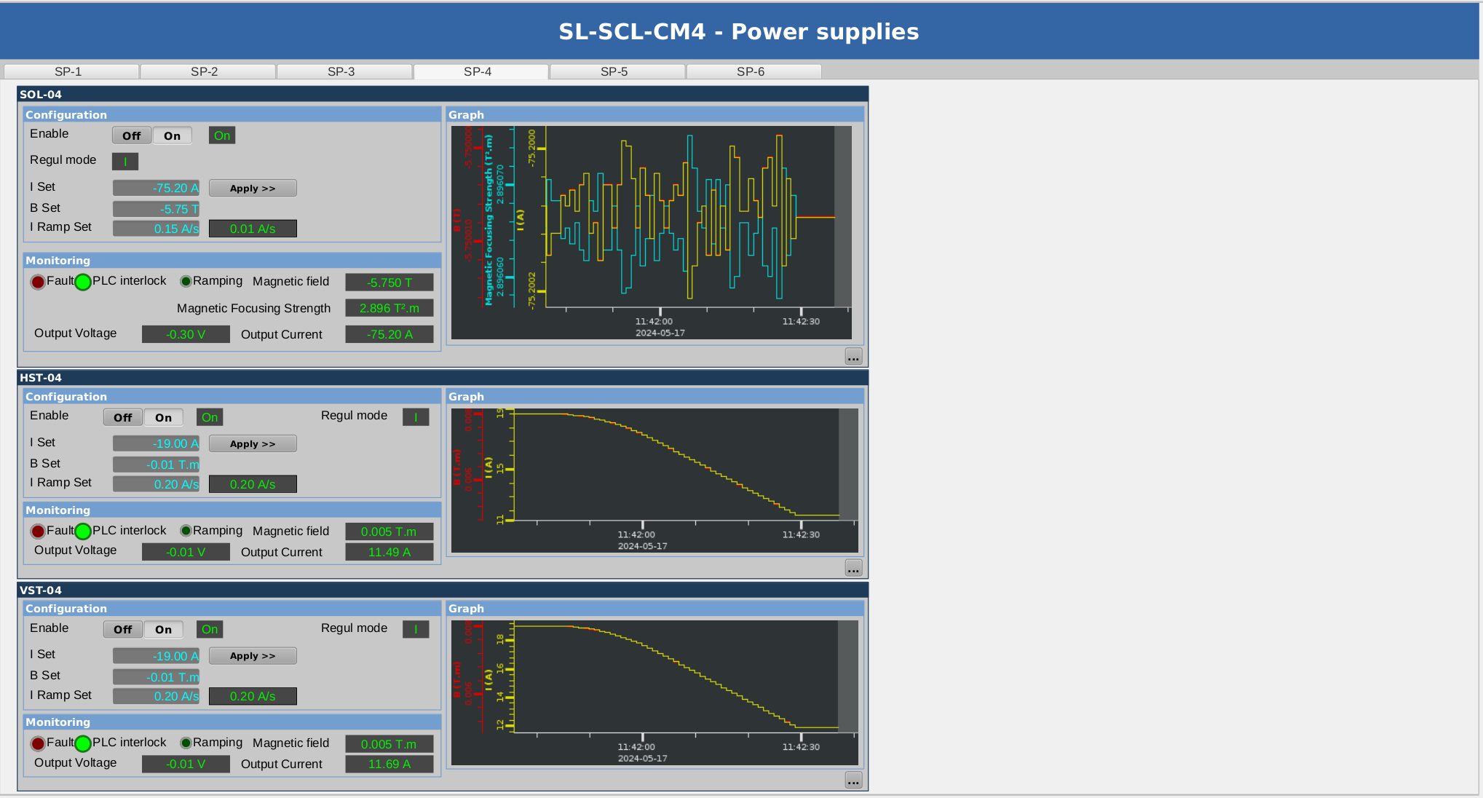
Solenoid control GUI

Slide 26
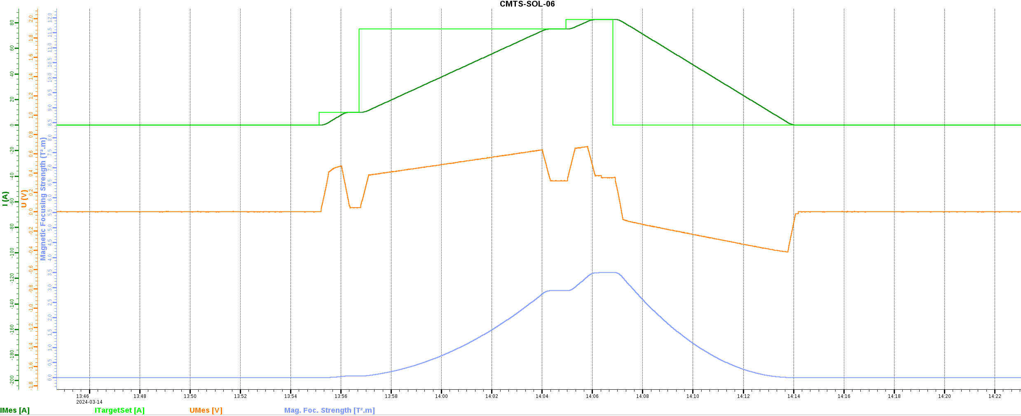
Solenoid test results
Ramping all solenoids to their nominal current (75.2A) + 10% :
The ramping rate is very important because the voltage measured in the current leads, which must not exceed 500mV, is related to current variation
Determining the appropriate ramping rate :
From 0A to 75.2A at 0.2A/s
From 75.2A to 82.7A at 0.15A/s
A few quenches were observed that were solved by training (repetition of current ramps)

Slide 27
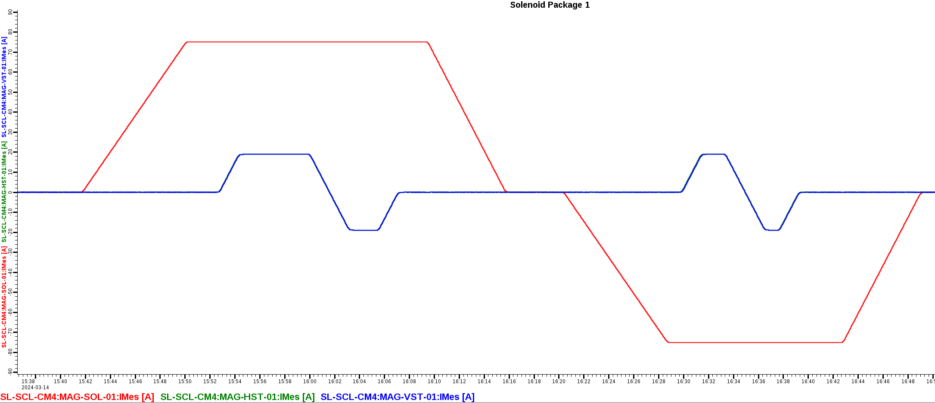
Solenoid test results
Testing all magnetic configurations for each solenoid package :
Positive current in the main solenoid
Positive and negative current in the steerers
Negative current in the main solenoid
Positive and negative current in the steerers

Slide 28
Main Control System tools
5

Slide 29
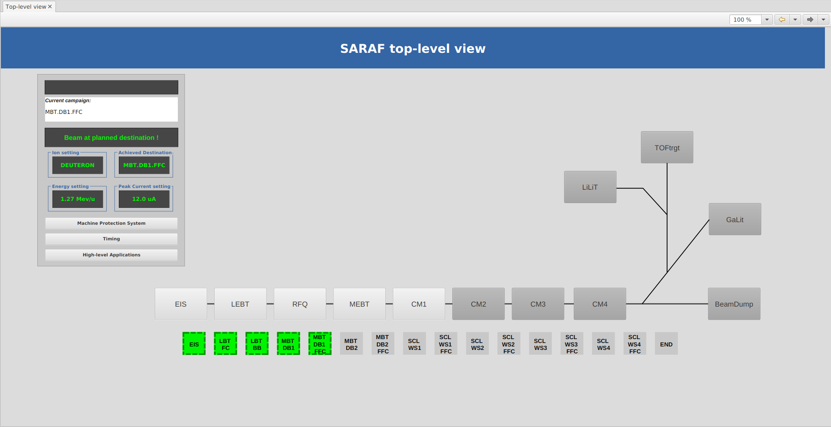
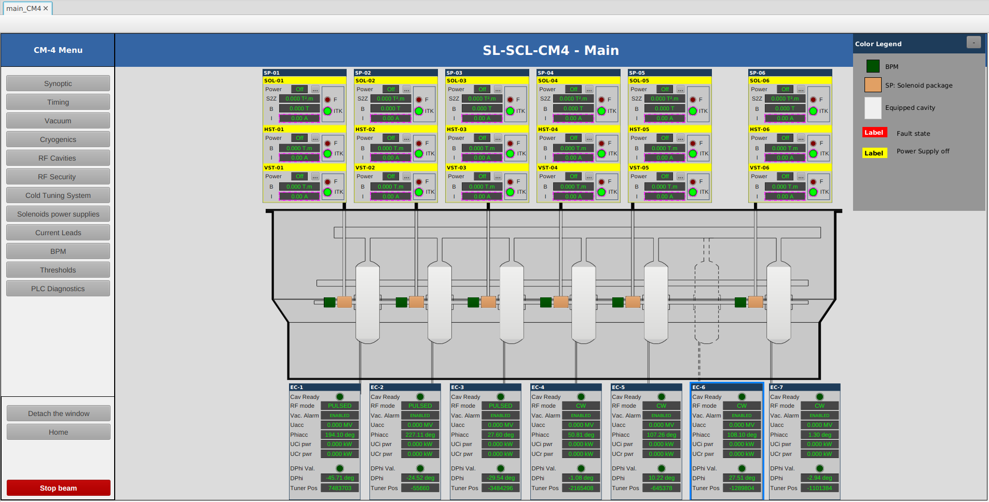
Phoebus GUI navigation
Large scale transition from CSS BOY to CSS Phoebus (~600 .opi files)

Slide 30
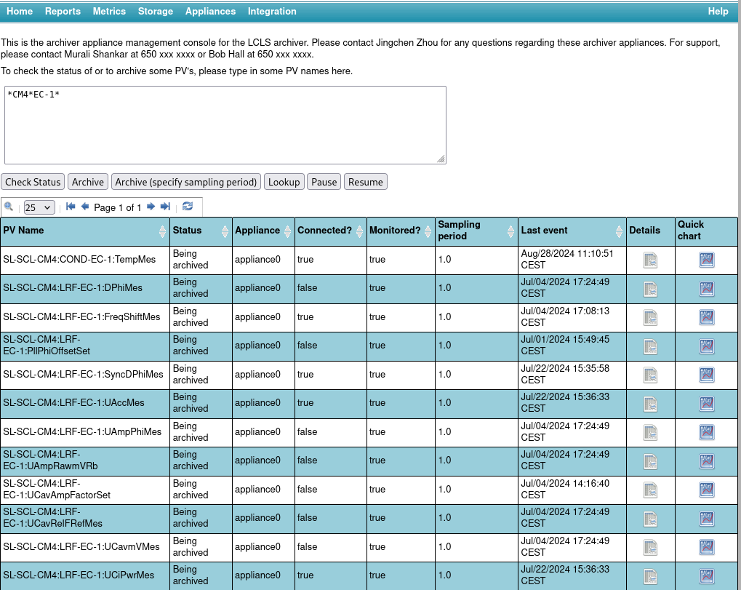
EPICS Archiver Appliance
Operators enjoy the Data Browser

Slide 31
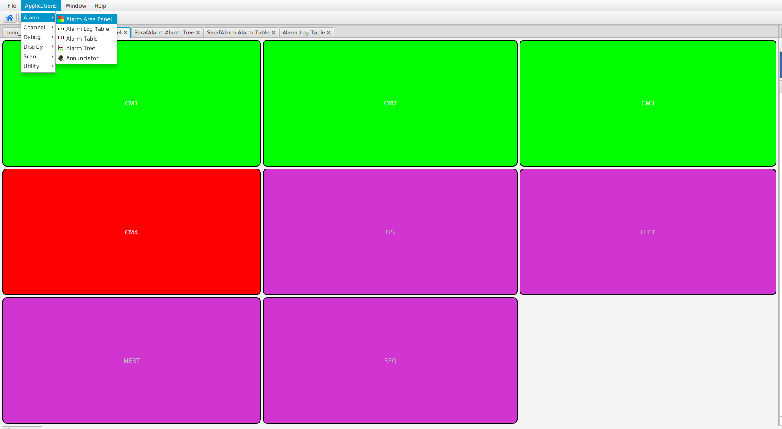
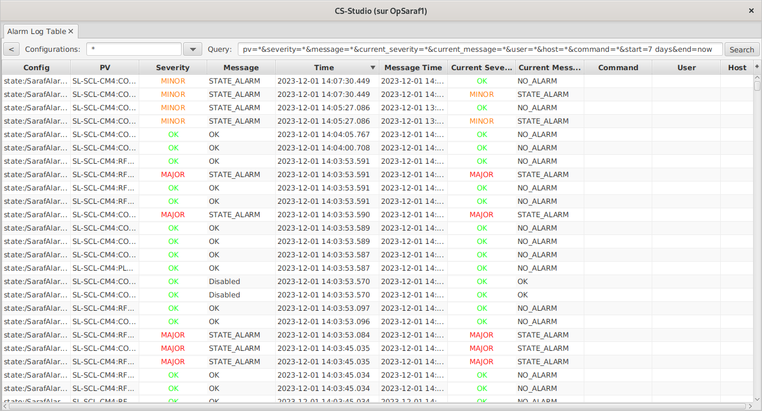
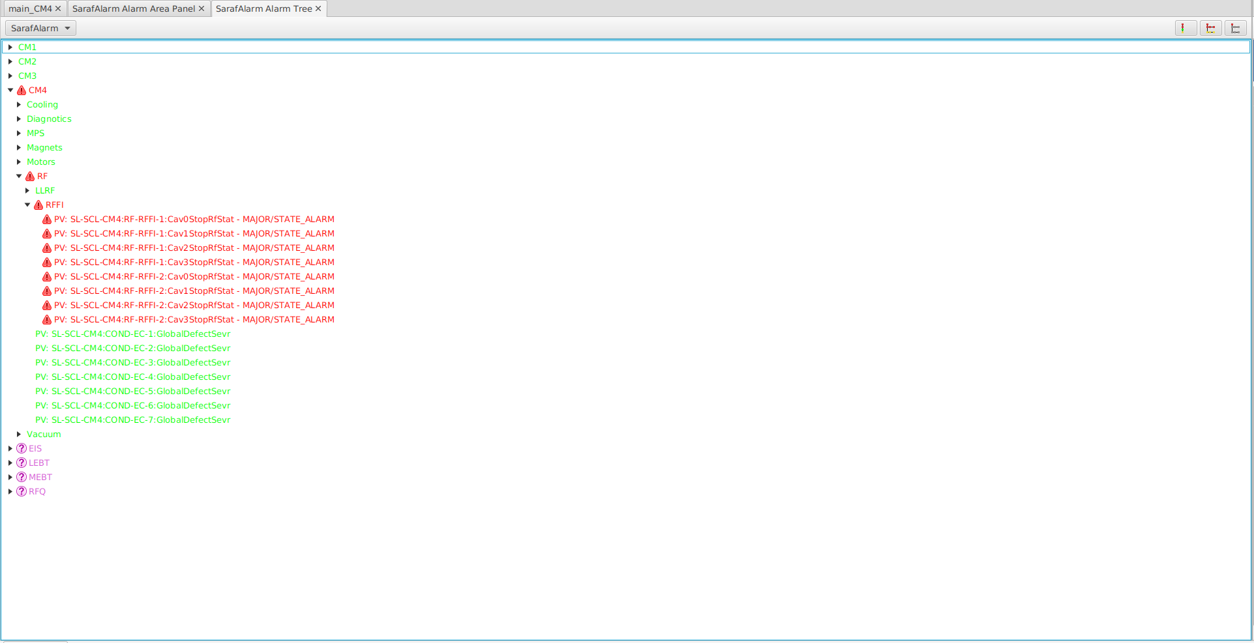
Phoebus Alarm Server
One of the important motivation for the transition from CSS BOY to CSS Phoebus

Slide 32
Conclusion
6

Slide 33
Conclusion
All 4 cryomodules have been successfully tested at CEA between 2023 and 2024 :
The lapse of time between the test of each cryomodule allowed the control to be debugged and enhanced before its delivery to SNRC
Cryomodule 1 is being tested at SNRC
The Cryomodule Test Stand has been an opportunity for the control team to bring evolutions compared to the initial baseline :
Transition from CSS BOY to CSS Phoebus
Transition from EPICS 3.15 to EPICS 7
Deployment of high-level tools such as the Phoebus Alarm Server

Slide 34
Thank you

