Slide 1
UX Analytics Toolkit for Phoebus
Evan Daykin

Slide 2
Contents
Background
Objective
Technical Requirements
Technical Details
Progress (As of 13 Sep)
Remaining Tasks

Slide 3
Background
Phoebus: Primary client application for supervisory control of large scientific machines
Collaboration led by Oak Ridge and Brookhaven National Labs, used by FRIB and others
Uses custom-built displays, runs in a JavaFX Application.
Supports a ‘plug-in’ development model. Sites can pick and choose features to build into their distribution, with minimal interdependencies.

Slide 4
Problem
Feedback from Operators: Due to distributed nature of an accelerator, with many intertwined subsystems, displays can be poorly integrated and difficult to navigate
Due to distributed nature of an accelerator, with many intertwined subsystems, displays can be poorly integrated and difficult to navigate
No existing way to see how our displays are being used
  (caputlog only tells us something was written)

Slide 5
Objective
Gather, from live usage, anonymous user interaction data from display instances
Store this data in an accessible place
Build a quantitative representation of where users are navigating, and how frequently.
Use this representation to identify organizational pain points
  5 sub-menus to change one common setting
  Busy display with 10,000 unused buttons
  Displays never used at all
Modify existing screens accordingly

Slide 6
Technical Requirements
Must be fast
  Adapters between existing representations and this module should be very simple
  Should not slow down the User’s work
Must be modular
  Fully self-contained in a plugin module
  Modifications to existing modules, if any, should not introduce any dependencies on this module
Must be scalable
  Tracks large volume of actions (mouse clicks)
  Back-end priority should be efficient storage operations
Must be understandable
  Analytics client application should present a human-readable representation of user interactions

Slide 7
Technical Details
Requirement 1: Speed
  Anything that needs to run in the JavaFX Application thread is as simple as possible.
  Captures JFX representation events and associated Phoebus-specific abstractions, hands them off to a background thread for anything fancier
Requirement 2: Modularity
  Analytics toolkit is its own module, registered via core ‘AppDescriptor’ SPI
  Few modifications to existing code. Exposes JavaFX objects so events can be fired when they change.
Requirement 3: Scalability
  Adapter code keeps track of representation in thread-safe Java containers (ConcurrentHashMap?)
  Overall hierarchy for Application creates one listener for each ‘tab’ (View is structured like a web browser), singleton backend connections – exactly one per application instance.
Requirement 4: Understandability
  Use Neo4J to construct a graph database of traversals (opening new tab/window from another tab) and control actions (writing new value to process variable)
  Use a standard SQL database to store click events within a page.

Slide 8
Progress
UI menu to configure MongoDB connection, Neo4J connection
  Backend connection menu complete
Background ‘tree’ hierarchical representation of application state
  ActiveWindowsService (singleton) to track map of each window to its…
  …ActiveTabsOfWindow, to track map of each Window To its tab,
  …ActiveTab to catalog a runtime tab, and manage listeners
  ‘UXAMonitor’ as the ‘nexus’: holds reference to the ActiveWindowsService and backend connection(s)
Backend Connection Interface w/ a couple of reference implementations
  Neo4J Connection substantially complete
  SQL Connection substantially complete
  Filesystem Image Client substantially complete

Slide 9
Remaining Tasks
UI menu to configure ‘Opt-in’
  Need pop-up for ‘informed consent’ (what is collected, why is it used, never show me this again, I don’t care)
Keep databases at arm’s length from user application
  Service layer application running in Payara (née Glassfish) in progress
  Brokers transactions such that only valid events can be written to database
  Prevents accidental (or intentional) destructive operations
Software testing
Acceptance testing
Custom Viz app? Existing off-the-shelf app?

Slide 10
Question Marks
Widgets enumerated by exposing DisplayRuntimeInstance.ActiveModel
  Formerly package-private
  We need to know which file/hierarchy a Widget belongs to when it notifies a ToolkitListener
  Practical to get the top-level model from the Widget passed into a ToolkitListener.handle… method?
ToolkitListener with tab attribute can pass this ownership info along^
Uniquely identifying file and version
  Finding root of display tree
Displays are only tracked if revision controlled^
  Node name will be vcs_root/filename_<first-8-of-sha1>
Noting how a display was opened
  “Top” menu
  File Browser
  Open Display button action
Special “static” origin points for opening from outside of a display runtime instance.^
Worth implementing if we’re moving toward web view? Things like e.g. Hotjar already exist for web

Slide 11
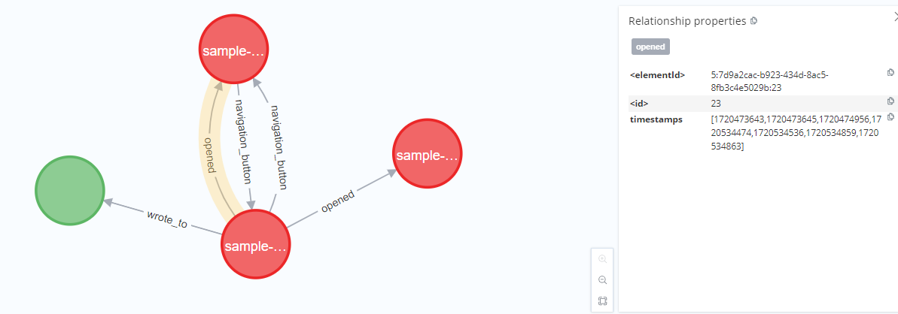
Neo4J UI

Slide 12
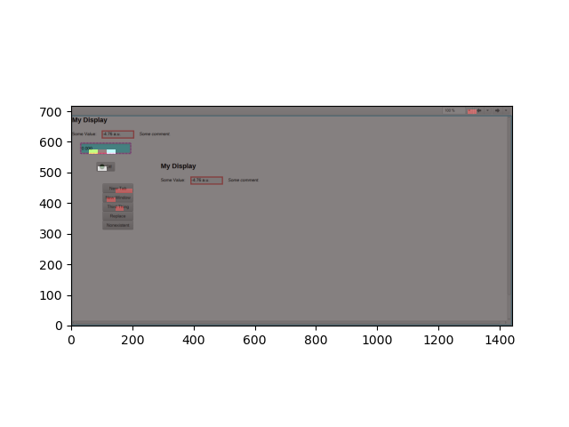
Heatmap Example

Slide 13
Questions?

