Slide 1
Berkeley Center for Structural Biology (BCSB)
Developing and Integrating EPICS Driver in Python
Gabriel Gazolla
(Computer Systems Engineer)
John Taylor
(Head of Software and Instrumentation)

Slide 2


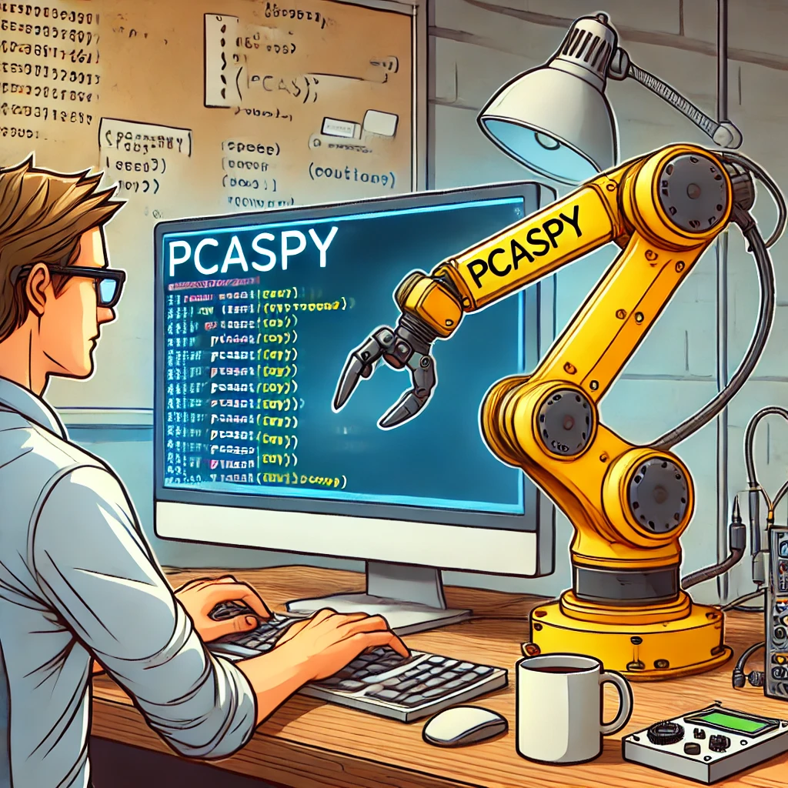
Agenda & Objectives
A
B
C
Learn what PCASpy is capable of.
Be able to understand and read a PCASpy implementation.
Implement a basic PCASpy driver.

Slide 3

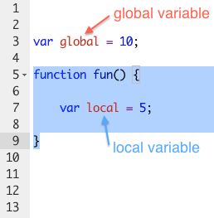
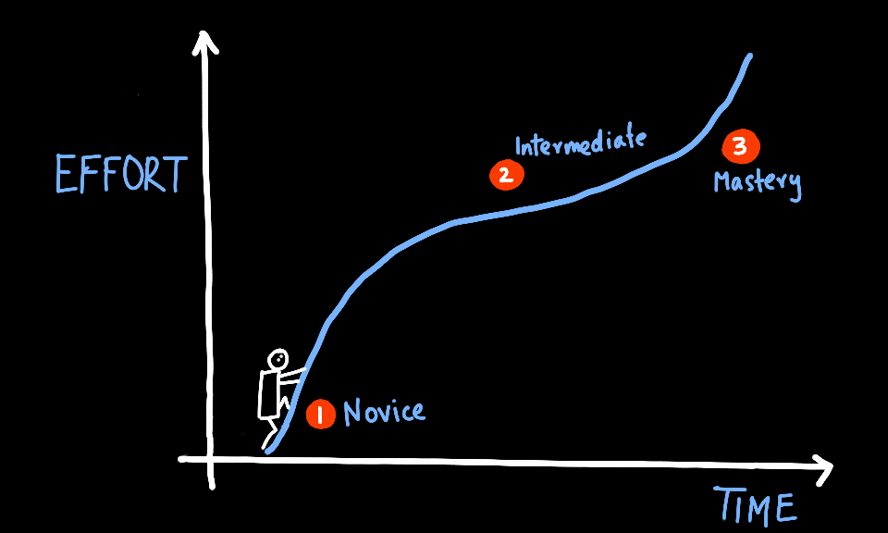
What is the motivation for this talk ?
EPICS

Slide 4

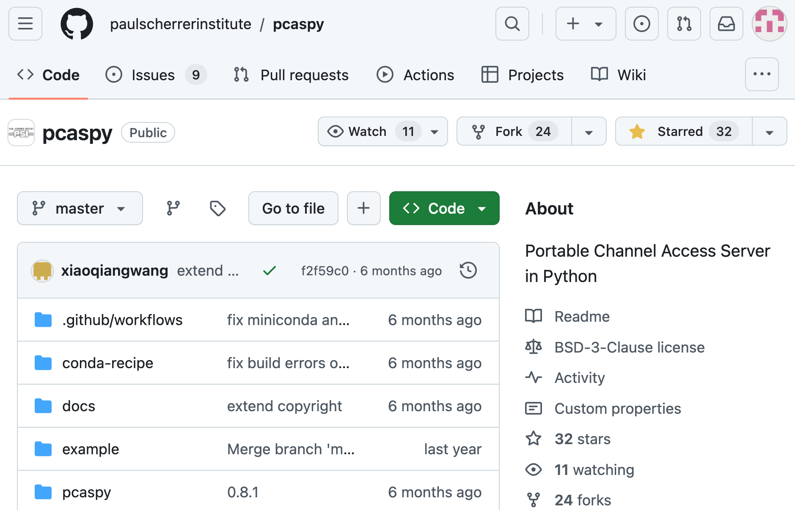
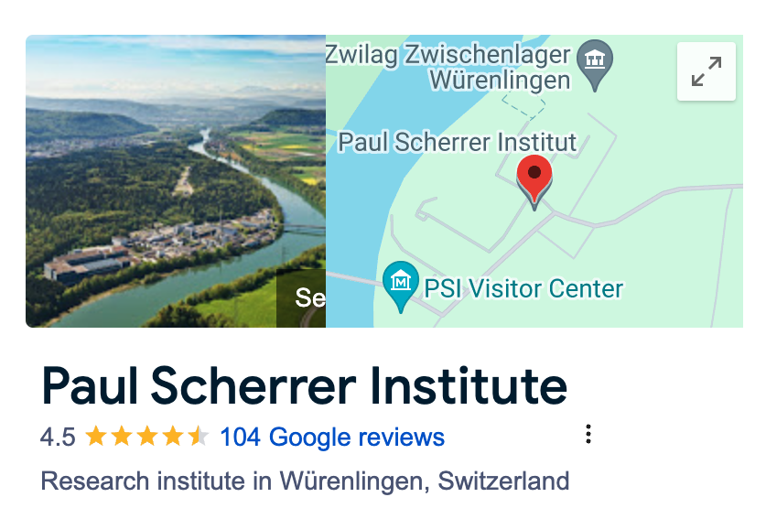

What is PCASpy ?
PCASpy /’pi:kas,pai/ provides not only the low level python binding to EPICS Portable Channel Access Server but also the necessary high level abstraction to ease the server tool programming.

Slide 5
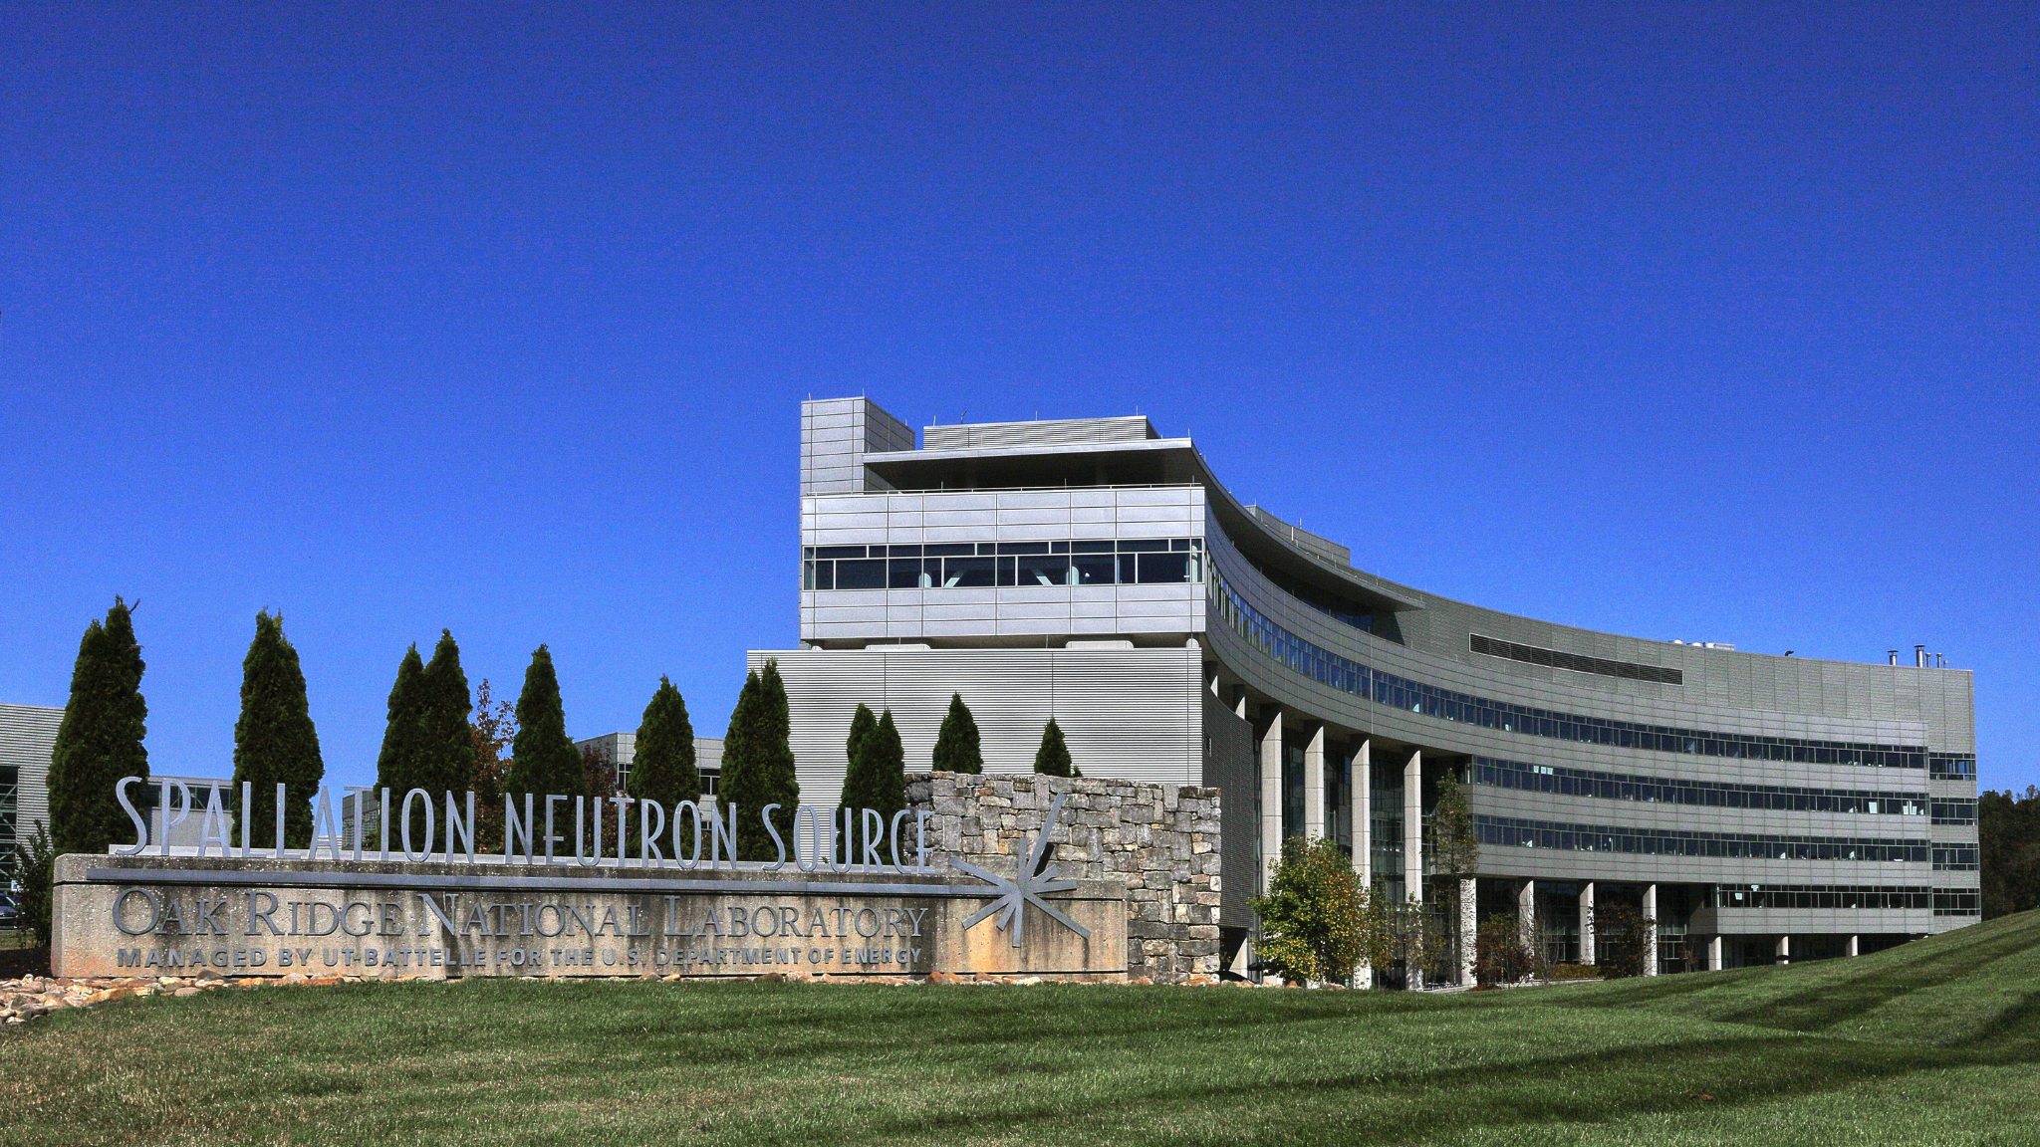

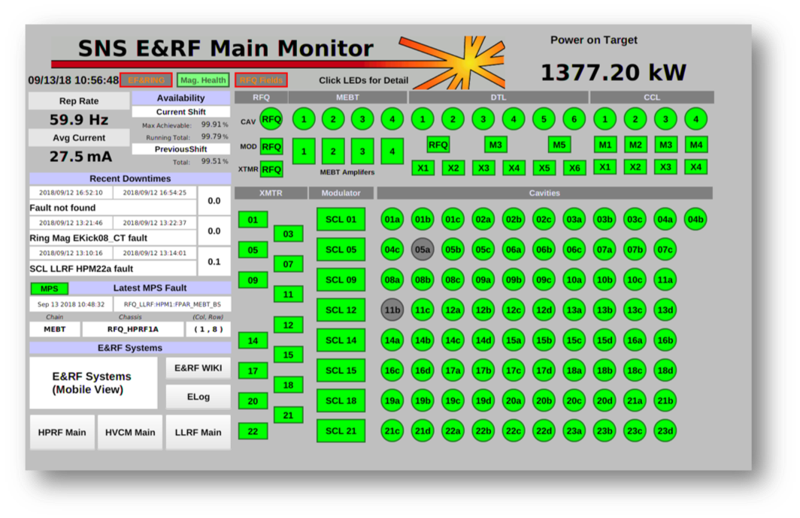
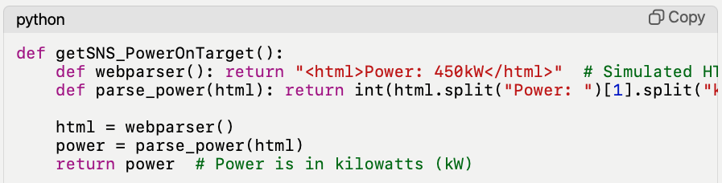



PCASpy Example
Problem is transformed into: “Do I know how to implement a get/set for the function I need?

Slide 6
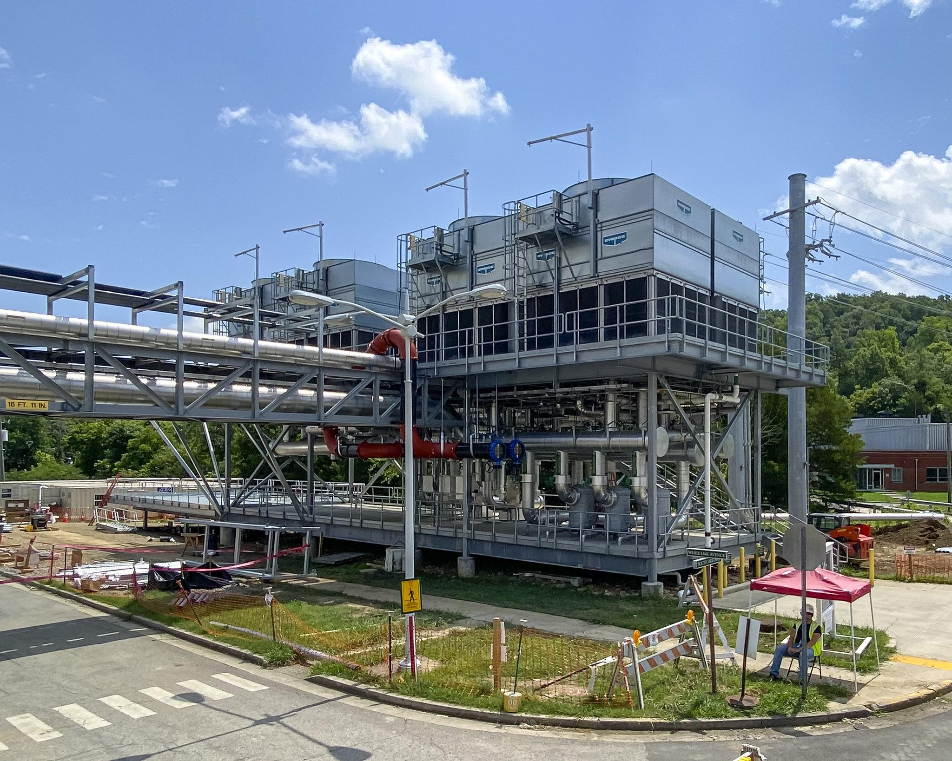
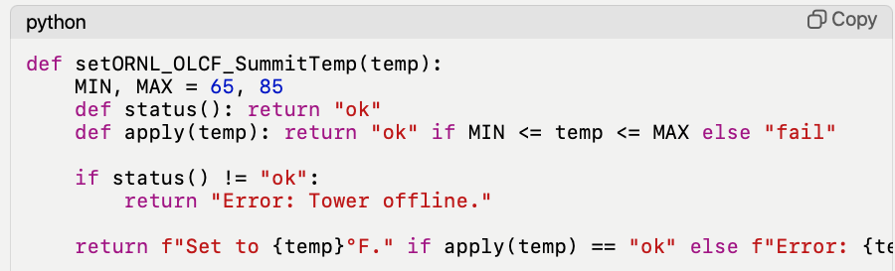
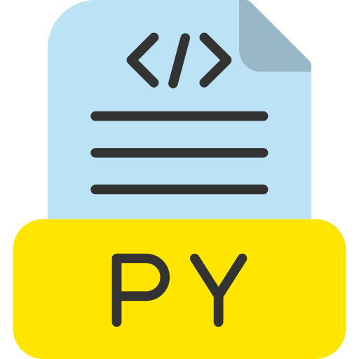
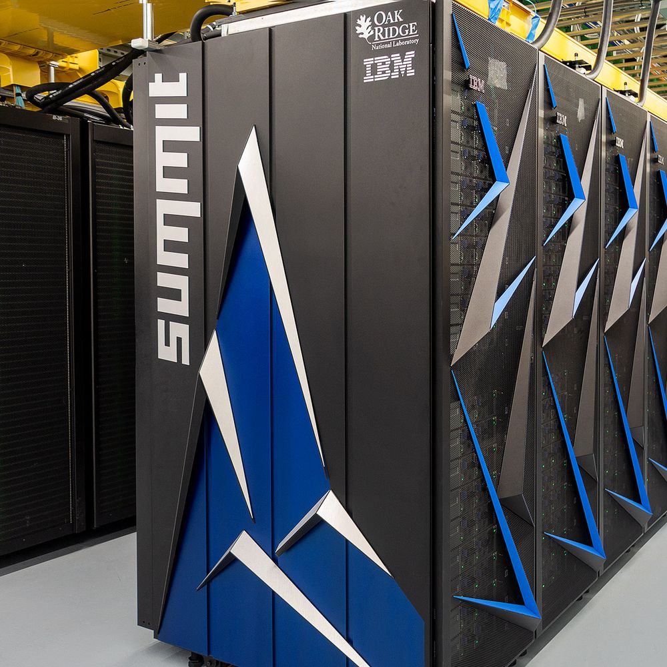

PCASpy Example
Problem is transformed into: “Do I know how to implement a set for the function I need?

Slide 7

Agenda & Objectives
A
Learn what PCASpy is capable of.

Slide 8
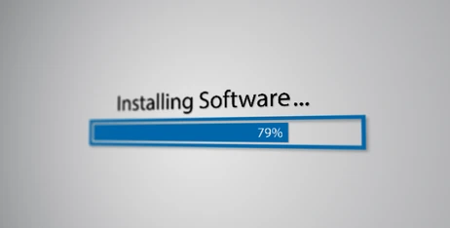

How to install PCASpy ?

Slide 9


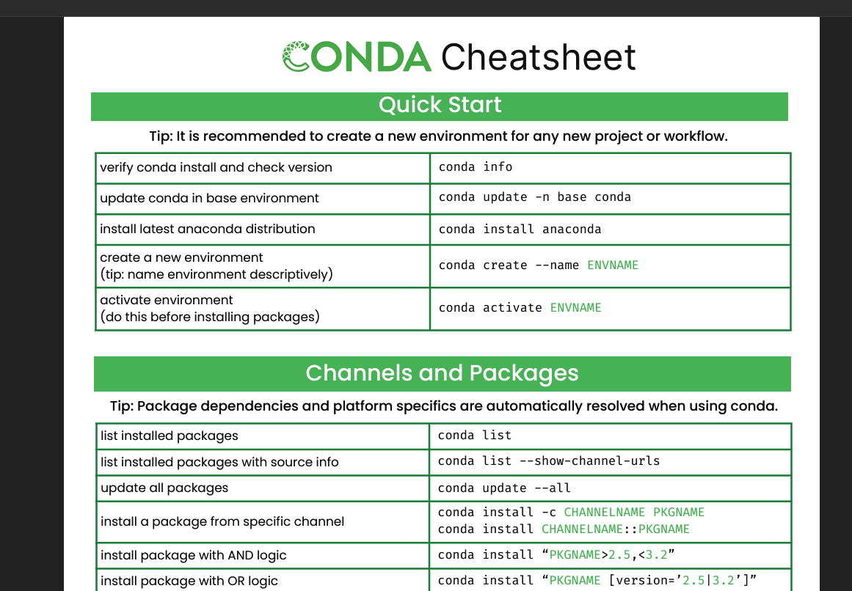
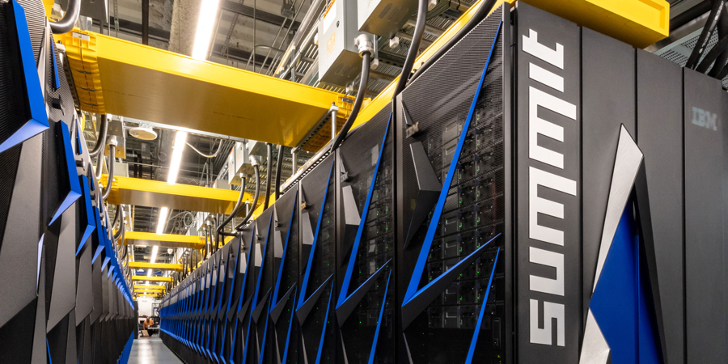

What is Anaconda ?
Anaconda is a distribution of the Python and R programming languages for scientific computing that aims to simplify package management and deployment.

Slide 10
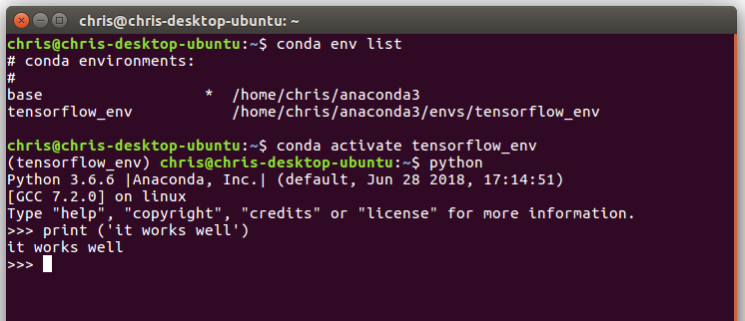
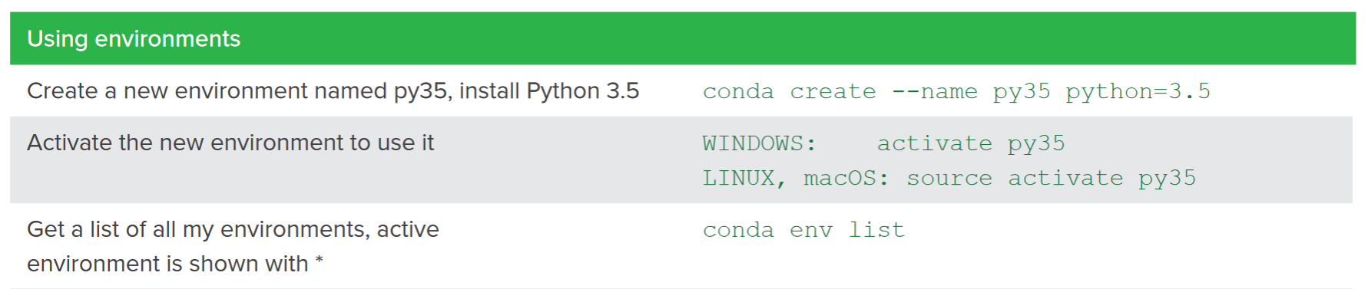
Using Conda
LearningPCASpy
LearningPCASpy

Slide 11
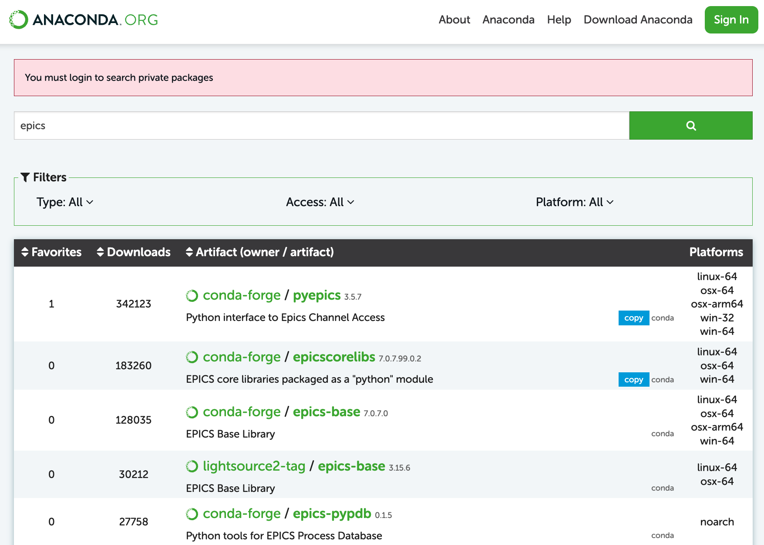
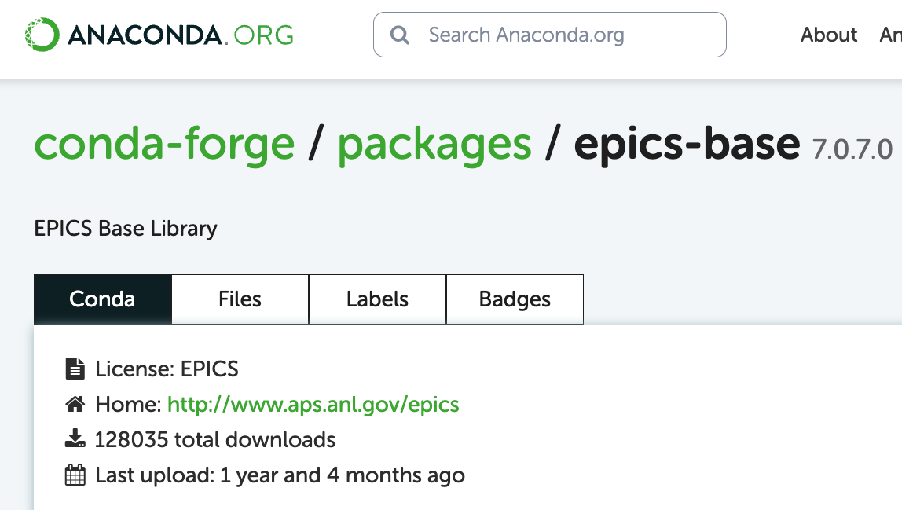
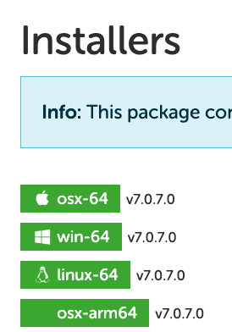

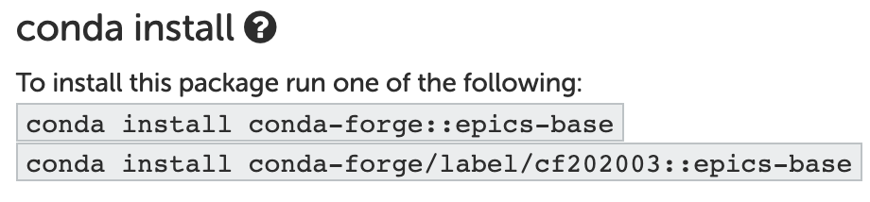
Installing EPICS Base with Conda

Slide 12
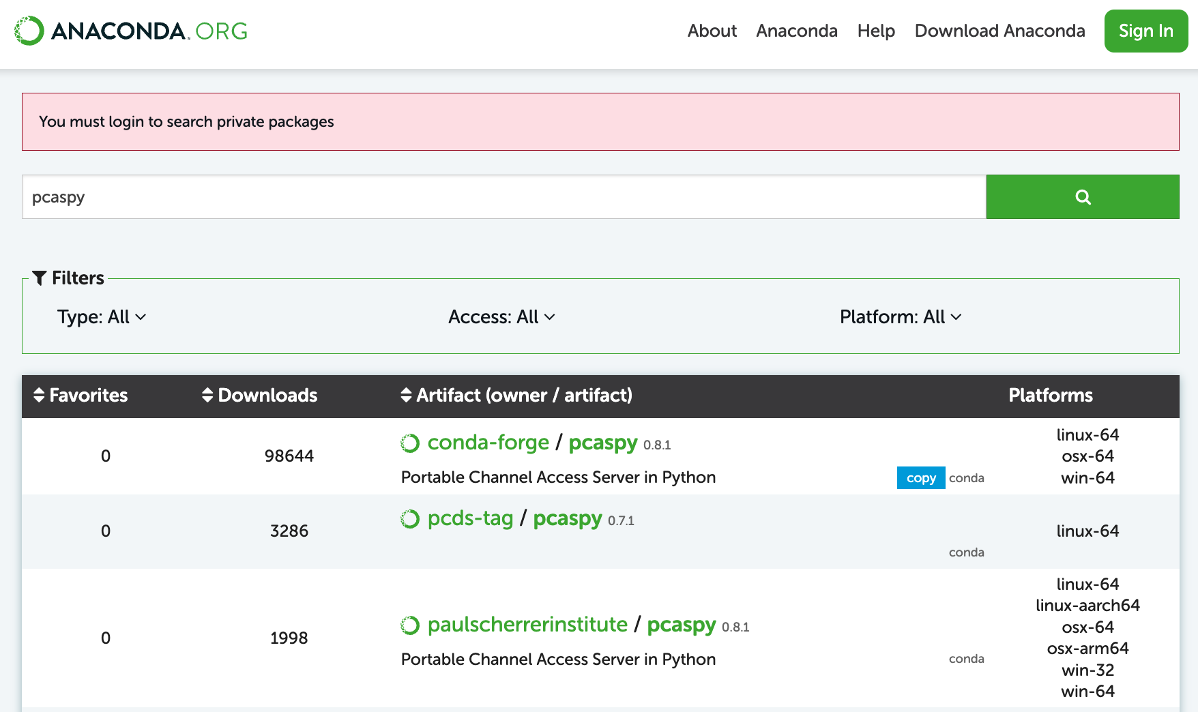
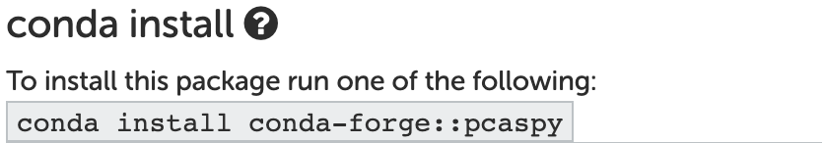
Installing PCASpy - Easy Installation

Slide 13



example using PCASpy
Random Number Generator [1,N]

Slide 14
Agenda & Objectives
A
B
C
Learn what PCASpy is capable of.
Be able to understand and read a PCASpy implementation.
Implement a basic PCASpy driver.

Slide 15
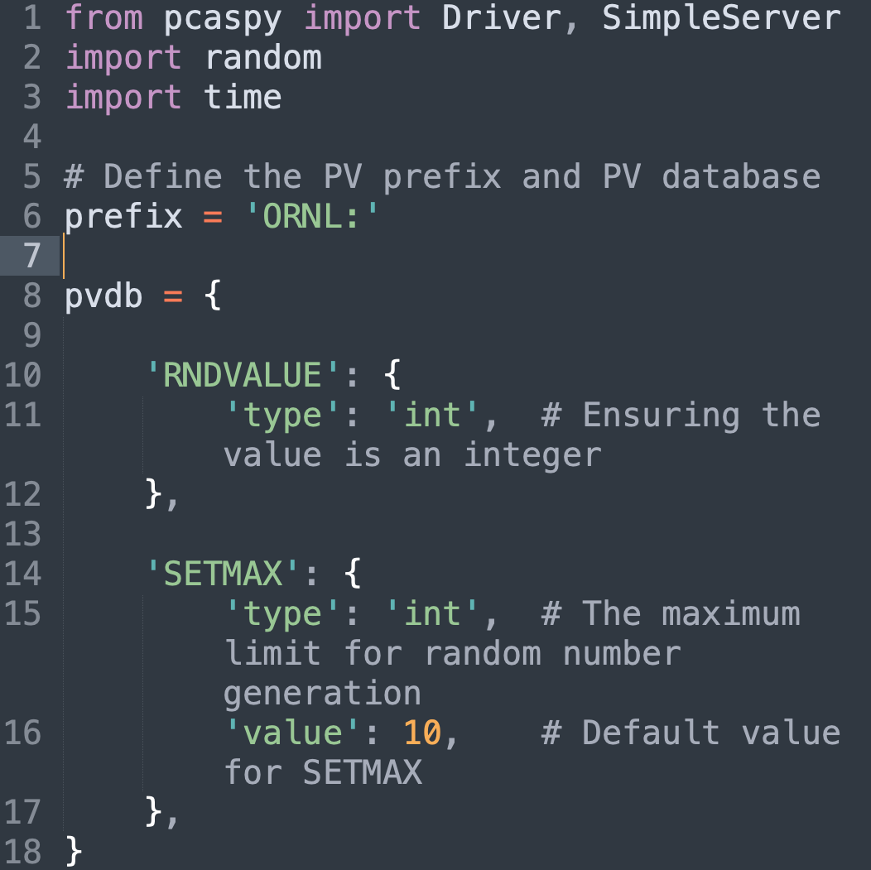
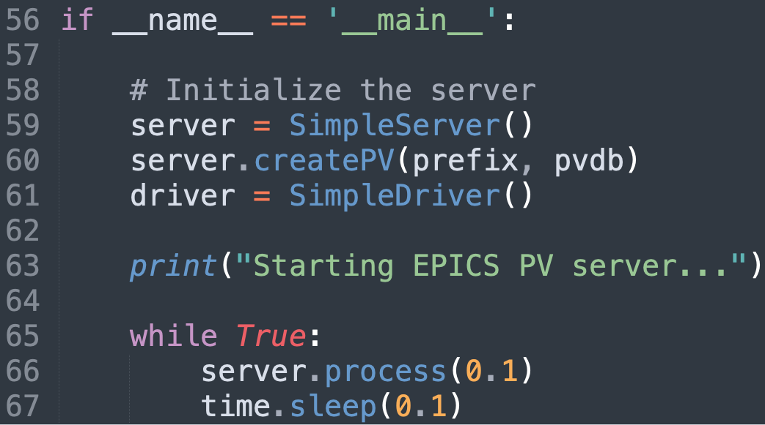
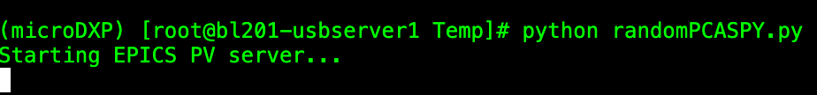
PCASPy - EPICS - Random Number Generator

Slide 16
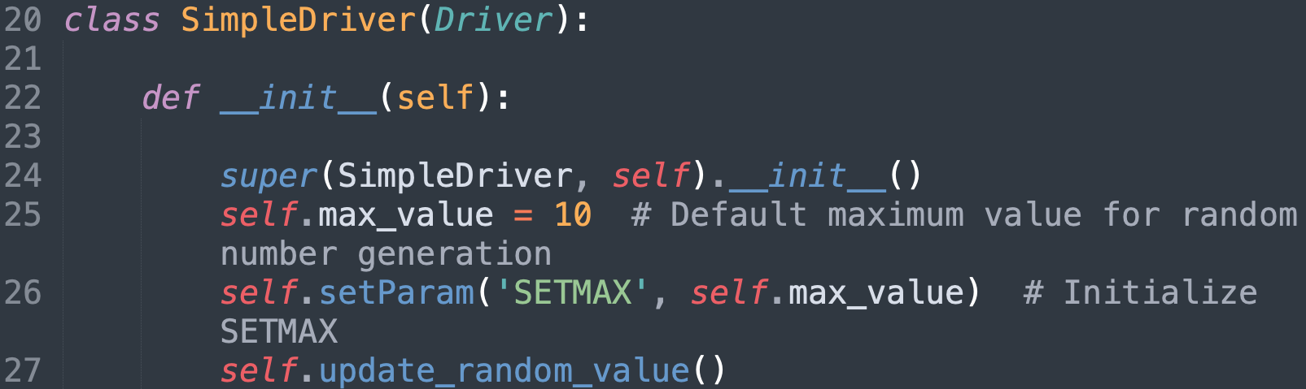
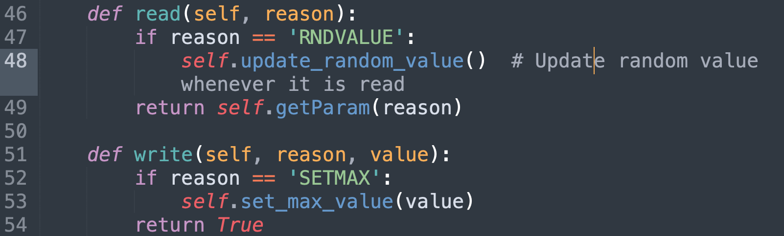
PCASPy - EPICS - Random Number Generator

Slide 17
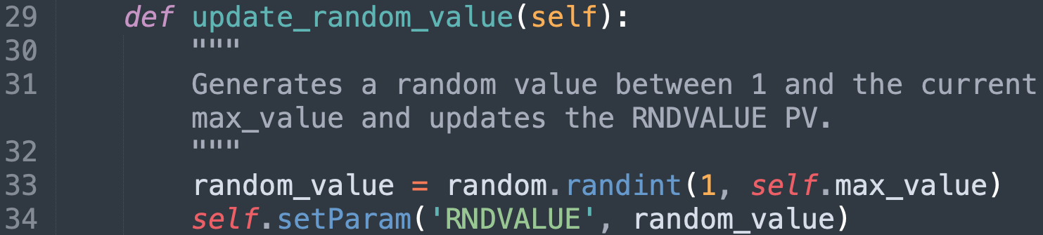
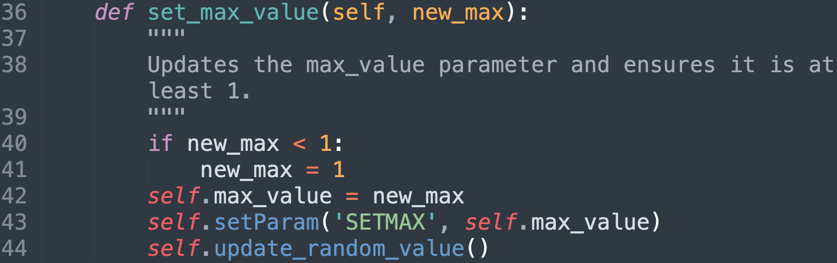
PCASPy - EPICS - Random Number Generator

Slide 18
Agenda & Objectives
A
B
C
Learn what PCASpy is capable of.
Be able to understand and read a PCASpy implementation.
Implement a basic PCASpy driver.

Slide 19

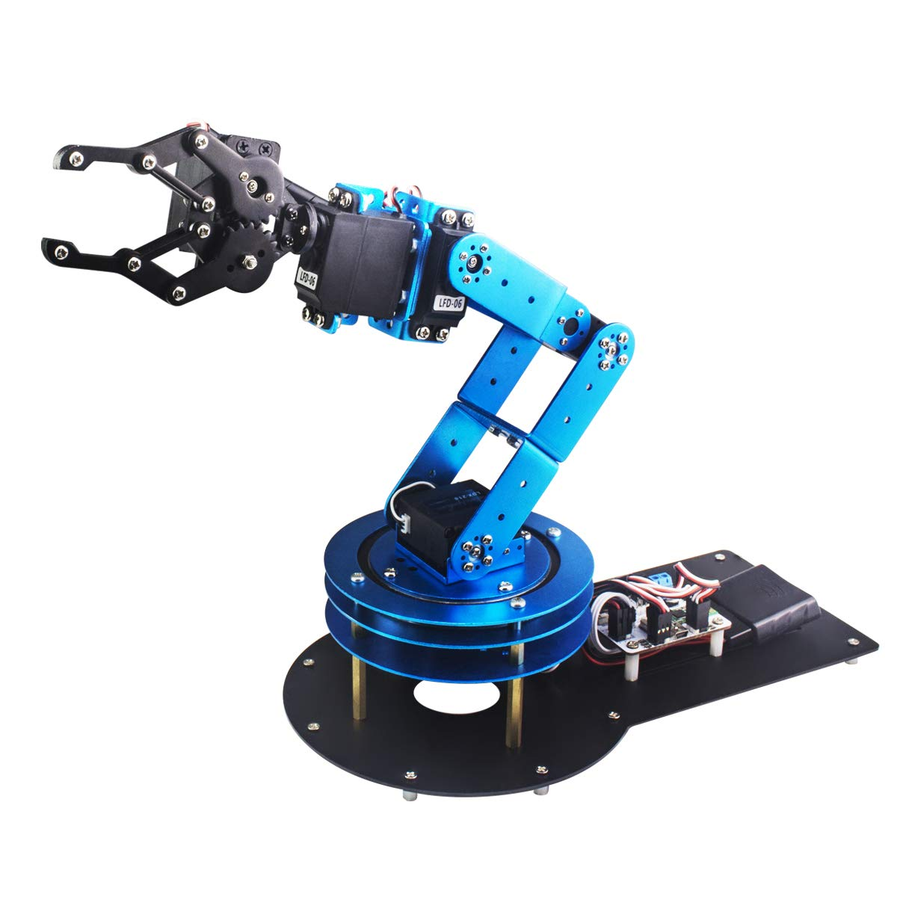
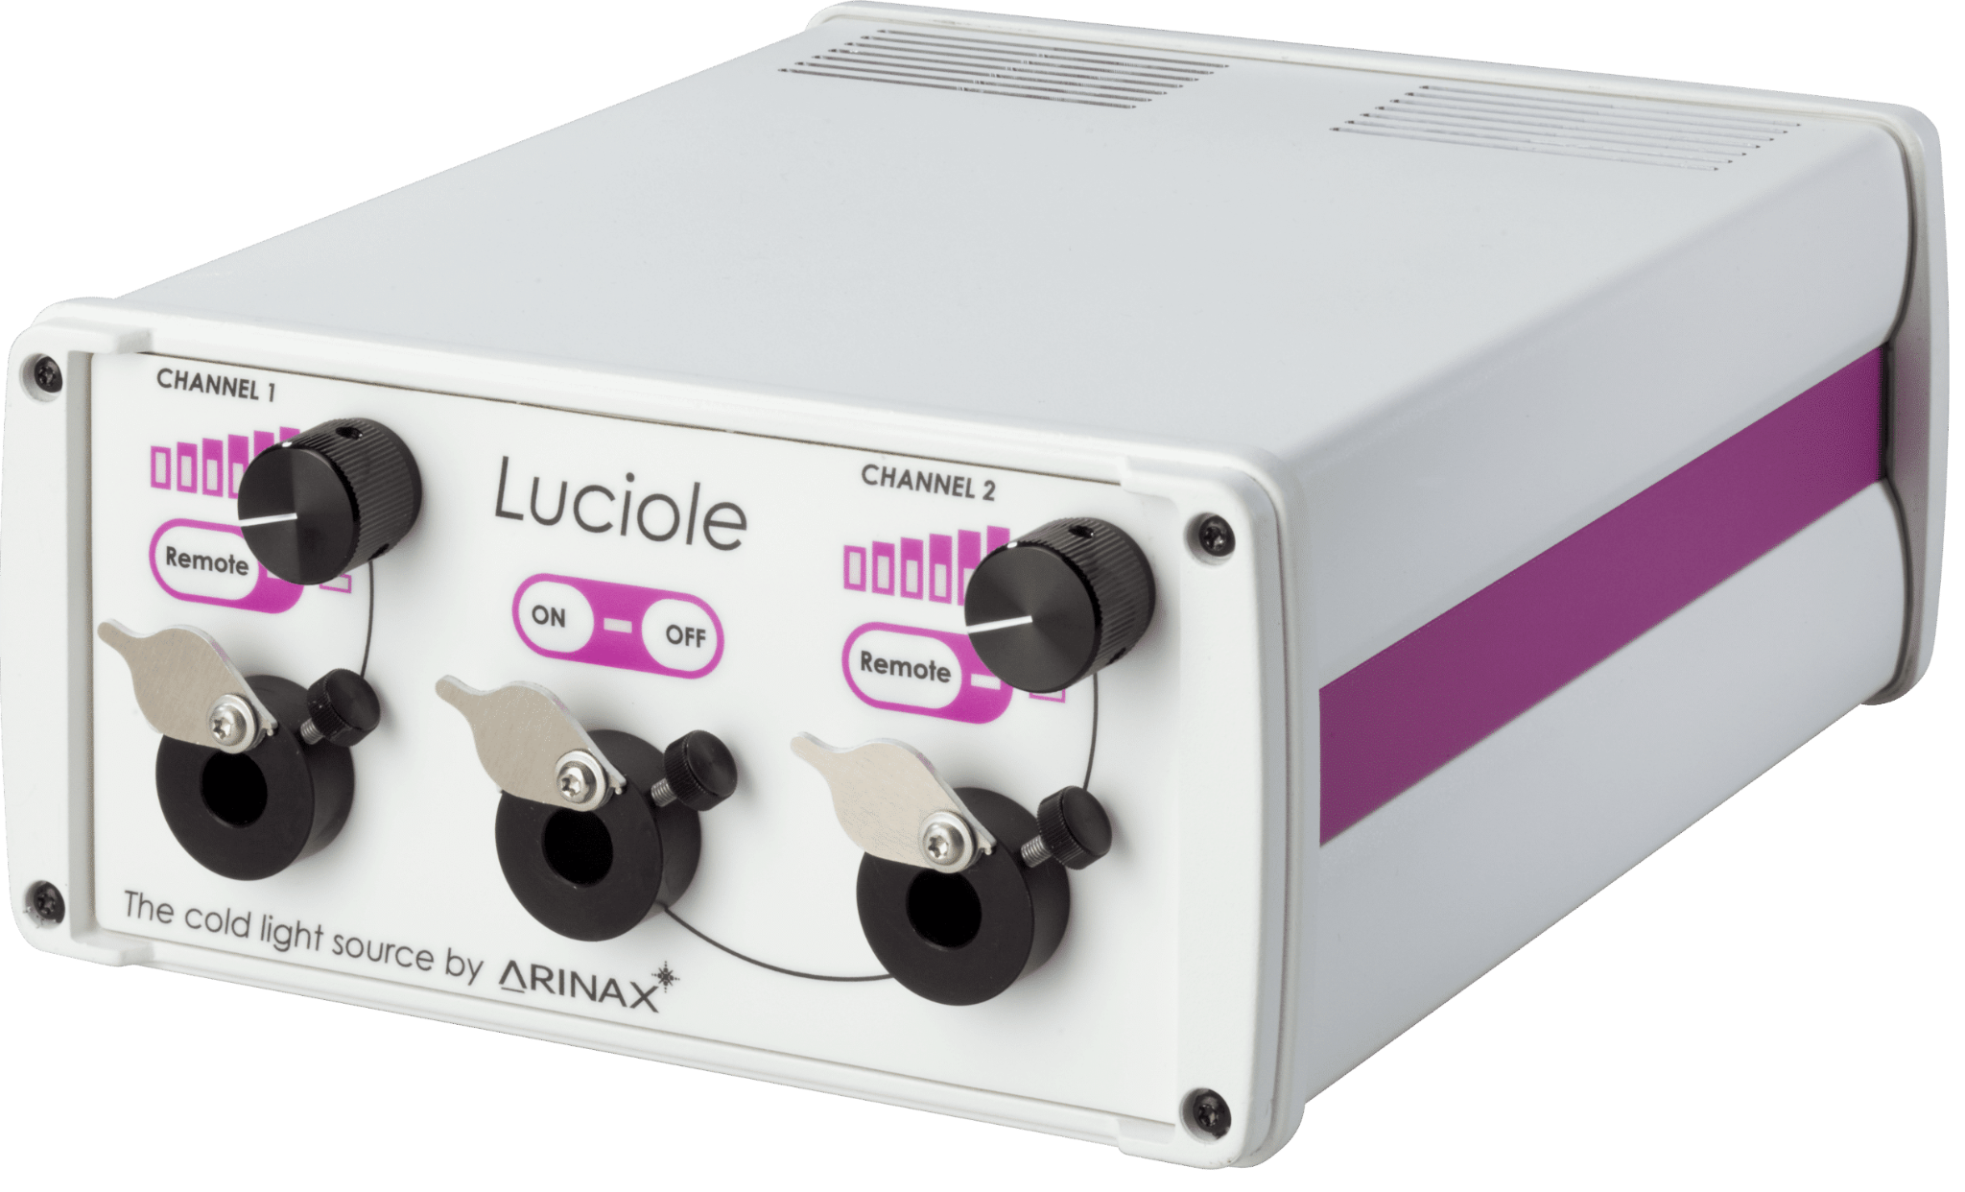




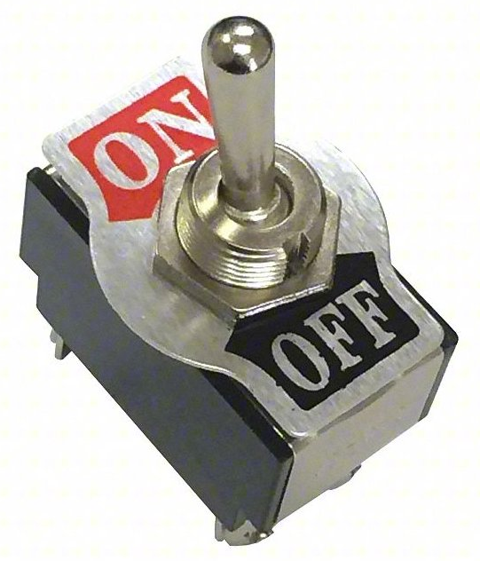


Limitations
Speed | Trade Off | Real Time Requirements

Slide 20
Real Case Scenario at BCSB (LBL)

Slide 21
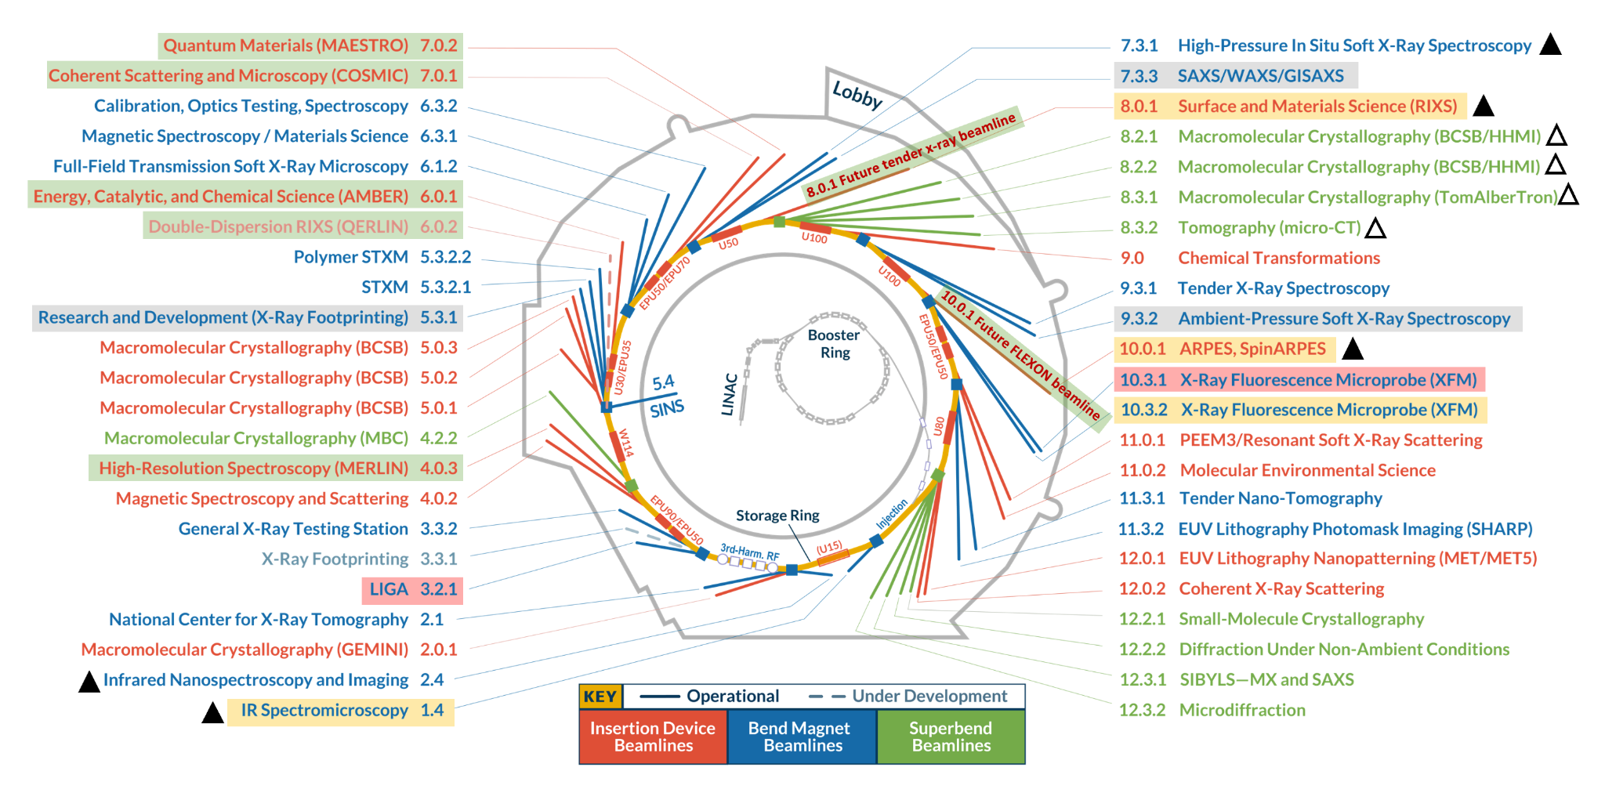

BCSB
The Berkeley Center for Structural Biology brings over 20 years of experience to beamline management and innovation. We operate six high-throughput protein crystallography beamlines at the Advanced Light Source at Lawrence Berkeley National Laboratory.
7 out of ~44

Slide 22
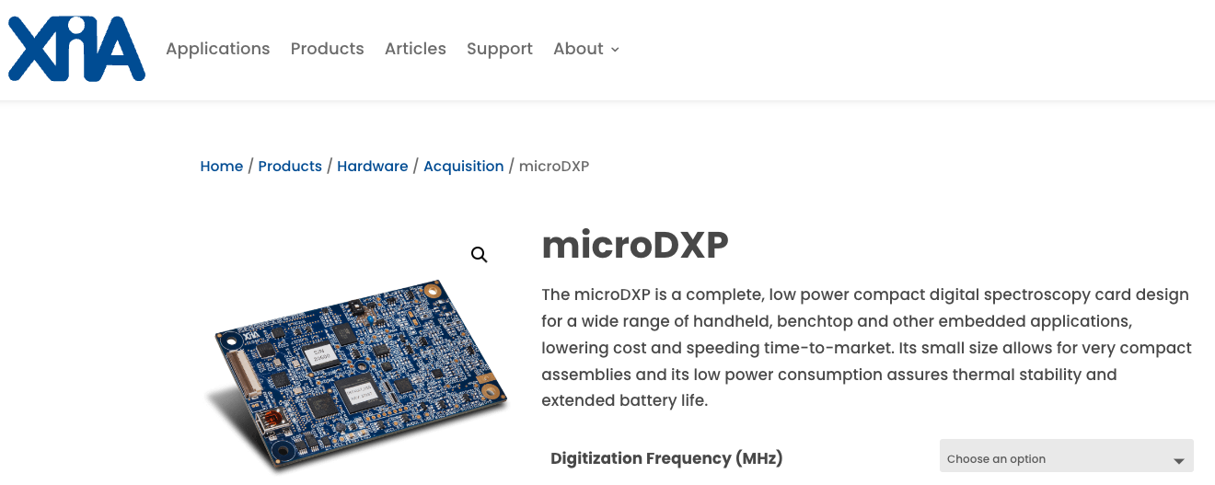

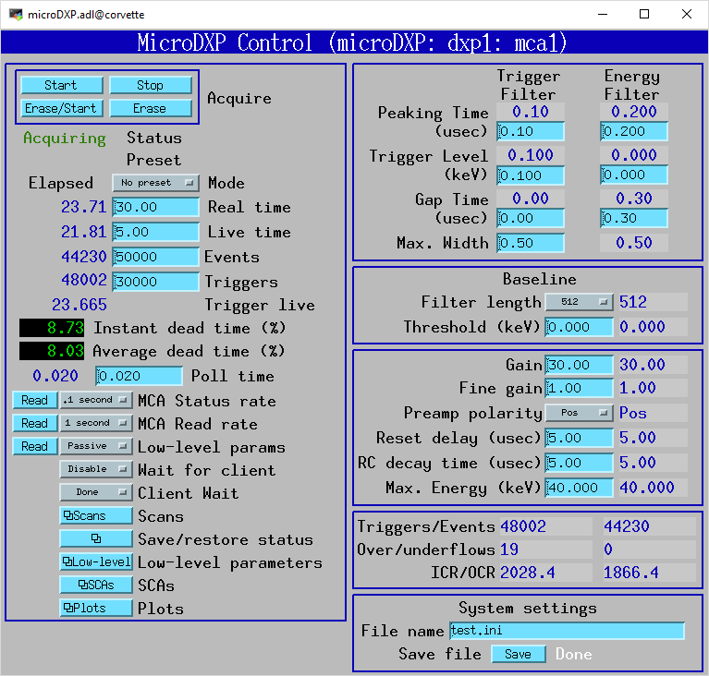
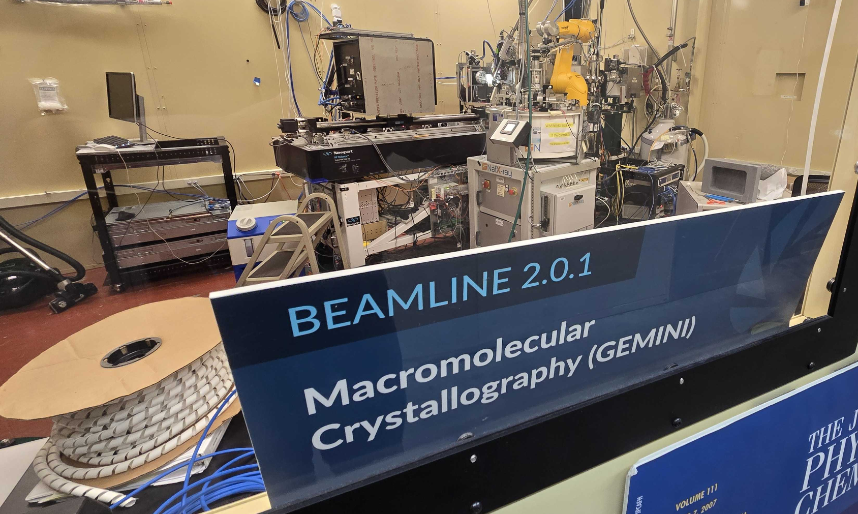
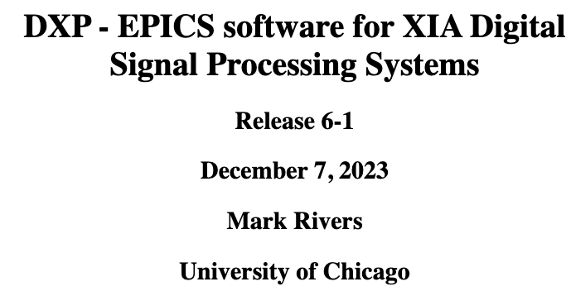

Slide 23
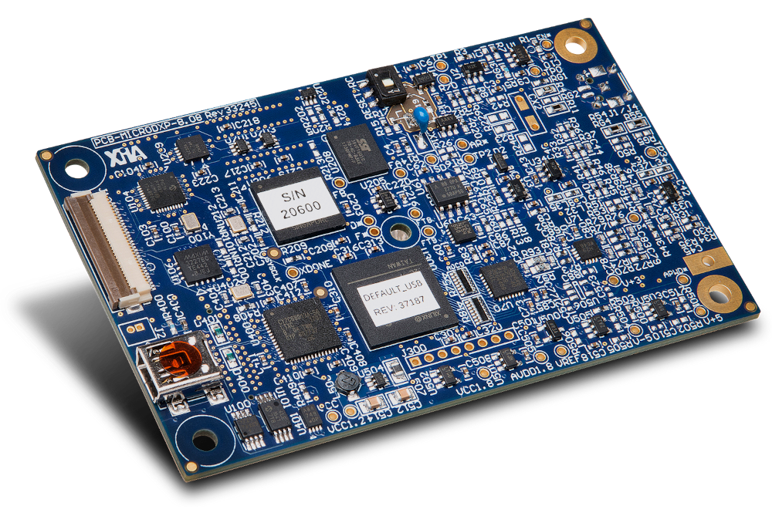

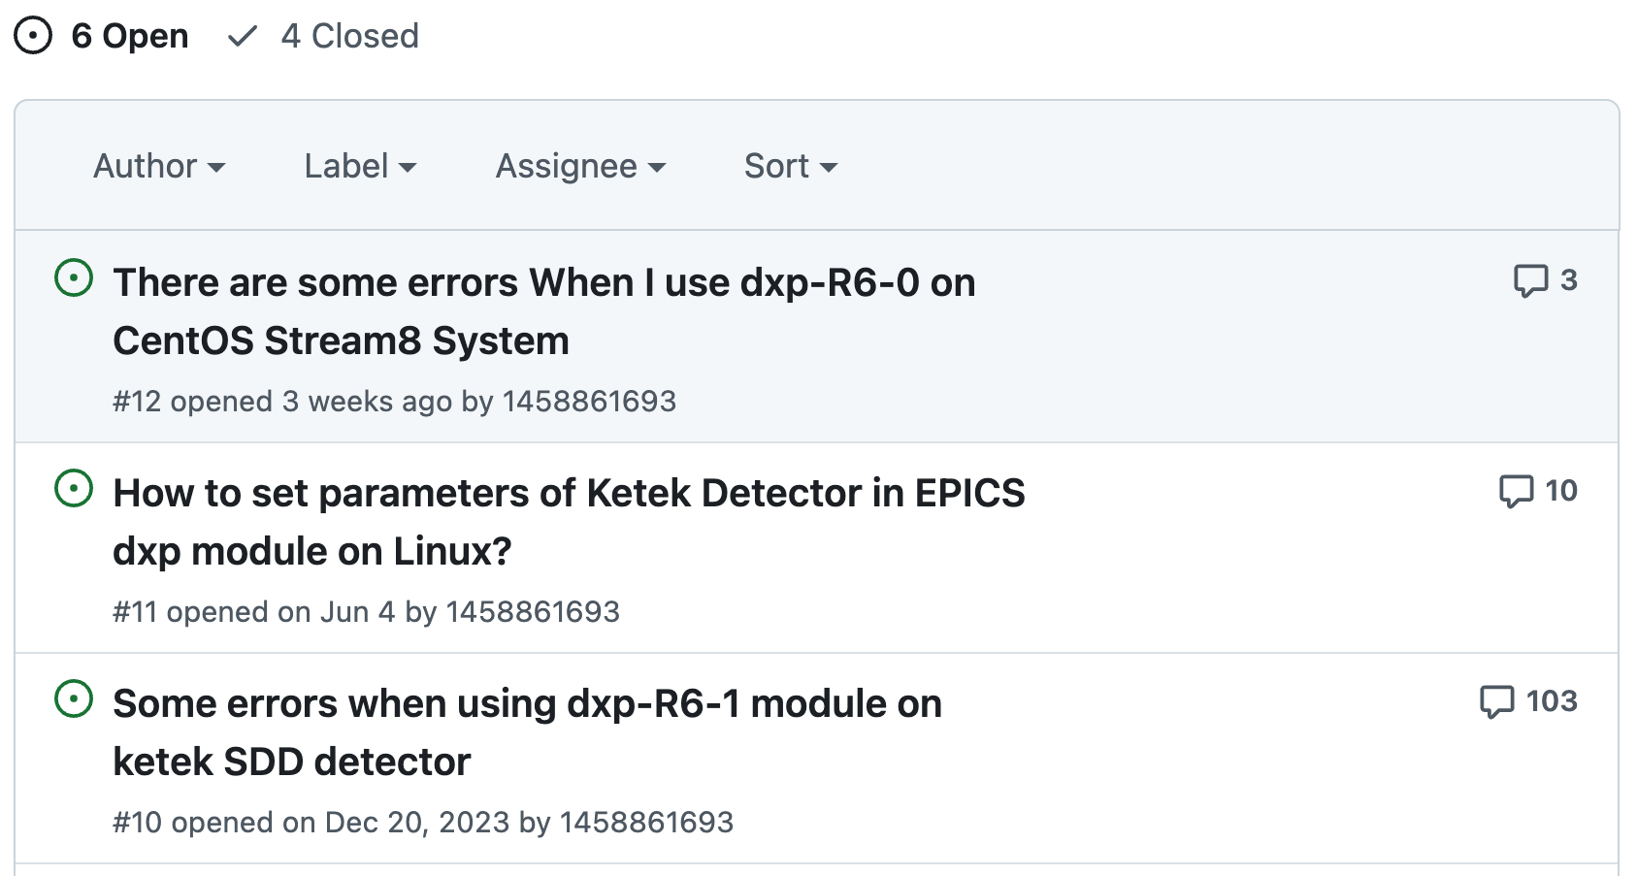
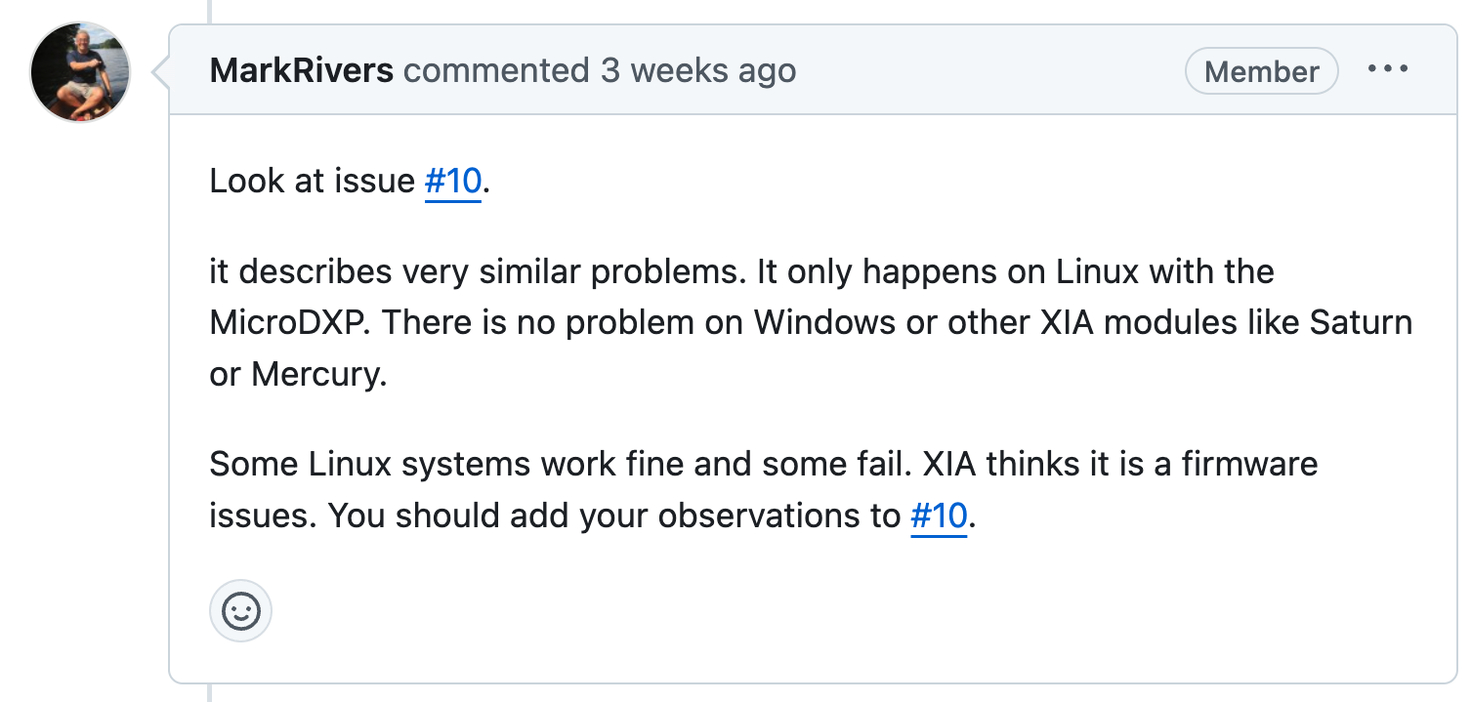

Slide 24

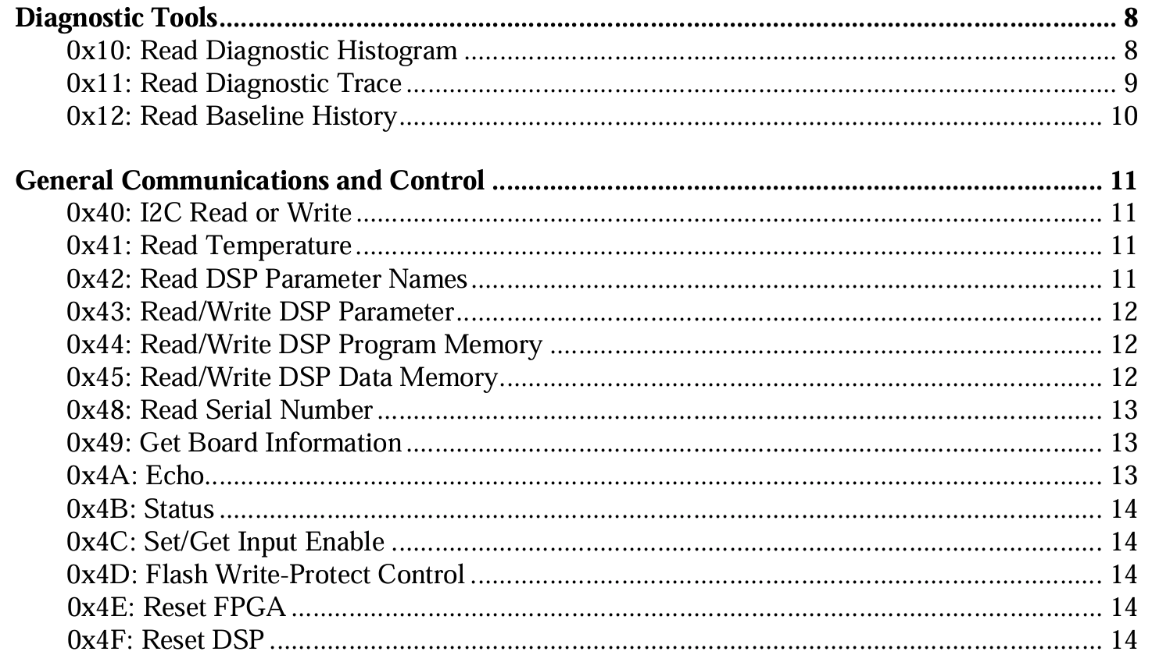

Using Serial Communication Over USB

Slide 25
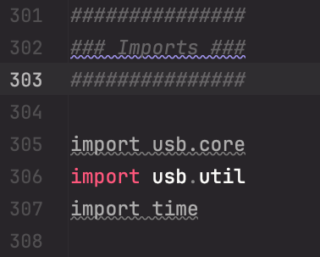
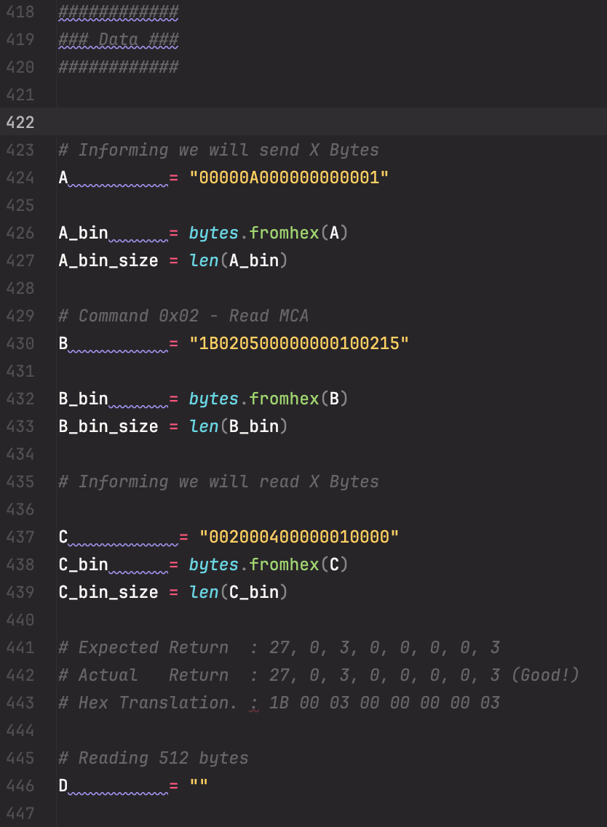
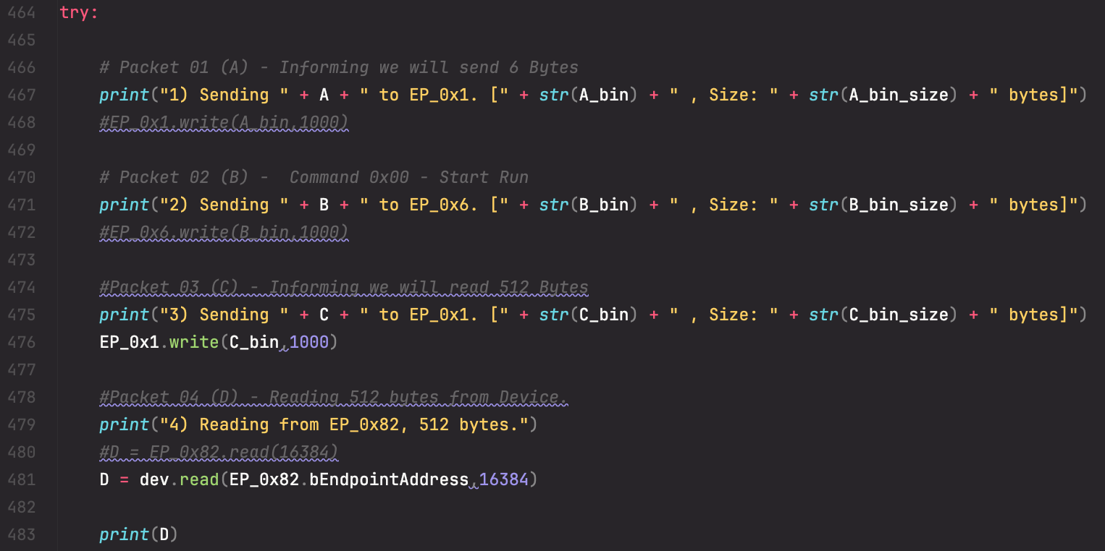
Using Serial Communication Over USB

Slide 26
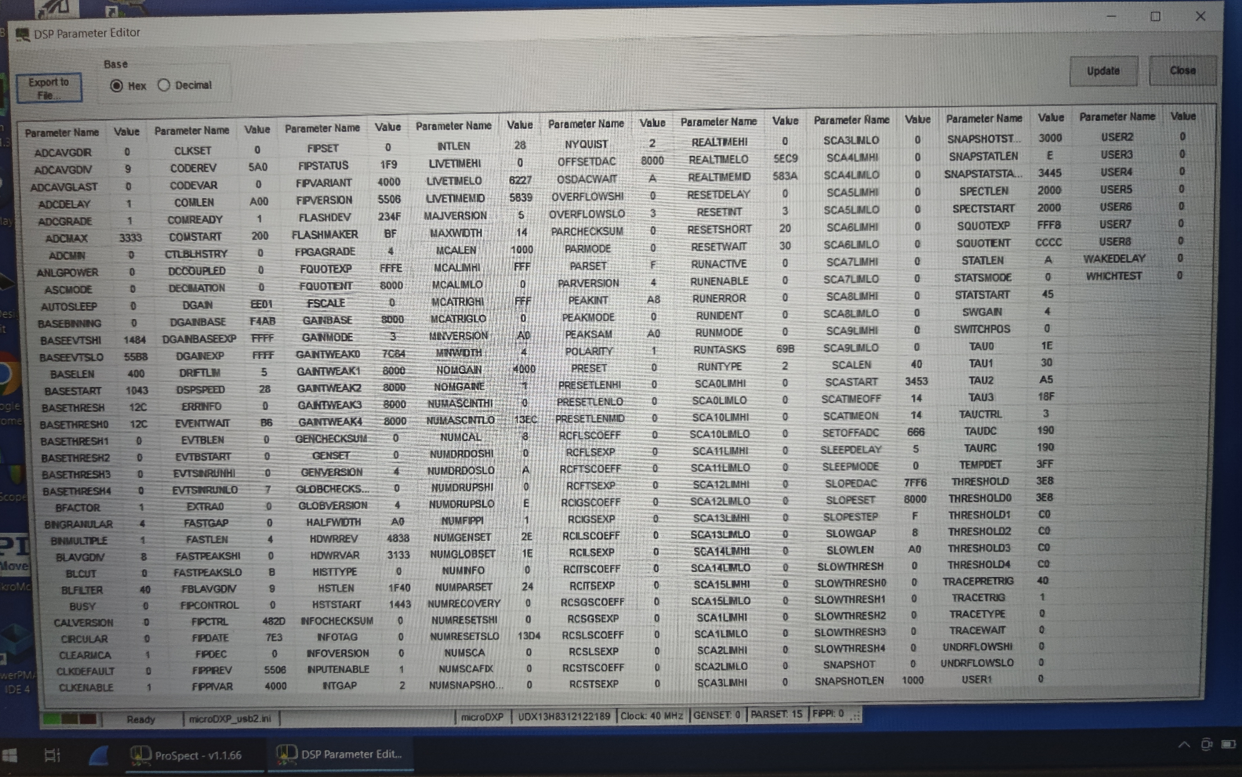
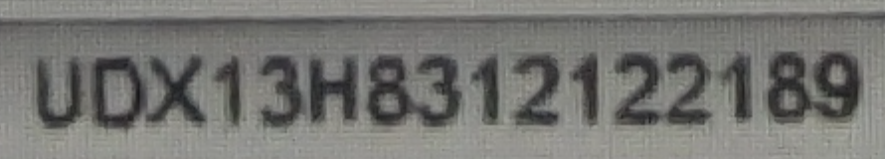
Using Serial Communication Over USB

Slide 27
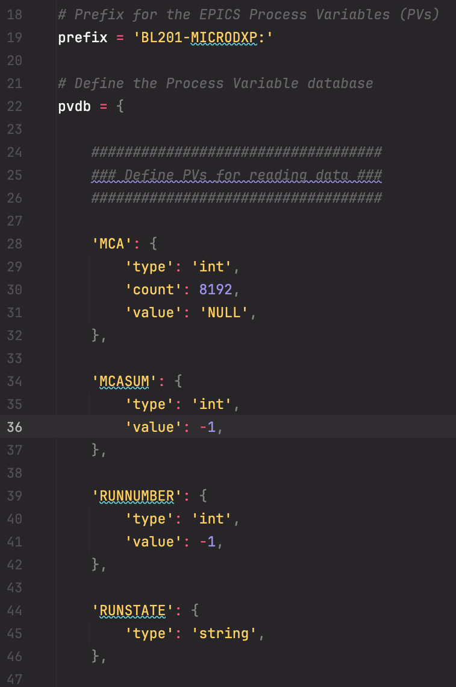
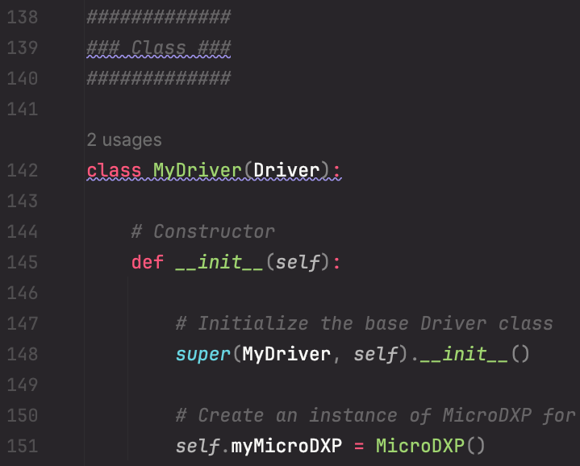
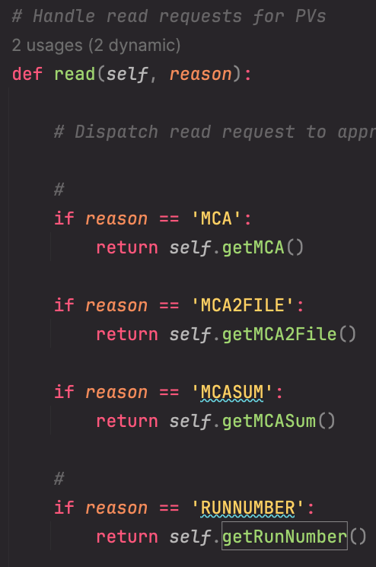


caget BL201-MICRODXP:RUNNUMBER

Slide 28


Tip: Running the IOC inside a Conda Environment
Virtual
Session
Listing Virtual Environments
Running in the background inside a Conda Environment

Slide 29




Slide 30





Some Success Stories from GitHub

Slide 31
Agenda & Objectives
A
B
C
Learn what PCASpy is capable of.
Be able to understand and read a PCASpy implementation.
Implement a basic PCASpy driver.

Slide 32


Closing Remarks (1/2)
PCASPy simplifies certain aspects of working with EPICS but introduces its own set of challenges in the process.
Additional effort is required to establish Python code.
Best suited for non-real-time critical applications due to its Python foundation.

Slide 33


Closing Remarks (2/2)
Not a universal solution but useful as a tool for specific cases requiring new driver implementation.
This presentation covered the basics; there are many more advanced features to explore and learn.

Slide 34





Acknowledgments
The Berkeley Center for Structural Biology (BCSB) is supported by the Howard Hughes Medical Institute, Participating Research Team members, and the National Institutes of Health, National Institute of General Medical Sciences, ALS-ENABLE grant P30 GM124169. The Advanced Light Source is a Department of Energy Office of Science User Facility under Contract No. DE-AC02-05CH11231.

Slide 35


Questions and Discussion
Software and Instrumentation (SWI) Group at BCSB.
John Taylor
Gabriel Gazolla
Head of SWI
Computer Systems Engineer
jrtaylor@lbl.gov
gabrielgazolla@lbl.gov

