Slide 2

Climbing the OACTree
First time user’s experiences with learning about OACTree
PRESENTED BY Timo Korhonen

Slide 3
Agenda
1 Background
2 Learning curve part 1: theory
3 Trying it out (demo)
4 Comparison with SNL/SEQ
5 Integration (wishes)
6 Conclusions

Slide 4
2
Background

Slide 5
Why I got interested?
The initial motivation
At ESS
  We have a lot of needs for automation and sequencing
  The traditional sequencer (SNL/SEQ) has a number of drawbacks:
    No support for pvAccess 😢 and not much hope of getting any
    Poor scalability over several IOCs and complex systems
    Users (e.g., operators) cannot create or modify the sequences (at least easily…)
    Then I learned about OACTree, and decided to take a look.
    Client-side tool, written for operations ✅
    Supports pvAccess ✅
    Plugin architecture ✅

Slide 6
2
Embark on the learning curve…

Slide 7

A new concept…
I had not heard about Behaviour Trees before…
As a start:
Learn the concept by reading some articles.
Quite different from state machines!
But the concept is very powerful.
Any finite state machine (FSM) can be replaced by a BT.
Large BTs can be composed of modular sub-trees
How Behavior Trees Modularize Hybrid Control Systems and Generalize Sequential Behavior Compositions, the Subsumption Architecture, and Decision Trees.
Colledanchise, M., Ögren, P. (2017)
IEEE Transactions on robotics, 33(2): 372-389
Behavior Trees in Robotics and AI
An Introduction
Michele Colledanchise and Petter Ögren
-textbook, available as PDF (and printed, from online bookstores)

Slide 8
Figuring out…
How to put together functioning trees?
New concepts to be kept in mind:
Node types
Fallback
Sequence
Parallel
Action
Condition
Return status of a node
  Success,
  Failure, or
  Running
Sequence: run through all nodes unless one fails.
Fallback: return success as soon as first success is found (left to right)
Action: return success, failure or running.
Condition: return success or failure

Slide 9
2
Trying it out…

Slide 10
The classic “APS virtual LINAC”
Old, but gold!
Making up some test cases did not feel great…
Then I remembered the Virtual LINAC simulator
It is simple but not trivial. It takes some exercise to manually thread the beam through.
It includes some pieces of SNL code to automate operation.
Implemented in EPICS 3.x
But easy to run in an EPICS 7 IOC, with pvAccess support.

Slide 11
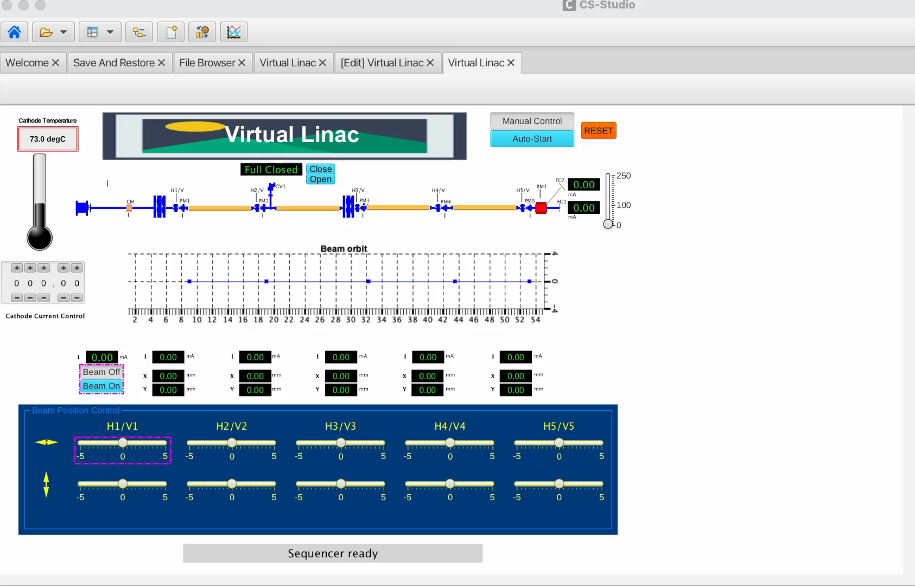
The result (Demo)
Simple Linac simulation; only a few components
The core implementation is ”just” an EPICS database
Created >20 years ago
Worked almost untouched
Display medm -> Phoebus
Original SNL programs:
  Auto-start
  OrbitDisplay
Both replaced with OACTree
The original looked much nicer; I did not have the time to fix all details in the Phoebus OPI
Alarms, etc., skipped for now.

Slide 12
Some OT snippets from the demo (#1)
Wait for a condition before proceeding
</Sequence>
<WaitForCondition varNames="OpMode" timeout="1e9">
    <Equals leftVar="OpMode" rightVar="AutoStart"/>
</WaitForCondition>
<Copy inputVar="seqStartMsg" outputVar="msg"/>
<Wait timeout="1.0"/>
<Copy inputVar="false" outputVar="beamOn" />
<Copy inputVar="heaterSet" outputVar="htr"/>
<Copy inputVar="WaitHtrMsg" outputVar="msg"/>
<Copy inputVar="Ramp" outputVar="psMode"/>
</Sequence>
->
OpMode = AutoStart
copy
wait
copy
copy
copy
copy
Here, ”copy” maps to pvput.

Slide 13
OT snippet #2: Repeat
In this case, “forever”
<Repeat maxCount="-1">
<Sequence>
<WaitForCondition varNames="OpMode" timeout="1e9">
    <Equals leftVar="OpMode" rightVar="AutoStart"/>
</WaitForCondition>
<Copy inputVar="bpm1_X" outputVar="bpmXpos.[0]" />
<Copy inputVar="bpm2_X" outputVar="bpmXpos.[1]" />
<Copy inputVar="bpm3_X" outputVar="bpmXpos.[2]" />
<Copy inputVar="bpm4_X" outputVar="bpmXpos.[3]" />
<Copy inputVar="bpm5_X" outputVar="bpmXpos.[4]" />
<Copy inputVar="bpmXpos" outputVar="bpmX" />
<Wait timeout="0.2"/>
</Sequence>
</Repeat>
->
OpMode = AutoStart
copy
copy
copy
copy
copy
wait
This is for updating the orbit display,
SNL in the original demo.
Here, copy maps to pvput.

Slide 14
”Code” comparison with SNL
Not exactly same steps, but same functions…
state waitForAuto
{
when(mode) /* transition condition + actions */
{
beamOn = 0;
pvPut(beamOn);
gv1 = 0;
pvPut(gv1);
%% epicsThreadSleep(.2);
sprintf(msg,"Setting Cathode Temperature");
pvPut(msg);
htr = 12.3;
pvPut(htr);
/* Set PV that connects ramping PVs to PS PVs */
/* uses Simulation Mode of AO record */
psMode = 0;
pvPut(psMode);
%% epicsThreadSleep(3);
} state waitForHtr /* Move to next state */
}
</Sequence>
<WaitForCondition varNames="OpMode" timeout="1e9">
    <Equals leftVar="OpMode" rightVar="AutoStart"/>
</WaitForCondition>
<Copy inputVar="seqStartMsg" outputVar="msg"/>
<Wait timeout="1.0"/>
<Copy inputVar="false" outputVar="beamOn" />
<Copy inputVar="heaterSet" outputVar="htr"/>
<Copy inputVar="WaitHtrMsg" outputVar="msg"/>
<Copy inputVar="Ramp" outputVar="psMode"/>
</Sequence>
Variables and values (constants) are defined
in a separate section.

Slide 15
Conclusions
What did I learn?
After learning the concepts, and some help from Walter @ ITER, I was able to re-implement state notation language programs and run them successfully in OACTree. But OACTree goes a lot further:
BTrees can be combined into larger units – not trivial or even possible with SNL programs
This is a client-side tool and thus more suitable for control room applications
  Trees can be created and modified by operators.
OACTree can be extended with plugins
  Phoebus Save & Restore would be my first wish!
However:
The concept needs some effort to learn. Try not to think in SNL or procedural way.
  But when you get it, you will appreciate the power.
Overall I think OACTree fills a big gap in the EPICS ecosystem. I hope it will become a part of the community toolset.

Slide 16
Thank you for your attention!
Questions?

