Slide 1
Real-Time Linux Notes Experience of using real-time Linux features with EPICS
Kay Kasemir, kasemirk@ornl.gov
Sept. 2024 EPICS Meeting

Slide 2
Moving from VME & VxWorks to … µTCA? & plain Linux?
VME & VxWorks
Real-Time
Comparably simple
One ‘process’ with threads
That process can receive interrupts
All I/O memory mapped
Shell that can read/write memory and thus I/O
Robust
VME hardware hard to find
VxWorks is not free ($)
µTCA & (plain) Linux
Not Real-Time
Comparably complex
Need ‘MCH’ to configure PCI
Need to develop kernel driver to get interrupts and memory-mapped I/O
Separate user process then calls ‘iocctl()’ or ‘poll()’ to get interrupts, ‘mmap()’ to get at I/O
Need to write own shell tools
Have seen early hardware failures; long-term robustness unclear
µTCA hardware is available ^{(but long lead times)}
PCI is faster than VME
Linux is free

Slide 3
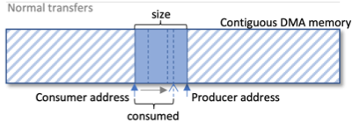
What about Real-Time?
VME & VxWorks
Interrupts deterministically trigger processing synchronized to machine cycles, beam, …
µTCA & (plain) Linux
Non-deterministic delays via kernel module, then waking user thread
Workaround: Buffered streaming from hardware to software* Demonstrated sustained transfer of 250 MB/sec for many months, no buffer overruns
Interrupt
Interrupt
Kernel
IOC
IOC
* Klemen V. et al, “The Linux Device Driver Framework for High-Throughput Lossless Data Streaming Applications”, ICALEPCS 2019, NY, USA

Slide 4
High throughput because buffering accommodates occasional delays! What if I need low throughput but must act on each machine cycle (SNS: 60 Hz), “real time”?

Slide 5
What is “Real Time Linux”?
RTLinux was a WindRiver product
Also “Open RTLinux”, cool logo
Real time kernel runs normal kernel as one big process
Discontinued in 2011
PREEMT_RT is a patch for the Linux kernel
https://wiki.linuxfoundation.org/realtime/start
Ubuntu is available with that patch, otherwise DIY
Features included in recent kernels, but _RT patch kernel still a little more preemptable
RHEL 9 uname –a shows PREEMPT_DYNAMIC, enable via echo "full" >/sys/kernel/debug/sched/preempt
Buildroot kernel.config has options CONFIG_PREEMPT_...=y
What you get:
Thread priorities, highest priority thread gets to run
Memory locking to avoid paging
Priority inversion protection of mutexes
PREEMPT..
_NONE
_VOLUNTARY
_FULL
_RT

Slide 6
Support in EPICS
Since R3.14.8 (2006)!
See configure/CONFIG_SITE USE_POSIX_THREAD_PRIORITY_SCHEDULING = YES
Run IOC as root, or better like this (details depend on OS):
prlimit --memlock=10000000000 --rtprio=99 sudo -u ioc_user ./st.cmd
ulimit –l 10000000000 –r 99 –e 99; sudo –u ioc_user ../bin/linux/ioc st.cmd
LimitMEMLOCK=infinity and LimitRTPRIO=99 in systemd config
https://epics-controls.org/resources-and-support/documents/howto-documents/posix-thread-priority/

Slide 7
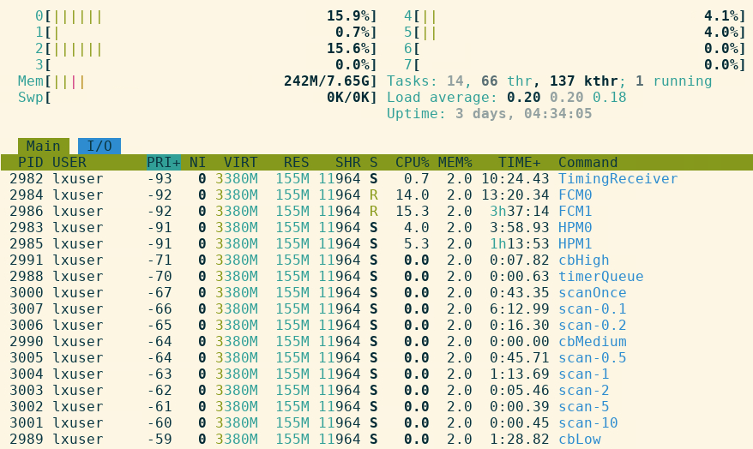
Thread Priorities
epicsThreadCreate uses RT priorities and SCHED_FIFO
Driver threads set above epicsThreadPriorityBaseMax
5 driver threads, 8 CPU cores → always get to run!
scan threads run above CA or PVA threads
Shell, procServ below RT priorities
htop example. May also check ’OSSPRI’ in epicsThreadShowAll

Slide 8
Memory Locking
EPICS base calls mlockall(..) to lock virtual address space in RAM. Avoids unpredictable delays from paging.
grep Vm /proc/`pgrep st.cmd`/status
➔ Almost all memory locked
Sounds good, but unclear how to test/quantify…

Slide 9
Priority Inversion Protection
Single core, threads scheduled by priority
PTHREAD_PRIO_INHERIT as used by epicsMutex
Blocks on mutex
Thread Priority
Keeps low priority thread from running …
Take mutex
Time
Blocks on mutex
Runs at elevated priority, releases mutex
Completes work with mutex
Thread Priority
Runs…
Take mutex
Time
Tested, works as advertised!

Slide 10
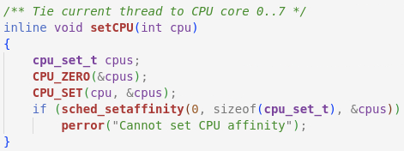
Lock CPU Cores?
You may lock threads to a CPU core
Isolate cores via boot line: isolcpus=6,7
Set thread’s CPU affinity:
➔ Not doing that
Why not use all the CPU cores as OS sees fit?
Till Straumann: May only be useful for very specialized applications, if you really understand details of your hardware

Slide 11
Down the Rabbit Hole
watch -n1 -d "cat /proc/interrupts”
https://wiki.linuxfoundation.org/realtime/documentation/howto/tools/rt-tests
cyclictest, hackbench, hwlatdetect
What’s relevant?
➔ Toggle hardware outputs from key software sections to track timeline on oscilloscope
https://xkcd.com/2582/

Slide 12
Interrupt Latency Check
Hardware gate that triggers interrupt
Start..end of software interrupt handler which toggles spare output of device
➔ Up to ~200µs latency Compare VME/VxWorks: ~20µs
“Infinite Persistence” screen capture over several days

Slide 13
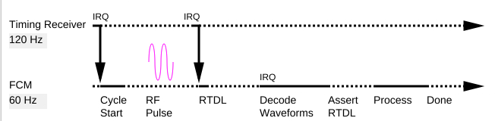
Timeline Check on Scope
Repeatable 60 Hz operation
Board1 and Board2 handled in parallel
Completes 5..7 ms before end of each cycle
Next cycle
Previous cycle
“Infinite Persistence” screen capture

Slide 14
Conclusion
Recent Linux kernels include real-time features
‘RT’ Thread priorities
Priority inversion protection
No need to “patch” kernel
EPICS uses these features, if available
epicsThread* calls use RT priorities
‘scan’ threads run above ‘CA’ or ‘PVA’ threads
epicsMutex creates POSIX mutex with priority inversion protection
Important to test; verify timeline on oscilloscope
IOCs benefit from “Real Time Linux” when timeliness matters (for high throughput, plain Linux suffices)
Thanks to Andrew Johnson, Han Lee, Klemen Vodopivec, Martin Konrad, Michael Davidsaver, Ralph Lange, Till Straumann for their related work on EPICS base, example kernel drivers, and discussions

