Slide 1

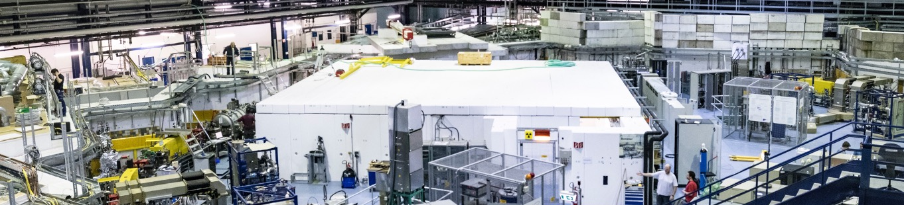
Update: Transition to Phoebus at the Karlsruhe Institute of Technology
Edmund Blomley & Sebastian Marsching
Copyright M. Breig

Slide 2
Outline
KIT Accelerators & Environment
Backend Infrastructure
User Space
Panel Migration
Summary & Outlook

Slide 3
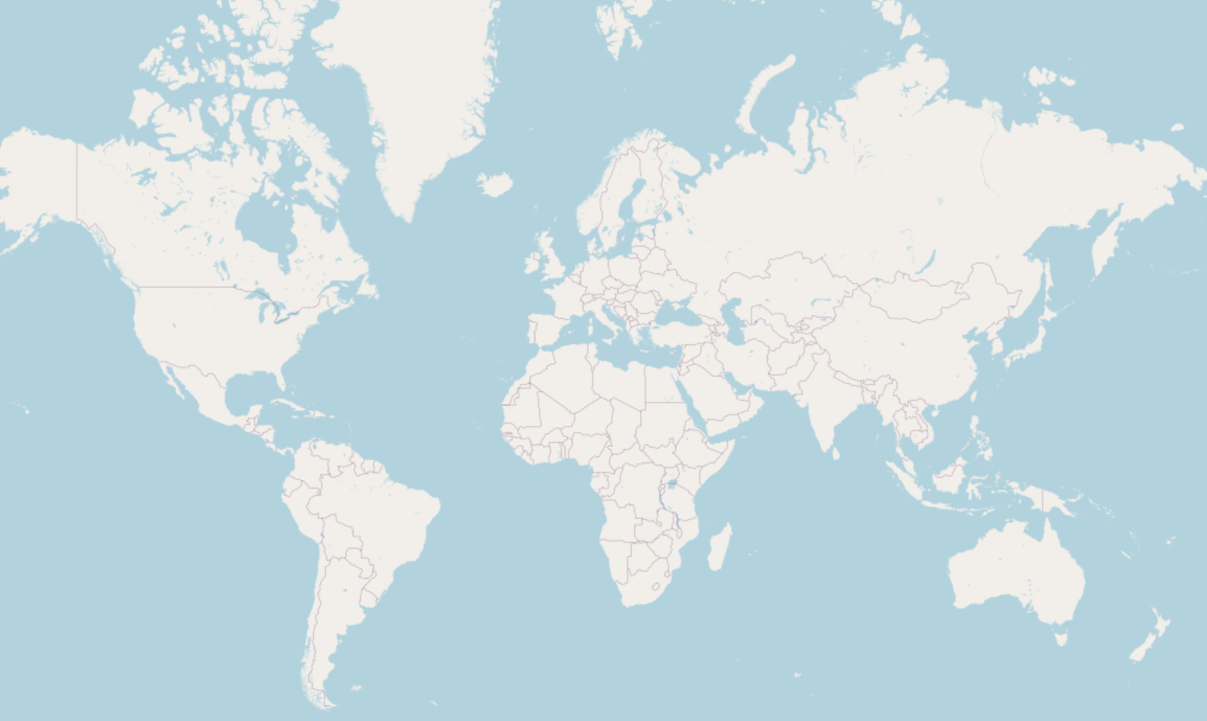
Location: Karlsruhe – Germany
OpenStreetMap.org

Slide 4



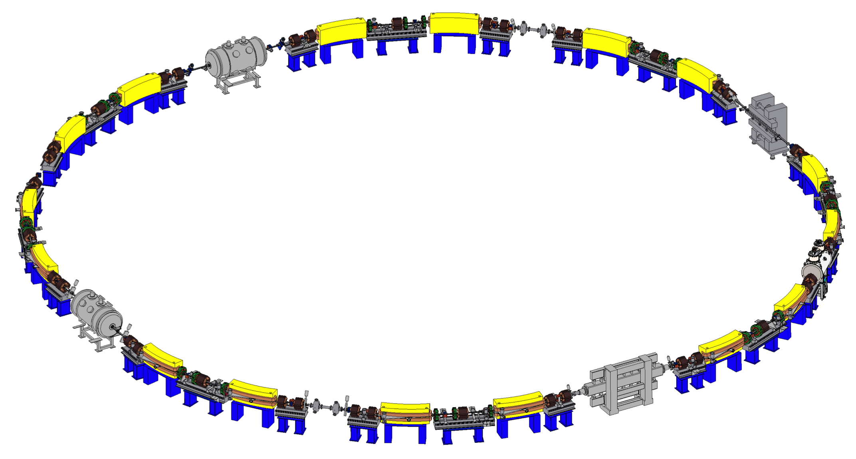



Karlsruhe Research Accelerator (KARA)
KIT synchrotron light source & accelerator test facility
  until 2015 known as “ANKA”
Circumference: 110.4 m
Ramped storage ring: 0.5 - 2.5 GeV
Mostly “stable“ IOCs & panels
One week per month:
  Beam physics experiments and tests
  Very variable in energy, filing pattern,
  bunch current and operational condition
Default user operation
1 Hz injection at 0.5 GeV
accumulation for 30-45 minutes
energy ramp up to 2.5 GeV
beam decay for 23 hours
Image: U. Herberger

Slide 5

Far-Infrared Linac and Test Experiment
50-90 MeV linear electron accelerator
Goal: Ultra short electron pulses (1-300 fs), THz experiments
Panels and IOCs much more fluid
  Overlap in panels, IOC support and general controls infrastructure
  But separate network, building, operators and users

Slide 6

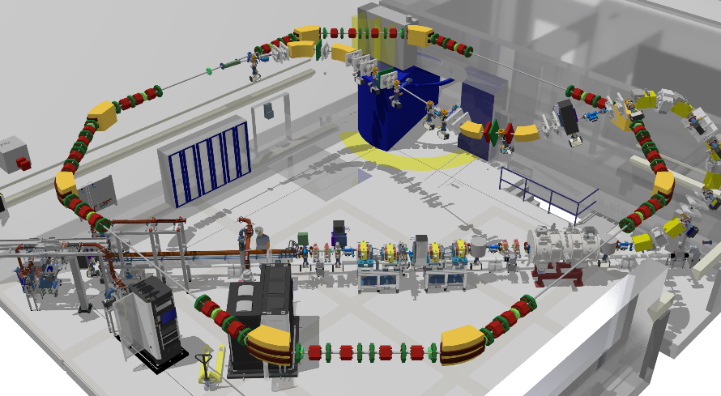
Very Large Acceptance compact
Storage Ring (VLA-cSR)
New storage ring in TDR/FDR phase
Circumference: 43.2 m (6.9 MHz revolution frequency)
Installation and commissioning 2026-2027
Store ultra-short bunches (~ 10 fs – 1 ps)
  from FLUTE
  from LPA(s)
No panels or IOCs yet
  Extension to FLUTE controls
  Opportunity to rework/redesign panels

Slide 7






Controls Environment
EPICS 7
  Still 99% Channel Access
  IOCs mostly on virtual machines
  GUI: Control System Studio
Ubuntu LTS for all servers and terminals
  About to migrate to 24.04
Code repository with lots of CI usage: GitLab
  IOCs, EPICS distribution, software packaging, …
IT orchestration: Salt Project
  (comparable to Ansible)

Slide 8
Backend Infrastructure

Slide 9
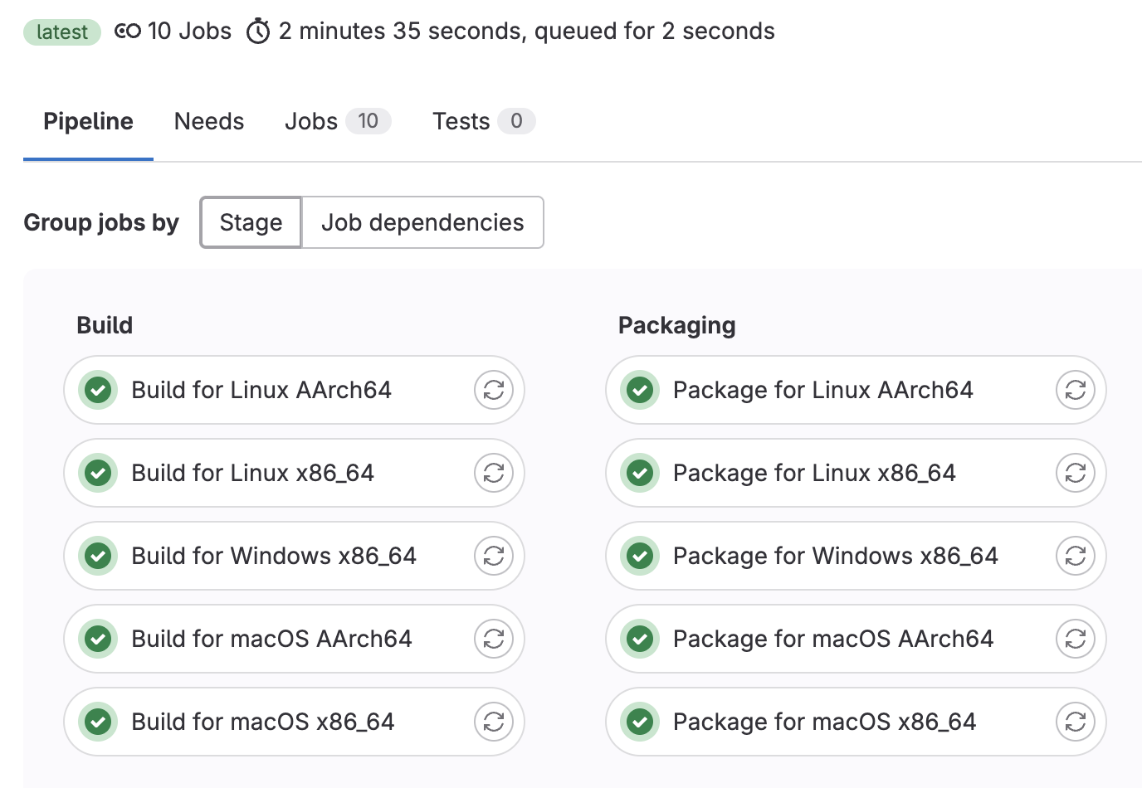
Building Phoebus
Try to be as close to upstream as possible
GitLab CI to build for all platforms
  Using only Linux Docker images
  (Removed Linux ARM build due to
  issues with JavaFX)
Modifications made to upstream
  EPICS Jackie PV source (alternative to JCA / CAJ)
  JSON / HTTP based archive reader
  Improvements to Elasticsearch and Kafka connection code

Slide 10
Alarm Server & Logger
Each build separately to its own Docker image
Alarm server container running in “host” network mode
Current issue for alarm server: experiencing long load times during channel import
Using Elasticsearch and Kafka HA clusters (changes to connection code have been merged upstream)

Slide 11
Channel Finder
Use existing PV export feature to feed channel finder server
  Was used so far for PV bash completion
  No recast modules in IOCs
Might change at a later point of time to replace custom PV export
Improvements to Elasticsearch connection code:
  Allow specifying multiple servers (HA cluster)
  Allow use of HTTPS
  Allow authentication

Slide 12
Phoebus Server Cluster
Manage HA services via Pacemaker
Node setup via Salt
File storage via CephFS cluster
Elasticsearch and Kafka running as a three-node HA cluster
Clients download Phoebus client, configuration, and panels from web server using a HA IP address.

Slide 13
Phoebus Server Cluster
Managed by Pacemaker
Cluster IP
Channel Finder
Alarm Logger
Alarm Server
Node 1
Node 2
Node 3
Apache Webserver
Apache Webserver
Apache Webserver
Elasticsearch
Elasticsearch
Elasticsearch
Kafka
Kafka
Kafka
CephFS Shared Storage

Slide 14
User Space

Slide 15
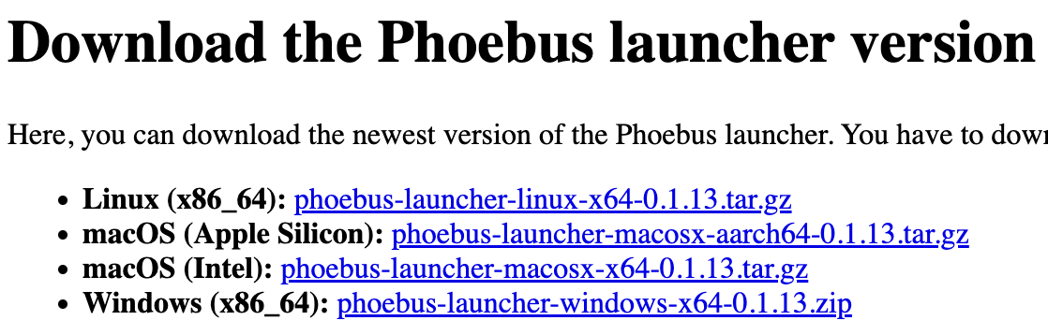
Phoebus Distribution
Download and installation via webserver
  phoebus.kara.ibpt.kit.edu
  Based on client network decides for office or accelerator version
Custom launcher
  Updates Phoebus version and configuration settings automatically
  settings.ini & kafka.properties
Provides environments
  Choose from stored mementos (layouts)

Slide 16
Panel Distribution
Shared Panels
git submodule
KARA Panels
Panels are stored in GitLab
  One project per accelerator
  CI pipeline deploys panels to webserver
Shared project
  EPICS modules (areaDetector)
  IOCs used across both accelerators
  Common “resource” panels
By default, panels (and mementos) are accessed via the webserver
Path to (local) panels can be provided to launcher
  Mostly for panel development
deploy via CI + SSH key + rrsync
Webserver
Phoebus Client
Access via URL
alternative?

Slide 17
Panel Migration
Phoebus can open .opi files and migrate to .bob files
  AdvancedConvertor for mass migration
~10 years of CSS panels across two accelerators
  Created and maintained by different groups
Decided for “manual” migration approach
  Includes re-structuring and clean-up of old panels
  Re-align style and behaviour for both accelerators
  → Much slower migration, but hopefully worth the effort

Slide 18
Summary
Alarm Server
Alarm Logger
Phoebus Distribution
Channel Finder
Webserver
clog
PVInfo
High availability: Phoebus backend services with docker in cluster setup
Simple end-user interface
  Only needs to download one file once
  Self-configurating & automatically updating
  Remote panels
Use “opportunity” to re-work/structure long history of panel development
Next steps: new electronic logbook & PVInfo

