Slide 1
Data Acquisition System at APS
Elaine Chandler, Sinisa Veseli, Ned Arnold, Dan Paskvan, Guobao Shen, Steve Shoaf
Controls Group / Accelerator Systems Division
Advanced Photon Source
Argonne National Laboratory

Slide 2
Overview
Designed new data acquisition system for the Advanced Photon Source Upgrade (APS-U) project to provide time-correlated data for statistics, diagnostics, monitoring, and fault recording
Need and specifications for system are driven by the technical system implementations that use state-of-the-art FPGAs and high bandwidth communication links that capture data at high rates that must be consumed by the control system.
Design paper: “Data Acquisition System for Advanced Photon Source Upgrade” (S.Veseli, ICALEPCS2019)
In production since April 2024

Slide 3
Overview
    Key Features
    System Architecture
    IOC Design and EPICS technology used
    Use case examples

Slide 4
Key Features of APS Data Acquisition System
  Acquires time-correlated synchronously sampled data from several subsystems at various sample rates
        Storage ring (SR): turn-by-turn beam position monitor (TBT BPM) data at 271kHz, unipolar and bipolar power supply (PS) data 22kHz
        Other systems: IETS, RF, etc..
  Supports continuous acquisition and triggered acquisition.
  Can route data to any number of applications
  Use of pvAccess PV objects to encapsulate numerous signals and events in an atomic data packet (ensures data synchronicity to the same event)
  Provide a “standard solution” for technical system DAQ implementations for code reuse and consistent interfaces for clients

Slide 5
DAQ Systems
Technical System DAQ | # of Channels | Signals | Sample Rate | Repeat Rate | Anticipated Data Rate (Per IOC)
Fast Orbit Feedback | 256 (x 20) | 28 BPMs: x,xError,y,yError 32 Correctors: error,delta,drive | 22.6 kSPS | Continuous (2,260/daq obj.) | 24MB/s
Power Supply Fast Monitoring | 354 (x 20) | 118 PSs: setpoint, extCurRdbk, status | 22.6 kSPS | Continuous (2,260/daq obj.) | 32.3MB/s
BPM Turn-by-turn | 84-224 (x 20) | 28 BPMs: x, y, sum (5 other optional) | 271 kSPS | Continuous (27,120/daq obj.) | 94MB/s (~2.5 hrs per TB)
Single Bunch BPMs | 54 | 18 BPMs: x, y, sum | 271 kSPS | aperiodic
IX/EX Waveforms | 16 (x 2) | 8 captured waveforms 8 reference waveforms | 4GSPS for 50ns | 1Hz max | 2.7MB/s (aperiodic)
IETS (Booster Timing Ctlr) | 2 | tuning word, frequency | 3kSPS for 0.5 s | 1Hz max | 1Hz
Longitudinal Feedback Transverse Feedback | 1 (x3) | Phase, x, y (bunch-by-bunch) | 352 MSPS | 2Hz | 48MB/s per acquisition (~34ms or 9.3K turns) (2 acquisitions/s max) Plan to provide turn-by-turn correlation with other DAQ data
Bunch Lengthening System | 64 | 8 RF ADC’s (I,Q,mag/pwr,phs) + internal control signals | variable 19 to 305kSPS | continuous | <100MB/s (variable)
Booster RF (5) | 64 (x 5) | 8 RF ADC’s (I,Q,mag/pwr,phs) + internal control signals | variable 19 to 305kSPS | continuous | <100MB/s (variable)
PAR RF (3) | 64 (x 3) | 8 RF ADC’s (I,Q,mag/pwr,phs) + internal control signals | variable 19 to 305kSPS | continuous | <100MB/s (variable)
Systems not in production yet are in italics

Slide 6
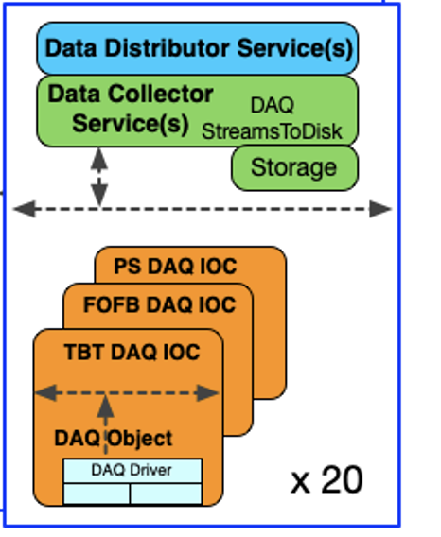
APS-U Data Acquisition System : Hardware Architecture
DAQ Server
DSDAQ server
DAQ Server
DAQ Server
DAQ Server
DSDAQ servers connected to TBT, PS and FOFB systems for 20 Double Sectors around storage ring
Operates on separate VLAN to isolate from regular operations

Slide 7
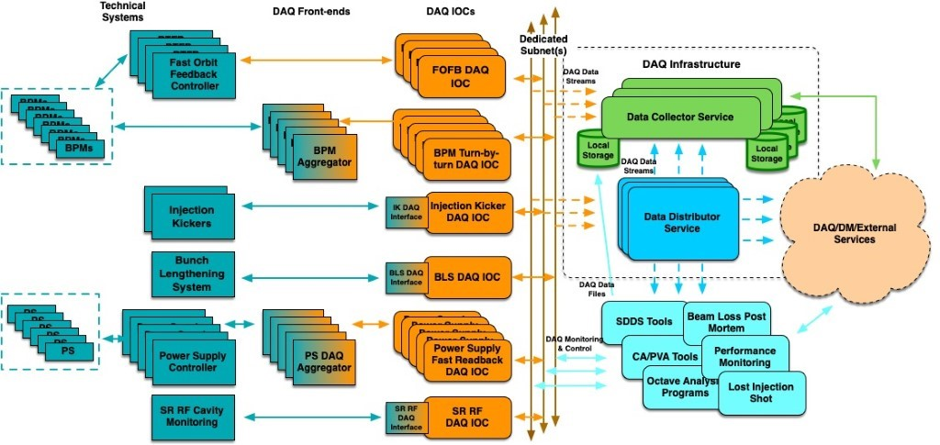
System Architecture
DAQ front-ends
FPGA hardware connected to technical system
Used when direct IOC connection is impractical or impossible
Collects timestamp and event data and sends along with sample data
Uses standardized DAQ message format to send data packets
storage ring data correlated within one beam revolution or better (3.6us)
DAQ IOCs
Collects data from technical systems or front ends
Time-correlates events with sample data
Encapsulates data into atomic objects
Contains collection of plugins to further process data
Data exposed via PvAccess channels
DAQ services
Services that process data from DAQ IOCs
Data collector/Data Manager services writes data to common storage
Aggregator/Orbit services aggregate data across double sectors and publish via PvAccess channel

Slide 8
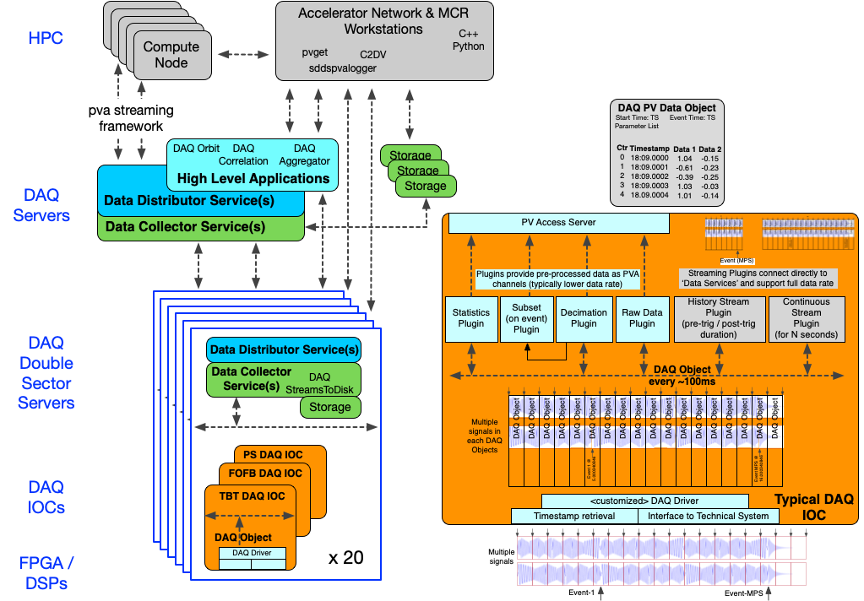
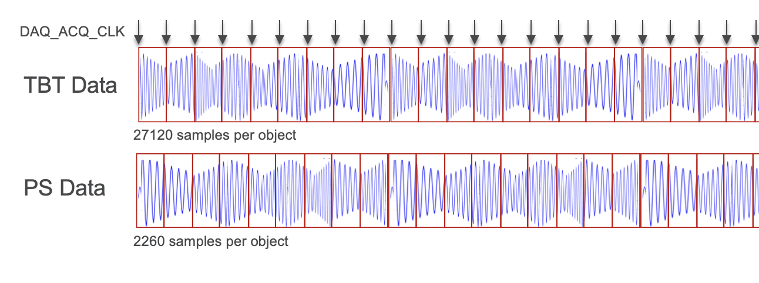
DAQ IOC design
IOC driver data writes fast and slow data into “DAQ objects”, pvData structures
Streaming data from double sectors split into 100ms chunks synchronized by 10hz DAQ acquisition clock event
Data objects streamed to various data processing plugins using the AreaDetector framework

Slide 9
IOC data processing plugins
Raw plugin –publishes raw data from technical systems to pvAccess channel. Traffic from high-volume channels isolated to specific VLANs
Decimation Plugin – averaged or sampled data to reduce data size, publishes data to pvAccess. Can be chained in front of other plugins
Subset plugin – Publish samples before and after event to pvAccess channel
Stream plugin – Store a range of DAQ objects to disk. Triggered by event or manually
History plugin – Store DAQ objects before and after event trigger to disk. Used for post-mortem.
Statistics plugin – Publishes statistics to pvAccess channel
Example workflow
Driver
Raw
Dec1
History
Subset1
Subset2

Slide 10
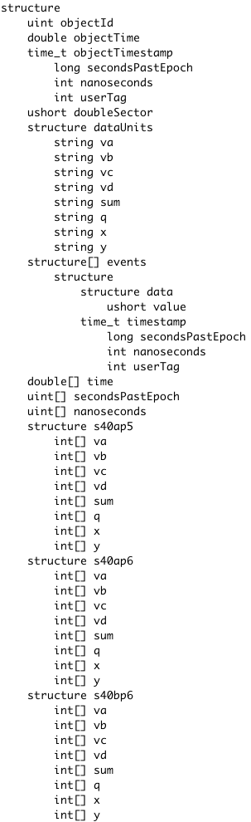
EPICS technology used
AreaDetector framework: flexible architecture that allows easy extensibility and scalability
  Use plugins to support different user workflows
  Achieve scalability running multiple plugins in parallel. ex. DAQTBT IOCs has 21 plugins
pvData structures: Internal implementation of DAQ objects. Self-describing structures, correlates multiple data sources with time and events
  Ex: DAQTBT objects store waveforms for 28 BPMs, typically ~98MB per object
pvAccess protocol: network protocol allows easy access to data for other applications

Slide 11
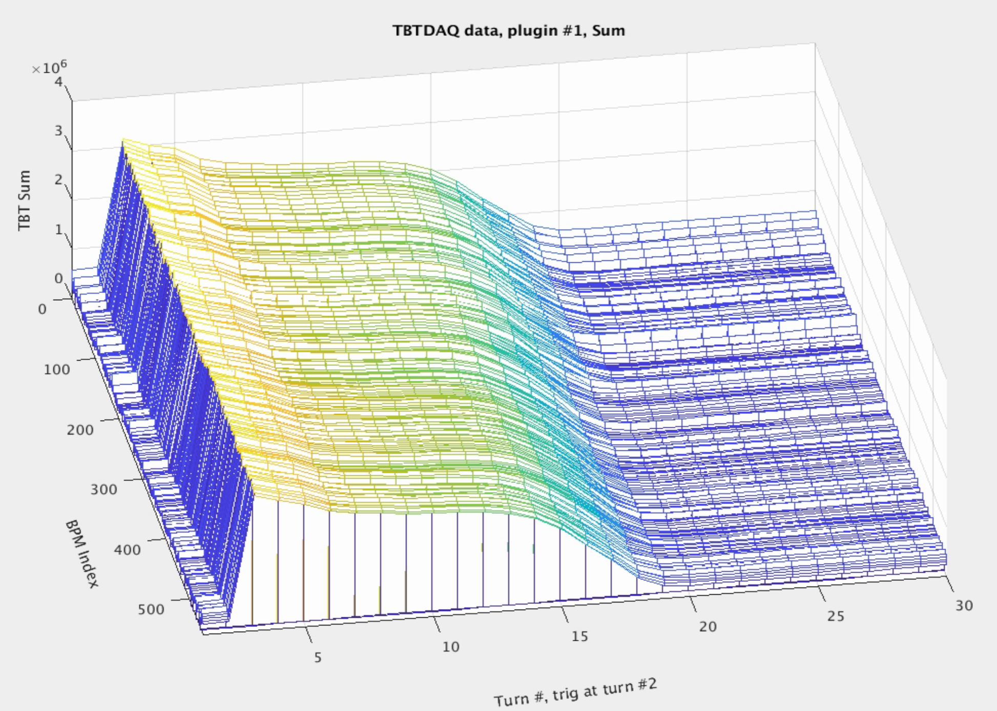
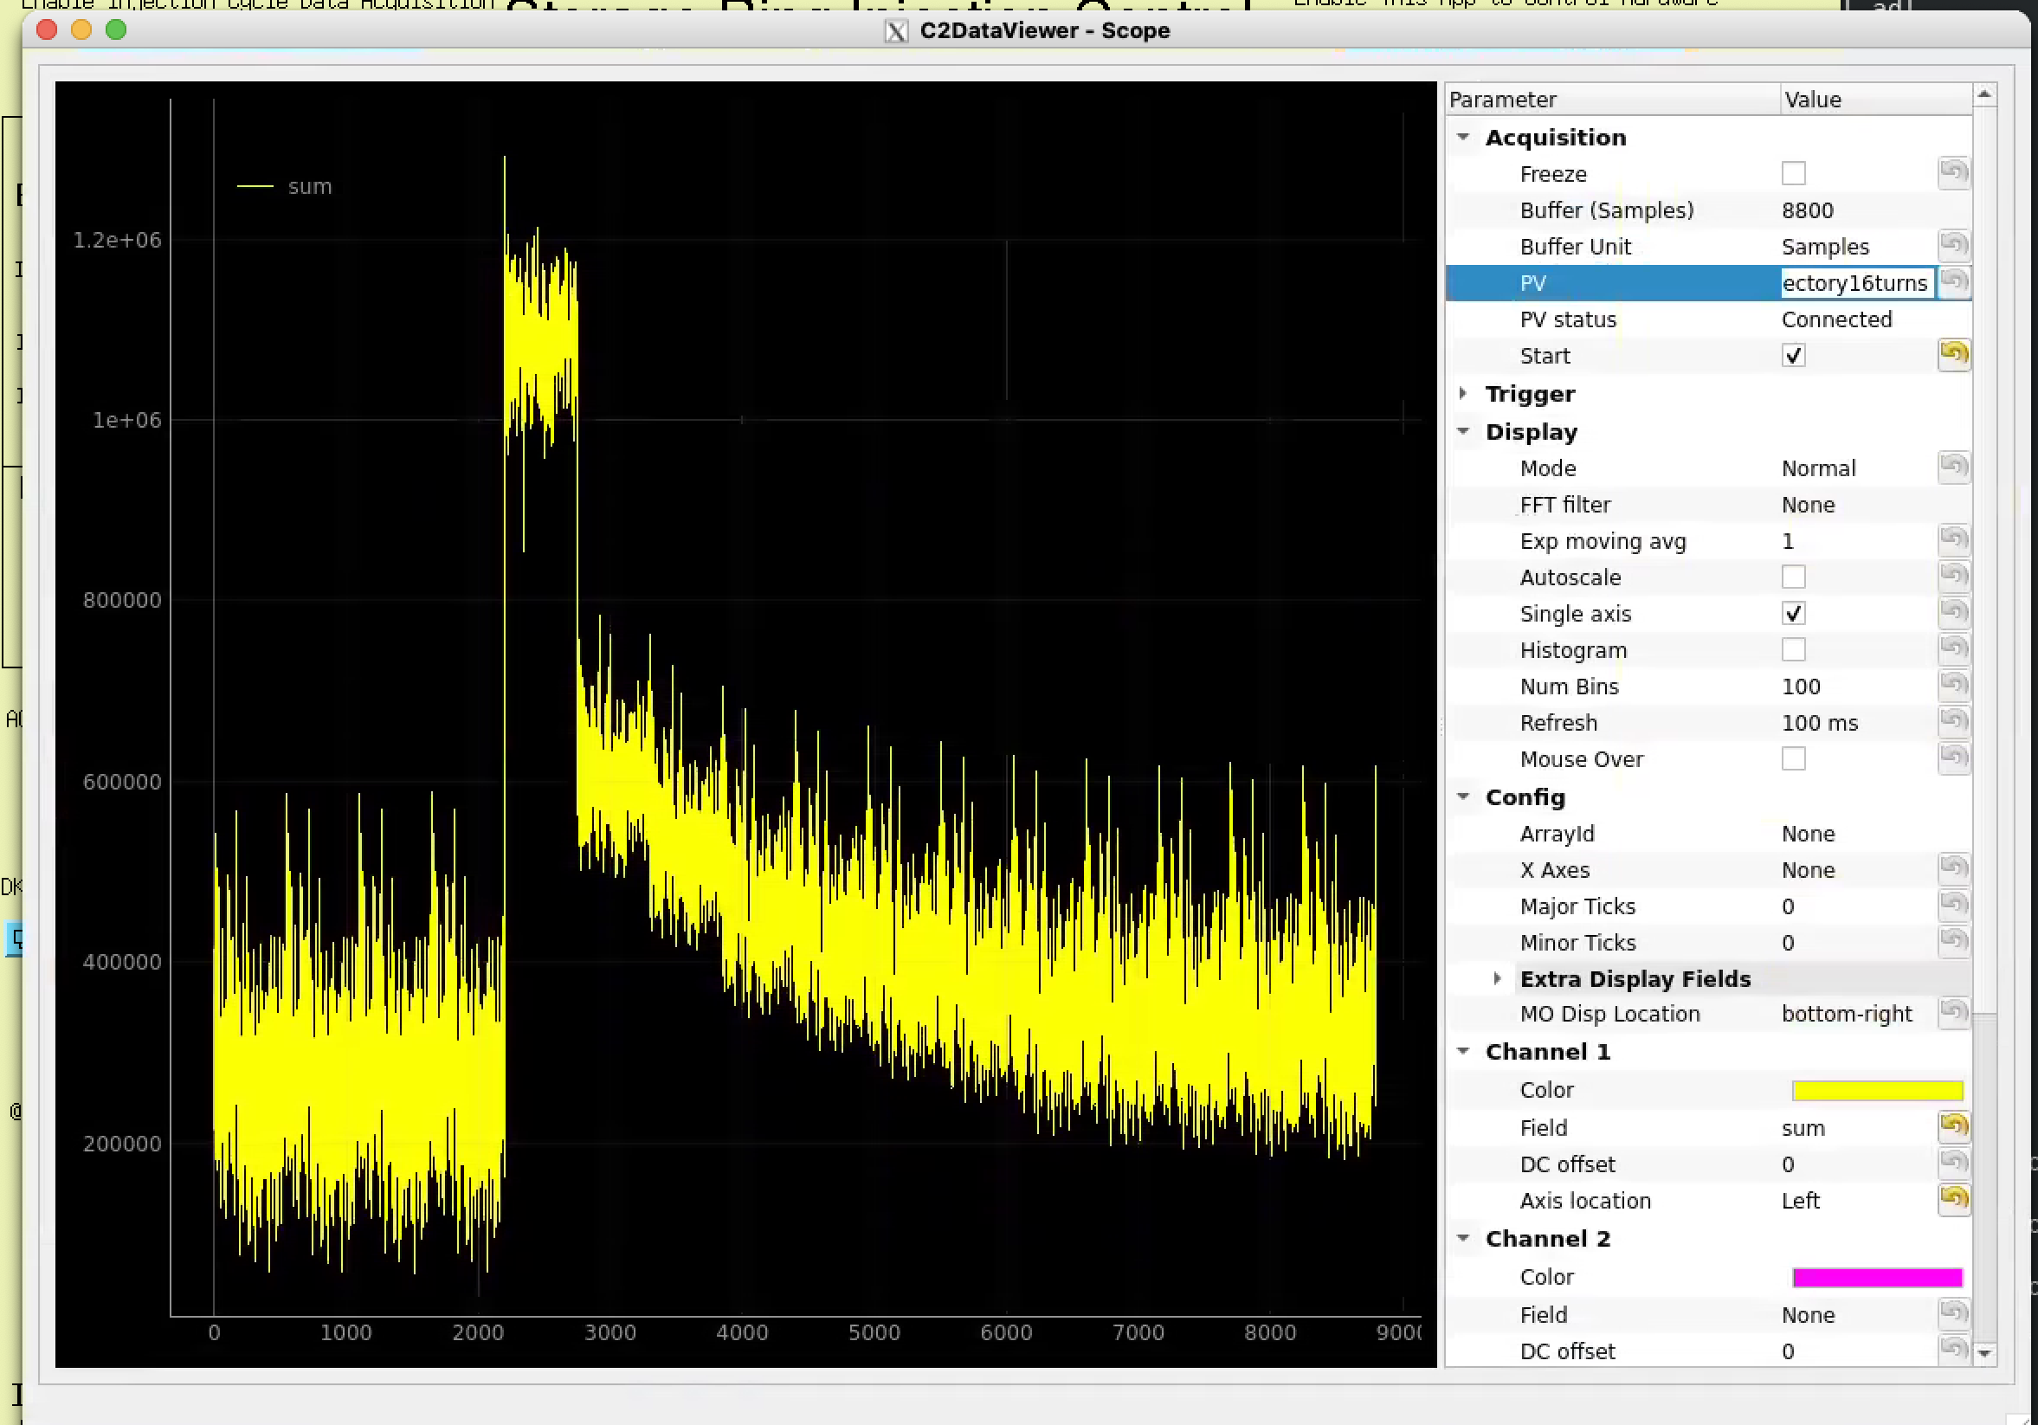
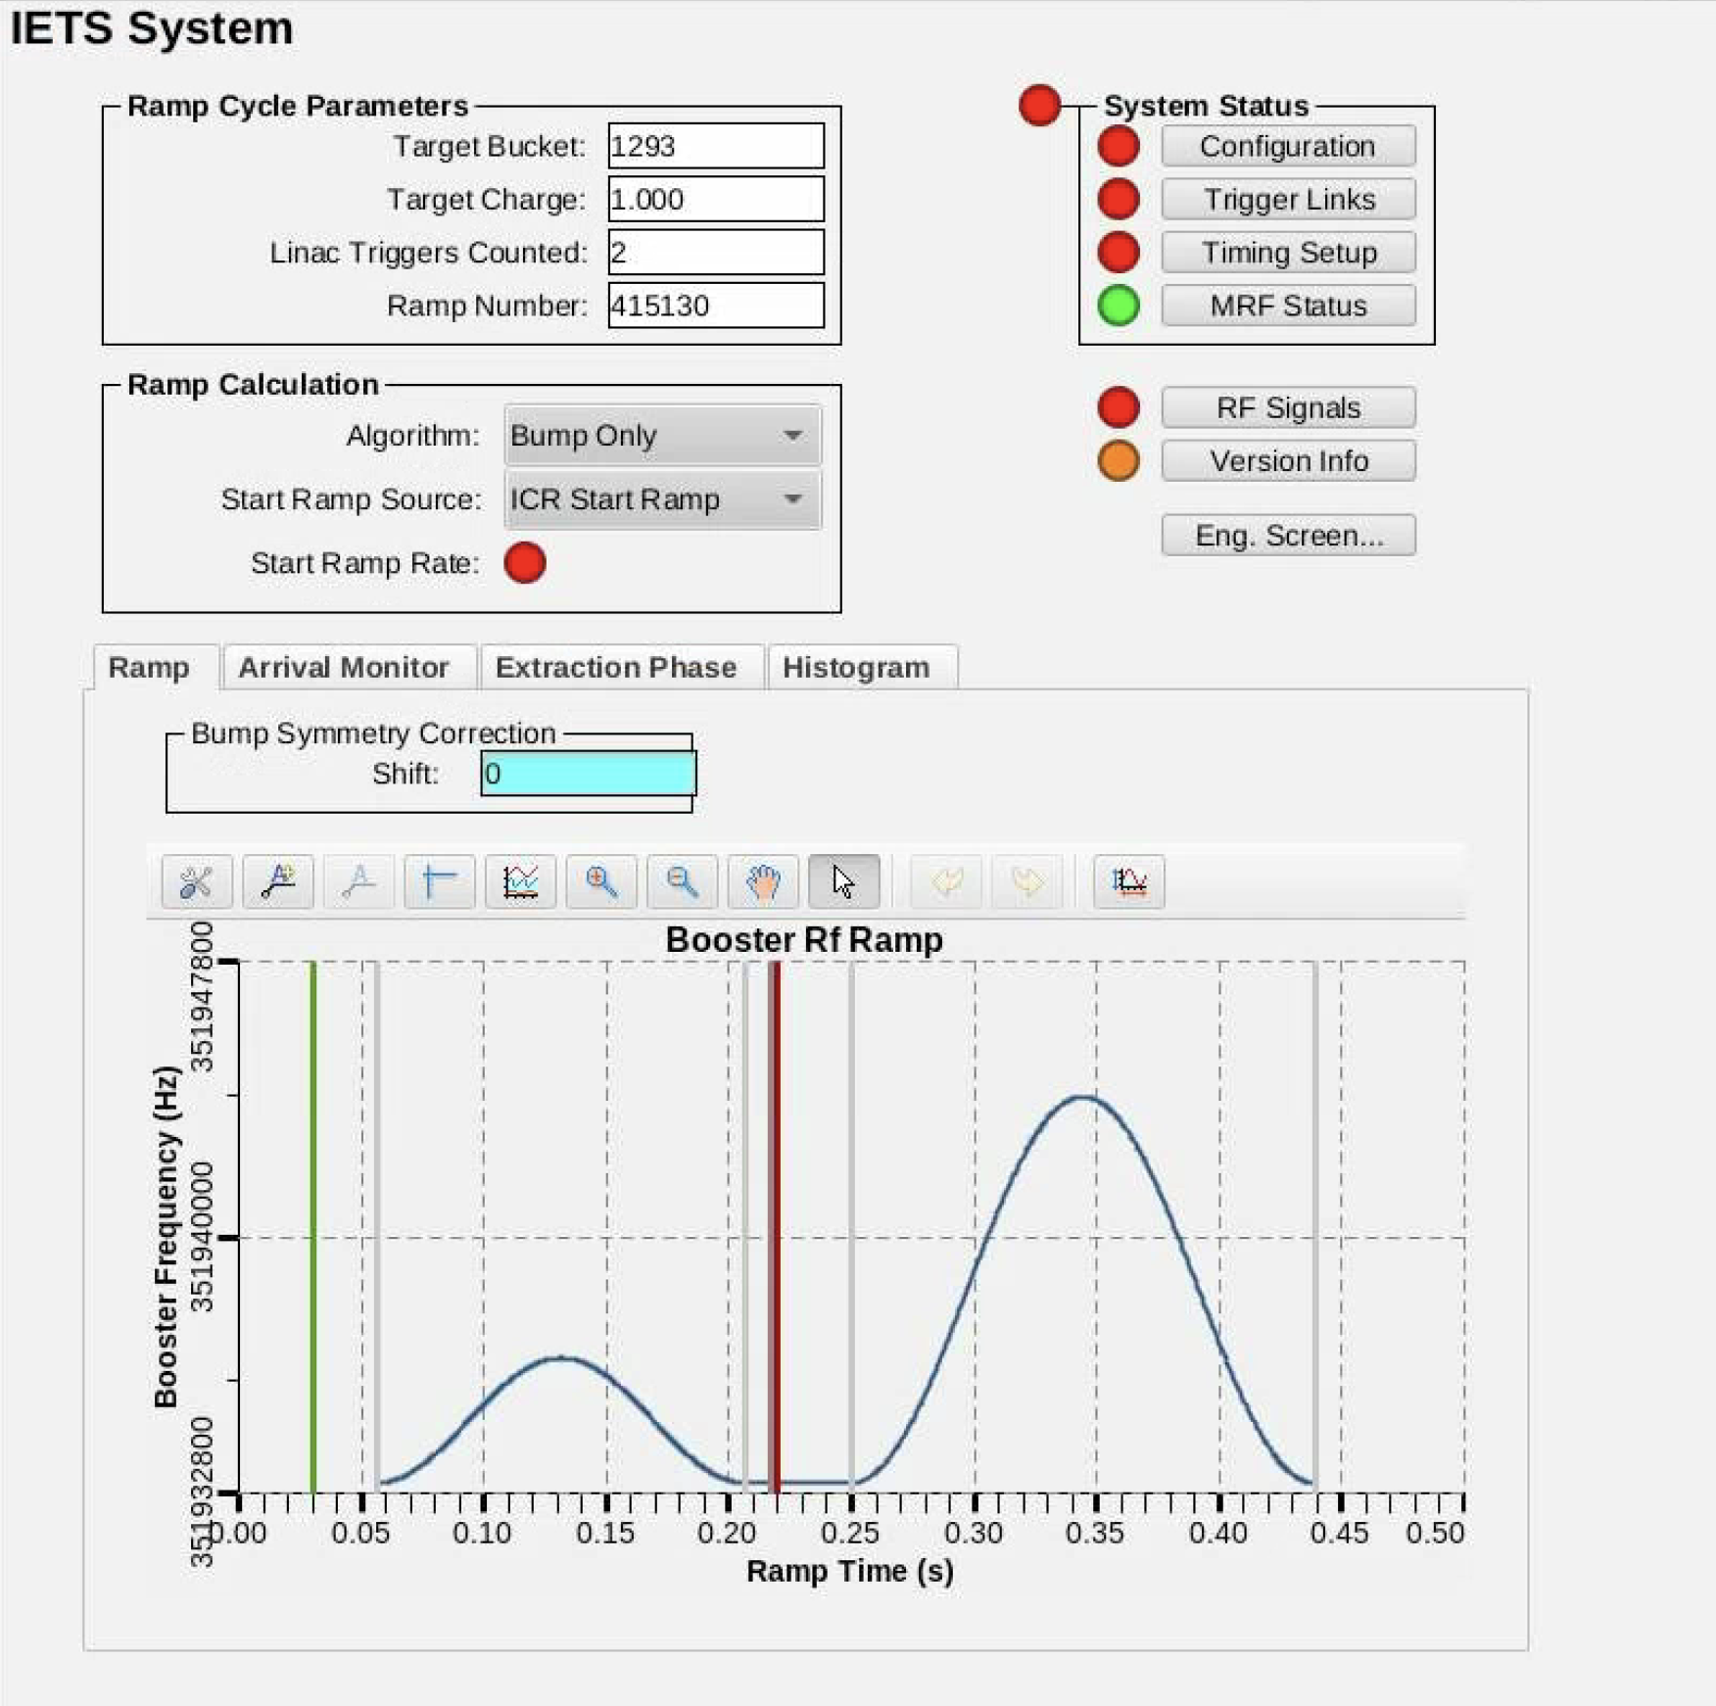
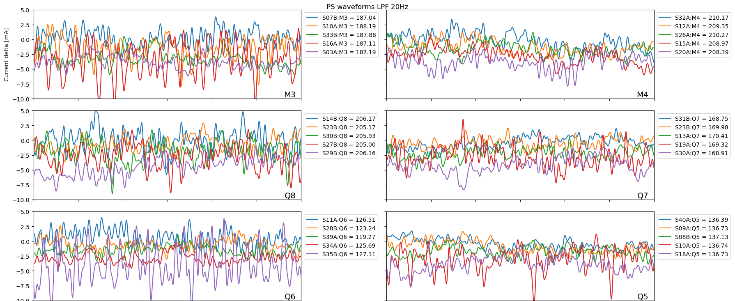
Client interface
DAQ users use both EPICS tools and libraries to access pvAccess data
  Custom python and C++ tools and applications using pvapy library and EPICS pvaClient module
  Once consumed, uses applications like Jupyterlab to process or writes to SDDS files to be processed by SDDS applications
  Use C2DataViewer, CSS phoebus to visualize live pvAccess data

Slide 12
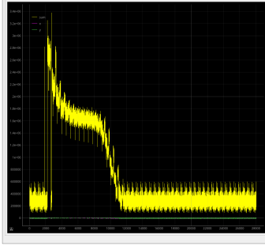
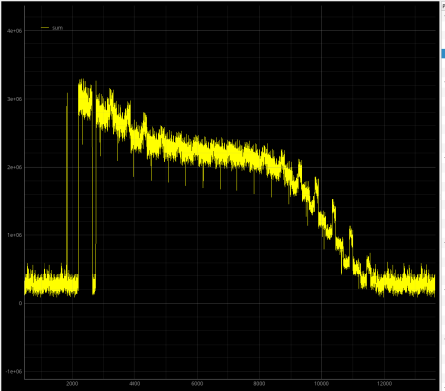
Use case example: Injection Efficiency tuning
User tunes injection kickers and observes changes in storage ring beam sum after injection
Uses IOC’s subset plugin to capture 100 samples after injection event
27120 samples per object
Injection Event
Use DAQ Orbit tool to plot beam sum from all 20 double sectors

Slide 13
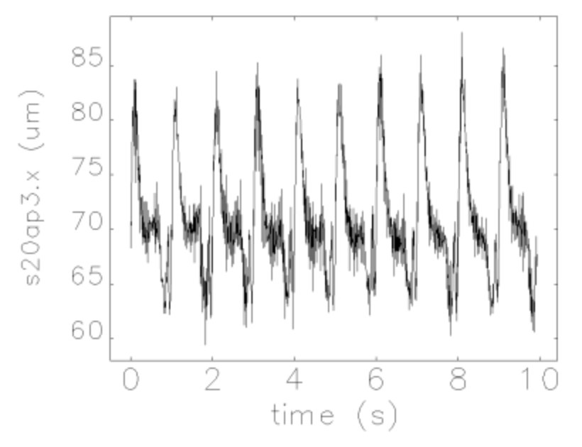
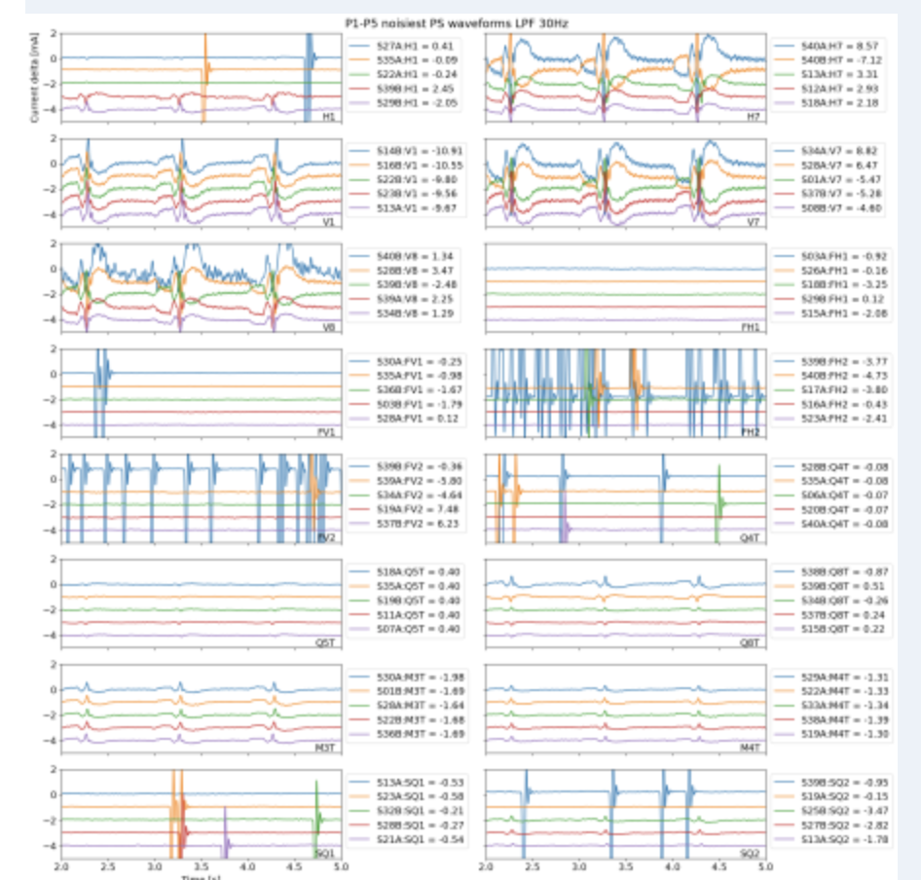
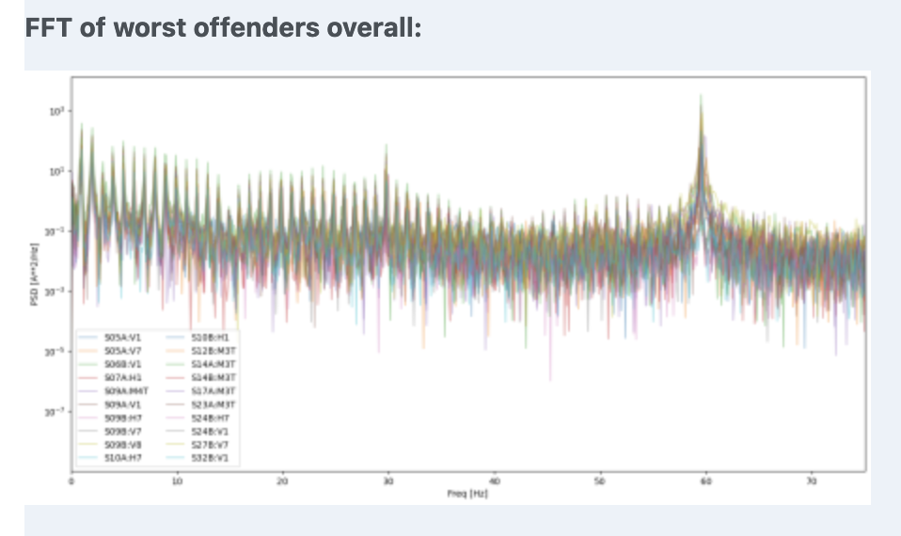
Use case example: 1hz noise troubleshooting
Observed in TBTDAQ data 1hz oscillation several BPMs
Captured ~10s correlated BPM data and power supply data from PSDAQ using Subset plugin triggered by the same event
Found 1hz pattern in some correctors
Narrowed down family of correctors that was causing the 1hz noise
TBTDAQ data
PSDAQ data

Slide 14
Other use case examples
Post-mortem: Beam dump event triggers capturing data range (ex. 0.5s before, 2 seconds after) for all 20 double sectors. SDDS files written to local disk
Power supply glitch detection: Use PS statistics PVA channel to detect high current readback. Trigger capture of power supply data to disk when condition is detected.
Beam motion (compensation with MOFB)
Beam sum (finding loss locations for beam abort commissioning, lifetime server)

Slide 15
User feedback
Users like the flexibility of acquiring data
  Collect data from any machine using pvAccess
  Change data capture range on the fly
  Collect large amounts of data
Users want larger amount of data collected then expected
  Expected only a few thousand samples around event. They want 2+ million samples at a time
Users want faster data rates then 10hz
  Faster reaction time
Users want more plugin workflow options
  Expand number of plugins on IOCs

Slide 16
The End
Questions, Comments?

Slide 17
EXTRA SLIDES

Slide 18
Next steps
Improve resilience
Switch to use PVXS
Open source generic DAQ epics modules

Slide 19
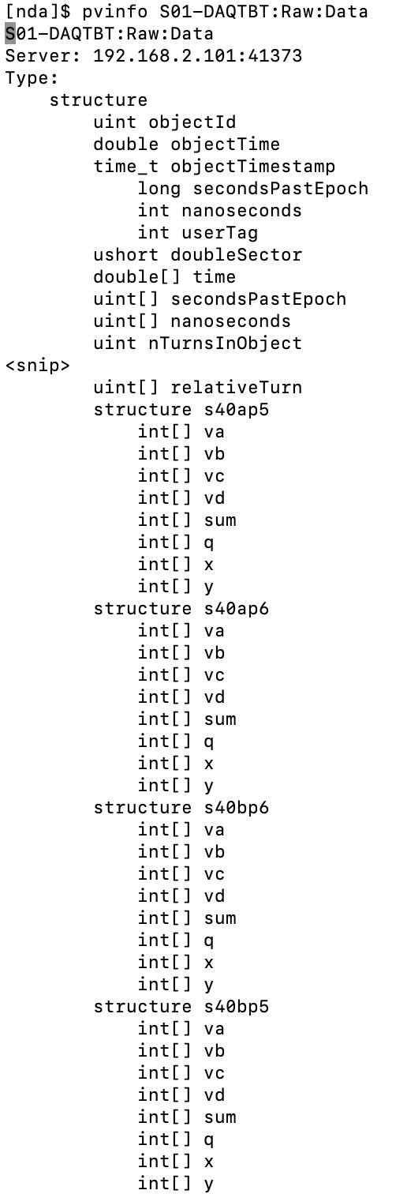
APS-U Data Acquisition System : Software Architecture

Slide 20
DAQ Interfaces
 | Item | From | To | Interface
BPM Turn-by-turn DAQ | BPM Data Links (x7) | Libera Brilliance+ (x7) | BPM Aggregator | Fiber aurora link (x7)
 | APS-U Fast Event Link | Double-sector VME crate | BPM Aggregator | MRF Event Link Fiber
 | Connection to DAQ Double-sector Server | Server 10Gb ethernet NIC | BPM Aggregator | 10Gb Ethernet Fiber
PS Fast Data DAQ | FOFB/PS Network | Cut-through Switch Port | PS Fast Data Aggregator | 1Gb Ethernet Fiber
 | Connection to DAQ Double-sector Server | Server 1Gb ethernet NIC | PS Fast Data Aggregator | 1Gb Ethernet
FOFB DAQ | Connection to DAQ Double-sector Server | Server 1Gb ethernet NIC | FOFB Controller via µTCA Chassis | 1Gb Ethernet
IX/EX DAQ | Connection to server running the DAQ IOC | Server 1Gb ethernet NIC | IX/EX Waveform Capture Chassis | 1Gb Ethernet
Bunch Lengthening System | DAQ IOC integrated within LLRF Controller | Server 10Gb ethernet NIC | BLS LLRF Controller | 10Gb Ethernet
 | APS-U Fast Event Link | Double-sector VME crate | BPM Aggregator | MRF Event Link Fiber
Longitudinal Feedback (x1), Transverse Feedback (x2) | iGp12 (COTS) Network Port | Server 1Gb ethernet NIC (already required) | iGp12 (COTS) | 1Gb Ethernet
 | iGp12 (COTS) Triggers (x2) | EVR in Local VME crate (already required) | iGp12 (COTS) Trigger | TTL; 50 Ohm

Slide 21
List of DAQ Hardware
Item | Quantity | Description | Source of Timestamp/Events
BPM Turn-by-turn Aggregator | 20 | FPGA Chassis to receive data streams from 28 BPMs (7 Libera Brilliance+ units) and pass them on the DAQ TBT IOC | Fast Event Link
PS Fast Data Aggregator | 20 | FPGA card (PCIe) in double-sector controller to receive data streams from 20 Power Supply Controllers and pass them on to the PS Fast readback DAQ IOC | Embedded in the data from the Power Supply Controllers
DAQ Double-sector Servers | 20 | Mid-range linux servers to run DAQ IOCs and double-sector services Intel Xeon CPU @ 2.20GHz 40 cores, 32GB RAM, 3TB SSD | Embedded in the data received
DAQ Central Servers | 8 | Mid-range linux servers for integrating all DAQ data or support “one-of” systems | Embedded in the data received
Fast Orbit Feedback, LFB, TFB, BLS, IX/EX | - | Integrated with the technical system hardware | Fast Event Link or obtained from the IOC that provides the triggers to the LFB/TFB controllers

