Slide 1
Integration of Fermilab’s Legacy Controls System into EPICS/Phoebus
William Badgett
Fermi National Accelerator Laboratory, aka “Fermilab”
Batavia, IL 60540 USA
EPICS Collaboration Meeting ORNL September 18, 2024

Slide 2
Outline
Brief introduction to Fermilab
The PIP2 Linear Accelerator Project
  Motivation
Existing Accelerator controls “ACnet”
  Accelerator Controls Network
  History, examples
PIP2 Controls
  Select of EPICS/Phoebus
  Integration with ACnet
Use of EPICS/Phoebus elsewhere at Fermilab

Slide 3
Fermilab Accelerator Complex
America’s premier High Energy Particle Physics Laboratory
At heart Fermilab is a high energy proton factory, in stages of increasing energy:
  LINAC: 400 MeV to be replaced by PIP2
  Booster: 8 GeV
  Main Injector: 120 GeV
  Tevatron, until 2011: 980 GeV
Whence protons, a whole panoply of other particles can be produced
Physics Beams:
  Main physics programs: Neutrino Physics, and Muon Physics
  Protons from Main Injector [MI]
  Secondary and tertiary beam from MI in switchyard e, μ, π, ν_{μ} K, p, p, …
  Muon beam for g-2, eventually for μ2e
  NuMI: muon neutrinos ν_{μ} and anti-neutrinos
  BNB Booster Neutrino Beam ν_{μ} for SBN program

Slide 4
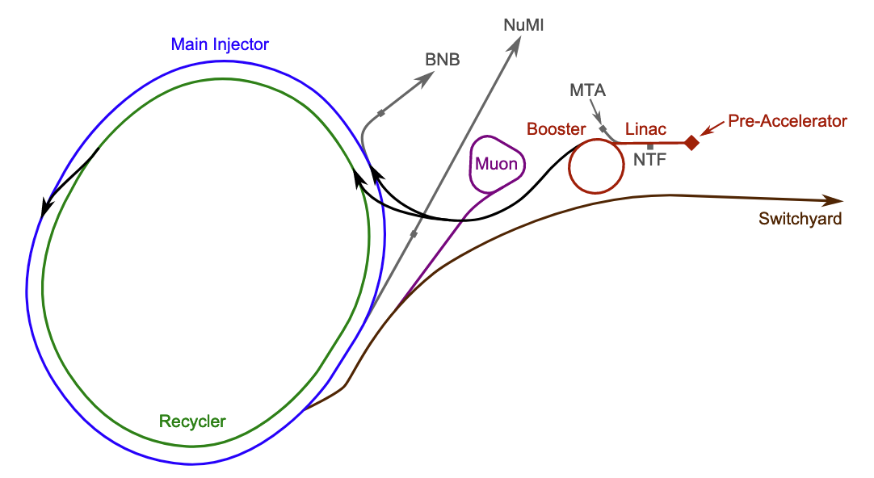
Schematic View of Current Beam Complex
To NOνA northern Minnesota
To SBN, SBND and ICARUS
To be replaced by PIP2 LINAC
400 MeV
Bottle of H
120 GeV
Fixed Target Experiments and Test Beam
8 GeV
NuMI To be replaced by LBNF to DUNE in South Dakota

Slide 5
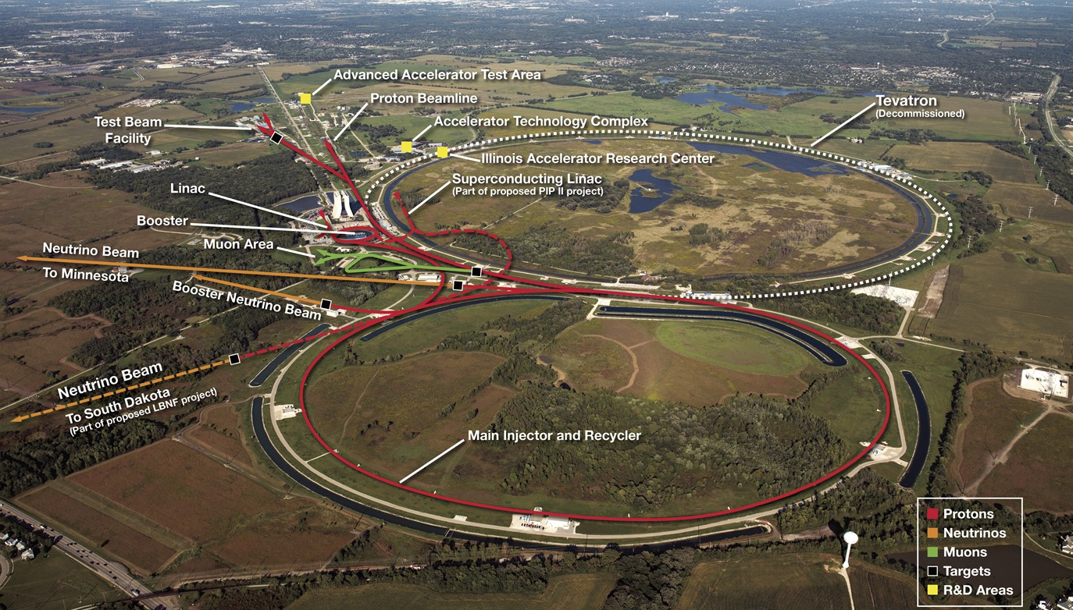
Fermilab Accelerator Complex

Slide 6
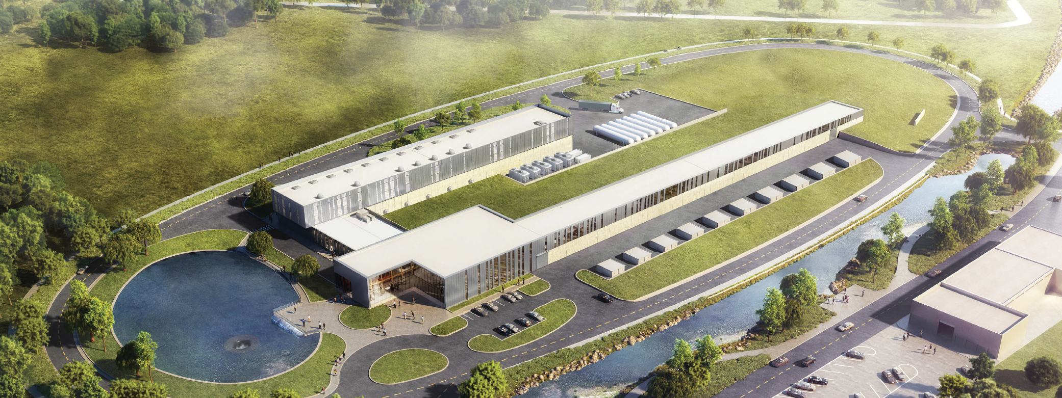
Proton Improvement Plan 2 (PIP2)
Increase Main Injector beam power to 1.2 MW.
  Super Conducting LINAC
  Replace the existing 400 MeV LINAC with a new 800 MeV superconducting LINAC → increase in Booster intensity.
    Provide a platform to increase LBNF [beamline for DUNE] power to 2.4 MW
  Provide path for a 100 kW Mu2e-II
  Provide capability for 1.6 MW at 800 MeV, CW beam
  Platform for high duty-factor / power operations to multiple experiments

Slide 7
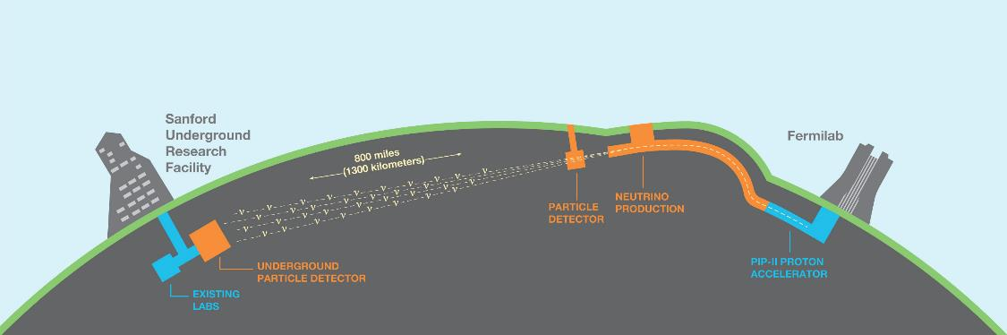
Motivation for PIP2: Neutrino Physics
  Origin of matter. Investigate leptonic CP violation. Are neutrinos the reason the universe is made of matter?
  Neutron star and black hole formation. Ability to observe neutrinos from supernovae events and perhaps watch formation of black holes in real time.
  Unification of forces. Investigate nucleon decay, advance unified theory of energy and matter.

Slide 8
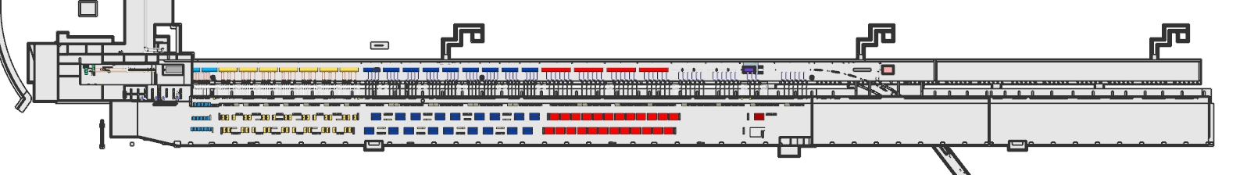
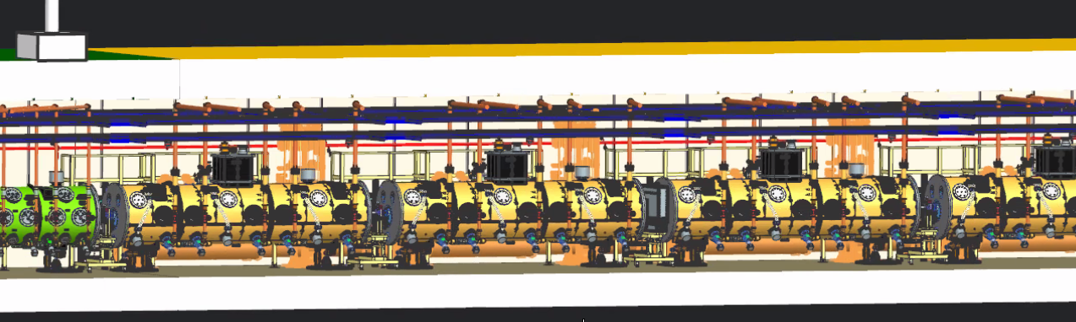
PIP2 3D CAD Model
Direction of protons and increasing energy
plan view
Transfer Line to Booster
SSR2 Strand
SSR2 String
8
5/11/2022
PIP-II Integrated Model Discussion

Slide 9
Future Accelerator Controls at Fermilab
PIP2 will use EPICS and Phoebus and associated tools and applications
  Decided early in the PIP2 planning process
  By itself it is a “green field” project, but...
  What about the rest of the accelerator complex?
ACORN! 🐿️ Accelerator Control, Operations, and Research Network
  Replace aging parts (over 50+ years)
  Power supplies, data acquisition hardware, and controls system with modern systems
  ACORN will include EPICS and Phoebus
Caveat: the original ACnet systems cannot disappear overnight
  Will continue to exist for several more years
  We must interface old and new systems in a variety of way

Slide 10
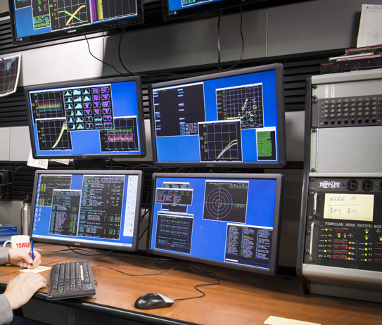
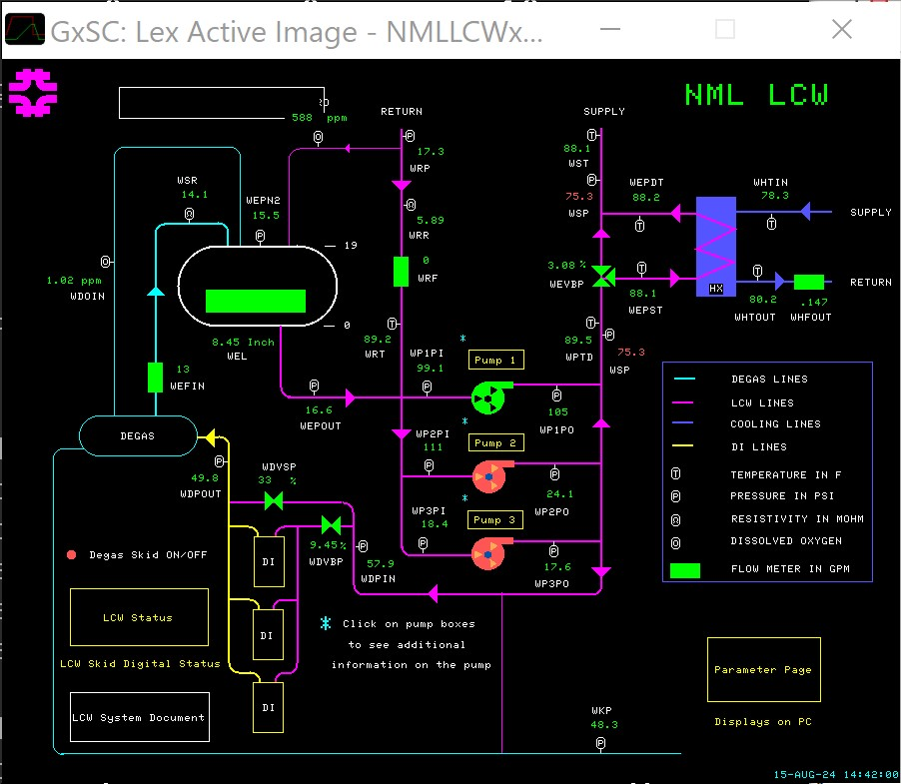
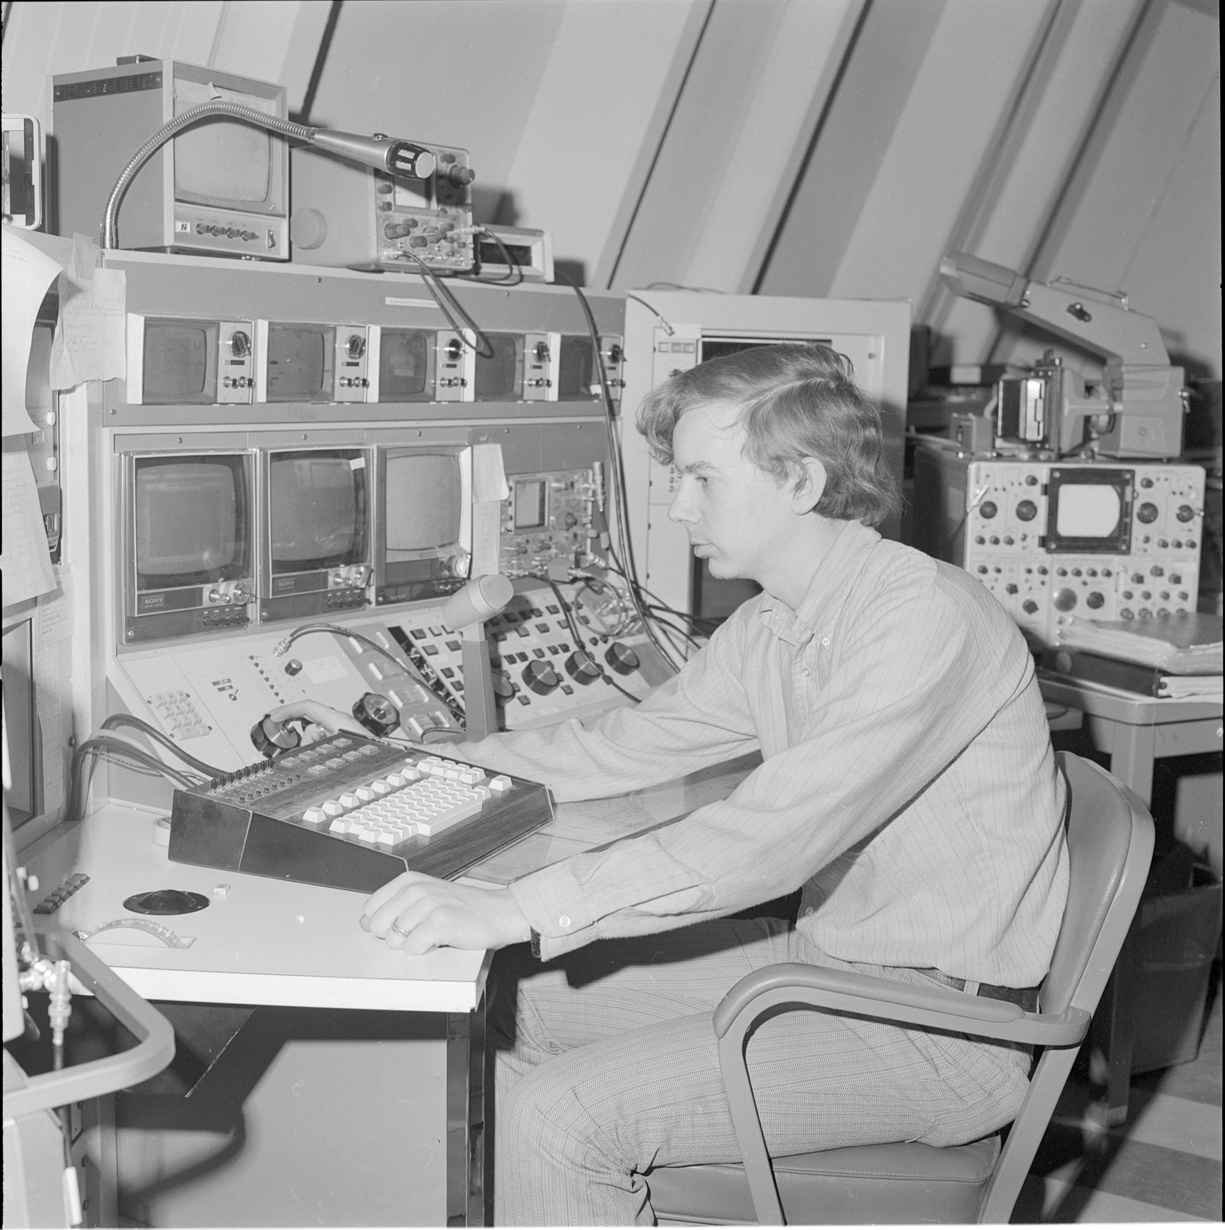
ACnet Accelerator Controls Network – Existing
Born around 1983 to control the new Tevatron proton synchrotron and coordinate the control of the entire Fermilab beams complex
  Initially developed on VAX/VMS with Fortran, text displays and time series plotting
  Ported to Linux and C++ with Java later, late 1990’s
  Java: more complex “Synoptic” displays similar to Phoebus
  Developed significant complexity over decades
MCR 1972

Slide 11
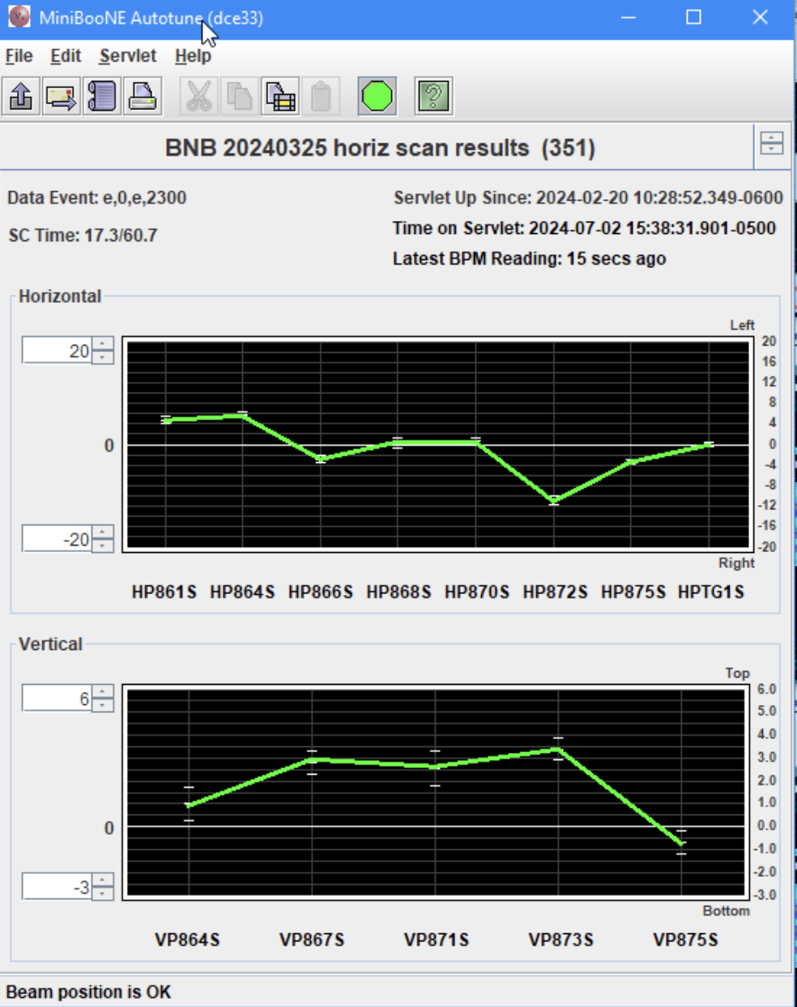
Custom Java Based Display Example
Pro: Custom Java applications have unlimited access to all Java graphics libraries plus external libraries
Con: You have to be reasonably proficient in writing Java applications

Slide 12
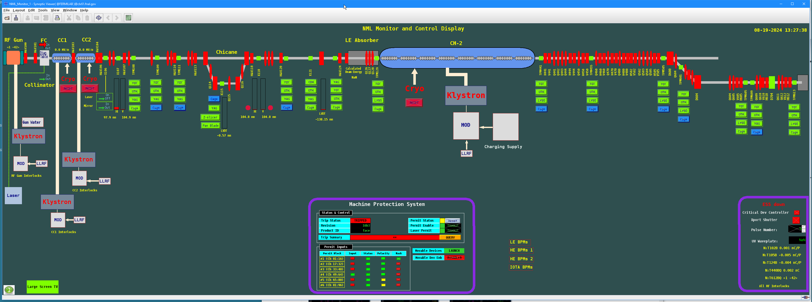
Example of Synoptic Java Based Display – Beam Line
Pro: Drag and drop GUI builder; no coding
Con: Hard to fine tune; hard to customize features

Slide 13
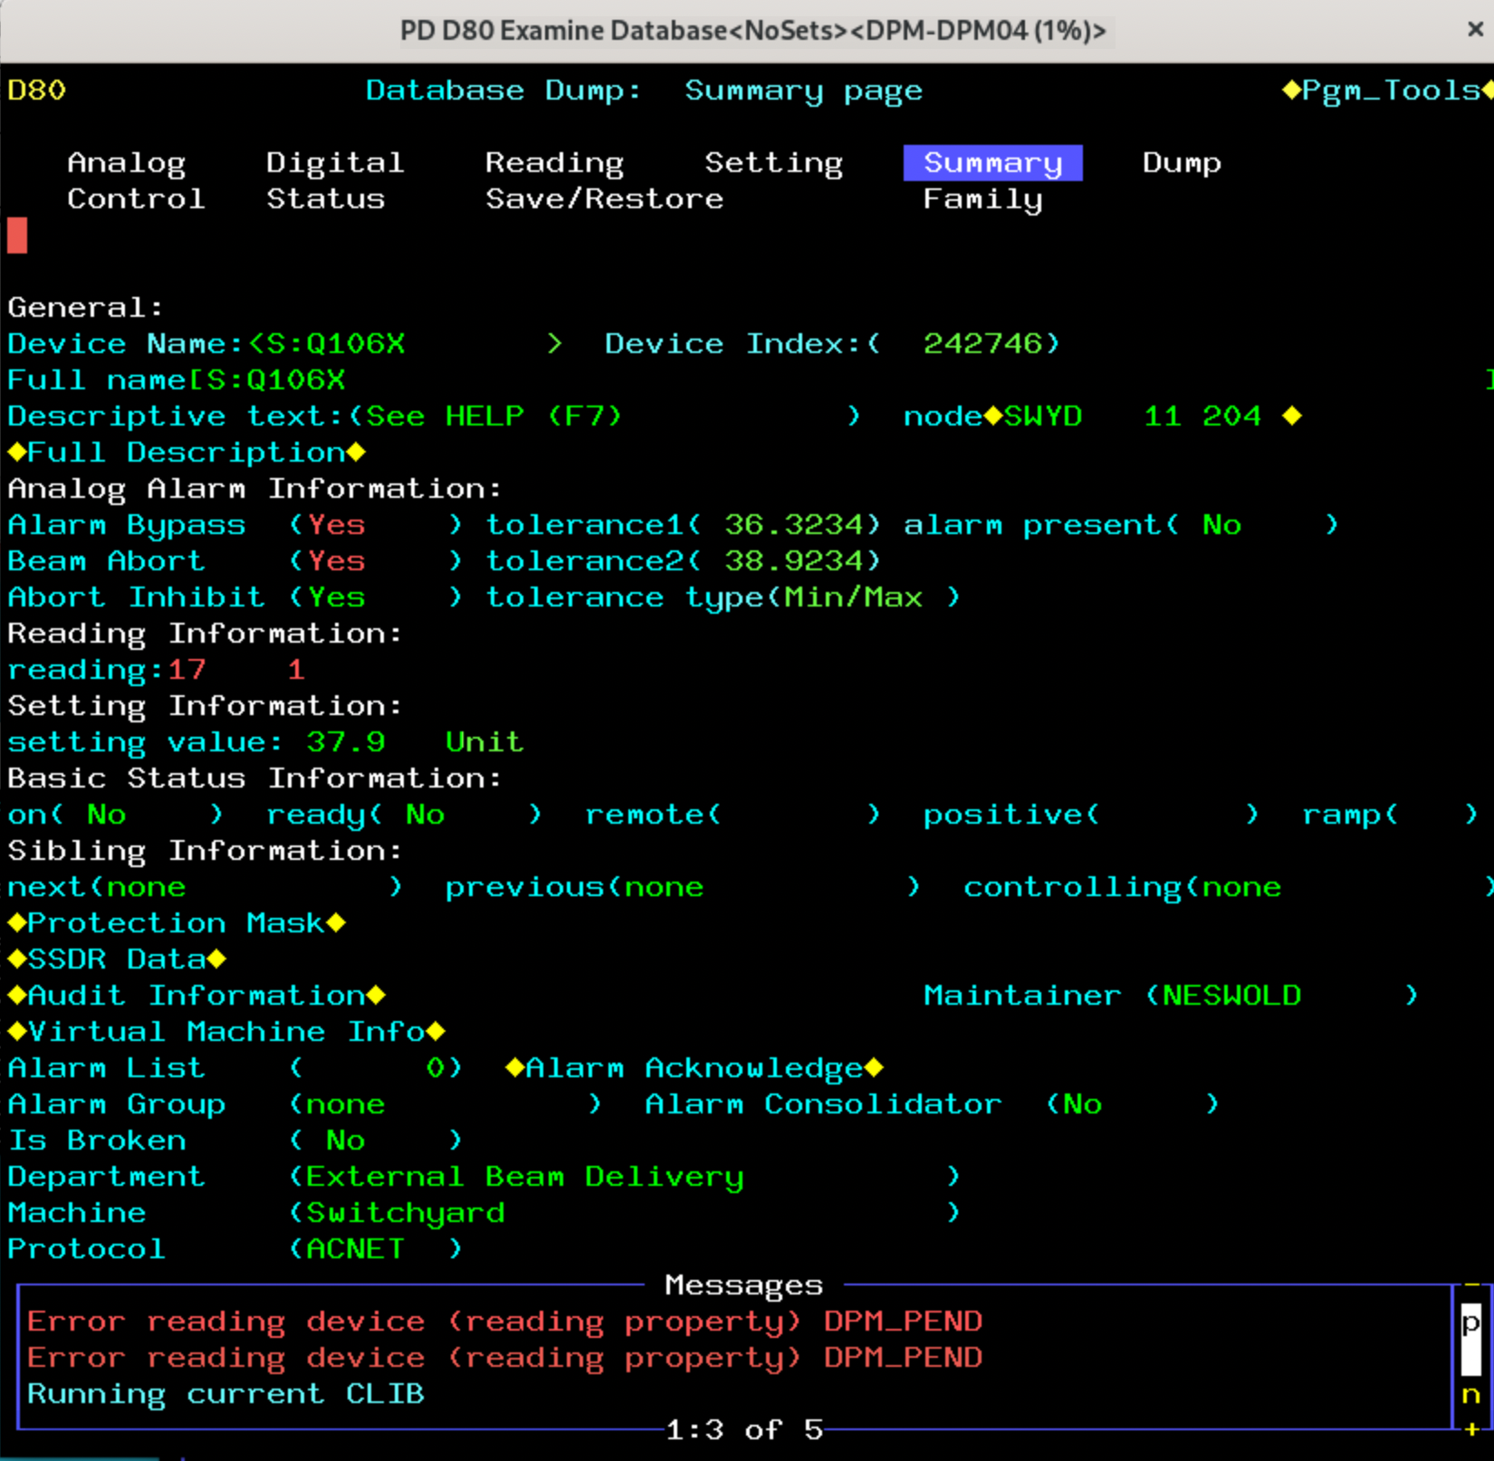
Central ACnet Concept: the Device
Example: Switchyard quadrupole power supply S:Q106X
Integrated Object:
  Reading, Setting, Alarms, Control (commands), Digital Status, etc.
  Many optional attributes
  Designed initially for power supplies, but extensible for many devices
  Device characteristics stored in a relational database, PostGreSQL
Contrast to EPICS: single device may have multiple Process Variables
  E.g. separate ai and ao for readings and settings

Slide 14
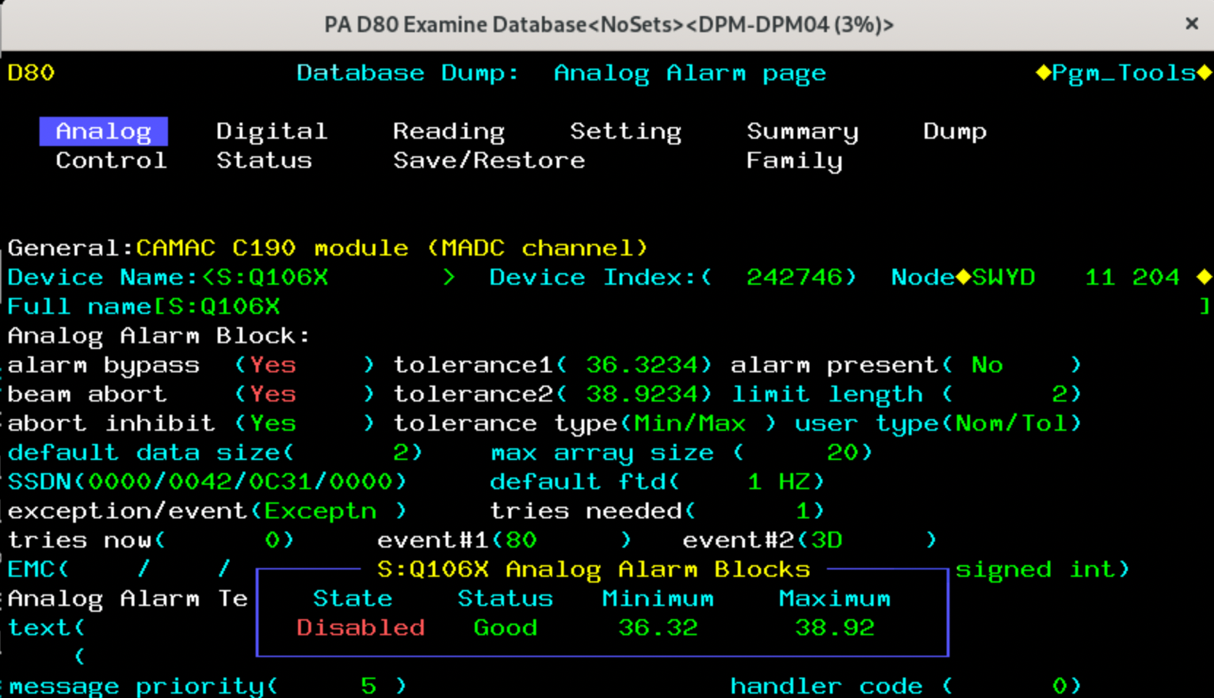
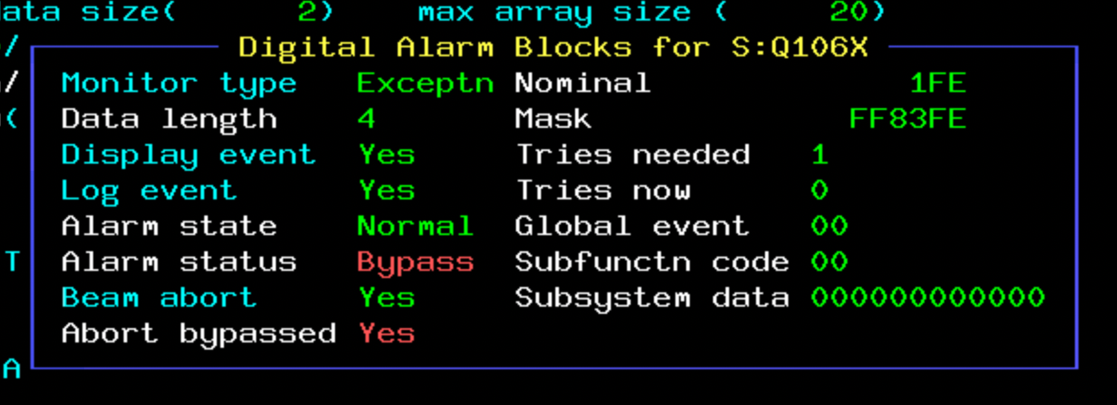
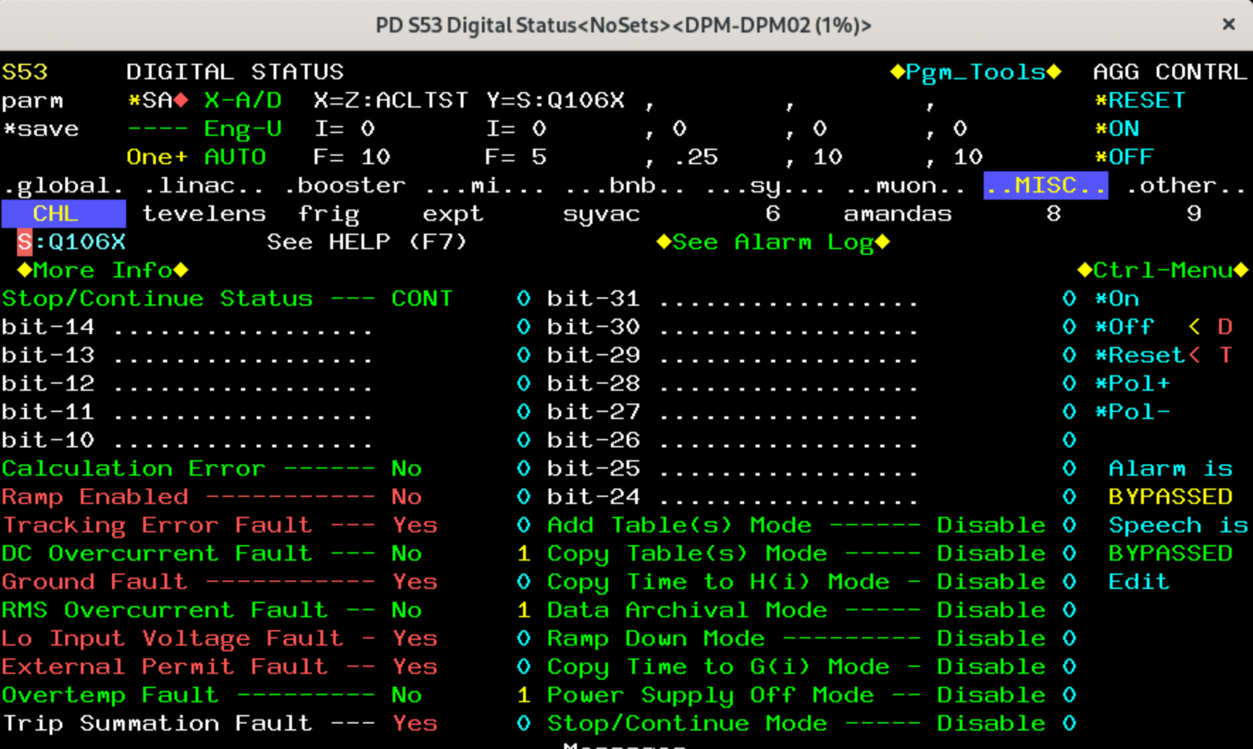
ACnet: Alarm Concepts
Analog Alarm
  Similar to EPICS HIHI and LOLO
  Alarms on device reading deviation from normal range
  No concept of intermediate warning like HIGH and LOW
Digital Alarm
  32-bit mask
  Each bit corresponding to a device condition, good or bad
  Mask and compare to nominal, and generate digital alarm on disparity
  Something like EPICS mbbi record type

Slide 15
Detailed Flow Chart of ACnet Communications
Recent comprehensive review of ACnet by ACORN
Comprehensive diagram of applications and interconnections within ACnet
Protocols and functions increase with time
Goal: consolidation and simplification
…but this is not going away any time soon…

Slide 16
Interfacing Old and New
ACnet world and EPICS world cross-communicate
ACnet: publish/subscribe model, Data Pool Management [DPM]
  User provides ACnet device name, property and data fetch method
    Fixed scan rate or accelerator event based, e.g. “Booster beam spill event”
  User provides a callback (Listener in Java) to process incoming data
The Phoebus package provides extensibility through plug-ins
  Extremely valuable feature
  Either core, pv, or applications
  Extends functionality – maven is all about plug-ins
  We have written a core-pv plug-in to bridge ACnet and Phoebus, pv-acsys
  Allows seamless display in Phoebus and Alarm system handling
  Future: integrate into ArchiveApplianece

Slide 17
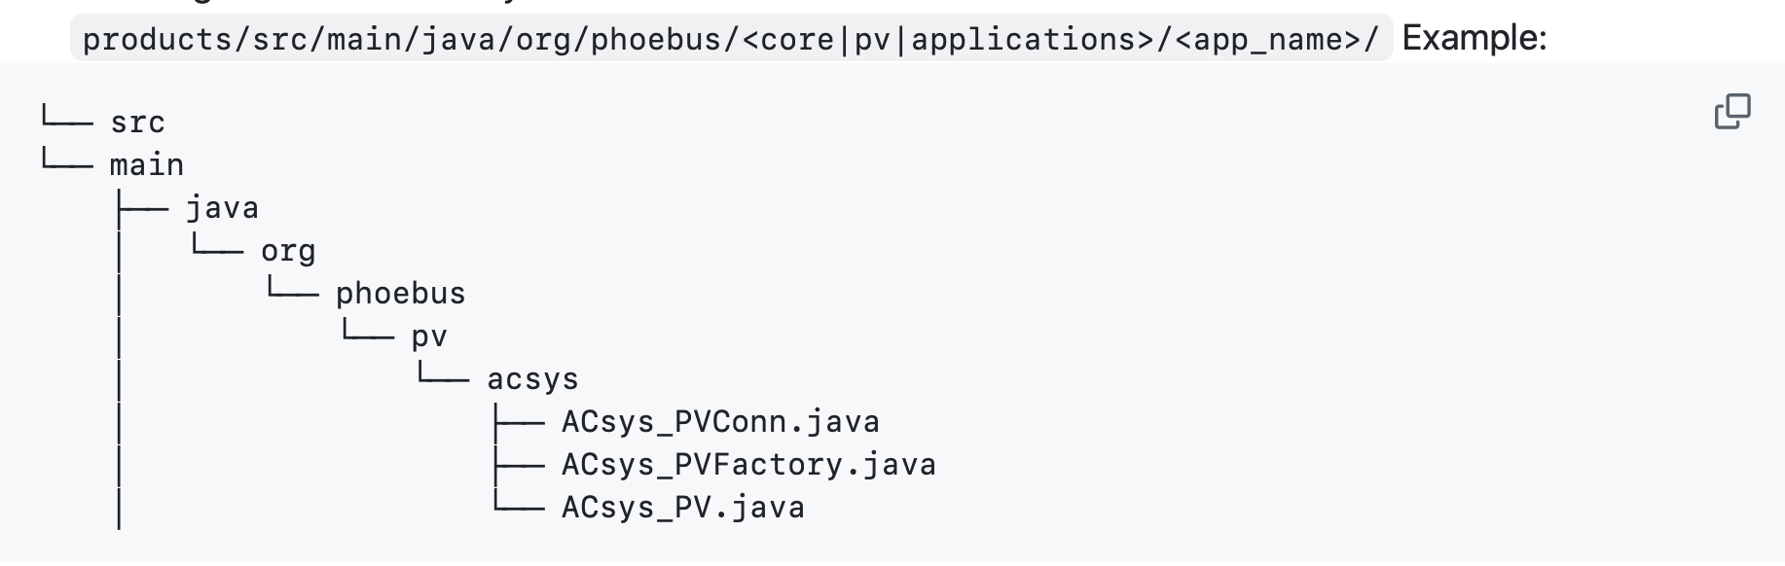
Phoebus Plugins
Phoebus has the ability for the user to fold in their own code or applications as a plugin, e.g. implement a new PV class that implements an external protocol:
ACsys_PVConn handles all communications with ACnet, inform PV objects on new data
ACsys_PVFactory creates PV objects while ensuring there are no duplicates
  Reuse existing PV objects to minimize resource usage
ACsys_PV provides new data to listening Phoebus widgets and assembles various data sources into one VType object
Create a “shadow” package with your additions
Use Maven to fold them in with main builds
Thanks to Kay and Kunal

Slide 18
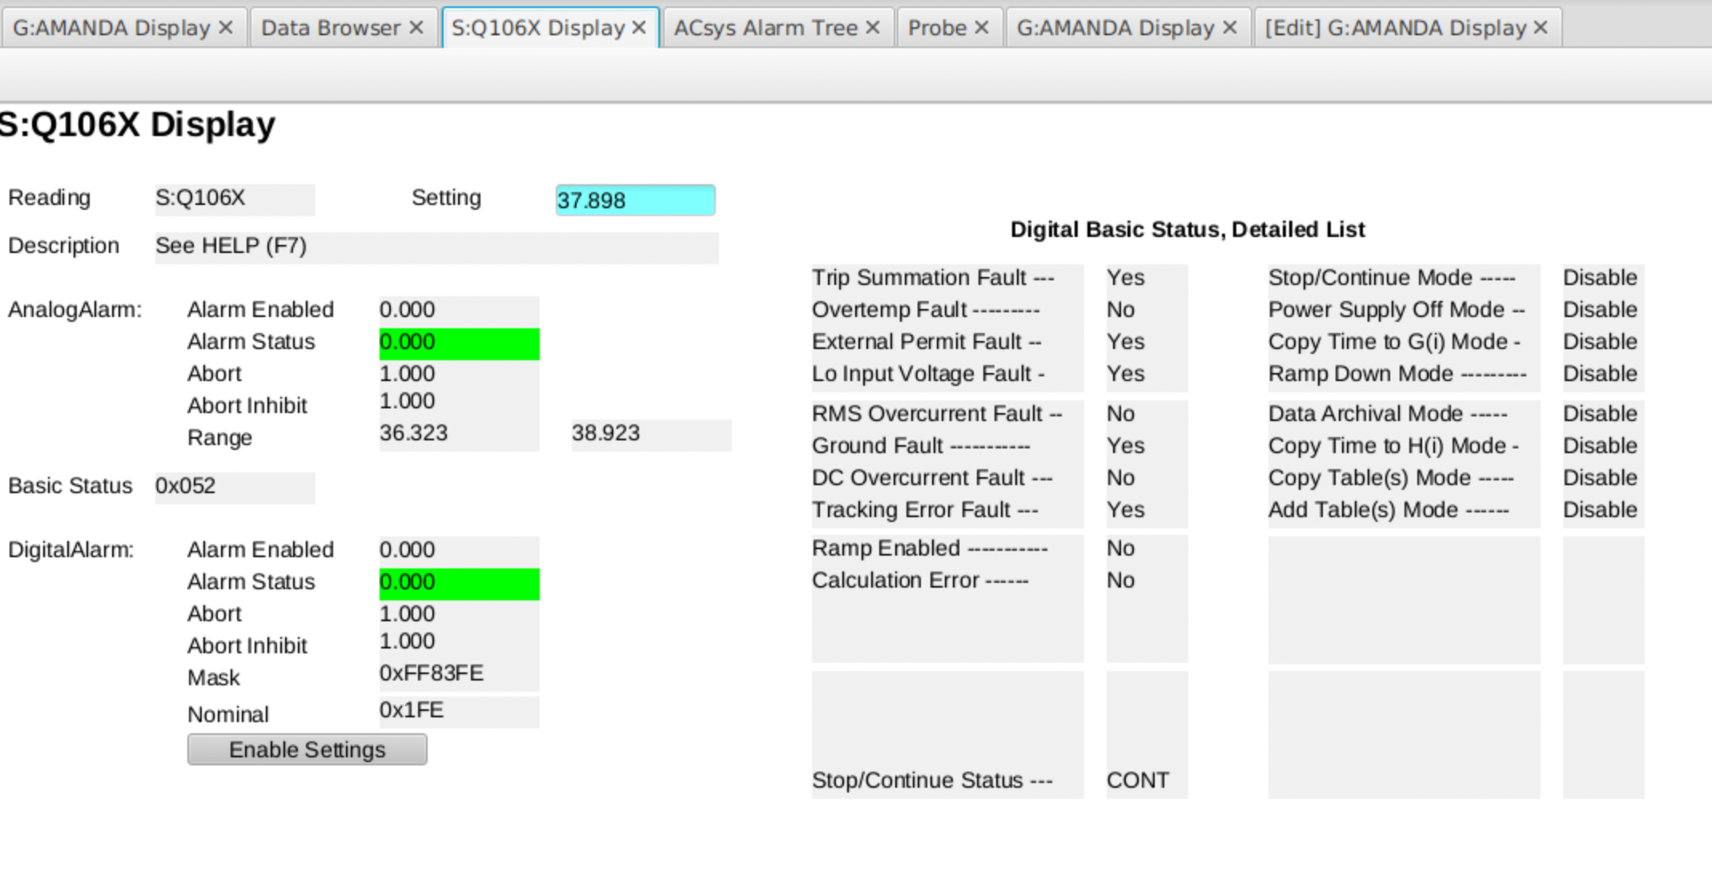
Phoebus Display of ACnet Device
The quadrupole power supply we saw earlier
ACnet include Kerberos authentication and authorization built into the protocol!
Proof of principle for the transfer of the most important ACnet info

Slide 19
Fitting an ACnet Device into a Normative Type in Phoebus
Phoebus expects widget updates to come in the form of a child class of VType with standard data fields:
  Value of the PV
  Time
    Timestamp, UserTag
  Alarm
    Severity, Status, Name
  Display
    Ranges: Display, Alarm, Warning, Control, Unit, Description, NumberFormat
      Each with min and max
Each field above can be derived from several different ACnet DPM data requests
  Must then be assembled into one ACsys_PV object to provide Phoebus with a complete VType object
S:Q106X.READING
S:Q106X.READING timestamp
UserTag: Scan rate or Acc Event

Slide 20
Mapping from ACnet to Normative Type, e.g. VDouble
VDouble Field | ACnet Field, example
Double value | S$Q106X.READING
Timestamp | From S$Q106X.READING
UserTag | Scan rate or Accelerator Event
Alarm range | S$Q106X.ANALOG_ALARM.MIN and S$Q106X.ANALOG_ALARM.MAX
Description | S$Q106X.DESCRIPTION
Alarm Severity | OR of Analog or Digital alarms
Alarm Name | HIHI/LOLO analog; add DIGI for digitial alarms
  The primary ACsys_PV object
  Must assemble Vtype information from a variety of ACnet request
  Various requests arrive asynchronously
  Requires persistency of data within the PV object in order to construct VType object
  If any field updates, this PV updates all Phoebus widgets listening to it
  [Subset of field mapping]

Slide 21
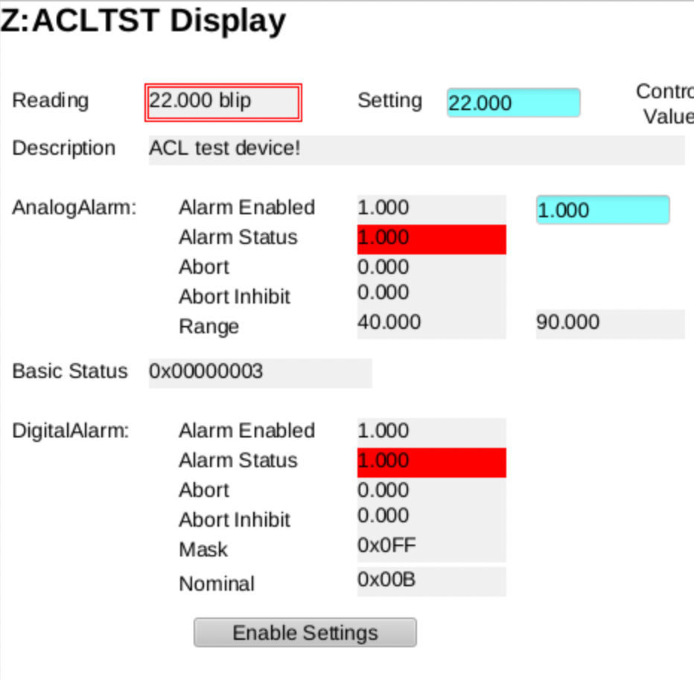
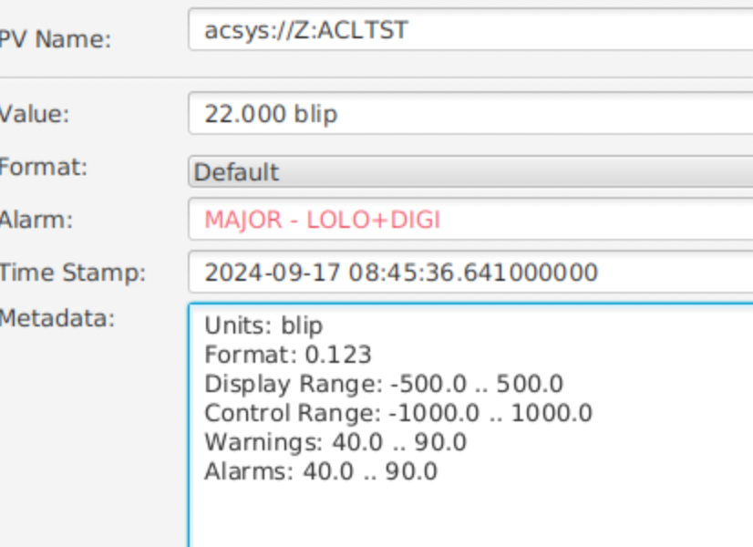
Visualization of Alarms, test device
PV Probe Display
Text “name” alarm field has flexibility to adapt to different protocols, here distinguishing analog and digital alarms

Slide 22
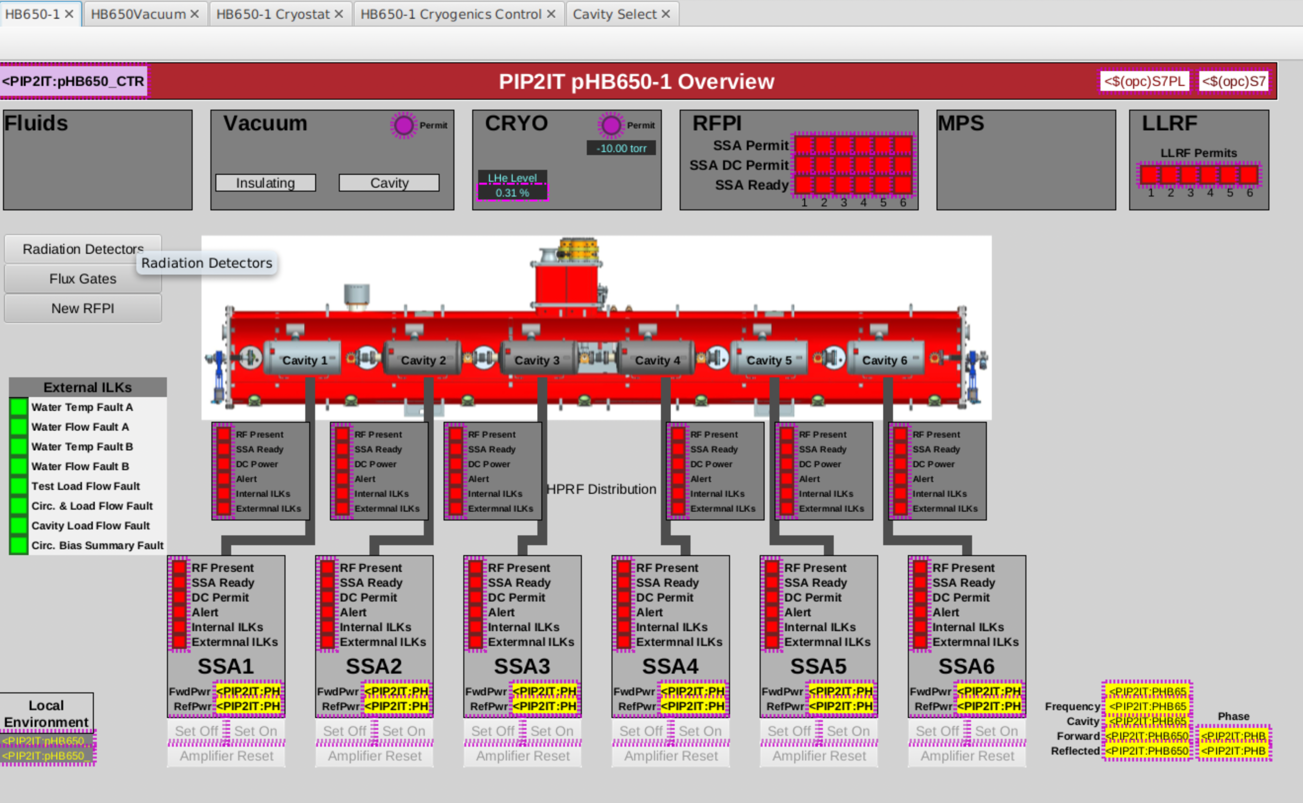
Conclusions
PIP2 will use EPICS and Phoebus
  Two successful integration test stand runs for two flavors of RF modules, SSR1 and HB650 at our Cryogenic Module Test Facility
  HB650:
    Fully instrumented EPICS IOCs and ~ 600 PVs
    Dozens of Phoebus display screens
    ArchiverAppliance, alarm-server and alarm-logger
  PIP2 cryogenics plant
    Parts and devices begin arriving in December 2024
    Now assembling the associated EPICS infrastructure
    First production system!
  Looking forward to installation of RF cavities, magnets, etc. over the next few years
EPICS is spreading organically to other parts of the lab, beams and experiments! 🌱
Pierrick Hanlet

Slide 23
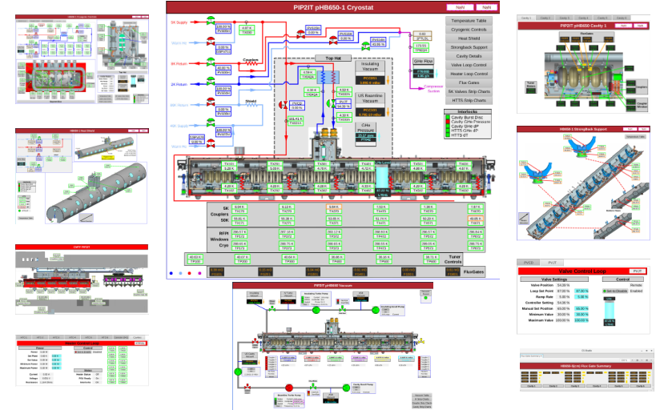
HB650 RF Module Test Stand Scope
HB650 testing invaluable test bed to develop and test EPICS and Phoebus
Not technically production, but most components will be reused
Pierrick Hanlet

