Slide 1
Digital Cameras For Beam Diagnostics @APS
The EPICS Collaboration Meetings
2024 Sep16-20 SNS
Co Authors
Suyin Grass Wang
APS
Ned Arnold Lingran Xiao
Andrew Johnson
Steve Shoaf
Rich Diviero
Guobao Shen

Slide 2
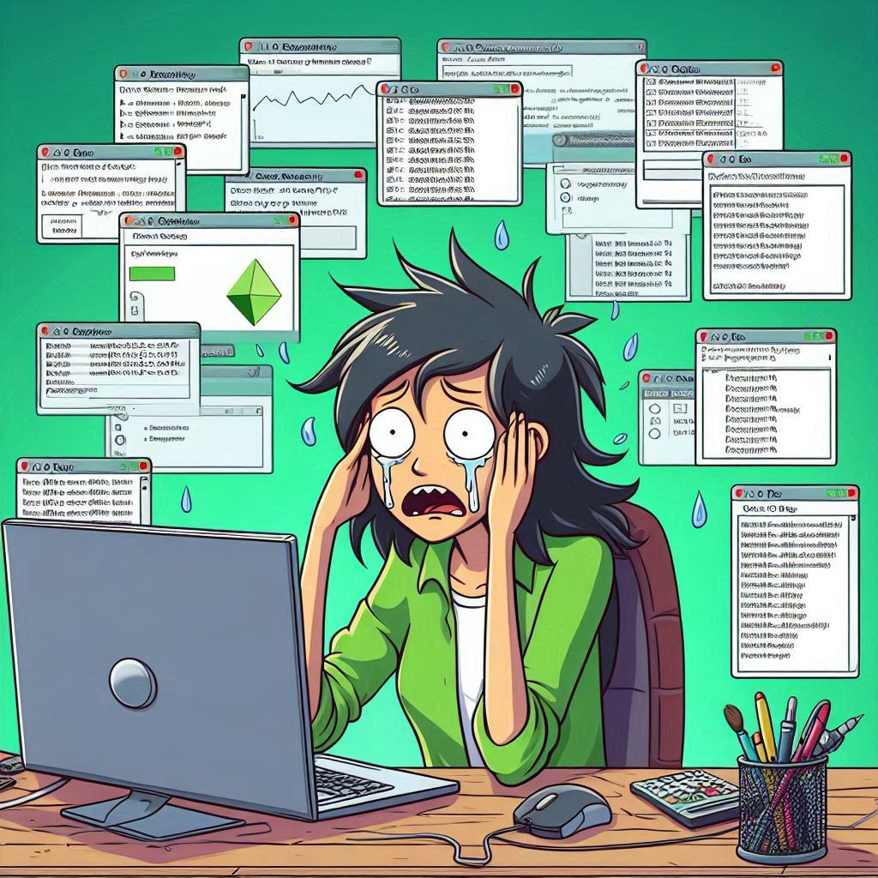
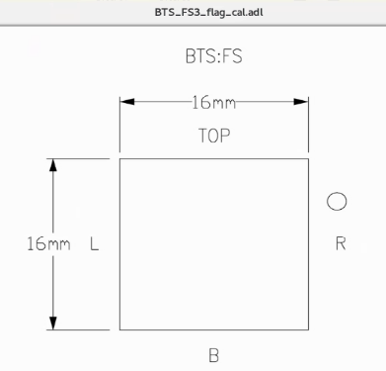
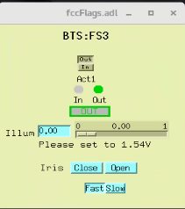
Simplify the Control System with Digital Cameras
APS has been using framegraber with analog cameras for the Beam Dianostics
Some flags come with a mask for beam size calibration, and a pinhole for the image orientation
Some flags come with a motor to move the lens, with the lens moved, the real time calibration could be handy
Upgrading happens to be a great chance to simplify the control system
Analog multiplexer
sdds
APS Video AutoRoute
medm
Frame grabbers
ImageJ
View Image
adxv
sequence program
Steve Shoaf
Rich Diviero

Slide 3
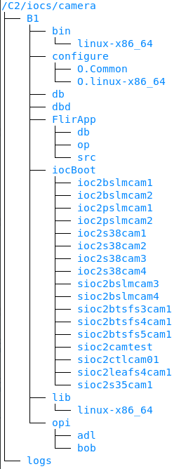
Digital Camera IOC Setup
All Camera IOCs share one ioc folder and Display screens
The USB cameras connecting to a workstation, and the ioc runs on the workstation (ioc2xxx)
The GigE cameras connecting to a PoE network switch and runs on a VM (sioc2xxx)
MODULE
AREA-DETECTOR
$(AREA-DETECTOR)/ADCore
$(AREA-DETECTOR)/ADSupport
ADGENICAM
ADARAVIS
NDDRIVERSTDARRAYS
BASE
SEQ
BUSY
SSCAN
CALC
AUTOSAVE
FLIR cameras
USB
GS3_U3_23S6M
PoE GigE
BFS-PGE-13Y3M-C
BFS-PGE-13Y3C
BFS-PGE-88S6M
BFS-PGE-19S4M
BFS-PGE-70S7M-C
Andrew Johnson's talk on Tuesday

Slide 4
Extra Feature with CSS-Phoebus
Local PV in CSS-Phoebus for color-range of image, so each user can use the color range of their choice while looking at the same image
Using rules to adopt the camera with different image size
Special Thanks to Kaz Gofron for the great help of Script and Rules

Slide 5
Dianostics Camera With Calibration Mask
Using ROI1 to match the mask size
Utilized the CSS Phoebus feature for Real time ROI modification by hand-dragging the ROI box position and size to align the mask
Add new database for
Mask size and unit
Calibrated value for
Image size
X-axis PV
Centroid, Sigma, and Cursor from NDPluginStats
Users can choose profile unit between pixel or calibrated unit

Slide 6
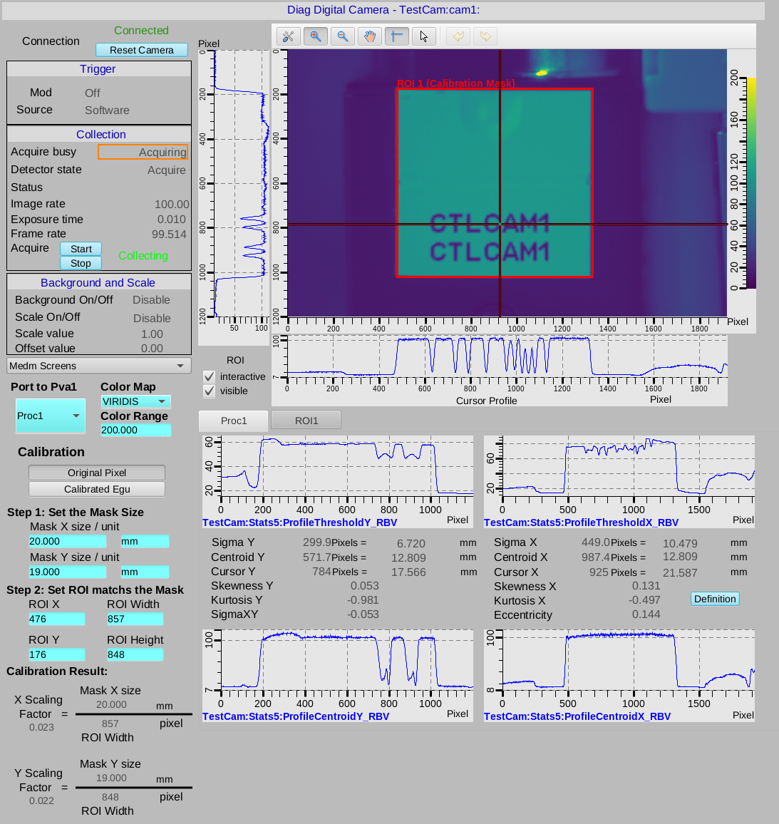
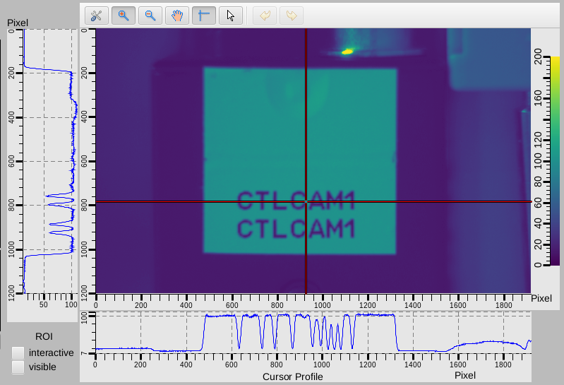
Calibration Feature
The example use a 20x19 mm label as a mask
Set the mask size by typing the value and unit
We use ROI1 to set the calibration mask
The ROI can be set by dragging the box in the image
Or Set the number by typing the value
Use the check box to change ROI box on the screen, disable to interactive/visible to avoid accidentally change the ROI

Slide 7
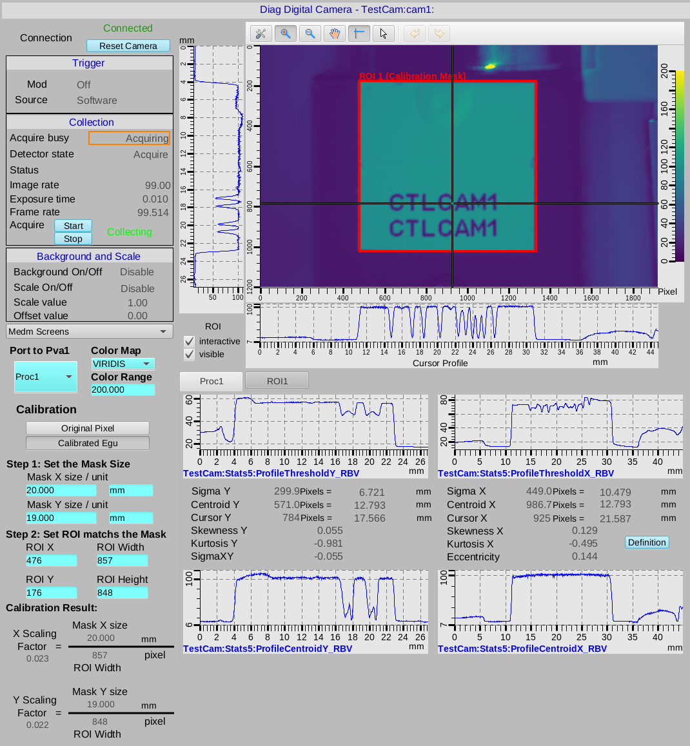
Switch the unit of axis for all waveforms by choosing Pixel or Calibrated Egu

Slide 8
Switch Between ROI view and Proc1 view.
Note this is also what pip to port Pva1

Slide 9
Customized Background And Scale Sequence
For the area-detector the background subtraction, the background image must take when no background and scale factor applies
A simple sequence to
save the scale factor, offset, and background status
Turn of all off it
Took a background image
Set all back to saved status

Slide 10
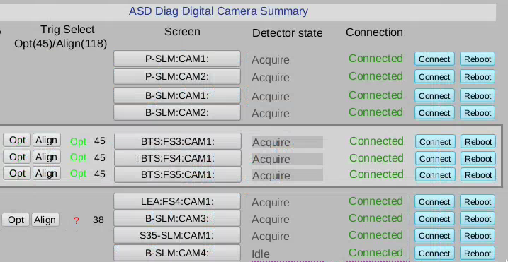
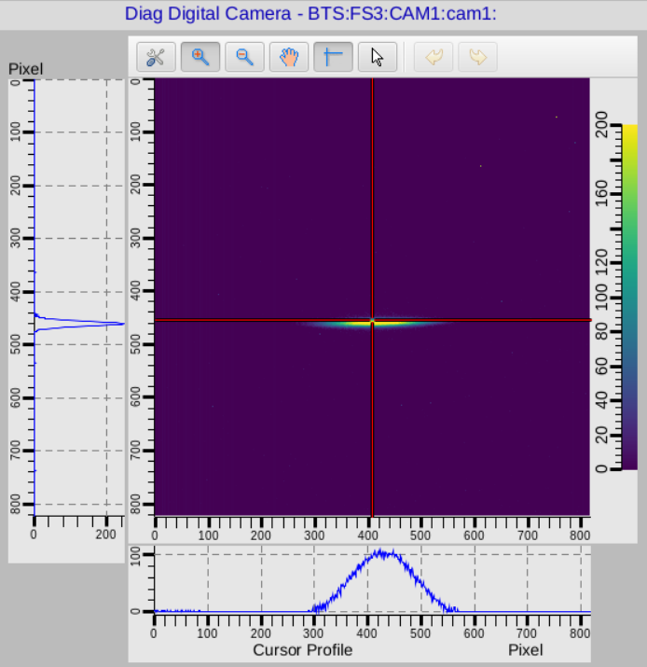
Add-on feature
Trigger the camera with selected MRF Event
(See Ran Hong's talk)
Re-connection after a network glitch
The ARResetCamera PV in ADAravis module could reconnect the camera
The SysReset PV in iocStats module could reboot the ioc after reconnection

Slide 11
Hybrid Screen Structure: medm + PhoebusCSS This allow us to phase in the software upgrade to minimize disruption
/C2/screens
├── adl
│ ├── iocs
│ │ ├── bcm -> /C2/iocs/bcm/B1/opi/adl
│ │ ├── befi -> /C2/iocs/befi/B1/opi/adl
│ │ ├── ....
│ │ └── xsrcpt -> /C2/iocs/xsrcpt/B1/opi/adl
│ └── systems
│ ├── oag -> /usr/local/oag/screens/adl
│ ├── site
│ └── sr
├── bob
│ ├── iocs
│ │ ├── bcm -> /C2/iocs/bcm/B1/opi/bob
│ │ ├── btsblmApp -> /home/helios/SHOAF/C2/iocs/btsdiag/main/btsblmApp/op/bob
│ │ ├── ...
│ │ ├── sr-controls -> /C2/iocs/sr-controls/B1/opi/bob
│ └── systems
│ ├── bts
│ ├── site
│ └── sr
└── devices
├── BTS-BESOCM
│ └── C2-1
├── libera-Bplus -> Libera-Bplus
├── Libera-Bplus
│ ├── C2-1
├── Libera-LLRF
│ ├── bob -> /home/helios/GRASS/C2/screen/libera-llrf/bob
│ └── C2-1
├── Libera-SparkELHL
│ └── C2-1
└── Libera-SparkERXR
└── C2-1
Combination of softlink and git repository
Individual Engineers push the update to git repository of each EPICS module or IOC
The each element in the structure softlinks to the opi folders of each EPICS module or IOC
Lingran Xiao
Ned Arnold
Andrew Johnson
Guobao Shen
Andrew Johnson's talk on Tuesday

Slide 12
Thank you!!

Slide 13
Backup slides

Slide 14
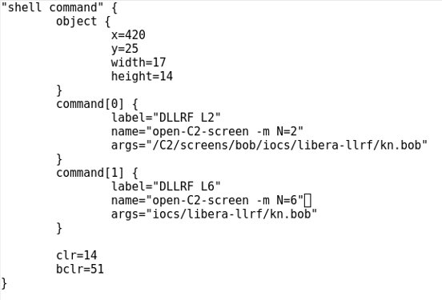
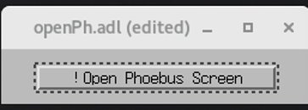
Open CSS Phoebus screen from medm
There are two way to add apply macro with command line.
The official way to call a CSS Pheobus screen from command line is
phoebus.sh -resource file:/path/to/file?MACRONAME=macrovalue
One can use another line
MACRONAME=macrovalue phoebus.sh -resource file:/path/to/file
But if you use env this way, when the phoebus.sh already running, and this command just add a screen the running CSS Phoebus , the env won't kick in.
When put the command line in medm screen or any script, one should use method two to avoid the problem
The "?" Is a special character in medm
The work-around would be using a shell script as the medium
phoebus.sh -resource file:$1?$2=$3
CTL group has open-C2-screen
open-C2-screen -m macro=value -m macro2=value2 file.bob
Andrew Johnson

