Slide 1
Phoebus Tools and Services
Kunal Shroff, Dimitri Gavrilov – NSLS2
Kay Kasemir – SNS
Georg Weiss, Sky Brewer, Lars Johansson – ESS
Ivan Finch - ISIS
Martin Gaughran – DLS
Katy Saintin, CAOUEN Loïc - CEA
Tynan Ford – ALS
Evan Daykin – FRIB
Jacqueline Garrahan – SLAC
Ralph Lange – ITER
Dariusz Jarosz – APS

Slide 2
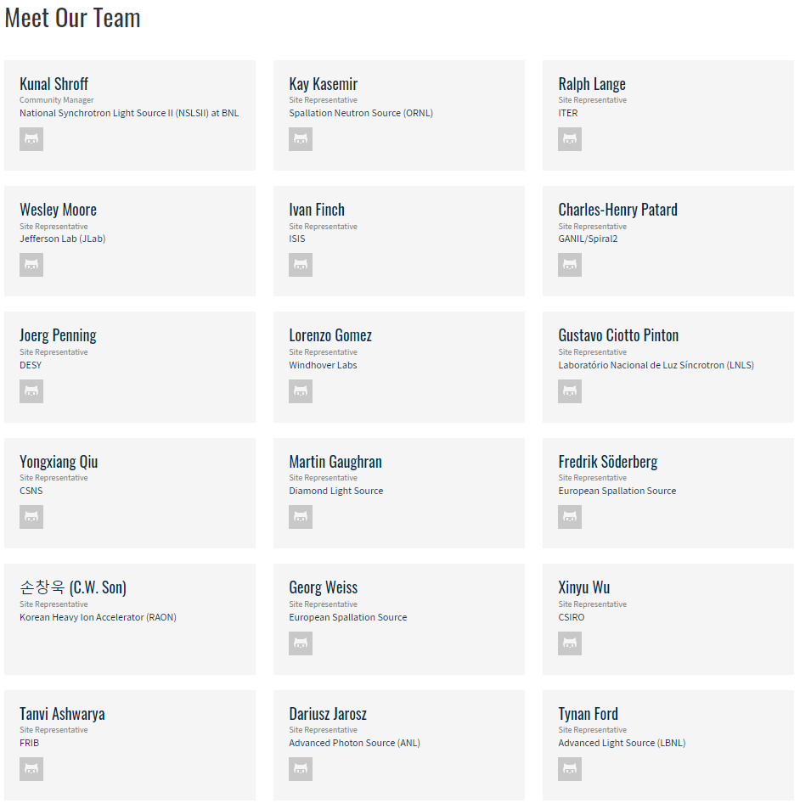
Phoebus / CS-Studio Collaboration
17+ sites actively packing a site-specific CS-Studio products or Participating in the development of one or more of the EPICS services
(NSLS2, SNS, ESS, FRIB, ALS, ITER, DLS, ISIS, CEA, NSRCC, KEK, FZB, DESY, CSNS, LNLS, ROAN, JLAB,…)
12+ sites/labs/institutions using prepackaged products
Additionally, many users who do not create their own products.

Slide 3
Phoebus Tools and Services
The Ecosystem
EPICS Tools
Phoebus
CS-Studio
EPICS core java:
Consists of Channel Access and PVAccess client libraries, utility libraries (epics-util, VType)
EPICS middle layer Services:
Archiver, Alarm, Save Restore, Channel Finder, Olog, …
EPICS tools:
CS-Studio & Phoebus
EPICS Service
Archiver, ChannelFinder
Save Restore, Olog,
Alarm
…
Notes:
Explain each of the modules

Slide 4
EPICS Tools
Phoebus
CS-Studio
EPICS Service
Archiver, ChannelFinder
Save Restore, Olog,
Alarm
…
EPICS Core Java
Notes:
Explain each of the modules

Slide 5
Phoebus Tools and Services
EPICS Tools
Phoebus
CS-Studio
The ChannelAccess libraries are stable
  Minor fixes
    Parsing tables, etc..
PVAccess libraries
  SNS Added Security
  ESS Expanded support for handling Tables
  STFC Included the use of `CompletableFuture`
Phoebus core-pv has 2 implementations of channel access connections
  jca & Jackie
  Validated our modular / pluggable claims
  This is a useful debugging and diagnostic option now
Future Plans
  deprecate PVAccessJava, PVDataJava, normativeTypesJava
  ChannelAccess Name Server using ChannelFinder
EPICS Service
Archiver, ChannelFinder
Save Restore, Olog,
Alarm
…
Notes:
Note that several methods return a CompletableFuture.
+ * This has been done because at this time the Futures used internally are indeed CompletableFutures
+ * and this type offers an extensive API for composition and chaining of futures.
+ * But note that user code must never call 'complete(..)' nor 'completeExceptionally()'
+ * on the provided CompletableFutures.

Slide 6
EPICS Tools
Phoebus
CS-Studio
EPICS Service
Archiver, ChannelFinder
Save Restore, Olog,
Alarm
…
Phoebus Middle Layer Services
Notes:
Explain each of the modules

Slide 7
Phoebus Tools and Services
EPICS Tools
Phoebus
CS-Studio
Standardization of middle layer services
Standardization Authentication Authorization
  spring-security (ldap, ActiveDirectory,…)
  ChannelFinder, Phoebus-Olog, Save and Restore
Standardization Documentation
  readthedocs
  Use swagger to generate REST API documentation
  Generate python clients using swagger
  https://github.com/mrakitin/pychannelfinder/
EPICS Service
Archiver, ChannelFinder
Save Restore, Olog,
Alarm
…
Notes:
Explain each of the modules

Slide 8
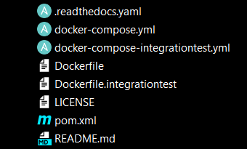
Phoebus Tools and Services
EPICS Tools
Phoebus
CS-Studio
Integration tests with Docker containers
Junit5 + Testcontainers
EPICS Service
Archiver, ChannelFinder
Save Restore, Olog,
Alarm
…
Notes:
Testcontainers for Java is a Java library that supports JUnit tests, providing lightweight, throwaway instances of common databases, Selenium web browsers, or anything else that can run in a Docker container.

Slide 9
Phoebus Tools and Services
EPICS Tools
Phoebus
CS-Studio
Alarm Annunciator
  Pluggable annunciator
  @Override
  public void speak(final AnnunciatorMessage message)
  The audio annunciator will play the audio files specified for the associated alarm severity levels. Currently supported formats are AIFF and WAV files.
Olog actions
  A pluggable interface allows adding specific operations to be performed when a Log entry is created
  e.g. send an email to xyz when a new log entry is created with a specific tag.
Save and Restore
  Check out Georg’s talk
EPICS Service
Archiver, ChannelFinder
Save Restore, Olog,
Alarm
…
Notes:
Explain each of the modules

Slide 10
EPICS Tools
Phoebus
CS-Studio
EPICS Service
Archiver, ChannelFinder
Save Restore, Olog,
Alarm
…
CS-Studio & Phoebus
Notes:
Explain each of the modules

Slide 11
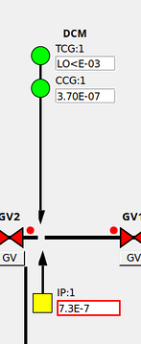
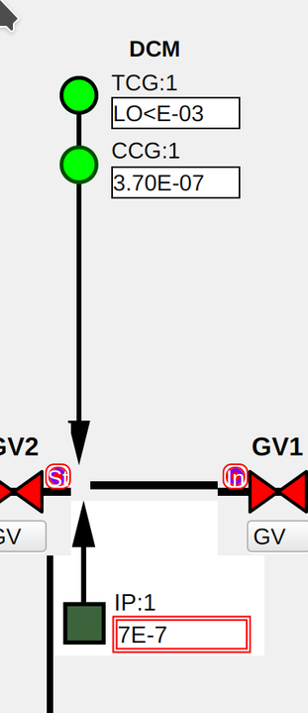
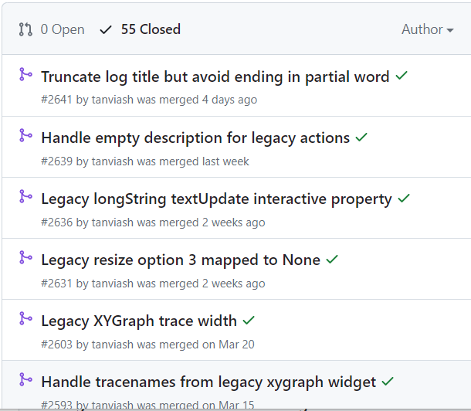
Converting screens
Vast majority of facilities have moved to Phoebus
(SNS, ESS, ISIS, ALS, CEA, HZB, …)
NSLS2
  All the beamlines and Accelerator will be moving to Phoebus by 2025
  25k screens
Expand the Phoebus Converter functionality
  to pre- and post-process the display files
  handle conversion of scripts by fixing the imports
  import "org.csstudio.display.builder" instead of "org.csstudio.opibuilder"
  recursive conversion

Slide 12

























Converted screens…but better
ITER icons
A group of engineering sysmbols
  Electrical, Fluid, Electronics, Civil Engineering, Integration and Controls
ISIS and NSLS2 adopting these symbols in conjunction with the Phoebus
Symbol & Text Symbol Widgets
Notes:
Symbols display an image, a glyph or a text depending on the value of their PVs.

Slide 13
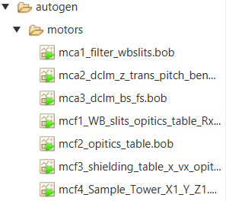

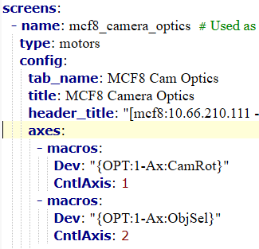
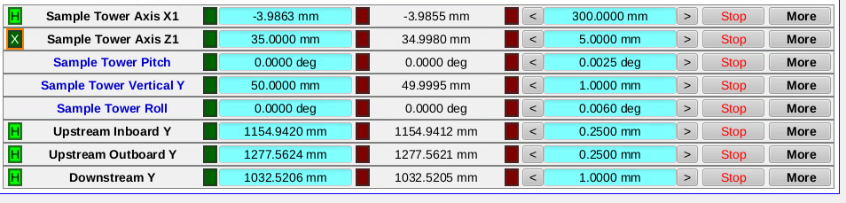
Converted screens…but better
ALS Phoebusgen
autogen.py
phoebusgen
Notes:
- name: mcf8_camera_optics # Used as file name. Must contain no spaces
type: motors
config:
tab_name: MCF8 Cam Optics
title: MCF8 Camera Optics
header_title: "[mcf8:10.66.210.111 - xf27id1-ioc1:5011] Camera Optics, Sample Tower Ry1, Rx1, Rz1"
directory: motors
margin_top: 20
margin_bottom: 20
margin_left: 15
margin_right: 15
axes_all:
controller: PowerPMAC
widget_desc_width: 200
widget_val_width: 150
show_home_status: true
macros:
Sys: "XF:27IDF-OP:1"
CntlSys: "XF:27IDF-CT"
CntlDev: "MC:08"
Mtr: "Mtr"
axes:
- macros:
Dev: "{OPT:1-Ax:CamRot}"
CntlAxis: 1
- macros:
Dev: "{OPT:1-Ax:ObjSel}"
CntlAxis: 2
- macros:
Dev: "{OPT:1-Ax:Focus2}"
CntlAxis: 3
- macros:
Dev: "{OPT:1-Ax:Focus1}"
CntlAxis: 4
- macros:
Dev: "{OPT:2-Ax:Focus}"
CntlAxis: 5
- macros:
Dev: "{OPT:2-Ax:CamRot}"
CntlAxis: 6
- macros:
Dev: "{SMPL:1-Ax:Ry1}"
CntlAxis: 7

Slide 14
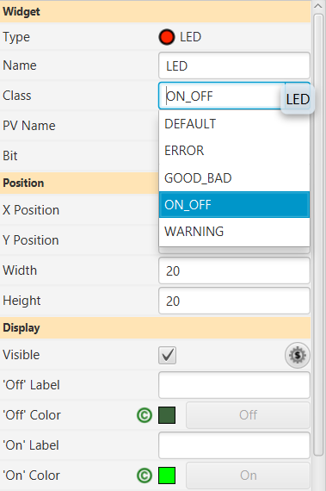
Converted screens…but better
.bcf
Use Widget classes
  Maintain a consistent look
  Reduce duplication of effort
Notes:
Symbols display an image, a glyph or a text depending on the value of their PVs.

Slide 15
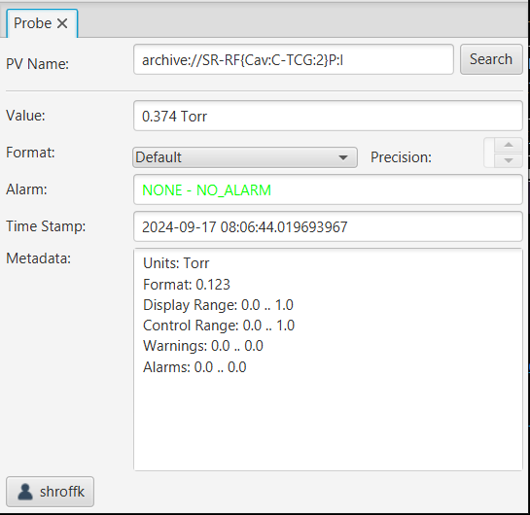
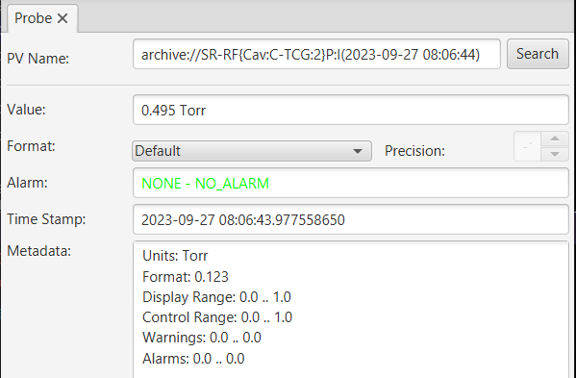
Archive DataSource
archive://
Retrieves a single archived value at a particular instant of time.
archive://pv_name
  Retrieves the latest value in the archiver.
archive://pv_name(time)
  Retrieves the last value at or before the specified "time".

Slide 16
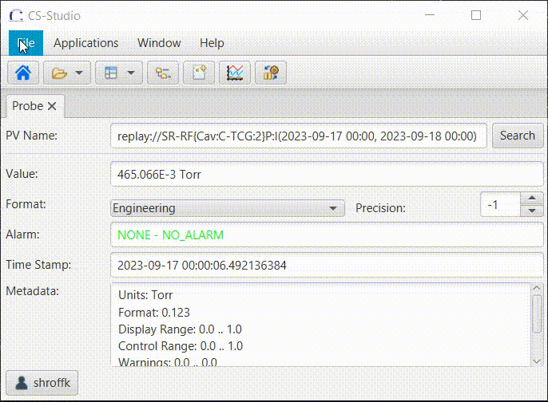
Archive DataSource
replay://
Creates a PV that recreates changes in values based on data from the archive.
replay://pv_name
(start, end, update_rate)
Recreates the PV value changes using the data from the archiver between the specified start and end times. Updates occur at the rate specified by `update_rate` (a value defined in seconds).

Slide 17
Archive DataSource
Use Cases
archive://pv_name(time)
  Creating Save and Restore Snapshots
  *Recreate Phoebus application states at a specific point of time (OPI’s, …)
replay://pv_name(start, end, update_rate)
  *Recreate the behavior of Phoebus applications
  *Simulate controls channels using real historical data

Slide 18
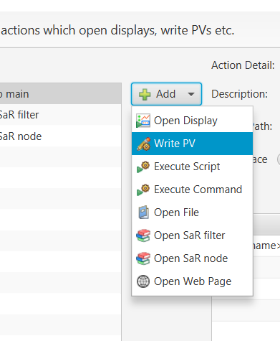
Pluggable actions
Expand the list of Display Builder Actions
  Interface for contributing an Action Operations
  Interface for contributing an Action Editor
e.g.
  Dedicated actions for Save and Restore operations

Slide 19
Pluggable actions
Benefits
Much easier to use
  Custom-made editor interface
More Efficient
  Use the features and functionality provided by the Phoebus framework
    Scheduling and Concurrency support - Jobs
    Credential management
    Connection pools
      PV’s
      rest clients
    Type definitions
Safer
  OPI screen developers don’t have to add manage thread, connection, etc…

Slide 20
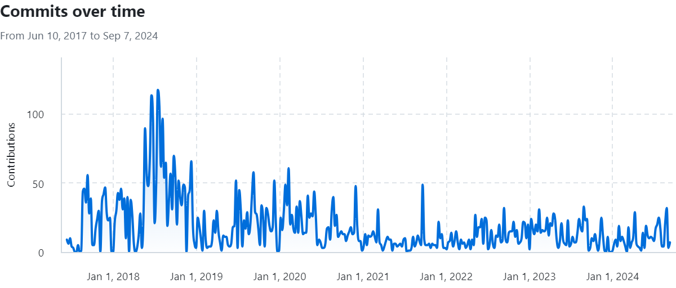
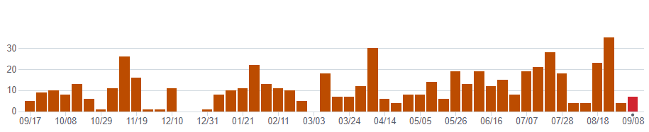
Phoebus Tools and Services
EPICS Tools
Phoebus
CS-Studio
EPICS tools:
CS-Studio & Phoebus
EPICS Service
Archiver, ChannelFinder
Save Restore, Olog,
Alarm
…
Notes:
Explain each of the modules

Slide 21
Phoebus Tools and Services
EPICS Tools
Phoebus
CS-Studio
EPICS tools:
CS-Studio & Phoebus
Phoebus is in production at multiple sites
Drinks for contributors!!
  XavSPM
  Mathis-Hu
  Smarsching
  mgotz
  Daykin
  jbellister-slac
  hboutemy
  ptsOSL
EPICS Service
Archiver, ChannelFinder
Save Restore, Olog,
Alarm
…
Notes:
Explain each of the modules

Slide 22
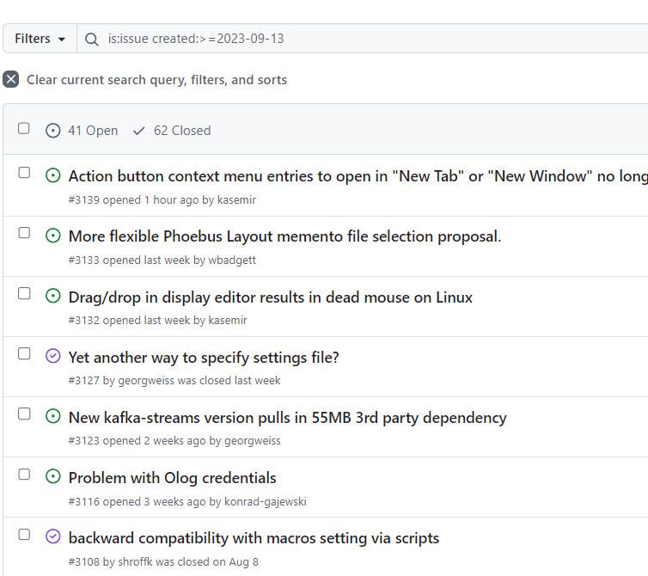
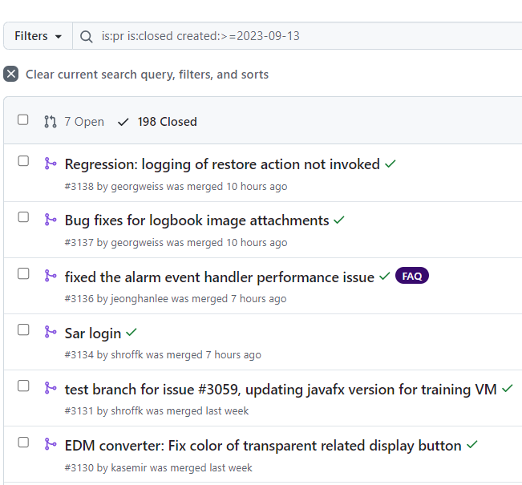
Collaboration Status
Phoebus
  ~200 PR’s
  ~100 Issues with 80% closed in 2 weeks
ChannelFinder, Phoebus-Olog, …
https://github.com/ControlSystemStudio

Slide 23
Next Steps
Eclipse based CS-Studio supported till Oct, 2025
Preparing release 4.7.4
JavaFX 22 and JDK 17

Slide 24
How to contribute
GitHub Issues
Monthly meetings on the 2nd Wednesday of each month.

Slide 25
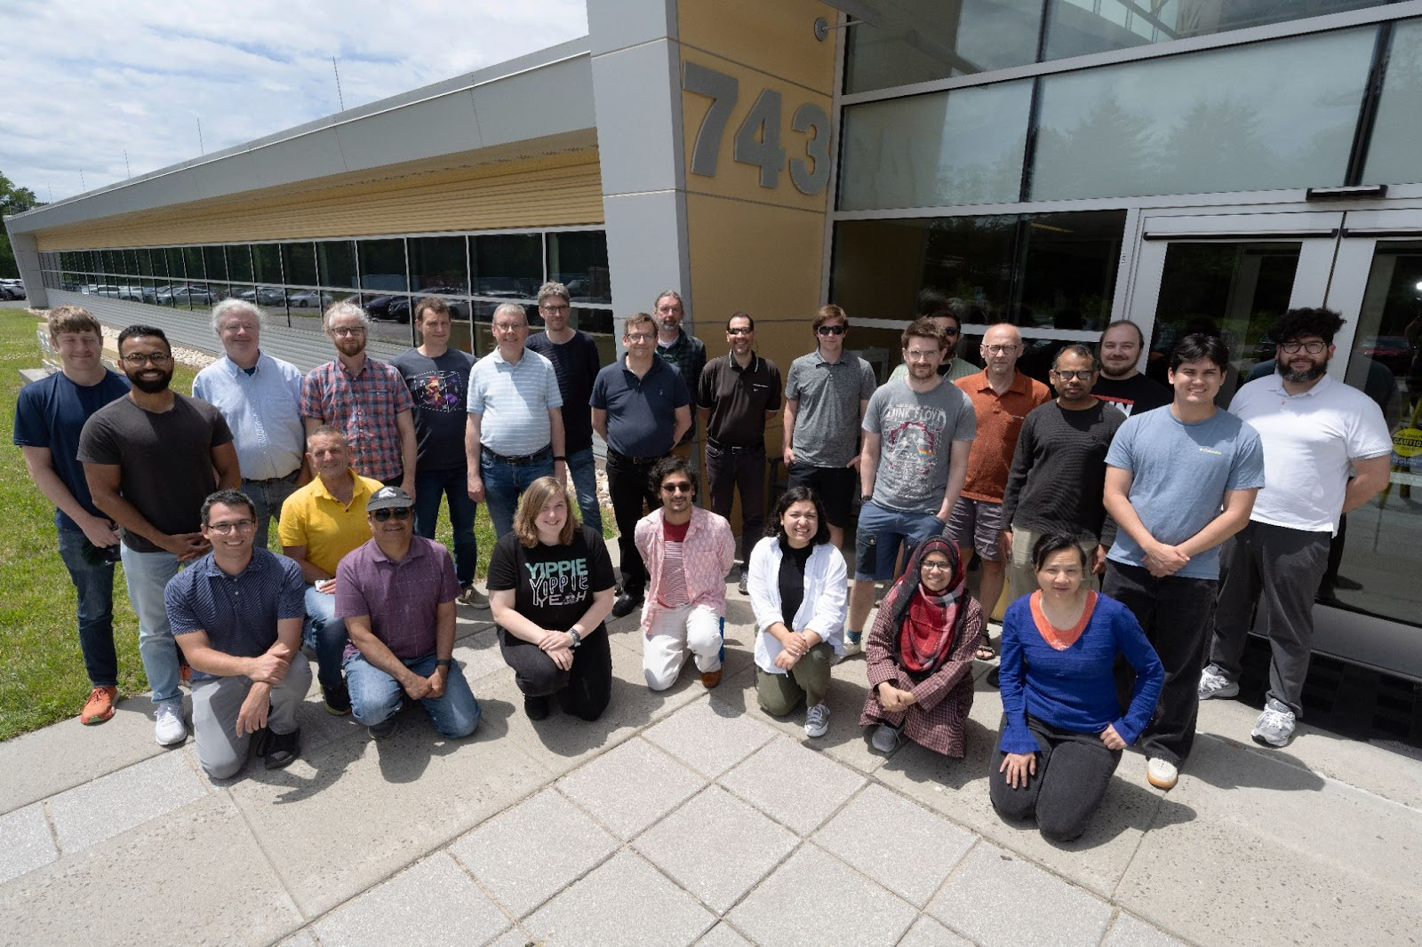
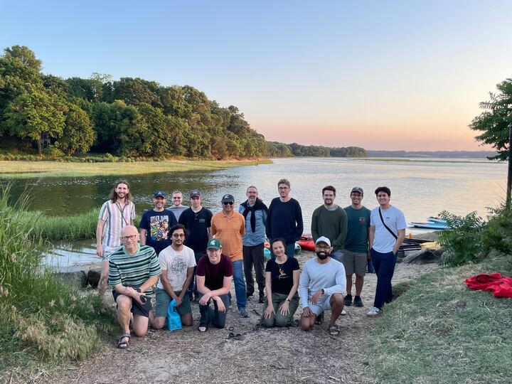
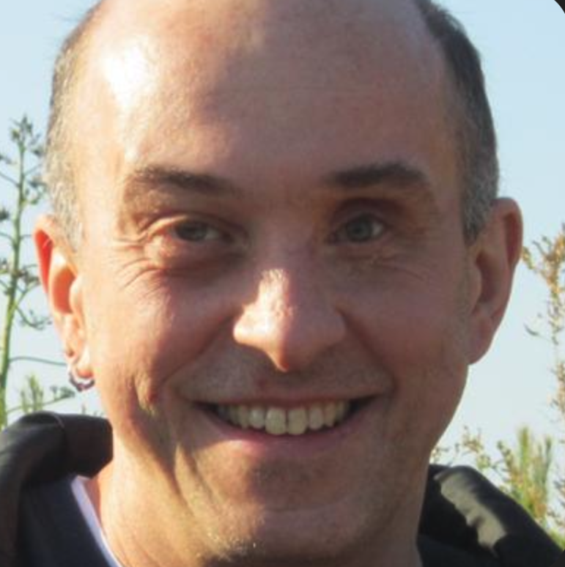
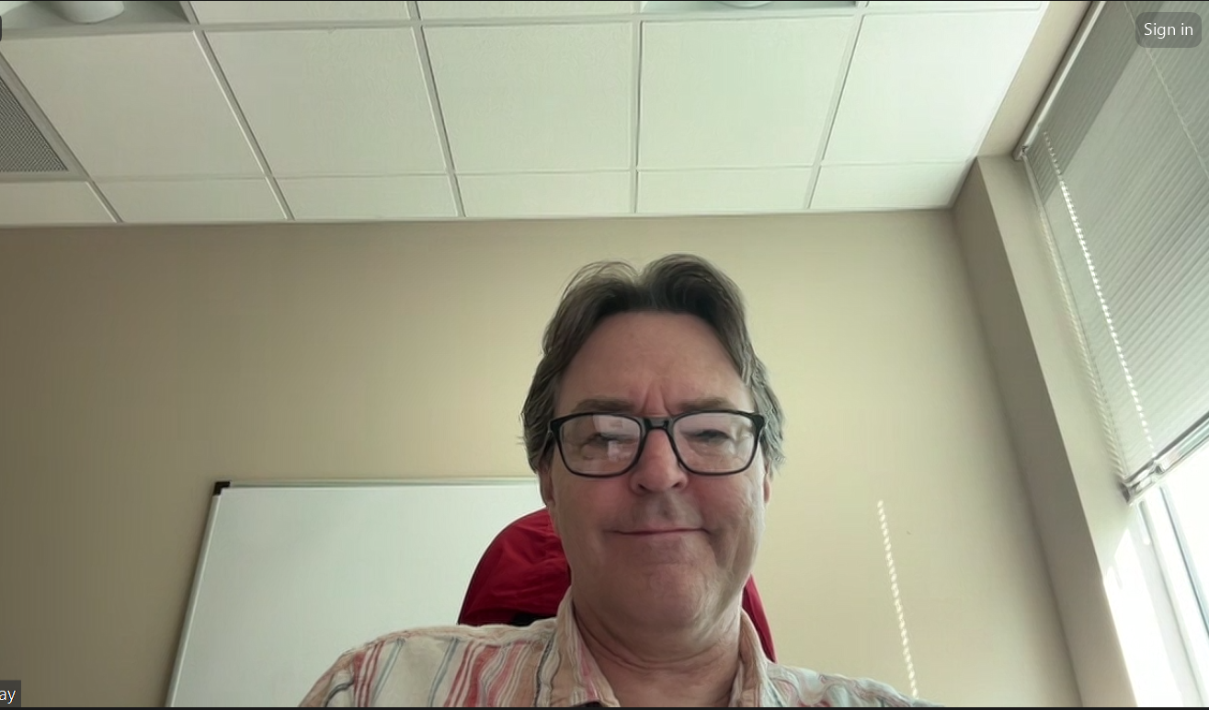
Developers Meeting
June 2024
26 in person + 2-3 remote participants

Slide 26
Developers Meeting
Epics core session
Phoebus tools and services session
Common Session
  Documentation
  Protocol related topics
    Security, Types, etc…
Complete Meeting Minutes
Notes:
Manifest Reality
the idea that you can make your dreams and goals a reality by believing you can achieve them.

Slide 27
Developers Meeting
Anything we can do to increase the longevity of Phoebus?
  We cannot control graphics libraries (X, Motif, SWT, JFX, …)
We can try to limit dependencies
Well-structured code
  Shared development allowed moving from Eclipse to Phoebus in a few years. Harder for site-specific additions
Modular architecture
  Pluggable Action Button
  CEA proposed additional customization of automated actions for alarms.
A plan for community owned and maintained training infrastructure and resources
Fix controls system studio website
Notes:
Manifest Reality
the idea that you can make your dreams and goals a reality by believing you can achieve them.

Slide 28
Developers Meeting
ChannelFinder
  Completed the changes to recsync + ChannelFinder to have a Name server based on ChannelFinder: PVAccess Name server prototype ( work on Channel Access name server is on going )
Epics Archiver Appliance
  Converted Epics Archiver Appliance documentation to readthedocs.org (Pull request #243)
  Closed all open PR’s and fixed some small regression bugs in the Epics Archiver Appliance; it is significantly closer to being beta. Should be able to release a beta version in a couple of weeks.
  Moved all the python2 scripts to python3 ( sample scripts - done, policies.py - ongoing)

Slide 29
Developers Meeting
Hands on introduction to the technology stack
  Shout out to Tynan, Max, Loïc, Katy, for mentoring new members
  Timo for helping us learn how write things nice
Upcoming Codeathon Hosted by Diamond Light Source,
February 24-28, 2025

Slide 30
Useful links
https://controlsystemstudio.org/
http://phoebus.org
Fork us on github
https://github.com/ControlSystemStudio
ChannelFinder
http://channelfinder.github.io/
Olog
https://github.com/Olog
SaveRestore, Alarm Services, Scan Server
https://github.com/ControlSystemStudio/phoebus/tree/master/services

