Slide 1

EPICS at ORNL
Karen S. White
Doug Curry, Steven Hartman, Claudell Harvey, Kay Kasemir, Rob Knudson, Bogdan Vacaliuc
September 17, 2024

Slide 2
Progression of EPICS in Neutron Sciences at ORNL
Early
2000s
EPICS is selected for SNS machine during early design phase
Also selected for SNS beamlines, but this changed
2006
SNS machine commissioned with EPICS
Reliability improvements
2013-2019
2018 - now
Conversion of beamline controls to EPICS
Conversion of HFIR beamlines to EPICS

Slide 3
EPICS expands beyond Neutron Sciences
EPICS for other projects at ORNL
STS new target station for SNS
MPEX fusion project
US-ITER (to follow ITER standards)

Slide 4
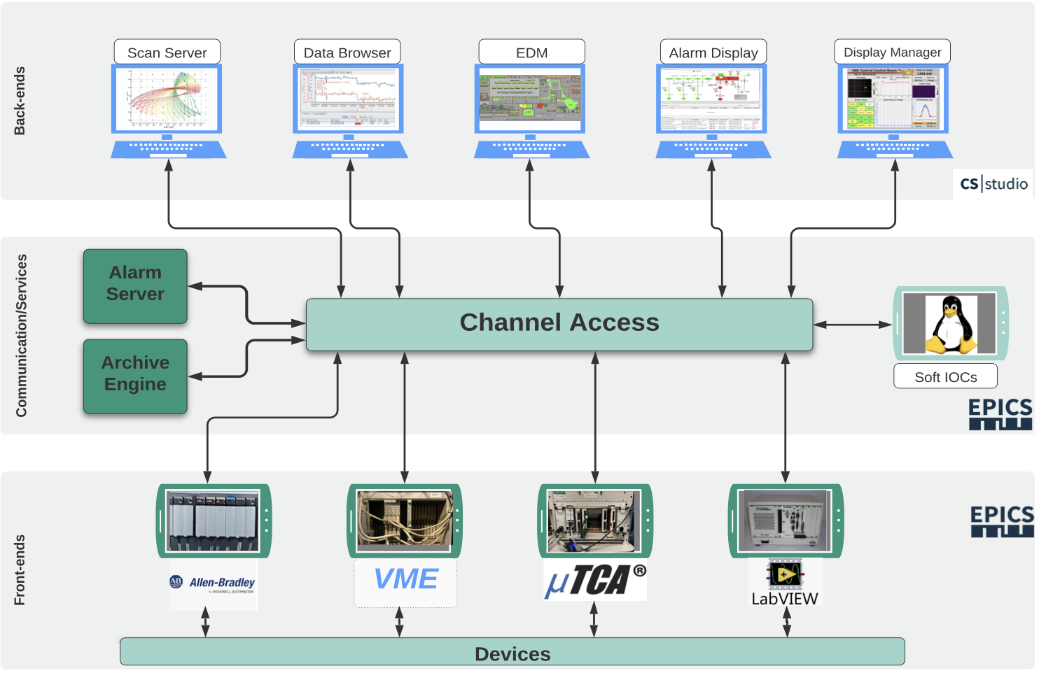
SNS Machine
Converting to CSS DM
Add PV Access
Upgrade to EPICS 7

Slide 5
SNS Machine
Recently completed controls for Power Upgrade Project
Keep up with growth (size of system is more than double original)
Continuing modernization efforts
  Replaced timing and MPS systems
  Renewed infrastructure
  Virtualization, added storage
  Working on growing cybersecurity challenges
Phasing out VME => soft IOCs, PLCs, µTCA
Replacing 15-year-old PLC hardware and communications modules

Slide 6
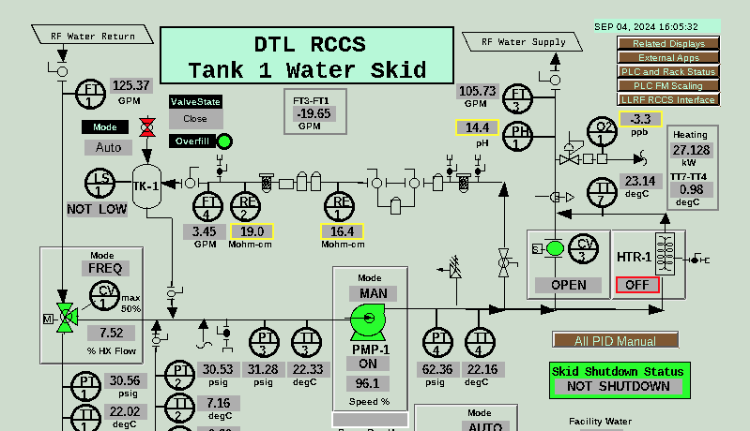
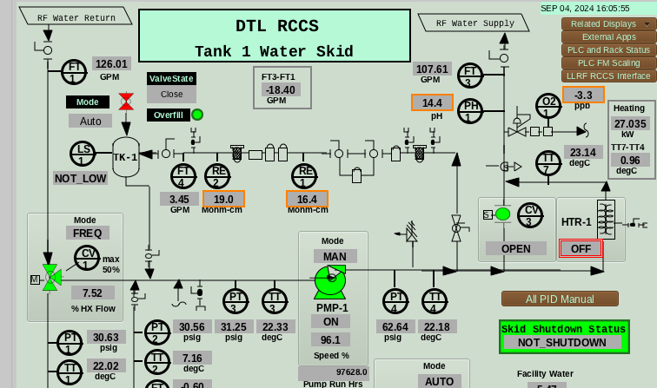
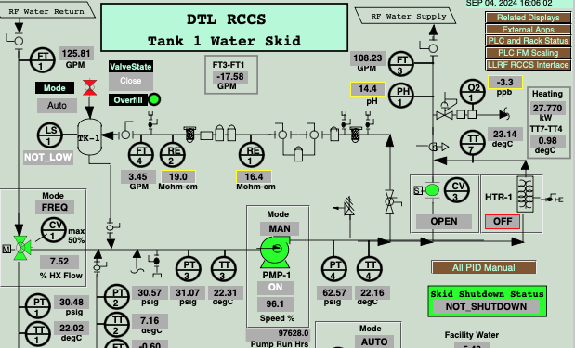
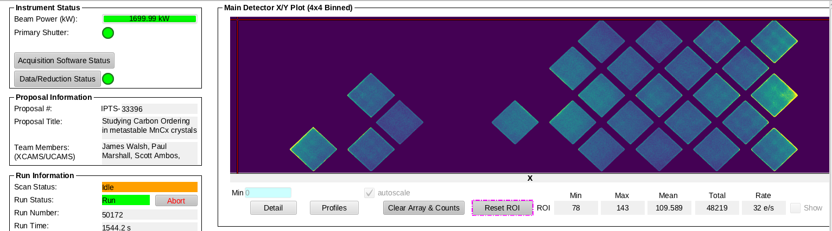
Display Evolution
EDM
Phoebus
Early SNS contributions used MEDM
Accelerator was built with EDM
Instruments, adopting EPICS later,
used CS-Studio/Eclipse
All now use CS-Studio/Phoebus for alarms, archive, and new displays
  Phoebus can open most EDM displays,
  but EDM still prevalent
Remote EDM viewing via Web-EDM (Ryan Slominski, JLab)
Remote CS-Studio displays via
Display Builder Web Runtime
Web-EDM
Phoebus (or Display Builder Web Runtime?)

Slide 7
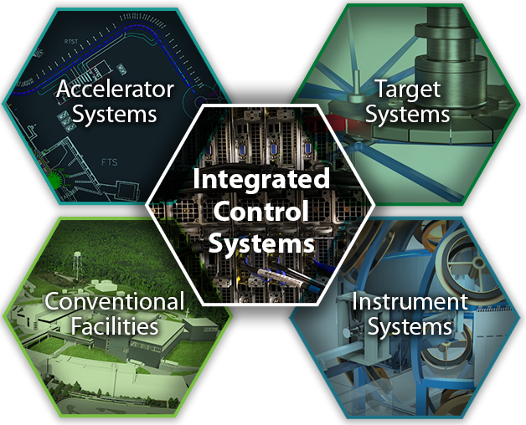
The STS Project will deliver the brightest source of cold neutrons with an initial suite of 8 instruments
Integrated Control Systems
provide the control systems, data acquisition, computing, and safety systems across accelerator, target, neutron instrument systems, and conventional facilities
The STS control systems must retain interoperability
with the existing EPICS based control systems at SNS

Slide 8
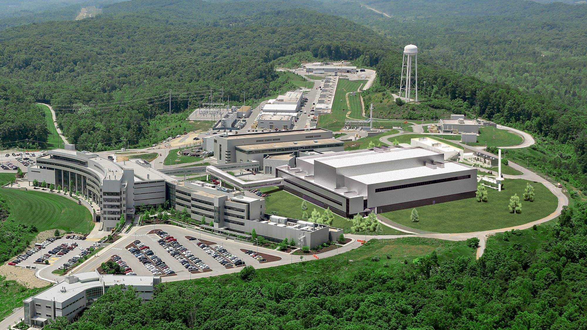
The $2B STS Project anticipates initial operations ~2033 with project completion by 2039
Given the long project duration, a major focus for controls is addressing obsolescence and ensuring continued viability for the EPICS toolkit
  Timing System and Run Permit System
  Port IOCs from VME/vxWorks
  to µTCA, "Real Time" Linux
  PVA, Java implementation
    Complete library update (core.pva)
    IPv6 capability
    TLS encryption

Slide 9
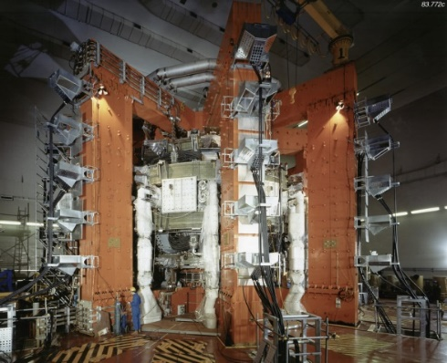
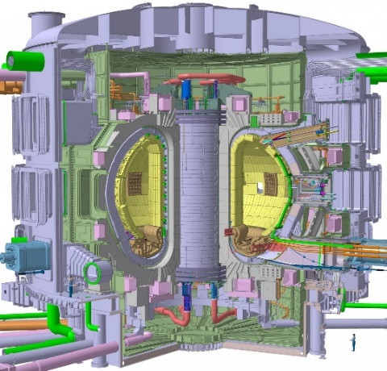
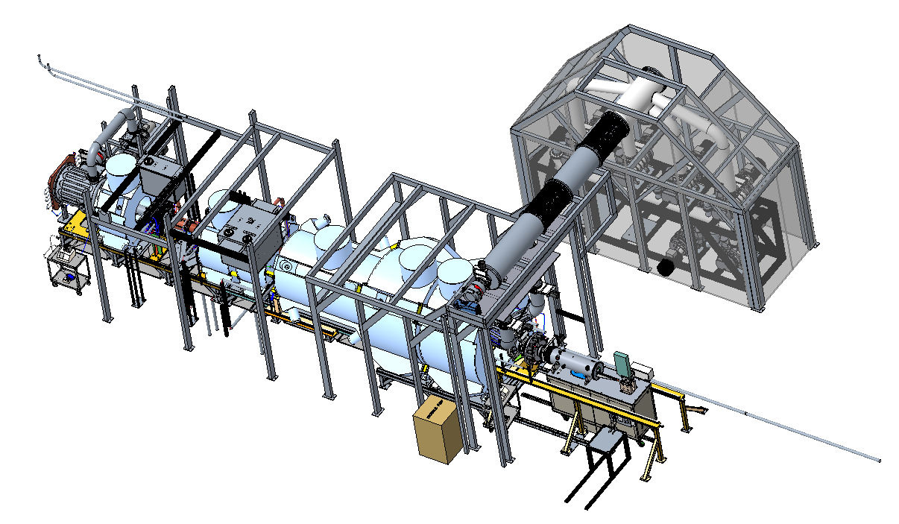
MPEX - Material Plasma Exposure eXperiment; tool for understanding challenges for divertor plasma facing components
JET ITER Fusion Reactor
5000x ion fluence
10⁶x neutron fluence
5x ion fluence
100x neutron fluence
MPEX will advance plasma facing materials up to end of lifetime studies
Notes:
ITER burning plasma in 2035

Slide 10
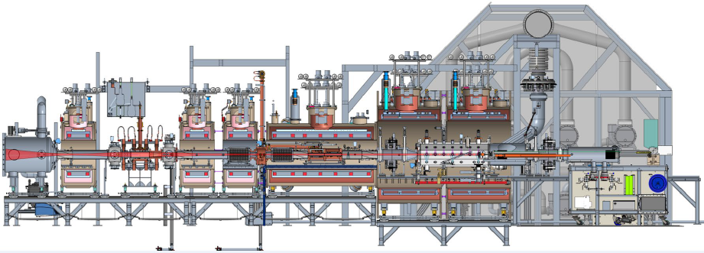
MPEX Overview
Main vacuum Pumping
400 kW electron heating
175 kW plasma source
310 kW ion heating
Room temperature coils
Superconducting coils
Target Exchange Cart

Slide 11
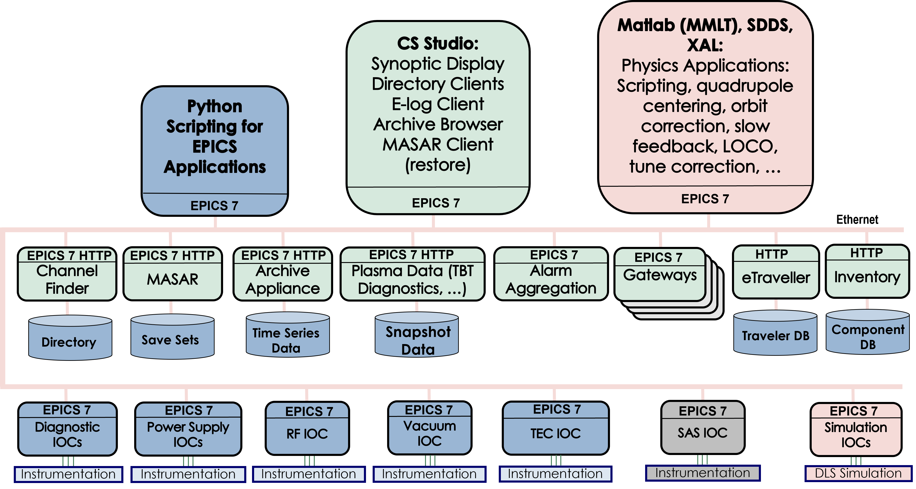
MPEX I&C Requirements
The MPEX I&C central operating station provides for the unified operation of MPEX from a central location.
  Distributed control system
There will be alarm and response systems.
  Alarm Manager
Record all system control actions.
  Archive Appliance
The control shall monitor and control the MPEX vacuum system, RF systems, cooling systems, gas fueling, magnet assemblies, and cryogenics systems.
  Synoptic displays
The MPEX data storage systems comprise databases which store the operational and scientific data.
  Save and restore
  Synchronous acquisition

Slide 12
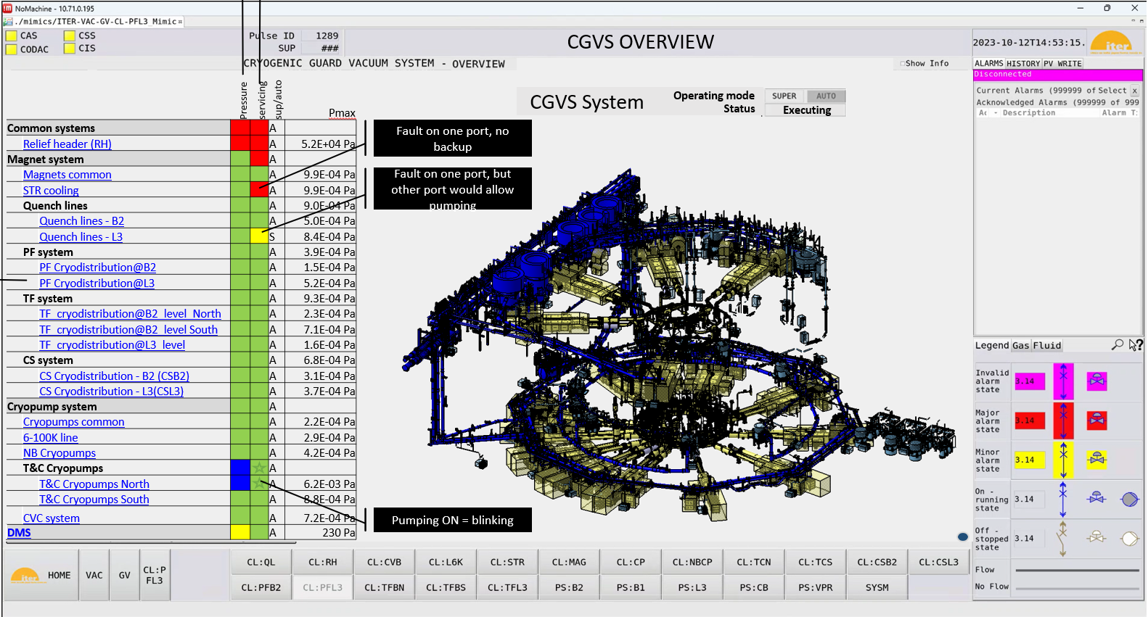
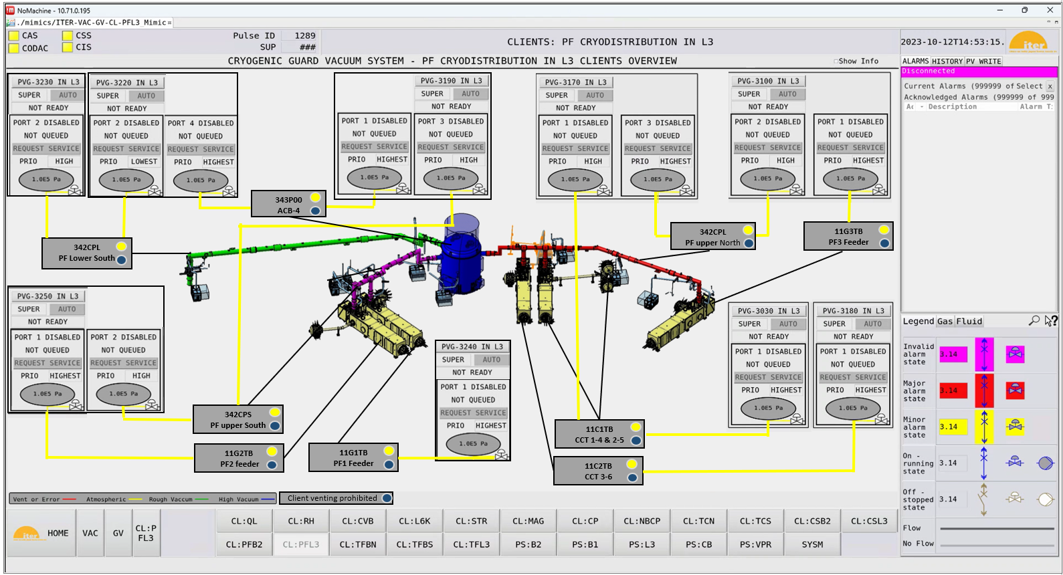
US-ITER
WBS 1.09.03.02 I&C VAS Technical Progress to Date on Authorized Hardware Deliverables
VAS.02 CGVS Software Development with Cosylab, Inc., Ljubljana, Slovenia
Software development complete, preparing for FAT
CGVS Overview Screen
ORNL project for the US contributions to ITER follows ITER established control systems standards including the use of EPICS
CGVS Level 3 (L3) Clients Overview Screen

Slide 13
Conclusion
SNS built by a collaboration of six partner labs; all delivered their components with EPICS controls
ORNL is effectively leveraging EPICS success at SNS to build new projects
All groups benefit from the accumulated staff experience and the EPICS collaboration
Contributing to CS-Studio development
Communication between groups helps to prevent duplication of effort
Having expertise in eight groups also helps to staff peak loading on projects
What’s next?

