Slide 1
EPICS-IPMI Device Support Module
Intelligent Platform Management Interface
Operational experience and difficulties at SNS
Brad Webb
Klemen Vodopivec
September 2024

Slide 2
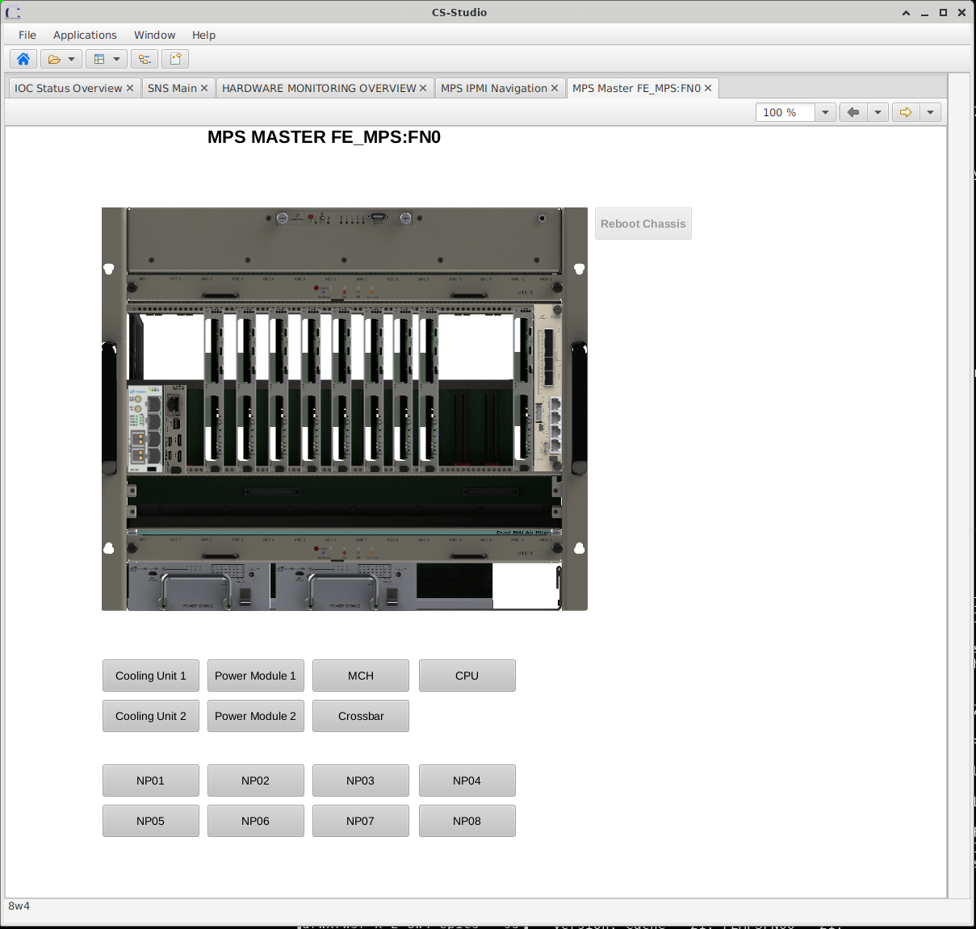
IPMI Sensors Overview
IPMI uses a sensor model:
  To provide access to monitored information:
    Temperatures
    Voltages
    Fan statuses
    Etc.
Sensor data types:
  Analog
    Temperature
    Voltage
    Fan RPM
  Discrete (Multiple States)
    Hot Swap
    Redundancy
    Presence
    Fault
Hardware Chassis
BMC
Local IPMI Bus, IPMB
Power Module
Voltage
Current
Temperature
Fault
Presence
Cooling Unit
Temperature
Current
Fan Speed
Presence
Other FRUs
Sensor 1
Sensor 2
Sensor <n>

Slide 3
IPMI SDR Repository Overview
Every IPMI device keeps a repository of its sensors
Stored in the format of a Sensor Data Record (SDR)
Each record contains information about the sensor
  Name, type, owner, etc.
Each record is uniquely identified by a record ID number
Inform software what is supposed to be installed/present
freeipmi-1.6.14/sbin/ipmi-sensors -D LAN -h 172.31.138.1 -u "" -p "" -W authcap --bridge-sensors -r 194 -v
Record ID: 194
ID String: CU TEMP2
Sensor Type: Temperature (1h)
Sensor Number: 17
IPMB Slave Address: 41h
Sensor Owner ID: 82h
Sensor Owner LUN: 1h
Channel Number: 0h
Entity ID: cooling unit/cooling domain (30)
Entity Instance: 97
Entity Instance Type: Physical Entity
Event/Reading Type Code: 1h
Lower Critical Threshold: N/A
Upper Critical Threshold: 80.000000 C
Lower Non-Critical Threshold: N/A
Upper Non-Critical Threshold: 65.000000 C
Lower Non-Recoverable Threshold: N/A
Upper Non-Recoverable Threshold: 81.000000 C
Sensor Min. Reading: -64.000000 C
Sensor Max. Reading: 191.000000 C
Normal Min.: N/A
Normal Max.: N/A
Nominal Reading: N/A
Sensor Reading: 32.000000 C
Sensor Event: 'OK'

Slide 4
Problems with the IPMI SDR repository
Sensor names are not unique
Sensor numbers are not unique
SDR rebuilds itself dynamically
  Reindexes sensor numbers
  Reindexes record-IDs
This makes addressing sensors difficult
Even ipmitool has an issue with duplicate names

Slide 5
IPMI Entities…
Code |  | Entity
10 | 0Ah | Power Supply
29 | 1Dh | Fan / Cooling Device
30 | 1Eh | Cooling Unit
freeipmi-1.6.14/sbin/ipmi-sensors -D LAN -h 172.31.138.1 -u "" -p "" -W authcap --bridge-sensors -r 194 -v
Record ID: 194
ID String: CU TEMP2
Sensor Type: Temperature (1h)
Sensor Number: 17
IPMB Slave Address: 41h
Sensor Owner ID: 82h
Sensor Owner LUN: 1h
Channel Number: 0h
Entity ID: cooling unit/cooling domain (30)
Entity Instance: 97
Entity Instance Type: Physical Entity
Event/Reading Type Code: 1h
Lower Critical Threshold: N/A
Upper Critical Threshold: 80.000000 C
Lower Non-Critical Threshold: N/A
Upper Non-Critical Threshold: 65.000000 C
Lower Non-Recoverable Threshold: N/A
Upper Non-Recoverable Threshold: 81.000000 C
Sensor Min. Reading: -64.000000 C
Sensor Max. Reading: 191.000000 C
Normal Min.: N/A
Normal Max.: N/A
Nominal Reading: N/A
Sensor Reading: 32.000000 C
Sensor Event: 'OK'

Slide 6
The EPICS Interface
//st.cmd
ipmiConnect “dev1” “1.2.3.4” “user” “password” “auth-type” “lan”
Map Records to sensors
//xxx.db
Record(ai, “Dev1:CU1_TEMP2”)
{
field(DTYP, “ipmi”)
field(INP, “@dev1 sensor 30:97 ‘CU TEMP2’”)
}
Record(ai, “Dev1:CU2_TEMP2”)
{
field(DTYP, “ipmi”)
field(INP, “@dev1 sensor 30:98 ‘CU TEMP2’”)
}

Slide 7
MPS Master Chassis

Slide 8
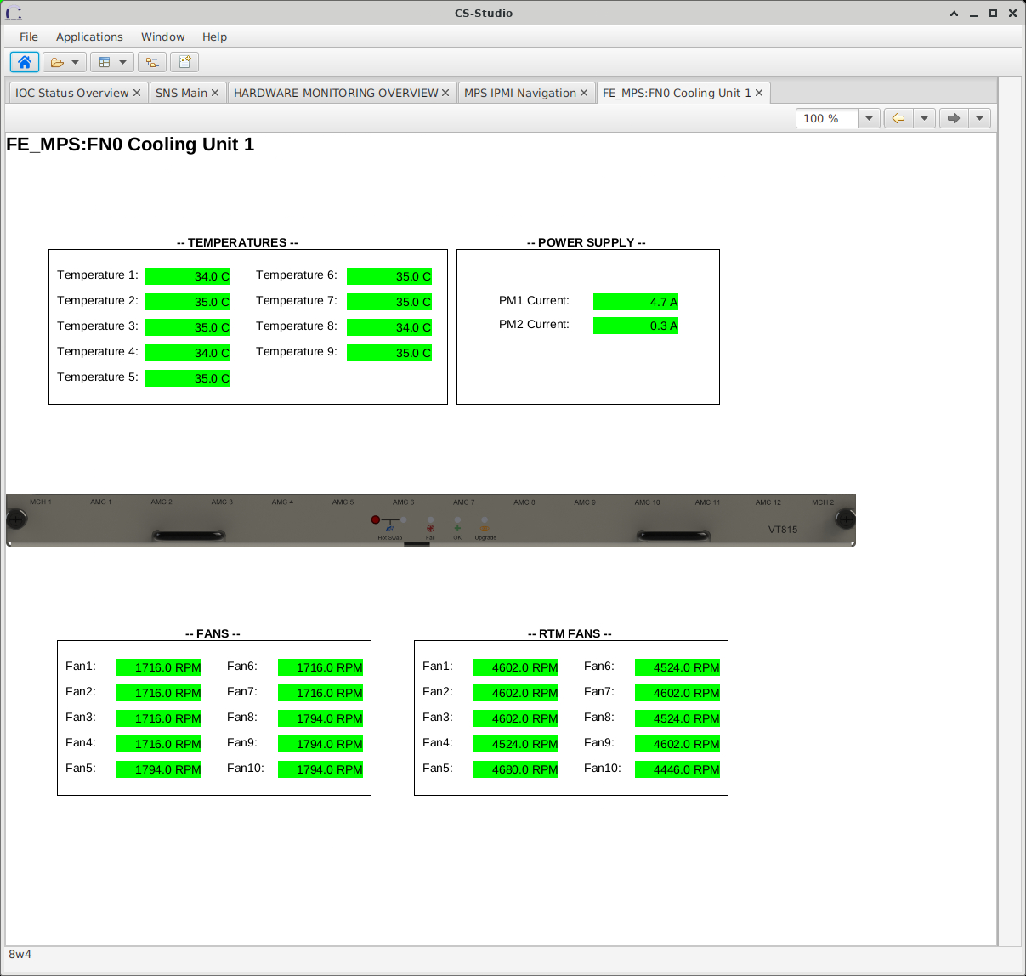
MPS Master Cooling Unit 1

Slide 9
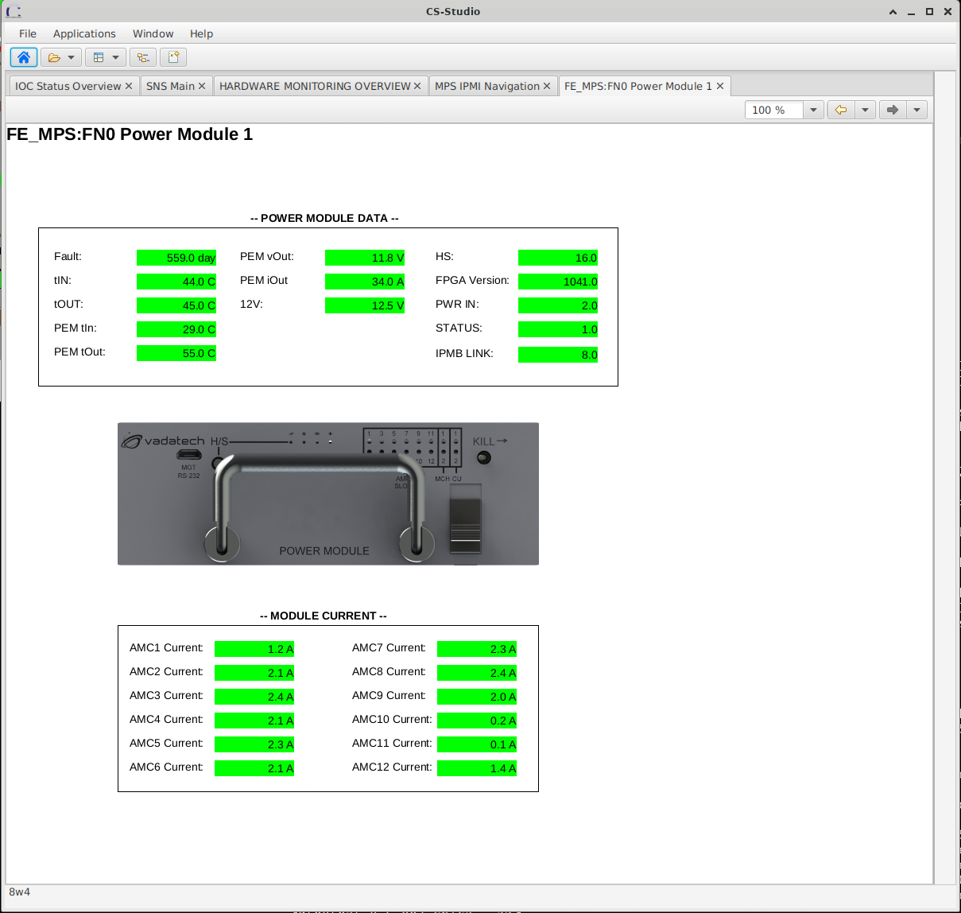
MPS Master Power Module 1

Slide 10
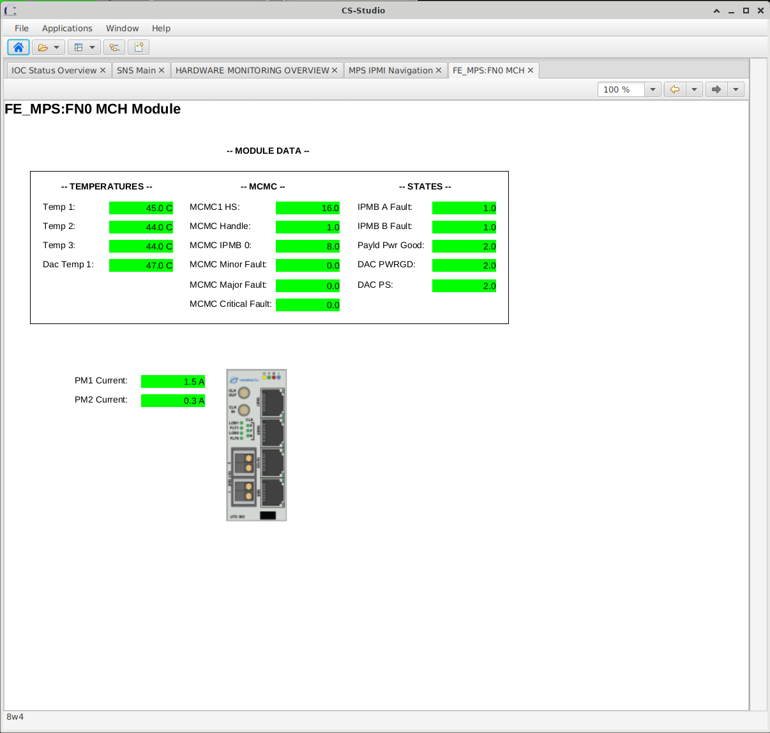
MPS Master MCH Module

Slide 11
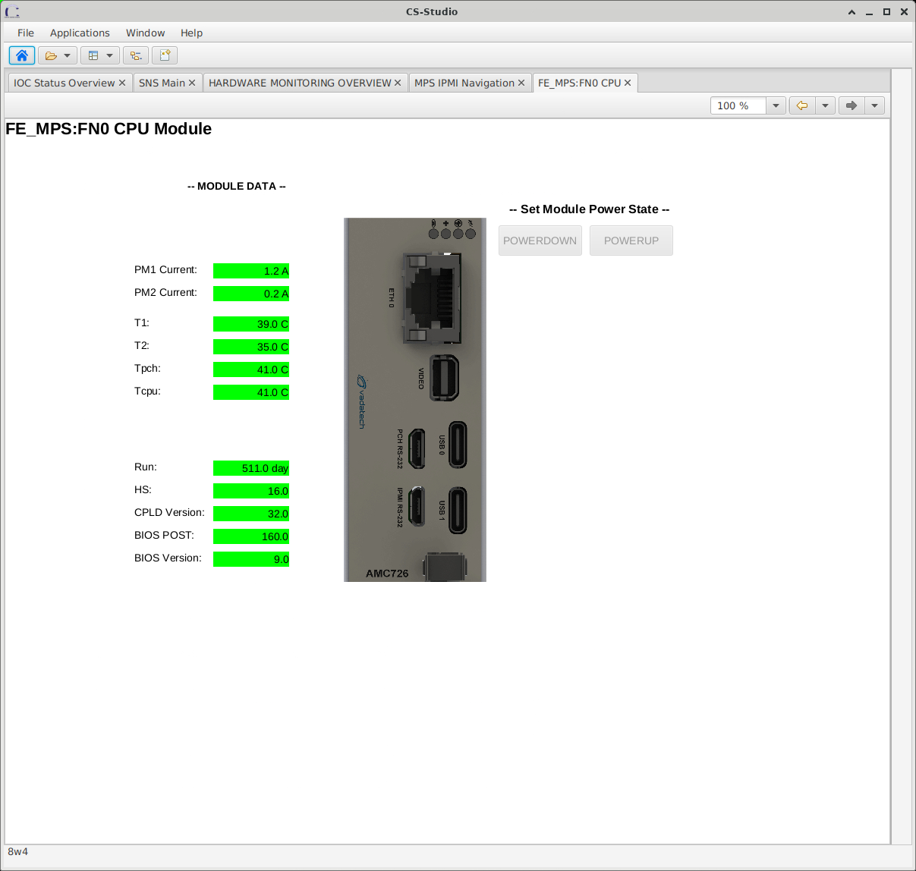
MPS Master CPU Module

Slide 12
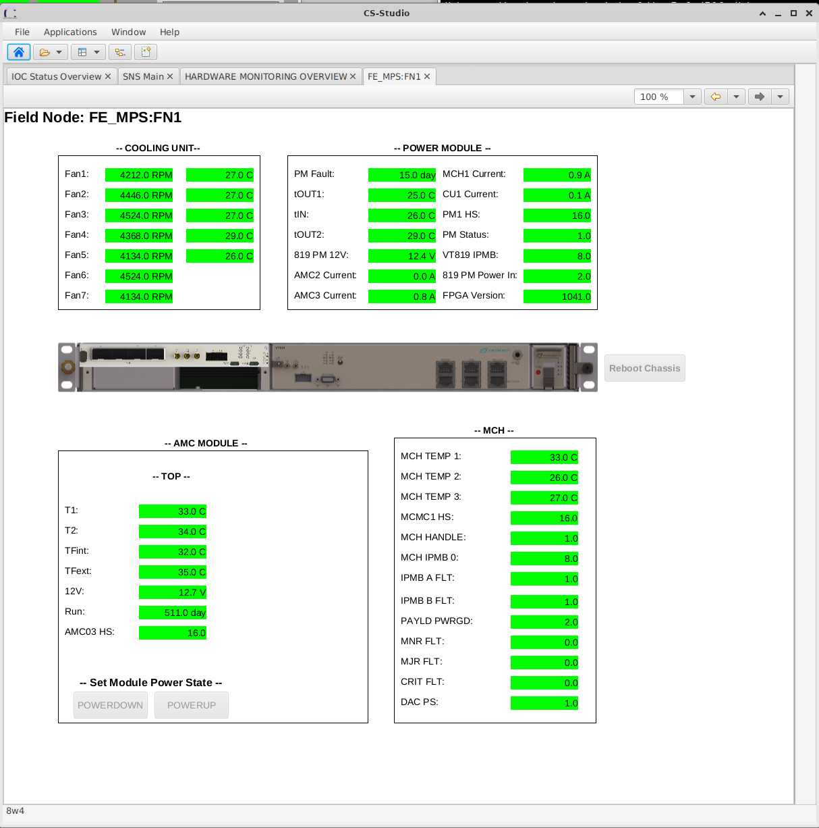
MPS Field Node Chassis

Slide 13

What’s Under the Hood?
EPICS uses the GNU Free IPMI Library
https://www.gnu.org/software/freeipmi/
A complete IPMI API to:
  Connect to an IPMI device
  Read the SDR
  Get Sensor Readings
  Access FRU data
  Build packets
  Send raw commands
  And more…

Slide 14
Pros and Cons to using Free IPMI
Pros:
Reliable
Stable
Built-in workarounds
  Essential for vendor compliance issues.
Cons:
High CPU
  47 devices (51 PVs per)
  2400 ai PVs
  Scanning @1s
  Consumes 100% CPU

Slide 15
Database tool in device support
Usage: report-sdr [-H hostname or ip address] [-u username] [-p password]
[--auth-type [none, plain, md2, md5]] [--privilege-level [admin, operator, user]]
[--create-report-file [FILE NAME]] [--create-db-file [FILE NAME]]
Description
Read the SDR (Sensor Device Repository) and display the sensor records.
Options:
-H Hostname or IP address (DNS name or 123.456.789.123)
-u Username
-p Password
--auth-type Authentication Type (none, plain, md2, md5)
--privilege-level Privilege Level (admin, operator, user)
--create-report-file Create a file that contains the SDR data
--create-db-file Create an EPICS database file from the SDR data
Examples:
To print the SDR to the console:
./report-sdr -H 192.168.201.205 -u "ADMIN" -p "Password0" --auth-type md5 --privilege-level admin
To create an EPICS database from the SDR:
./report-sdr -H 192.168.201.205 -u "ADMIN" -p "Password0" --auth-type md5 --privilege-level admin --create-db-file /tmp/server.db

Slide 16
report-sdr Tool
FRU 40 'VT VT103' [65, 0, 0, 1, 0, 30, 97]
Sensors attched (32)
[40:1]
* ID-String: 'CU TEMP1’,
* Record-Id: 179,
* Sensor-Owner-Id-Type: 'IPMB_SLAVE_ADDRESS' (0),
* Sensor-Owner-Id: 65,
* Sensor-Owner-LUN: 1,
* Channel Number: 0,
* Sensor Number: 2,
* Entity-Id: 'Cooling Unit' (30),
* Entity Instance: 97,
* Sensor Type: 'Temperature' (1)
* Event/Reading Type Code: 'Threshold' (1)
[40:2]
* ID-String: 'FAN6’,
* Record-Id: 184,
* Sensor-Owner-Id-Type: 'IPMB_SLAVE_ADDRESS' (0),
* Sensor-Owner-Id: 65,
* Sensor-Owner-LUN: 1,
* Channel Number: 0,
* Sensor Number: 7,
* Entity-Id: 'Fan' (29),
* Entity Instance: 97,
* Sensor Type: 'Fan' (4)
* Event/Reading Type Code: 'Threshold' (1)

Slide 17
report-sdr Tool to build EPICS database
./report-sdr -H 172.31.138.1 -u "" -p "" --privilege-level admin --create-db-file /tmp/dev1.db
record(ai, "$(P):FRU40_CU_TEMP1")
{
field(DTYP, "ipmi")
field(INP, "@<dev> sensor 30:97 'CU TEMP1’”)
field(SCAN, "1 second")
field(EGU, "C")
field(PREC, "1")
}
record(ai, "$(P):FRU40_FAN6")
{
field(DTYP, "ipmi")
field(INP, "@<dev> sensor 29:97 'FAN6’”)
field(SCAN, "1 second")
field(EGU, "RPM")
field(PREC, "1")
}

