Slide 1
Integrating Machine Learning Models into EPICS
Kathryn Baker (k.baker@stfc.ac.uk)
On behalf of Mateusz Leputa (mateusz.leputa@stfc.ac.uk), Kathryn Baker
EPICS Collaboration Meeting September 2024 - ORNL
19 September 2024

Slide 2
Overview
Why ML in EPICS?
What did we do before?
Current Solution
Lume-deployment Overview
Repeatability with cookiecutter
Results
Future Work

Slide 3
Why Integrate ML Models into EPICS?
Creation of ‘virtual’ components
  Offline interface testing
  Offline application testing
Integrates with existing tools
  Display using Phoebus, CS Studio, PyDM
  Out of the box archiving (if required)
Offline operator training opportunities
Fewer Interfaces to manage

Slide 4
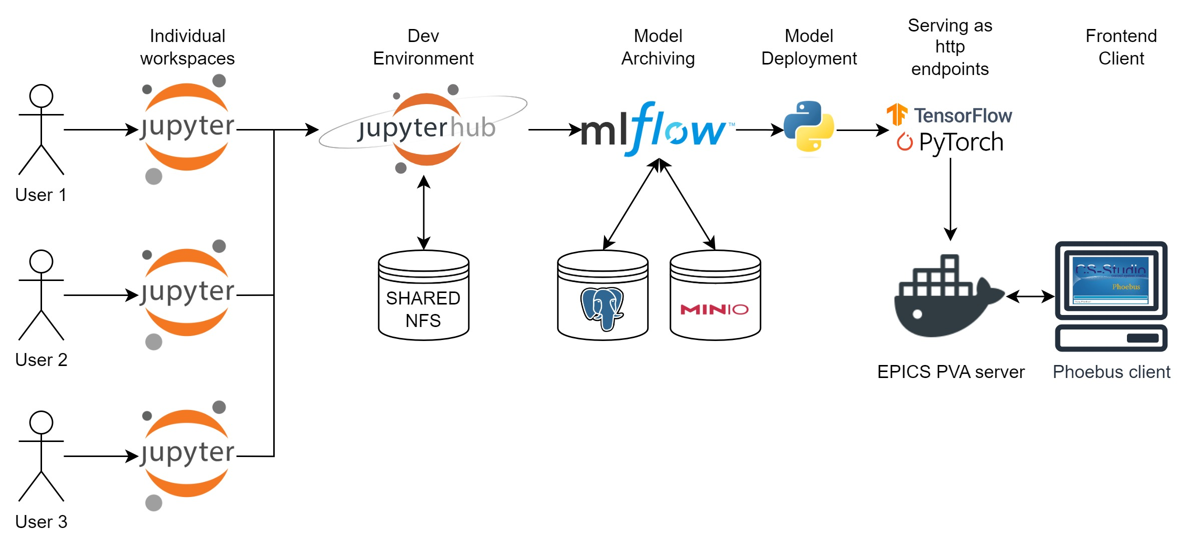
What did we do Before?
training
deployment
A previous iteration of our deployment pipeline used TorchServe to deploy individual models as HTTP endpoints within our Docker swarm. EPICS PVA Servers then needed to be coded by the developer to send and receive updates from this model as EPICS PVs (also deployed as Docker containers)

Slide 5
What did we do Before?
training
Repeated, complex, multi-step code
deployment
This resulted in multiple stages of deployment and repeated code across projects with the PVA Servers being written slightly different depending on the developer (see yesterday’s talk on standardising p4p servers).

Slide 6

Current Solution – lume-deployment
training
Templated, containerised code
deployment
Lume-deployment was developed by Mateusz Leputa while on secondment at SLAC working with Jesse Bellister and Auralee Edelen. It is designed to integrate with the LUME environment developed and in use at SLAC.
https://github.com/MatInGit/lume-deployment

Slide 7
Current Solution – lume-deployment
training
Templated, containerised code
deployment
Lume-deployment* resolves a lot of the repetition in code by handling required model transformations, additional computation and serving of EPICS PVs into a Python CLI program with easy integration for MLFlow and local models
https://github.com/MatInGit/lume-deployment

Slide 8
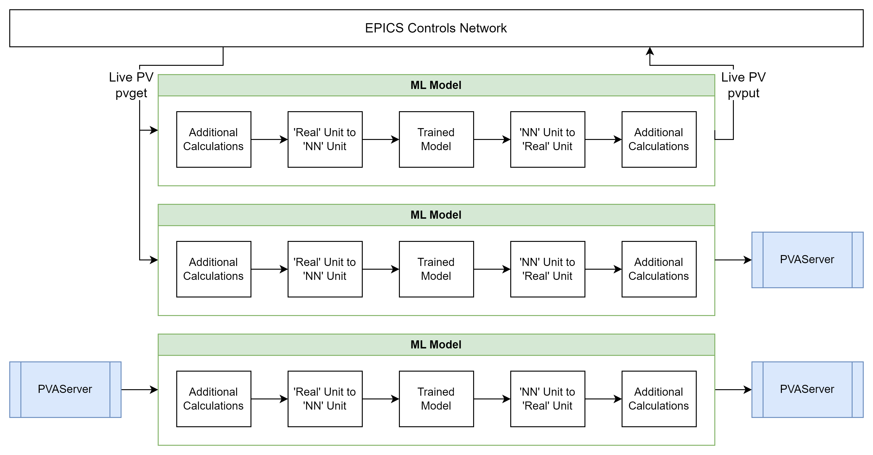
lume-deployment: Design Overview
Lume-deployment is designed to work in a variety of cases depending on your level of interaction with your machine
Case 1: Reinforcement Learning
Read/write
Case 2: Anomaly Detection, Model quality monitoring
Read only
Case 3: Surrogate Model
Isolated

Slide 9
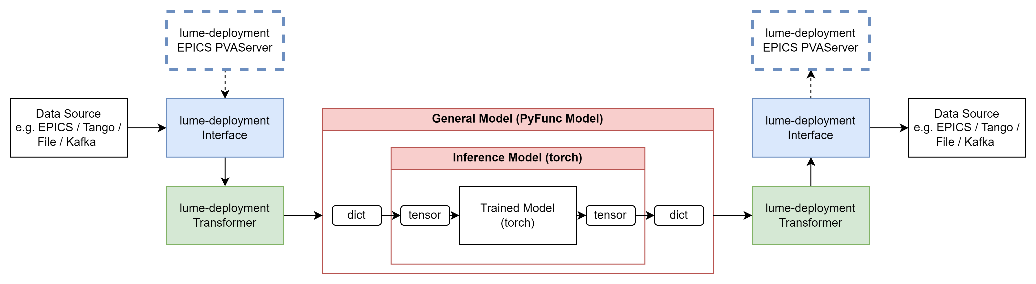
lume-deployment: Key Components
Transformer* takes your data from ‘data source’ units to units used to train the NN and can perform simple calculations
*NOTE class name may change!*
Interface collates data from your data source e.g. EPICS, Tango, files and passes it to the transformer.
Custom Interface allows you to create a PVA Server using p4p to host your PVs (case 2 and 3)
Model is used to interact with the trained neural network. The General model passes and returns dictionaries while the Inference model handles tensors. Both can be used to make additional calculations on top of inputs or outputs.
Notes:
NOTE names subject to change (transformer)

Slide 10
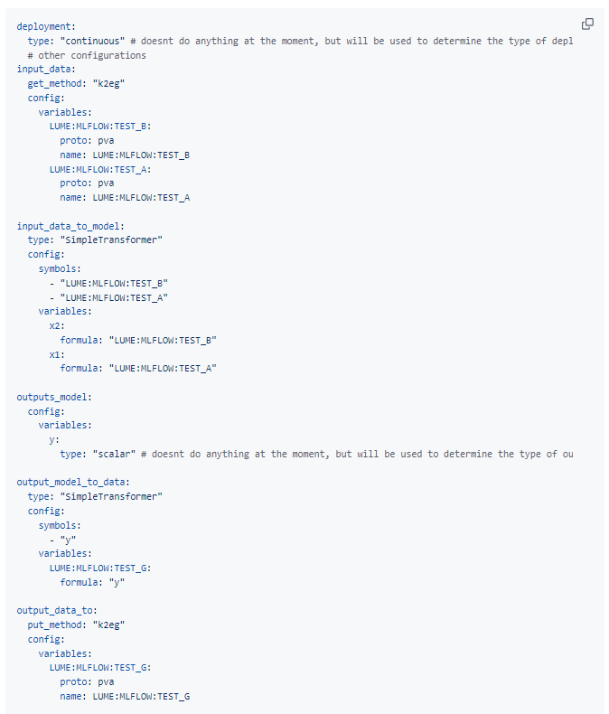
lume-deployment: Key Components
Configuration of Interfaces and Transformers is defined in a `pv_mapping.yml` file.
Found during use that there was a lot of repetition in how you use the deployment, particularly for complex models. In each case, you had to write the same boilerplate python scripts and yaml files.
As users, we wanted automation and templating!
Notes:
NOTE names subject to change (transformer)

Slide 11
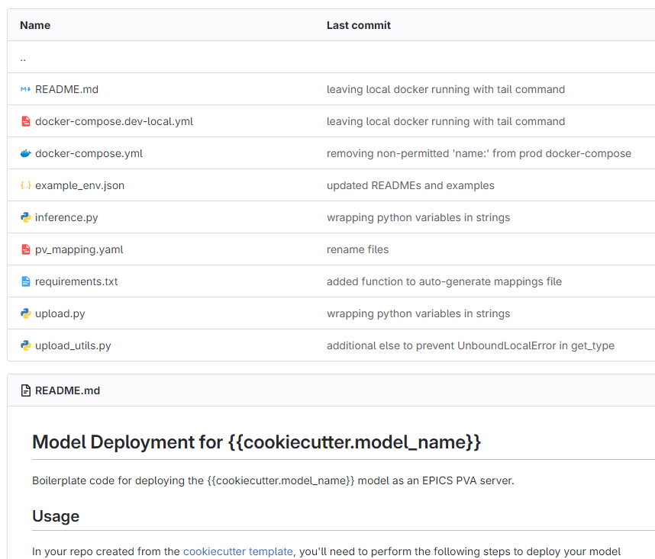
lume-deployment: Repeatability with cookiecutter
User runs:
cookiecutter local/path/to/template/repo
User provides:
Folder name
Model_name and model_version
Experiment name and run ID (mlflow)
Notes:
Cookiecutter to reduce boilerplace code and provide utility functions (e.g. auto-generating the pv_mapping.yml file)

Slide 12
lume-deployment: Repeatability with cookiecutter
Developer then follows steps from README:
fill in the inference.py file
run the upload.py file with the appropriate flags to store the model in mlflow (if desired)
Use generated docker-compose files to deploy locally or in production
Notes:
Cookiecutter to reduce boilerplace code and provide utility functions (e.g. auto-generating the pv_mapping.yml file)

Slide 13
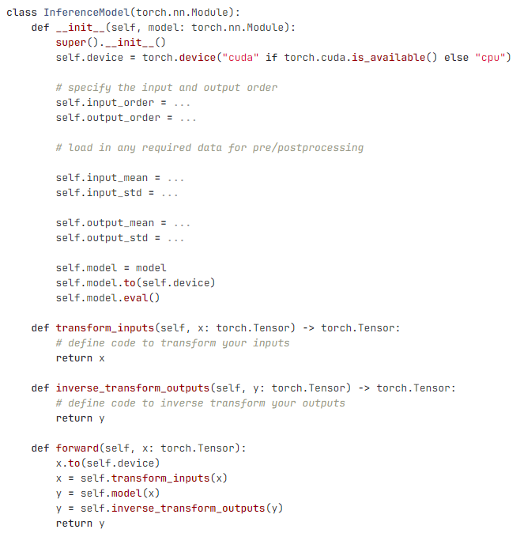
lume-deployment: Repeatability with cookiecutter
Developer then follows steps from README:
fill in the inference.py file
run the upload.py file with the appropriate flags to store the model in mlflow (if desired)
Use generated docker-compose files to deploy locally or in production
Notes:
Cookiecutter to reduce boilerplace code and provide utility functions (e.g. auto-generating the pv_mapping.yml file)

Slide 14
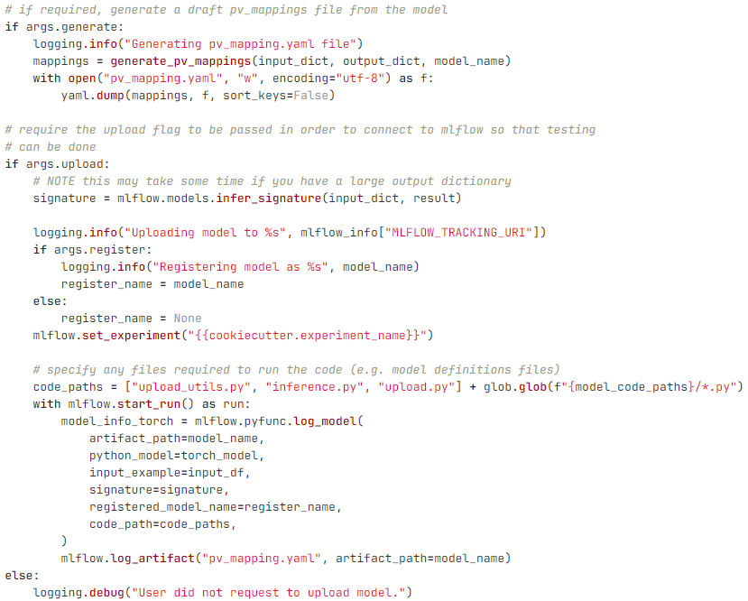
lume-deployment: Repeatability
Developer then follows steps from README:
fill in the inference.py file
run the upload.py file with the appropriate flags to store the model in mlflow (if desired)
Use generated docker-compose files to deploy locally or in production
Notes:
Cookiecutter to reduce boilerplace code and provide utility functions (e.g. auto-generating the pv_mapping.yml file)

Slide 15
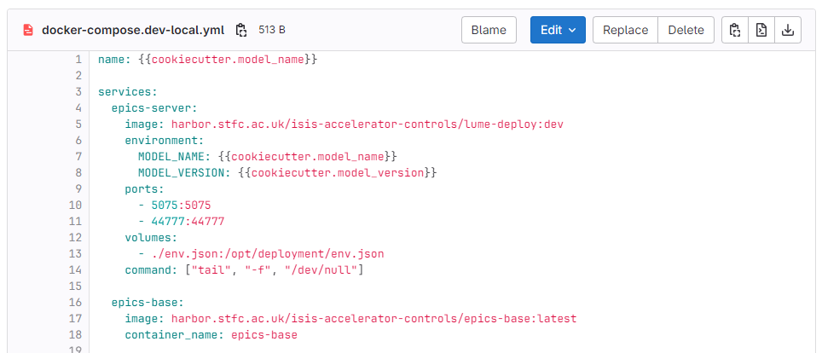
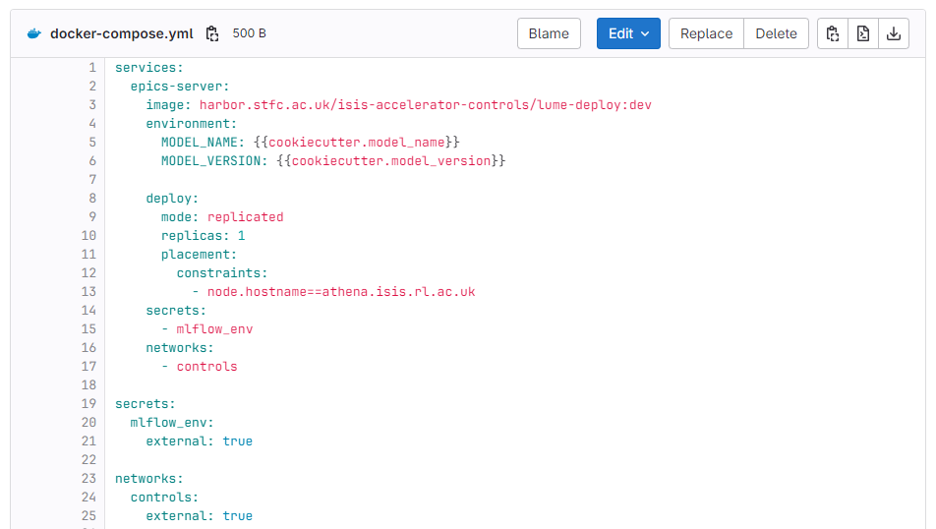
lume-deployment: Repeatability
Developer then follows steps from README:
fill in the inference.py file
run the upload.py file with the appropriate flags to store the model in mlflow (if desired)
Use generated docker-compose files to deploy locally or in production
Notes:
Cookiecutter to reduce boilerplace code and provide utility functions (e.g. auto-generating the pv_mapping.yml file)

Slide 16
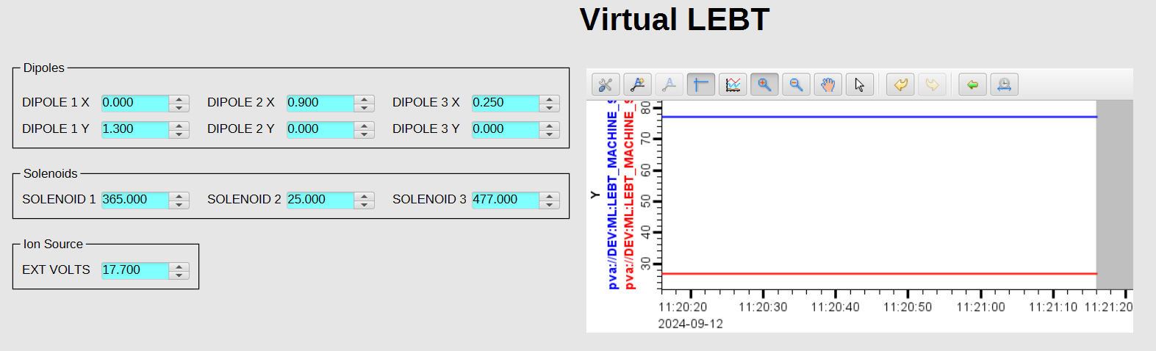
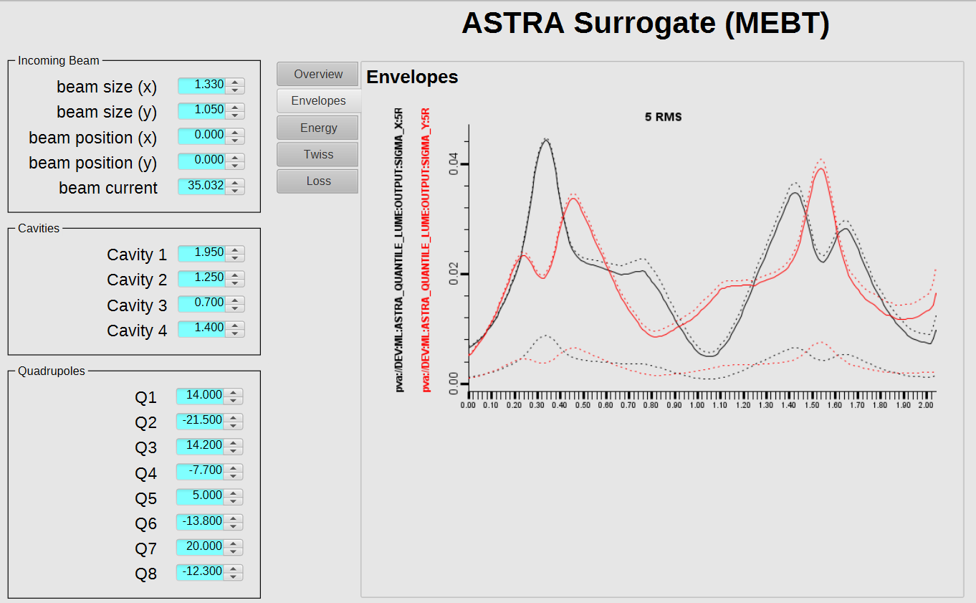
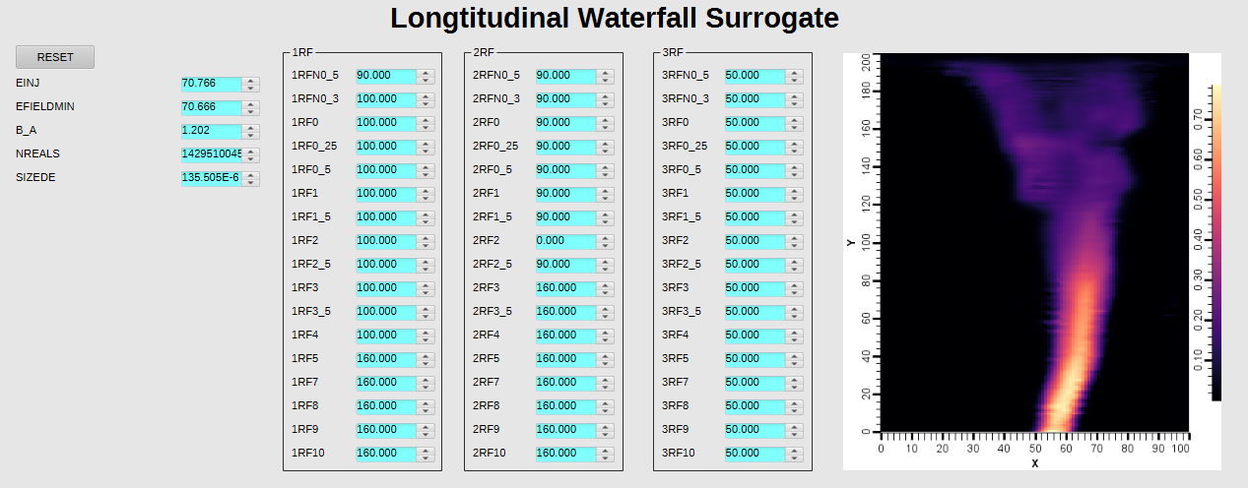
lume-deployment: Results
3 surrogate models (case 3) deployed to EPICS within 1 week

Slide 17
Future Work
Testing of Case 2 models (anomaly detection / model performance tracking)
Additional Transformers (e.g. time series)
Automating re-deployment of models with CI/CD
  E.g. on update of version number in Docker Compose
  Possibly automating re-deploying on push of new MLFlow version?
Link with p4p for ISIS to allow more functionality for p4p servers (e.g. control limits, alarm limits etc
Extending interfaces (e.g. HTTP, Kafka, File Types)

Slide 18
Thank you!
Any questions?

