Slide 1
APS Controls Infrastructure Monitoring System
September 2024
Dariusz Jarosz
Andrew N. Johnson (ANL)
Elaine Chandler (ANL)
Lingran Xiao (ANL)
David Wallis (ANL)
Guobao Shen (ANL)
Ned D. Arnold (ANL)
Software Engineer

Slide 2
Overview
Monitoring Requirements
Uptime Kuma
IOC Status Services + Kuma Agent
Uptime Kuma Status Pages
Grafana Integration + Dashboards
Notifications
Usage Stories

Slide 3
Monitoring requirements
Over 1000 IOCs
Heartbeat + time check
PV value + alarm state
Web Applications + Services
Component Database
ELK
systemd service status
etc.
Hardware Monitoring
Local FS
NFS Mounts
CPU, memory, swap, temps, etc.

Slide 4
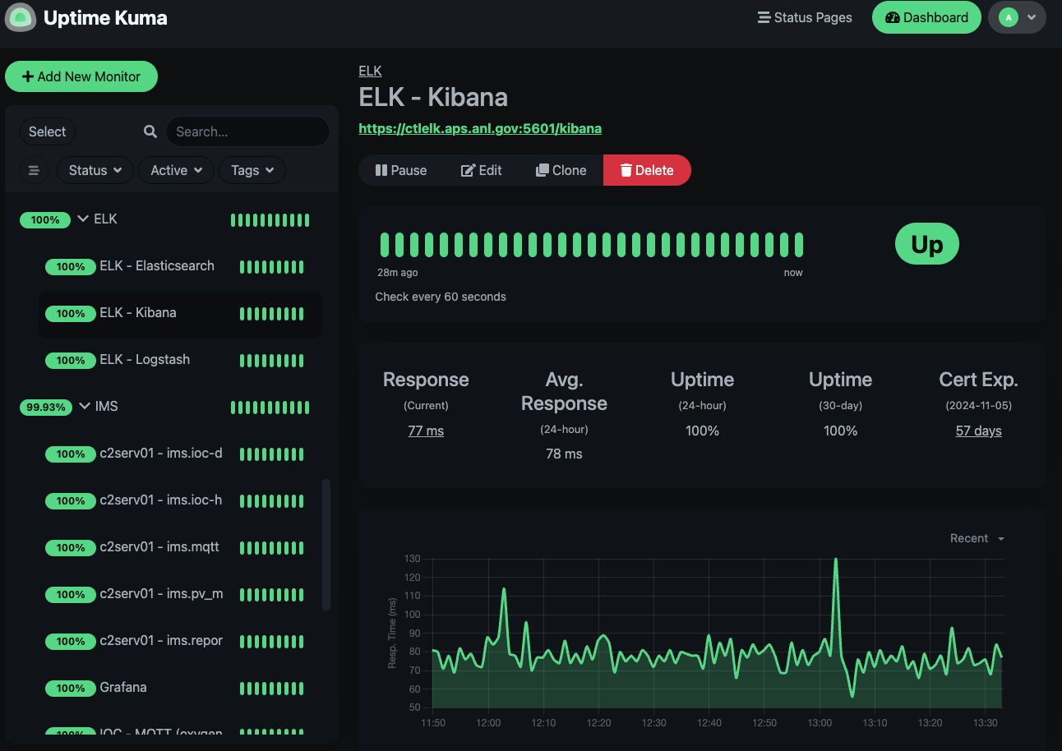
Uptime Kuma Overview
Open source, self hosted monitoring tool.
Actively developed.
Features:
Monitors
Monitor groups
Status pages
Notifications
Metrics endpoint
WebSocket Dashboard UI
Live updates

Slide 5
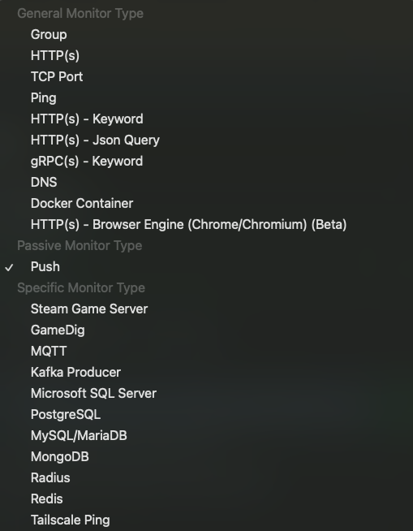
Uptime Kuma Monitor Types
HTTP
Various web apps and REST APIs.
TCP Ping
Services such as DBs, MQTT, etc.
Push Monitors
Everything else.
Many others: Ping, gRPC, DNS, etc.
Service specific ones: mqtt, mongodb, mariadb, etc.

Slide 6
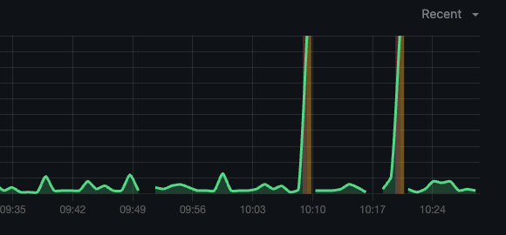
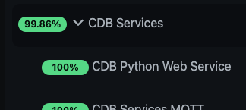
Uptime Kuma Monitor Data
Status
Up/down or pending
“Response time” graph
Configuration
Monitor group
Notifications
Heartbeat interval + retries
Name, description, tags
Monitor type specific configuration: port, db name, user, password, etc.

Slide 7
Using Push Monitor Type
Passive monitor type
Supports interval
Supports “response time” graph.
Push URL
push key
params: status, message, ping
IMS Service
https://uptime-kuma/api/push/push_key?status=up&msg=123 status_message&ping=123
Notes:
requires external service to send it status updates.
Supports interval so will go down when IMS service is not sending updates for a certain period.
Supports response-time graph.

Slide 8
IOC Status Services
IOC Discovery
MQTT Broker
IMS Reporter
PV Monitor
Heartbeat Monitor
IOC
Notes:
IOC Discovery service discovers active IOCs. Reads iocinfo/bootparams directories. Publishes the list of active iocs to mqtt broker.
The heartbeat monitor uses the list of active IOCs published by discovery service and start monitoring ioc heartbeat pvs as well as compares ioc timestamp to real service host time.
It publishes this ioc status data into mqtt broker.
IMS reporter listens for IOC status updates and reports them to uptime-kuma. It is also aware of the existing monitors and will automatically create new ones in uptime-kuma whenever needed. It also assigns the hostname tag to the new monitor.

Slide 9
Kuma Agent
Service used for hardware/system monitoring using plugins.
CPU, disk, loadavg, memory, health, net.
process, systemd service status.
Represented as UK monitor with optional graph.
Easy deployment on new systems
NFS
Systemd
Env file
Template configuration file
Hostname configuration file
Automatic creation of Uptime-Kuma monitor.
Kuma Agent
Notes:
Kuma agent provides functionality that allows for monitoring hardware as well as system statistics monitoring.
It has a plugin architecture that currently supports monitoring hardware stats such as CPU, disk , load average, memory, health, network.
It also allows monitoring other system stats such as process identified by its name and the count of process.
Each running plugin is represented in uptime kuma as a monitor. Each monitor has a ”response time” graph, this can be used to represent CPU usage percentage for example. Or a network utilization.
Deployment of KumaAgent is quite easy.
The binaries and configuration files are stored on a shared NFS mount.
A common system file can be used with an env file that defines a template configuration file and a hostname specific configuration file.
The template configuration file includes the default configurations for each host such as all the hardware stats for the system.
Once the service is started for the first time a template file is copied into a host specific configuration file where additional plugins can be configured.
Also once started KumaAgent creates all the necessary monitors and saves its push keys in the configuration file. These keys are used to later reference the monitor with updated data from kumaAgent.

Slide 10
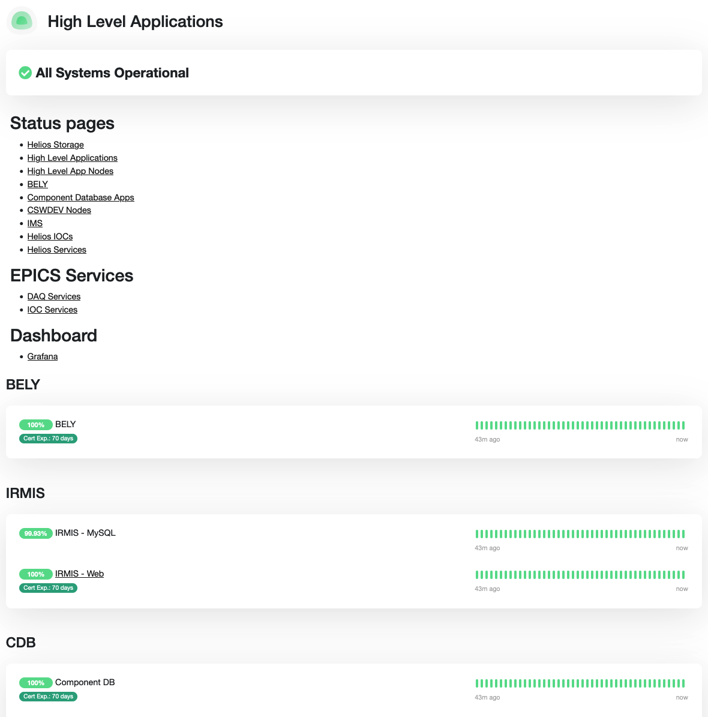
Status Pages in uptime kuma
Title + Slug
Description (text at top) + Footer
Support Markdown
Status page navigation
Sections/Groups
Monitors

Slide 11
Grafana Integration
https://uptime-kuma/metrics
Data Source
Uptime Kuma
Prometheus
Database for time series metrics
Grafana
Custom dashboards
Visualizes data over time
Notes:
Uptime Kuma provides a metrics endpoint. Prometheus consumes the metrics endpoint and stores time series metrics about uptime kuma monitors. Grafana uses promoethus as a database and allows for building of custom dashboards as well as analysis of data over time.

Slide 12
Grafana Dashboards Overview
Home Overview
All Services
Hardware Monitoring
SSL
IOC

Slide 13
Grafana Dashboards - Home

Slide 14
Grafana Dashboards – All Services

Slide 15
Grafana DashboardS - Hardware

Slide 16
Grafana Dashboards - SSL

Slide 17
Grafana Dashboards - IOC

Slide 18
Uptime Kuma Notifications
Supports many notification types
Email (SMTP)
MS Teams
Slack
Apprise (78+)
Many others.
Send for status changes

Slide 19
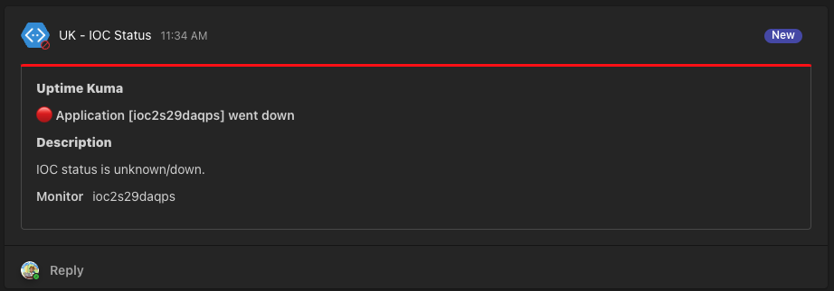
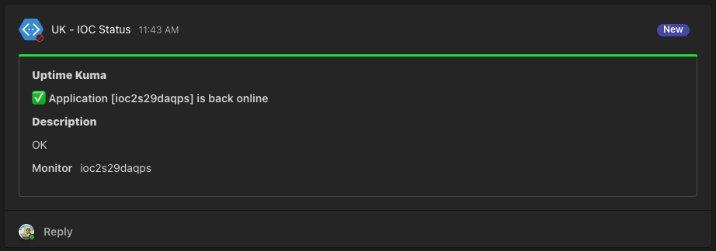
Uptime Kuma Notifications At APS

Slide 20
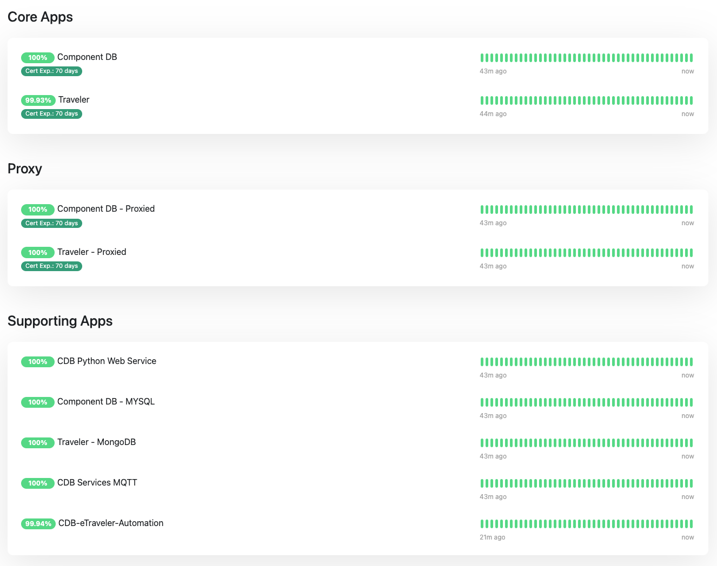
Usage Stories – Restore Services
Server reboot after updates
Checklist to restore services

Slide 21
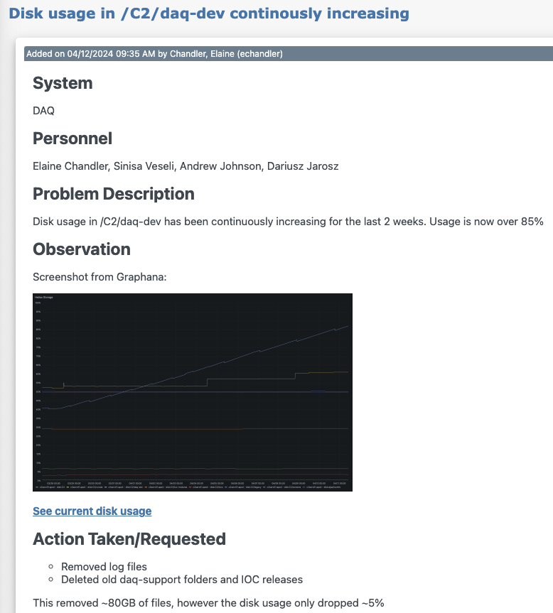
Usage Stories – Disk Usage Increasing

Slide 22
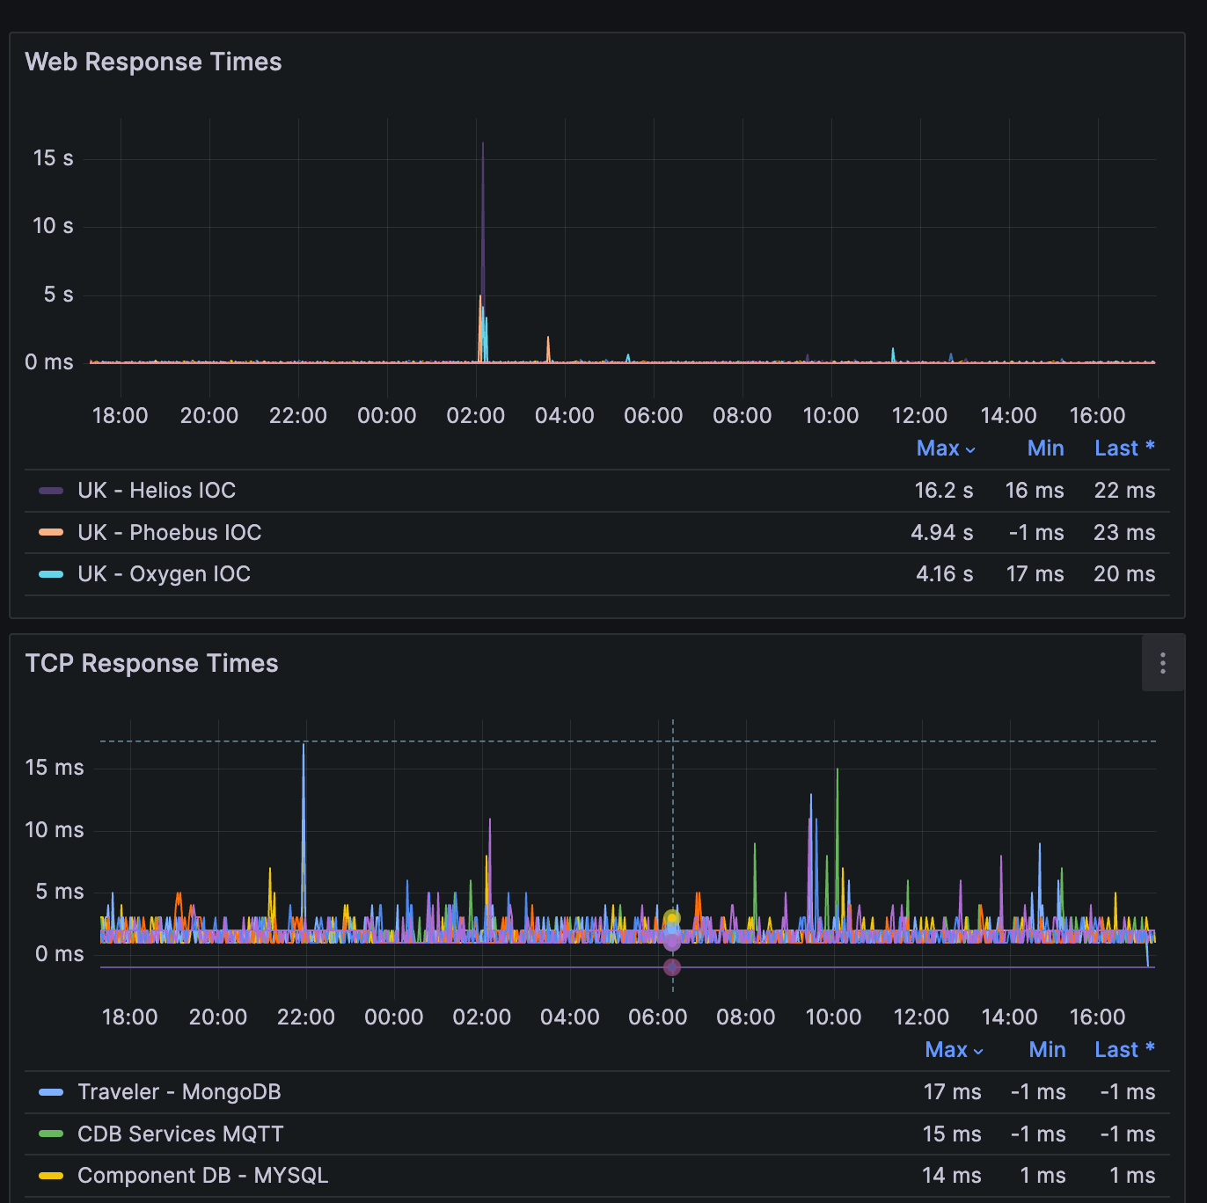
Investigating Network Latency Issues
Finding times of latency issues
Comparing it to other stats such as CPU
Working with IT and the timestamps

Slide 23
Troubleshooting IOC performance
Monitoring performance as PV writes increases.
At ~18:00 100Hz setpoints start.
Normal vs under load.
Other tools were used to further investigate.

Slide 24
Questions?

Slide 25
Backup Slides

Slide 26
Uptime Kuma Configuration CLI
Help manage 1000s of monitors.
CLI functionality
Dynamically define status pages
IOC System
Services + Hardware health
”description” markdown
Grouping
Hardware monitors into a single hostname.
Mass assign notifications
Clean up deprecated IOCs
Backup Grafana dashboards
And many more

