Slide 1
Standardising the Creation of PVAServers at ISIS Accelerators
Kathryn Baker (k.baker@stfc.ac.uk)
On behalf of Aqeel AlShafei, Kathryn Baker, Ivan Finch, Ajit Kurup and Mateusz Leputa
EPICS Collaboration Meeting September 2024 - ORNL
18 September 2024

Slide 2
Overview
Why do we need PVA Servers?
Is p4p not enough?
What should p4p for ISIS achieve?
p4p for ISIS Overview
Lessons learned
Future plans

Slide 3
Why do we need PVAServers?
Transition Vsystem to EPICS 7
Running a hybrid system throughout
Some hardware easily migrated to EPICS ‘out of the box’
Only requires acceptance testing
Vsystem hardware created as EPICS PVs in Python ‘IOC’ during transition
pvecho using pvapy
Other hardware not-so-easily migrated to EPICS…
E.g.
in-house developed hardware
hardware with no EPICS integration – using MQTT/python IOCs instead*
ML applications
Python more common than C++ in our group
*see ICALEPCS poster TUMBCMO26 https://accelconf.web.cern.ch/icalepcs2023/posters/tumbcmo26_poster.pdf

Slide 4
Is p4p Not Enough?
Pros:
Relatively easy to make a PVA server
Groups responsible for hardware can create their PV applications themselves
Contains standard definitions for Normative Types
Allows flexibility for cases where NT aren’t needed

Slide 5
Is p4p Not Enough?
Pros:
Relatively easy to make a PVA server
Groups responsible for hardware can create their PV applications themselves
Contains standard definitions for Normative Types
Allows flexibility for cases where NT aren’t needed
Cons:
Varied EPICS experience
People don’t know to use Normative Types
Alarm and control limits aren’t handled
Flexibility in p4p allows interpretation of implementation
Very difficult to enforce policy around naming, PV broadcast, updates
No guarantee of tests

Slide 6
What should p4p for ISIS achieve?
Enforce policy for PV creation
Structure
Naming
Automatically handle complex aspects of PV logic
Automatic integration of EPICS tools (reccaster, ioc stats etc)
Allow users to make IOCs with limited Python code – yaml integration
Allow policy changes to be rolled out across applications easily
Rigorous testing

Slide 7
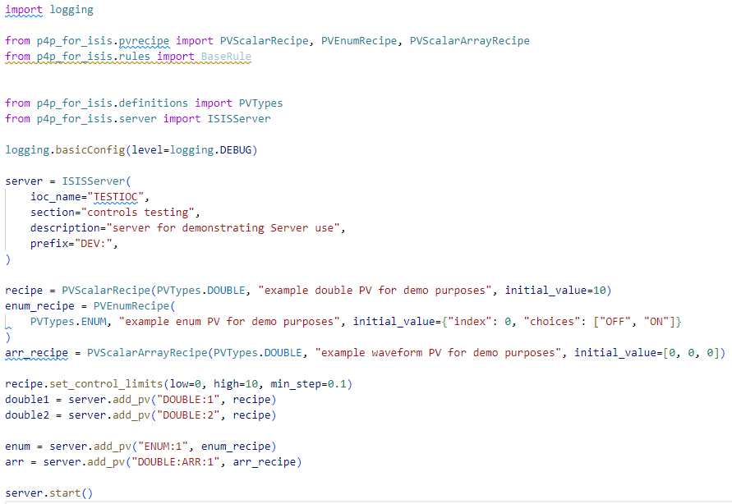
p4pforISIS
Python library that wraps p4p enforcing policy decisions
Example script to create a basic server using p4p for ISIS

Slide 8
p4pforISIS - Server
ISIS Server contains info about the IOC that the user is forced to provide
Info can be passed to ChannelFinder using pyRecCaster (see Ivan’s talk)
Prefix allows you to create multiple instances of the same server on the same network e.g. development vs production

Slide 9
p4pforISIS - Recipes
Recipes provide templates for creating PVs according to Normative Types
Allow you to set control and alarm limits depending on the PV type
Once PV is created, all logic is evaluated under the hood by handlers (pre-configured in recipe)

Slide 10
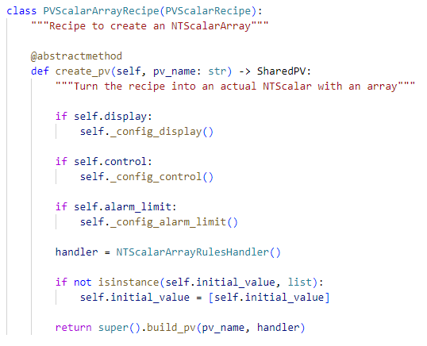
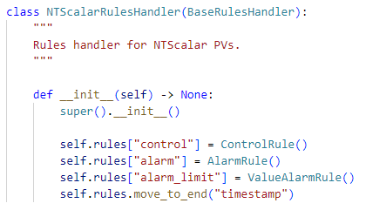
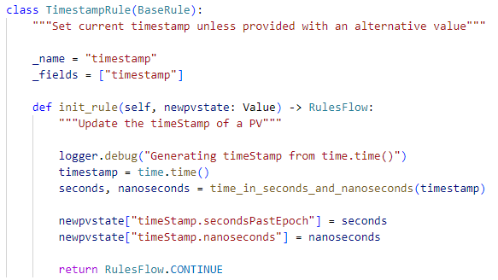
p4pforISIS – Handlers & Rules
Within each NT recipe, a specific Handler is assigned which consist of Rules (appropriate to that type) that are applied on changes to the PV
Examples include:
Updating timestamp
Read-only preventing update
Evaluating alarms
Evaluating control limits

Slide 11
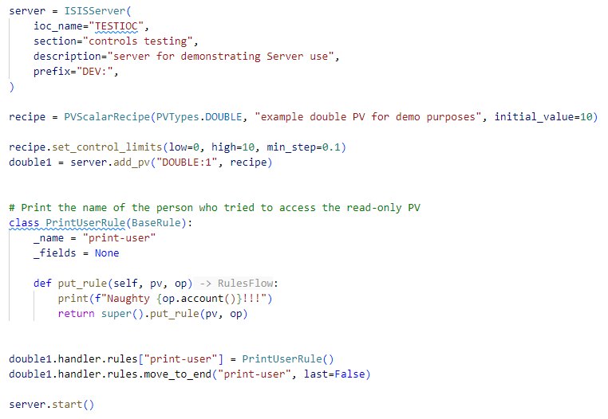
p4pforISIS – Handlers & Rules
Users can apply their own rules if they want!
e.g. additional logging, complex alarm handling, complex control logic

Slide 12
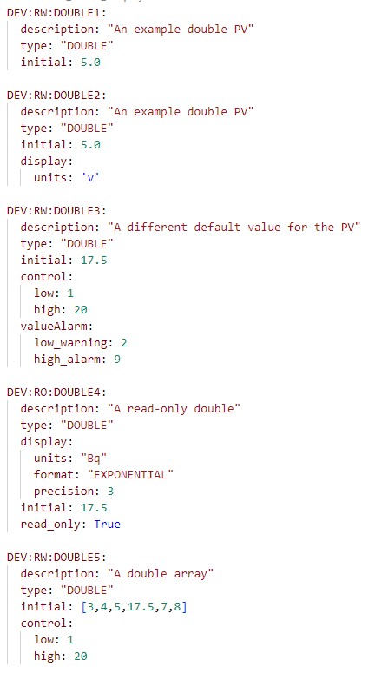
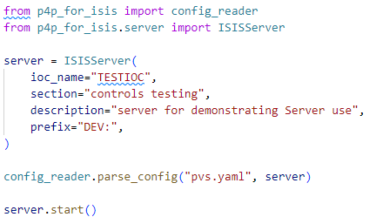
p4pforISIS – YAML Integration
Loading from yaml file for users who aren’t as comfortable with Python or for rapid development of IOCs from existing systems (e.g. CPS)

Slide 13
Lessons Learned
How to persist values of PVs (using sqlite)
Better understanding of Normative Type specifications
Better understanding of p4p
Contribution back to main p4p where appropriate

Slide 14
Work in Progress – Future Plans
Implementation of forward linking and CALC-style PVs
Grateful for guidance on how this has been done for other p4p applications!
What if the PVs are external?
Testing in production & user feedback
Integration of EPICS tools
E.g. pyreccaster, ioc stats, auto-archiving
Naming convention validation

Slide 15
Thank you!
Any questions?

Slide 16
Why not pythonSoftIOC?
Uses QSRV under the hood
Limited by constraints of doing PVAccess in a CA environment
Requires a much more in-depth knowledge of EPICS which we’re trying to abstract away
Use of handlers gives us much more flexibility over what can be done when processing a PV e.g. the alarm state
Doesn’t allow PLC owners control over alarms

