Slide 1
EPICS Software Development of the Fast Event System for APS-U
Ran Hong
Controls Engineer
Advanced Photon Source
Argonne National Laboratory
Sep 16, 2024

Slide 2
Outline
Fast Event System for SR and Linac
Device support development for the MRF VME-300 series cards
Delay compensation
Virtual gate generation
Timestamp generation
System Integration at APS:
User interface PVs and Legacy PVs
GUI development
On-going development
Merging with the main repository
Run the EPICS IOCs on RTEMS

Slide 3
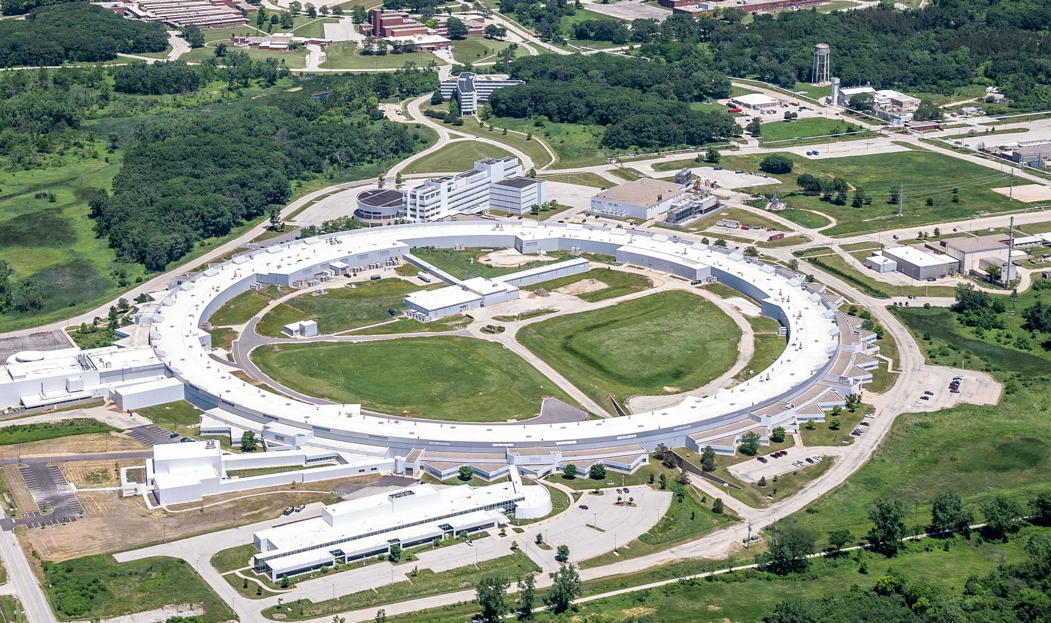
Timing and Event Systems for APS
Fast event system for the new storage ring
Providing timing signals to event-based devices: BPMs, DAQ aggregators, …
Providing edge triggers to conventional devices
Hardware components made by Micro-Research Finland (MRF) (VME based 300-series)
Legacy timing and event system for the injection complex
Booster, Particle Accumulation Ring (PAR) and part of the Linac
Providing edge triggers and events (legacy APS Event system components)
Refurbished timing system for the Linac
Providing edge triggers to existing devices
MRF event system components (VME based 300-series)
APS-U Storage Ring
Linac
Booster
PAR

Slide 4
Fast Event System for SR and Linac
SR RF/3, ~117MHz
SR Double-sectors
BTS
…
Embedded EVRs
LB+ BPMs
MPS BPLD
TBT DAQ Aggregator
PS DAQ Aggregator
…
EVM
Fan-out module
EVM
From MCR
EVM
EVM
EVM
EVM
…
EVM
Fan-out module
EVM
MCR
EVR
Edge-triggered devices
Typical Double-sector
Linac RF/24, ~119 MHz
Fan-out module
EVR x6
Event generation
Edge triggers from the legacy timing system
Internal frequency divider
Software command
Edge trigger examples
Pulsed septum
Cerenkov Beam Loss monitor
BPMs
…
Edge-triggered devices
EVM
EVR
Edge-triggered devices
EVR
Edge-triggered devices
EVR
Edge-triggered devices
Linac

Slide 5
EPICS Device Support Development
Main repository: https://github.com/epics-modules/mrfioc2
Evolved from the device supports of the 230-series hardware
Leverage some developments from mTCA-300-series EVM/EVR by ESS to VME64x platform
Providing the API functions, database template, CSS/Phoebus screens
APS Local repository
Forked from the main repository
Adapted to VME-300-series EVM and EVR
Features in recent firmware releases are supported
Merging to the main repository in progress

Slide 6
Device Support Development: Delay Compensation
Must be able to adjust its delay to cover the major delay for the end-component not supporting delay compensation
EVR
Embedded EVR
EVM
Fan-out module
Most of the embedded EVRs do not support delay compensation yet
Embedded EVR
EVM
EVM
EVM
EVM
Embedded EVR
Embedded EVR
EVM
Delay compensation development
Previously, EVMs only measure the delay, but not able to adjust its FIFO to introduce delay
Delays introduced by EVMs are crucial for embedded EVRs not having the delay compensation support
Firmware updated to allow EVMs to adjust FIFO depth to introduce delay
Supports both static delay or dynamic delay
APS Configuration
Static delays for EVMs in local stations
Delays to local stations are measured by MRF EVRs
Delay variance among local stations: 300ps, 3 months after the initial configuration.

Slide 7
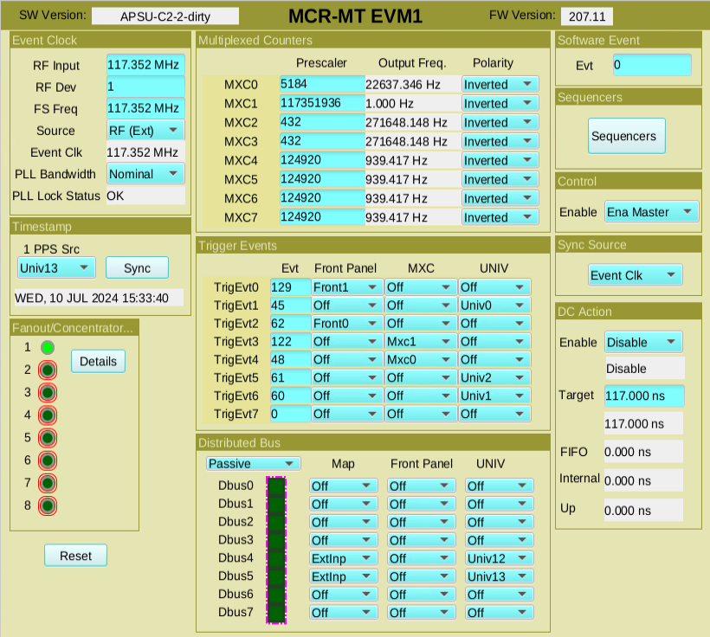
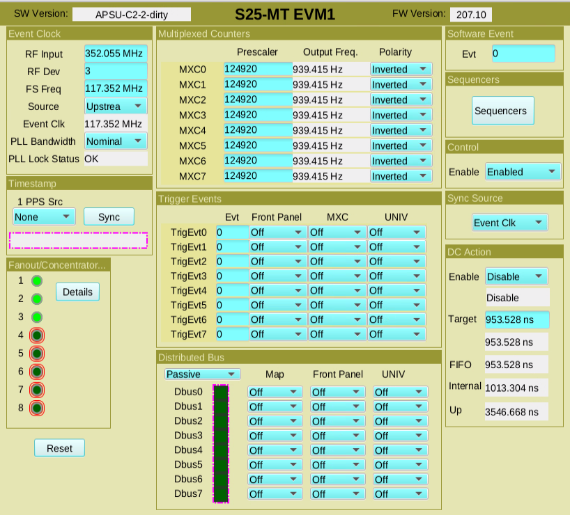
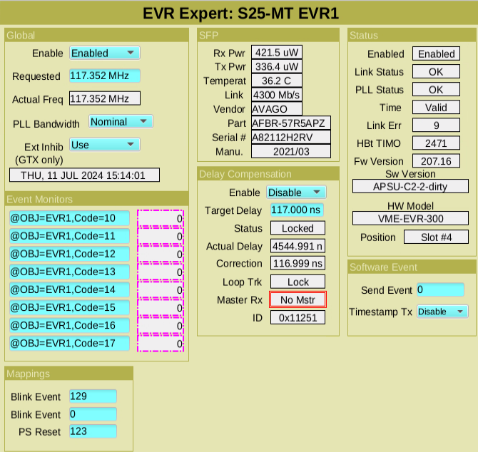
Screen Enhancement for Delay Compensation
Top-level EVM
Leaf-level EVM
EVR

Slide 8
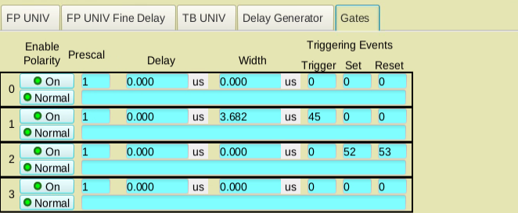
Device Support Development: Virtual Gate Generation
Virtual gates: pulse generator (ID = 28 – 31) in MRF EVR dedicated to enable-gates or masks for other pulse generators.
Before: virtual gates configured with the set and reset function.
Firmware update: virtual gates can also be generated as a triggered pulse with specified delay and width after the trigger event
Only for EVR-VME-300, not the embedded EVRs in EVM boards.
Example usage:
For SR, a typical use is to gate the P0 signals upon injection
Registries, API functions and GUI are available for setting a triggered pulse for the virtual gates, but previous firmware does not support this feature.

Slide 9
Device Support Development: Timestamp Configuration
Timestamp configuration for EVG-230
1 PPS source (interrupt source): second increment input (1 PPS GPS)
One trigger event configured for code 0x7d upon the 1PPS source
Event 0x70 and 0x71 generated by software
Timestamp configuration for EVM-300
DBus5: second increment input (1 PPS GPS)
DBus4: fast timestamp clock input (10MHz the GPS)
1 PPS source (interrupt source): same as DBus5
Event 0x7d, 0x70 and 0x71 generated by hardware automatically
Device support update
User can select either modes above
When the EVM-300 mode is chosen, software stops generating 0x70 and 0x71

Slide 10
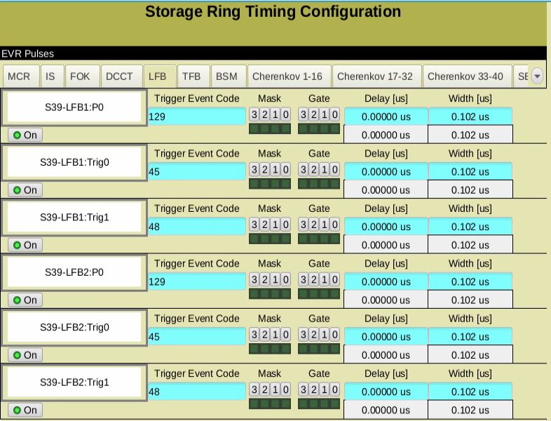
System Integration at APS: User-interface PVs and GUI
Relevant PVs are grouped together for pulse set up
Coarse and fine delays calculated in software
PVs for user interface are published and accessible to the users.
Device-interface PVs from the device support are protected by access security.

Slide 11
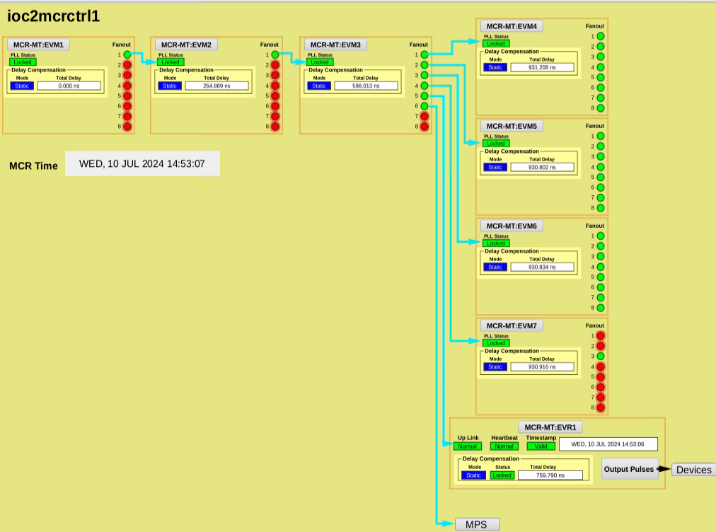
System Integration at APS: User-interface PVs and GUI
MCR

Slide 12
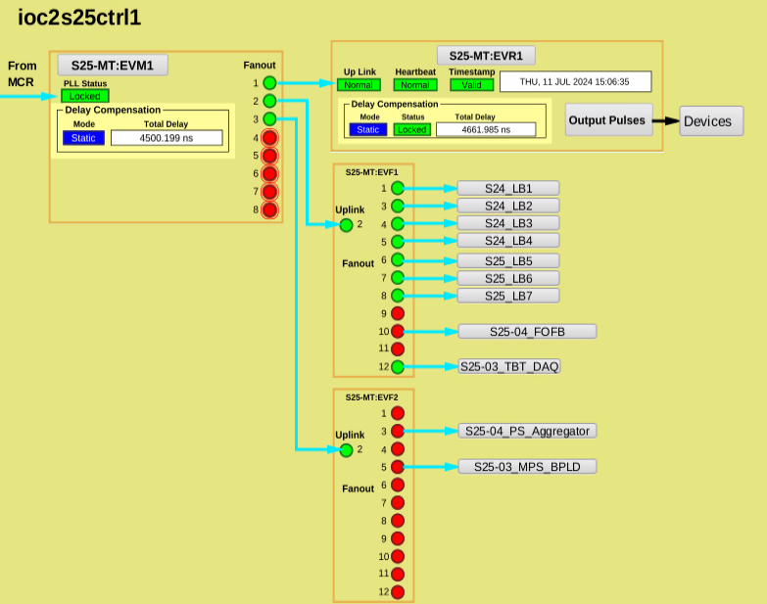
System Integration at APS: User-interface PVs and GUI
SR Local Station

Slide 13
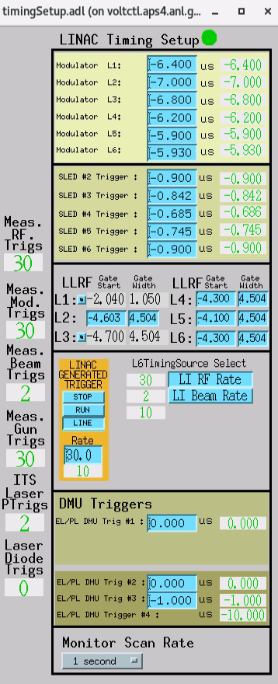
System Integration at APS: User-interface PVs and GUI
Linac Timing Screen
User PVs from old timing system are hosted in a soft IOC, and linked to the PVs of the new timing system
Minimized the changes on the client IOC and GUI.

Slide 14
Current Status at APS
Finished recently
EVM-300 and EVR-300 initialization and configuration
PLL Bandwidth selection
More options for the AC main trigger Synchronization source
EVR event clock mode selection
Flash I/O support
EVM delay compensation action
Multiplexed counter external reset
Hardware timestamp generation
Database substitution files for EVM-VME-300
Functions merged to upstream repo

Slide 15
Current Status at APS
Work in progress
Making the database template file compatible with both mTCA and VME cards
EVR-VME-300 CML/GTX mode word order fix: waiting for ESS to verify that the mTCA systems are not affected.
EVM reset button
EVR rear transition board fine delay
CSS/Phoebus screens for VME-300-series hardware
Merging to upstream repo ongoing
Merge requests submitted for the first 2 and under review
The rest on the way

Slide 16
Backups

Slide 17
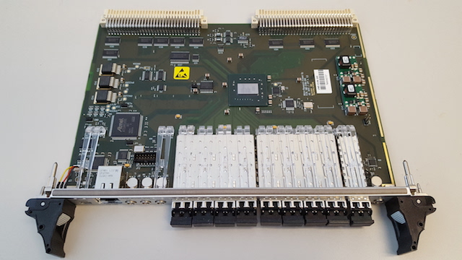
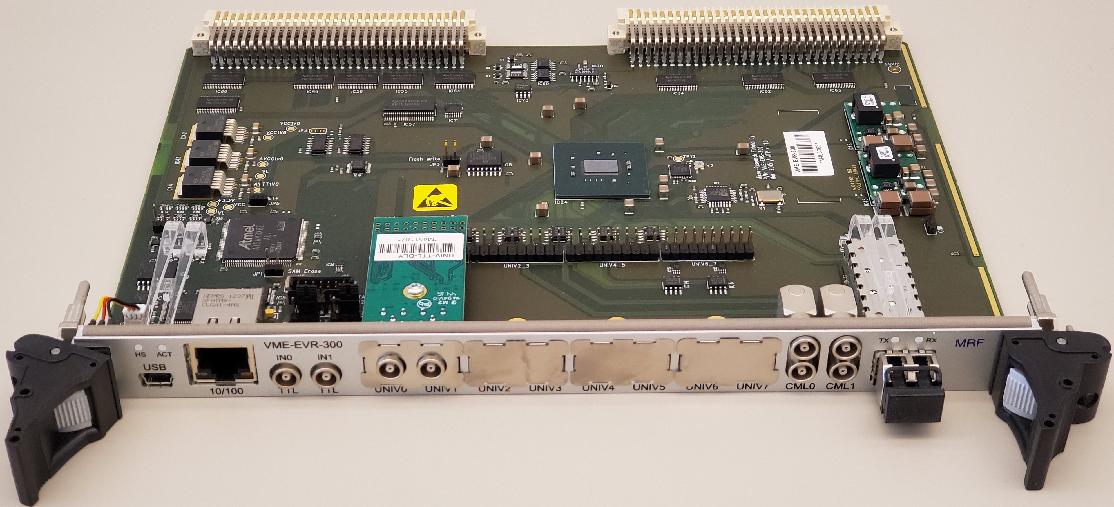
MRF event system components
Event system components by Micro-Research Finland Oy
MRF Event master (EVM-VME-300): event generation and fan-out and concentration
MRF Event Receiver (EVR-VME-300)
FOUT-12 event fan-out card (EVF): 12 way-event fan-out, 1 receiver port, 11 transmitter ports.
Universal I/O transition board: more I/O slots for EVM and EVR
MRF also provides components in other form factors (mTCA, PCIe, …)
MRF EVM-VME-300
Universal I/O Transition Board
MRF FOUT-12
MRF EVR-VME-300

Slide 18
MRF Event System at APS
EVR
Fan-out module
EVR
Event clock tick, 16-bit word
Fan-out module
Fan-out module
EVR
…
…
…
EVM
EVM
Event Generator
(EVG)
Event Receiver
(EVR)
EVR
Event Link
Fan-out module
EVR
Signals in the event link
Typical event system
The Fast Event System is a distributed timing and trigger system.
Synchronized clocks
Codes and data encoded in the clock signal for trigger distribution and synchronous frequency generation
The event system acts as a global timebase for applying timestamps to collected data and performed actions.
Some major components used at APS (VME64x based):
Event generator (EVM-300): generates event codes, programmable, can be daisy-chained
Event receiver (EVR-300): receives event codes and perform actions, programmable
Event fan-out module: duplicates event links

Slide 19
Delay Compensation
Code compatibility
Shared across VME, mTCA, PCIe, etc:
Registry addresses: shared register map
EPICS record interface mechanism: object + function
Low-level API (event generation, pulser configuration, delay compensation, etc)
Shared database template
Unique features of each platform:
Initialization functions
Number of I/O ports, available bits for delay and pulse width, etc.
Different substitution files for each platform/hardware variance
Valid PV value ranges are different
User interfaces on different sites
The main repository development makes sure the existing systems are not broken upon updates
Site-specific records are maintained locally

Slide 20
Device Support Development: Delay Compensation
Top-level EVM
EVM
Generating Beacon event 0x7e
EVM or EVR
Fan-out ch1
Beacon back
Uplink
Beacon out, delay value out
Beacon back
Fan-out ch2
Fan-out ch1
Uplink
…
…
Beacon out, delay value out
Fan-out ch8
Fan-out ch8
Delay compensation mechanism
Upstream EVM measures the delay to each downstream components using beacon event time difference
Measured delay values are sent to the downstream components via the data transfer channel in the event link (8 bits every 2 clock cycles)
EVM/EVRs measure their own delays
Additional delays are introduced by adjusting the FIFO depth
Operation modes
Static: Fix the delay introduced by an EVM/EVR
Dynamic: Set a delay target for EVM/EVR and let it adjust its own delay to reach the target delay

Slide 21
Device Support Development: Timestamp Configuration
Timestamp construction at EVR
Use 0x70 and 0x71 events to construct the next second value in the buffer
Upon event 0x7d, the buffer value is loaded as the current second value
Fast timestamp (nanosecond counter)
Nanosecond counter choices:
Event clock tick: fastest, but affected by reference frequency change (e.g. RF ramping studies)
Dbus4 (10MHz): constant frequency locked to GPS
Event 0x7c: older style, may introduced more event collisions
The clock tick frequency value can be set via an EPICS PV.
If too high: timestamp gap upon whole-second increment
If too low: overflow upon whole-second increment
RF Frequency are measured, and the TS clock tick frequency is updated
Event timestamp
Only events registered as FIFO events have timestamps recorded
For an EPICs record, to use the event time, the TSE should be set as the event code

