Slide 1
Deploying EPICS IOCs using Buildroot and Docker
Austin Geisert
Notes:
Austin

Slide 2
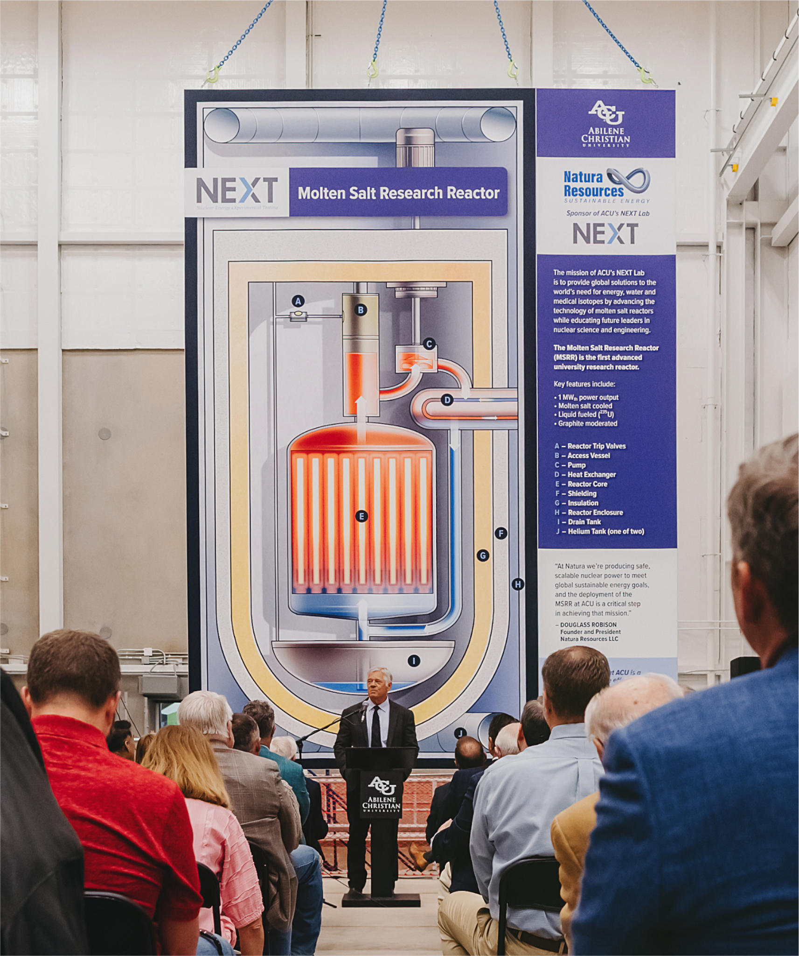
What is NEXT Lab?
Abilene Christian University Nuclear Energy eXperimental Testing Laboratory funded by Natura Resources.
Mission: Solve the the world's most critical needs for Energy, Water, and Medical Isotopes.
How: Build the Natura MSR-1 Molten Salt Research Reactor as a pathway for commercial deployment.

Slide 3
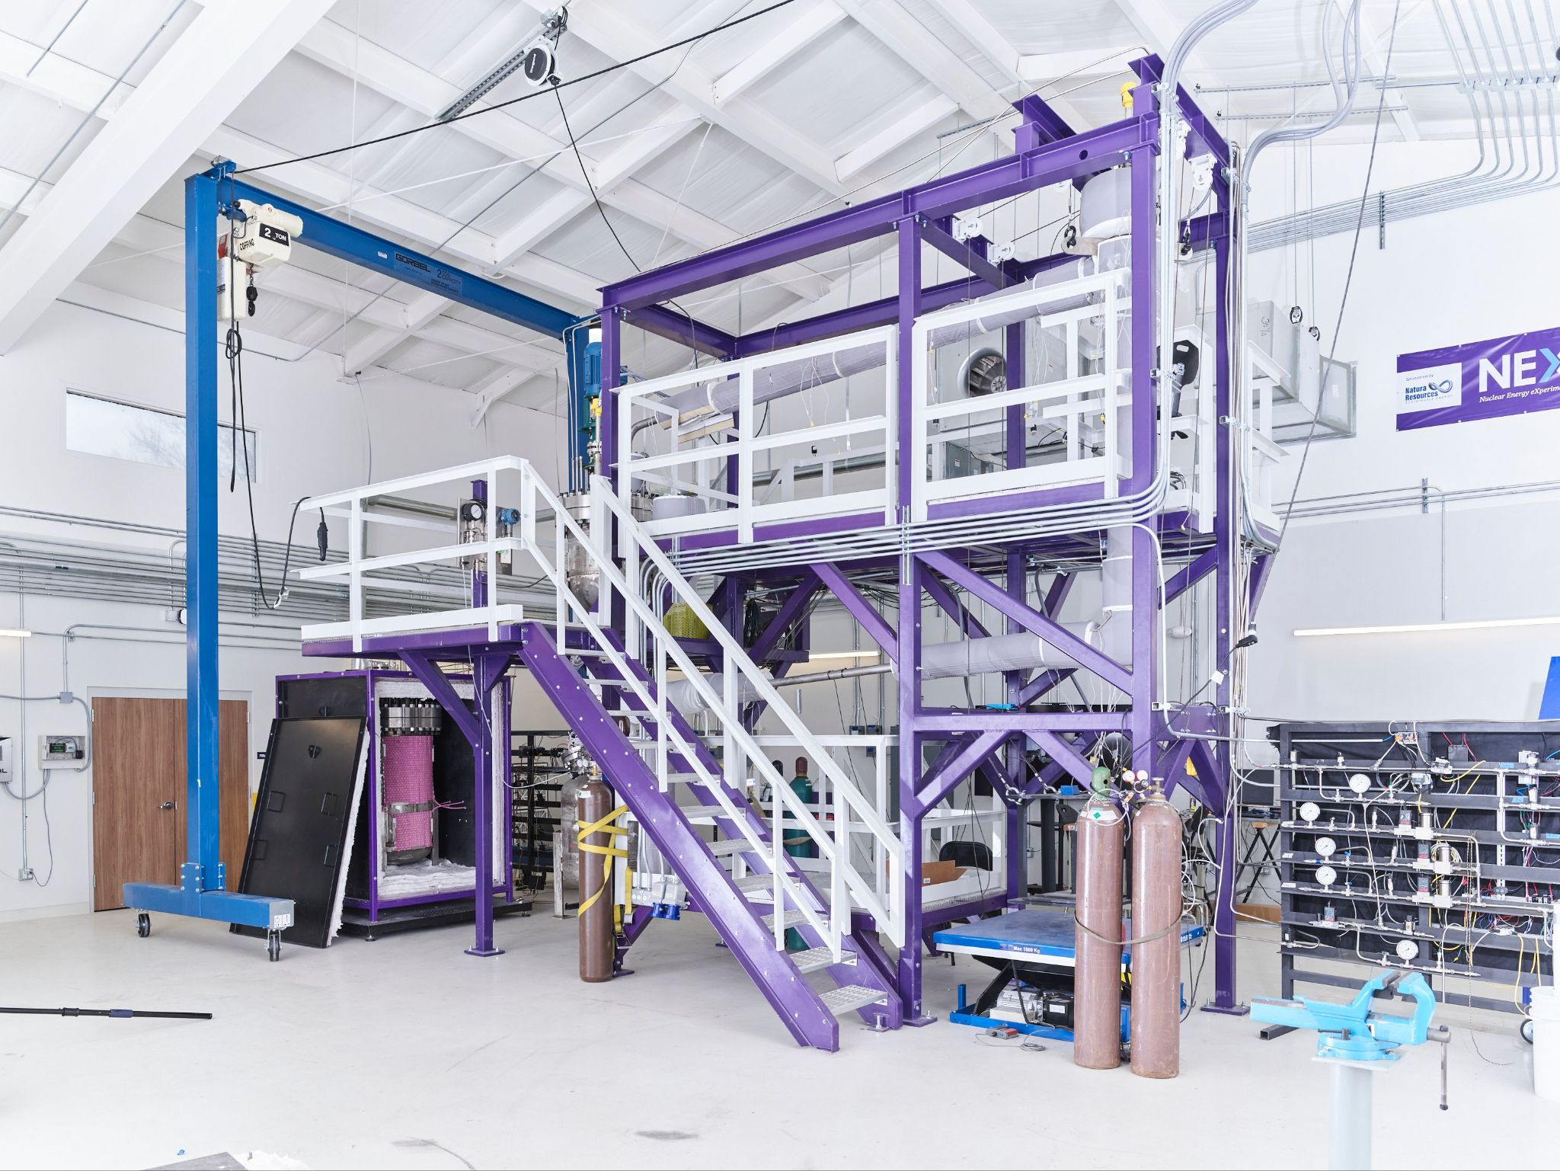
Notes:
55 Gallons or about 200 L

Slide 4
MSTS to MSR-1
Molten Salt Test System (MSTS) is a stepping stone to MSR-1
For molten salt loops like MSTS and MSR-1 we have 3 main control concerns:
Temperature
Pressure
Pump
EPICS’ Distributed Model is useful for separating concerns.
Notes:
Austin

Slide 5
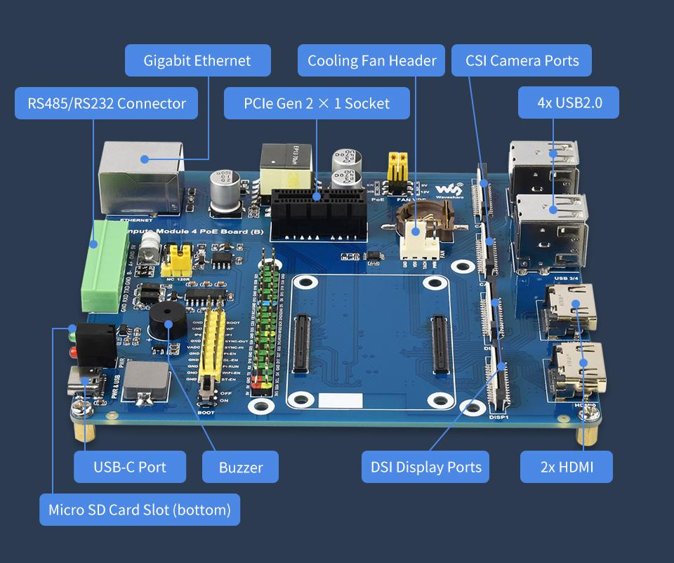
Why use Embedded Linux on SBCs?
Low Cost.
Wide range of Peripherals:
Example: RS-485 and RS-232 are available on Raspberry Pi Compute module compatible boards.
Simple to deploy and use for applications that don’t require quick sensors.
Capabilities and cost vary depending on use case.
https://www.waveshare.com/img/devkit/Compute-Module-4-PoE-Board-B

Slide 6
Goal:
We want to deploy a complete IOC to an Embedded Device automatically.

Slide 7
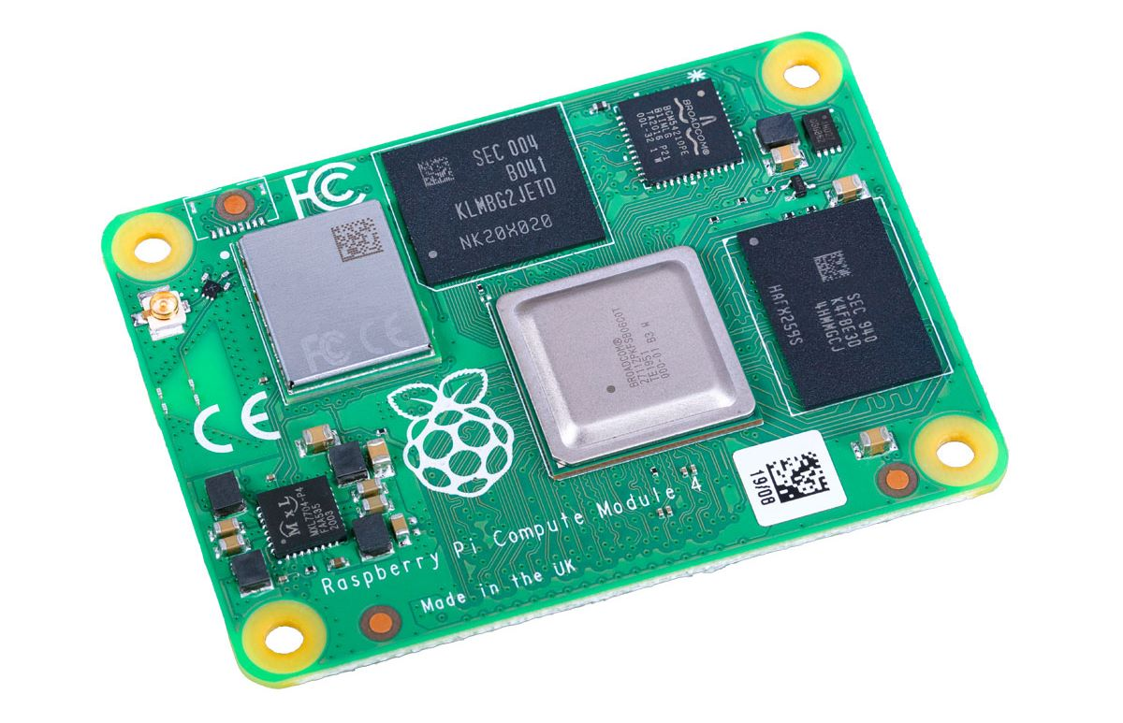
The Big Picture
DAQ Net
MSTS Net
IOC
Code
Gas Control
RG
Temp Control
Job
Pump Control
IOC Binary
Docker Runner
Notes:
Austin

Slide 8
Standard Build System
Three Compilation Targets:
Intel x86_64
Arm64
Arm32
Three Runtime Environments:
Development
Testing
Deployment
Input Output Controller
EPICS
Base
Support Modules
(e.g. Modbus)
Build Environment
Container
Compilation
x86_64
Arm64
Arm32
Notes:
Aidan / Austin

Slide 9
Build Environment
EPICS Base
EPICS Build Template
System Libraries
Support Modules
GitLab
Runner
Debian Linux
Configs
Docker Image
Simulation
Tools
Docker Container
Notes:
Aidan

Slide 10
Cross Compile
# epics-base/configure/CONFIG_SITE.local
CROSS_COMPILER_TARGET_ARCHS= linux-arm linux-aarch64
CROSS_COMPILER_HOST_ARCHS=linux-x86_64

Slide 11
Static Build
# epics-base/configure/os/CONFIG_SITE.linux-x86_64.linux-aarch64
# Set GNU cross compiler target name
GNU_TARGET = aarch64-linux-gnu
# Set GNU tools install path
GNU_DIR = /usr
#Setup for Static builds
STATIC_BUILD=YES
SHARED_LIBRARIES=NO

Slide 12
Dockerfile Overview
Copy EPICS base somewhere
Configure environment variables EPICS_BASE, EPICS_SUPPORT, EPICS_HOST_ARCH so they are exposed in the container properly.
Build EPICS inside the container.
Upload to gitlab container registry to be used by IOC build runners.

Slide 13
DAQ Net
MSTS Net
IOC
Code
Gas Control
RG
Temp Control
Job
Pump Control
IOC Binary
Docker Runner
Notes:
Austin

Slide 14
DAQ Net
MSTS Net
IOC
Code
Gas Control
RG
Temp Control
Job
Pump Control
IOC Binary
Docker Runner
Notes:
Austin

Slide 15
Linux by Buildroot
Some standard linux distributions include lots of good stuff like compilers, system management (systemd) and package managers.
However to run EPICS we don’t need all of these things especially if we know details of our networking and resource requirements ahead of time.
Bottom up vs Top down environments.
Buildroot allows for a bottom up approach with less hassle.
Helps avoid vender lock in for embedded sbcs.
Package management considered harmful for embedded systems.

Slide 16
Quick: How to Buildroot
Install required packages (Linux only)
Get Buildroot sources
Source code tarballs are released monthly or clone with git.
Run make menuconfig in the Buildroot source directory to configure the system.
Run make to build an image.
Useful Commands:
make list-defconfigs
make BR2_EXTERNAL=<outOfTreePath> myboard_defconfig
make savedefconfig

Slide 17
Some other cool things
Update the system with RAUC:
Atomic Updates.
Cryptographic signing and verification.
HTTP Streaming updates.
USB Stick Update.
Extremely Configurable.
Image from RAUC Documentation

Slide 18
Some other cool things (cont.)
Out of tree packages are supported using .mk files
Autotools, Cmake, Python, Go, Rust, and others are supported out of the box!
Offline builds are possible by downloading sources using make source command.
Kernel configuration via kconfig.
Thousands of popular packages as long as it’s not a compiler!
Target different boards with the same root filesystem structure.
NFS Boot, Live CD, QEMU are also possible targets for buildroot filesystems.

Slide 19
Questions?

Slide 20
Acknowledgements
Special Thanks to: Dale Cox, Jared Barker, Akram Idriss, Luis Ibarra, Kris Emmert , Sean Rolan, Walter Phillips
Natura Resources and ACU NEXT Lab
EPICS Contributors and Argonne National Lab
Buildroot Contributors, Linux Kernel Contributors
Notes:
Both

Slide 21
Sources and Reference
Natura Resources: https://www.naturaresources.com/
NEXT Lab: https://acu.edu/research/next-lab/
Buildroot Manual: https://buildroot.org/downloads/manual/manual.html
RAUC: https://rauc.readthedocs.io/en/latest/
Waveshare IO Board: https://www.waveshare.com/img/devkit/Compute-Module-4-PoE-Board-B

