Slide 1
An Update to Canadian Light Source
PV-Monitor
Augusto Yoshio Horita

Slide 2




Outline
PV Monitor
History
Features
Architecture
Next Steps

Slide 3




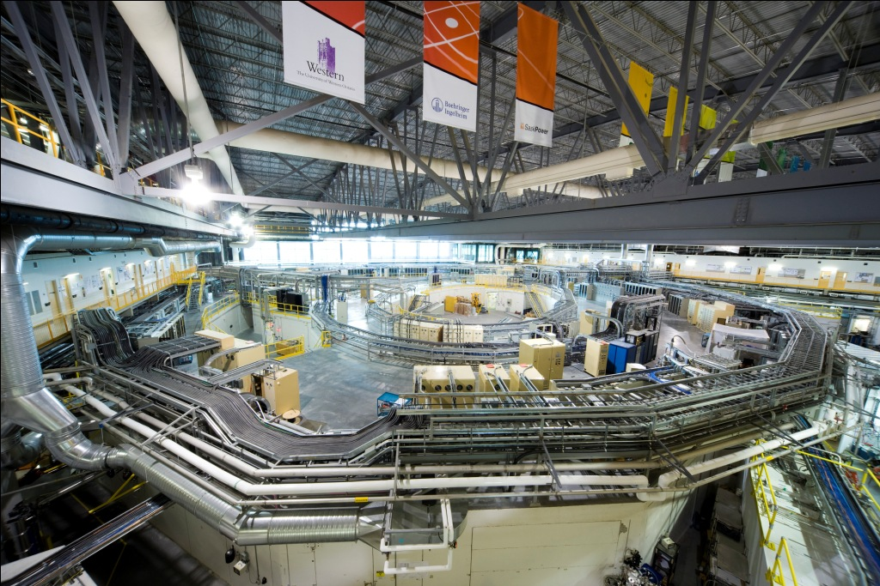

History
Monitor
Py-v2 to Py-v3
Refactoring
API
Bugs
ICALEPCS 2015
EPICS Collab 2016 (2)
EPICS Collab 2019
Health of the Control System
PV Requests
PV Connections
  IRMIS
  PV-Monitor
  Increment Feat.
22 beamlines
> 400 IOC-Servers
> 1k EPICS-Apps
> 500k PV’s
Notes:
2.9 GeV
76 meters in diameter
14 people in Controls and Instrumentation

Slide 4

Features
Track
PV requests
Number of requests
Origin of last request
PV name

Slide 5
Features
Track
PV requests
Includes
Requests that used to get a response
Duplicate PVs
Malformed PV names
Number of requests
Origin of last request
Requests that never get a response
PV name

Slide 6
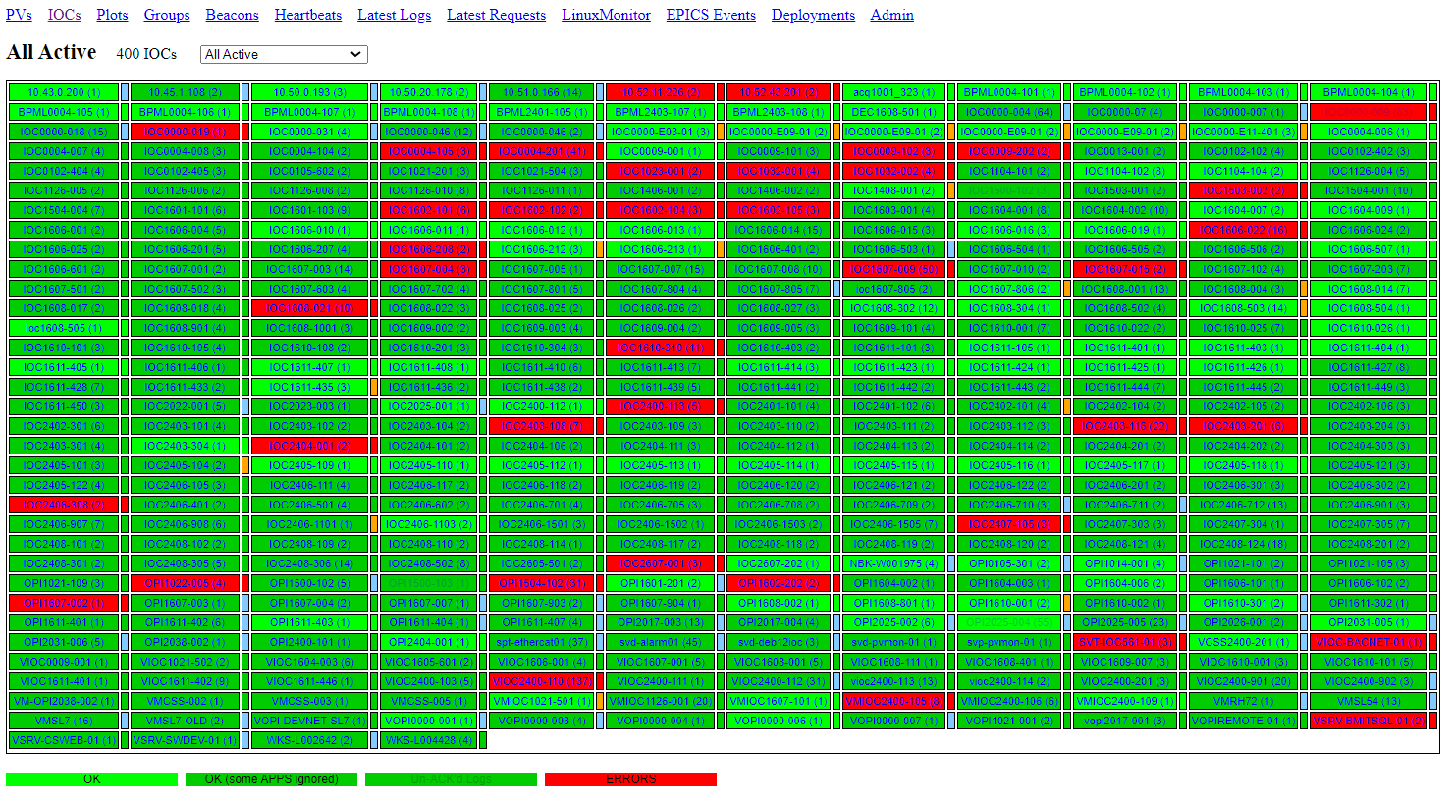
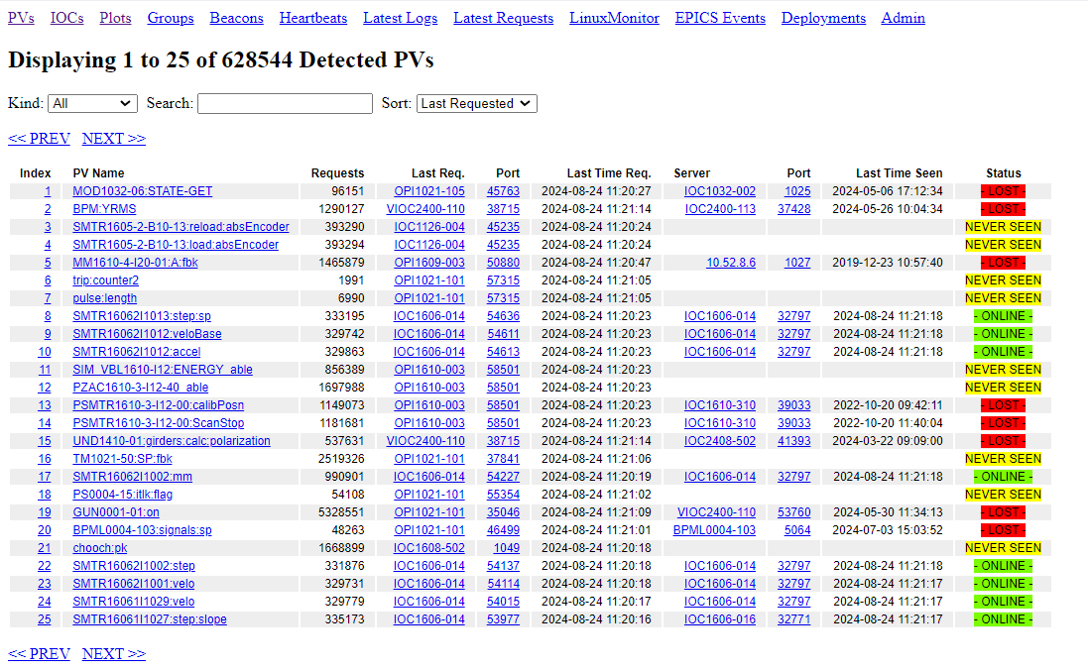
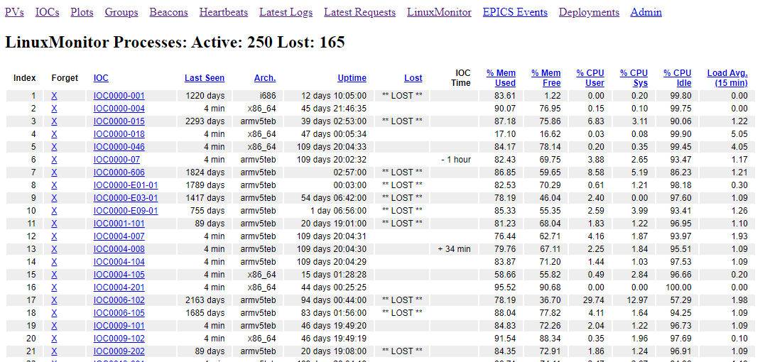
Features
IOC-Servers View
Track
PV requests
Includes
Requests that used to get a response
Duplicate PVs
Malformed PV names
Application serving the PV
EPICS IOC-Servers Names
Applications quantity running on a host
Uptime estimates of server applications
Applications that are no longer broadcasting
Number of requests
Origin of last request
Requests that never get a response
PV name
PVs View
LinuxMonitor View

Slide 7

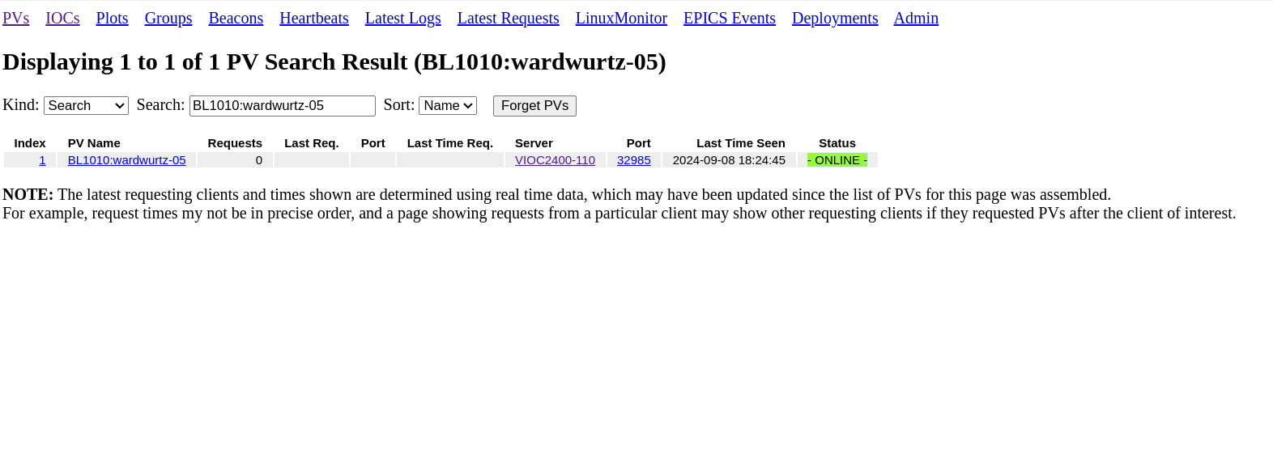
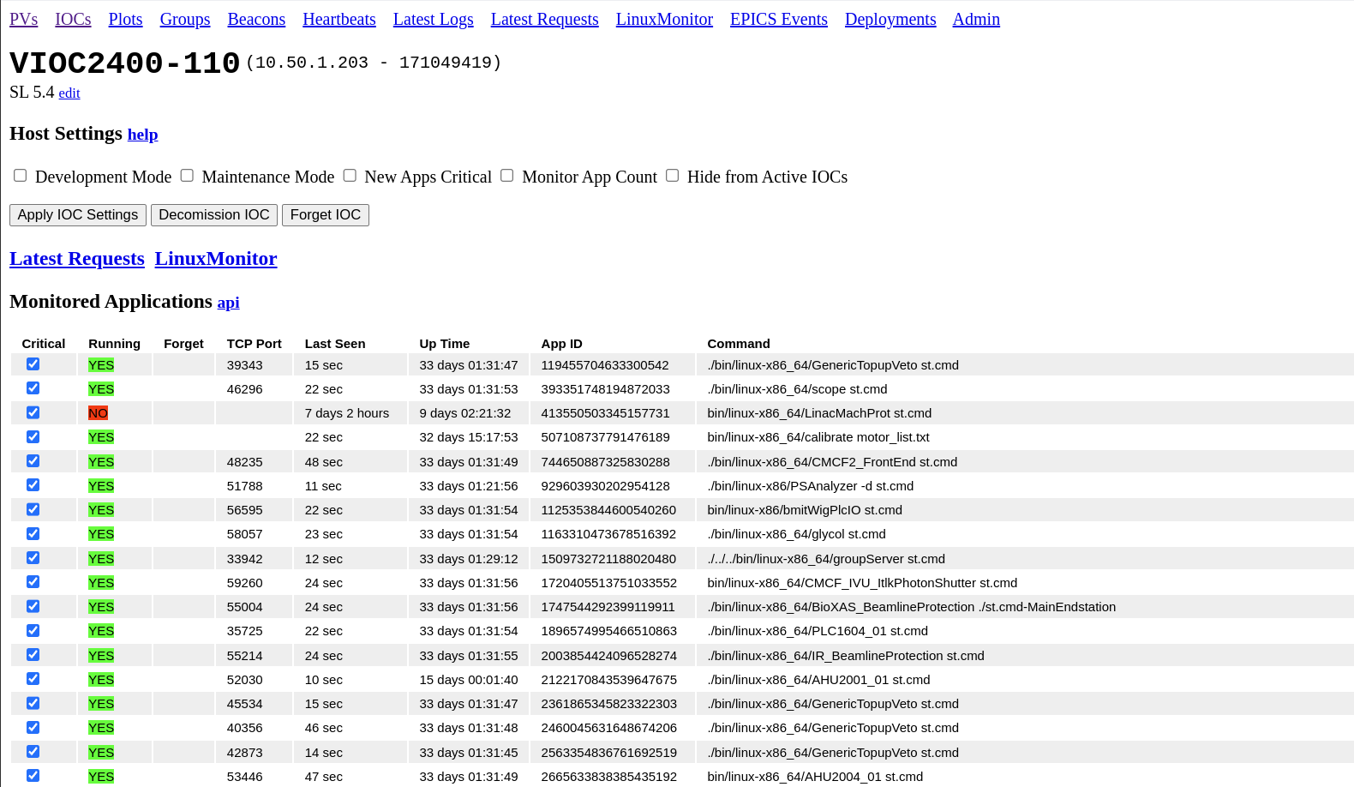
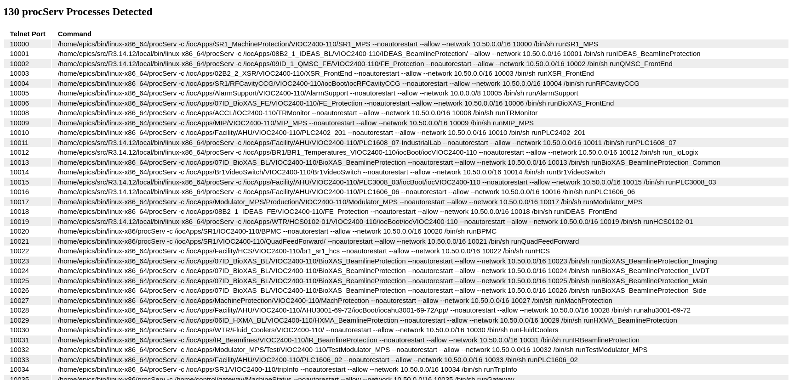
Features – Use Case 1
Daily case: “PV ABC-123 is not available!”
Notes:
7

Slide 8
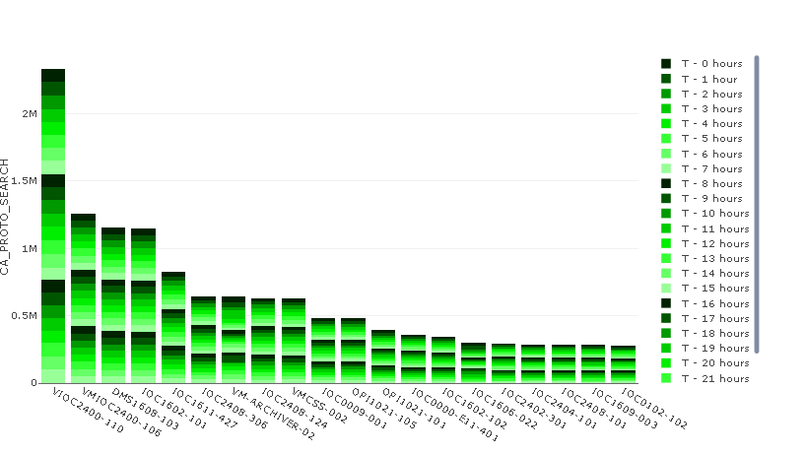
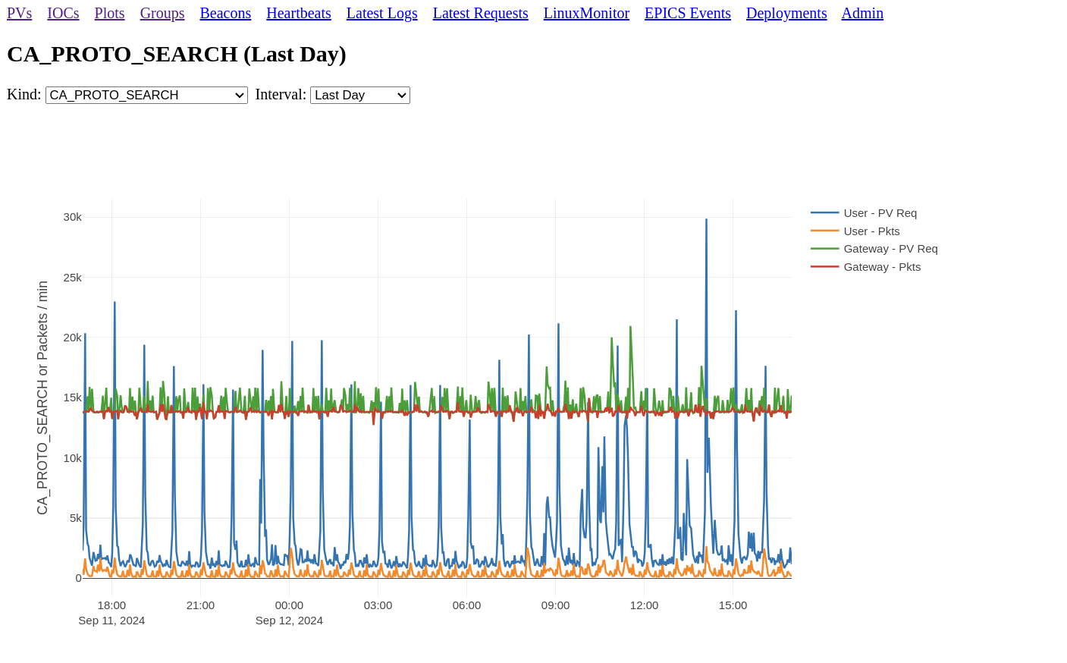
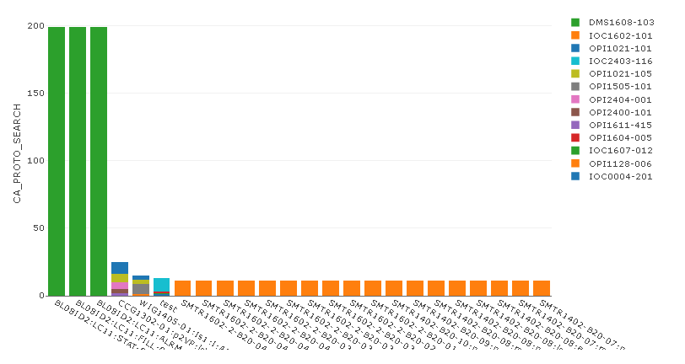
Features – Use Case 2
Detected overload of CA_PROTO_SEARCH on BL-VLAN
Notes:
8

Slide 9
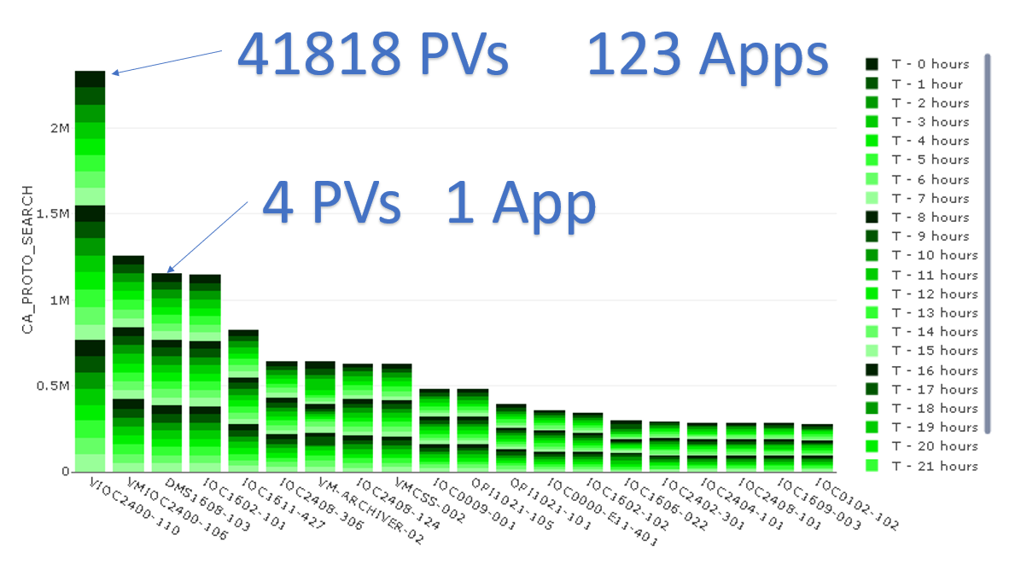
Features – Use Case 2
Detected overload of CA_PROTO_SEARCH on BL-VLAN
Notes:
9

Slide 10
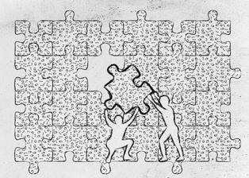
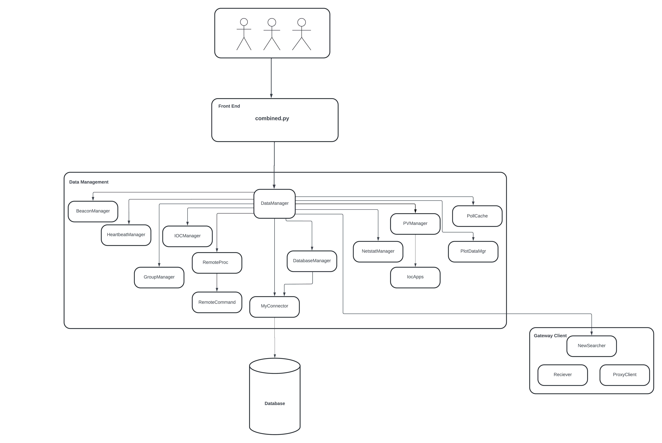
Architecture - Before
Find the PV’s doing cagets would be just too slow
  Timeout waiting for lost PV’s
pyCaGet sometimes Segfaults
  pyCaget uses epics library
Bypass and do CA_PROTO_SEARCH directly
Remote software needed:
  IOC-Applications
    EPICS Beacons
    Heartbeat (developed by CLS)
  IOC-Servers
    LinuxMonitor (IOC-Application)
Notes:
Monitor the EPICS traffic
Over time this gives you a list of PV names – throw them in a database in RAM
Cycle through the database polling the PV’s by creating our own requests – now you show
uld find out who is hosting the PV, if anyone
So far works on all versions of EPICS we are running, the latest being 3.12.14
Combined.py merged the original PV monitor with other CLS developed monitoring systems.

Slide 11
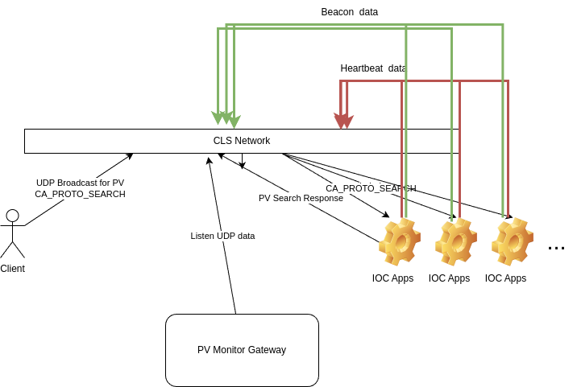
Architecture - Before
Find the PV’s doing cagets would be just too slow
  Timeout waiting for lost PV’s
pyCaGet sometimes Segfaults
  pyCaget uses epics library
Bypass and do CA_PROTO_SEARCH directly
Remote software needed:
  IOC-Applications
    EPICS Beacons
    Heartbeat (developed by CLS)
  IOC-Servers
    LinuxMonitor (IOC-Application)
Passive Acquisition
Notes:
Monitor the EPICS traffic
Over time this gives you a list of PV names – throw them in a database in RAM
Cycle through the database polling the PV’s by creating our own requests – now you show
uld find out who is hosting the PV, if anyone
So far works on all versions of EPICS we are running, the latest being 3.12.14

Slide 12
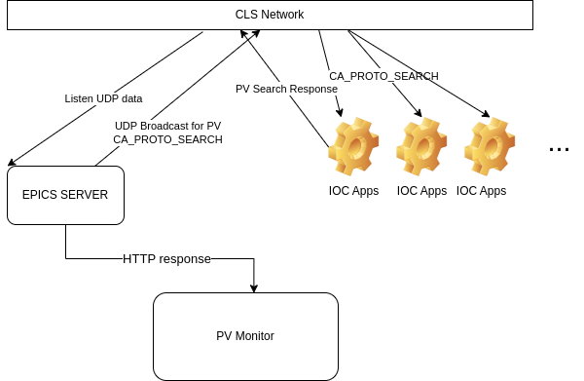
Architecture - Before
Find the PV’s doing cagets would be just too slow
  Timeout waiting for lost PV’s
pyCaGet sometimes Segfaults
  pyCaget uses epics library
Bypass and do CA_PROTO_SEARCH directly
Remote software needed:
  IOC-Applications
    EPICS Beacons
    Heartbeat (developed by CLS)
  IOC-Servers
    LinuxMonitor (IOC-Application)
Active Acquisition
Notes:
Monitor the EPICS traffic
Over time this gives you a list of PV names – throw them in a database in RAM
Cycle through the database polling the PV’s by creating our own requests – now you show
uld find out who is hosting the PV, if anyone
So far works on all versions of EPICS we are running, the latest being 3.12.14

Slide 13
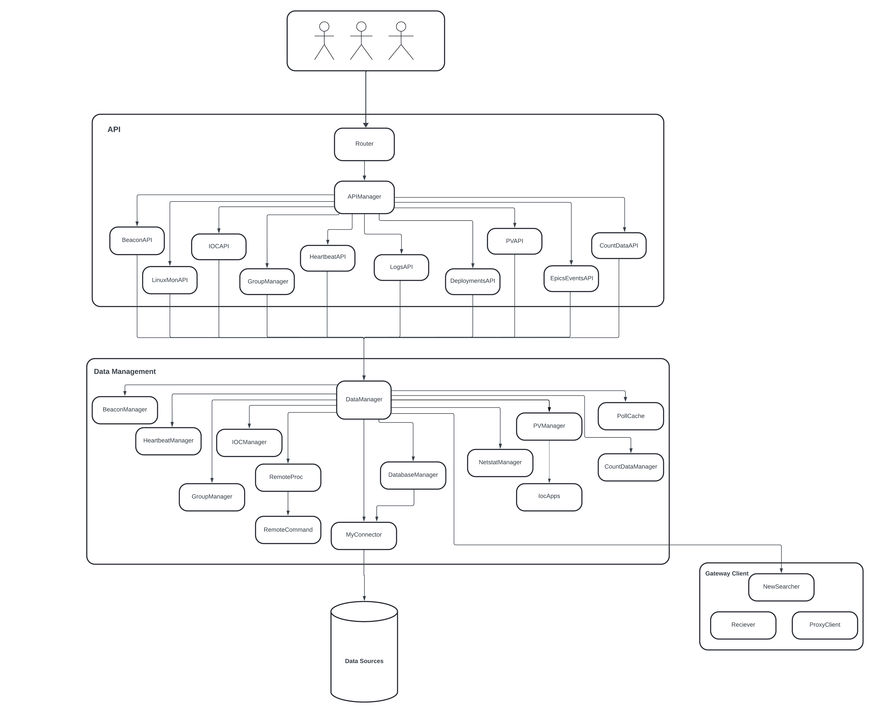
Architecture - After
Updated Python
Decoupled facility configuration from source-code
Added Automatic tests
Refactored code
Previous “Front-End” level structured into APIs
Notes:
The above images were generated using a project called
pyreverse
. The images represent the file structure and the communication between the files, before and after code refactoring.

Slide 14

Next Steps
New front-end web page using the API version
Refactor Data Management block
Make it facility-configurable – Welcome to test Beta
Release PV Monitor as open-source software
Make it PVA compatible

Slide 15

Augusto Yoshio Horita
e-mail: augusto.horita@lightsource.ca
Notes:
15

