Slide 1
Recsync-rs / PyRecCaster
Aqeel AlShafei
Oak Ridge National Laboratory
17 Sept 2024

Slide 2

Table of Content
Problem Statement
What is RecSync, RecCaster, and RecCeiver
Recsync-rs and PyRecCaster Implementation
github.com/ISISNeutronMuon/recsync-rs
Notes:
I’m talking rather than Aqeel because Aqeel didn’t clear ORNL security in time
I’ll be repeating the URL and QR code at the end of the talk

Slide 3
Problem Statement
At the ISIS Accelerators we have a number of tools developed in Python (pvapy & p4p) which create PVs. Currently it is not easy to track these PVs using standard tools such as ChannelFinder.
We needed a Python library which would implement RecCaster and thus allow Python created PVs to interact with EPICS tools such as ChannelFinder. This library would ideally be able to seamlessly integrate with our existing infrastructure and archiving systems. However, there was no existing RecCaster implementation available outside of the EPICS native IOC.
Notes:
Note that the Phoebus project has recently developed a Java implementation of RecCaster to test performance of the system?

Slide 4
Recsync, RecCaster, and RecCeiver
Allow synchronisation of record information from EPICS IOCs into ChannelFinder
RecSync is a project orginating in collaboration between Brookhaven National Laboratory and Helmholtz-Zentrum Berlin für Materialien und Energie as a part of the ChannelFinder project
Zero-Configration protocol from the IOC side
RecCeiver is the server side and RecCaster is the IOC side – collectively RecSync

Slide 5
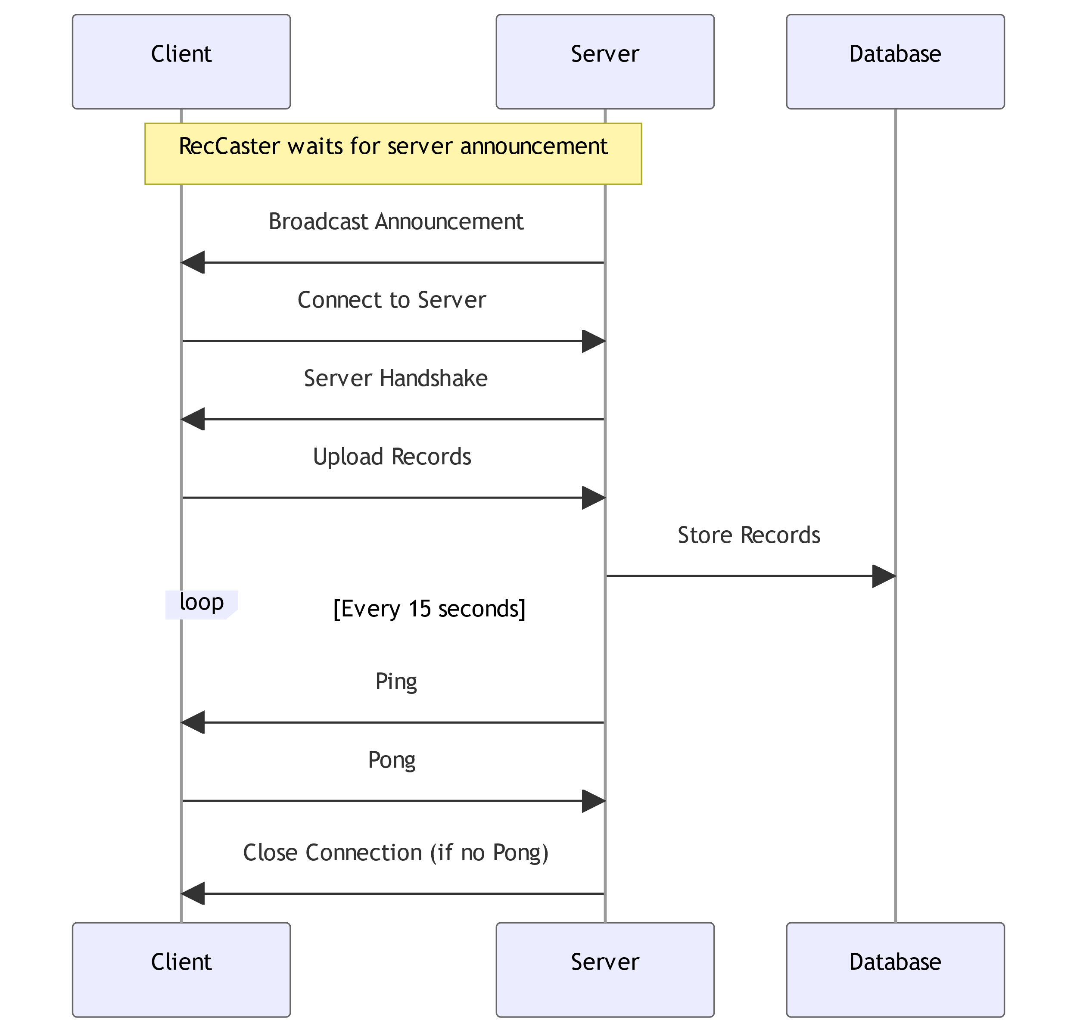
RecCaster and RecCeiver
Like EPICS protocols RecSync relies on UDP broadcast for service discovery and then switches to TCP.
Records are uploaded to a database, i.e. ChannelFinder.
Connection is maintained through regular ping/pong messages which allow IOC out-of-service to be detected.

Slide 6
PyRecCaster Implementation
Implemented in Rust with Python wrapper using PyO3
Accessible from Rust and Python with potential support for other languages if needed.
Cross-Compilation with minimal configuration (Windows x86, Linux x86, ARM 64)
Uses Tokio for async io
Avoids the Global Interpreter Lock (GIL) so it does not affect p4p put operation
Potential RecCeiver implementation
Notes:
PyO3 is Rust bindings for Python
Although we have cross-compiled for ARM we haven’t tested properly as we lack a test device.
The implementation in Rust was in part motivated by the need not to lock the GIL when updating

Slide 7
Project Structure
Wire – internal library of the RecSync protocol messages
RecCaster-rs – rust implementation of RecCaster, available as a rust library
PyRecaster – Python (pyo3) binding of RecCaster
Note, the project is structured so reimplementation of RecCeiver is possible if needed.
However, we only needed a Python RecCaster implementation/wrapper for our p4p IOCs

Slide 8
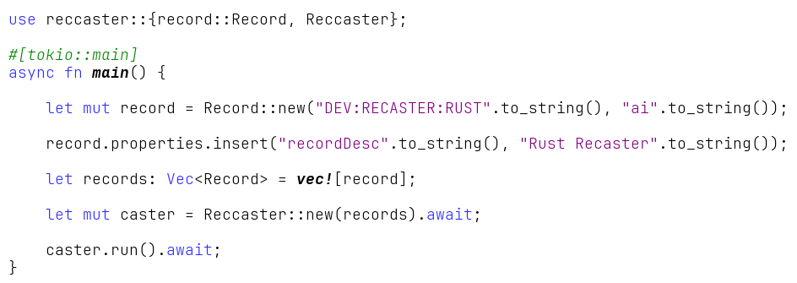
Rust Usage

Slide 9
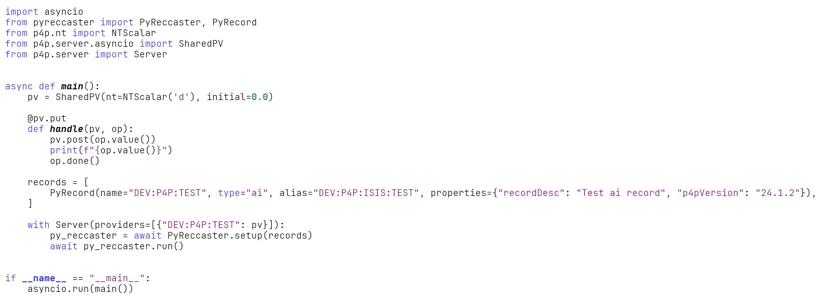
Python Usage

Slide 10

github.com/ISISNeutronMuon/recsync-rs
Notes:
Give demo here!

Slide 11
Reference
https://github.com/ChannelFinder/recsync
https://github.com/ChannelFinder/ChannelFinderService
https://channelfinder.github.io
https://github.com/ChannelFinder/pvinfo

Slide 12
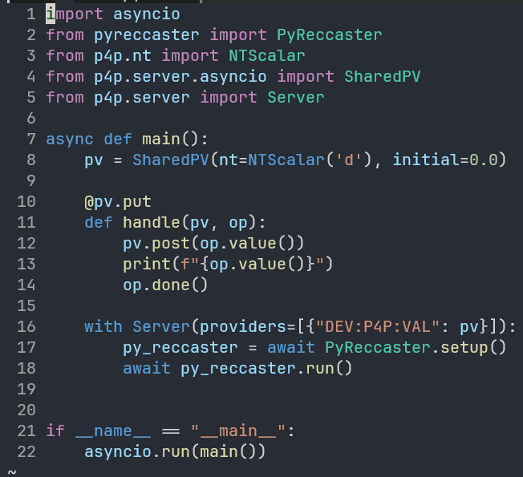
Python Usage

Slide 13
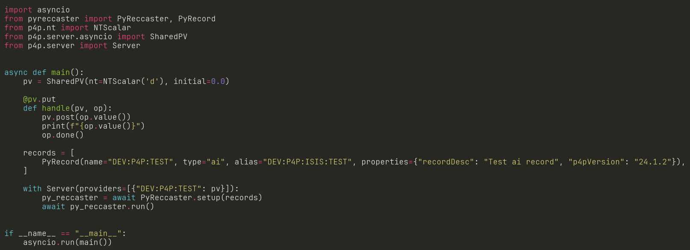
Python Usage

