Slide 1
PVAccess, Docker, and the UDP Broadcast Problem
Ivan Finch
SNS, Oak Ridge, Tennessee
Weds 18 Sept

Slide 2
UDP – Postal Analogy
UDP is like a postcard.
We send if off to an (IP) address and receive no notification about whether it was received.
Notes:
Let’s send a postcard from Oak Ridge to Oxford.
It’s a postcard because anyone can read the text; to make it secure we need other tools.
UDP is used for DNS, Why do we use UDP if it’s unreliable? It’s fast and lightweight

Slide 3
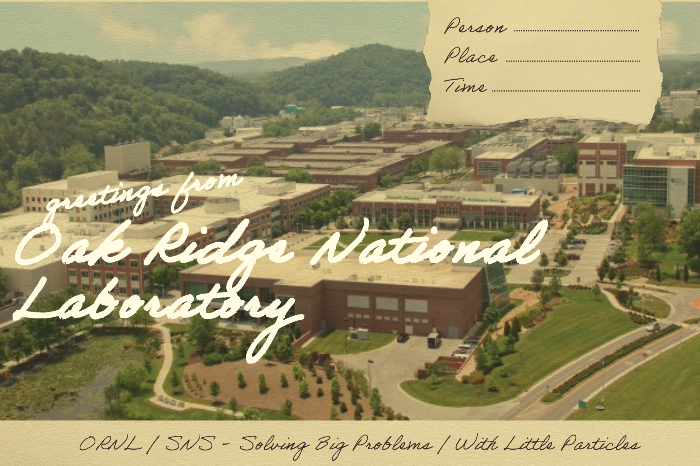
TCP – Postal Analogy
TCP is like a postcard.
Except that our recipient always writes back to tell us whether they received the message and whether any parts of it were missing.
Dear Sender,
I acknowledge receipt of your postcards but did not receive message 3 out 4. Please resend. I will not read your messages until this has been received.
1 of 4
Notes:
TCP is used in more familiar places: http, smtp (email), etc.

Slide 4
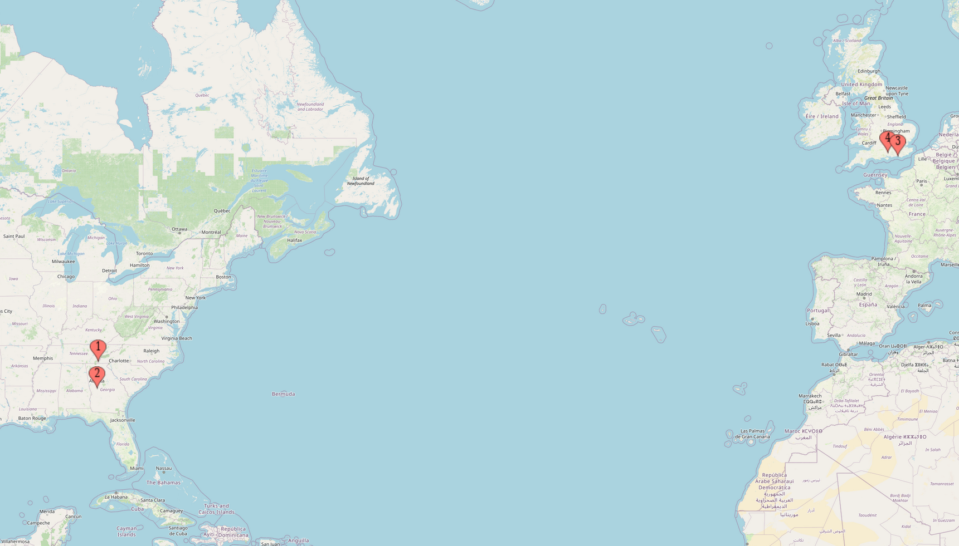
Routing – Postal Analogy
Post doesn't just teleport!
We can imagine our postcard from a post box in Oak Ridge goes to the local sorting office, then onto a US Post international sorting office (in Atlanta?), a plane to a Royal Mail international sorting office in London, then to a local sorting office in Oxford, and then to my colleagues.
This also works a lot like a simple model of the internet!

Slide 5
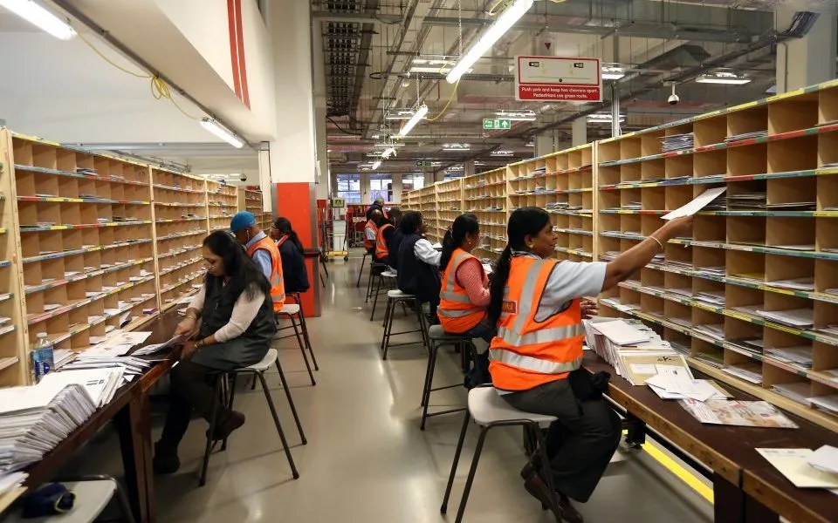
UDP Broadcast – Postal Analogy
Imagine we send a postcard to our sorting office and it sends a copy to every address it serves – this is roughly how UDP Broadcast works.
An important limitation is that it will only be sent to local addresses. Even though we know our sorting office can send messages to England we can't get these broadcast messages to there.
Notes:
There is no TCP multicast, only UDP has multicast. TCP is unicast only and the usual way of using UDP is unicast too.
We can nickname this SpamShot!

Slide 6
Network Boundaries
We are often in a situation where two devices (servers, clients, IOCs, etc.) can talk to each other via TCP and UDP unicast but because of network boundaries cannot talk to each other via UDP Broadcast.
In our postal analogy, postcards may be sent between the two devices but they are served by different sorting offices.
Network Boundary
Device 1
Device 2

Slide 7
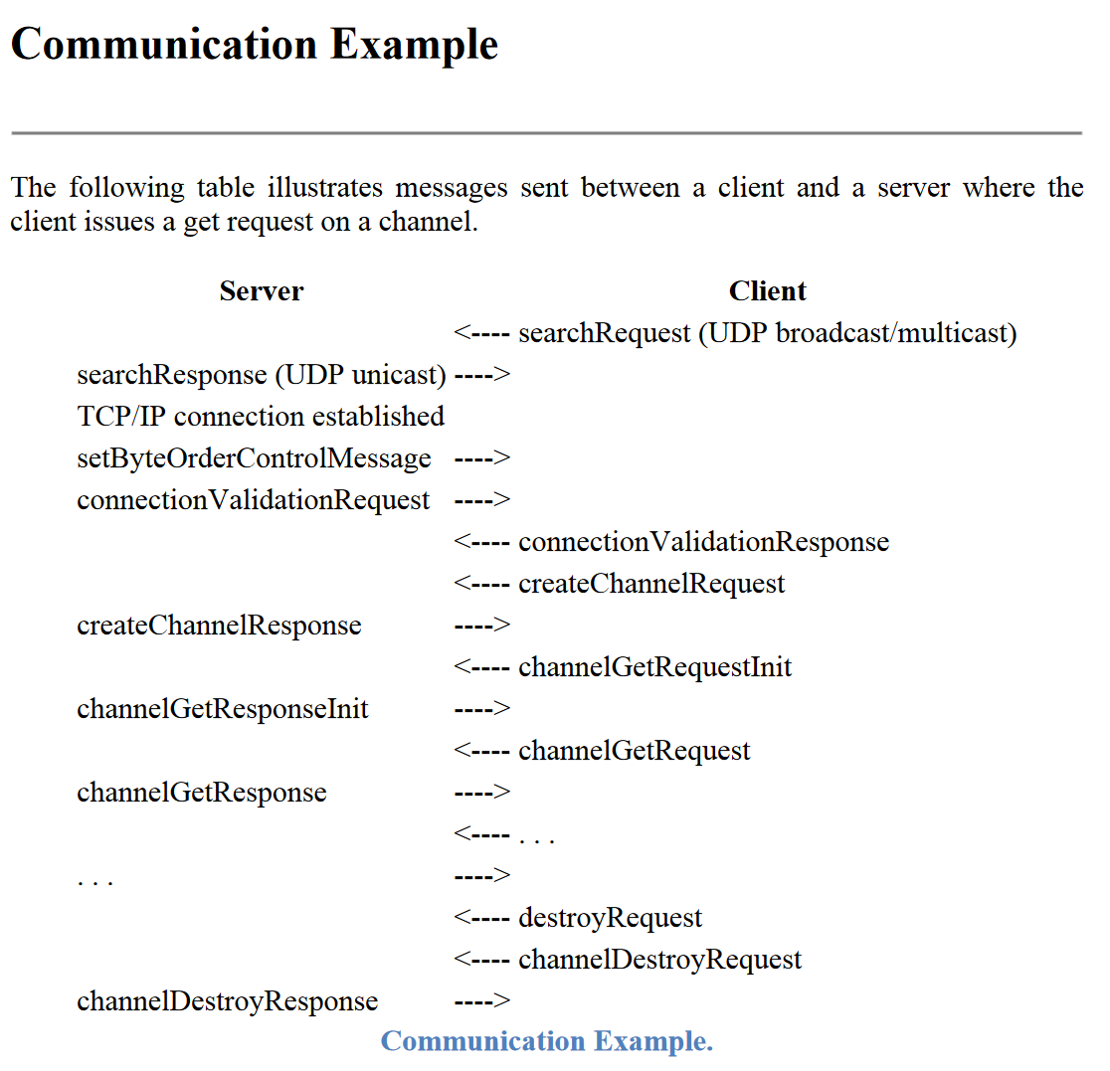
pvAccess
pvAccess uses a combination of UDP Broadcast (or Multicast), UDP unicast, and TCP
The basic pattern is that when a client wants to know if a server (IOC) has a PV it sends out a search message as a UDP Broadcast on the local network. If any server has the PV it replies via UDP unicast and the systems establish a TCP connection to exchange further information.
Notes:
Communication example from standard specs document

Slide 8
What's the Problem?
Using pvAccess in combination with containers:
Everything works as expected within the same container
Everything works between containers. If they're on the same machine and container network – typical for development
UDP broadcasts can't escape the container network, e.g. Phoebus on the local machine cannot see PVs inside a container on the same machine. (This can also be useful for development!)
UDP broadcasts cannot cross between nodes in a Docker Swarm setup, even if they are in the same container network.
Together these make it hard to develop pvAccess with containers and makes normal redundancy schemes difficult to implement on container orchestration systems.
Notes:
I’m not going to explain what Docker or containers are.
You can get around this by using host networking on Linux, but this solution doesn't work on Windows

Slide 9
Docker Swarm
Node 1
Node 2
Node 3
Client
PV
Docker Swarm is Docker’s rough equivalent of Kubernetes – a way of orchestrating containers across multiple systems. It uses the same basic configuration as the familiar Docker Compose files and offers robust failover. If a node leaves the swarm its containers migrate to other available nodes.
Docker networks are transparent across nodes in the Swarm. However, this is not true for UDP broadcast. It is not possible to search for PVs on other nodes in the swarm.

Slide 10
What's the Solution? – EPICS_PVA_NAME_SERVERS
In some cases, there is an easy way around this limitation.
The environment variable EPICS_PVA_NAME_SERVERS allows us to bypass the UDP broadcast search and UDP unicast search reply. Instead, we can set the EPICS_PVA_NAME_SERVERS environment variable to point directly at the IP address of the required server if we know it.
EPICS_PVA_NAME_SERVERS is supported in:
pvxs – C++ library for pvAccess
p4p – Python library for pvAccess (built on pvxs)
Phoebus
It is not yet supported by EPICS base. This support is anticipated to arrive in the next release.
As we are bypassing search we must set the IP address of every IOC / container in advance.
There are also security implications around EPICS_PVA_NAME_SERVERS. It is possible to believe that IOCs cannot be controlled from outside the local network when this is not the case
Notes:
The big problem here is that we need to need to know in advance all the IP addresses of all the PVs we might want to use

Slide 11
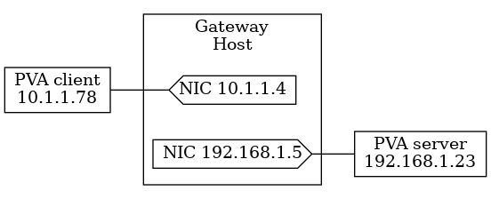
What's the Solution? – PVA Gateway
There is an existing solution for making pvAccess PVs available across network boundaries: PVA Gateway
PVA Gateway has a client side and a server side, which may be on different networks, and allows connections to bridge between these two networks.
A useful trick for docker is that we can target the default bridge network as the server side. This allows a gateway on bare metal to see containers on the same node.
PVA Gateway is part of p4p, written by Michael Davidsaver.
https://epics-base.github.io/p4p
Images from PVA Gateway documentation

Slide 12
PVA Gateways on a Docker Swarm
Node 1
Node 2
Node 3
Ingress and Egress PVA Gateways use different TCP ports so that they do not interfere with one another.
Egress
PVA Gateway
Egress
PVA Gateway
Egress
PVA Gateway
Ingress
PVA Gateway
Ingress PVA Gateway
Ingress
PVA Gateway
PV
Bare Metal
PVA Gateway
Bare Metal
PVA Gateway
Bare Metal
PVA Gateway
Get
Notes:
This proved unreliable in practice. It generates large numbers of error messages about duplicate PVs, produced hard to diagnose problems, and kept blowing up or servers with out of control logs.
Just look at it! It smells bad

Slide 13
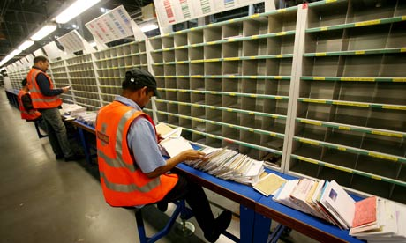
Relaying UDP Broadcast Messages
Back to the postal analogy one last time. We want pvAccess Search messages to cross between defined network boundaries. We can do this by establishing a relay system.
We have an agent that receives UDP broadcasts from one sorting office and forwards them on by conventional UDP to another agent at a different sorting office. The second agent then performs a UDP broadcast, acting as a relay.
Relay
Relay
Notes:
Packet spoofing

Slide 14
SnowSignal on Docker Swarm
Node 1
Node 2
Node 3
Relay
Relay
Relay
PV
Client
Bare Metal
PVA Gateway
Bare Metal
PVA Gateway
Bare Metal
PVA Gateway
Get

Slide 15
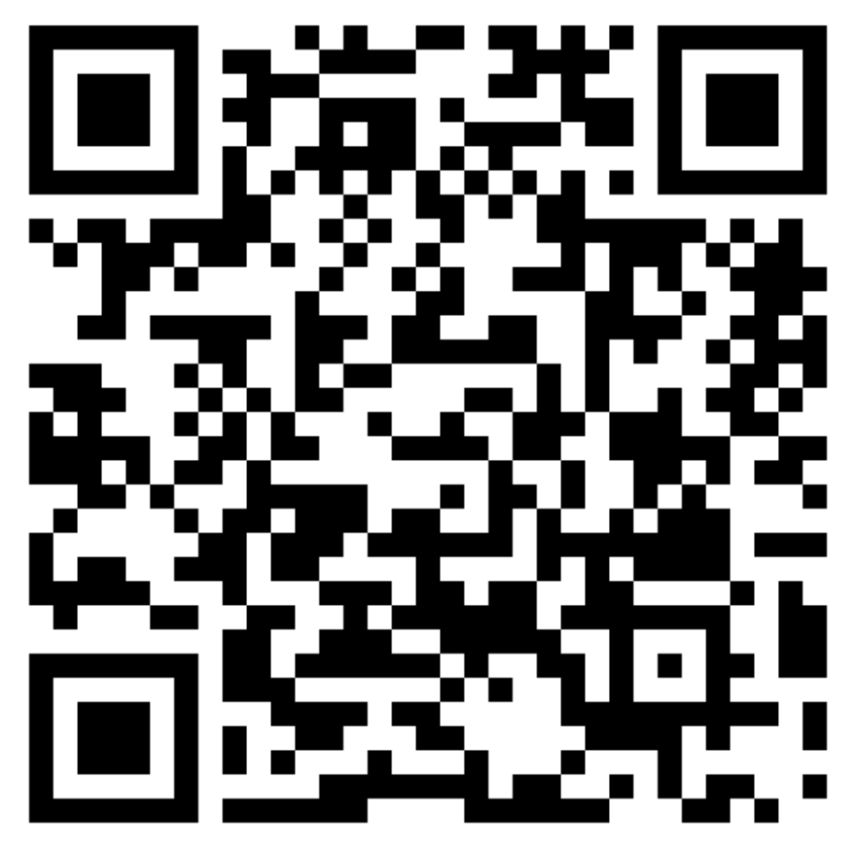
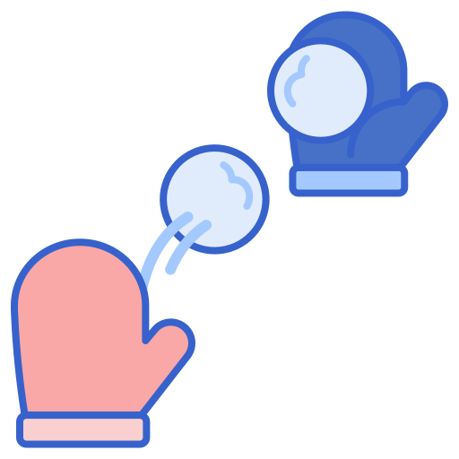
SnowSignal
https://github.com/ISISNeutronMuon/SnowSignal

Slide 16
SnowSignal compared to PVAGateway
SnowSignal
PVAGateway
Allows pvAccess UDP broadcast search and beacon messages to cross network boundaries via UDP & TCP unicast
Allows pvAccess across independent networks
Allows filtering by PV name
Allows authentication and authorisation
Allows use of alternate ports to standard ports

