Slide 1
Status Update on the EPICS Transition at the ISIS Accelerators
Ivan Finch
Spallation Neutron Source, Oak Ridge National Laboratory
EPICS Collaboration Meeting Fall 2024
Tues 17 Sept

Slide 2
EPICS at the ISIS Accelerators
Every site does EPICS differently. This is how we do ours:
PVAccess (preferred over Channel Access; no CA so far)
IOCs where we can re-use existing code, new interfaces in Python / p4p
Most of our PVs are still in our old Vsystem control system with a bridge to EPICS (pvecho)
Container based development and deployment
Docker Swarm + Portainer
GitLab CI/CD used to deploy IOCs and other services
Custom pipeline to deploy IOC
Using Phoebus and its infrastructure for HMIs and other user interfaces
HMIs made available through nginx webserver
Notes:
Thank for advice from the EPICS community starting at EPICS Collaboration Meeting at ITER 2019
Usual caveat that we don’t have a unified controls team and that Freddie Akeroyd / Beamlines & Instrumentation are already on EPICS – CA & Windows
Kathryn will be speaking about our unusual use of p4p later in the week
Note that pvecho is/was developed by Kathryn
We recently had to rebuild our entire production swarm. This was made possible by our use of git

Slide 3
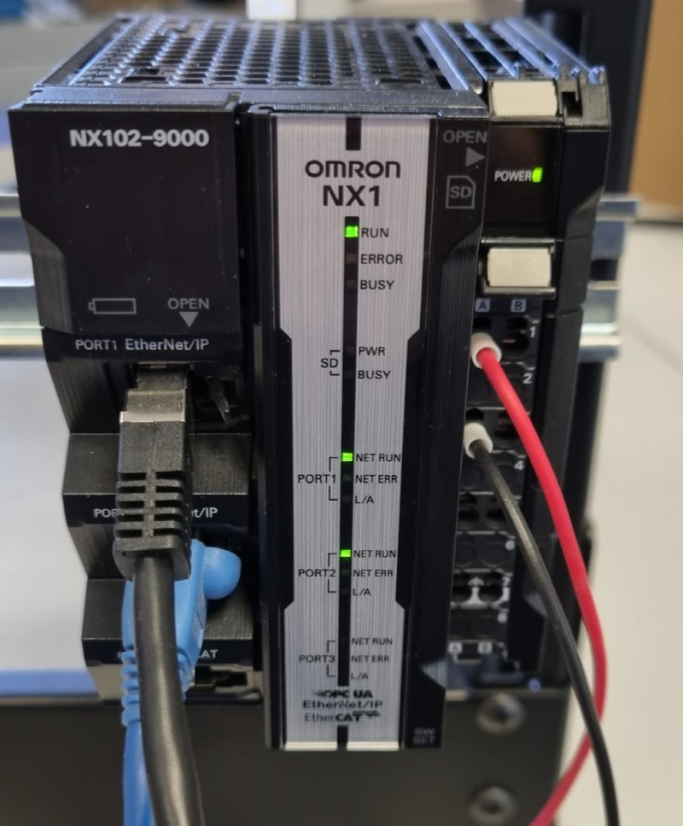
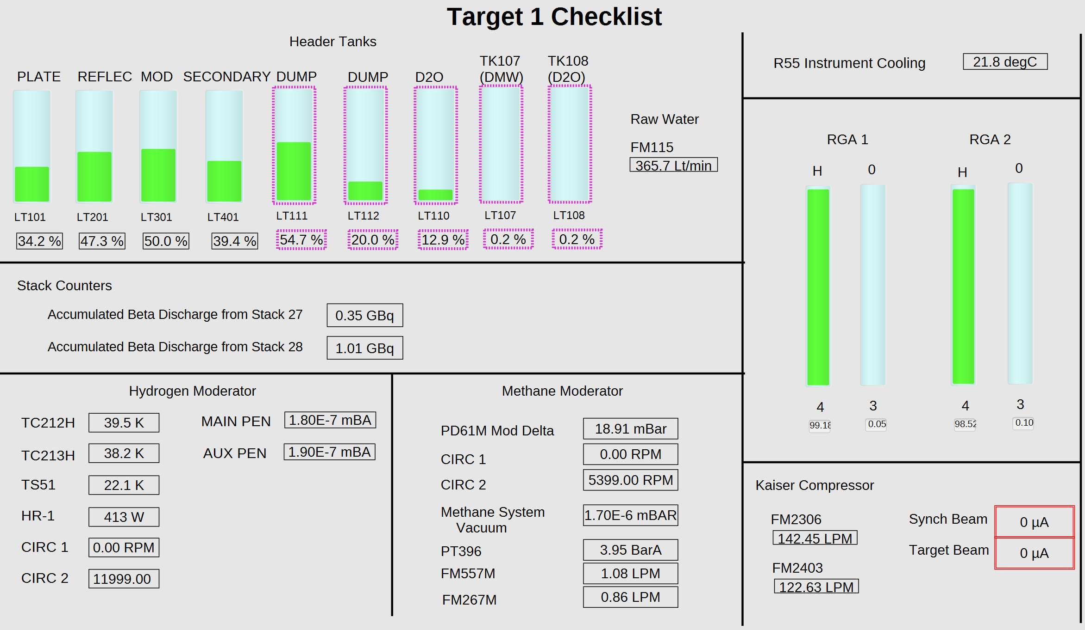
A Control System
Hardware
Interfaces
Backend /
Infrastructure
User
Interfaces
Our users care about the interfaces:
Hardware interfaces for equipment owners
User interfaces for operators and equipment owners
But we have spent a considerable time in this period working on backend and infrastructure.
Notes:
The story is simple for hardware and user interfaces and more complex for backend / infrastructure

Slide 4
Hardware Interfaces
Vsystem Only (pvecho) | Conventional IOC | p4p
MPX* | FINS – TS1, TS2, other older PLCS Mobiis conversion of existing Vsystem configuration | PXI / CPS* – In-house systems Largest number of existing PVs
STE* | Modbus – PLCs, Synch RF, Mag PSUs | Omron – New TS1 PLCs Used CIP, moving to MQTT
 | Personnel Protection System (PPS) | Serial / Moxa
 | Digital Waveform System (DWS)* | DWS*
* ISIS specific | Red Pitaya
Newly added systems EPICS only where possible; PVEcho enables continued Valarm use
Exploring: OPC-UA (conventional IOC developed at ITER)
Open Problem: LabView (no existing PVAccess library); simpler systems will use CPS/PXI interface
Notes:
PXI / CPS represents >50% of channels in control systems with FINS the next largest. Largest problem remains logic embedded in existing databases and scripts reliant on them
For MPX and STE the plan was always to let them go obsolete with Vsystem, no effort to develop EPICS interfaces. MPX based on CAMAC system in use at CERN in the ‘70s. Two crates still in backup use.
FINS (Gareth) uses an IOC from Experiment Controls / Diamond; Mobiis are working to convert our existing Vsystem configurations to EPICS. Undergoing testing, some initial issues with speed and embedded logic
Modbus (Aqeel) – used by Schneider PLCs, new RF systems and under-procurement (?) magnet power supplies. Working well and importantly a prototype for our new deployment pipeline
PPS interface; read status only – hardware upgrade by Diamond, software by Daresbury. Not sure of status
Red Pitaya (Rob Abel / R106 RF Amp EPICS IOC) – our first example of someone wanting to add their own IOC to our setup
DWS (Kuang, Aqeel+Kathryn) – using manufacturer developed IOC but some prototying/intermediate interface in p4p
PXI / CPS (Ajit) – under-development, mention Ajit part-time but going full-time
Omron (Mat) – in-use for TS1 but unsatisfactory (speed, reliance on no longer maintained library). Mat has developed a new MQTT library. Note the non-standard requirement that PLCs control alarm settings
Serial / Moxa (Nadir) – supporting change to uTCA and cheaper alternative to existing serial interfaces. Testing showed an important point about embedded logic
Overall – progress looks good but there are some important delays and remaining progress is difficult to judge

Slide 5
Backend / Infrastructure
Hardware interface / Equipment Owner facing:
p4p for ISIS / pyRecCaster
Policy for required IOC Modules – IOCstats & RecCaster
PVEcho – e2v (EPICS to Vsystem) for alarms
Tickit / LEWIS for PLC simulation
Internal Tools:
PVA Gateways / SnowSignal (UDP Broadcast Relay)
Automated renaming of PVs, esp. Vsystem derived
Early investigations of Traefik
ChannelFinder + PV Info
Frontend / User facing:
Phoebus services
Olog,
EPICS Alarms & Alarm History,
PVWS + DBWR
Save-and-Restore
sshrelay
Deployment pipeline for Single Channel Profile Monitors
Other:
Continuing work on PV Naming standards
Machine learning – Automated tuning of LEBT, interaction with surrogate models, use through Phoebus
Early exploration of BlueSky / Ophyd, Phoebus Scan Editor, etc. for simple scripting
Italics show tasks that will be obsolete on completion of transition to EPICS
Notes:
Remember to name who is responsible for each of these
Deployment pipeline for Single Channel Profile Monitors is an example of user interface requirement for p4p for ISIS (DEMO!)
A major theme is tracking PVs (e.g. pyRecCaster, ChannelFinder) as this is a major change in philosophy from centralised Vsystem
IOC modules policy should probably include IOC autosave
PVA Gateways esp in combination with docker have been experimental and have caused problems during maintenance and startups but so far proved reliable in cycle

Slide 6
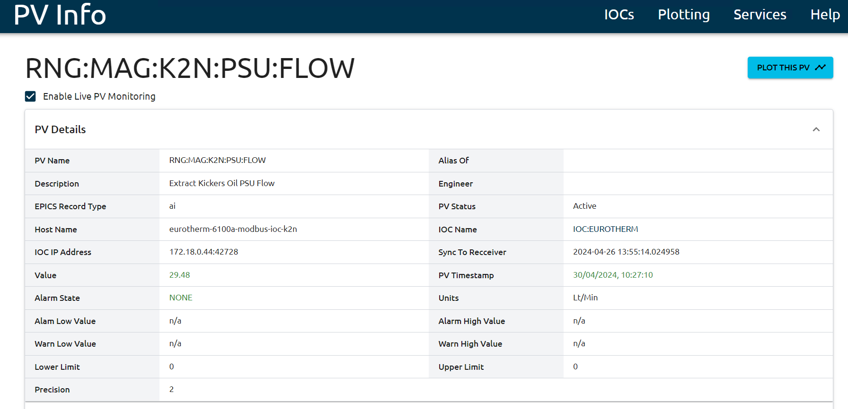
User Interfaces – Phoebus and Other Interfaces
Previously we had enabled the EPICS Archiver Appliance and our users were using the Phoebus Data Browser even before the first HMIs were ready.
We are now using or testing many more Phoebus features:
Olog – electronic logbook (being tested by target controls)
Save-and-Restore – initial testing by machine physicists, possibly awaiting point-in-time features
Alarm Area Panel, Alarm Tree, and Alarm Table – early testing in the MCR
DBWR – rendering of control screens to web interface, very early testing
Outside of Phoebus we are implementing other support services:
RecSync / ChannelFinder for PV tracking and searching (integrated into Phoebus)
PVInfo as a web front-end for above and other support services (such as pvws)
Notes:
The theme here is using a collection of services developed by the Phoebus collaboration. This isn’t new but we are trying to leverage a lot of work by other institutions
Phoebus is itself deployed through Microsoft SCCM (Software Center) in cooperation with our central IT team
Our biggest problem with User Interfaces is non-technical. It is finding the time to train users and to move acceptance along. We did our initial deployment of Save-and-Restore with machine physics a year ago but they’re not really using it. They’re using a primitive system cobbled together out of Basic scripts running off an 8-hourly schedule on OpenVMS or just screenshots and notes.

Slide 7
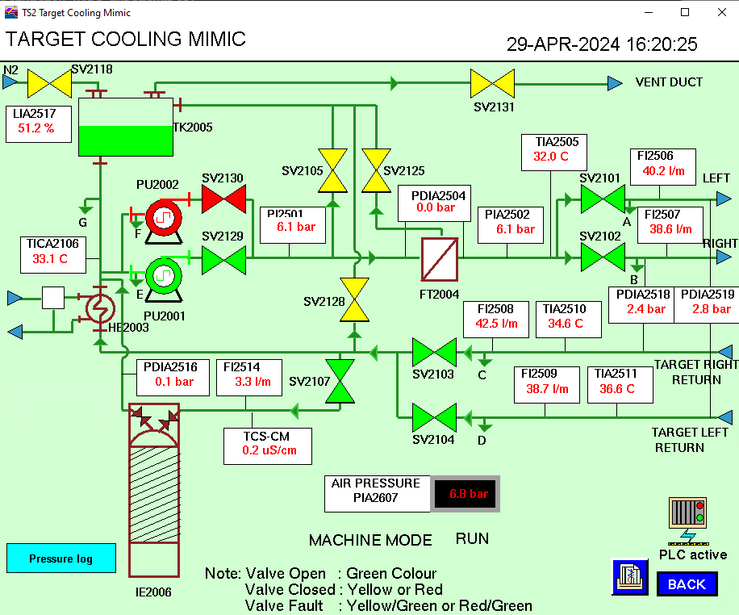
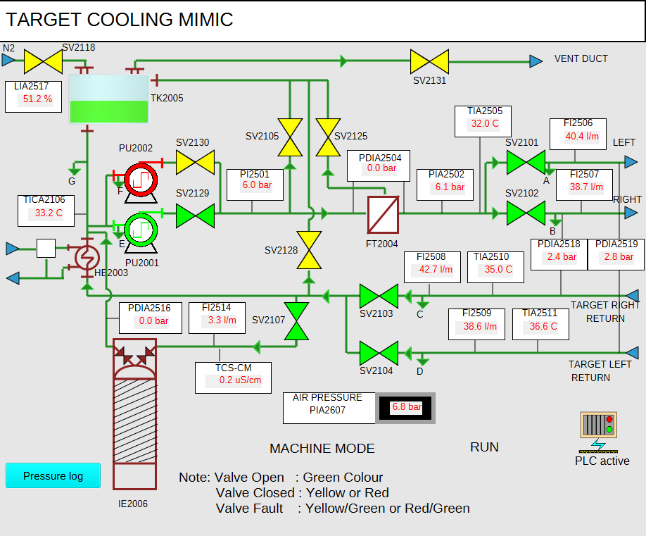
User Interfaces - HMIs
We use Phoebus for HMIs, with screens deployed via nginx.
Previously we had:
New Target 1 HMIs developed in Phoebus (and with data from EPICS)
Autoconverted Vsystem HMIs (with data from Vsystem via pvecho)
Our contractors Mobiis have finished review of all autoconverted screens and manual corrections. We are now merging the corrected screens before acceptance testing by operators.
We have a number of screens (Synch RF, Synch correction magnets, etc.) which are too complex to be made from autoconverted screens and will need to be redesigned.
Notes:
Phoebus is itself deployed through Microsoft SCCM (Software Center) in cooperation with our central IT team
This is still a halfway house as we will not have a unified look-and-feel and will not have

