Slide 1
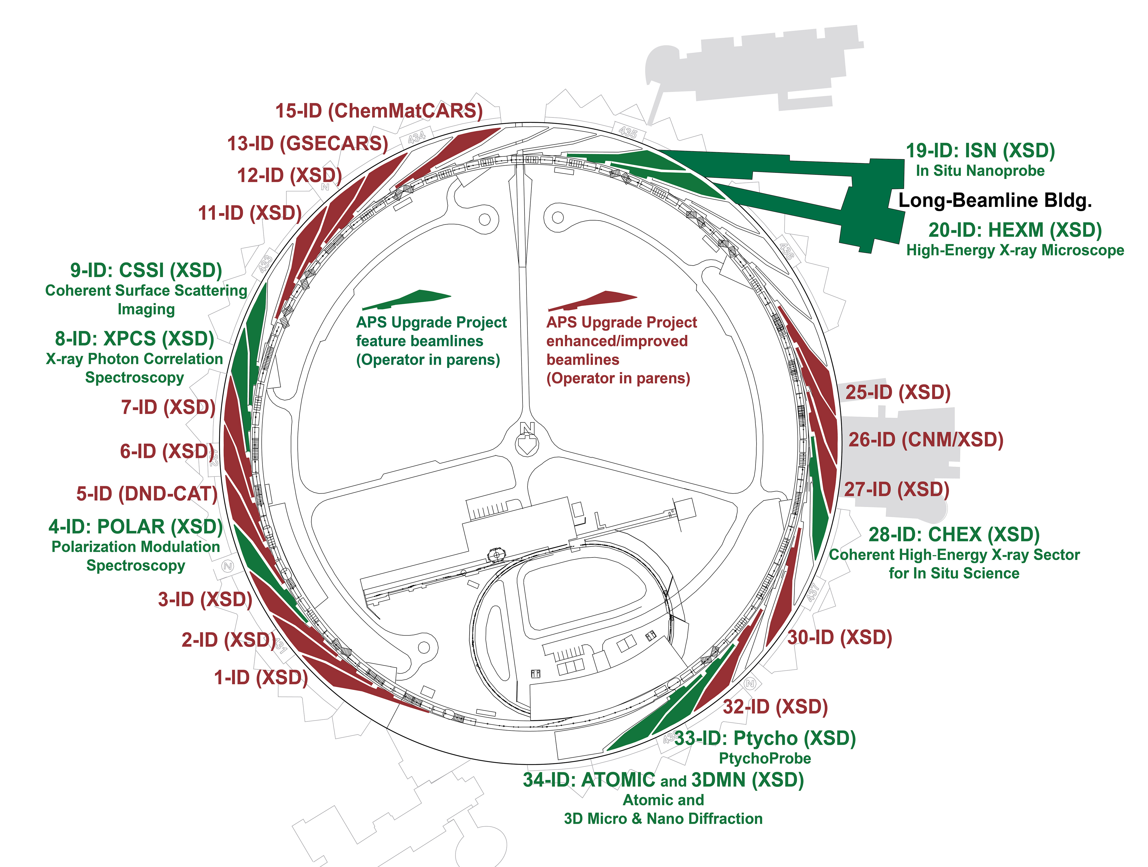
Beamline Data Pipeline Design Experiences Under APS Upgrade
Keenan Lang
(Beamline Controls)

Slide 2
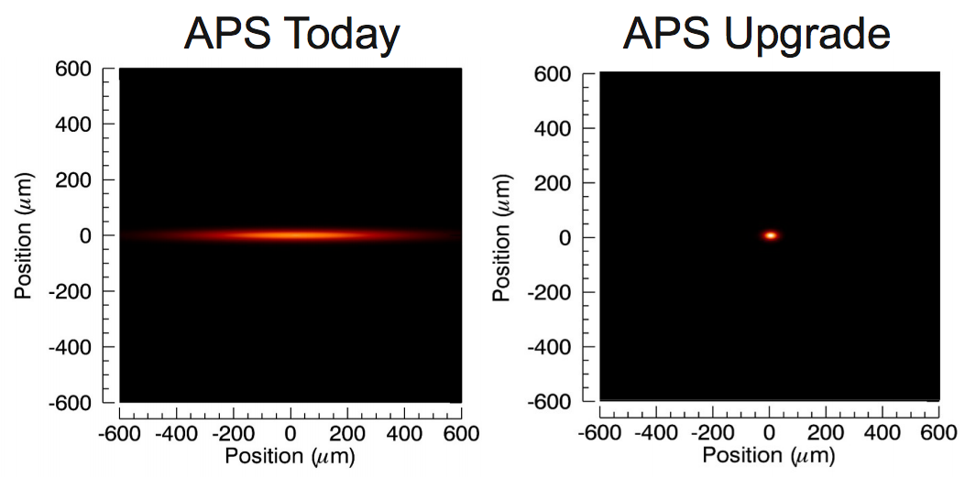
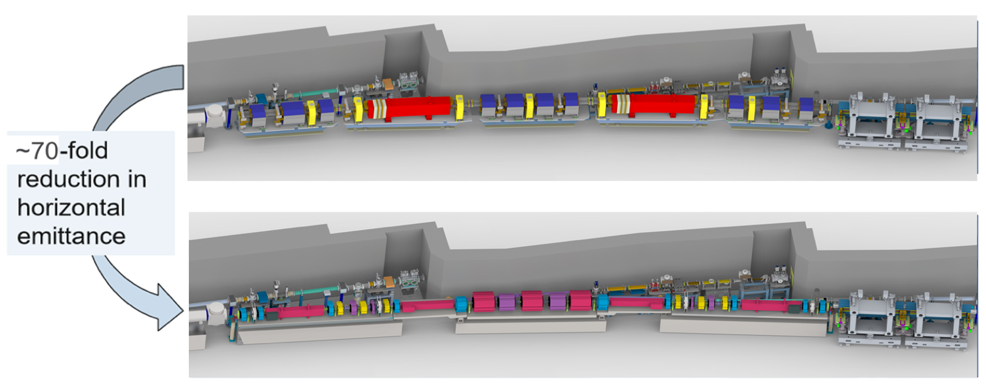
APS-U
APS Light Source Improvements
X-ray detector capabilities are constantly improving: bigger frames, higher frame rates => more raw data
APS Upgrade: Higher brightness => more x-rays can be focused onto a smaller area => more raw data in greater detail and less time
Typical APS-U detectors support ~MB frames at ~kHz rates => GB/s data rates
APS double bend lattice
APS-U 7-bend achromat lattice
Data Deluge: Next Generation Detectors Have Higher Spatial Resolution and More Photons Enable Faster Detector Operation

Slide 3
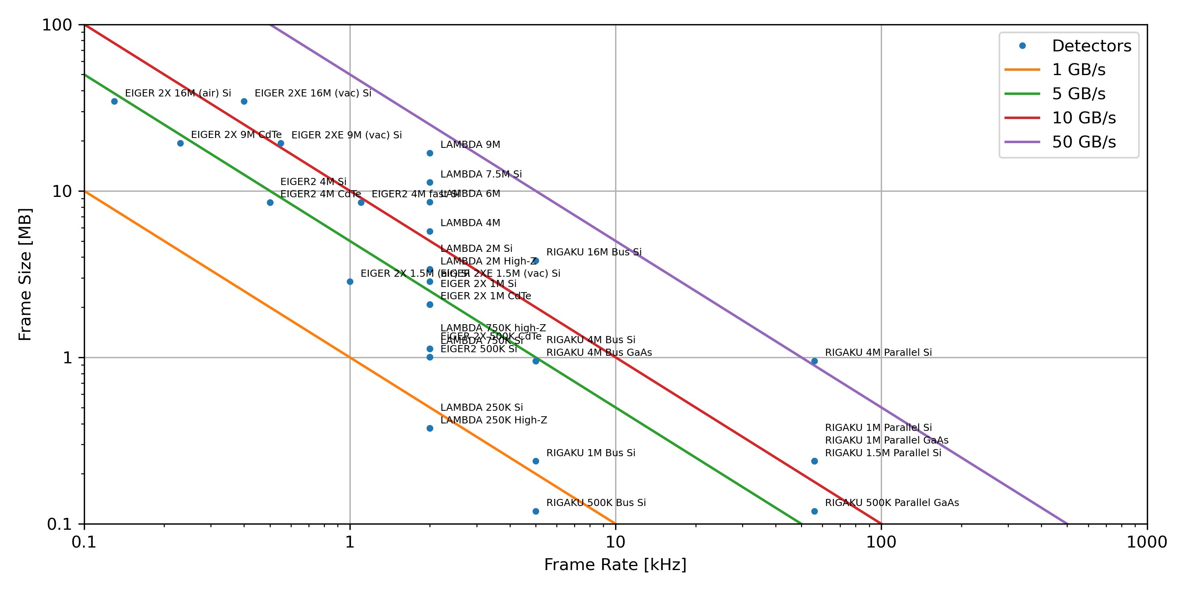
Candidate APS-U Detector Data Rates
New High Data Rate Detectors Necessitate Software and Hardware Infrastructure Capable of Bridging Detectors, and Compute and Storage Resources

Slide 4
Scale of the challenge
Multiple Order-of-Magnitude Increase in Demand For Computing Resources Over Next Decade
APS-U Era
~68 beamlines
9 feature beamlines and many enhanced beamlines
Over the next decade the APS will
Generate 100s of petabytes (PBs) of raw data per year
Require 10s of PFLOP/s of on-demand computing power for first pass data processing and reduction
For more information see the APS Scientific Computing Strategy document
Estimated APS Data Generation Rates Per Year
Log Scale: Estimated data generation volumes per year at the APS. Data generation will drop temporarily due to the installation of new storage ring and beamline upgrades.
<number>

Slide 5
Guiding Philosophy
Solution will prefer existing APS and synchrotron light source community tools and technologies, for example​
  EPICS (including areaDetector and synApps)​
  Bluesky​
  APS Data Management System​
  Globus​
Entirely new developments will only be undertaken when necessary and no suitable existing solutions are found.​
We will deliver a working solution that is deployable at a facility-wide scale that makes best use of existing resources and support mechanisms.​

Slide 6
Rebuilding the Beamline

Slide 7
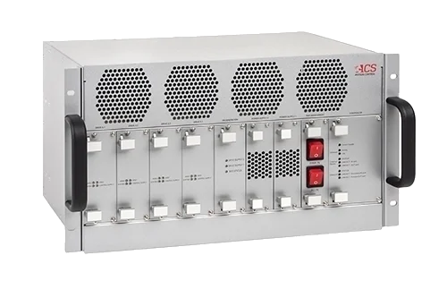
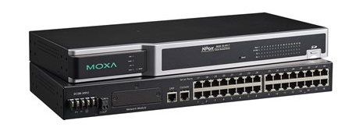
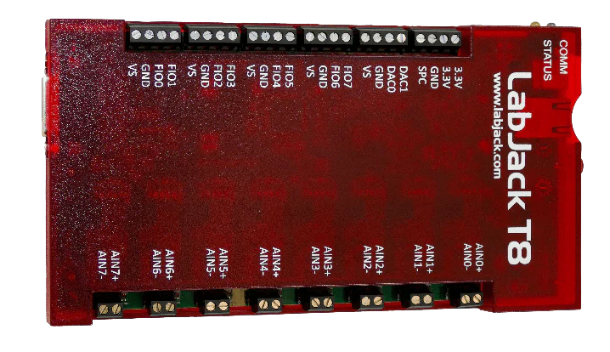
Beamline Hardware
Moving away from VME for anything new
Focusing on networked based devices
  Motors: ACS MP4U
  Comms: Moxa Serial Terminals
  I/O
    Labjack
    Measurement Computing
    TetrAMM
    SoftGlueZynq

Slide 8
Beamline Software (IOCs)
All IOCs using or upgraded to synApps 6-3 built against base-7.0.8
  https://github.com/EPICS-synApps/assemble_synApps
EPICS v7 / PVA
  For AreaDetectors, still primarily using CA
Control scripts allowing remote start/stop/restart features
Automatic iocConsole logs
iocshLoad-enabled scripts for ease of loading support
  iocshLoad("ADGeniCam.iocsh", "PREFIX=8idaSoft:, INSTANCE=flag1, CAM_IP=x.x.x.x, MODEL=AVT_Alvium_G1-510m, XSIZE=2464, YSIZE=2064, TYPE=UInt8")

Slide 9
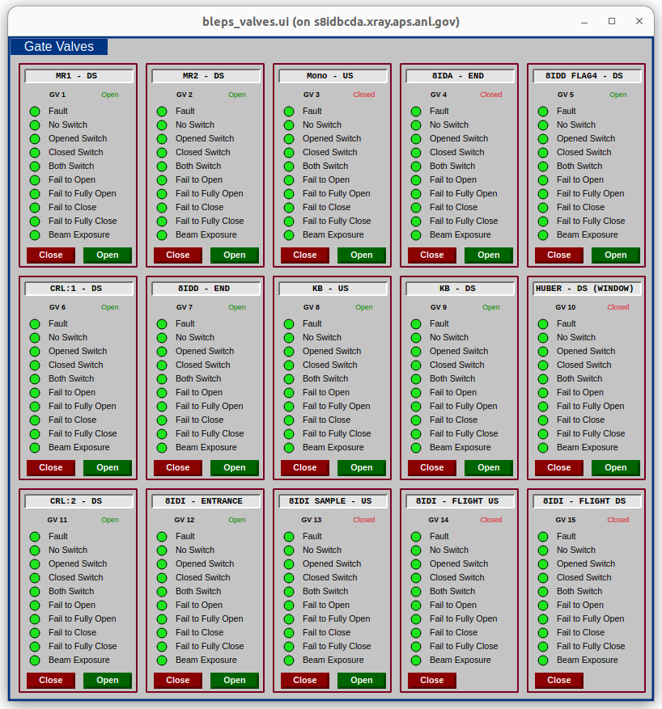
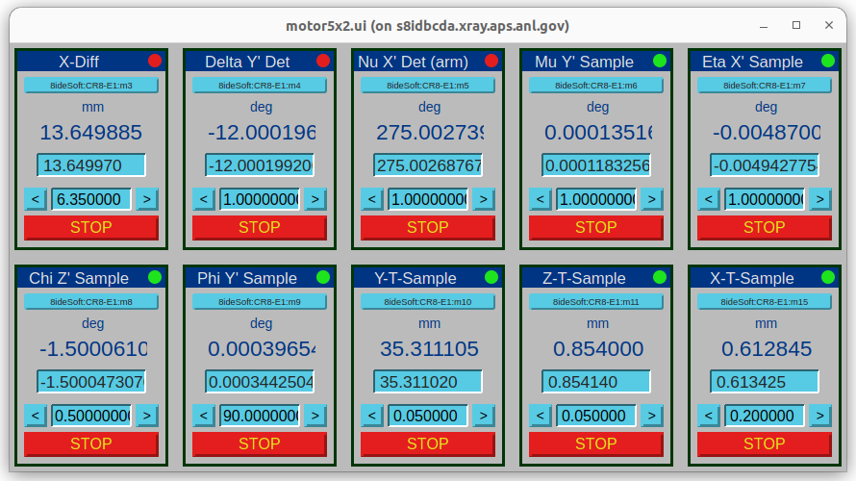
Beamline Software (UI)
Using CaQtDM (PSI)
  will likely be moving to CSS-Phoebus in the future
Takeaway: Use generation software for screens
  Phoebusgen (https://github.com/als-epics/phoebusgen)
  GESTALT (https://github.com/BCDA-APS/gestalt)

Slide 10
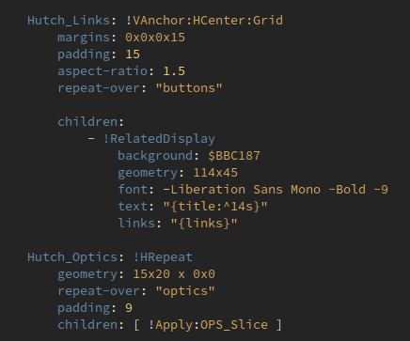
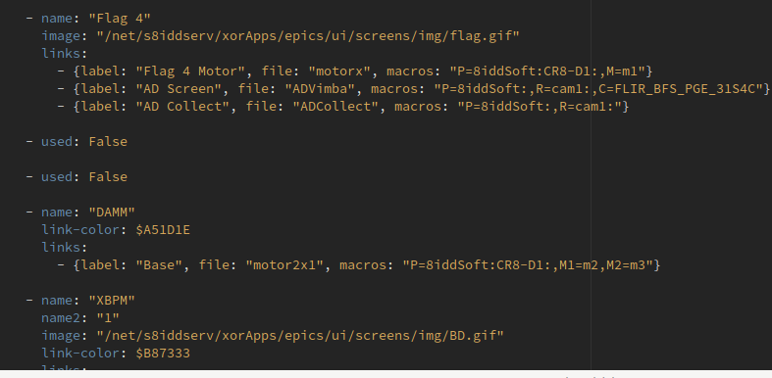
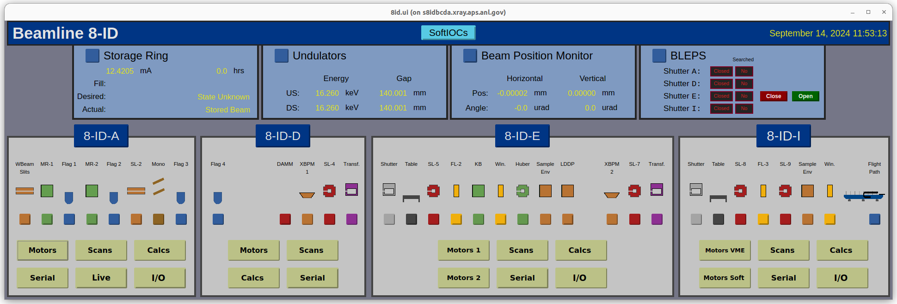
+
=

Slide 11
Beamline Data Pipeline

Slide 12
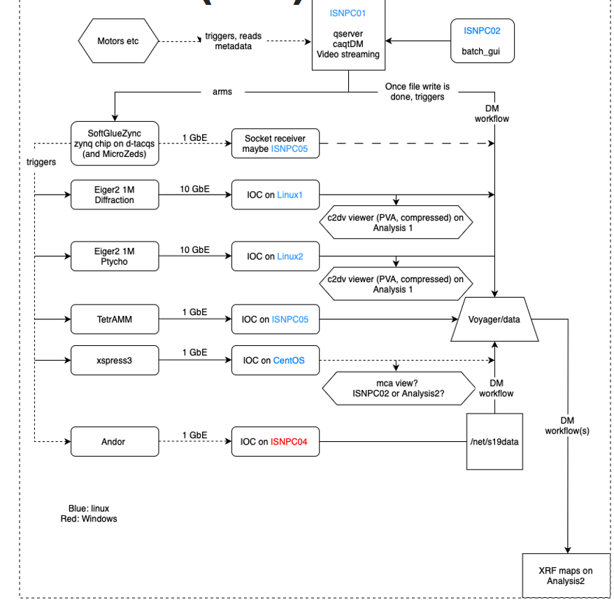
Data Acquisition
Example Detectors:
  Rigaku 3m
    3 megapixels, 2 bit @ 56,000hz
    ~300 Gbps
  Lambda 2m
    2 megapixels, 16 bit @ 2,000hz
    ~50 Gbps
Fast detector computers receive GPFS links
  Write to shared file system
  Accessible by Computing Facility
Standardized on HDF5 file format
  Flexible metadata structure
  Allows us to connect multiple pieces of data together using references

Slide 13
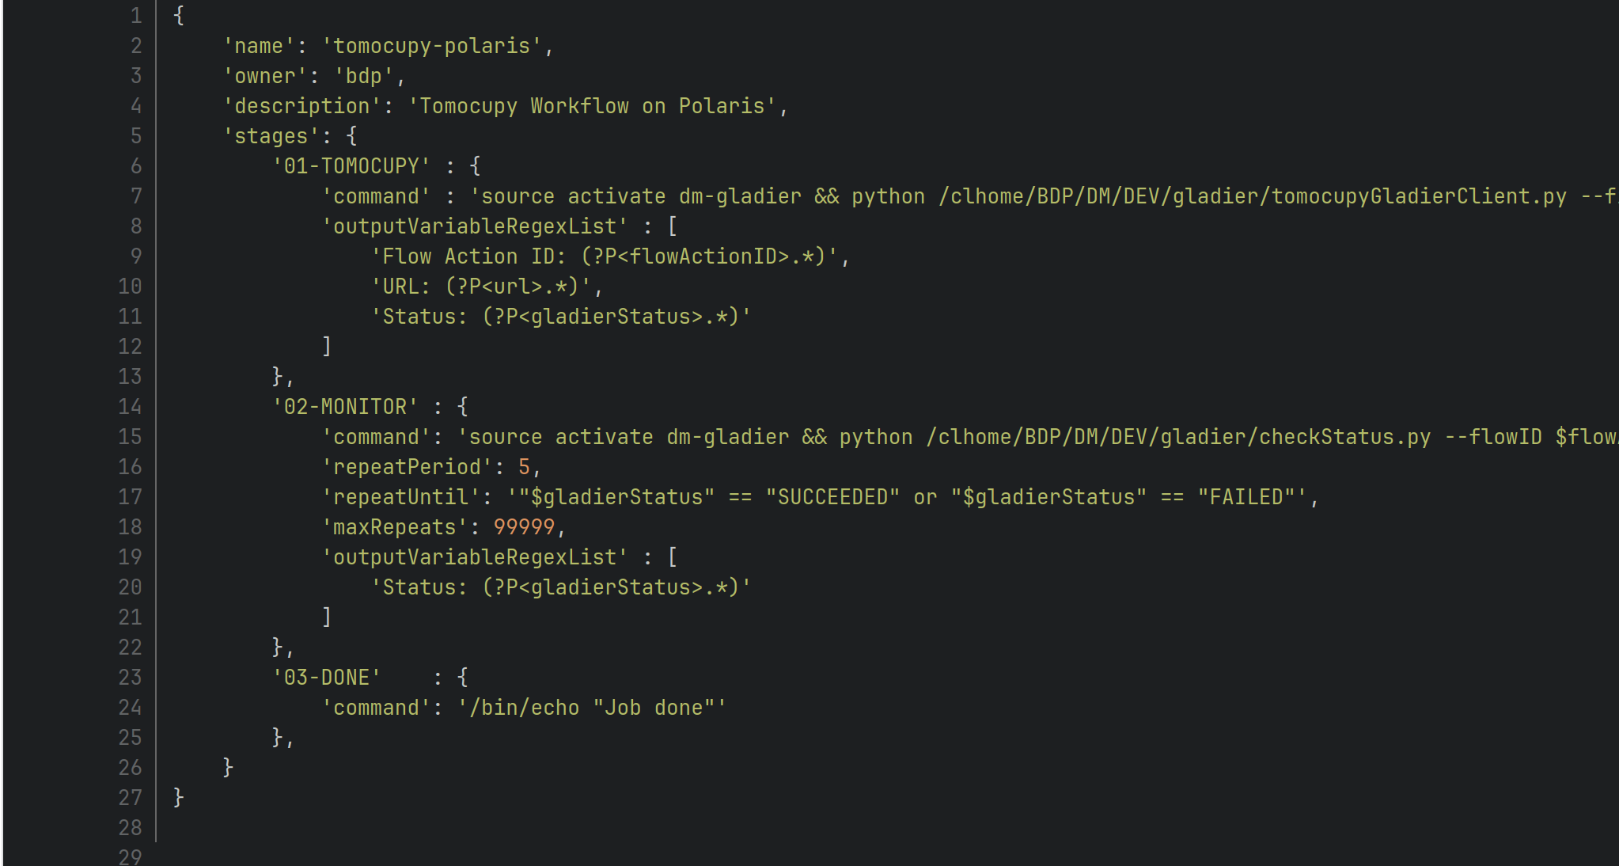
Data Management and Analysis
Use Bluesky with Bluesky Queue Server to control experiments
Integrates with APS Data Manager Workflow API
  https://www.aps.anl.gov/Science/Scientific-Software/DataManagement
  JSON-based
  Commands and execution flow
  that are run on remote computer
  Queues time on polaris
  Can be triggered manually or
  watch files/folders

Slide 14
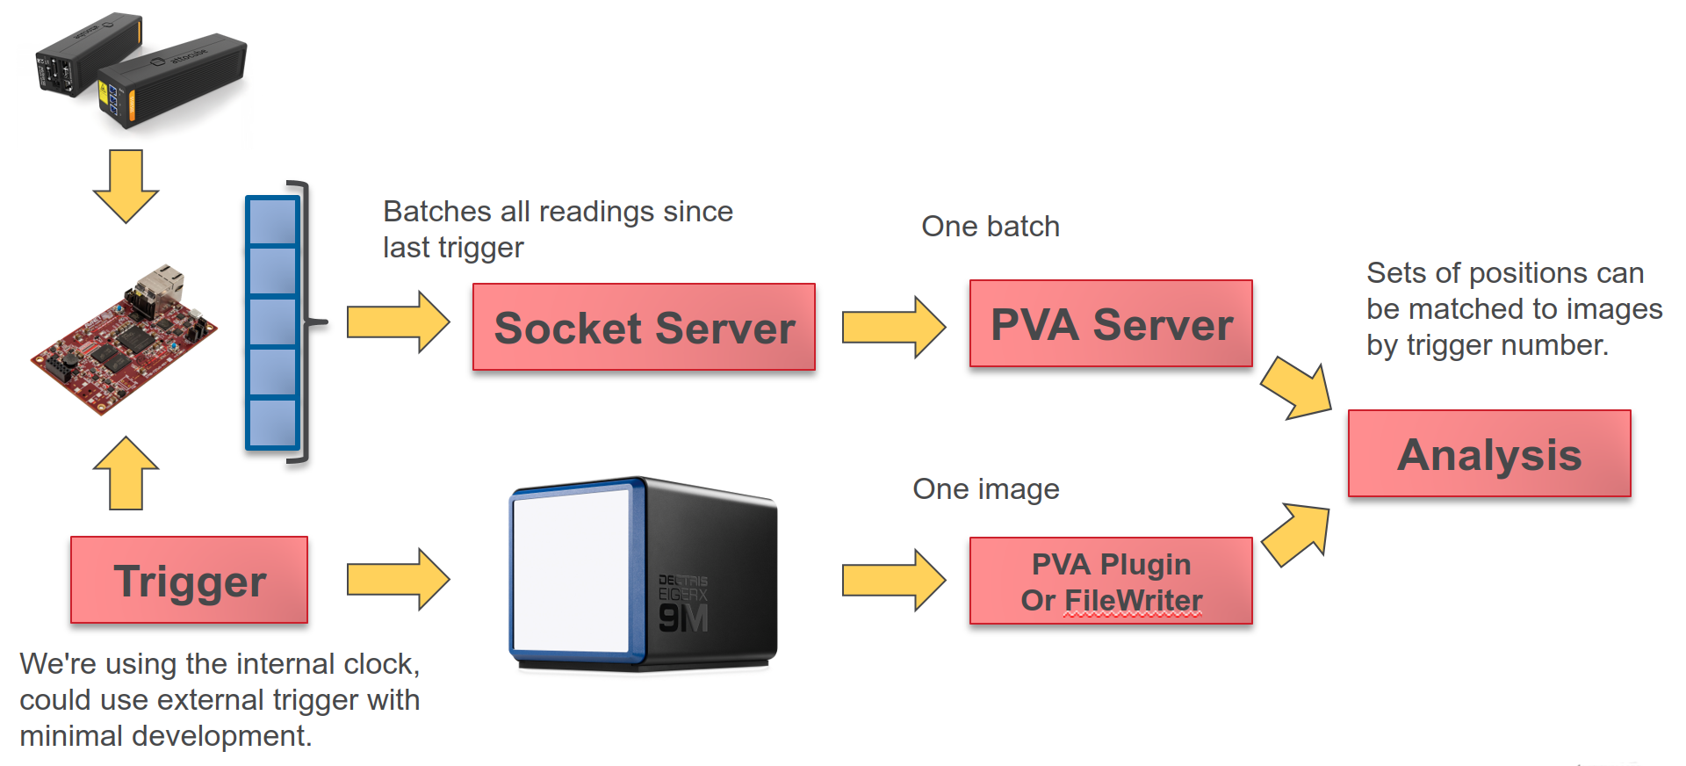
In Development
Updating more analysis programs to support PVA as input
  Using pvaPy as integration library (https://github.com/epics-base/pvaPy)
  Live data analysis
  Including streaming to and from our Computing Facility
Interferometry Position Streaming and Association

