Slide 1
EPICS Deployment at Sigray using Docker
Presenter: Hong Truong
Co-authors: Benjamin Stripe, Ernesto Paiser, Ibrahim Saleh, Richard Farnsworth
Notes:
Remember to introduce myself as a Software Engineer

Slide 2
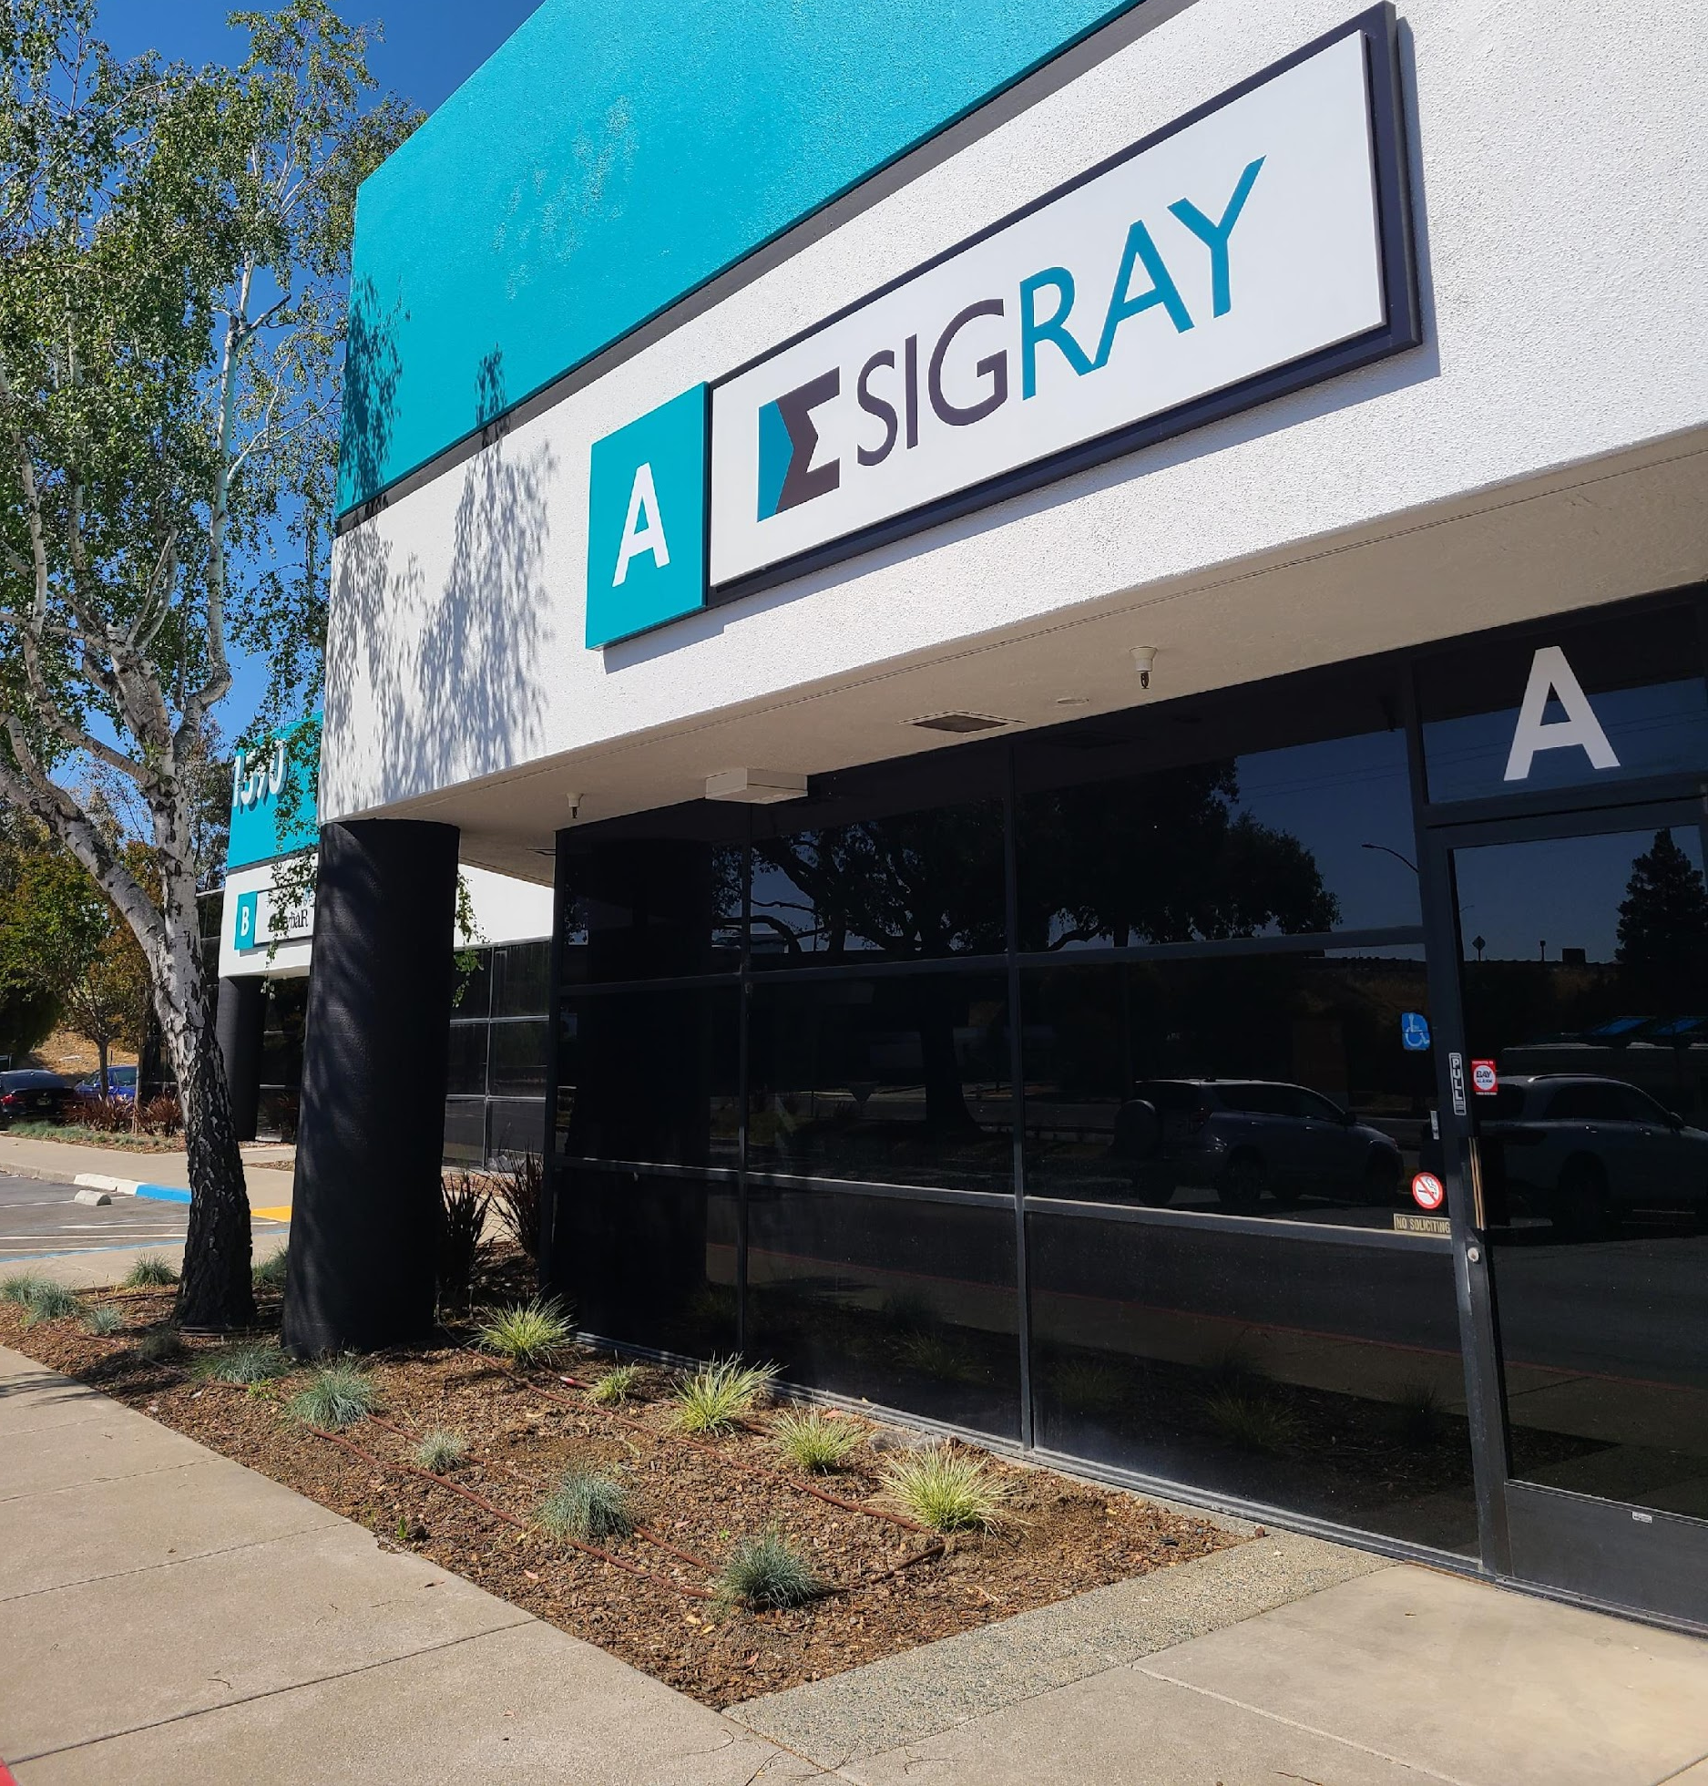
Intro to Sigray
Founded in 2013
Dr. Wenbing Yun (OSA Fellow and serial entrepreneur that founded Xradia, now Carl Zeiss X-ray Microscopy) and Sylvia Lewis
Our Technology:
Strong IP: 64 patents, 30+ pending, many trade secrets
Disruptive x-ray components (source & optics)
5 world leading product families
Rapidly Growing:
34k sq. ft. facility in Concord, CA (San Francisco Bay Area) and 82 employees
Global installation base of leading universities and companies (semiconductor & pharma)
Mission: Bring next-generation x-ray analytical capabilities from the synchrotron to the laboratory
Refer to Benajmin Stripe’s presentation for more information.

Slide 3
Contents
Motivation
Technologies
How it works
Usage
Deploying updates
Takeaways

Slide 4
Motivation
The pre-existing setup
A machine has multiple devices, each controlled with an EPICS IOC
IOC settings may be different between machines
Differences can include what db, template, or iocsh files are called, environment settings, IP addresses, etc.
Difficult to maneuver IOCs to allow us to do this natively
We already had dockers for each IOC
Each docker had its own folder
Not in version control
Difficulties
Hard to know what dockers are existed
Hard to track the configuration differences between machines
This leads to making it hard to identify and propagate fixes that were made on one machine and not others
Hard to reproduce a machine

Slide 5
Motivation
We wanted to …
Track the configuration of machines after shipment to be able to reproduce the machine
Set up new machines
Reinstall dockers if a computer fails
Debug issues with shipped machines
Make it easy to share fixes and feature updates across all machines
Can involve changing synApps module versions, manual fixes to IOC source code via docker, system startup service scripts, etc.
Standardize shared configuration to make debugging and setup easier
Ports, IP addresses, paths
Allow offline updates (and builds) due to customer restrictions
Make it easy to create new IOCs

Slide 6
Motivation
Who would be the user?
A mix of users
Non-Linux users unfamiliar with a terminal or bash
Varying ranges of familiarity with Python and docker
Controls engineers and software engineers
Add new IOCs and docker services
Systems engineers
Customize files for the system (e.g. hdf5 xml files for areaDetector and db files)
Field service engineers
Perform updates
Reload autosave files

Slide 7
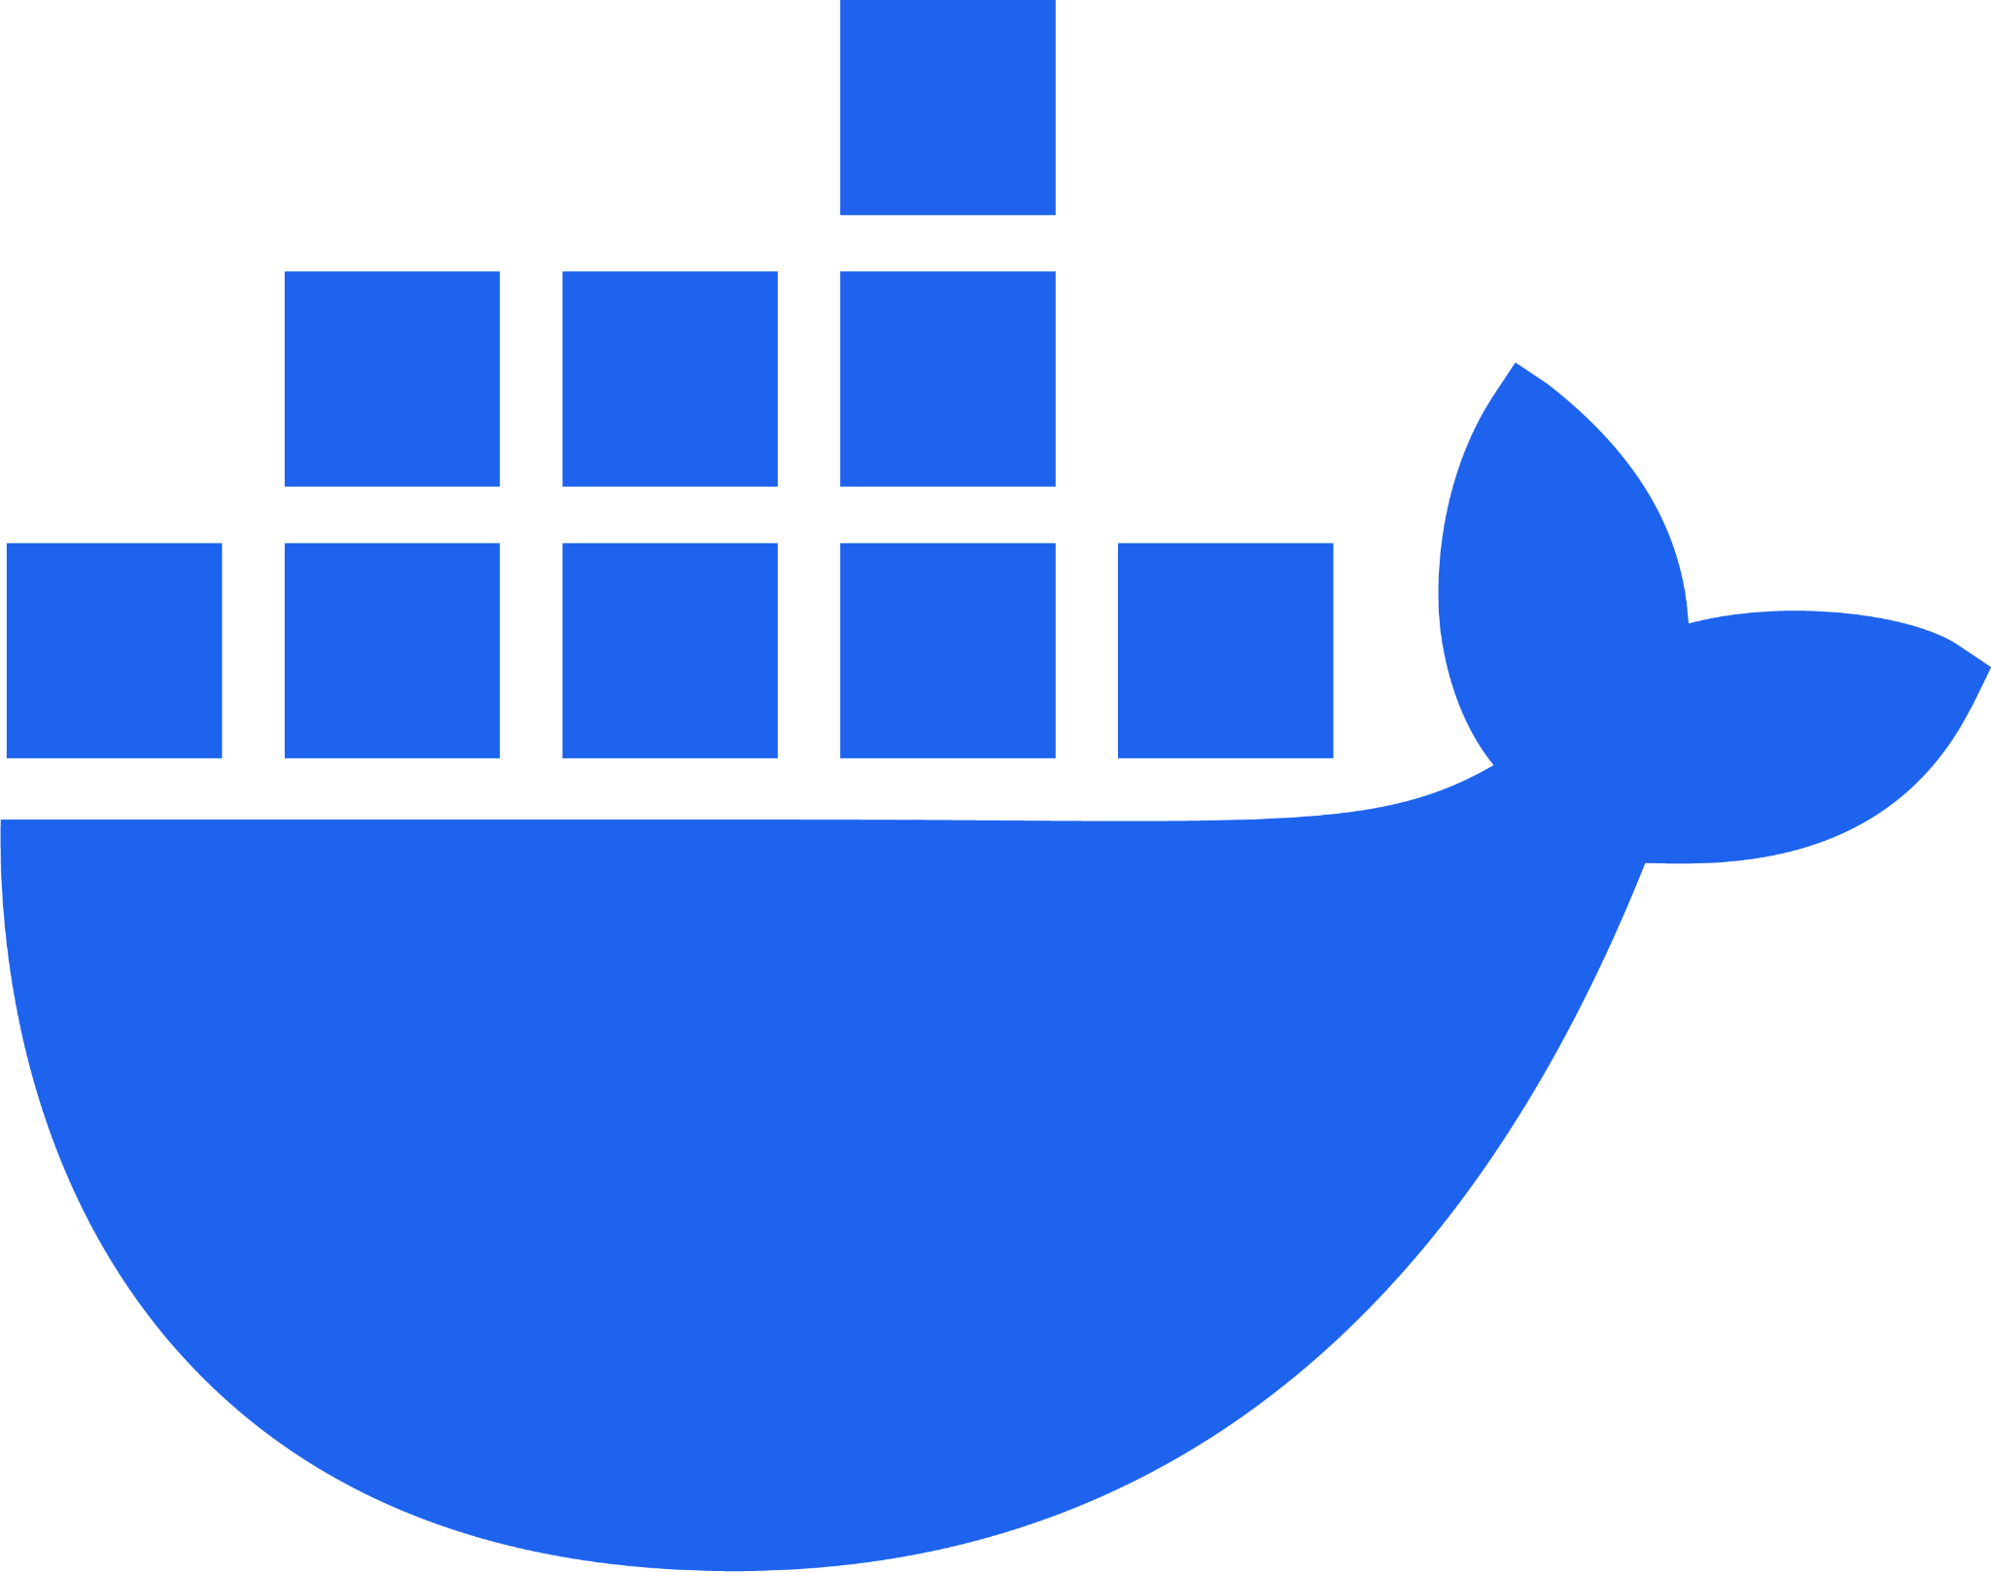
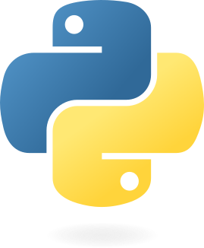
Technologies
Docker
Allow conflicting dependencies
Freeze dependencies
Easy to deploy
Docker Compose
Allow inheritance of docker service definitions
Can define multiple dockers and their build and run settings in one file
Portainer
Docker management
Procserv
Wrapper for running IOCs as background processes with telnet access
Bash
Helper scripts
Easier to call most commands directly
Python
Helper scripts and GUI
Will replace most of the bash scripts because it’s more readable and easier to debug
Poetry
Python dependency manager
Tests
Bats framework for bash tests
pytest for everything else
Notes:
So I went ahead and made it as confusing as possible for those types of users (please laugh).

Slide 8
CIDER
Overview
Configuration, Installation, and Deployment of EPICS Repositories
Basic idea
One repository to store all docker-related files and machine configuration files
Have one base docker image for online dependencies
Mostly installing synApps modules with assemble_synApps.sh
Each IOC docker image builds on top of the base docker image and includes no online dependencies at build time
Each machine mounts its own set of files at runtime, overwriting existing IOC files
Use environment variables and inheritance to avoid code duplication
Allows us to:
View existing docker services for IOCs (and other utilities) and add them for specific machines
Make and track modifications to the IOCs per machine
Standardize values in an environment file and propagate them to all dockers
Notes:
CIDER
Everyone shares a base set of environment variables, allowing standardization

Slide 9
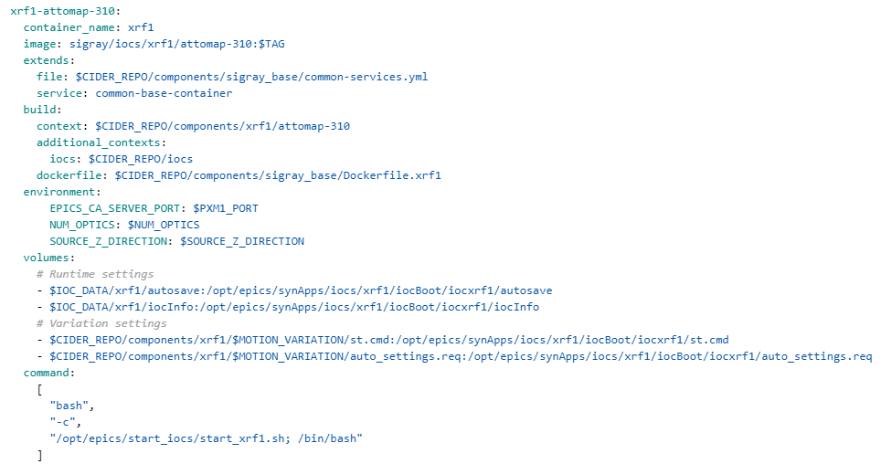
CIDER
File Structure Example
components/
component_a/
common-services.yml
compose.yml
Dockerfile
common/
variation_1/
…
ioc_submodules/
machine_compose_files/
compose.am-1124.yml
environment_files/
common_env_vars
am-1124.config
Notes:
CIDER
Everyone shares a base set of environment variables, allowing standardization

Slide 10
CIDER
File Structure Example
components/
component_a/
common-services.yml
compose.yml
Dockerfile
common/
variation_1/
…
ioc_submodules/
machine_compose_files/
compose.am-1124.yml
environment_files/
common_env_vars
am-1124.config
Notes:
CIDER
Everyone shares a base set of environment variables, allowing standardization

Slide 11
CIDER
Environment files
Machine Callgraph
Bash/python wrapper
env vars
The machine is configured using:
Environment files dictate:
Machine compose file
What paths are mounted
IOC settings (e.g. sequencer, st.cmd, .db. etc)
A machine compose file to dictate what IOC dockers it uses
Simply extends component definitions to reduce code duplication
Docker bind mounts to overwrite specific IOC files
Docker Compose
Machine compose file
Component compose files
Component compose files
Component compose files
env vars
Dockerfile
Runtime files
systemd script
IOC
defect files, hdf5 xml files, st.cmd, db, template files, medm files, etc
env vars

Slide 12
Usage
How we use CIDER

Slide 13
Usage
Machine setup
Set up new machines
Set up udev rules (for serial-specific devices) and network settings
Create configuration files
Build and run docker services
Save settings
Autosave files
OS version
udev rules
Network configuration
Total setup time: 30-60 minutes (including build time)
Assuming there aren’t any new devices or issues
Not including Jenkins and PRs
Notes:
Now everyone has access to the

Slide 14
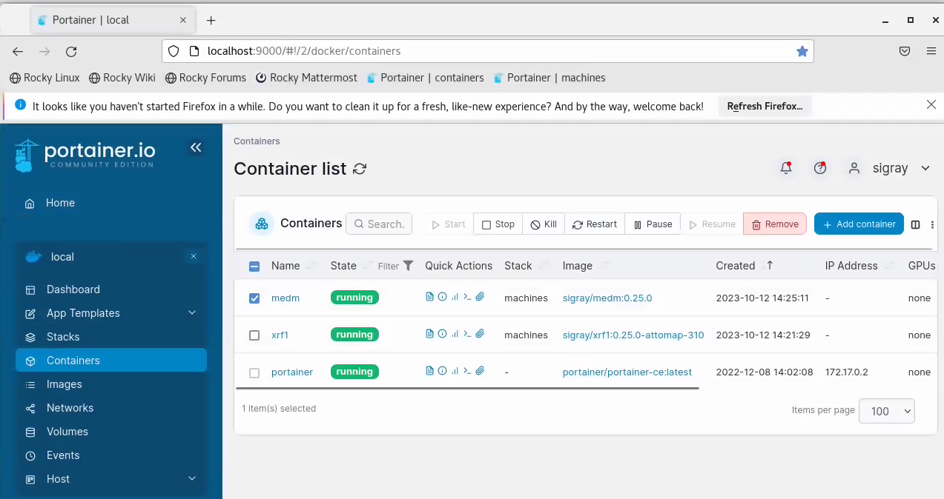
Usage
Tools - Portainer
Use Portainer to restart the dockers/IOCs with updates

Slide 15
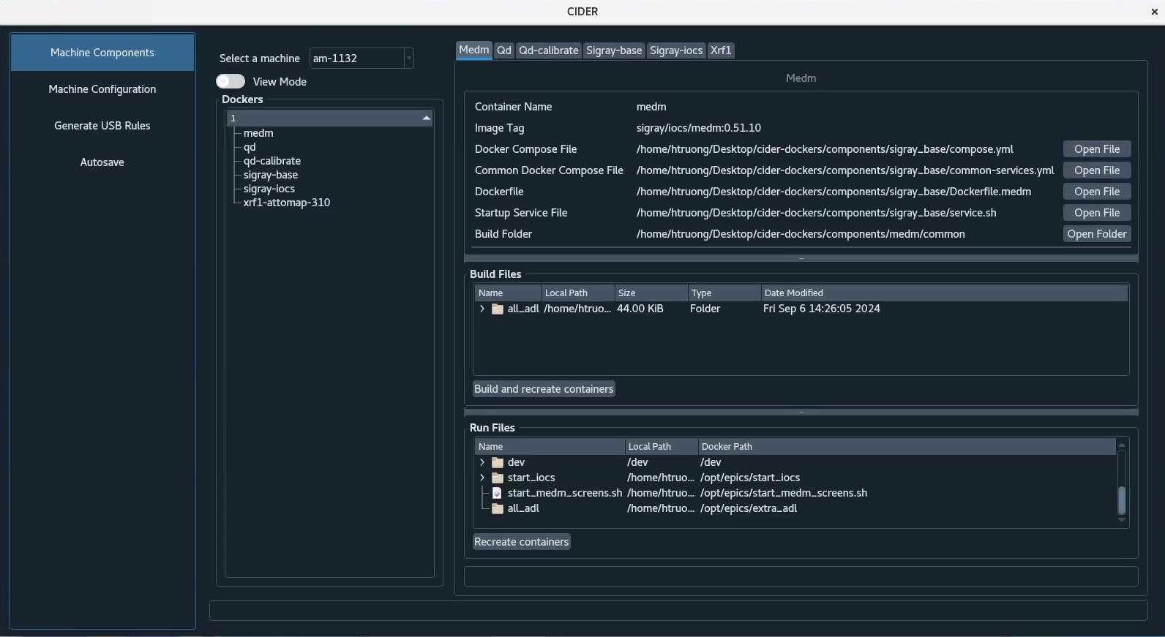
Usage
Tools - GUI
Easy access to files for system engineers
Rebuilding dockers and recreating containers
Portainer does not quite have this feature

Slide 16
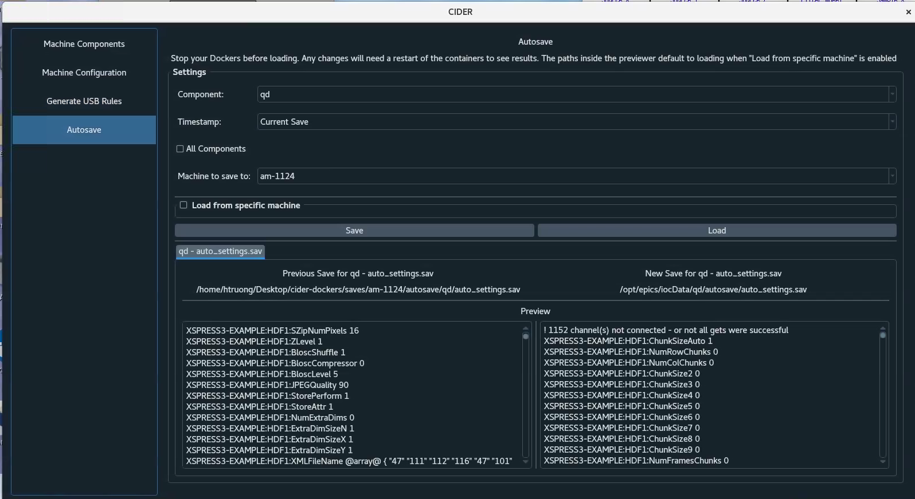
Usage
Tools - GUI
Load and save autosave files
Doing this manually can be quite tedious if there is more than one autosave file
This is confusing for non-EPICS users to do manually

Slide 17
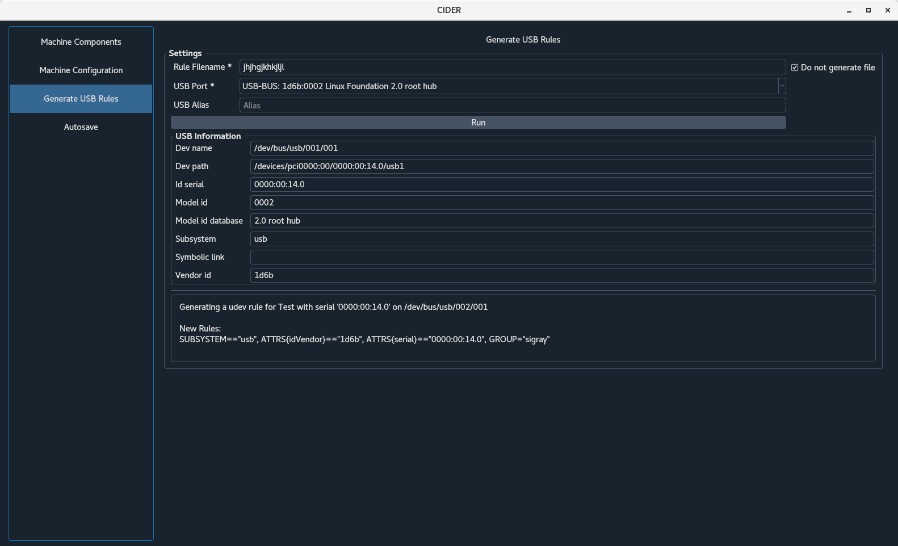
Usage
Tools - GUI
Other system setup tasks, like generating udev rules for USB devices
Very easy to mess up with a typo and very hard to debug

Slide 18
Deploying Updates

Slide 19
Online Updates
Update the CIDER repository
Run update scripts
Update the environment
Build dockers
Run hardware tests

Slide 20
Goal: Offline Updates
Customer Restrictions
No internet access allowed
Cannot rebuild docker images that access internet (e.g. assemble_synapps)
File size restrictions
Cannot export 7+ docker images that are 2-3 GB each
Cannot put all contents into one giant docker image

Slide 21
Goal: Offline Updates
Expected Procedure
Files
Base docker image
Contains all shared online dependencies like synApps, Linux packages, etc
CIDER
Contains environment files, configuration files, and helper scripts
GUI folder
Generated by pyinstaller, making python dependencies portable
Procedure
Jenkins pipeline builds and generates files
Copy generated files to machine
Installer imports the base docker image tar
Installer updates CIDER and configuration files
Rebuild docker images

Slide 22
Takeaways
This includes CIDER, EPICS, and non-EPICS takeaways.

Slide 23
Takeaways
The Bad
CIDER is difficult to develop with
The file structure can be confusing, and developers need to know what files are in the IOC submodule and what files are overwritten by CIDER
Having a branch per machine can lead to more toil if changes are frequently made after PRs are merged
Perhaps a file structure refactor with local config files and a version controlled configuration repository will improve this
Having one environment file makes it unclear what variables correspond to what docker service
This makes it hard to know what environment variables to define or remove when adding/removing docker services
Hopefully the addition of multiple environment files in docker compose or just plain old Python to generate the environment files and machine compose files
Storing configuration files in the same repository is not sustainable
Repository size will keep growing as we build more systems
Plan to move them into their own repository or make them local

Slide 24
Takeaways
The Bad
Autosave can be unreliable
Turning off power to devices can lead to some PVs being wiped in autosave
Some PVs will randomly reset when the IOC or computer restarts
MEDM is not very dynamic, and it can be hard to make modifications
EPICS can be confusing to develop with (requires training) and debug
Some of these issues may totally be due to my insufficient knowledge of EPICS!

Slide 25
Takeaways
The Good
Reuse an IOC repository as much as possible to make it easier to propagate changes to all machines
Achieved by moving as many build-time settings to run-time as possible to avoid requiring recompilation (and thus a new docker image)
Use environment variables in sequencer, st.cmd, .db
This also makes testing faster and easier, since we can heavily test the base IOC and sprinkle tests for the runtime settings
Migration scripts have helped with ensuring machine settings are not lost during updates, even if the configuration files have changed structurally
Keeping configuration files in version control is great!
Track why changes were made, rollback to an older version, diff files, etc
ADAravis is great for creating new IOCs for GenICam-compatible detectors!
Doesn’t always work right off the bat

Slide 26
Takeaways
The Good
Docker and docker compose has some helpful features that allows us to have a simpler file structure
multiple build contexts
Can organize things in terms of logical categories rather than in terms of docker images
Avoids duplication of files that belong in multiple docker images
The docker compose file itself can use environment variables
Useful for storing all env vars in one file and propagating them
(Future) The include top-level element
Allow us to define dependencies without:
Duplicating docker service definitions
Defining service definitions in the same docker compose file

Slide 27
Thank you!

