Slide 1
EPICS use in Industry- Sigray Inc.
Presenter: Benjamin Stripe
Co-Authors: Hong Truong, Ibrahim Saleh, Richard Farnsworth, Wenbing Yun

Slide 2
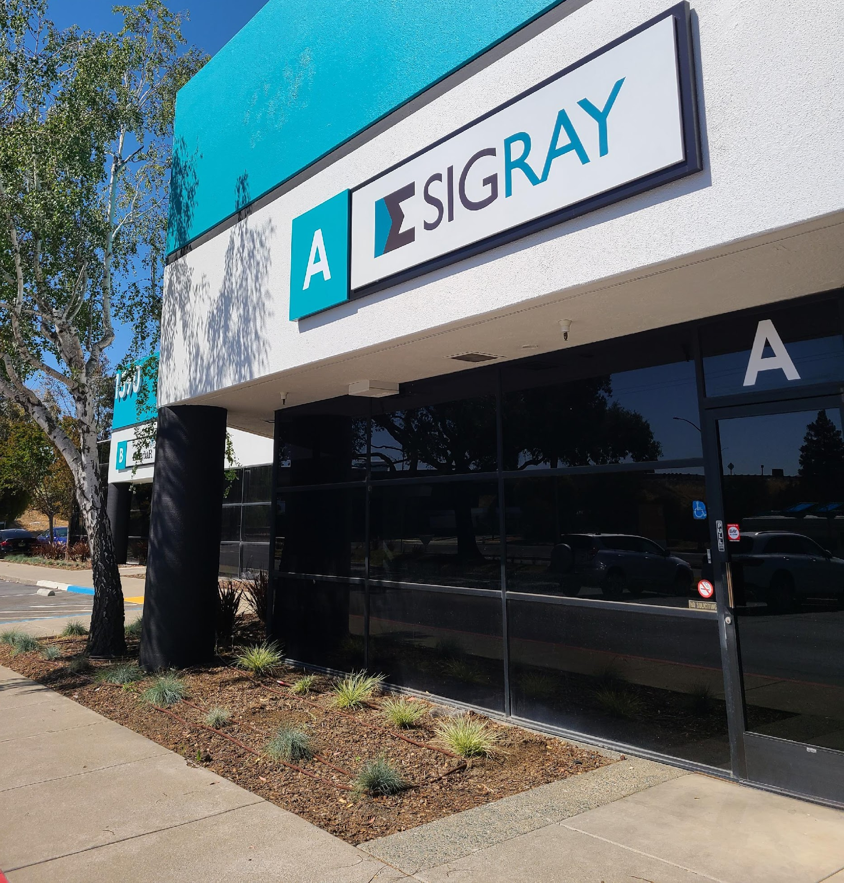
Intro to Sigray
Founded in 2013
Dr. Wenbing Yun (OSA Fellow and serial entrepreneur that founded Xradia, now Carl Zeiss X-ray Microscopy) and Sylvia Lewis
Our Technology:
Strong IP: 64 patents, 30+ pending, many trade secrets
Disruptive x-ray components (source & optics)
5 world leading product families
Rapidly Growing:
34k sq. ft. facility in Concord, CA (San Francisco Bay Area) and 82 employees
Global installation base of leading universities and companies (semiconductor & pharma)
Mission: Bring next-generation x-ray analytical capabilities from the synchrotron to the laboratory

Slide 3
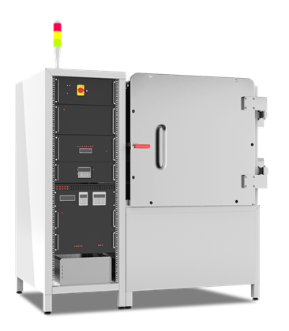
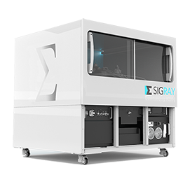
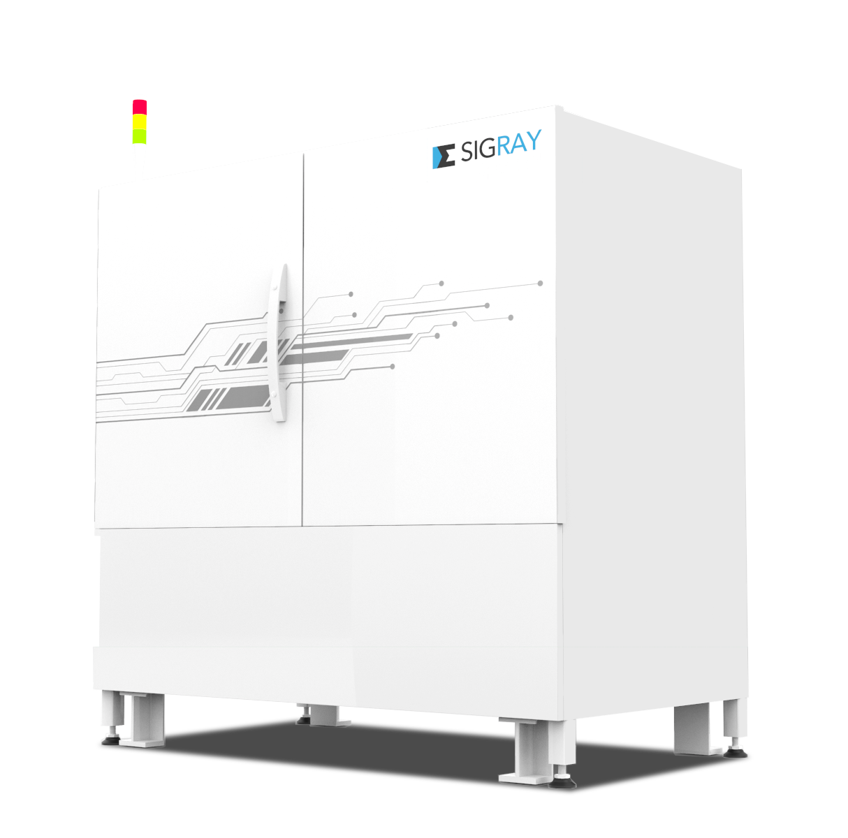
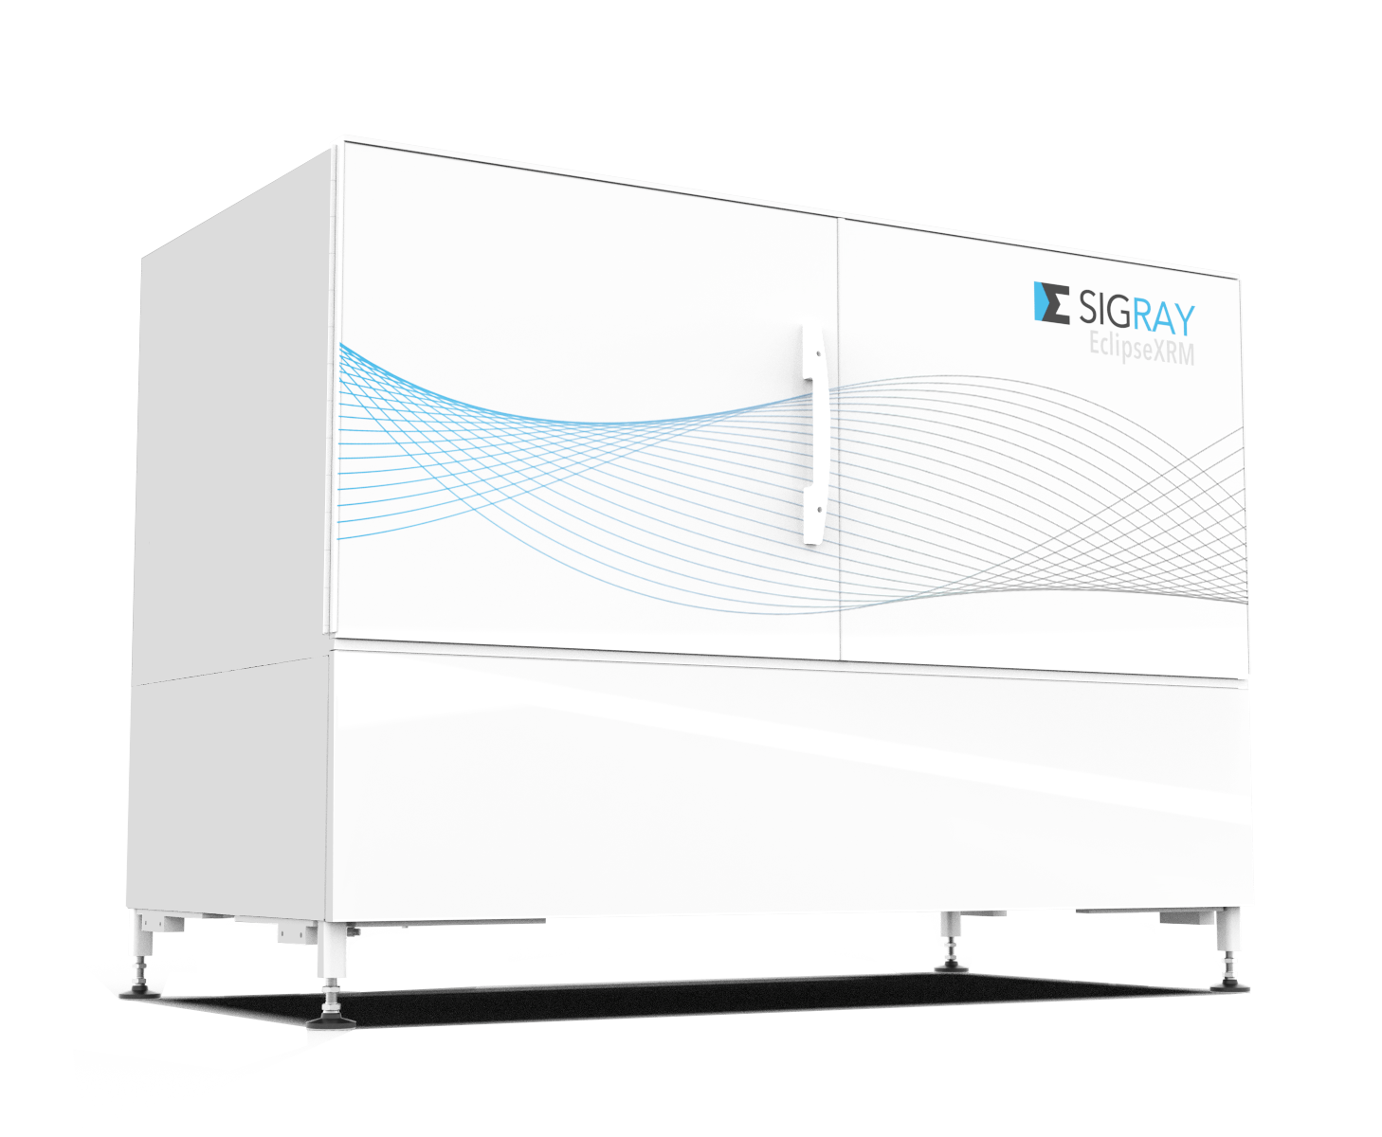
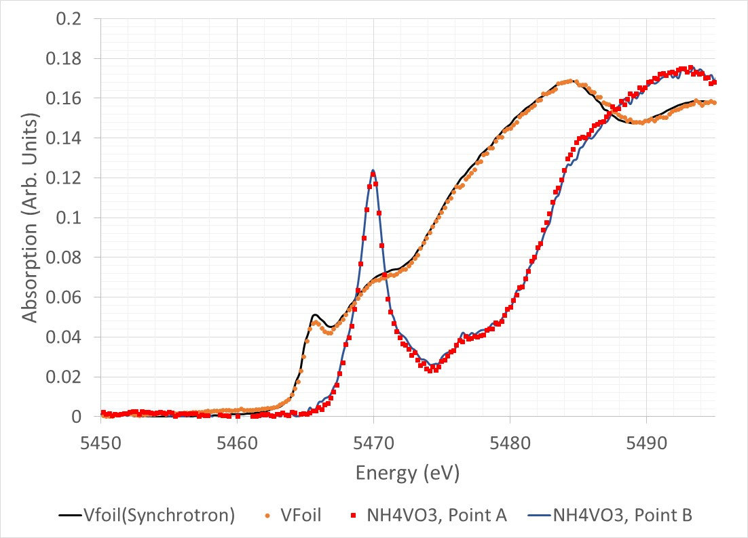
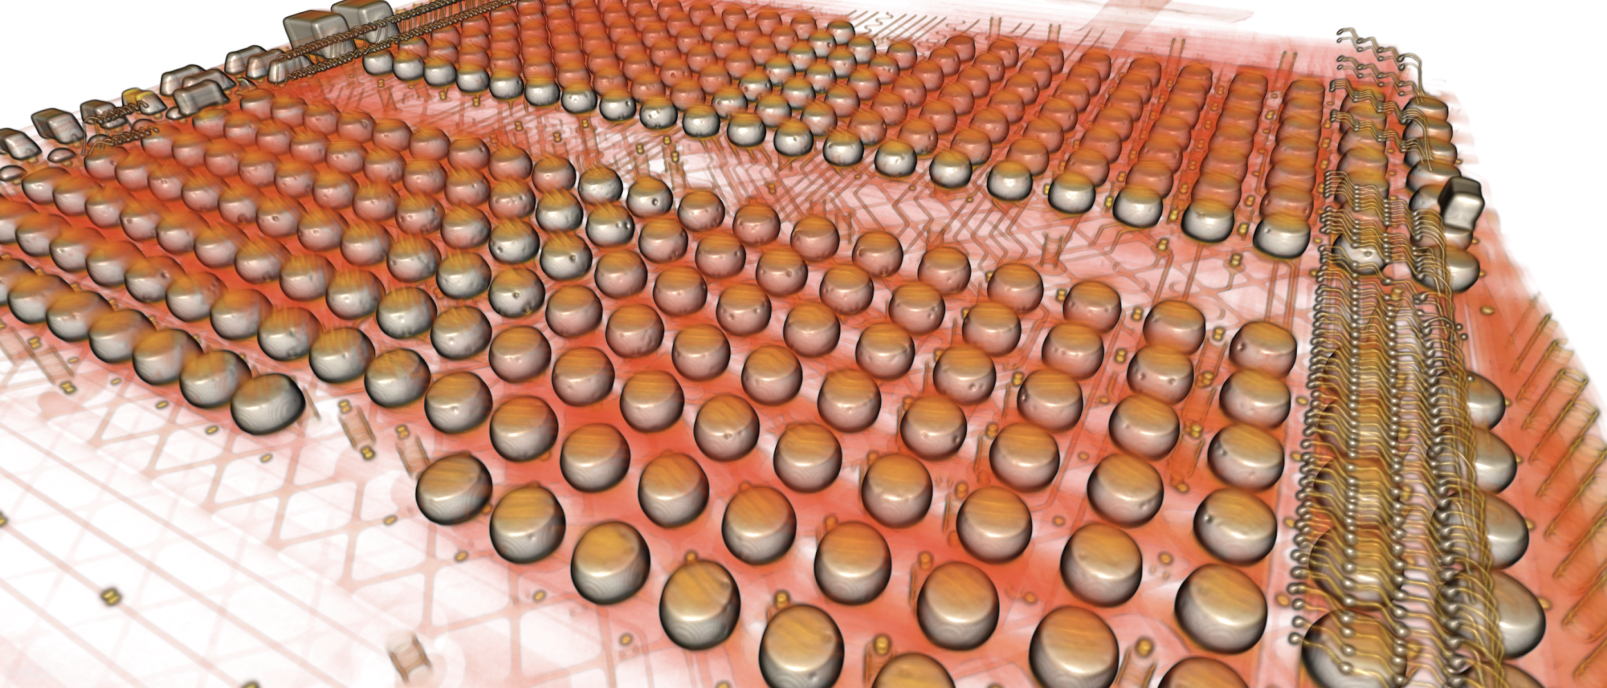
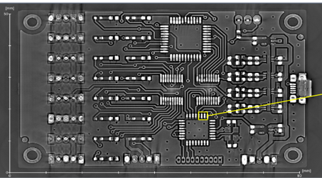
Suite of Synchrotron Beamline-like Systems
AttoMap microXRF
Highest sensitivity to low Z
Highest resolution microXRF
QuantumLeap XAS
Only commercial f-XAS
Highest quality EXAFS
EclipseXRM
Highest resolution (0.3μm spatial) 3D
x-ray microscope on the market
Apex XCT
Highest throughput 3D x-ray tool (>1000X) for semi

Slide 4
Overview
Introduction to Sigray (Complete)
Why EPICS for Sigray?
Scope and deployment differences from larger laboratory deployments
Solutions we have implemented
Docker, Portainer, CIDER - internally developed deployment management
Outstanding and Emergent Issues
Instrument API and automation access.
Instrument state tracking, Error handling and recover.
“Sigray Connect” - GRPC instrument state machine

Slide 5
Why EPICS for Sigray?

Slide 6
Why EPICS for Sigray
Historical Choices
Sigray’s first instrument was a scanning x-ray fluorescence system (XRF)
System requirements
15 motors
Alignment of x-ray capillary optic
Downstream Scientific CCD
Sample Alignment - Real time on-axis camera
Data acquisition from Silicon Drift Detector.
Step and Fly scanning integration
For people with experience from the synchrotron light source community, there are some obvious options for integration spanning many choices of motion control, pulse processors and CCDs
EPICS
TANGO
Labview
Roll your own
etc …

Slide 7
Scope and Development Differences

Slide 8
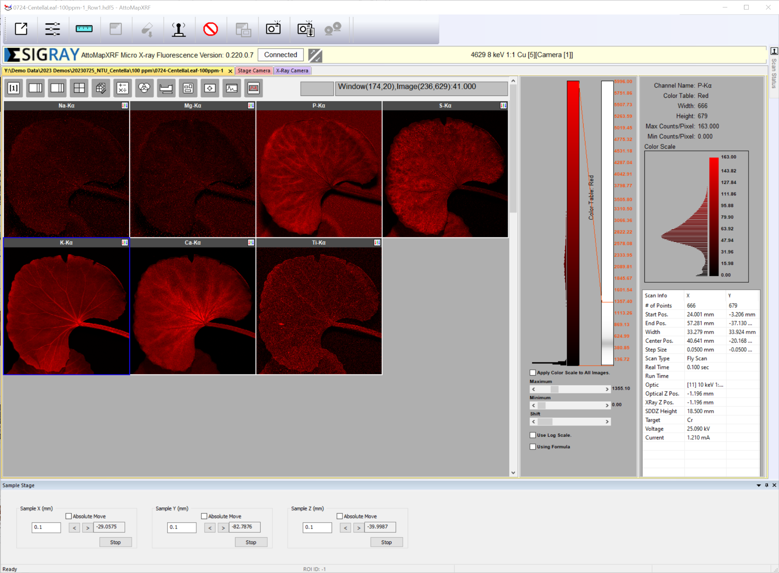
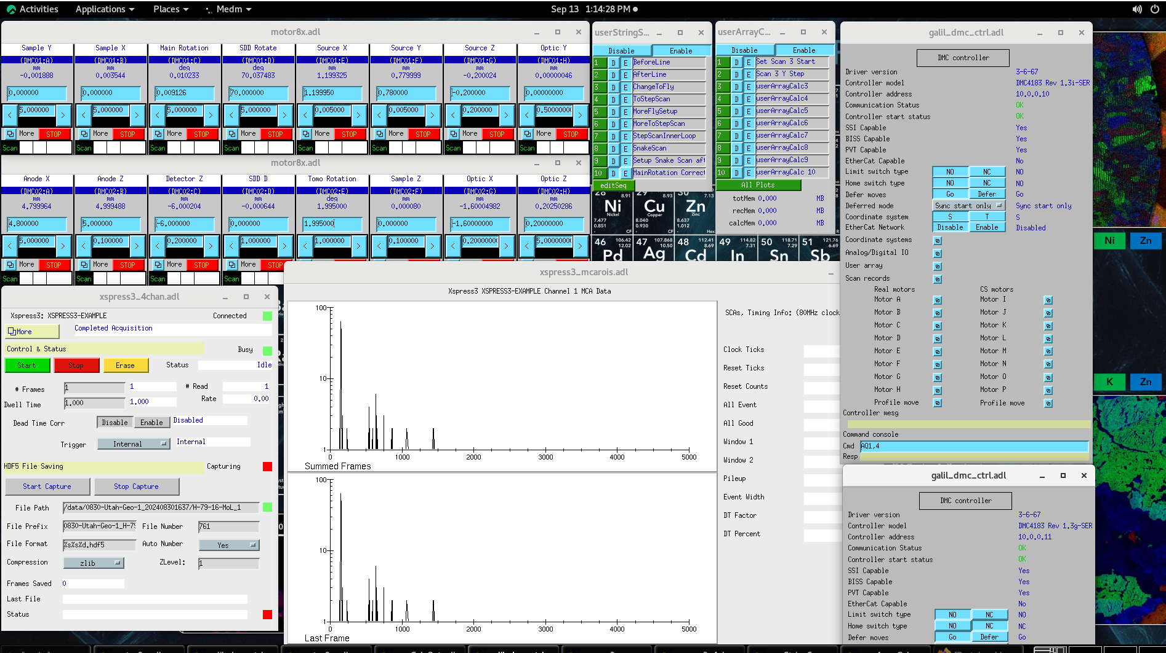
Scope and development differences
As an industrial deployment, very few users actually see the underlying controls system
We have developed top level GUI software for driving most of the machines.

Slide 9
Scope and development differences
Top level software adds a lot of features
Starting Acquisitions from optical images
Automating alignment
Batch scans
High level sequencing and automation
MEDM is still regularly used as an engineering and Rapid R&D interface!
EPICS has a real strength here! Software R&D time for complex motion and acquisition can be very slow if done using a self-made or in-house framework
Problems arise when you have 5 different systems
They develop incremental changes with time (Newer bigger detectors, faster motors …)
You need to deploy update and maintain the controls software on machines in concrete basements with no internet access!

Slide 10
Solutions we have Implemented

Slide 11
Like others in the community we looked at packaging our IOCs as application deployment Images
Settled on docker containers
Still have a number of variations from system to system
Different detector IOCs to run
Different pixel defect maps
Encoder and stage / motion controller changes
Developed a tool called CIDER to help with this
Use a base Docker Image
Allows us to track and mountain certain files at build or run time as needed
st.cmd changes
.db alterations
Pixel defect maps
See Hong Truong’s presentation later for the specifics

Slide 12
Outstanding and Emergent Issues

Slide 13
Outstanding and Emergent Issues
Because of our historical choices and being a small company, as we added products, we tasked different programers to develop user interfaces for each system
User interfaces in MFC, Python-QT , UWP, some C# - QT
Most of these apps direct control logical sequencing for the instruments
Turn on x-rays
Move motors directly through channel access
Acquire and render overview images
Set up scan parameters, populate the scan record, and render data

Slide 14
Outstanding and Emergent Issues
This had lead us to three major emergent problems as we grow and look to support all of these systems
There is very little reuse of code between systems at the user interface level
Simple things like turning on X-rays can be run through EPICS, through a stand alone application, or directly through the acquisition GUI.
Systems “Statedness”
Systems runs with a workflow oriented GUI, sequences things like scan record as needed and monitors until the process finishes
Dealing with interrupts, errors, power outages.
No higher level interface: API or interface to automate the system
Move in to industries like semiconductor come with wants to
Control the tool as part of a larger system
Automate process control
CAD Based feature identification

Slide 15
“Sigray Connect”
EPICS CA and GRPC glued

Slide 16
Sigray Connect
Work in progress
Essentially a modular state machine based middle man
Use Google Remote Procedure Calls (gRPC)
gRPC is supported in basically every language
Can call a procedure in python that runs on another machine in C# or any other language
Is a protocol that can be versioned and is fault tolerant
Asynchronous server style communication
Allows us to Implement system “Statedness”
Allows us to address aborts, interrupts and errors
Allows us to reuse procedures between systems
No need to write two CAD software interface modules
Allows us to separate procedures on different machines
Start Scan procedure can stay on the controls machine
Updating the Acquisition client no longer runs a risk of changing controls code. Similar to implementing firmware procedure calls, even if if the scan sequence is different as machine Hardware evolves the interface does not care.

Slide 17
Sigray Connect
Work in progress
This interface allows us to do things like trigger the exact MFC scan start sequence we have implemented in the in acquisition GUI through gRPC in a python script!
Previously system scripting/R&D/Automation using python required setting up the scan records directly. A completely separate scan start sequence. This improves code and system robustness significantly!
Sigray Connect is Modular in the sense that.
We can add interface modules for that manage the state of Motion controllers, area detector, turbo pumps, enclosure lighting….
We can add modules to create other communication channels to interact with the state machine
HTTP based process command API for semiconductor
Could support REST or even RS232 API access….
Modules are introspective
Can automatically generate simple engineer level GUI screens to link inputs and outputs. (Much like how we use MEDM it’s really powerful to have an engineering interface for rapid R&D)
While most of the modulus interact with EPICS via Channel Access, there is no reason we have to restrict ourselves in this way. With the developments in modern APIs some CDDs for example, can be much quicker to develop directly.

Slide 18
Discussion
Some of these are issues standard in software development
Code base splitting
Multiple languages
Historical baggage
These issues are our own making. Have answers relatively independent of the community
Other Issues are current to the community
“Statedness”
Code/function/procedure reuse
Higher level Asynchronous control and automation
Projects like Bluesky with its server modules look to overcome many of the same obstacles. Although still relatively driven be python command line calls.
In my opinion Channel Access and EPICS base enable system controls at scalability,speed, and functionality that really is amazing.
At the code and deployment level it is in sharp need of a modern build environment. Even an upgrade to apt-get level deployment would be amazing. Currently too common to see dockers/images as management solutions.
This would also enable much more direct modernization of high level controls interfaces and or reusable modules like Bluesky. Ways to make reusable acquisition routines with abort,pause,stop….
Really excited to see where the community is going! Thank you!

