Slide 1
Upgrading the APS Accelerator EPICS Control Systems
September 17, 2024
Andrew Johnson
ASD/Controls Group
Argonne National Laboratory

Slide 2
Outline
A few of the technical changes & challenges the APS Controls group implemented to build the “C2” APS Accelerator control system
CVS ⇒ Git and GitLab
EPICS Extensions ⇒ Conda environments with environment-modules
Manual module configuration ⇒ Building support modules using EPICS Sumo
sysvinit scripts to start soft IOCs ⇒ systemd for managing soft IOCs
One accelerator IP subnet ⇒ 5 subnets for IOCs, 2 for CA clients, 30 for I/O

Slide 3
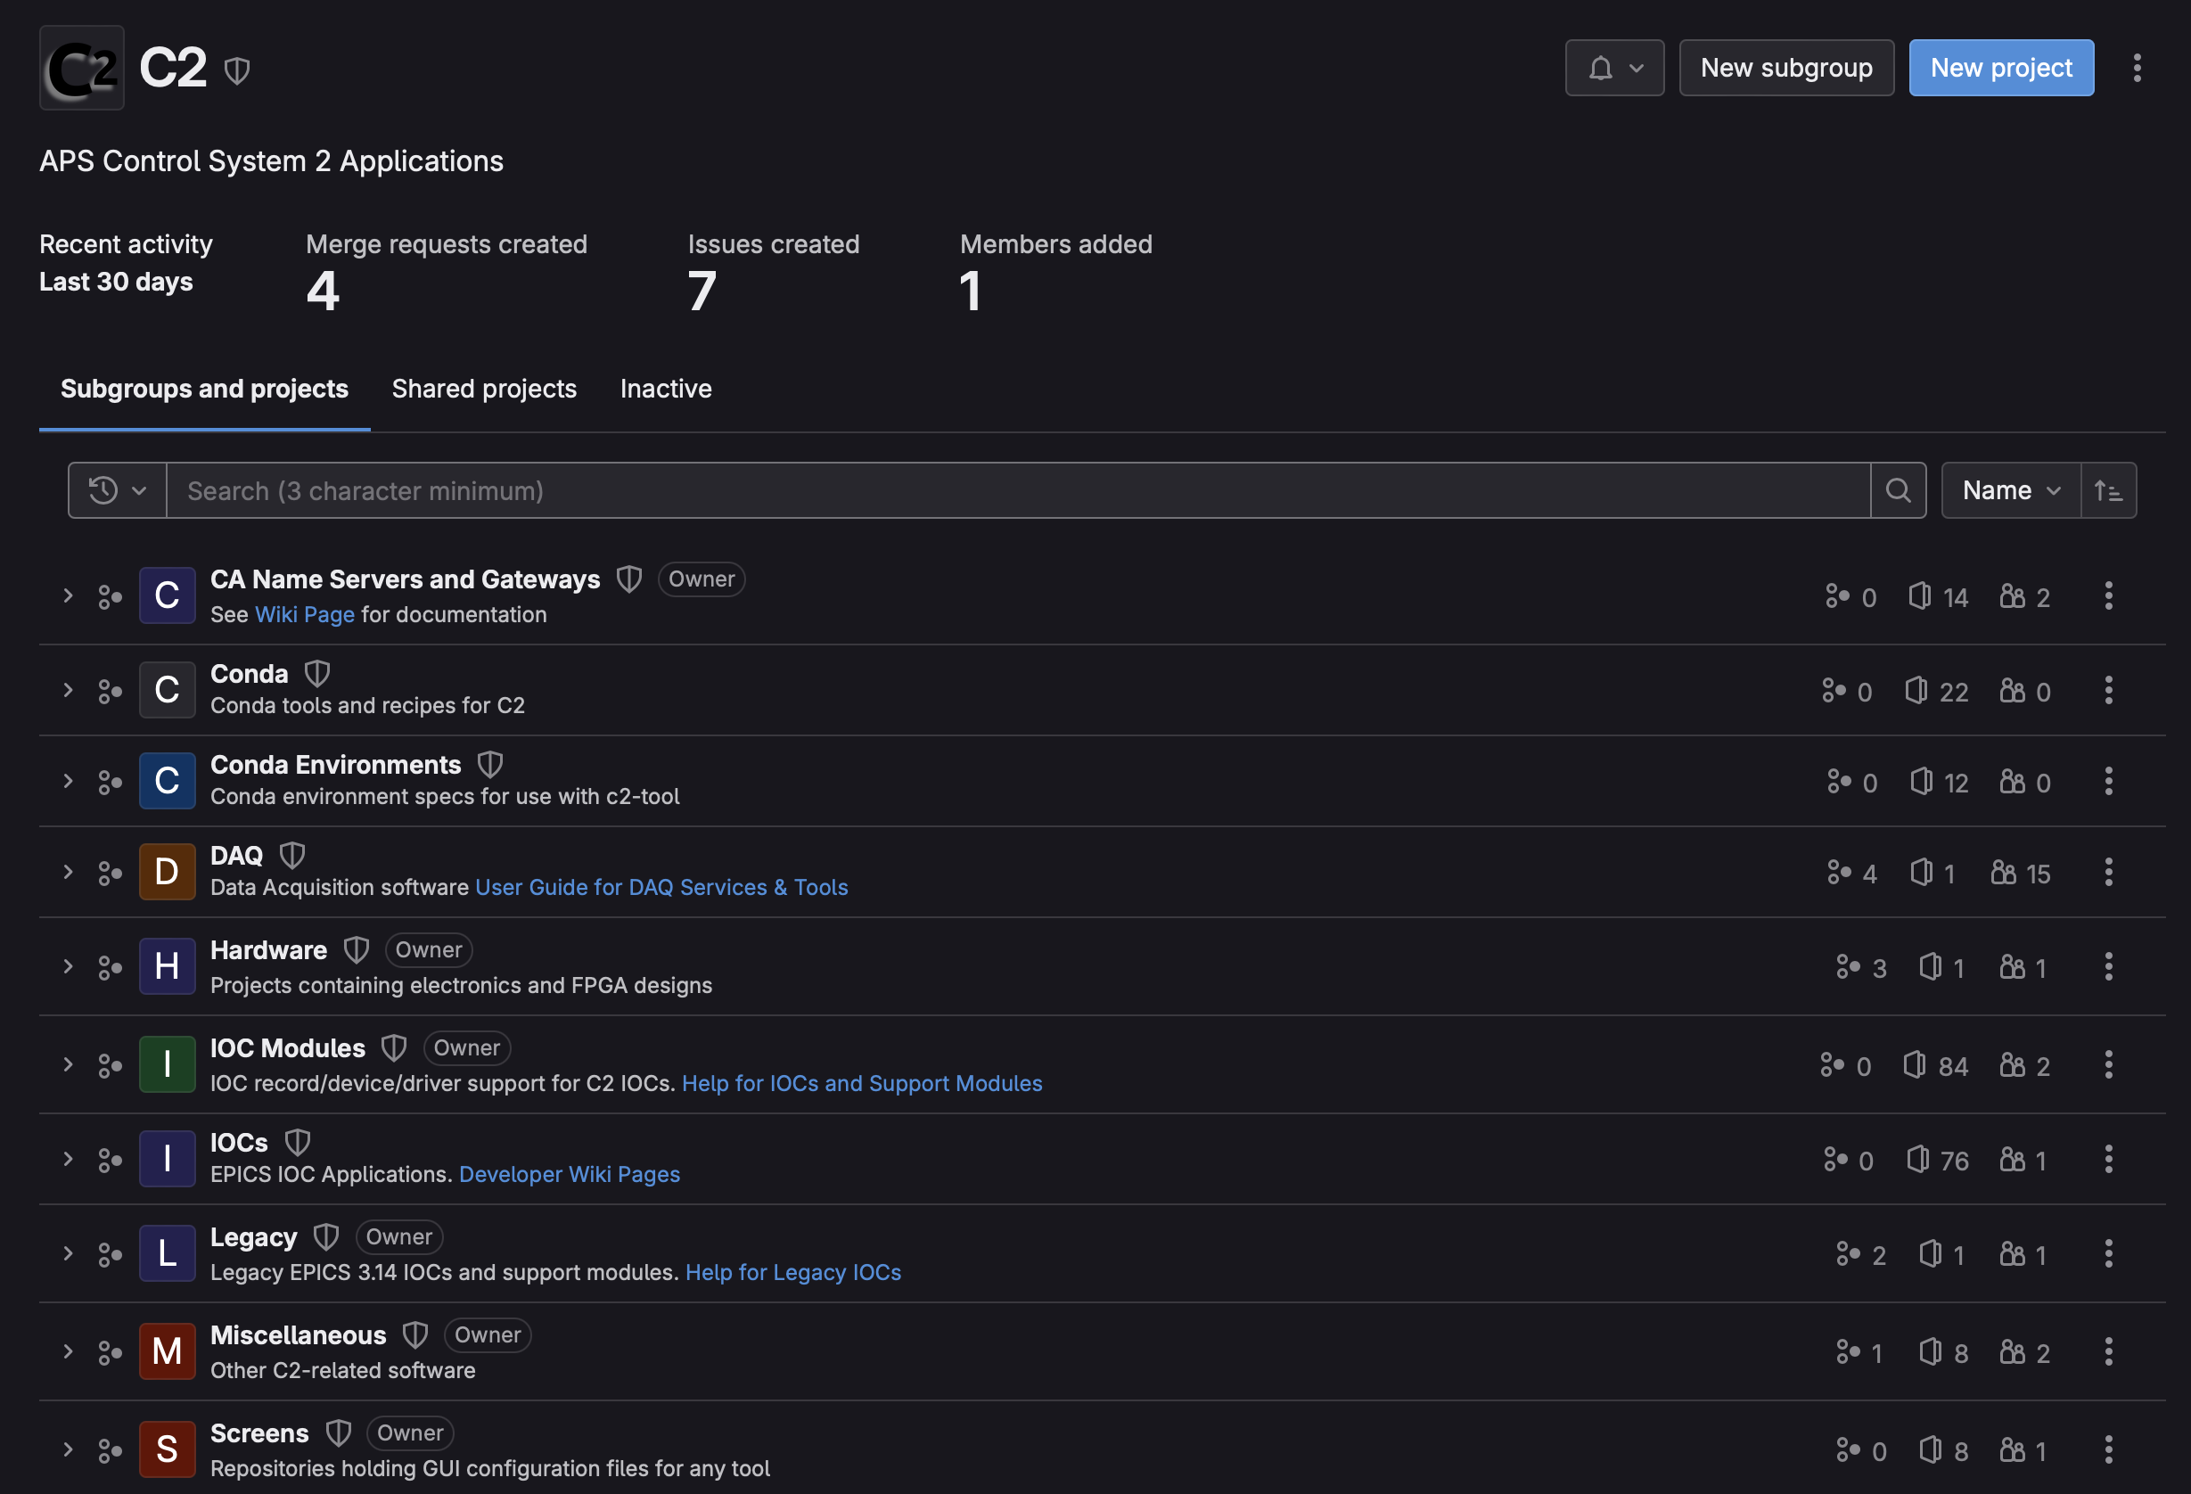
GitLab Server for Source Code control
Repositories containing:
All Controls software that we build from source
External sources are imported from released versions, not Git repo’s
Most software configuration data (Sumo DB, Gateways, Conda environment specs)
Display screen files for CSS/ Bob and MEDM (all legacy MEDM screens still in CVS)
Scripts, systemd unit files, environment-modules, etc.
FPGA code, documentation

Slide 4
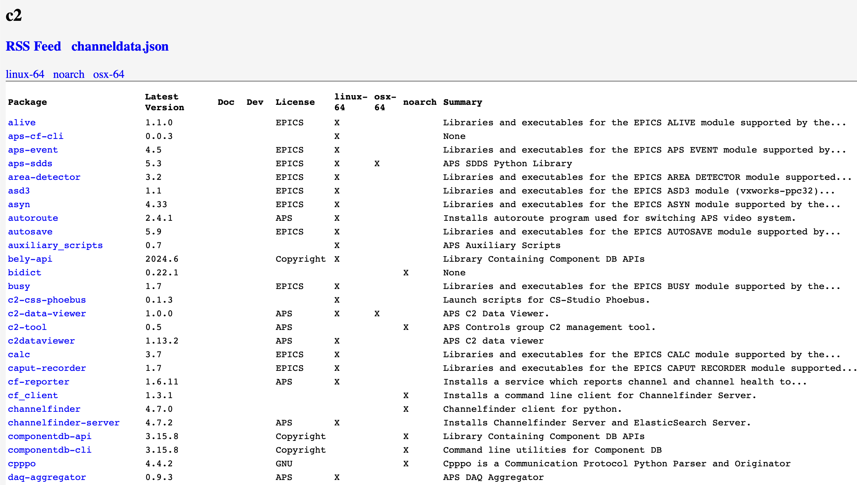
package Repository webserver
For deployed Conda packages and other imported software
Web server containing:
Conda packages, both imported and locally built for deployment
Tar-balls & zip-files for all open-source code that we build or install unmodified
Commercial SDKs and other binary packages we install

Slide 5
NFS, Conda and EPICS Sumo
NetApp & Linux NFS servers store & backup many file-systems
RHEL-8 still provides NFSv2 over UDP (not supported by RH)
Needed for a dwindling set of legacy RTEMS-4 devices
Conda to package and deploy versioned applications
EPICS Sumo builds support modules and populates configure/RELEASE files
Scripts to checkout/update and build IOCs in production area
Manually initiated, limit access to the account used for production builds
Separate build areas for legacy (EPICS 3.14) and C2 (EPICS 7) IOCs
Converted 65 legacy IOC tops and 133 modules from CVS to Git, rebuilt
Legacy IOCs needed a few updates, e.g. to change device IP addresses

Slide 6
Using Conda for many applications
Developed C2-Tool to version-control our installed application environments
Simplifies deployment of standardized applications to the /C2 areas
Packaged many applications, both internal and external
EPICS Base, Sumo, our IOC tools, c2dv, CSS-Phoebus, Logstash, etc.
Use Conda for python applications
Auxiliary-scripts area for simple scripts that we don’t package for Conda

Slide 7
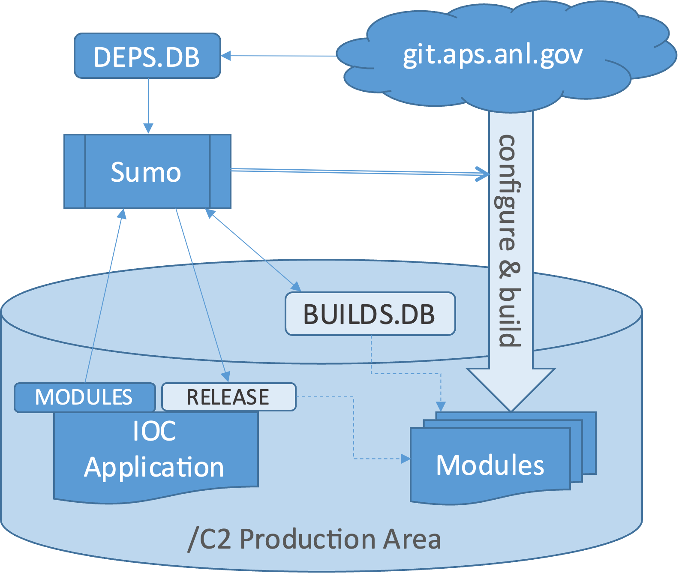
EPICS Sumo — automates EPICs builds
A single command builds a set of dependencies from source in git
SUpport MOdule Manager for EPICS
Very useful software from HZB
pip install epics-sumo
Uses a dependency database DEPS.DB to checkout and build a set of EPICS support module versions requested by an IOC top
Reuses modules already built against the same set of dependencies
Creates the IOC configure/RELEASE files

Slide 8
Build script Output from an IOC update
-------- acis/B1 >>>>>>>>
Updating IOC branch at /C2/iocs/acis/B1
Commits to apply:
551e019 Changed db/SYNCACISPLCTIMEAGAIN.db database to db/SYNCACISPLCTIME.db
970f7ce Changed $(Z)-ACIS:EPICS:ClockSyncC OUT field to 'EPICS_Clock_Pulse'
Updating 923d7ac..551e019
Fast-forward
iocBoot/sioc2acis5/st.cmd | 2 +-
xlsx/ACISSR.xlsx | Bin 342433 -> 342688 bytes
2 files changed, 1 insertion(+), 1 deletion(-)
Reusing configure/RELEASE
Building IOC branch at /C2/iocs/acis/B1
IOC build succeeded, logged in /C2/iocs/acis/logs/build-B1-2024-09-04-16:11.log
<<<<<<<< acis/B1 --------

Slide 9
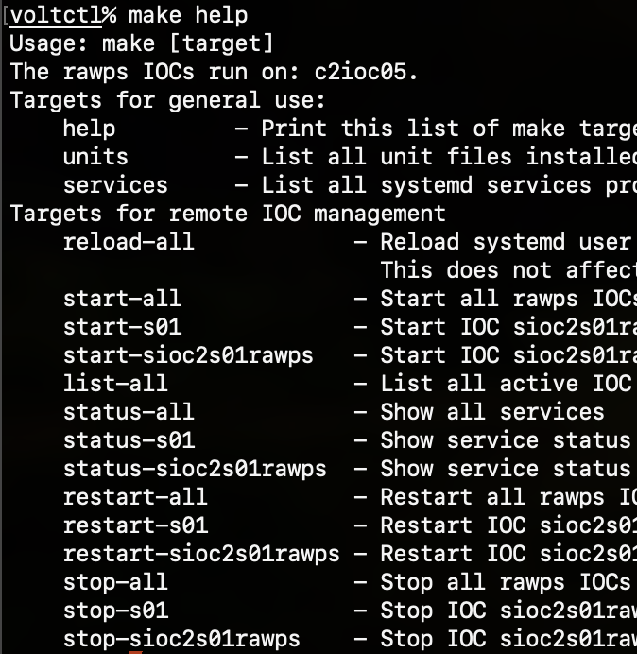
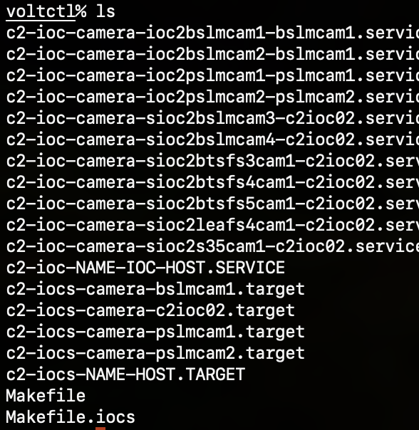
Use Systemd + Makefiles to manage Soft IOCs
Makefiles run systemctl --user commands remotely over ssh
Help commands
Templated unit files
Systemd unit hierarchy

Slide 10
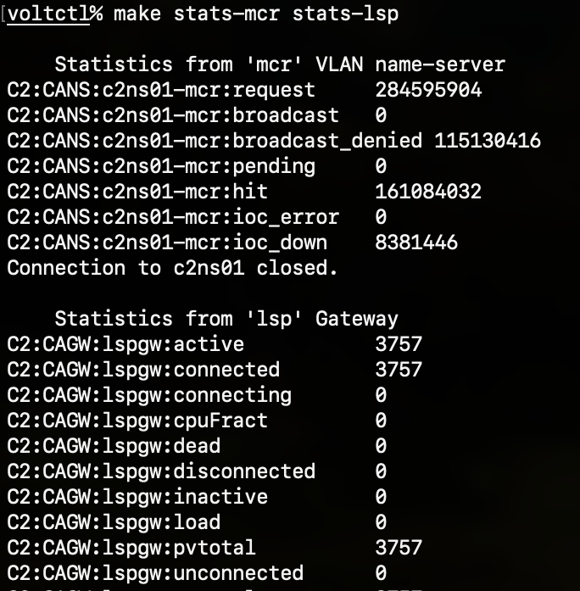
CA Name Servers and Gateways
How CA clients connect between the multiple network VLANs we use
CA search paths
CA data paths
Use systemd & make
MCR
DAQ
MCR
DAQ
Cluster
Cluster
IOCs
NS
Brilliance+ BPMs
IOCs
Brilliance+ BPMs
Gateway
Gateway
Gateway
Gateway
Spark BPMs
Booster BPMs
Spark BPMs
Booster BPMs

Slide 11
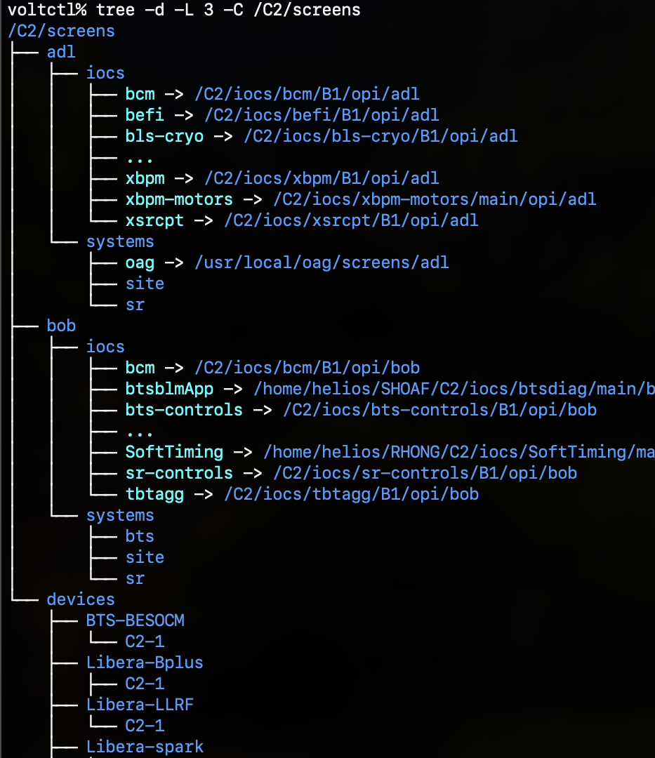
display screen files
/C2/screens tree structure
Holds screens for both MEDM (.adl) and CSS/Bob (.bob, .ui) display managers
Uses soft-links to simplify paths to IOC tops
Long related-display paths break easily when their destination moves
IOC builds install screens needed from their support module versions, providing the right screen for the records & databases loaded
A script open-C2-screen can open both types of screen, with macros, to allow links between the screen types
Could implement a display search path for CSS/Bob, which doesn’t have one

Slide 12
Any Questions?

