Slide 1
EPICS and Related Software at NSLS-II
John Sinsheimer, Data Science and Systems Integration (DSSI) Group
09/17/24

Slide 2
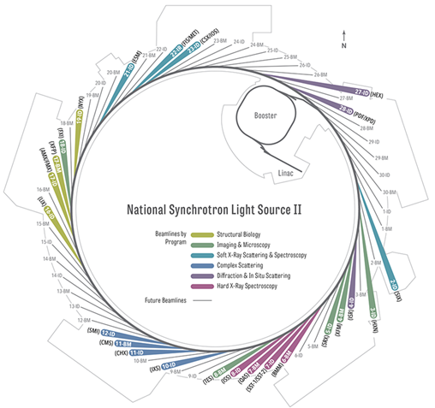
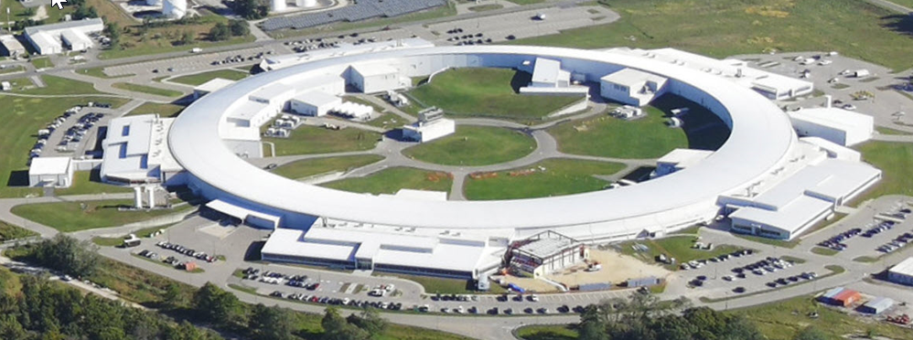
National Synchrotron Light Source II
U.S. Department of Energy Facility
  Hosts peer reviewed science and technology research
  Serves scientific, industrial and education communities
Competitive brightness on the World stage
  3 GeV electron beam energy
  792m in circumference
  Designed for current up to 500 mA
  Can host ~ 60 Beamlines; currently 29 in user operations from InfraRed to Hard X-rays
  3 beamlines in construction
  5 more on the drawing board
Unprecedented ramp-up
  First light October 2014
  GU ops started July 2015
Slide Courtesy of Erik Johnson

Slide 3
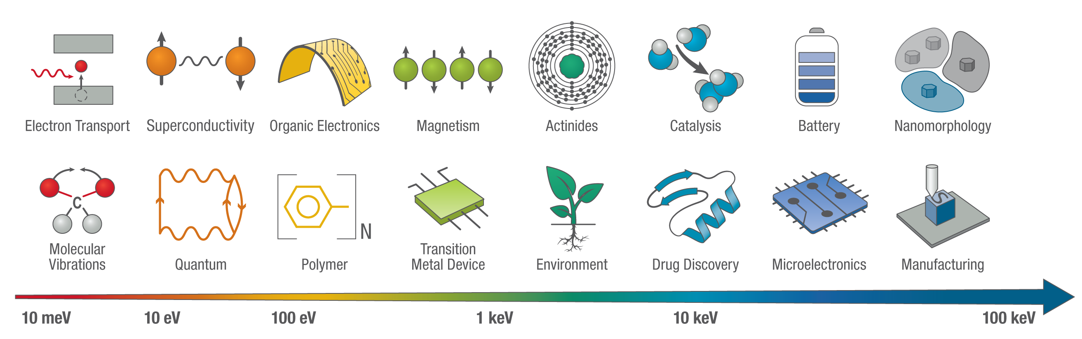
NSLS-II Mission
  To develop and operate a premier user facility that embraces diversity to safely and efficiently deliver high-impact and cutting-edge science and technology for the benefit of society
  The challenges of today are complex and multiscale and require a multimodal approach enabled by an advanced data infrastructure
Slide Courtesy of Erik Johnson

Slide 4
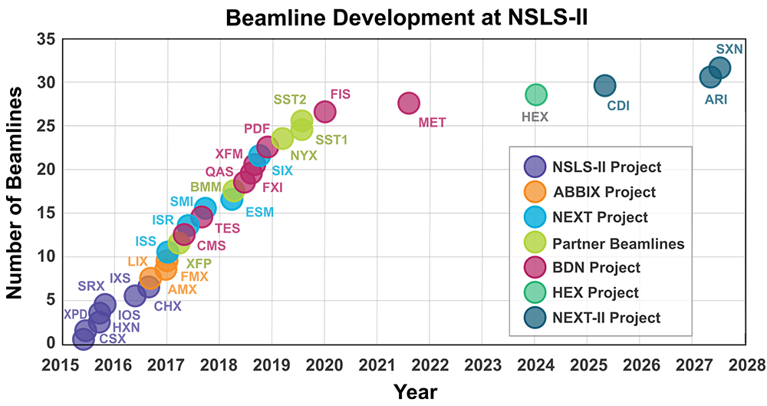
Upcoming New Beamlines
NSLS-II Experimental Tools II (NEXT-II): Three new beamlines with construction starting or imminent, starting with Coherent Diffraction Imaging beamline
NSLS-II Experimental Tools III (NEXT-III): Plan to build 8-12 more beamlines over the next ~11 years as four subprojects. Includes a software project (N3XTware) to develop tools and automation

Slide 5



Data Science and Systems Integration (DSSI)
DSSI subgroups: Engineering & Equipment Pool, Instrument and Controls, Data Acquisition & Detectors, Data Engineering, Scientific Data Analysis & Visualization, Scientific Information Services
Beamline programs each have an assigned DSSI team matrixed from most subgroups to collaboratively meet operational needs
Additional matrixed teams for facility wide projects and/or new beamline construction
We're hiring to meet operational needs

Slide 6
Current and Upcoming EPICS Related Project Highlights

Slide 7
Migration From Physical Servers to Centralized Hypervisors / VMs
Reduced labor compared to physical servers over the life cycle
  Purchasing, deployment, maintenance, replacement
Virtual Machine features
  Snapshots, resilient to hardware faults, simplified monitoring
Concern about bandwidth issues, but can set software limits
Local detector control machines still needed in most cases
Develop scripts to migrate soft IOCs from existing servers to VMs

Slide 8

IOC Deployment with Ansible
Jakub Wlodek and Dmitri Gavrilov
Unique information to each IOC instance put into one .yaml file
  PV names, IP address(es), substitution file rows, etc
Each hostname has a yaml config file for manage-iocs config
Assumption, for now, is that compiled IOC source code is available in another directory
Eventually will define releases for source modules or may integrate with containers
Extend to create Phoebus displays in some cases, such as motors.
Automate ophyd device instantiation for Bluesky usage

Slide 9
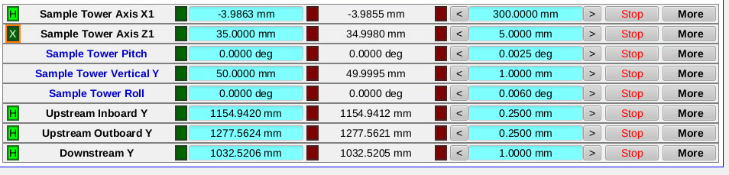
Automatic Phoebus Display Generation
For Motion Control
Dmitri Gavrilov
Generic motor control interface
yaml file defines each row, which is combined with custom Python script and phoebusgen (ALS)

Slide 10
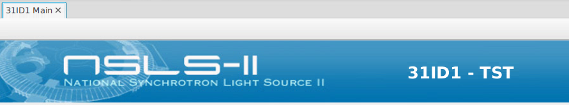
Testing Environment Development
31-ID "Test Beamline"
Laboratory testing space with some real devices and some virtual
Create software environment analogous to real beamline with same pattern of network layout, user accounts and service accounts, workstations, IOC servers, etc.
Device testing and software development
Employee training

Slide 11
Migration from CS-Studio to Phoebus
First glance: ~6000 .opi files on accelerator repository and ~16000 .opi files on the beamlines
  Many of these are copies with only slight differences
  Migration is an opportunity to better simplify and standardize, aided by scripting in some cases
Different file extension (.bob vs .opi) allows work in parallel
Start with one beamline per program, divide accelerator into subsections, to work with manageable chunks

Slide 12
Additional ongoing projects
CAproto : A pure python channel access implementation for Python based device control
Further standardization of common devices
  Motion control standards, simple analog/digital I/O, electrometers
Automated backups of PMAC motor controllers via ansible or EPICS
Develop generic framework for fly scanning, utilizing PandABox
Greater education and usage of EPICS services (Alarm, Save/Restore, Archiver)

Slide 13
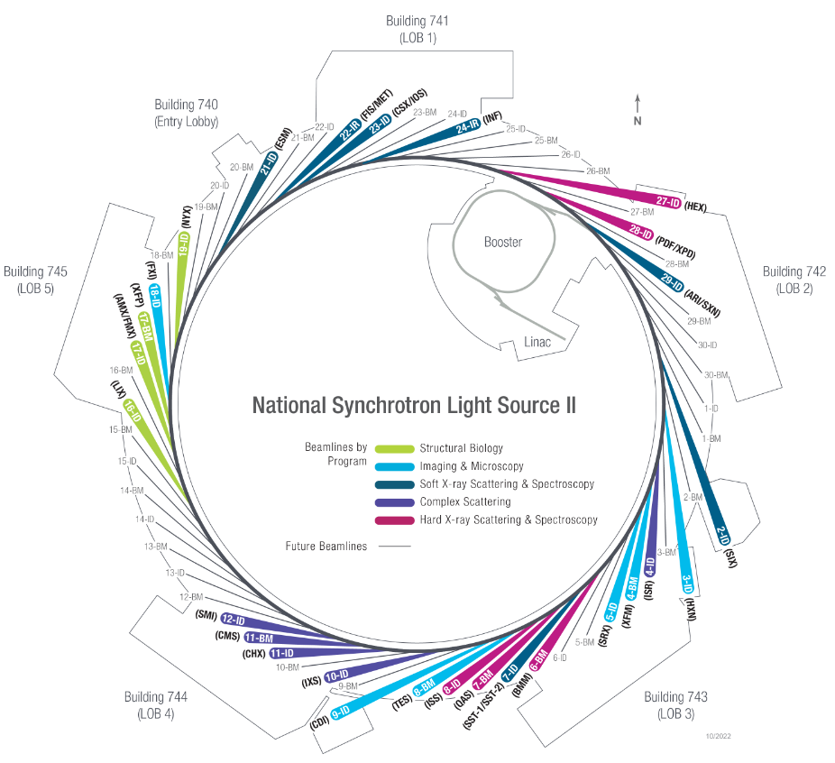
Conclusion
NSLS-II is a growing facility and the Data Science and Systems Integration group is working towards more scalable and automated management of EPICS IOCs, Phoebus displays, and associated hardware and software.

