Slide 1
Transitioning to EPICS at EIC: UDP-Based Waveform Monitoring
Kyle A. Fahey
Electrical Engineer
EPICS Collaboration Meeting
September 17, 2024

Slide 2
Outline
Pre-Existing Interfaces
EPICS Interface
UDP Interface
Workflow for Waveform Conversion
Python
EPICS-ADO Bridge
LogView
Conclusion
2024 EPICS Collaboration Meeting
Kyle A. Fahey

Slide 3
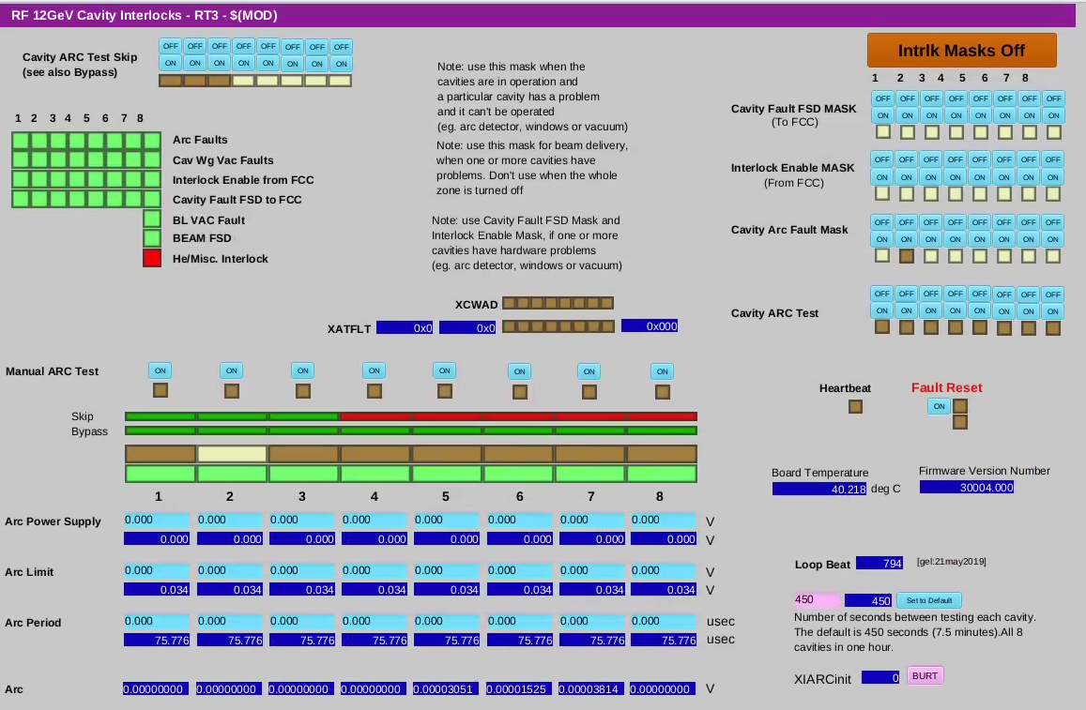
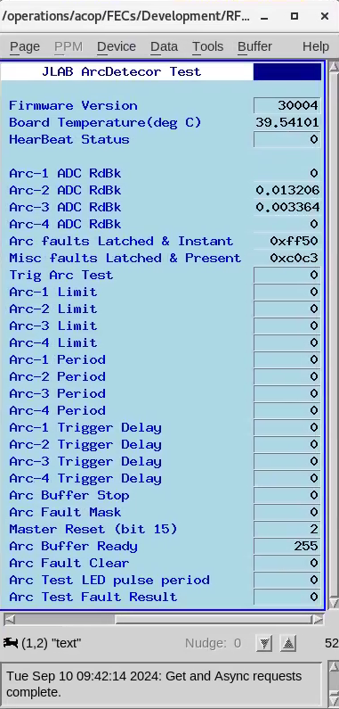
EPICS Interface for Arc Detector
Arc detector chassis provided by Jefferson Lab for performance evaluation
IOC for controls and statuses provided
EDM UI provided, converted to CS-Studio by Latif Kabir
EPICS PVs usable in BNL systems
ADO exists to mirror PV data
Pet pages
Logged data
EPICS PVs can be used to set up arc test conditions with onboard LED
Modified CS-Studio UI
BNL’s Pet view
2024 EPICS Collaboration Meeting
Kyle A. Fahey

Slide 4
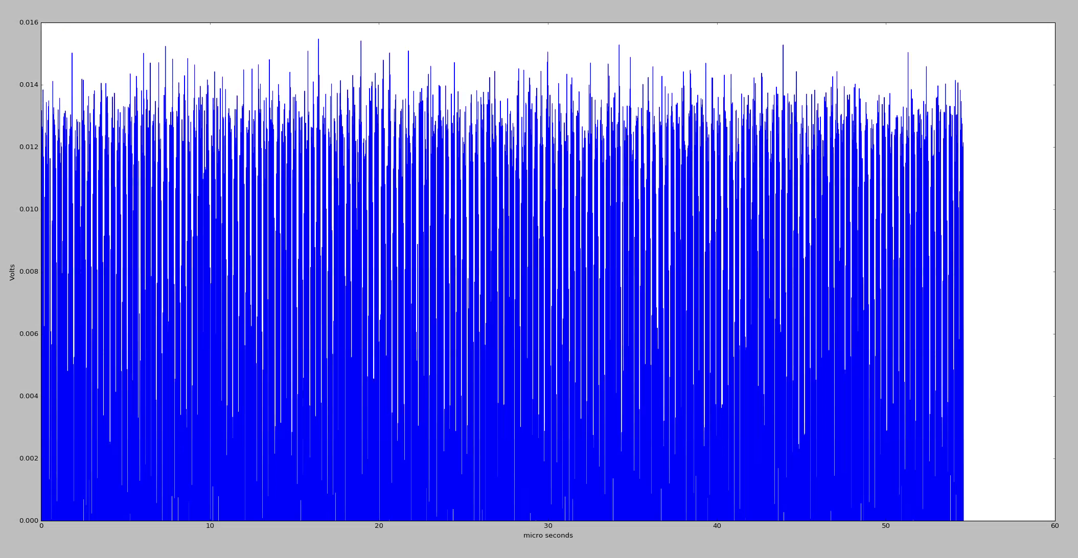
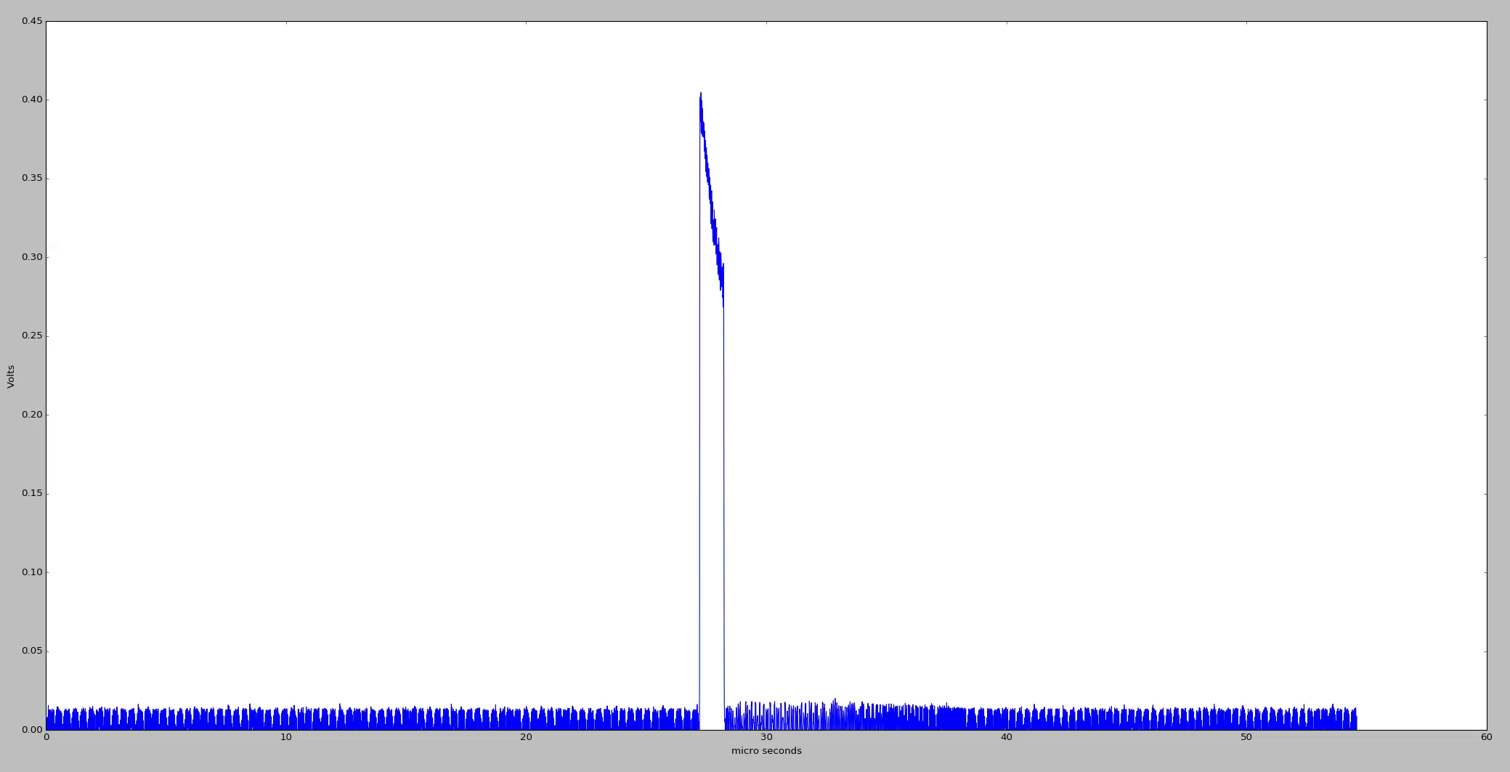
UDP Interface for Arc Detector
UDP Interface provides more functionality
Controls to simulate an arc condition
Ability to view raw waveform data
Ability to quickly reset all parameters
Communicates via Python script given by JLAB
Waveform viewable through matplotlib
Data is not readily available for use in BNL systems
We want to periodically save raw waveform data
Normal Waveform
Arc Test Waveform
2024 EPICS Collaboration Meeting
Kyle A. Fahey

Slide 5
Waveform Workflow
Arc Detector
Python Script
EPICS IOC
EPICS-ADO Bridge
ADO Device
LogView
Logged Data
2024 EPICS Collaboration Meeting
Kyle A. Fahey

Slide 6
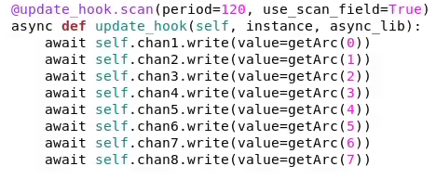
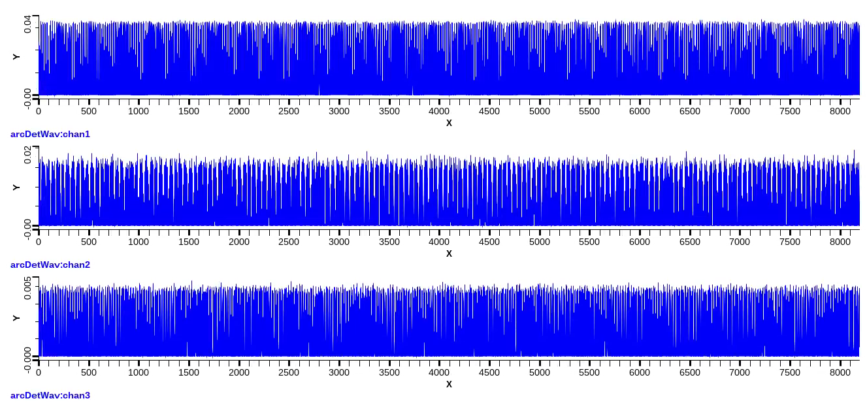
Python Script
Uses caproto library
Implementation of Channel Access protocol in Python, found at https://caproto.github.io/
Periodically runs through all ADCs to get raw waveform data
Hooks into separate “softIoc” process
Getting data from waveforms takes too long for an internal IOC to handle requests
Calling waveform function for all waveforms periodically
Waveforms for the 3 connected detector heads
2024 EPICS Collaboration Meeting
Kyle A. Fahey

Slide 7
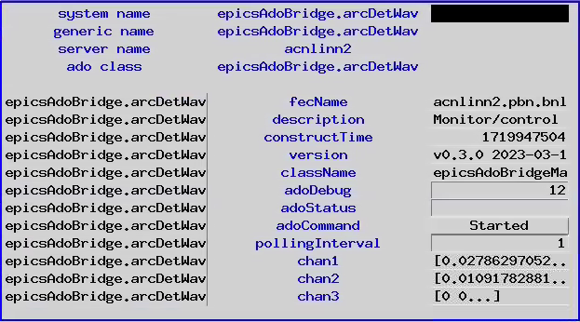
EPICS-ADO Bridge
Designed at BNL
Interface Between EPICS and ADO – (Andrei Sukhanov, James Jamilkowski)
Translates EPICS PVs for use with ADO software
Pet
LogView
Simple Setup
Create mapping file
Create ADO definition in manager application
Run bridge, pointing to mapping file
Definition of EPICS-ADO Bridge Parameters
Pet Page for ADO Generated by EPICS-ADO Bridge
2024 EPICS Collaboration Meeting
Kyle A. Fahey

Slide 8
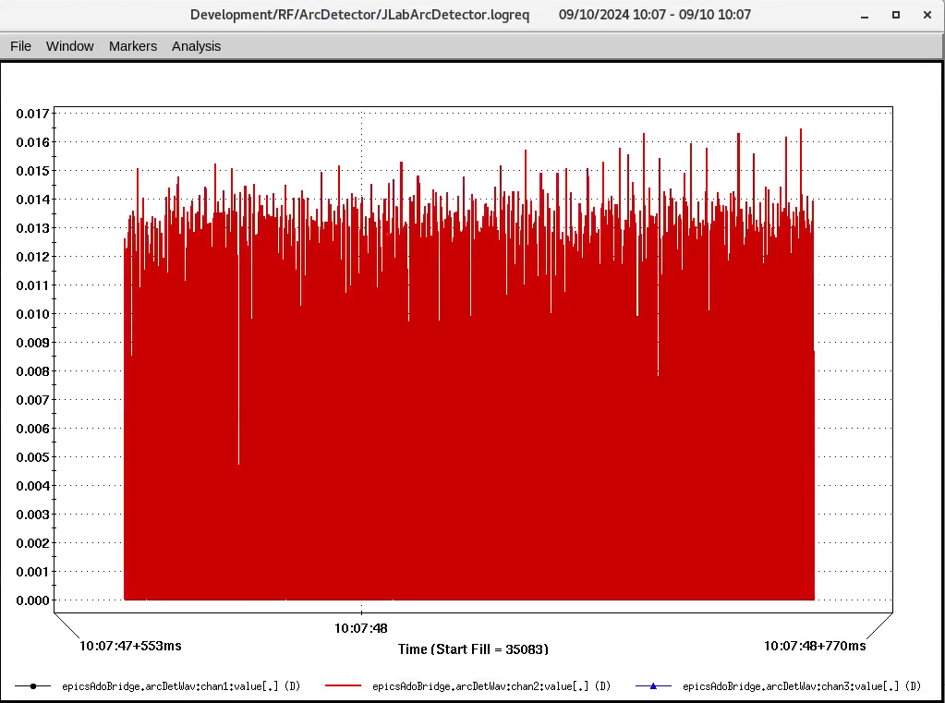
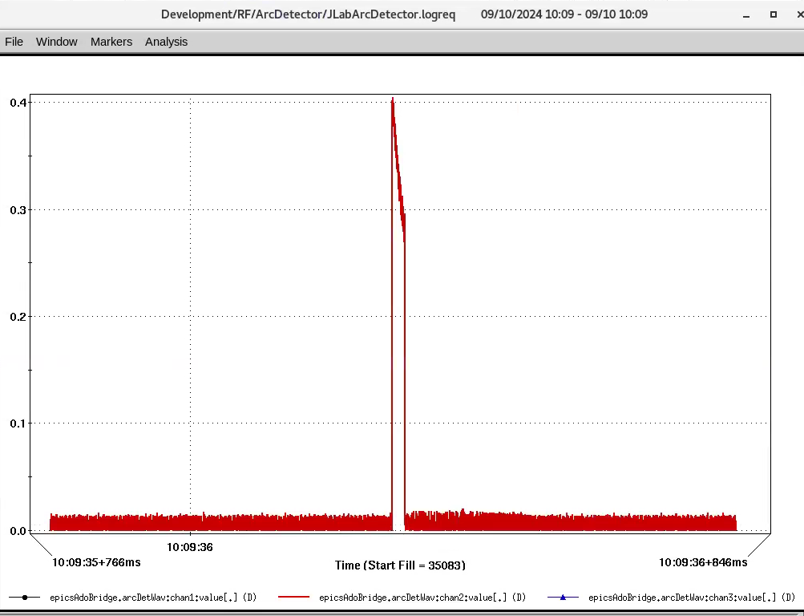
LogView
Application written by BNL to save ADO data over time
Logreq file defines ADOs to point to
Set up using General Purpose Monitor application
Logged Normal Waveform
Logged Arc Test Waveform
2024 EPICS Collaboration Meeting
Kyle A. Fahey

Slide 9
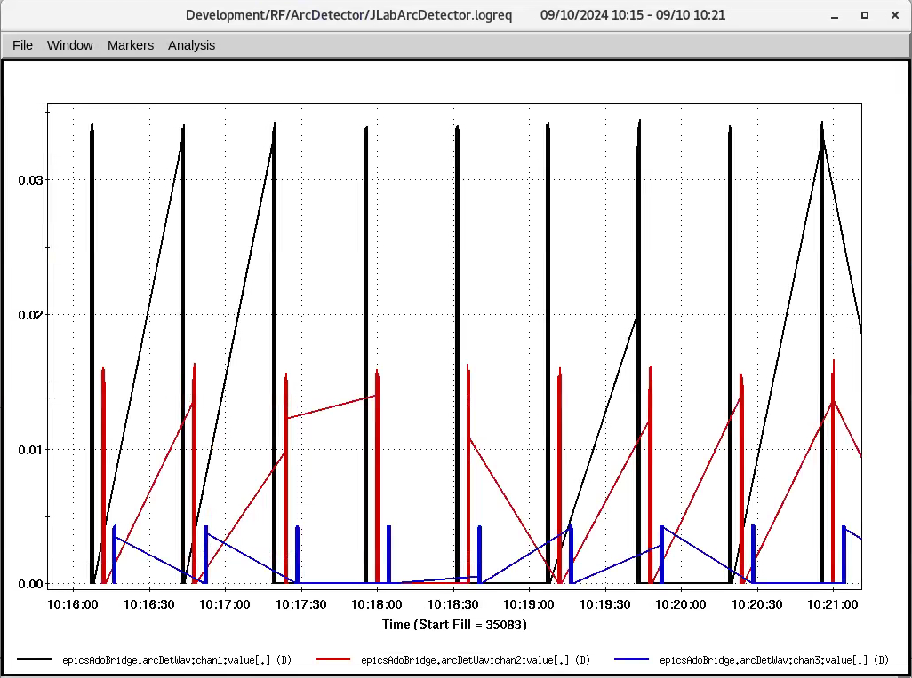
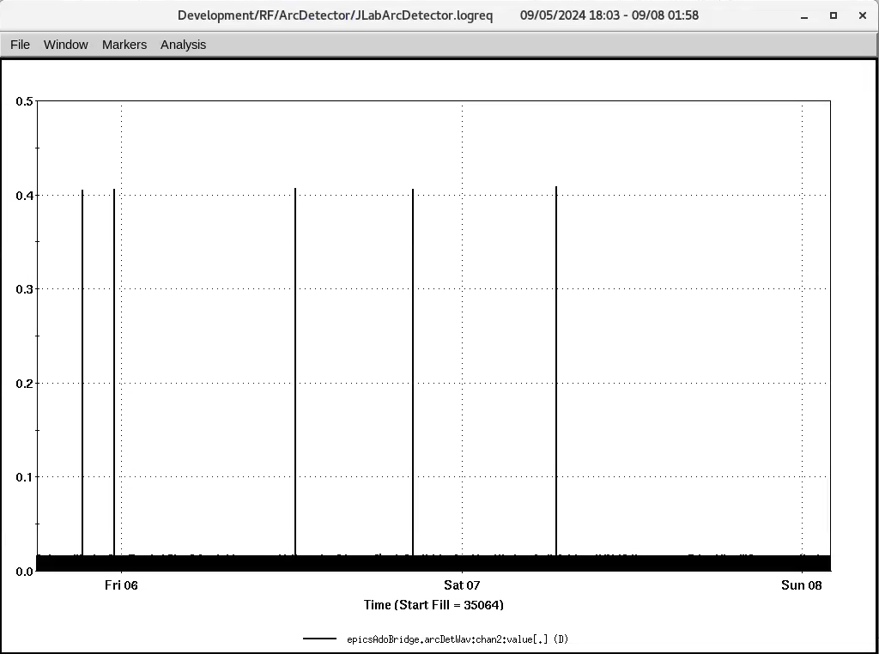
LogView Over Time
Allows for long-term monitoring of values
Logged Waveforms of 3 Connected Detector Heads
Logged Waveforms of Detector Head #2 Over Several Days
2024 EPICS Collaboration Meeting
Kyle A. Fahey

Slide 10
Conclusion
EIC LLRF is testing an arc detector chassis from Jefferson Lab, which includes EPICS functionality
Raw waveform data was not included in the provided IOC, but accessible over UDP commands
Python script was created to periodically request waveform data and integrate it into an EPICS IOC
EPICS IOC converted for use with BNL’s LogView software using EPICS-ADO Bridge
Arc detector is being monitored reliably since July 2024
2024 EPICS Collaboration Meeting
Kyle A. Fahey

Slide 11
2024 EPICS Collaboration Meeting
Kyle A. Fahey

