Slide 1
Machine Learning Data Platform
Overview of the Machine Learning Data Platform (MLDP) with focus on the Data Platform (DP) subsystem
Christopher K. Allen
Craig McChesney

Slide 2
Topics
MLDP Overview - “The Big Picture”
Survey of MLDP Elements
Project Status and Road Map
Summary

Slide 3
MLDP Overview “The Big Picture”
Motivation
Concept
Subsystems

Slide 4
MLDP Overview Motivation
Full-stack support for machine learning and general data science applications for the diagnosis, modeling, control, and optimization of large particle accelerator and experimental physics facilities.
From high-speed data acquisition to rapid ML/AI application development and deployment.
A standardized platform for rapid implementation and deployment of ML/Data Science algorithms to different operating configurations and different facilities.
Data science perspective of archived facility data

Slide 5
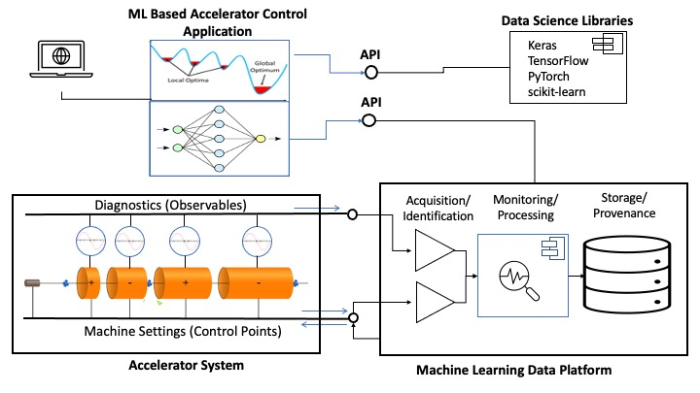
MLDP Overview Concept
The Machine Learning Data Platform (MLDP) has 3 primary functions:
High-speed data acquisition (EPICS).
Archiving, processing, and management of heterogeneous, time-correlated data.
Data Analysis: Broad query, annotation, and processing of archive. (data science/ML/AI applications)
Functions are realized by separate subsystems each supporting a category of use cases.
Conceptual diagram of Machine Learning Data Platform

Slide 6
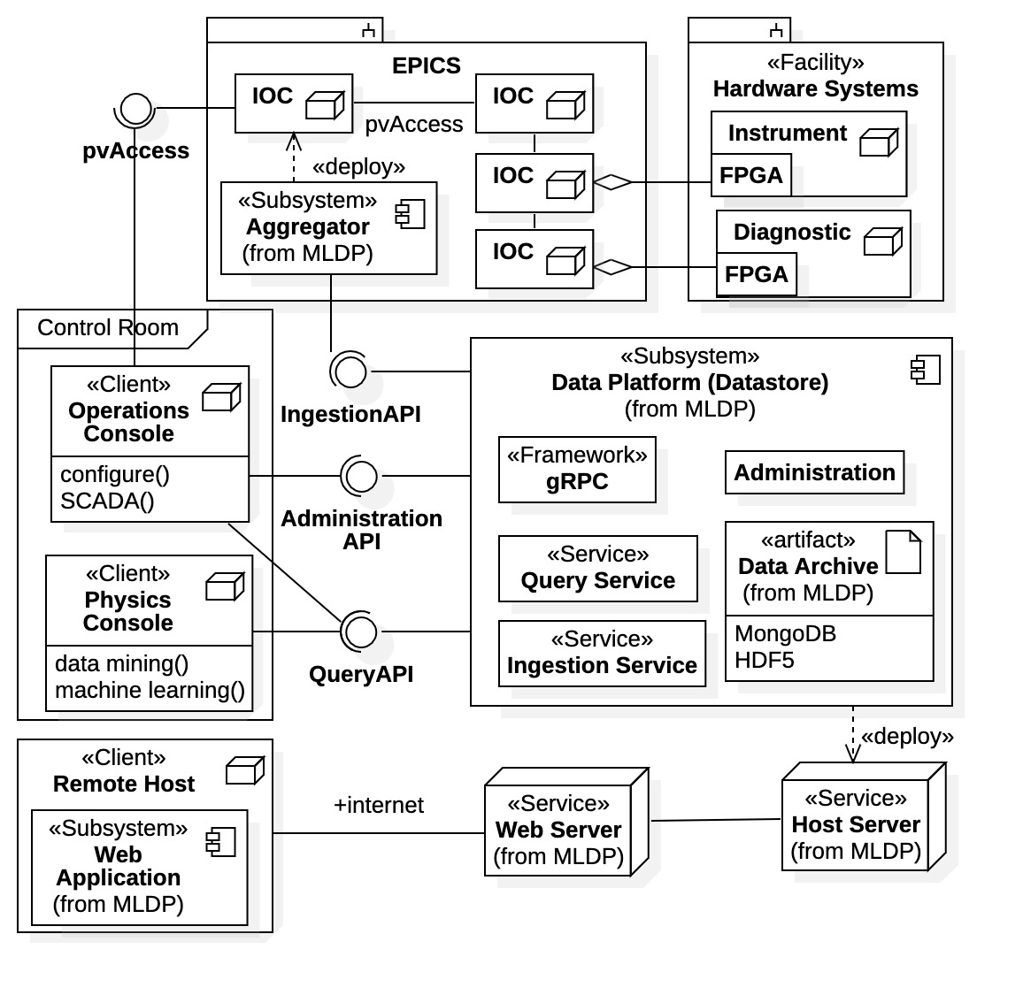
MLDP Overview Subsystems
Aggregator (a Data Provider)
High-speed data acquisition and collection of facility hardware data.
Deployed with EPICS control system.
Data Platform (previously Datastore)
Standalone – deployed on separate server(s), EPICS not required.
Any facility may use data platform.
Contains the Data Archive.
Composed of collaborating services.
Independent gRPC comm. framework.
Well-defined APIs for communication.
Web Application provides remote access to Data Archive using an internet web browser.
Attaches to the Data Platform subsystem.
Machine Learning Data Platform subsystems and deployment

Slide 7
Topics
Overview of the MLDP - “The Big Picture”
Survey of MLDP Elements
Project Status and Road Map
Summary

Slide 8
Survey of MLDP Elements
Tech Stack
Aggregator / Data Provider
Data Archive
gRPC API
Data Platform / Core Services
Client Libraries
Web Application

Slide 9
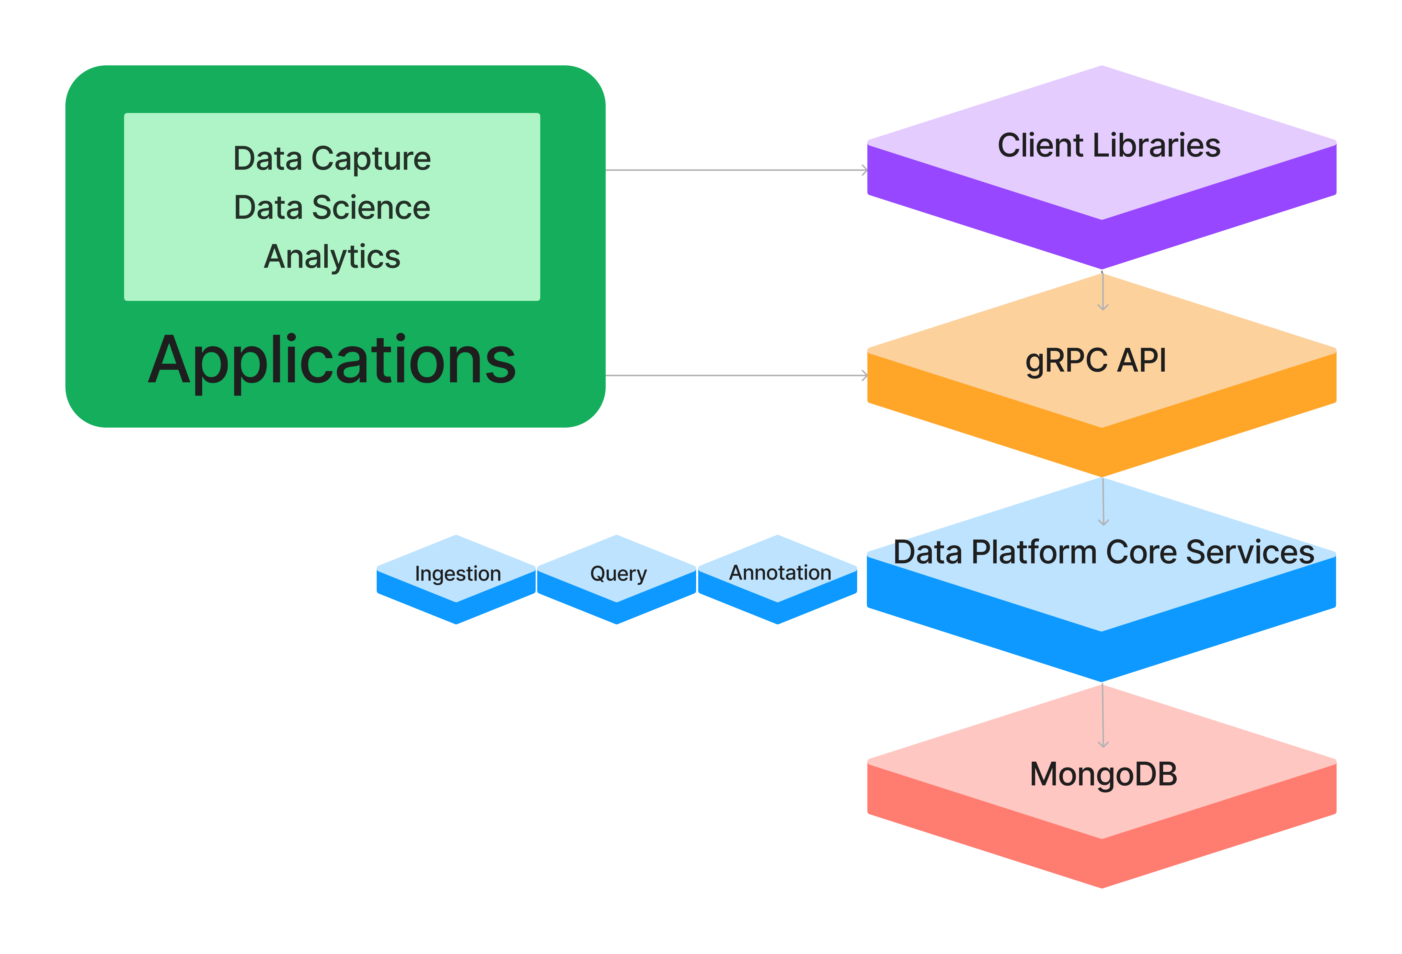
MLDP Elements Tech Stack
The Data Platform Core Services are implemented as Java server applications.
The MongoDB document-oriented database management system is used by the services for persistence.
The Data Platform API is built upon the gRPC open-source high-performance communication framework.
Java and Python Client Libraries are provided for higher-level interaction hiding the gRPC API details.
Applications communicate either directly via the gRPC API or using the Client Libraries.

Slide 10
Survey of MLDP Elements
Tech Stack
Aggregator / Data Provider
Data Archive
gRPC API
Data Platform / Core Services
Client Libraries
Web Application

Slide 11
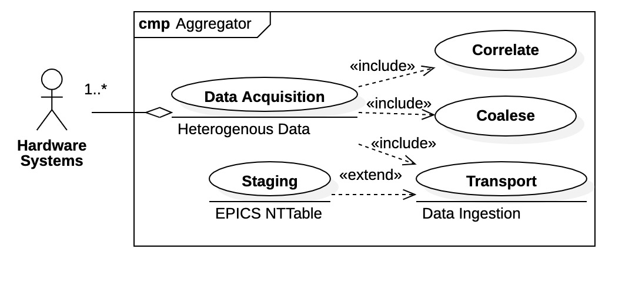
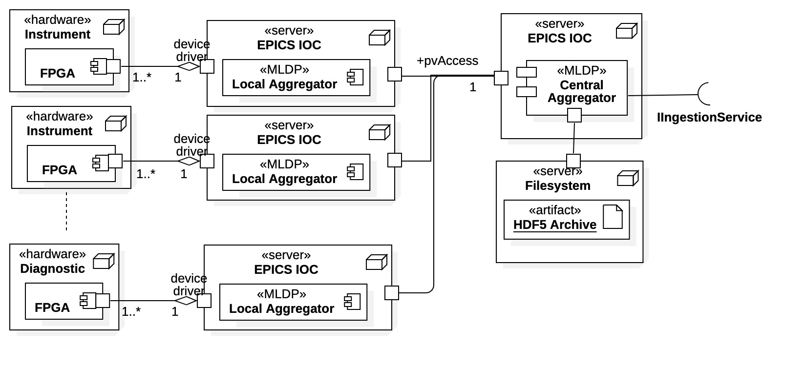
MLDP Elements Aggregator / Data Provider
Clients here are hardware systems
Aggregator performs synchronous, high-speed data acquisition and collection within EPICS control system.
Aggregator use cases
Distributed system
Local Aggregators – proximal to hardware
Collect and align local hetero data.
May have multiple data sources.
Transport to Central Aggregator.
Central Aggregator
Coalesce all aggregated data.
Stage as NTTable “snapshots”.
Transport to Data Platform via API.
Aggregator system architecture

Slide 12
Survey of MLDP Elements
Tech Stack
Aggregator / Data Provider
Data Archive
gRPC API
Data Platform / Core Services
Client Libraries
Web Application

Slide 13
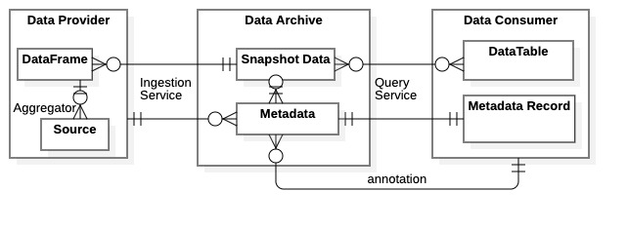
MLDP Elements Data Archive
Data Archive contains
PV Time-Series Data – Heterogenous, correlated, time-series device data.
Flows in as Data Frames (NTTables) .
Flows out as dynamic Data Tables.
Metadata – Characteristics/associations/properties within snapshot data.
Created by Ingestion Service and augmented by Query Service.
Flows out as Metadata Records.
Annotations – User additions to data archive (notes, relations, calculations).
Created by Data Consumers as “value-added” data.
Flows out as Annotation Records.
NOTE: The MLDP data archive is maintained completely by the Data Platform subsystem.
MLDP data flow diagram

Slide 14
Survey of MLDP Elements
Tech Stack
Aggregator / Data Provider
Data Archive
gRPC API
Data Platform / Core Services
Client Libraries
Web Application

Slide 15
MLDP Elements gRPC API
The gRPC communication framework was originally developed by Google for use in connecting microservices.
It uses HTTP/2 for transport, and Protocol Buffers as both the interface definition language and message interchange format.
Supports simple unary single request / response APIs as well as unidirectional and bidirectional streaming.
We chose gRPC for the Data Platform API because it can meet our performance requirements for data ingestion, provides bindings for virtually any programming language, and supports a variety of application styles.

Slide 16
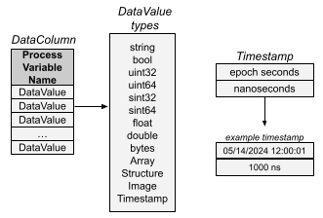
MLDP Elements gRPC API: Heterogeneous Data
The API defines type “DataValue” to represent a range of heterogeneous data types for use in the ingestion and query interfaces ranging from simple scalar data types to complex types including multi-dimensional arrays, structures, and images.
Each DataValue can optionally include “ValueStatus” information captured from the control system.
Times are represented using components for epoch second and nanoseconds (a third component could be added for finer resolution).

Slide 17
Survey of MLDP Elements
Tech Stack
Aggregator / Data Provider
Data Archive
gRPC API
Data Platform / Core Services
Service Model
Ingestion Service
Query Service
Annotation Service
Client Libraries
Web Application

Slide 18
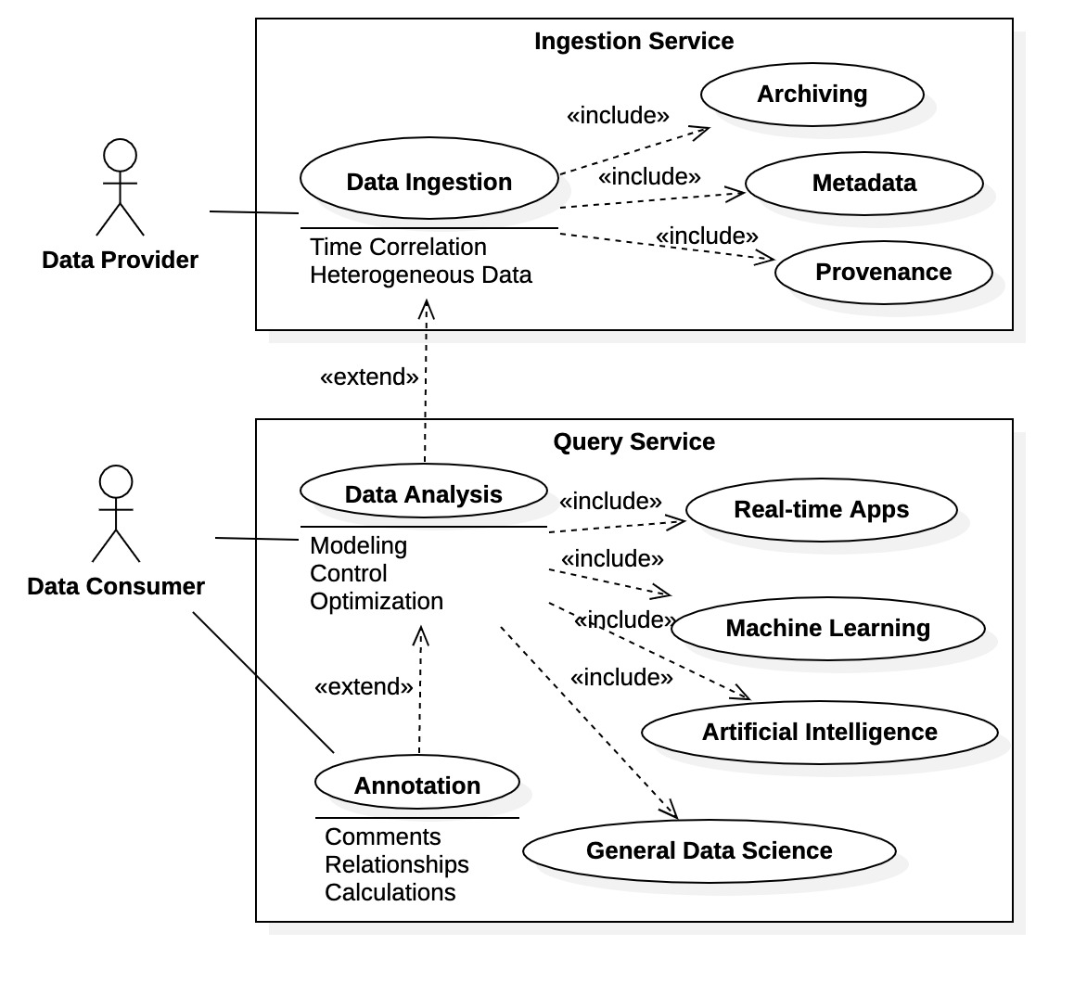
MLDP Elements Data Platform- Service Model
Clients are generically divided into Data Providers - populate data archive Data Consumers - utilize data archive
The Data Platform Core Services manage the Data Archive and are the primary interaction point for clients.
The Data Platform is a standalone system, independent of EPICS.
Fundamental components implemented as services
Ingestion Service – clients are Data Providers that supply data to the Archive.
Query Service – clients are Data Consumers that interact with the Data Archive.
Engineers, data scientists, physicists, applications, remote users, etc.
Annotation Service – clients are Data Consumers that supply ”value added” information to the Data Archive.
Data Platform use cases as seen by clients

Slide 19
MLDP Elements Data Platform / Core Services Ingestion Service
The Ingestion Service provides APIs for provider registration, data ingestion, and querying status of ingestion requests.
Processing is asynchronous to maximize performance.
Writes time-series data “buckets” to MongoDB, each containing vector of data values for a single PV over a time range.
Bucket stores data values using serialized Protobuf format, and specifies timestamps for data values using start time, sample period, number of samples (or explicit list of timestamps).
rpc registerProvider (RegisterProviderRequest) returns (RegisterProviderResponse);
rpc ingestDataStream (stream IngestDataRequest) returns (IngestDataStreamResponse);
rpc queryRequestStatus(QueryRequestStatusRequest) returns (QueryRequestStatusResponse);

Slide 20
MLDP Elements Data Platform / Core Services Query Service
The Query Service provides APIs for retrieving PV time-series data in bucketed or tabular format, and for querying metadata about data sources.
Data query response contains data buckets matching query’s PV and time range criteria.
Client Library provides tools for assembling bucketed data from response to a tabular structure, if appropriate.
rpc queryDataStream(QueryDataRequest) returns (stream QueryDataResponse);
rpc queryTable(QueryTableRequest) returns (QueryTableResponse);
rpc queryMetadata(QueryMetadataRequest) returns (QueryMetadataResponse);

Slide 21
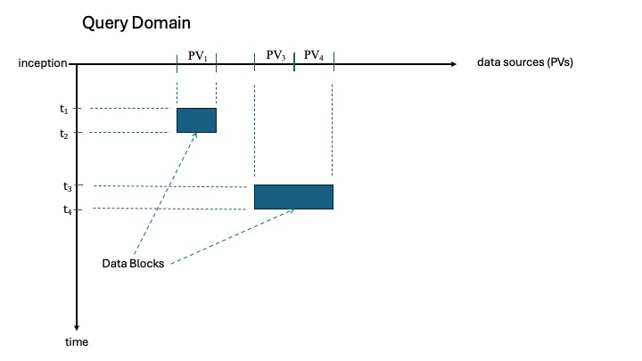
MLDP Elements Data Platform / Core Services Annotation Service
A Dataset is comprised of Data Blocks, each specifying PV(s) and time range.
The Annotation Service provides APIs for identifying “Datasets” in the archive, adding annotations to them, and performing queries.
A number of different types of annotations are supported (or planned), including basic descriptive information, links between related datasets, calculations, derived datasets, and provenance.
rpc createDataSet(CreateDataSetRequest) returns (CreateDataSetResponse);
rpc queryDataSets(QueryDataSetsRequest) returns (QueryDataSetsResponse);
rpc createAnnotation(CreateAnnotationRequest) returns (CreateAnnotationResponse);
rpc queryAnnotations(QueryAnnotationsRequest) returns (QueryAnnotationsResponse);

Slide 22
Survey of MLDP Elements
Tech Stack
Aggregator / Data Provider
Data Archive
gRPC API
Data Platform / Core Services
Client Libraries
Web Application

Slide 23
MLDP Elements Client Libraries
Libraries are also available for building Data Platform clients (under development).
Client libraries avoid the complexities of direct gRPC communications.
Offer additional features, such as default configuration, buffering, dynamic data tables, etc.
Currently migrating high-level Java API libraries to new platform architecture.
An additional Python query API is planned.
Based upon Pandas library common to most data science.
An EPICS pvAccess interface to the Ingestion Service is also anticipated.

Slide 24
Survey of MLDP Elements
Tech Stack
Aggregator / Data Provider
Data Archive
gRPC API
Data Platform / Core Services
Client Libraries
Web Application

Slide 25
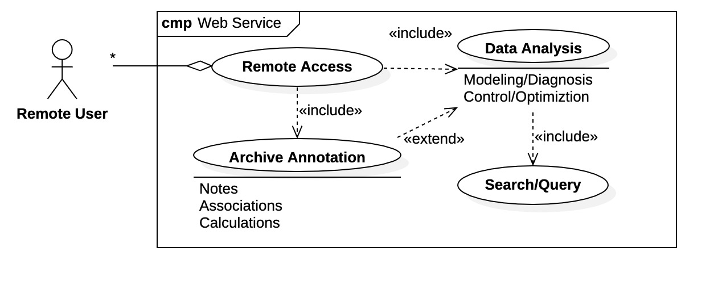
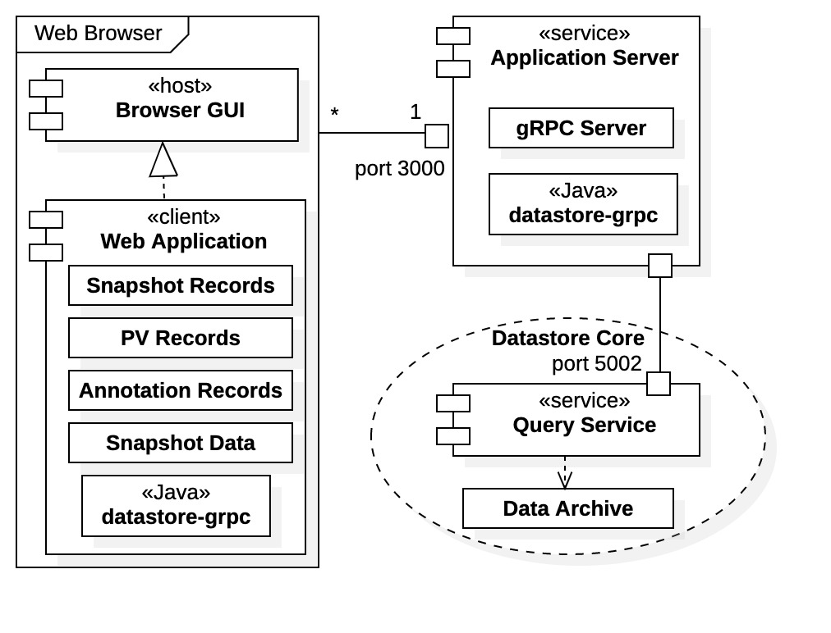
MLDP Elements Web Application
Web Application Use Cases
Web Application is a browser-based application built using JavaScript / React / Node.
Web Application provides remote access to the DP data archive.
Facilitates a subset of Query and Annotation Service use cases.
Tools for inspection, visualization, downloads, and data analysis.
JavaScript Node server provides API that augments Data Platform API.
Envoy proxy translates http traffic from browser application to http2 for consumption by gRPC servers.
Web Application Architecture

Slide 26
Topics
Overview of the MLDP - “The Big Picture”
Survey of MLDP Elements
Project Status and Road Map
Summary

Slide 27
MLDP Project Status and Road Map
Completed - Redesign of Data Platform Archive and Core Services
Eliminated many 3rd party dependencies from prototype – now restricted to Java, gRPC, and MongoDB.
Redesigned prototype gRPC API.
Evaluated C++ gRPC for datastream processing (~ 500 MBps transmission rates).
Created deployment tools.
Implemented core service API handling for Ingestion, Query, and Annotation Services.
Ingestion over 200x faster than prototype at ~ 200 MBps data ingestion rates.
Roadmap
Client Library development (Java and Python)
Export mechanism
More extensive load and scale testing
Additional annotation types
Data generator / simulator
Support for Real-time consumer use cases via inline ingestion data stream processing / algorithm
Framework for measuring data ingestion statistics from capture to archival
Token based authentication for query clients and web application
Age-based archival of data to reduce database footprint
Tools for replication / synchronization of data and index to distributed researchers
Investigate MongoDB clustering, sharding, and connection pooling
Investigate horizontal scaling for service deployment

Slide 28
Topics
Overview of the MLDP - “The Big Picture”
Survey of MLDP Elements
Project Status and Road Map
Summary

Slide 29
Summary
The Data Platform is a standalone subsystem of the larger Machine Learning Data Platform (MLDP).
Management of heterogenous data with focus on data science.
A working prototype was initially developed – “Datastore”.
A new, performance-based version is currently under development – “Data Platform”.
Data Platform has multiple components supporting use cases as collaborating services (with well-defined APIs).
Data Platform has 2 communication methods.
Direct gRPC communications
Client API libraries for Java and Python (under development).
A deployment system is available for latest DP releases.
Ingestion, Query, and Annotation Services are operational.
Only direct gRPC communication is currently available.

Slide 30
Supplemental

Slide 31
Supplemental Material
SBIR Project Background
Ingestion Data Flow Diagram
Bucket Pattern for Time-Series Data
DP Deployment
Example Data Flow
Why use an API?
Authentication / Authorization
Performance Benchmarks
Application Layer: Low-Level API vs. High-Level Library

Slide 32
MLDP Overview SBIR Project Background
MLDP development is supported by the US Dept. of Energy (DOE) under a Small Business Innovative Research (SBIR) grant starting in 2022.
A prototype MLDP was completed in Phase I with the following subsystems:
Aggregator – EPICS based, high-speed synchronous data acquisition of heterogeneous data.
Datastore – Standalone system for data ingestion, archive management and access.
Web Application – Universal, remote access and interaction with data archive.
SBIR Phase II awarded in 2023 (Fiscal Year 2024)
Redesign of Datastore archive and services with emphasis on performance (Year 1).
Support for full archive annotation (Year 1).
Datastore use case expansions (Year 2)
Datastream processing,
Algorithm Plugins,
Advanced Data Science Applications.
“Data Platform” (DP) references previous “Datastore” system of prototype MLDP.
Includes upgrades and extensions for Phase II project.

Slide 33
Supplemental Material
SBIR Project Background
Ingestion Data Flow Diagram
Bucket Pattern for Time-Series Data
DP Deployment
Example Data Flow
Why use an API?
Authentication / Authorization
Performance Benchmarks
Application Layer: Low-Level API vs. High-Level Library

Slide 34
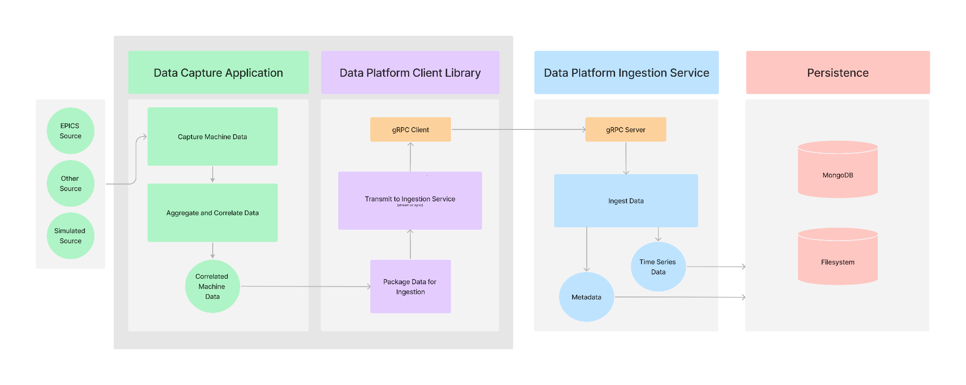
MLDP Elements Ingestion Data Flow Diagram

Slide 35
Supplemental Material
SBIR Project Background
Ingestion Data Flow Diagram
Bucket Pattern for Time-Series Data
DP Deployment
Example Data Flow
Why use an API?
Authentication / Authorization
Performance Benchmarks
Application Layer: Low-Level API vs. High-Level Library

Slide 36
MLDP Elements Data Platform / Core Services Ingestion Service: Bucket Pattern for Time-Series Data
Simple example with 3 measurements, each stored as an individual database record:
{ sensor_id: 12345, timestamp: ISODate("2019-01-31T10:00:00.000Z"), temperature: 40 }
{ sensor_id: 12345, timestamp: ISODate("2019-01-31T10:01:00.000Z"), temperature: 40 }
{ sensor_id: 12345, timestamp: ISODate("2019-01-31T10:02:00.000Z"), temperature: 41 }
Same 3 measurements stored in a single data bucket record, saving the overhead of sensor_id and timestamp for each measurement:
{ sensor_id: 12345,
start_date: ISODate("2019-01-31T10:00:00.000Z"),
sample_period_nanos: 1_000_000_000,
count: 3
measurements: [ 40, 40, 41 ] }

Slide 37
Supplemental Material
SBIR Project Background
Ingestion Data Flow Diagram
Bucket Pattern for Time-Series Data
DP Deployment
Example Data Flow
Why use an API?
Authentication / Authorization
Performance Benchmarks
Application Layer: Low-Level API vs. High-Level Library

Slide 38
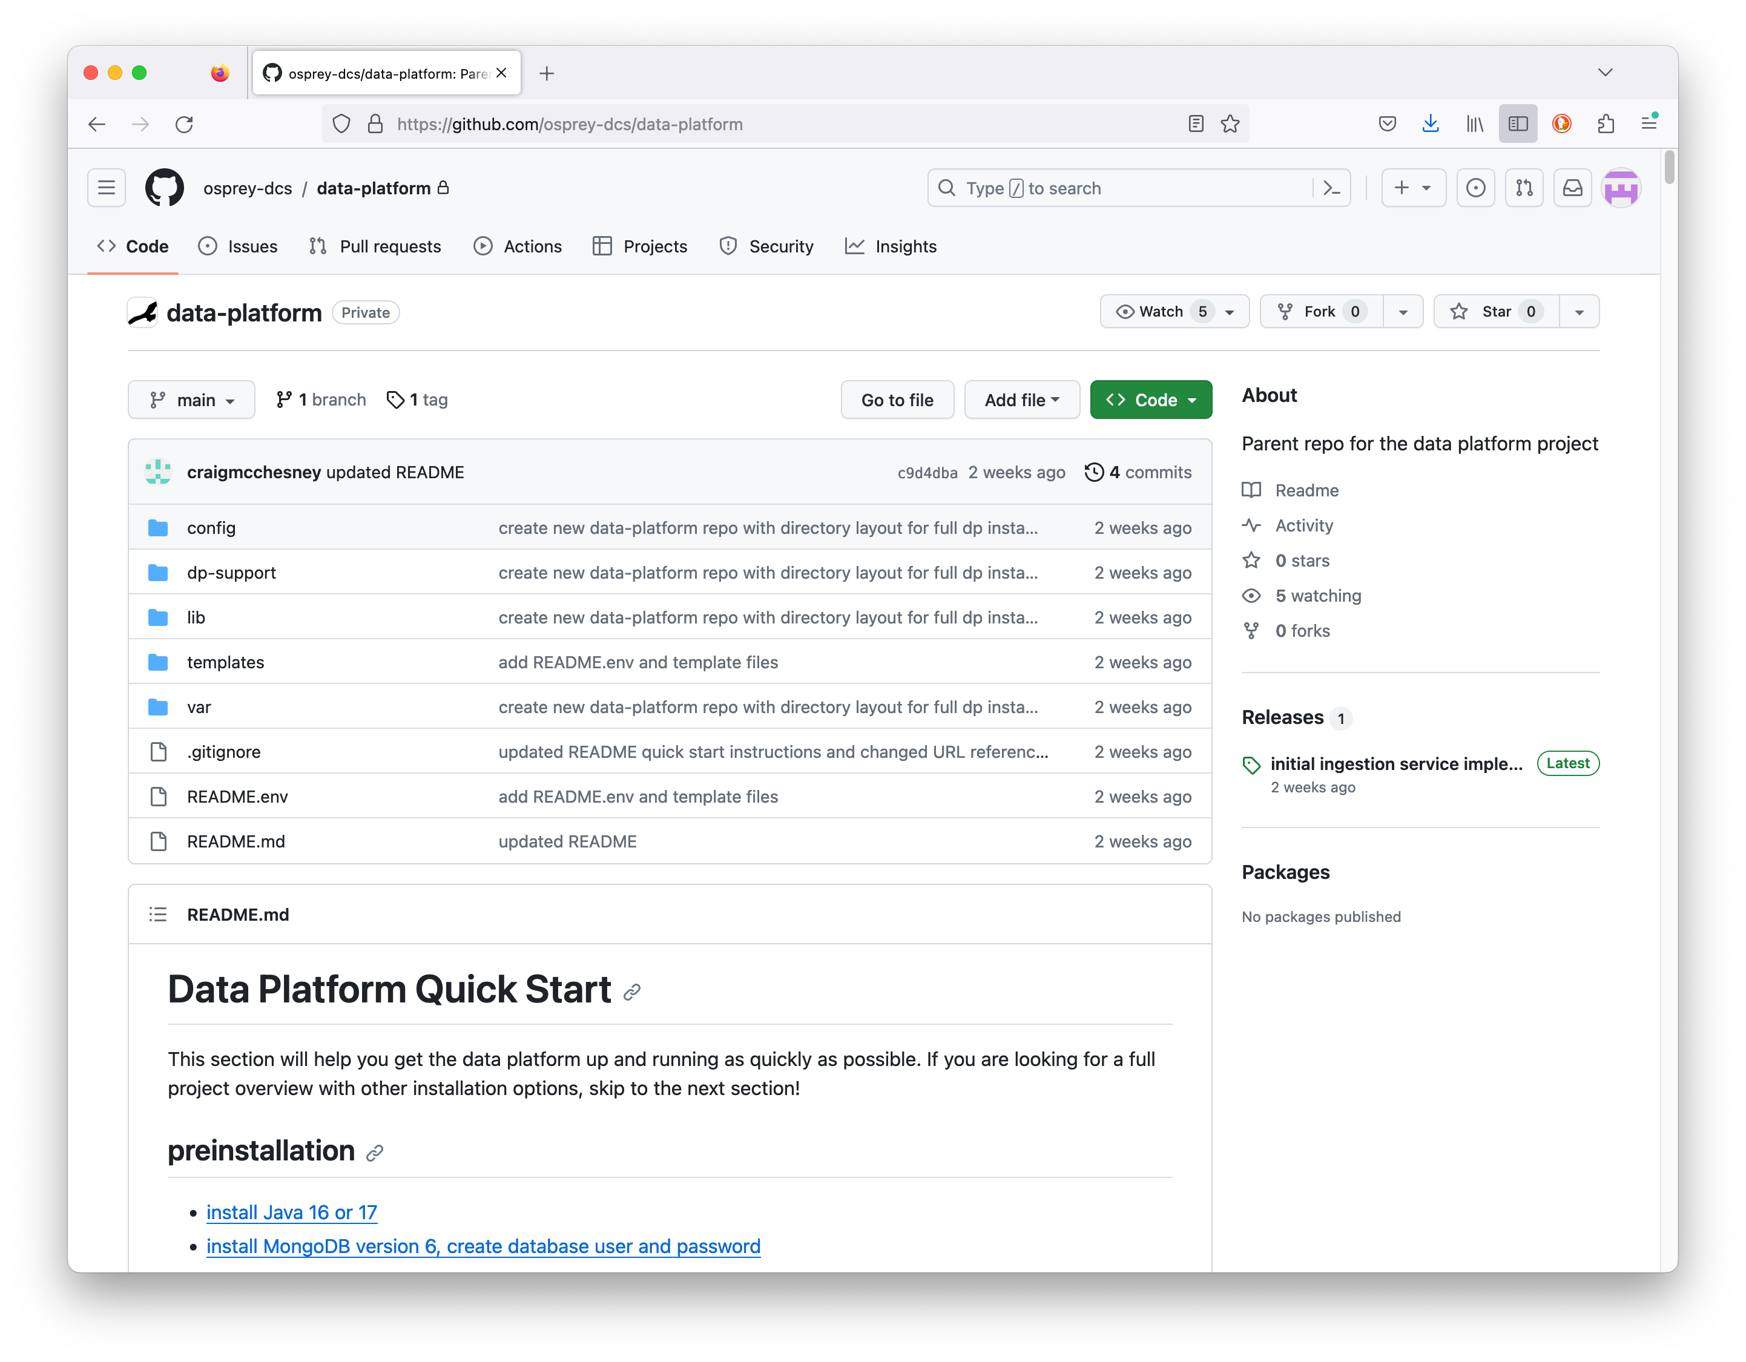
DP Deployment Installation Repository
https://github.com/osprey-dcs/data-platform
Installation distributed as a zipped archive.
Download and unzip into local installation directory.
Services deployed as Java “fat jars”.
Services are started with scripts.
located in expanded dp-support directory.
Process is well documented.
See Github repository page.
Instructions/documentation
data-platform-installer.tar.gz - Download and unzip.

Slide 39
Supplemental Material
SBIR Project Background
Ingestion Data Flow Diagram
Bucket Pattern for Time-Series Data
DP Deployment
Example Data Flow
Aggregator
Provider
Ingestion Service
Query Service
Annotation Service
Why use an API?
Authentication / Authorization
Performance Benchmarks
Application Layer: Low-Level API vs. High-Level Library

Slide 40
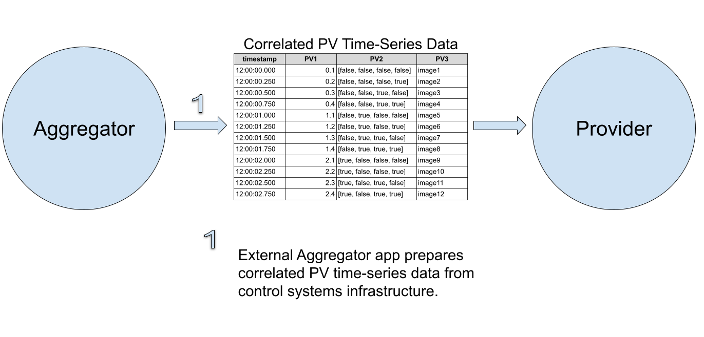
Example Data Flow Aggregator -> Provider

Slide 41
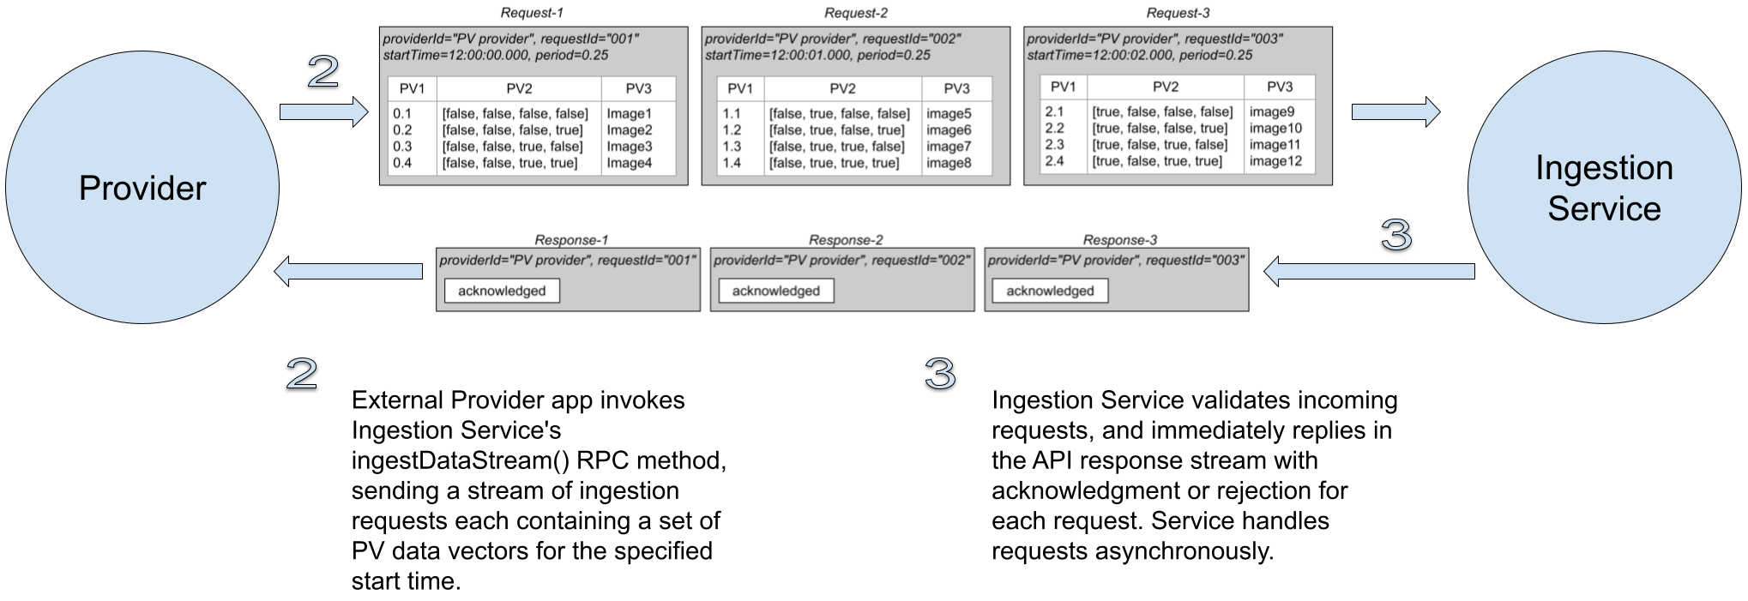
Example Data Flow Provider -> Ingestion Service

Slide 42
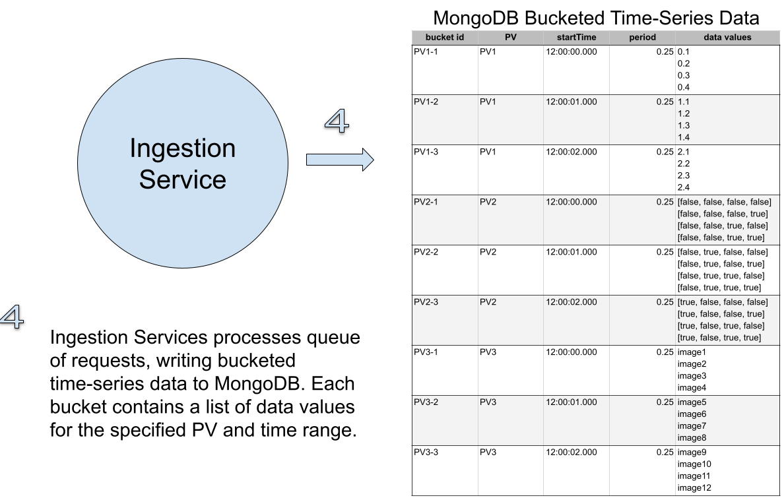
Example Data Flow Ingestion Service -> MongoDB

Slide 43
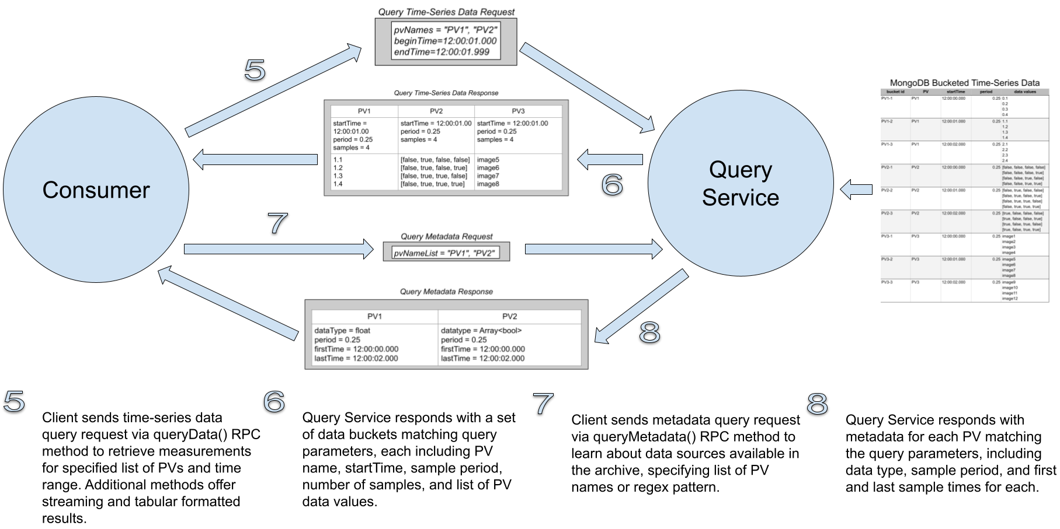
Example Data Flow Consumer -> Query Service

Slide 44
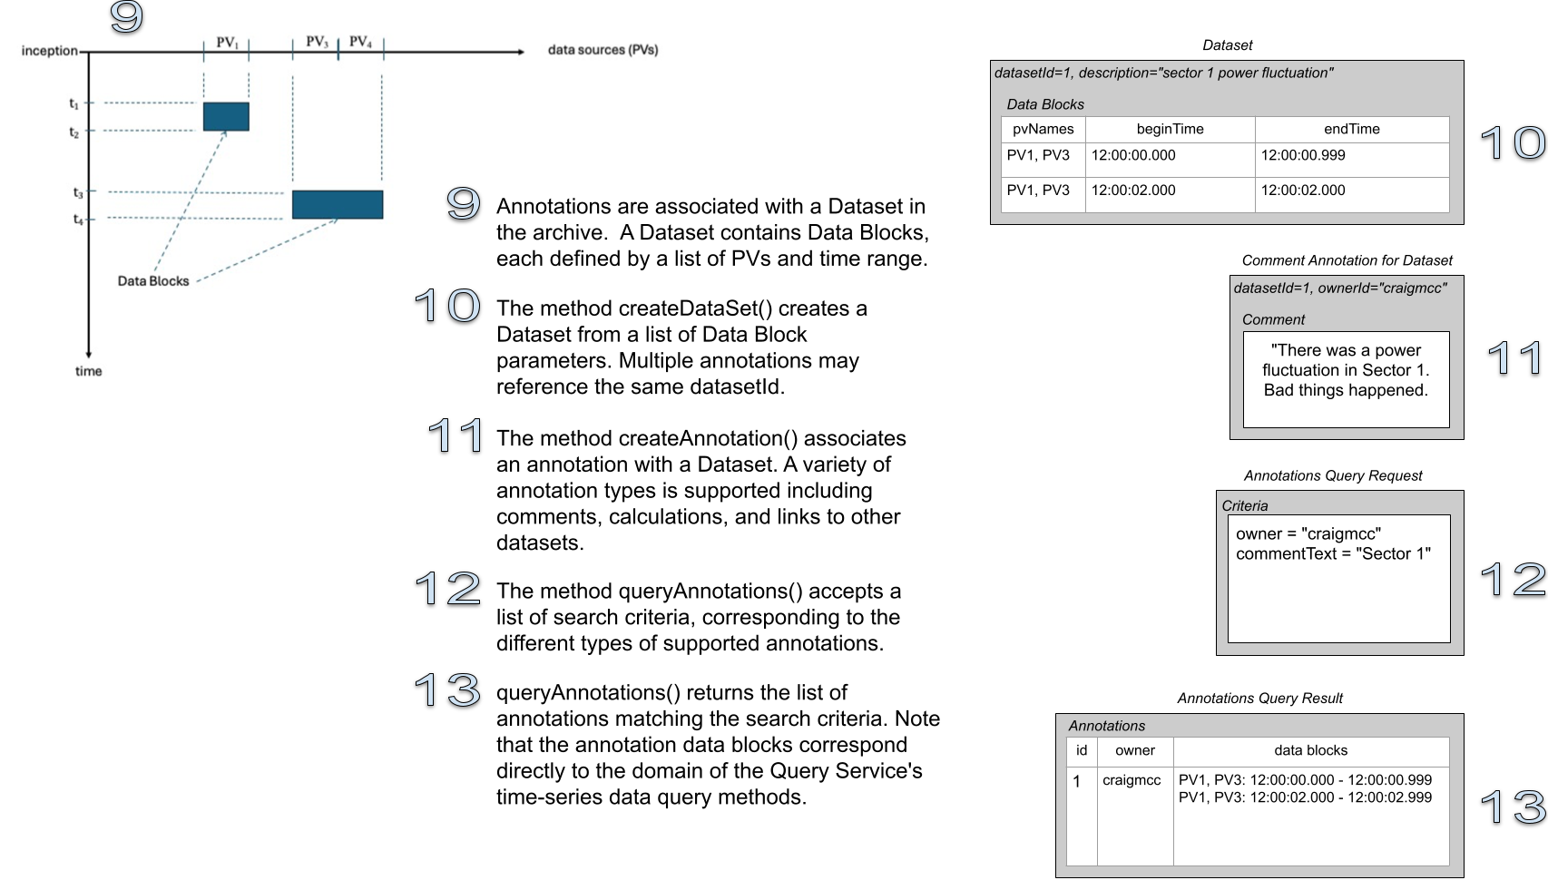
Example Data Flow Consumer -> Annotation Service

Slide 45
Supplemental Material
SBIR Project Background
Ingestion Data Flow Diagram
Bucket Pattern for Time-Series Data
DP Deployment
Example Data Flow
Why use an API?
Authentication / Authorization
Performance Benchmarks
Application Layer: Low-Level API vs. High-Level Library

Slide 46
Why use an ingestion service API instead of writing directly to the database?
This is a common question and is understandable when the focus is on ingestion performance. Using a service API facilitates:
Changing the underlying persistence technology or database schema transparently to the clients
Capturing data from a wide variety of devices without creating a custom capture client for each of them that exposes the details of the underlying persistence mechanism and must be kept in sync with database/schema changes
The performance measured for the initial ingestion service implementation is in the same range as our benchmark for writing data directly to MongoDB, so using the service API doesn't seem to degrade performance significantly.

Slide 47
Supplemental Material
SBIR Project Background
Ingestion Data Flow Diagram
Bucket Pattern for Time-Series Data
DP Deployment
Example Data Flow
Why use an API?
Authentication / Authorization
Performance Benchmarks
Application Layer: Low-Level API vs. High-Level Library

Slide 48
Authentication / Authorization
Assumption is that ingestion clients run behind firewall and that authentication is not required (e.g., similar to EPICS infrastructure components). Authentication is required for query clients. Initial thoughts about how we will handle authentication and authorization in the gRPC service:
Enable server authentication and secure transport via built in gRPC support for SSL/TLS.
Create a new "login" gRPC API method in the ingestion (and query) services. The login method will use the infrastructure LDAP service to authenticate the user credentials. It will return a JSON web token (JWT) to the caller.
In subsequent gRPC API calls, the client will attach the JWT token as metadata to the request header.
Investigate use of API token authentication for infrastructure applications (not tied to a specific user).

Slide 49
Supplemental Material
SBIR Project Background
Ingestion Data Flow Diagram
Bucket Pattern for Time-Series Data
DP Deployment
Example Data Flow
Why use an API?
Authentication / Authorization
Performance Benchmarks
Application Layer: Low-Level API vs. High-Level Library

Slide 50
Project Status Performance Benchmarks
NOTE: These measurements were obtained with v1.1 and need to be re-measured using v1.5+
Benchmark Description | Data Rates
 | Double Values (vals/sec) | Bytes (bytes/sec)
gRPC network transmission (Java) | 22M – 33M | 176M – 264M
Archiving, structured - HDF5 large | 68M – 77M | 544M – 616M
Archiving, structured - JSON files | 38M – 47M | 304M – 376M
Archiving, buckets - MongoDB | 7M – 11M | 56M – 88M
Archiving, buckets - MariaDB | 4.5M – 5.5M | 36M – 44M
Archiving, structured - HDF5 small | 1.3M – 2.4M | 10.4M – 19.2M
Archiving, points - InfluxDB | 750K – 940K | 6M – 7.52M
Archiving, points - MongoDB | 360K – 410K | 2.88M – 3.28M
Archiving, points - MariaDB | 140K – 162K | 1.12M – 1.3M
Metadata updates - MongoDB | 11K to 36K updates/sec | -
Redesign of Data Platform required extensive testing and benchmarking of existing technologies and methods.
Performance
Modularity/dependencies
Development effort
Ease of deployment
Final design decisions for Data Platform
Java – development/performance/deploy
gRPC – standalone comm. framework
MongoDB – both time-series and metadata
HDF5* – reserved for legacy data/performance
Data Platform component evaluation and benchmarking

Slide 51
Supplemental Material
SBIR Project Background
Ingestion Data Flow Diagram
Bucket Pattern for Time-Series Data
DP Deployment
Example Data Flow
Why use an API?
Authentication / Authorization
Performance Benchmarks
Client Application Communication Options
gRPC API vs. Client Library
gRPC API Client
Java Client Library Ingestion Example
Java Client Library Query Example

Slide 52
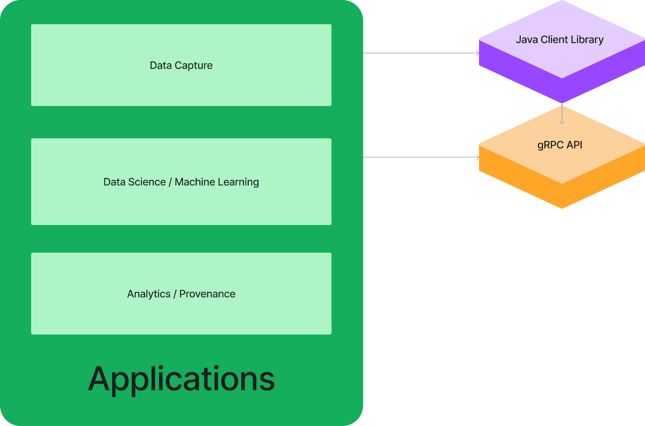
Client Application Communication Options gRPC API vs. Client Library
Applications can be built at two levels, either using the lower-level gRPC API directly or using the higher-level client library.

Slide 53
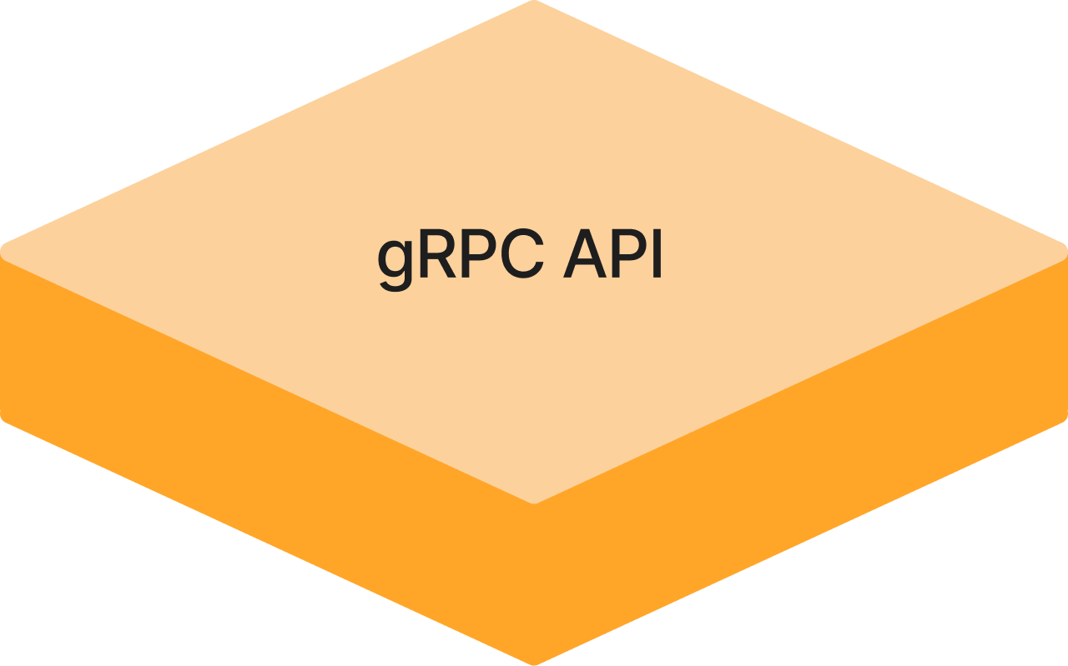
Client Application Communication Options gRPC API Clients
The low-level gRPC Ingestion and Query Service APIs can be used from a wide variety of programming languages to build applications.
The "protoc" compiler generates appropriate code for using the data structures and invoking procedures defined in the service "proto" API files.
// Create gRPC request message.
IngestionRequest.Builder requestBuilder = IngestionRequest.newBuilder();
// Set event timestamp in request.
Timestamp.Builder snapshotTimestampBuilder = Timestamp.newBuilder();
snapshotTimestampBuilder.setEpochSeconds(params.snapshotTimestampSeconds);
snapshotTimestampBuilder.setNanoseconds(params.snapshotTimestampNanos);
snapshotTimestampBuilder.build();
requestBuilder.setSnapshotTimestamp(snapshotTimestampBuilder);
// Set data in request.
IngestionDataFrame dataFrame = ingestionDataFrameForTable(pvDataTable);
requestBuilder.setIngestionDataFrame(dataFrame);
// Build and send request.
IngestionResponse = blockingStub.ingestData(requestBuilder.build());

Slide 54
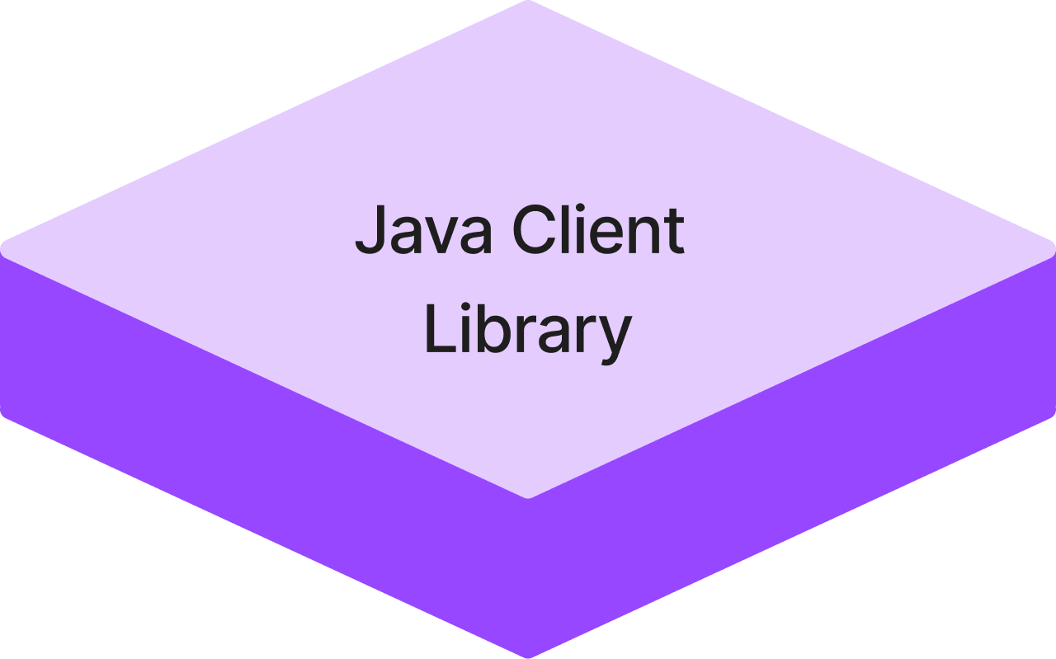
Client Application Communication Options Client Library
A Java client library provides a high-level data science oriented interface to the data platform.
It hides the gRPC API implementation from developers, allowing them to focus on the application instead of communication details.

Slide 55
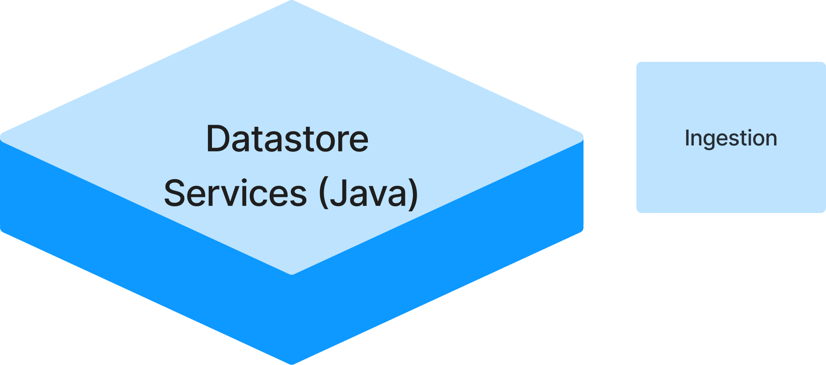
Client Application Communication Options Java Client Library Ingestion Example
Example: Open streaming connection to Datastore Ingestion Service, create data frame for current interval, send to service.
// Create interface to streaming ingestion service.
IIngestionStream ingStream = DsIngestionServiceFactory.connectStream();
// Open stream for PV data provider registration.
ingStream.openStream(pvProviderRegistration);
// Create DataFrame from PV table for current interval.
DataFrame dataFrameCurrentInterval = DataFrame.from(pvValueTable);
// Send data frame to ingestion service in current stream.
ingStream.streamData(dataFrameCurrentInterval);

Slide 56
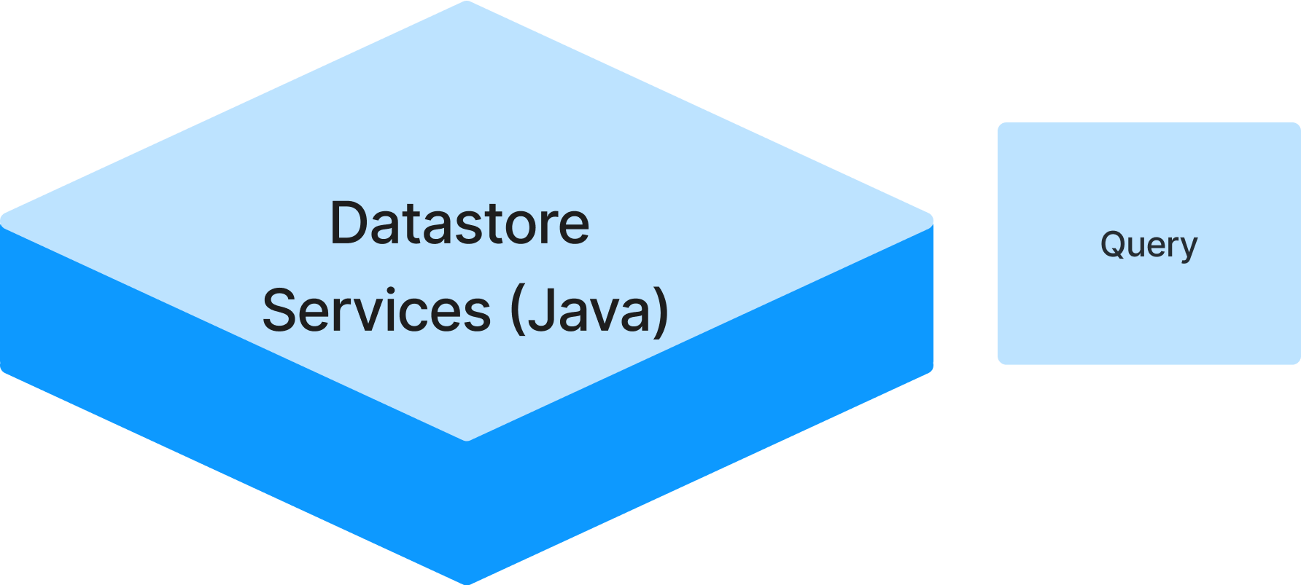
Client Application Communication Options Java Client Library Query Example
Objective: Retrieve PV data from Datastore Repository to train a machine learning model, or feed data to predictive ML model embedded in a control application.
Approach: Use Datastore streaming query API to retrieve latest BPM values for relevant PVs and feed them to ML model.
/ Create interface to query service.
IQueryServiceData qrySvc = DsQueryServiceFactory.connectData();
// Create query request for relevant PVs starting from now.
qryRequest = qrySvc.newRequest();
qryRequest.rangeAfter(Instant.now()); // or use "rangeBetween" to specify time range
qryRequest.selectPvs(”S01-GCC01", ”S01-GCC02");
// Send query request and invoke callbackFunction with query.
IDataTableDynamic tblResult = qrySvc.requestDataAsync(qryRequest, callbackFunction);

