Slide 1
HKL diffractometer computations as an EPICS IOC using PyDevice
Kazimierz Gofron and Alexander Baekey
EPICS Collaboration Meeting
Location: ORNL / SNS, Bldg. 8600
Date: 2024/9/19
This research uses resources at the High Flux Isotope Reactor and the Spallation Neutron Source, DOE Office of Science User Facilities operated by the Oak Ridge National Laboratory.

Slide 2
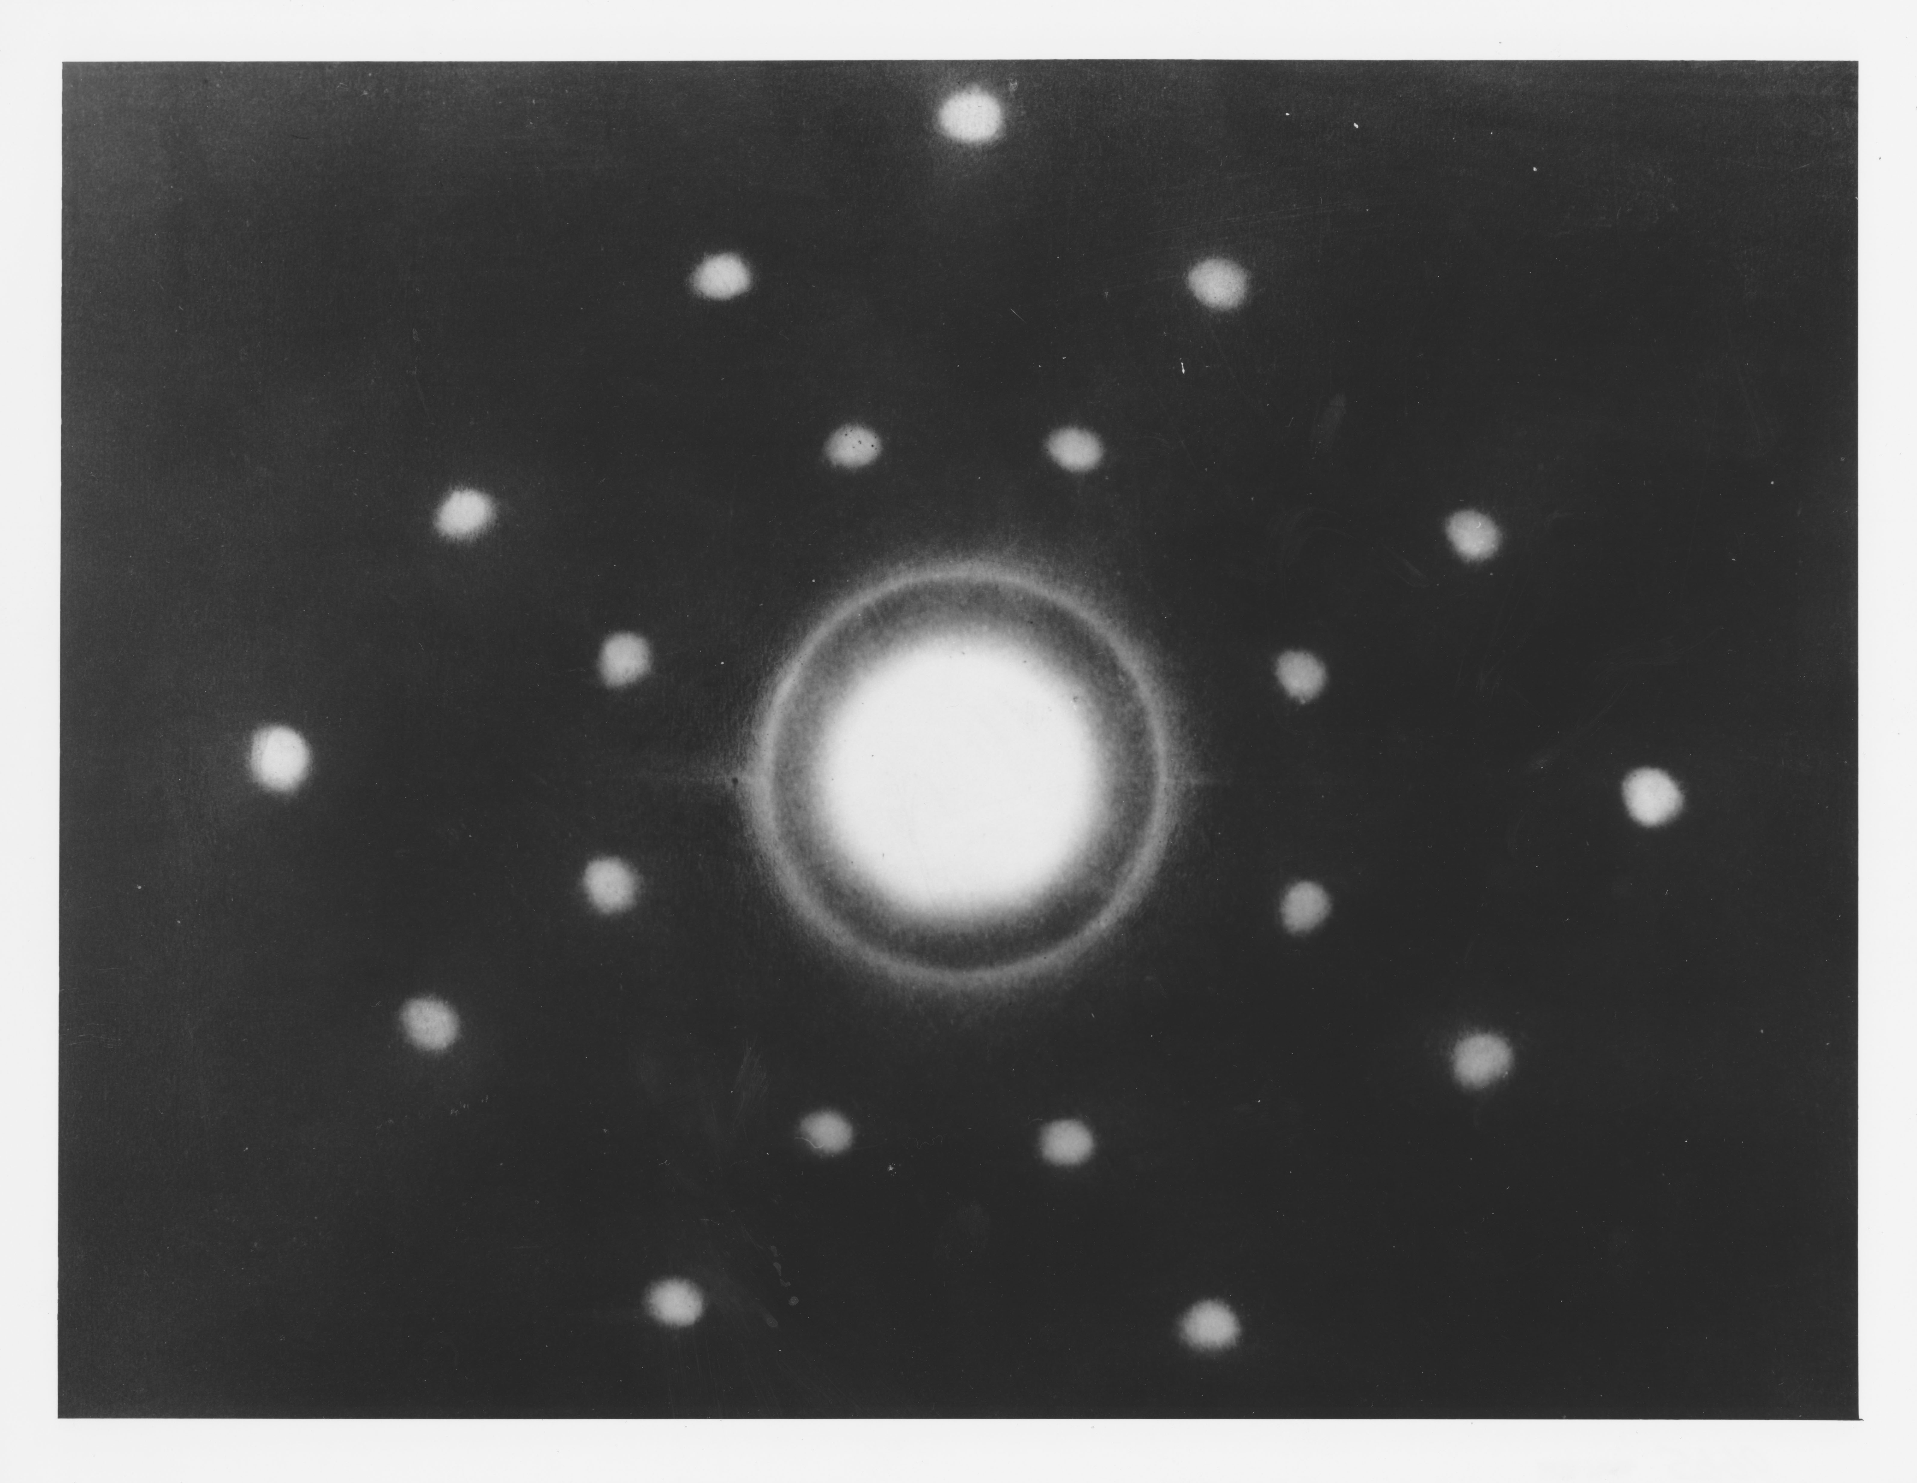
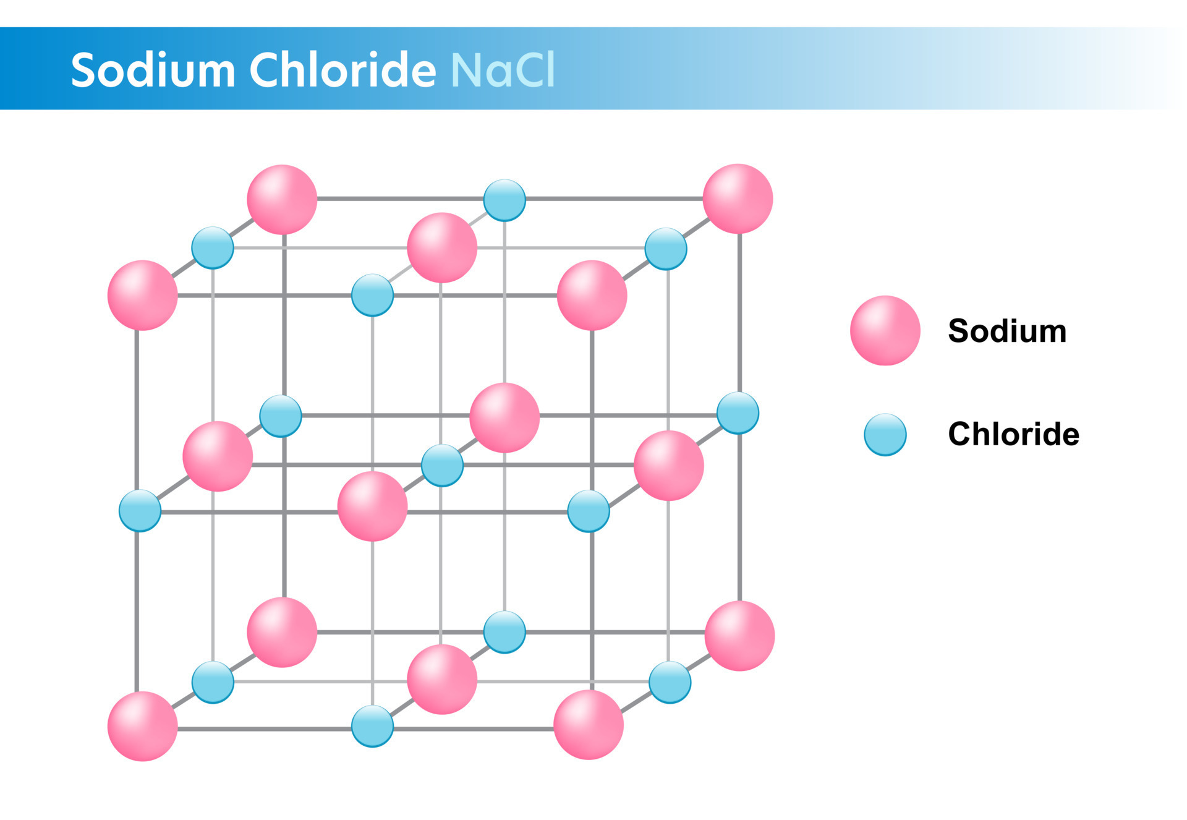
Diffractometer Geometries
Figure 1a:The first neutron Laue diffraction pattern of NaCl measured by Wollan, Shull, and Milton Marney in 1948 at the Graphite Reactor.
https://neutrons.ornl.gov/content/history-neutron-scattering-ornl
Busing – Levy [1, 2]
H. Yu [3]
Figure 1a: Four-circle diffractometer Figure 1b: Six-circle diffractometer

Slide 3
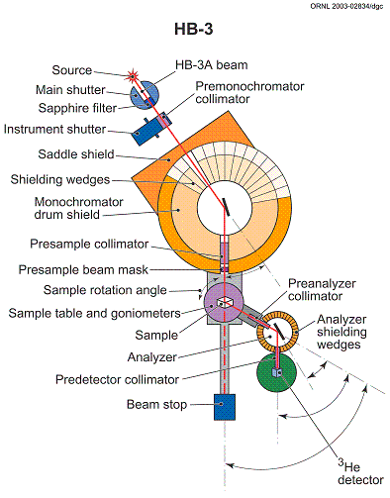
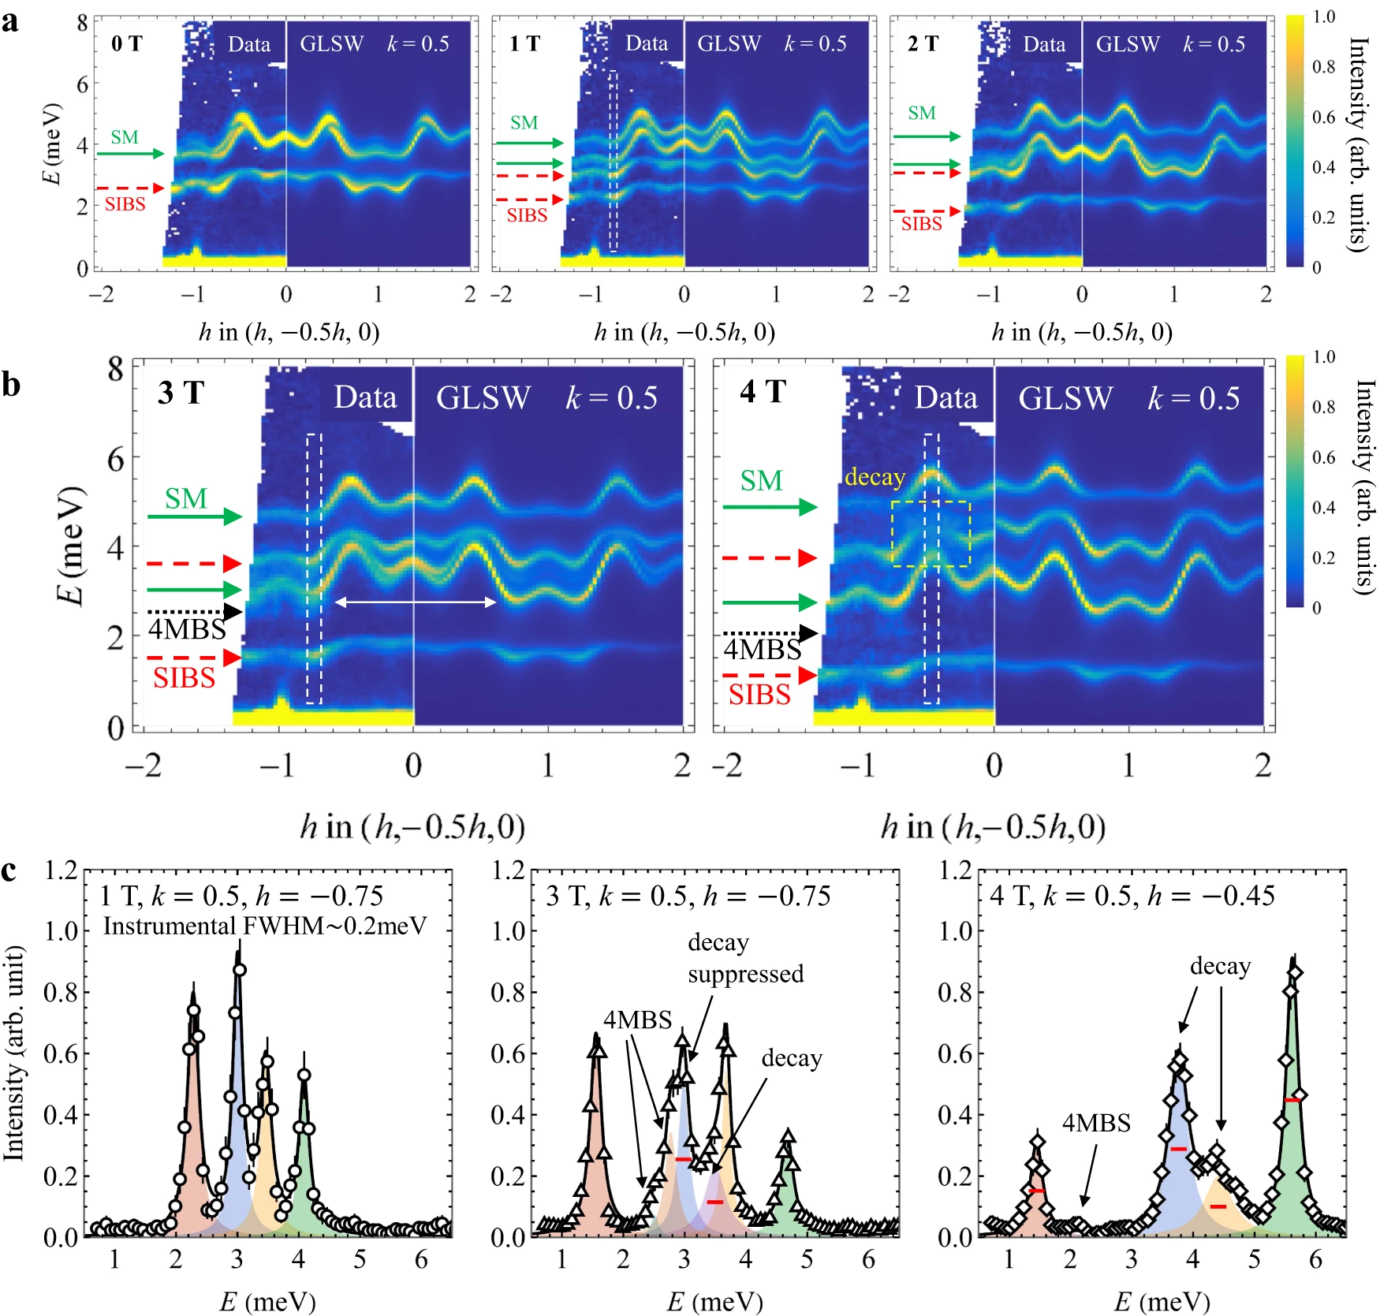
HFIR Triple-Axis Spectrometer and SNS HYSPEC instrument
Brag’s Law:
$$λ=2d\sin\left(θ\right)$$
Q
k_{i}
-k_{f}
k_{f}
$$Q= (ki−kf)$$
$$∆E=\left(\frac{ℏ2}{2m}\right)(ki2−kf2)$$
Complex magnetism in FeI measured using Inelastic neutron-scattering experiments performed on the HYSPEC spectrometer at the Spallation Neutron Source (SNS), Oak Ridge National Laboratory (ORNL), US. Xiaojian Bai et. al, Nature Communications | ( 2023) 14:4199, https://doi.org/10.1038/s41467-023-39940-1

Slide 4
Abstract
We integrate a diffractometer HKL software package [5] into an EPICS [4] IOC with the help of PyDevice [6].
This IOC provides a generalized interface for mapping real space motor positions to HKL reflections with the advantage of being built directly in the EPICS control system.
This approach binds core C functions to Python which takes advantage of the efficiency of C and the readability of Python.
The IOC is applicable to reciprocal space calculations for neutron and X-ray diffraction.
Multiple diffractometer setups (4-circle and 6-circle in Eulerian and Kappa geometries) are supported with planned extension to triple-axes spectrometers.
The UB matrix HKL crystal orientation is performed using Busing & Levy [2] for two reflections and simplex computations with more than two reflections using GSL library.

Slide 5
Introduction
This EPICS IOC is used to factorize single crystal diffraction angles computation for different diffractometer geometries. The IOC uses the hkl C library [5], and features mode computations and different diffractometer geometries.
The UB matrix computations use Busing & Levy [4] with 2 reflections (fig. 4). UB matrix and crystal lattice refinement is calculated as a simplex computation (fig. 5) with more than 2 reflections using the GSL library. Computations are for right-handed convention for all angles, and direct space orthogonal base.
The integrated hkl library uses quaternions to describe diffractometer geometries and 3D rotations.
The library also allows for addition of custom diffractometer geometries.
Phoebus .bob files show details of the EPICS control for the four-circle E4CV diffractometer. Fig. 2 shows all other current EPICS-integrated diffractometer geometries.
https://github.com/hkl-projects/ioc-hkl

Slide 6
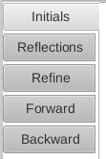
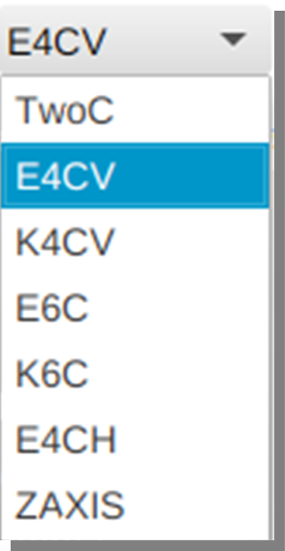
Supported Diffractometers
Clients: DAQ, GUI
PV
ioc-hkl
Figure 2b (top):
HKL computation tabs in GUI
PV
Goniostat EPICS Motors
(omega, chi, phi, tth)
Figure 2c: Diffractometer selection
For this presentation, we will use four-circle (E4CV) diffractometer.
Figure 2a: ioc-hkl within beamline control

Slide 7
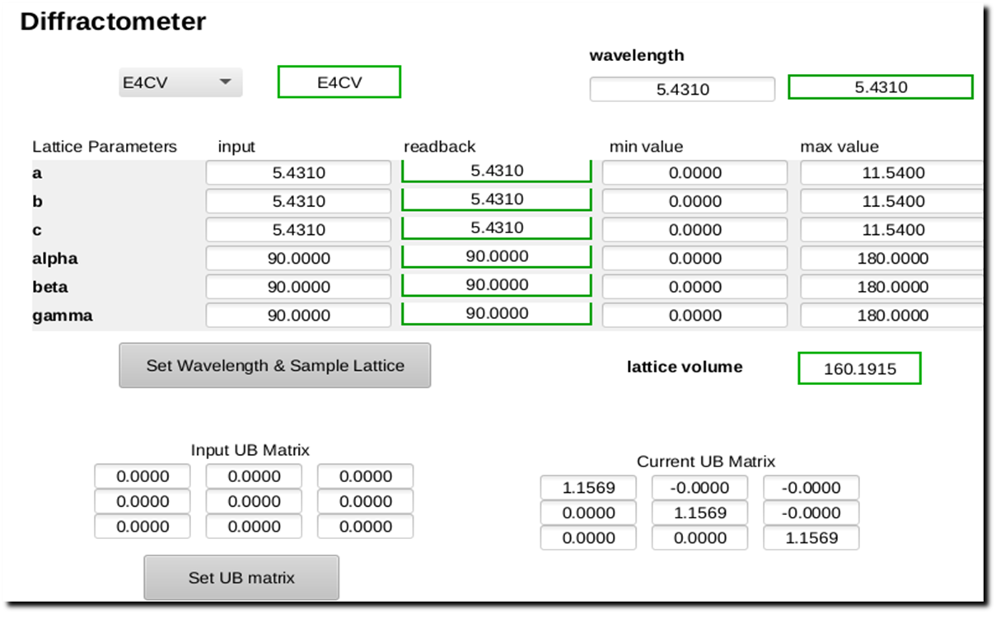
Input
Figure 3: Setting initial conditions
We use the cubic lattice parameters for Silicon as an example for its simplicity. Lattice parameters: a, b, c, alpha, beta, and gamma establish the basis vectors of the sample lattice.

Slide 8
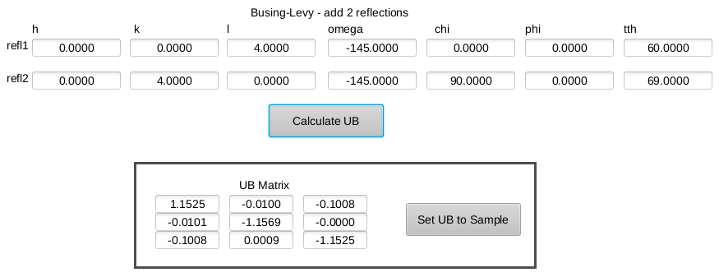
Bussing-Levy reflections
Figure 4: Orientation (UB) matrix
Calculating a UB matrix using the Busing & Levy formalism [4]. From the (0,0,4) and (0,4,0) reflections and their corresponding motor positions, the orientation of the sample is calculated.

Slide 9
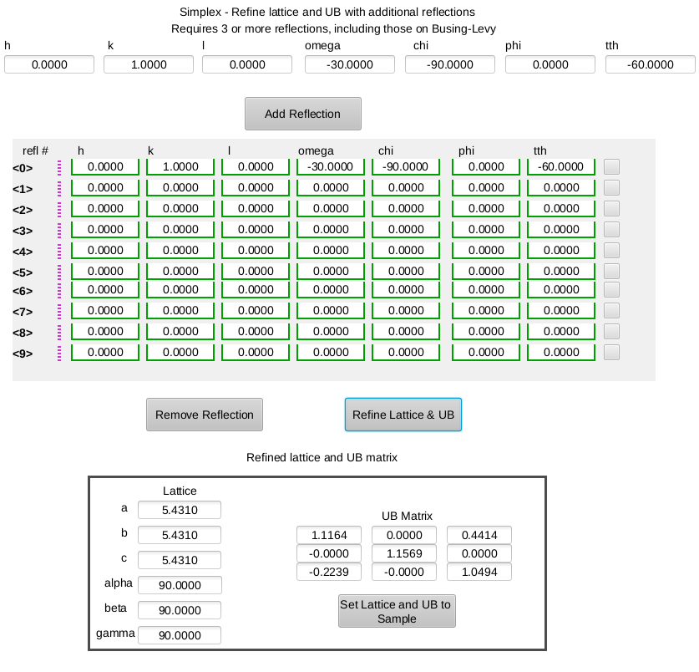
Simplex technique
Figure 5: Orientation (UB) matrix
Refining a UB matrix and crystal lattice using the simplex technique.

Slide 10
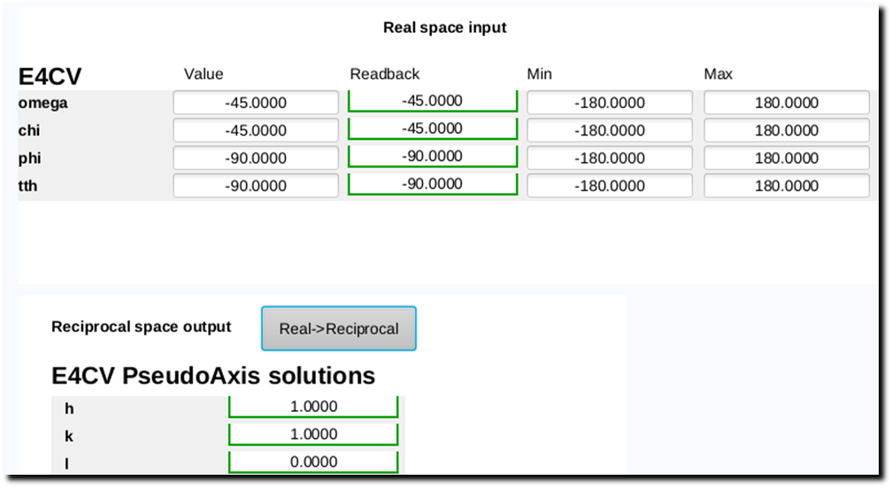
Real space -> Reciprocal space
Figure 6: Forward calculation
(motor rotations → Miller indices)
For Silicon, the motor positions: Ω = -45°, Χ = -45°,
Φ = -90°, 2Θ = -90° map to the reflection (1, 1, 0).

Slide 11
Reciprocal space -> real space
Figure 7: Inverse calculation
(Miller indices → motor rotations)
The third solution of the inverse calculation for (1, 1, 0) corresponds to the motor rotations input into the forward calculation.

Slide 12
Next steps
Add specific additional diffractometers
Triple-Axis Spectrometer
Neutron beamlines use arcs instead of circles, because of weight of cryostats, and superconducting magnets
Intensity calculations
Energy to wavelength and neutron velocity calculations
Boundary conditions – valid solutions within allowed space
Collision avoidance

Slide 13
Conclusions
We successfully integrated four-circle, six-circle, and kappa diffractometer HKL computations into an EPICS IOC. The integration of HKL computations into EPICS [2] control system allows automation of the single crystal beamline instruments.
Future work will include extending the hkl package to other diffractometers and inelastic scattering, with the goal of applying the IOC to neutron triple-axis beamlines.
https://github.com/hkl-projects/ioc-hkl

Slide 14
Acknowledgements
Thanks to Frédéric-Emmanuel Picca for his work on the HKL package as well as his input on our EPICS integration.
Thanks to Bogdan Vacaliuc, Mark Lumsden, and Songxue Chi at Spallation Neutron Source and HFIR Reactor for their helpful discussions.
Alexander Baekey research was supported in part by an appointment to the Oak Ridge National Laboratory GEM Fellowship Internship Program, sponsored by the U.S. Department of Energy and administered by the Oak Ridge Institute for Science and Education.
This manuscript has been authored by UT-Battelle, LLC, under contract DE-AC05-00OR22725 with the US Department of Energy (DOE). The US government retains and the publisher, by accepting the article for publication, acknowledges that the US government retains a nonexclusive, paid-up, irrevocable, worldwide license to publish or reproduce the published form of this manuscript, or allow others to do so, for US government purposes. DOE will provide public access to these results of federally sponsored research in accordance with the DOE Public AccessPlan (https://www.energy.gov/doe-public-access-plan).

Slide 15
References
[1] Lumsden, M. D. and Robertson, J. L. and Yethiraj, M., ‘UB matrix implementation for inelastic neutron scattering experiments‘ Journal of Applied Crystallography, vol. 38, no. 3, p. 405–411, Jun. 2005. doi:10.1107/S0021889805004875
[2] Busing, W. R. and Levy, H. A., ‘Angle calculations for 3- and 4-circle X-ray and neutron diffractometers‘, Acta Crystallographica, vol. 22, no. 4, p. 457–464, Apr. 1967. doi:10.1107/S0365110X67000970
[3] You, H., ‘Angle calculations for a ‘4S+2D’ six-circle diffractometer‘ Journal of Applied Crystallography, vol. 32, no. 4, p. 614–623, Aug. 1999. doi:10.1107/S0021889899001223
[4] EPICS, https://epics-controls.org/
[5] HKL package, https://repo.or.cz/hkl.git
[6] PyDevice, https://github.com/klemenv/PyDevice/
[7] Phoebus, https://controlssoftware.sns.ornl.gov/css_phoebus/
[8] Weinrach, J. B. and Bennett, D. W., ‘A simplex optimization method for the precise determination of symmetry-constrained lattice constants from diffractometer data‘, Journal of Applied Crystallography, vol. 24, no. 2, p. 91–95, Apr. 1991. doi:10.1107/S0021889890010718
[9] https://github.com/hkl-projects/ioc-hkl
[10] Proceedings of LINAC 2024 conference. To appear.

